Slide 1
Introduction to Unified Modeling Language (UML)
By Rick Mercer with help from
The Unified Modeling Language User Guide, Grady Booch, James Rumbaugh, Ivar Jacobsen , Addison Wesley, 1999, ISBN 0-201-57168-4

Slide 2
The Unified Modeling Language (UML)
UML or Unified Modeling Language comes from Rumbaugh, Booch, and Jacobson (the three amigos) who combined efforts to standardize on one modeling language
This is primarily a graphical communication mechanism for developers and customers
We will learn some, but not all, of the UML
  it is very complex, few understand all of it
6-<number>

Slide 3
UML
The main purpose of UML is to
  support communication about the analysis and design of the system being developed
  support the movement from the problem domain in the "world" to the solution domain in the machine
    Two views of the same system
      one view has diagrams
      source code is another view
    Sometimes it's nice to look at the overview
      Reverse engineer your code with a UML tool to see how your code looks in UML
6-<number>

Slide 4
UML is a Modeling Language
UML
  graphical notation to describe software design
  has rules on how to draw models of
    classes
    associations between classes
    message sends between objects
  has become the de facto industry standard
    Not official, but everyone uses it
  like a blueprint to show what is going on during analysis, design and implementation
    Some Projects require UML documentation
6-<number>

Slide 5
UML Defined by the Authors
The Unified Modeling Language User Guide, Booch, Rumbaugh, Jacobson states:
The UML is a language for
  visualizing
  specifying
  constructing
  documenting
the artifacts of a software intensive system
6-<number>

Slide 6
First up: Class Diagrams
A class diagram
  expresses class definitions to be implemented
  lists name, attributes, and methods for each class
  shows relationships between classes
UML allows different levels of detail on both the attributes and the methods of one class
  could be just the the class name in a rectangle
  or like the general form shown on the next slide
6-<number>

Slide 7
Software Specification (Class Name)
attribute
attribute : type
attribute : type = initial value
classAttribute
derivedAttribute
...
method1()
method2(parameter : Type) : return type
abstractMethod()
+publicMethod()
-privateMethod()
#protectedMethod()
classMethod()
...
6-<number>

Slide 8
AccountCollection
- allAccounts : HashMap
+AccountCollection ()
+getAccountWithID (ID: String) : Account
+add(accountToAdd: Account) : boolean
+iterator() : Iterator
Note: iterator is needed by the bank manager
6-<number>

Slide 9
Sterotypes
Stereotype is a UML element that allows designers to extend the UML vocabulary
  Often used to distinguish an abstract class name from an interface, both of which are written in italic
<<interface>>
Iterator
+hasNext(): boolean
+next(): Object
+remove(): void
6-<number>

Slide 10
Different levels of detail
Tips for modeling
  Express as much or as little detail as needed
  Often, a rectangle with a name is enough
    perhaps a method or an attribute clarifies
  Simple is good
  Sketches on paper or white board are effective
6-<number>

Slide 11
Relationships
Three Relationships in UML
  1) Dependency
  2) Association
  3) Generalization
6-<number>

Slide 12
1) Dependency: A Uses Relationship
Dependencies
  occurs when one object depends on another
  if you change one object's interface, you need to change the dependent object
  arrows point from dependent to needed objects
CardReader
Jukebox
CDCollection
SongSelector
6-<number>

Slide 13
2)Association: Structural Relationship
Association
  a relationship between classes indicates some meaningful or interesting connection
  Associations can be labeled getAccountWithID for example
  BTW: The box with association is an official UML comment, must have that fold ☺
association
Jukebox
getAccountWithID
JukeboxAccountCollection
1
1
6-<number>

Slide 14
Associations
Associations imply
  our knowledge that a relationship must be preserved for some time (0.01 ms to forever)
    Between what objects do we need to remember a relationship?
      Does a Transaction need to remember Account?
      Would AccountCollection need to remember Accounts?
AccountCollection
Stores
Account
1
0..*
6-<number>

Slide 15
Notation and Multiplicity Adornments
UML Association:
  a line between two concepts and a name
  they are bi-directional
  can have a multiplicity
  exist in class diagrams
*
T
zero or more;
"many"
1..
*
T
one or more
1..52
T
one to fifty two
Multiplicity adornments
5
T
exactly five
6-<number>

Slide 16
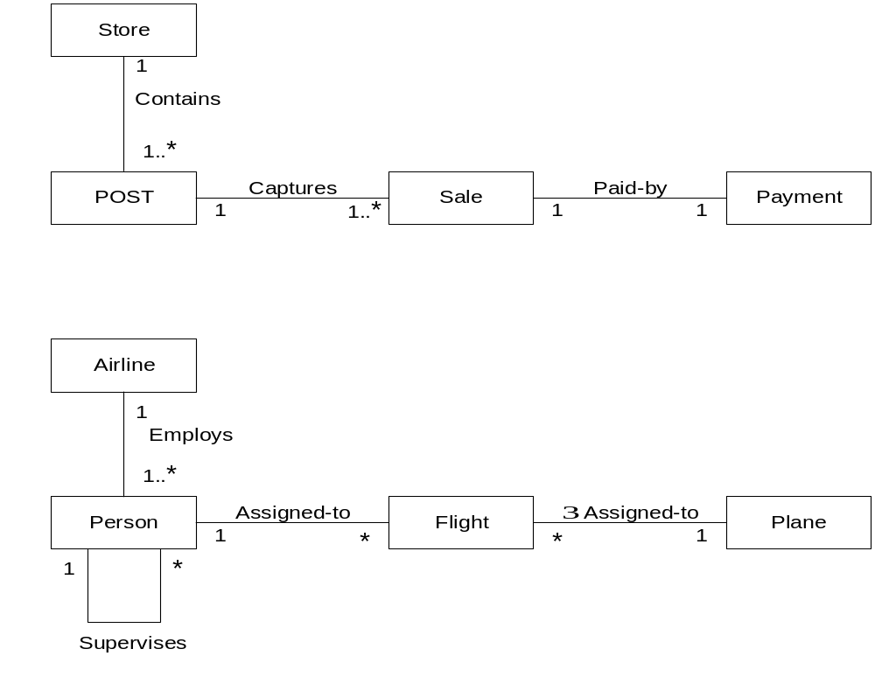
Association
Names
Read these Type-VerbPhrase-Type
  POST is a Point of Sale Terminal)
Not shown here: Attributes and Methods
This just shows associations between objects
6-<number>

Slide 17
Aggregation: A Special Association
Aggregation: whole/part relationships
  An association that models HAS-A relationships
  The objects can exist independently of each other
  No one object is more important than the other
  Place an open diamond on the whole
  School contains a collection of Student objects
School
Student
1..*
*
6-<number>

Slide 18
Composition: A Special Association
Composition: Stronger relationship
  One can not exist without the other
  If the school folds, students live on
    but the departments go away with the school
  If a department closes, the school can go on AIC* e.g.
School
Department
1
1..*
1..*
*
Student
6-<number>

Slide 19
How to draw Class Diagrams
Drawing class diagrams involves visualizing the structure of a system, including classes, their attributes, methods, and relationships. Here are the steps to draw class diagrams:
Step 1: Identify Classes:
  Start by identifying the classes in your system. A class represents a blueprint for objects and should encapsulate related attributes and methods.
Step 2: List Attributes and Methods:
  For each class, list its attributes (properties, fields) and methods (functions, operations). Include information such as data types and visibility (public, private, protected).
Step 3: Identify Relationships:
  Determine the relationships between classes. Common relationships include associations, aggregations, compositions, inheritance, and dependencies. Understand the nature and multiplicity of these relationships.
Step 4: Create Class Boxes:
  Draw a rectangle (class box) for each class identified. Place the class name in the top compartment of the box. Divide the box into compartments for attributes and methods.

Slide 20
Step 5: Add Attributes and Methods:
  Inside each class box, list the attributes and methods in their respective compartments. Use visibility notations (+ for public, – for private, # for protected, ~ for package/default).
Step 6: Draw Relationships:
  Draw lines to represent relationships between classes. Use arrows to indicate the direction of associations or dependencies. Different line types or notations may be used for various relationships.
Step 7: Label Relationships:
  Label the relationships with multiplicity and role names if needed. Multiplicity indicates the number of instances involved in the relationship, and role names clarify the role of each class in the relationship.
Step 8: Review and Refine:
  Review your class diagram to ensure it accurately represents the system’s structure and relationships. Refine the diagram as needed based on feedback and requirements.

Slide 21
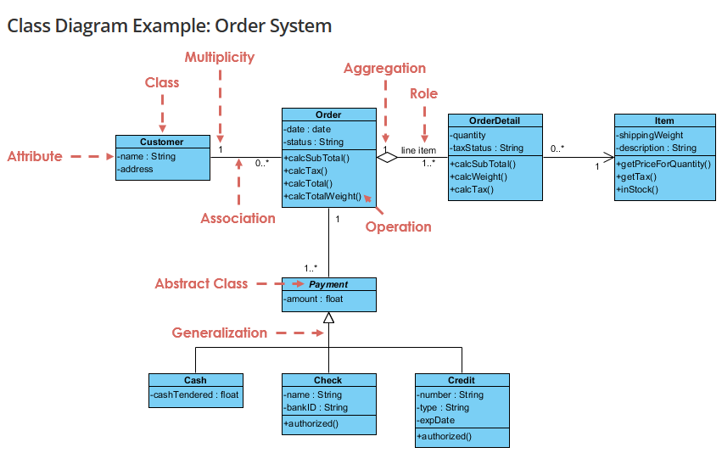

Slide 22
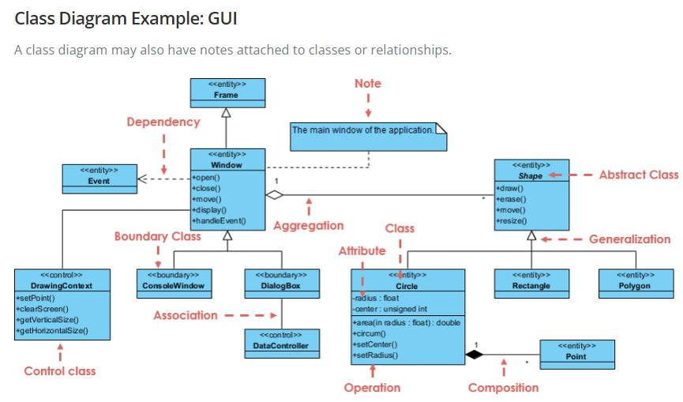

Slide 23
When to apply Use Case Diagram?
Use case diagrams are useful in several situations. Here’s when you should consider using them:
When you need to gather and clarify user requirements, use case diagrams help visualize how different users interact with the system.
If you’re working with diverse groups, including non-technical stakeholders, these diagrams provide a clear and simple way to convey system functionality.
During the system design phase, use case diagrams help outline user interactions and plan features, ensuring that the design aligns with user needs.
When defining what is included in the system versus what is external, use case diagrams help clarify these boundaries.

Slide 24
How to draw a Use Case diagram in UML?
Below are the main steps to draw use case diagram in UML:
Step 1: Identify Actors: Determine who or what interacts with the system. These are your actors. They can be users, other systems, or external entities.
Step 2: Identify Use Cases: Identify the main functionalities or actions the system must perform. These are your use cases. Each use case should represent a specific piece of functionality.
Step 3: Connect Actors and Use Cases: Draw lines (associations) between actors and the use cases they are involved in. This represents the interactions between actors and the system.
Step 4: Add System Boundary: Draw a box around the actors and use cases to represent the system boundary. This defines the scope of your system.
Step 5: Define Relationships: If certain use cases are related or if one use case is an extension of another, you can indicate these relationships with appropriate notations.
Step 6: Review and Refine: Step back and review your diagram. Ensure that it accurately represents the interactions and relationships in your system. Refine as needed.
Step 7: Validate: Share your use case diagram with stakeholders and gather feedback. Ensure that it aligns with their understanding of the system's functionality.

Slide 25
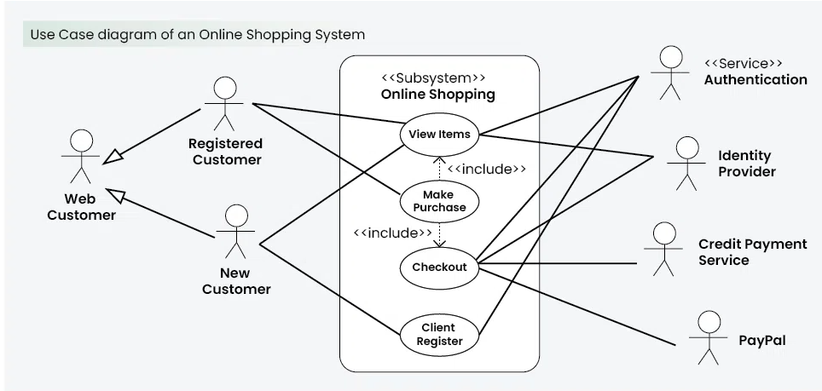

Slide 26
Why use Sequence Diagrams?
Sequence diagrams are used because they offer a clear and detailed visualization of the interactions between objects or components in a system, focusing on the order and timing of these interactions. Here are some key reasons for using sequence diagrams:
Visualizing Dynamic Behavior: Sequence diagrams depict how objects or systems interact with each other in a sequential manner, making it easier to understand dynamic processes and workflows.
Clear Communication: They provide an intuitive way to convey system behavior, helping teams understand complex interactions without diving into code.
Use Case Analysis: Sequence diagrams are useful for analyzing and representing use cases, making it clear how specific processes are executed within a system.
Designing System Architecture: They assist in defining how various components or services in a system communicate, which is essential for designing complex, distributed systems or service-oriented architectures.
Documenting System Behavior: Sequence diagrams provide an effective way to document how different parts of a system work together, which can be useful for both developers and maintenance teams.
Debugging and Troubleshooting: By modeling the sequence of interactions, they help identify potential bottlenecks, inefficiencies, or errors in system processes.

Slide 27
Sequence Diagrams
Interaction diagrams describe how groups of objects collaborate in some behavior
The UML defines several forms of interaction diagram, the most common is the sequence diagram
A class diagram shows a fixed view of a system
A sequence diagram represents a dynamic view of a system by capturing message sends over time
  Can document a scenario such as
    Dealer deals cards to all players
    Withdraw Money when there is enough balance
    Withdraw Money when there is not enough balance
6-<number>

Slide 28
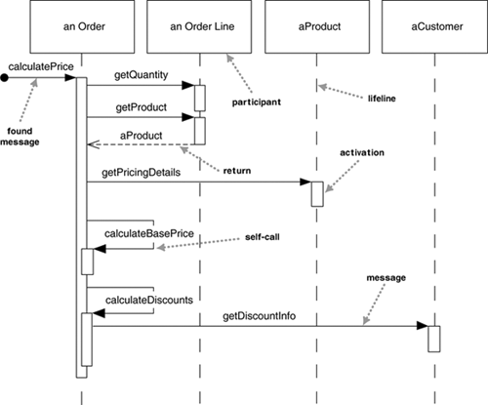
6-<number>

Slide 29
Sequence Diagrams
Not good at showing details of algorithms such as loops and conditional
Good at showing the calls between participants
Gives a good picture about which participants are doing which processing
6-<number>

Slide 30
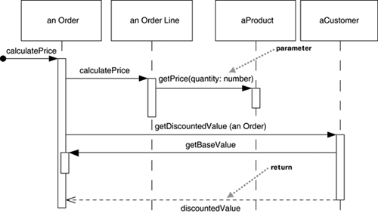
More Distributed Control Shown here
6-<number>

Slide 31
Syntax
Objects are lined up on top in rectangles
Object names :CardReader
Dashed lines represent lifetime of objects
Rectangles are activation lines
  When the object is "alive"
  Activation bar of the receivers of the message is smaller than the sender's activation bar
Not much detail written
6-<number>

Slide 32
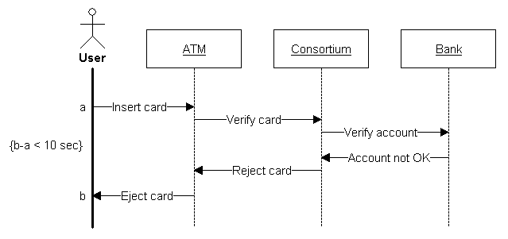
Another Example
http://www.ifi.uio.no/in219/verktoy/doc/html/doc/user/mg/dgmsuml6.html
Scenario: The user tries to use an ATM, but the account is not known
6-<number>

Slide 33
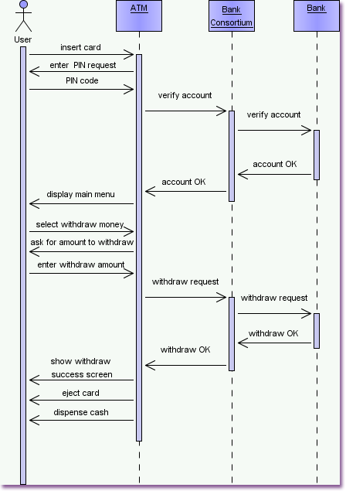
http://www.visual-paradigm.com/
VPGallery/diagrams/Sequence.html
Scenario: The user successfully withdraws money from an ATM
6-<number>

Slide 34
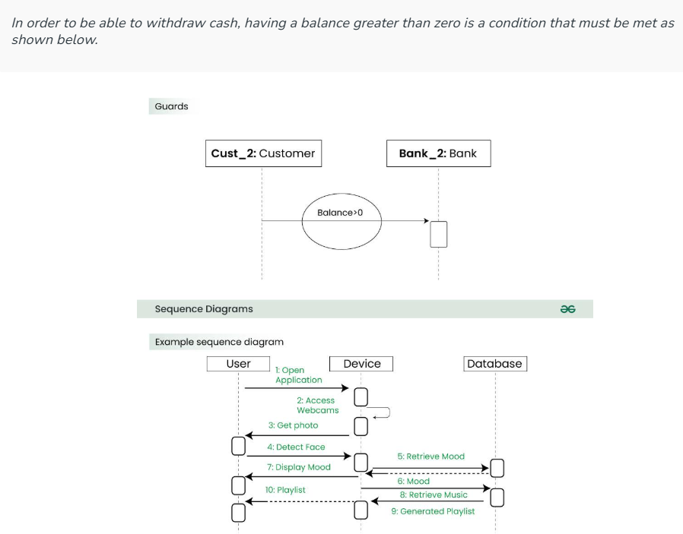

Slide 35
Class Collaborations
Relationships between classes:
  is-part-of — used when classes are part of an aggregate class.
  has-knowledge-of — used when one class must acquire information from another class.
  depends-on — used in all other cases.

Slide 36
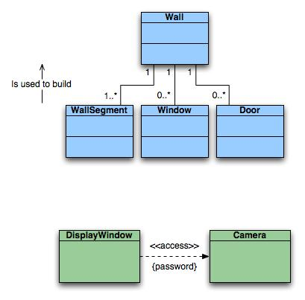
Class Diagrams
Top: Multiplicity
Bottom: Dependencies

Slide 37
Behavioral Modeling
Identifying Events :
A use-case is examined for points of information exchange.
The homeowner uses the keypad to key in a four-digit password. The password is compared with the valid password stored in the system. If the password in incorrect, the control panel will beep once and reset itself for additional input. If the password is correct, the control panel awaits further action.

Slide 38
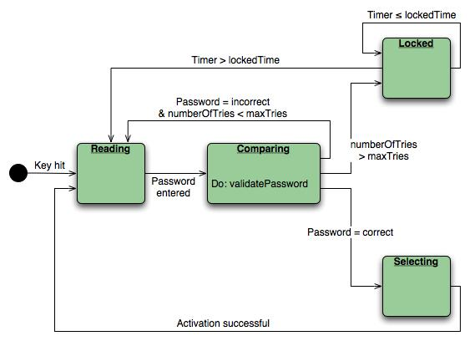
State Diagram
State diagram for the ControlPanel class

Slide 39
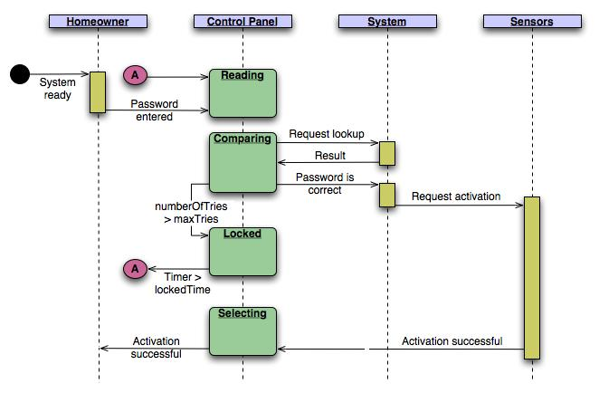
Sequence Diagram
Sequence diagram (partial) for the SafeHome security function

Slide 40
Activity diagrams
Activity diagram helps to describe the flow of control of the target system, such as the exploring complex business rules and operations, describing the use case also the business process. It is object-oriented equivalent of flow charts and data-flow diagrams (DFDs).
Useful to specify software or hardware system behaviour
Based on data flow models – a graphical representation (with a Directed Graph) of how data move around an information system
[order reject]
Receive
Fill
Ship
Close
Order
Order
Order
Order
[order
accepted]
Send
Invoice
Make Payment
Accept
Invoice
Payment

Slide 41
When to Use Activity Diagrams
The main reason to use activity diagrams is to model the workflow behind the system being designed.
Activity Diagrams are also useful for:
  analyzing a use case by describing what actions need to take place and when they should occur
  describing a complicated sequential algorithm
  modeling applications with parallel processes
Activity Diagrams should not take the place of interaction diagrams and state diagrams.
Activity diagrams do not give detail about how objects behave or how objects collaborate.

Slide 42
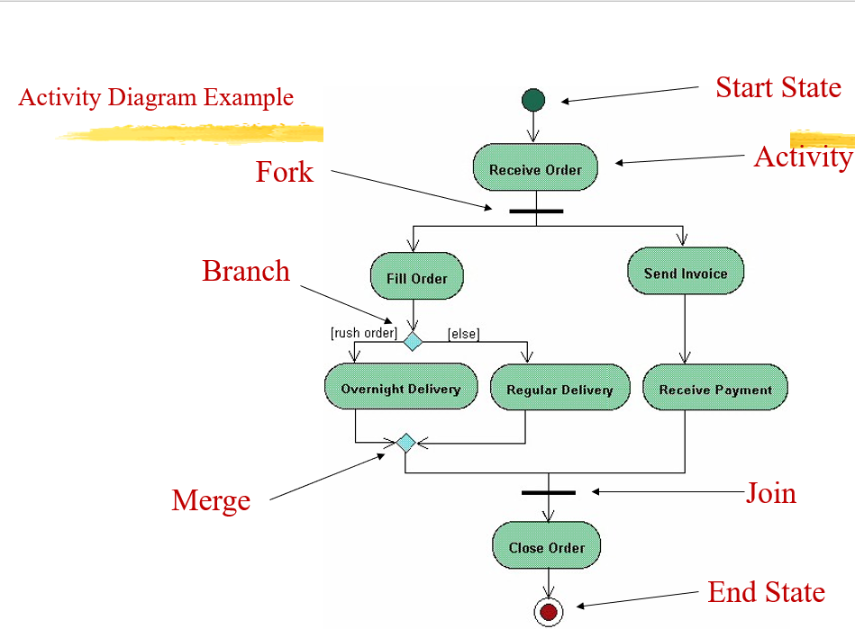
How to Draw an Activity Diagram
Diagrams are read from top to bottom and have branches and forks to describe conditions and parallel activities.
  A fork is used when multiple activities are occurring at the same time.
  A branch describes what activities will take place based on a set of conditions.
  All branches at some point are followed by a merge to indicate the end of the conditional behavior started by that branch.
  After the merge all of the parallel activities must be combined by a join before transitioning into the final activity state.

Slide 43

Use Case
Withdraw money from a bank account through an ATM

Slide 44
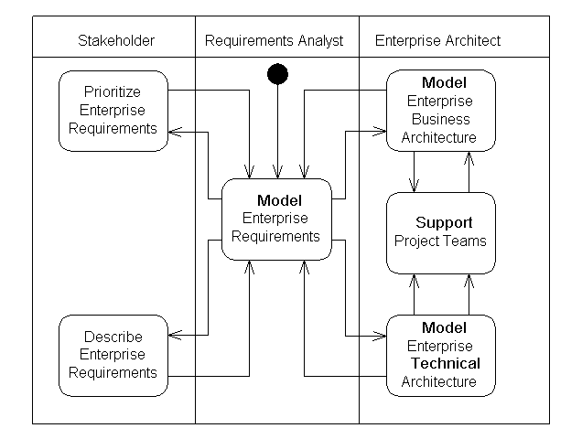
Activity diagram-example (swimlane)
Notes:
A swimlane is a way to group activities performed by the same actor on an activity diagram or to group activities in a single thread.

Slide 45
What is a Collaboration Diagram
Collaboration diagrams illustrate interactions between objects
The collaboration diagram illustrates messages being sent between classes and objects (instances).
Collaboration diagrams express both the context of a group of objects (through objects and links) and the interaction between these objects (by representing message broadcasts)

Slide 46
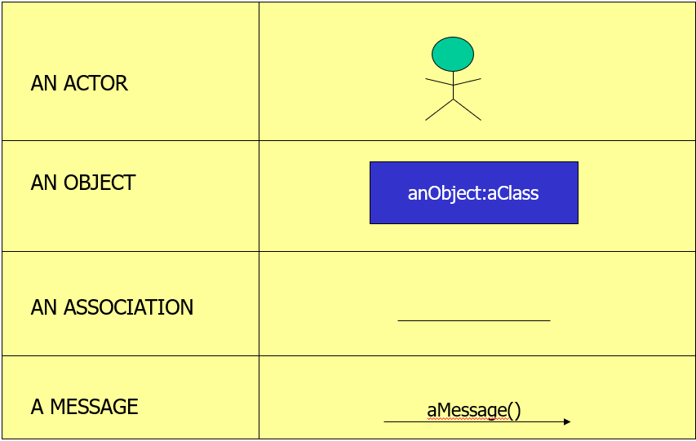
Collaboration Diagram Elements
There are three primary elements of a collaboration diagram:
  Objects
  Links
  Messages

Slide 47
Objects
Objects participating in a collaboration come in two flavors—supplier and client
Supplier objects are the objects that supply the method that is being called, and therefore receive the message
Client objects call methods on supplier objects, and therefore send messages
Links
The connecting lines drawn between objects are links
They enable you to see the relationships between objects
This symbolizes the ability of objects to send messages to each other
A single link can support one or more messages sent between objects

Slide 48
Messages
An interaction is implemented by a group of objects that collaborate by exchanging messages
Messages in collaboration diagrams are shown as arrows pointing from the Client object to the Supplier object.
Typically, messages represent a client invoking an operation on a supplier object
Message icons have one or more messages associated with them
Messages are composed of message text prefixed by a sequence number
Time is not represented explicitly in a collaboration diagram, and as a result the various messages are numbered to indicate the sending order
Flow by Numbers
1. Enter Borrower ID
1.1 CalcAmtCanBorrow
1.1.1 <<create>>
1.1.2 CalcBorrowerFines
1.2 Display Invalid User Msg

Slide 49
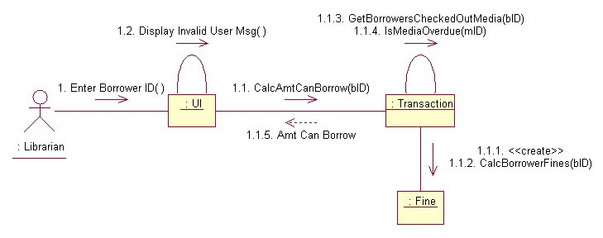
Transaction object acts as a Supplier to the UI (User Interface) Client object. In turn, the Fine object is a Supplier to the Transaction Client object.
The visual representation of a link is a straight line between two objects. If an object sends messages to itself, the link carrying these messages is represented as a loop icon. This loop can be seen on both the UI object and the Transaction object.

Slide 50

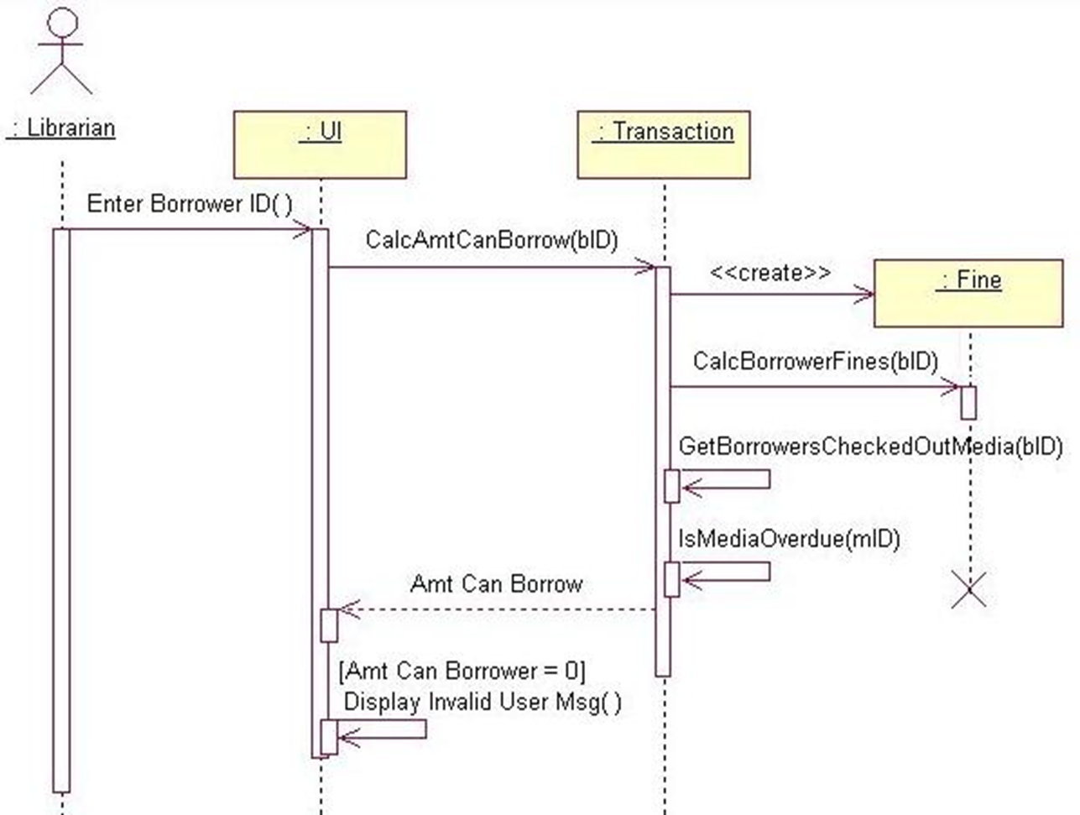
Collaboration vs Sequence Diagram
In reality, sequence diagrams and collaboration diagrams show the same information, but just present it differently
Not used as often as sequence diagrams but are closely related

Slide 51
Steps to Creating a Collaboration Diagram
Determine the scope of the diagram- the use case it relates to
Place the objects that participate in the collaboration on the diagram
  Remember to place the most important objects towards the center of the diagram.
If a particular object has a property or maintains a state that is important to the collaboration, set the initial value of the property or state
Create links between the objects
Create messages associated with each link
Add sequence numbers to each message corresponding to the time-ordering of messages in the collaboration

Slide 52
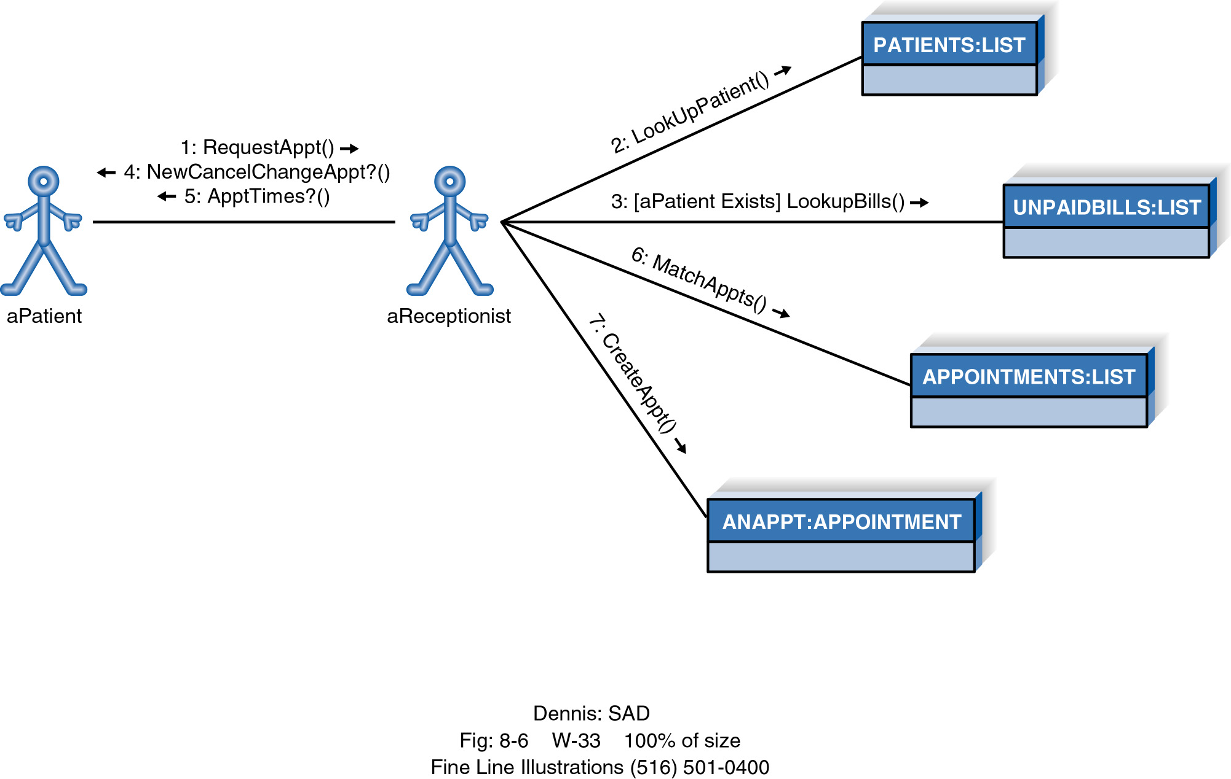
Example Collaboration Diagram

