Slide 1
Software Engineering
Legacy Systems
1 / 22

Slide 2
Outline
Introduction
Legacy System Structures
Legacy System Design
Legacy System Assessment
<number> / 22

Slide 3
Introduction..
Legacy systems: old computer-based systems still in use by organizations
  Many of them still business critical
  Incorporate many changes made over the years
  Many people have been involved in these changes
  Replacing legacy systems with new systems is risky, yet keeping them means new changes become more and more expensive
<number> / 22

Slide 4
.Introduction.
Risks of replacing a legacy system:
  Specification is difficult because existing documentation is typically incomplete
  Changing business processes (now adjusted to the system) may entail high costs
  Undocumented, yet important business rules may be embedded in the system; a new system may break these rules
  The new system may be delivered late, may cost more than expected, and may not function properly
<number> / 22

Slide 5
..Introduction
Factors that make changes to legacy systems expensive:
  In large systems, different parts were implemented by different teams, without consistent programming style
  It is difficult to find personnel who knows the obsolete programming languages used in old systems
  In may cases the only documentation is provided by the source code; even this may be missing
  It is difficult to understand the system given its ad hoc updating over the years
  Data used by the system is difficult to understand and manipulate; it can also be obsolete and/or redundant
<number> / 22

Slide 6
Legacy system structures….
Legacy systems involve more than software (they are computer-based systems). Typical logical parts of a legacy system are:
  System hardware
  Support software
  Application software (legacy software systems)
  Application data
  Business processes
  Business policies and rules
<number> / 22

Slide 7
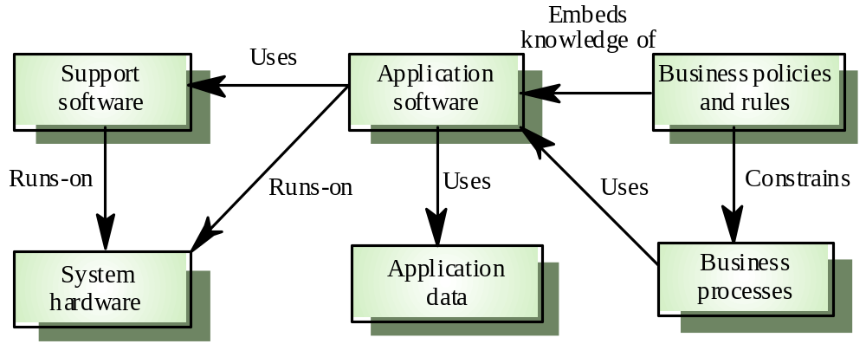
.Legacy system structures…
Legacy system components [Fig. 26.1 Somm00]
<number> / 22

Slide 8
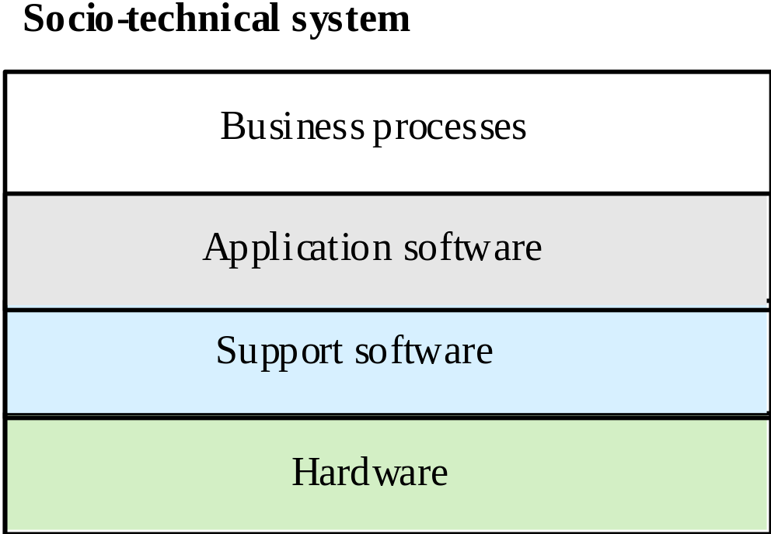
..Legacy system structures..
Alternative view of legacy systems: a layered model [Fig. 26.2 Somm00]
<number> / 22

Slide 9
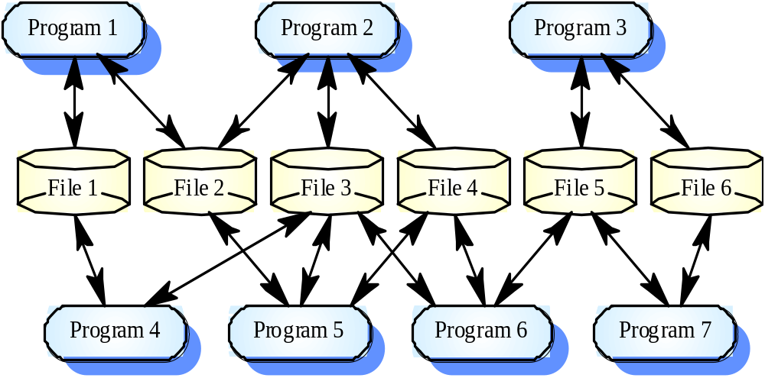
…Legacy system structures.
Legacy application software [Fig. 26.3 Somm00] Both programs and data files have been added over the years: components are heterogeneous and strongly coupled
<number> / 22

Slide 10
Legacy system design…..
Legacy systems design is typically function oriented. Two main classes:
  Batch processing systems: both input and output is provided in “batches,” e.g., a payroll system
  Transaction processing systems: input & output related to a database transaction, e.g., a flight reservation system
Both batch processing and transaction processing systems usually follow an IPO model:
  Input: inputs are collected from one or more sources
  Processing: some computations are performed on inputs
  Output: results are provided either in batches or as single-transaction outputs
  All IPO components may further be organized according the IPO model
<number> / 22

Slide 11
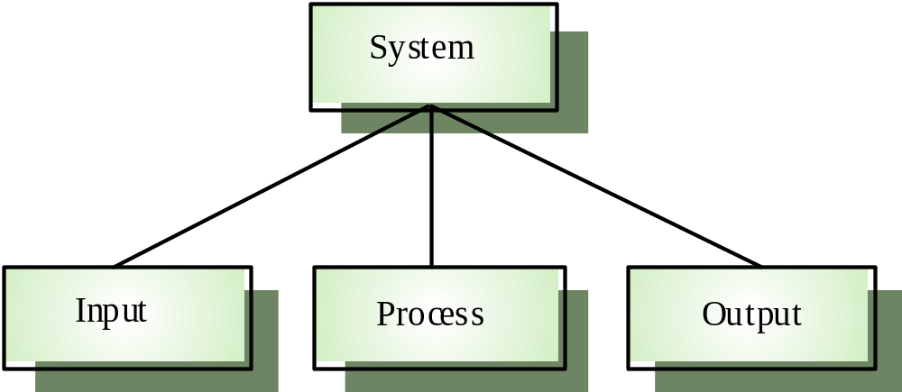
.Legacy system design….
The IPO Model [Fig. 26.7 Somm00].
<number> / 22

Slide 12
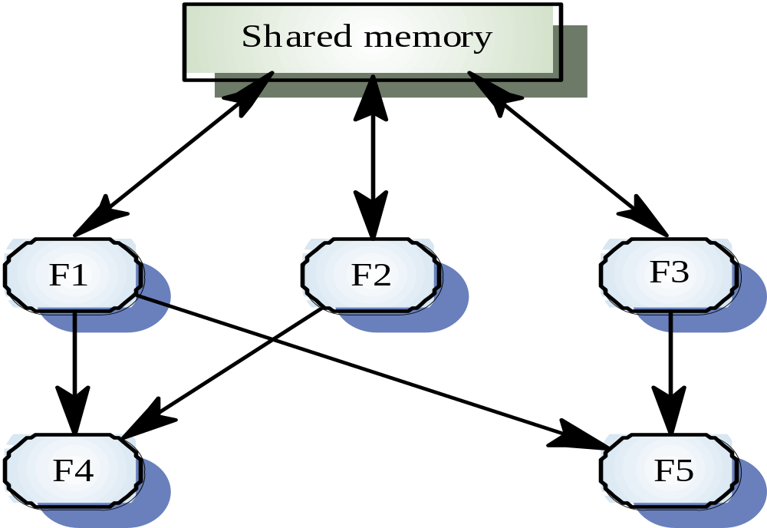
..Legacy system design…
A function-oriented view on design [Fig. 26.6, Somm00].
The main problem is the sharing of data (system state information), which can lead to unpredicted changes in functions’ behavior. Also, it is unlikely that a single person understands all parts of a large system.
<number> / 22

Slide 13
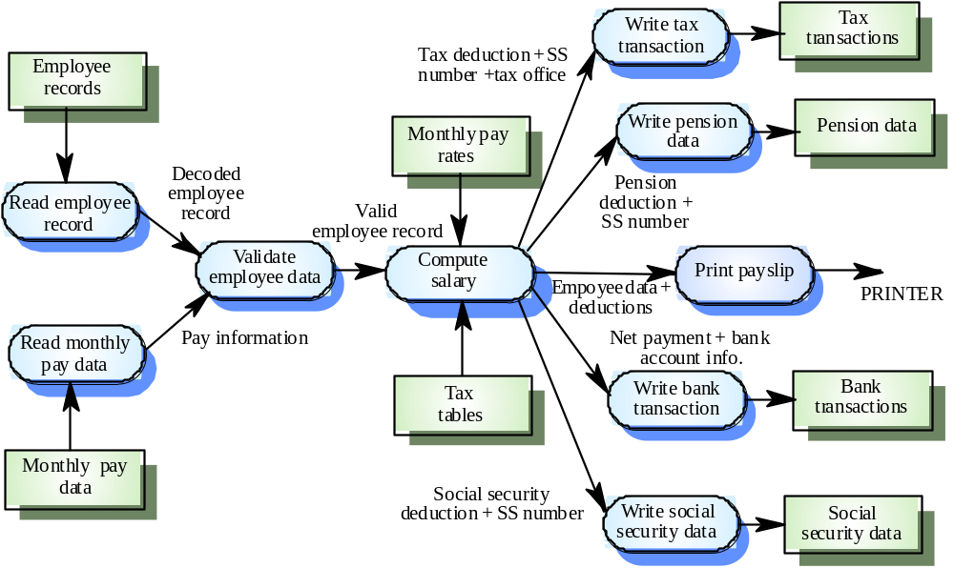
…Legacy system design..
Data flow diagrams are often used to design function-oriented systems. Example: a payroll system [Fig. 26.8 Somm00]
<number> / 22

Slide 14
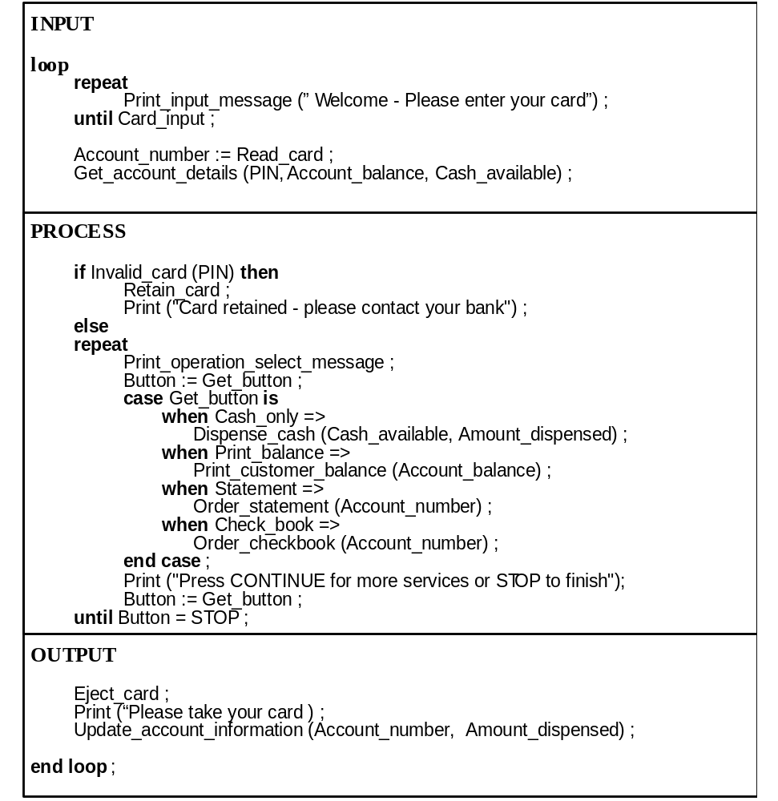
….Legacy system design.
A transaction processing system: design of an ATM [Fig. 26.9 Somm00]
<number> / 22

Slide 15
…..Legacy system design
Function oriented design is not restricted to legacy systems. Can be applied to new systems where:
  Data processing relies on processing transactions and updating a data store
  The company has invested heavily in structured methods, including staff training, development practices, and CASE tools
An interesting challenge for a company: to work with both approaches, function-oriented and object-oriented
<number> / 22

Slide 16
Legacy system assessment…..
Strategic approaches for dealing with legacy systems:
  Scrap the system completely
    When business practices have changed and no longer depend significantly on the system (they may be supported by new COTS)
  Continue to maintain the system
    The system works well, is fairly stable, and users do not request many changes
  Transform the system to improve maintainability
    When system quality was affected negatively by changes, yet changes are still required
  Replace the system with a new one
    When obsolete hardware precludes further operation or the new system can be built at reasonable cost
<number> / 22

Slide 17
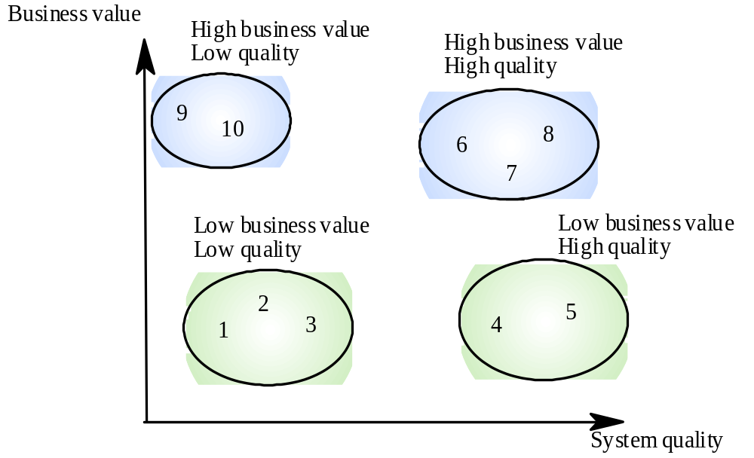
.Legacy system assessment….
Assessing legacy systems example [Fig. 26.10 Somm00]
<number> / 22

Slide 18
Legacy system categories
Low quality, low business value
  These systems should be scrapped
Low-quality, high-business value
  These make an important business contribution but are expensive to maintain. Should be re-engineered or replaced if a suitable system is available
High-quality, low-business value
  Replace with COTS, scrap completely or maintain
High-quality, high business value
  Continue in operation using normal system maintenance

Slide 19
Business value assessment
Assessment should take different viewpoints into account
  System end-users
  Business customers
  Line managers
  IT managers
  Senior managers
Interview different stakeholders and collate results

Slide 20
..Legacy system assessment…
Assessment of legacy systems includes:
  Business value assessment (subjective). Viewpoints:
    End-users: look at system’s functionality and performance
    Customers: look at the quality of services provided
    Business managers: assess the usefulness of the system in terms of business support
    IT managers: are concerned with the availability of technical support for the system
    Senior managers: interested in system’s contribution to the business goals
  System quality assessment (next)
<number> / 22

Slide 21
…Legacy system assessment..
System quality assessment. Look at all components of the system. Hence:
  Business process assessment. Possible questions:
    Are defined process models and procedures in place?
    Are processes applied consistently across the company?
    What adaptations have been made?
    Are relationships with other business processes necessary?
    Are processes suitably supported by application software?
  Environment assessment: support software & hardware platform (maintenance costs, faults, etc. – slide 21)
  Application software assessment. Factors considered as in slide 22 and quantitative data such as:
    Number of system change requests
    Number of different user interfaces
    Volume of data used by the system
<number> / 22

Slide 22
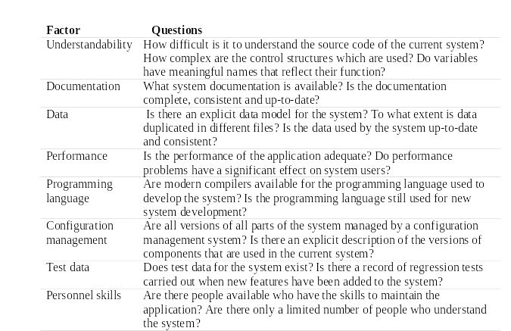
…..Legacy system assessment
Factors in application software assessment [Fig. 26.12 Somm00]
<number> / 22

Slide 23
Key points
A legacy system is an old system that still provides essential business services
Legacy systems are not just application software but also include business processes, support software and hardware
Most legacy systems are made up of several different programs and shared data
A function-oriented approach has been used in the design of most legacy systems

Slide 24
Key points
The structure of legacy business systems normally follows an input-process-output model
The business value of a system and its quality should be used to choose an evolution strategy
The business value reflects the system’s effectiveness in supporting business goals
System quality depends on business processes, the system’s environment and the application software

