Slide 1
ORDBMS OODBMS

Slide 2
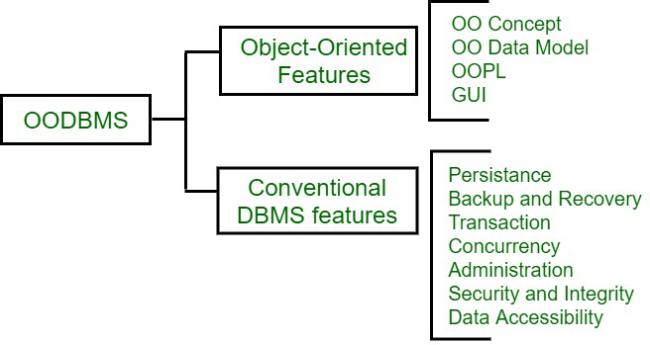
ORDBMS stands for Object-Relational Database Management System. It's a type of database management system that combines object-oriented and relational database models.

Slide 3
An object–relational database (ORD), or object–relational database management system (ORDBMS), is a database management system (DBMS) similar to a relational database, but with an object-oriented database model: objects, classes and inheritance are directly supported in database schemas and in the query language.

Slide 4
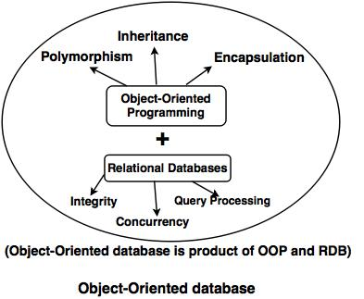
Object Oriented Database

Slide 5
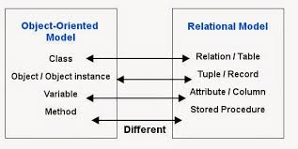

Slide 6
Object-Oriented Database (OODB)
combines object-oriented programming concepts with relational database principles.
It is managed by an object-oriented database management system (OODBMS).
OODBs contain the following elements:
Objects. The basic building block and an instance of a class. The type is either built-in or user-defined.
Classes. A schema or blueprint that defines object structure and behavior.
Methods. A blueprint that defines the behavior of a class.
Pointers. An entity that helps access elements of an object database. They also help establish relationships between objects.

Slide 7
The main feature of objects is the possibility of user-constructed types.
An object created in a programming language (such as Java) saves into an OODB as is.
All the information about an object is in a single package instead of spread across multiple tables.

Slide 8
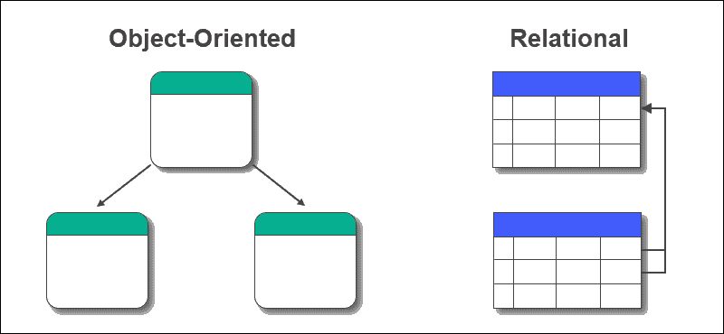
OODB vs. Relational Databases
The main difference between the two is how the data is structured:
Relational databases. Data resides in structured tables with rows and columns. It is queried using SQL, focusing mainly on data consistency and normalization.
OODB. Data is stored as a complete and complex object. It supports complex data types and inheritance. The main focus is to minimize the difference between a database structure and a programming language.

Slide 9
Object-Oriented Programming Concepts in Database Management
Four main features of OOP are:
Polymorphism.
Inheritance.
Encapsulation.
Abstraction.

Slide 10
Features of Object-Oriented Databases
Feature | Description
Query Language | Finds objects and retrieve data from the database.
Transparent Persistence | Allows accessing and using data with an object-oriented programming language without special handling.
ACID Transactions | Ensures that ACID transactions, and guarantees all transactions are completed without conflicting changes.
Database Caching | Creates a partial replica of the database in memory. Allows faster access to a database without reading from disk.
Recovery | Provides disaster recovery mechanisms in case of application or system failure.

Slide 11
Benefits of Object-Oriented Databases
Complex data and a wider variety of data types compared to MySQL data types.
Easy to save and retrieve data quickly.
Seamless integration with object-oriented programming languages.
Easier to model advanced real-world problems.
Extensible with custom data types.

Slide 12
Challenges of Object-Oriented Databases
It is not as widely adopted as relational databases.
No universal data model. Lacks theoretical foundations and standards.
Does not support views.
High complexity, which may lead to performance issues.
An adequate security mechanism and access rights to objects do not exist.

Slide 13
Object-Orient Databases: Use Cases
Object-oriented databases are beneficial in situations where there are complex data structures and relationships.
Multimedia applications. OODBs store and handle multimedia objects efficiently. Inheritance and encapsulation are advantages when working with this content type.
CAD/CAM systems. Engineering, automotive, and aerospace applications use CAD/CAM data. This data has highly interconnected elements and is best modeled as database objects.
Geographic information systems (GIS). Representing and managing spatial data, such as maps and terrain information, requires complex relationships and properties. These features, such as coordinates and topographical relationships, are best suited for object-oriented structures.
Telecommunications. OODBs efficiently handle hierarchical and interconnected data structures typical for telecommunication networks. The data includes network configurations, logs, and user preferences.
Real-time systems. OODBs enable quick updates and retrieval of complex data essential for real-time systems. These technologies are found in industrial automation, robotics, and embedded applications.

Slide 14
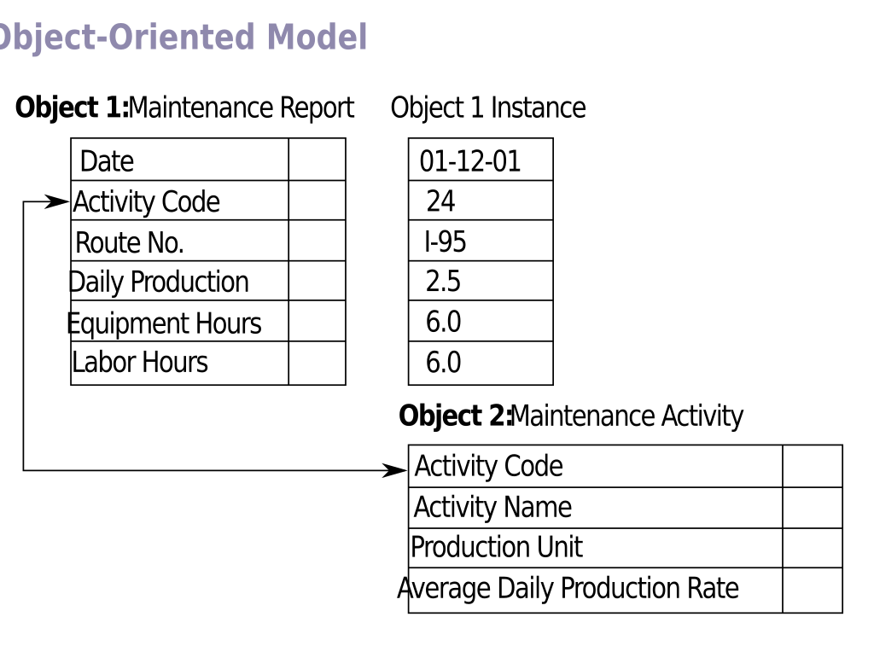
object–relational database management system (ORDBMS)
An object–relational database (ORD), or object–relational database management system (ORDBMS), is a database management system (DBMS) similar to a relational database, but with an object-oriented database model: objects, classes and inheritance are directly supported in database schemas and in the query language.

Slide 15
Advantages of ORDBMS
SQL Support: While ORDBMS supports the structures of the SQL query language, they are quite flexible when tested against query language make it easier to handle complex queries unlike OODBMS.
Scalability: It is easier and can accommodate large data sets as compared to OODBMS due to the fact that it retains the structure of relational databases.
Interoperability: ORDBMS appears to offer better compatibility with the conventional RDMS thus making it easy to migrate from the conventional normal database to more OOD respectively.

Slide 16
Disadvantages of ORDBMS
Complexity in Implementation: Although many object-oriented notions are supported by ORDBMS their representation using SQL can be problematic.
Overhead: The combination in a hybrid approach causes a certain overhead which does have its influence in cases where only object-oriented or tabular representations are needed.

Slide 18
Object Query Language (OQL)
Structured Query Language (SQL), which is used for relational databases.
How does OQL work?
OQL is used to perform queries and retrieve data from object databases.
OQL is based on SQL and was developed by the Object Data Management Group (ODMG).
OQL hides the complexity of the SQL schema of the data model.
OQL is powerful because it can express complex conditions.
OQL is efficient because one OQL query translates into one SQL query.

Slide 19
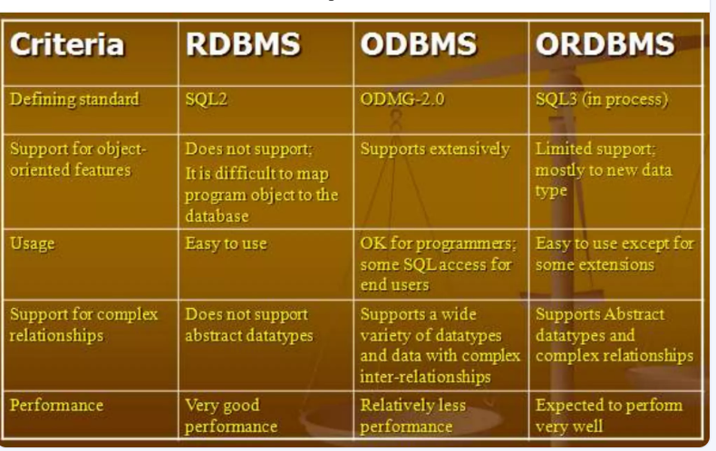

Slide 20
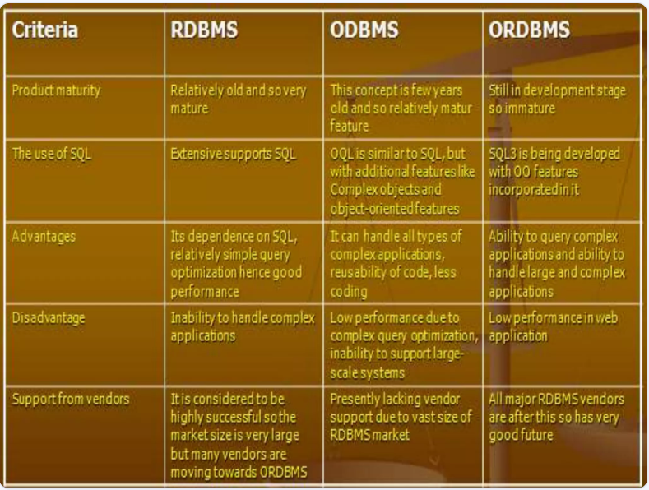

Slide 21
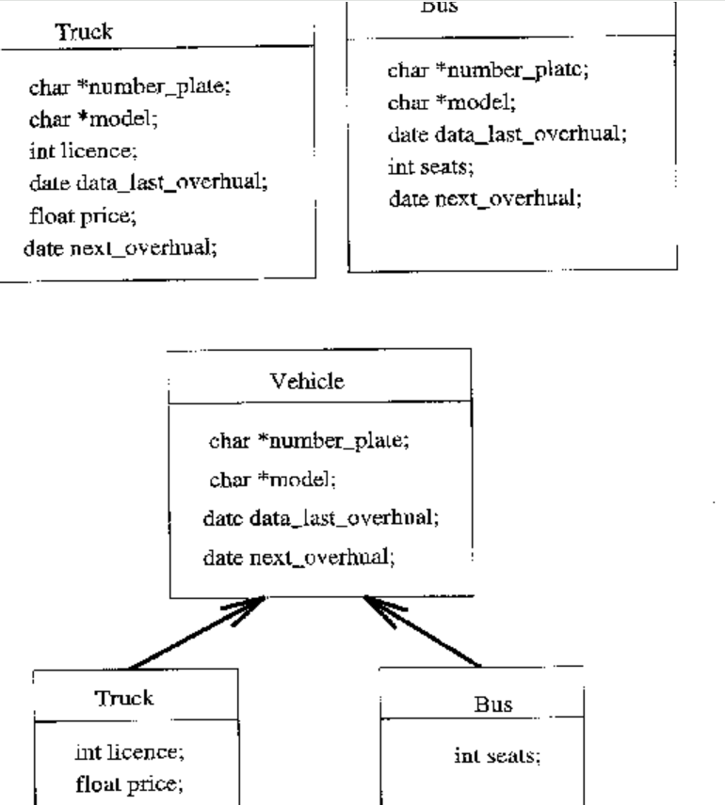

Slide 22
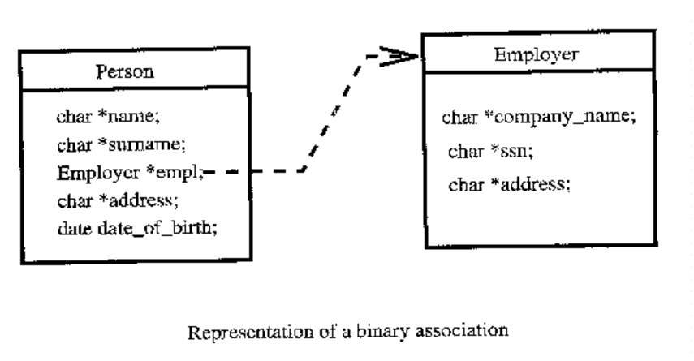

Slide 23
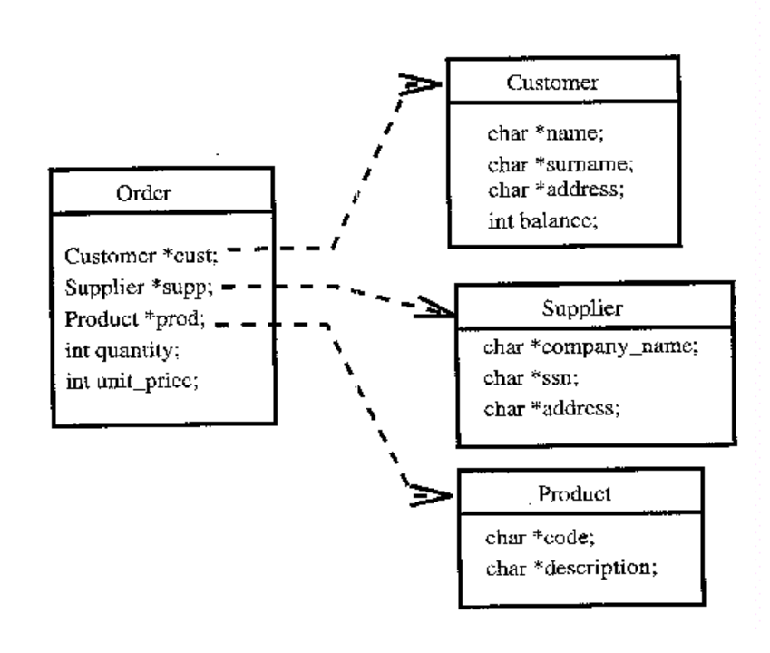

Slide 24
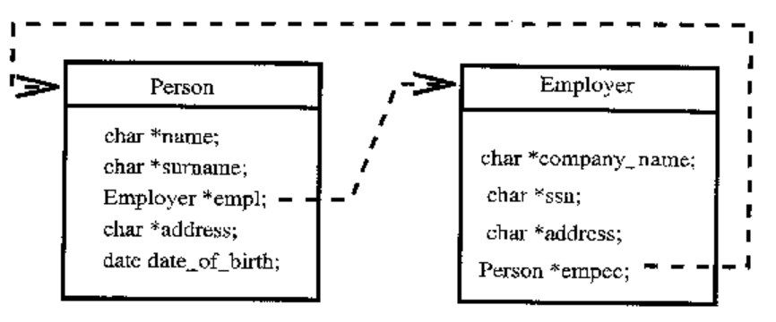

Slide 25
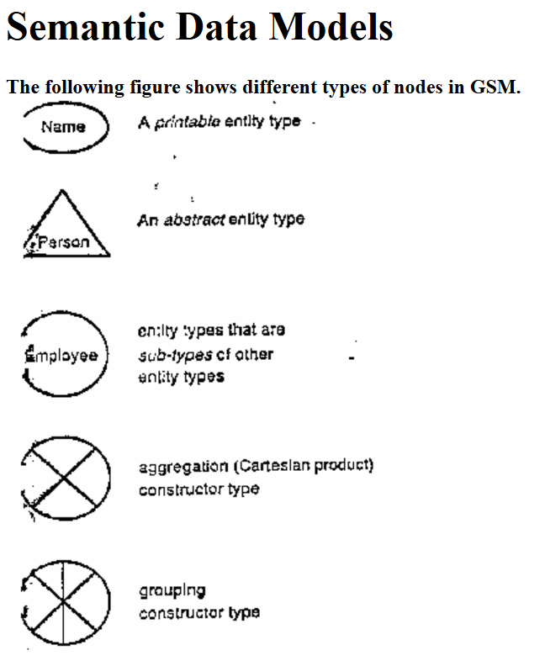
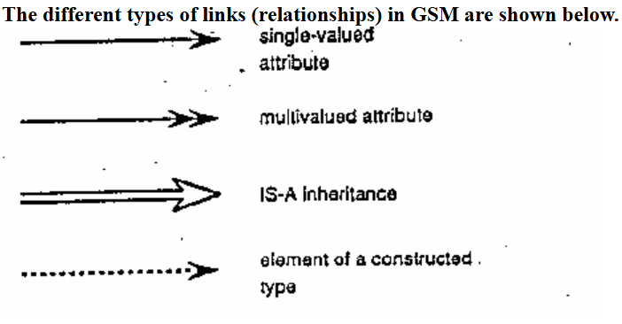

Slide 26
