Slide 1
First-Order Logic
Unit - 3

Slide 2
Outline
Why FOPL?
Syntax and semantics of FOPL
Using FOPL
Wumpus world in FOPL
Knowledge engineering in FOPL

Slide 3
Pros and cons of propositional logic
Propositional logic is declarative
Propositional logic allows partial/disjunctive/negated information
  (unlike most data structures and databases)
Propositional logic is compositional:
  meaning of B_{1,1} ∧ P_{1,2} is derived from meaning of B_{1,1} and of P_{1,2}
Meaning in propositional logic is context-independent
  (unlike natural language, where meaning depends on context)
Propositional logic has very limited expressive power
  (unlike natural language)
  E.g., cannot say "pits cause breezes in adjacent squares“
    except by writing one sentence for each square

Slide 4
First-order logic
Whereas propositional logic assumes the world contains facts,
first-order logic (like natural language) assumes the world contains
  Objects: people, houses, numbers, colors, baseball games, wars, …
  Relations: red, round, prime, brother of, bigger than, part of, comes between, …
  Functions: father of, best friend, one more than, plus, …

Slide 5
Syntax of FOL: Basic elements
Constants KingJohn, 2, NUM,...
Predicates Brother, >,...
Functions Sqrt, Factorial,...
Variables x, y, a, b,...
Connectives ¬, ⇒, ∧, ∨, ⇔
Equality =
Quantifiers ∀, ∃

Slide 6
Atomic sentences
Atomic sentence = predicate (term₁,...,term_{n}) or term₁ = term₂
Term = function (term₁,...,term_{n}) or constant or variable
E.g.,
Brother(KingJohn, RichardTheLionheart) ((Length(LeftLegOf(Richard))>Length(LeftLegOf(KingJohn)))

Slide 7
Complex sentences
Complex sentences are made from atomic sentences using connectives
¬S, S₁ ∧ S₂, S₁ ∨ S₂, S₁ ⇒ S₂, S₁ ⇔ S₂,
E.g.
Sibling(KingJohn, Richard) ⇔ Sibling(Richard, KingJohn)

Slide 8
Truth in first-order logic
Sentences are true with respect to a model and an interpretation
Model contains objects (domain elements) and relations among them
Interpretation specifies referents for
  constant symbols → objects
  predicate symbols → relations
  function symbols → functional relations
An atomic sentence predicate(term₁,...,term_{n}) is true
iff the objects referred to by term₁,...,term_{n}
are in the relation referred to by predicate

Slide 9
Universal quantification
∀<variables> <sentence>
Everyone at NMIMS is smart:
∀x At(x, NMIMS) ⇒ Smart(x)
∀x P is true in a model m iff P is true with x being each possible object in the model
Roughly speaking, equivalent to the conjunction of instantiations of P
    At(Neha, NMIMS) ⇒ Smart(Neha)
    ∧ At(Vidit, NMIMS) ⇒ Smart(Vidit)
    ∧ At(XYZ, NMIMS) ⇒ Smart(XYZ)
    ∧ ...

Slide 10
A common mistake to avoid
Typically, ⇒ is the main connective with ∀
Common mistake: using ∧ as the main connective with ∀:
  ∀x At(x,NUS) ∧ Smart(x)
  means “Everyone is at NMIMS and everyone is smart”

Slide 11
Existential quantification
∃<variables> <sentence>
Someone at NMIMS is smart:
∃x At(x, NMIMS) ∧ Smart(x)
∃x P is true in a model m iff P is true with x being some possible object in the model
Roughly speaking, equivalent to the disjunction of instantiations of P
  At(Neha,NMIMS) ∧ Smart(Neha)
  ∨ At(Vidit,NMIMS) ∧ Smart(Vidit)
  ∨ At(XYZ,NMIMS) ∧ Smart(XYZ)
  ∨ ...

Slide 12
Another common mistake to avoid
Typically, ∧ is the main connective with ∃
Common mistake: using ⇒ as the main connective with ∃:
∃x At(x,NMIMS) ⇒ Smart(x)
is true if there is “anyone who is smart at NMIMS!”

Slide 13
Properties of quantifiers
∀x ∀y is the same as ∀y ∀x
∃x ∃y is the same as ∃y ∃x
∃x ∀y is not the same as ∀y ∃x
Example:
∃x ∀y Loves(x,y)
  “There is a person who loves everyone in the world”
∀y ∃x Loves(x,y)
  “Everyone in the world is loved by at least one person”
Quantifier duality: each can be expressed using the other
∀x Likes(x,IceCream) ¬∃x ¬Likes(x,IceCream)
∃x Likes(x,Broccoli) ¬∀x ¬Likes(x,Broccoli)

Slide 14
Equality
term₁ = term₂ is true under a given interpretation if and only if term₁ and term₂ refer to the same object
E.g., definition of Sibling in terms of Parent:
  ∀x,y Sibling(x,y) ⇔ [¬(x = y) ∧ ∃m,f ¬ (m = f) ∧ Parent(m,x) ∧ Parent(f,x) ∧ Parent(m,y) ∧ Parent(f,y)]

Slide 15
Using FOL
The kinship domain:
Brothers are siblings
  ∀x,y Brother(x,y) ⇔ Sibling(x,y)
One's mother is one's female parent
  ∀m,c Mother(c) = m ⇔ (Female(m) ∧ Parent(m,c))
“Sibling” is symmetric
  ∀x,y Sibling(x,y) ⇔ Sibling(y,x)

Slide 16
Summary
First-order logic:
  objects and relations are semantic primitives
  syntax: constants, functions, predicates, equality, quantifiers
Increased expressive power
Information:
The law says that it is a crime for an American to sell weapons to hostile nations. The country Nono, an enemy of America, has some missiles, and all of its missiles were sold to it by Colonel West, who is American.
Prove that Col. West is a criminal

Slide 17
Example knowledge base
... it is a crime for an American to sell weapons to hostile nations:
  ∀x, ∀y, ∀z American(x) ∧ Weapon(y) ∧ Sells(x,y,z) ∧ Hostile(z) ⇒ Criminal(x)
Nono … has some missiles
∃x Owns(Nono,x) ∧ Missile(x)
… all of its missiles were sold to it by Colonel West
  ∀(x) Missile(x) ∧ Owns(Nono, x) ⇒ Sells(West, x, Nono)
  Missiles are weapons:
  ∀(x) Missile(x) ⇒ Weapon(x)
An enemy of America counts as "hostile“:
  ∀(x) Enemy(x, America) ⇒ Hostile(x)
West, who is American …
  American(West)
The country Nono, an enemy of America …
Enemy(Nono, America)

Slide 18
Represent the following sentences in first order logic
  Some students took French in spring 2001.
  Every student who takes French passes it.
  Only one student took Greek in spring 2001.
  The best score in Greek is always higher than the best score in French.
  Every person who buys a policy is smart.
  No person buys an expensive policy.
  There is an agent who sells policy only to people who are not insures.
  There is a barber who shaves all men in town who do not shave themselves.

Slide 19
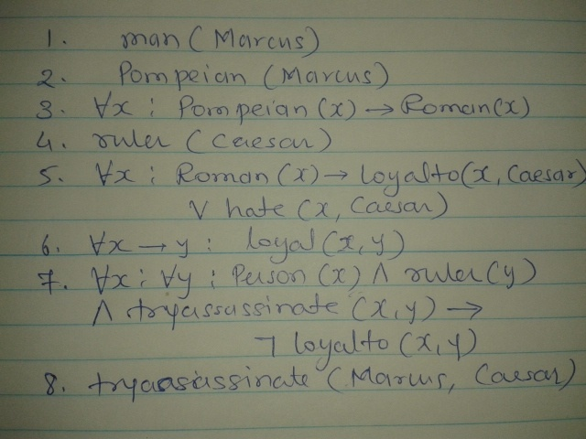
  Marcus was a man
  Marcus was a Pompeian
  All Pompeian were Romans
  Caesar was a ruler
  All Romans were either loyal to Caesar or hated him
  Everyone is loyal to someone
  People only try to assassinate ruler they are not loyal to
  Marcus tried to assassinate Caesar
  All men are people
Was Marcus loyal to Caesar ?
  Not loyalto(Marcus, Caesar)

Slide 20
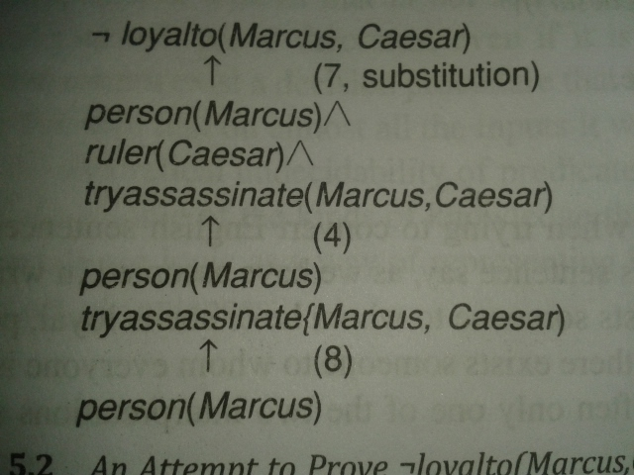
Query - Was Marcus loyal to Caesar ?
Proof start with - Not loyalto(Marcus, Caesar)

Slide 21
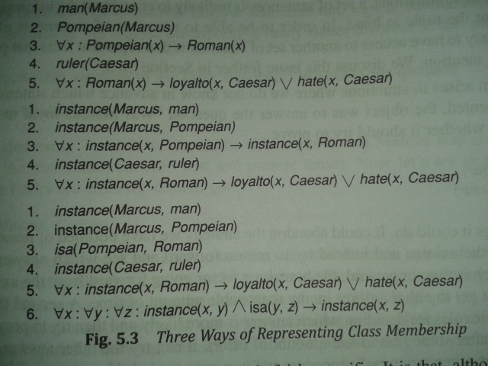
Another way of representing knowledge-
(Instance and Isa relationship)

Slide 22
Computable functions and predicates
gt(1, 0) lt(0, 1)
gt(2, 1) lt(1, 2)
gt (3+3, 2)

Slide 23
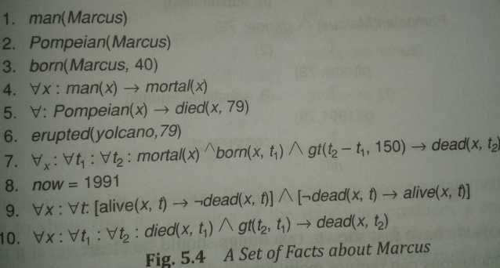
Example of Substitution Method
  Marcus was a man
  Marcus was a Pompeian
  Marcus was born in 40 AD
  All men are mortal
  All Pompeians died when the volcano erupted in 79 AD
  No mortal lives longer than 150 years
  It is now 1991
  Alive means not dead
  If someone dies, then he is dead at all later time
WFF

Slide 24
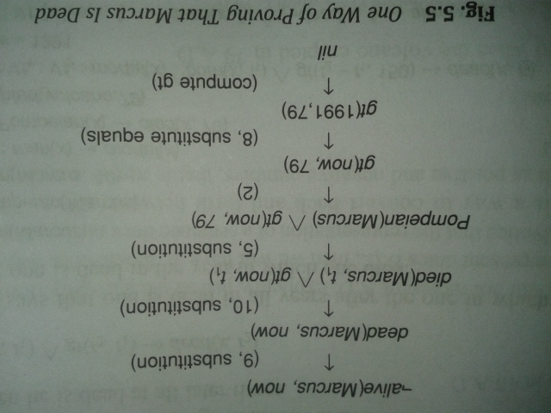
Query - Is Marcus alive ?
not-alive (Marcus, now) – Negation of the statement
Proof by substitution – First solution Sequence
Knowledge base in FOPL

Slide 25
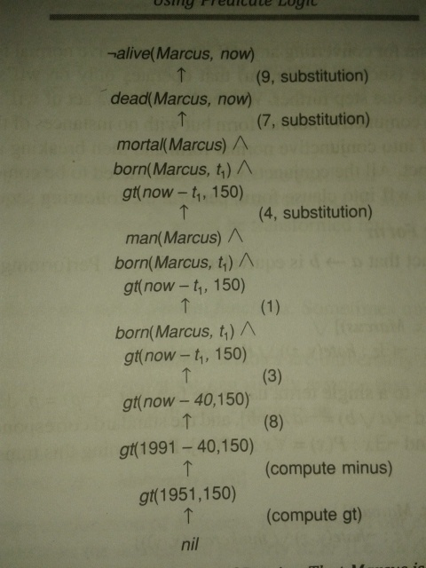
Second solution sequence

Slide 26
Resolution
Straight forward substitution method can not prove for complex WFF.
Resolution process is efficient
It operate on the statement that have converted into standard form : CNF
Proofs by refutation :
  It prove the statement by showing the negation of the statement produce a contradiction with the known statements

Slide 27


Resolution
Convert a statement into Clause form
“All Romans who know Marcus either hate Caesar or think that anyone who hates anyone is crazy”
WFF
CNF

Slide 28
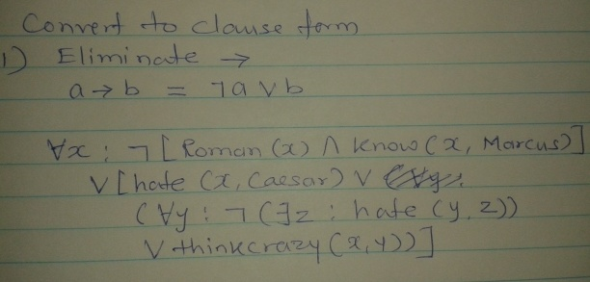
Conversion : WFF to CNF

Slide 29
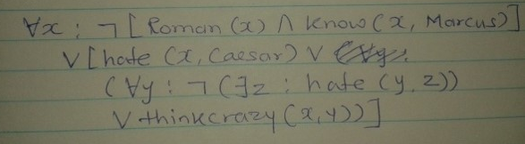
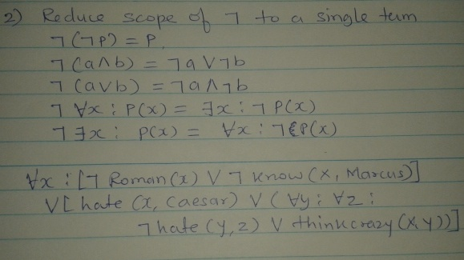
Step 1
output

Slide 30
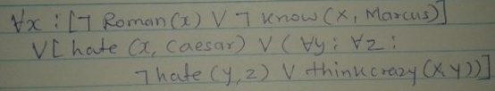
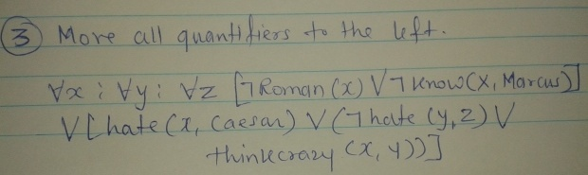
Step 2
output

Slide 31
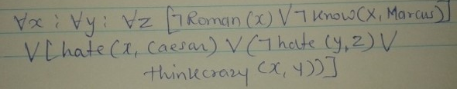

4. Drop prefixes : since all the variables are universally quantified
Step 3
output

Slide 32
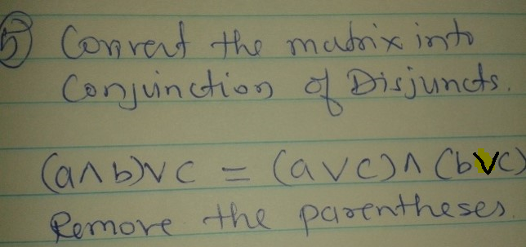
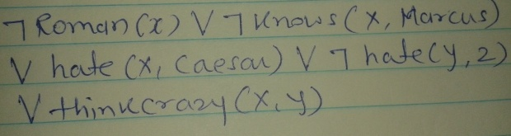
Step 4
output

Slide 33
Example for Resolution
  Marcus was a man
  Marcus was a Pompeian
  All Pompeian were Romans
  Caesar was a ruler
  All Romans were either loyal to Caesar or hated him
  Everyone is loyal to someone
  People only try to assassinate ruler they are not loyal to
  Marcus tried to assassinate Caesar
Was Marcus hated Caesar ?
  Not hate(Marcus, Caesar)

Slide 34
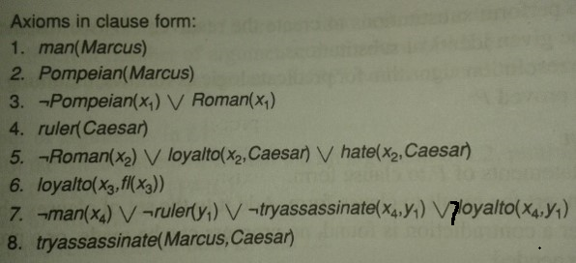
WFF
CNF

Slide 35
