Slide 1
Chapter 3:
Using SQL Queries to Insert, Update, Delete, and View Data
Guide to Oracle 10g

Slide 2
Lesson A Objectives
After completing this lesson, you should be able to:
Run a script to create database tables automatically
Insert data into database tables
Create database transactions and commit data to the database
Create search conditions in SQL queries
Update and delete database records and truncate tables
Guide to Oracle 10g

Slide 3
Lesson A Objectives (continued)
Create and use sequences to generate surrogate key values automatically
Grant and revoke database object privileges
Guide to Oracle 10g

Slide 4
Using Scripts to Create Database Tables
Script
  Text file that contains one or more SQL commands
Run a script
  Type start at SQL prompt
  Blank space
  Full path and filename of script file
Guide to Oracle 10g

Slide 5
Using the INSERT Command
Basic syntax for inserting into every column:
  INSERT into tablename
  VALUES (column1_value, column2_value, … );
Basic syntax for inserting into selected columns
  INSERT into tablename (columnname1, columnname2, … );
  VALUES (column1_value, column2_value, … );
Guide to Oracle 10g

Slide 6
Using the INSERT Command (continued)
Ensure all foreign keys that new row references have already been added to database
Guide to Oracle 10g

Slide 7
Format Models
Also called format mask
Used to specify different output format from default
For NUMBER data types
  9 represents digit
For DATE/TIMESTAMP data types
  Choose formats for year day, date, etc.
Guide to Oracle 10g

Slide 8
Inserting Date and Interval Values
Inserting values into DATE columns
  Use TO_DATE function to convert string to DATE
  Syntax
    TO_DATE('date_string', 'date_format_model')
Inserting values into INTERVAL columns
  Syntax
    TO_YMINTERVAL('years-months')
    TO_DSINTERVAL('days HH:MI:SS.99')
Guide to Oracle 10g

Slide 9
Inserting LOB Column Locators
Oracle stores LOB data in separate physical location from other types of data
LOB locator
  Structure containing information that identifies LOB data type
  Points to alternate memory location
Create blob locator
  EMPTY_BLOB()
Guide to Oracle 10g

Slide 10
Creating Transactions and Committing New Data
Transaction
  Represents logical unit of work
  All of action queries must succeed or no transactions can succeed
Commit
  Save changes in transaction
Rollback
  Discard changes in transaction
Guide to Oracle 10g

Slide 11
Creating Transactions and Committing New Data (continued)
Purpose of transaction processing
  Enable users to see consistent view of database
New transaction begins when SQL*Plus started and command executed
Transaction ends when current transaction committed
COMMIT command commits transaction
ROLLBACK command restores database to point before last commit
Guide to Oracle 10g

Slide 12
Creating Search Conditions in SQL Queries
Search condition
  Expression that seeks to match specific table rows
Syntax
  WHERE columnname comparison_operator search_expression
Comparison operators include:
  Equality and inequality operators
  Set operators
Guide to Oracle 10g

Slide 13
Defining Search Expressions
NUMBER example
  WHERE f_id = 1
Character data example
  WHERE s_class = 'SR'
DATE example
  WHERE s_dob = TO_DATE('01/01/1980', ‘MM/DD/YYYY')
Guide to Oracle 10g

Slide 14
Creating Complex Search Conditions
Complex search condition
  Combines multiple search conditions using logical operators
AND logical operator
  True if both conditions true
OR logical operator
  True if one condition true
NOT logical operator
  Matches opposite of search condition
Guide to Oracle 10g

Slide 15
Updating Table Rows
UPDATE action query syntax
  UPDATE tablename
  SET column1 = new_value1, column2 = new_value2, …
  WHERE search condition;
Guide to Oracle 10g

Slide 16
Deleting Table Rows
SQL DELETE action query
  Remove specific rows
Truncate table
  Remove all rows
DELETE query syntax
  DELETE FROM tablename
  WHERE search condition;
Guide to Oracle 10g

Slide 17
Deleting Table Rows (continued)
Child row
  Row’s value is foreign key
  Cannot delete row if it has child row
    Unless first delete row in which foreign key value exists
TRUNCATE syntax
  TRUNCATE TABLE tablename;
Cannot truncate table with foreign key constraints
  Must disable constraints first
Guide to Oracle 10g

Slide 18
Creating New Sequences
CREATE SEQUENCE command
  DDL command
  No need to issue COMMIT command
Guide to Oracle 10g

Slide 19
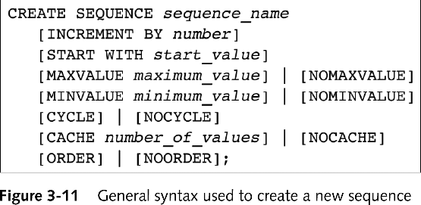
General Syntax Used to Create a New Sequence
Guide to Oracle 10g

Slide 20
Viewing Sequence Information
Query USER_SEQUENCES data dictionary view
  sequence_name column displays sequence names
Guide to Oracle 10g

Slide 21
Using Sequences
Pseudocolumn
  Acts like column in database table
  Actually command that returns specific value
CURRVAL
  Returns most recent sequence value retrieved
NEXTVAL
  Next available sequence value
  sequence_name.NEXTVAL
Guide to Oracle 10g

Slide 22
Using Sequences (continued)
DUAL
  Simple table in system user schema
  More efficient to retrieve pseudocolumns from DUAL
    SELECT sequence_name.NEXTVAL
    FROM DUAL;
DBMS uses user sessions
  To ensure that all sequence users receive unique sequence numbers
Guide to Oracle 10g

Slide 23
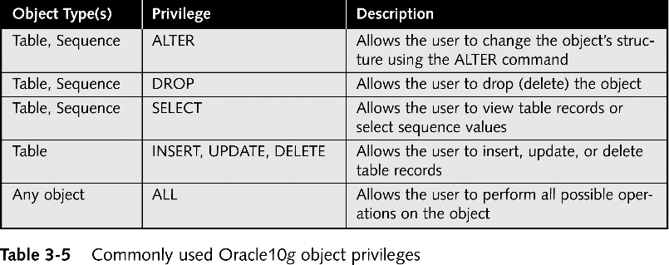
Database Object Privileges
Guide to Oracle 10g

Slide 24
Granting Object Privileges
SQL GRANT command
  Syntax
    GRANT privilege1, privilege2, …
    ON object_name
    TO user1, user2, …;
Guide to Oracle 10g

Slide 25
Revoking Table Privileges
REVOKE command
  Syntax
    REVOKE privilege1, privilege2, …
    ON object_name
    FROM user1, user2, …;
Guide to Oracle 10g

Slide 26
Lesson B Objectives
After completing this lesson, you should be able to:
Write SQL queries to retrieve data from a single database table
Create SQL queries that perform calculations on retrieved data
Use SQL group functions to summarize retrieved data
Guide to Oracle 10g

Slide 27
Retrieving Data From a Single Database Table
Syntax
  SELECT columnname1, columnname2, …
  FROM ownername.tablename
  [WHERE search_condition];
Retrieve all of columns
  Use asterisk ( * ) as wildcard character in SELECT clause
  SELECT * from …
Guide to Oracle 10g

Slide 28
Suppressing Duplicate Rows
SQL DISTINCT qualifier
  Examines query output before it appears on screen
  Suppresses duplicate values
Syntax
  SELECT DISTINCT columnname;
Guide to Oracle 10g

Slide 29
Using Search Conditions in SELECT Queries
Use search conditions to retrieve rows matching specific criteria
  Exact search conditions
    Use equality operator
  Inexact search conditions
    Use inequality operators
Search for NULL or NOT NULL values
  WHERE columnname IS NULL
  WHERE columnname IS NOT NULL
Guide to Oracle 10g

Slide 30
Using Search Conditions in SELECT Queries (continued)
IN comparison operator
  Match data values that are members of a set of search values
LIKE operator
  Use to match part of character string
  Syntax
    WHERE columnname LIKE 'string'
    Character string should contain wildcard character %, or _, or both
Guide to Oracle 10g

Slide 31
Sorting Query Output
ORDER BY clause
  Sort query output
  Syntax for select with ordered results
    SELECT columnname1, columnname2, …
    FROM ownername.tablename
    WHERE search_condition
    ORDER BY sort_key_column;
  Sort can be ascending or descending
  Can specify multiple sort keys
Guide to Oracle 10g

Slide 32
Using Calculations in SQL Queries
Perform many calculations directly within SQL queries
  Very efficient way to perform calculations
Create SQL queries
  Perform basic arithmetic calculations
  Use variety of built-in functions
Guide to Oracle 10g

Slide 33
Performing Arithmetic Calculations
Perform arithmetic calculations on columns that have data types
  NUMBER
  DATE
  INTERVAL
SYSDATE pseudocolumn
  Retrieves current system date
Use + and – to calculate differences between dates
Guide to Oracle 10g

Slide 34
Oracle 10g SQL Functions
Built-in functions perform calculations and manipulate retrieved data values
Called single-row functions
  Return single result for each row of data retrieved
To use:
  List function name in SELECT clause followed by required parameter in parentheses
Guide to Oracle 10g

Slide 35
Oracle 10g SQL Group Functions
Group function
  Performs operation on group of queried rows
  Returns single result such as column sum
To use:
  List function name followed by column name in parentheses
Guide to Oracle 10g

Slide 36
Using the COUNT Group Function
COUNT group function
  Returns integer representing number of rows that query returns
COUNT(*) version
  Calculates total number of rows in table that satisfy given search condition
  Includes NULL values.
The COUNT(columnname) version
  Does not include NULL values
Guide to Oracle 10g

Slide 37
Using the GROUP BY Clause to Group Data
GROUP BY clause
  Group output by column with duplicate values
  Apply group functions to grouped data
Syntax
  GROUP BY group_columnname;
  Follows FROM clause
All columns listed in SELECT clause must be included in GROUP BY clause
Guide to Oracle 10g

Slide 38
Using the HAVING Clause to Filter Grouped Data
HAVING clause
  Place search condition on results of queries that display group function calculations
Syntax
  HAVING group_function comparison_operator value
Example
  HAVING sum(capacity) >= 100
Guide to Oracle 10g

Slide 39
Creating Alternate Column Headings
Column headings for retrieved columns are names of database table columns
Specify alternate output heading text
  SELECT columnname1 "heading1_text ",
  columnname2 "heading2_text", …
Guide to Oracle 10g

Slide 40
Creating Alternate Column Headings (continued)
Alias
  Alternate name for query column
  Syntax
    SELECT columnname1 AS alias_name1…
Guide to Oracle 10g

Slide 41
Modifying the SQL*Plus Display Environment
SQL*Plus page consists of:
  Specific number of characters per line
  Specific number of lines per page
linesize property
  Specifies how many characters appear on line
pagesize property
  Specifies how many lines appear on page
Modify using environment dialog box
Guide to Oracle 10g

Slide 42
Formatting Data Using Format Models
TO_CHAR function
  Convert column to character string
  Apply desired format model to value
  Syntax
    TO_CHAR(column_name, 'format_model')
  Use for data types
    DATE
    INTERVAL
    NUMBER
Guide to Oracle 10g

Slide 43
Lesson C Objectives
After completing this lesson, you should be able to:
Create SQL queries that join multiple tables
Create nested SQL queries
Combine query results using set operators
Create and use database views
Guide to Oracle 10g

Slide 44
Joining Multiple Tables
Join
  Combine data from multiple database tables using foreign key references
Syntax
  SELECT column1, column2, …
  FROM table1, table2
  WHERE table1.joincolumn = table2.joincolumn
  AND search_condition(s);
Guide to Oracle 10g

Slide 45
Joining Multiple Tables (continued)
Must qualify column name in SELECT clause
  Specify name of table that contains column followed by period then column name
Join condition
  Specifies table names to be joined and column names on which to join tables
SQL supports multiple types of join queries
Guide to Oracle 10g

Slide 46
Inner Joins
Simplest type of join
VALUES in one table equal to values in other table
Also called:
  Equality join
  Equijoin
  Natural join
Query design diagram
Guide to Oracle 10g

Slide 47
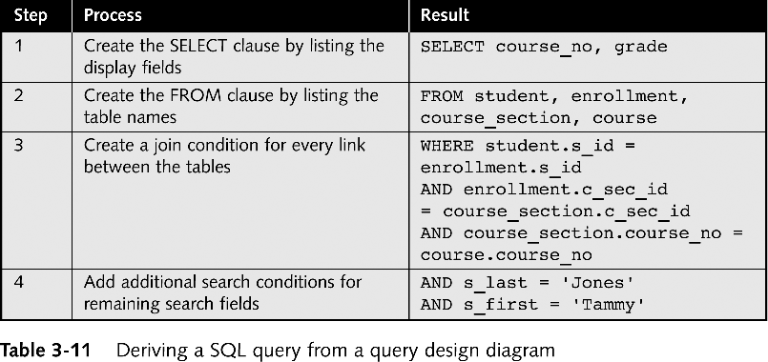
Deriving a SQL Query From a Query Design Diagram
Guide to Oracle 10g

Slide 48
Outer Joins
Returns all rows from one table
  Called inner table
And matching rows from second table
  Called outer table
Syntax
  inner_table.join_column = outer_table.join_column(+)
Guide to Oracle 10g

Slide 49
Self-joins
Query that joins table to itself
Must create table alias
  Alternate name assigned to table in query’s FROM clause
  Syntax
    FROM table1 alias1, …
Guide to Oracle 10g

Slide 50
Creating Nested Queries
Nested query
  Consists of main query and one or more subqueries
  Main query
    First query that appears in SELECT command
  Subquery
    Retrieves values that main query’s search condition must match
Guide to Oracle 10g

Slide 51
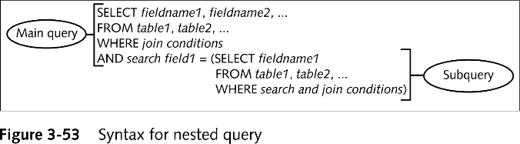
Creating Nested Queries with Subqueries that Return a Single Value
Guide to Oracle 10g

Slide 52
Using Multiple Subqueries Within a Nested Query
Use AND and OR operators
  To join search conditions associated with subqueries
Guide to Oracle 10g

Slide 53
Creating Nested Subqueries
Nested subquery
  Subquery that contains second subquery that specifies its search expression
Guide to Oracle 10g

Slide 54
UNION and UNION ALL
UNION set operator
  Joins output of two unrelated queries into single output result
  Syntax
    query1 UNION query2;
UNION ALL operator
  Same as UNION but includes duplicate rows
Guide to Oracle 10g

Slide 55
INTERSECT
Finds intersection in two queries
Requires that both queries have same number of display columns in SELECT statement
Automatically suppresses duplicate rows
Guide to Oracle 10g

Slide 56
MINUS
To find difference between two unrelated query result list
Guide to Oracle 10g

Slide 57
Creating and Using Database Views
Source query
  Used to create view
  Specify subset of single table’s columns or rows or join multiple tables
Updatable views
  Can be used to update database
Guide to Oracle 10g

Slide 58
Creating Views
Syntax
  CREATE VIEW view_name
  AS source_query;
  Or
  CREATE OR REPLACE VIEW view_name
  AS source_query;
Guide to Oracle 10g

Slide 59
Executing Action Queries Using Views
Use view to execute action queries that:
  Insert
  Update
  Delete data in underlying source tables
Can also execute update action queries and delete action queries using view
  Just as with database table
Guide to Oracle 10g

Slide 60
Retrieving Rows from Views
Query view using SELECT statement
Guide to Oracle 10g

Slide 61
Removing Views
DROP VIEW command
  Remove view from user schema
  Syntax
    DROP VIEW view_name;
Guide to Oracle 10g

Slide 62
Summary
INSERT action query
SQL search condition
  Match one or more database rows
UPDATE action query
DELETE command
SELECT query
  DISTINCT qualifier
Single row and group functions
Guide to Oracle 10g

Slide 63
Summary (continued)
Can change appearance of SQL*Plus environment
Join multiple tables in SELECT query
  Inner join
  Outer join
Nested queries
Set operators
Views
Guide to Oracle 10g

