Slide 1
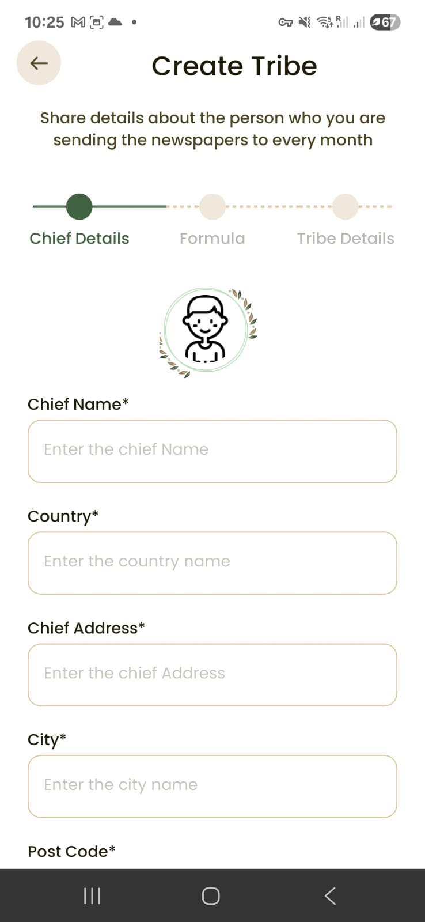
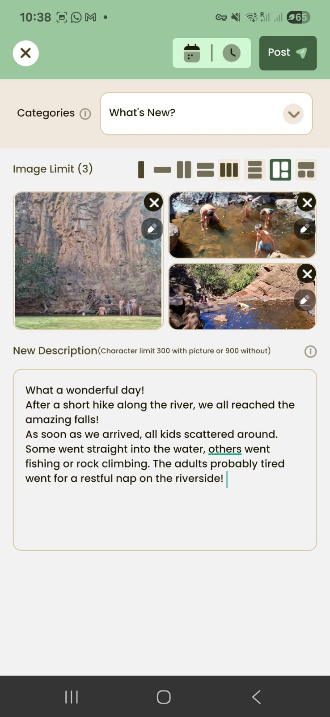
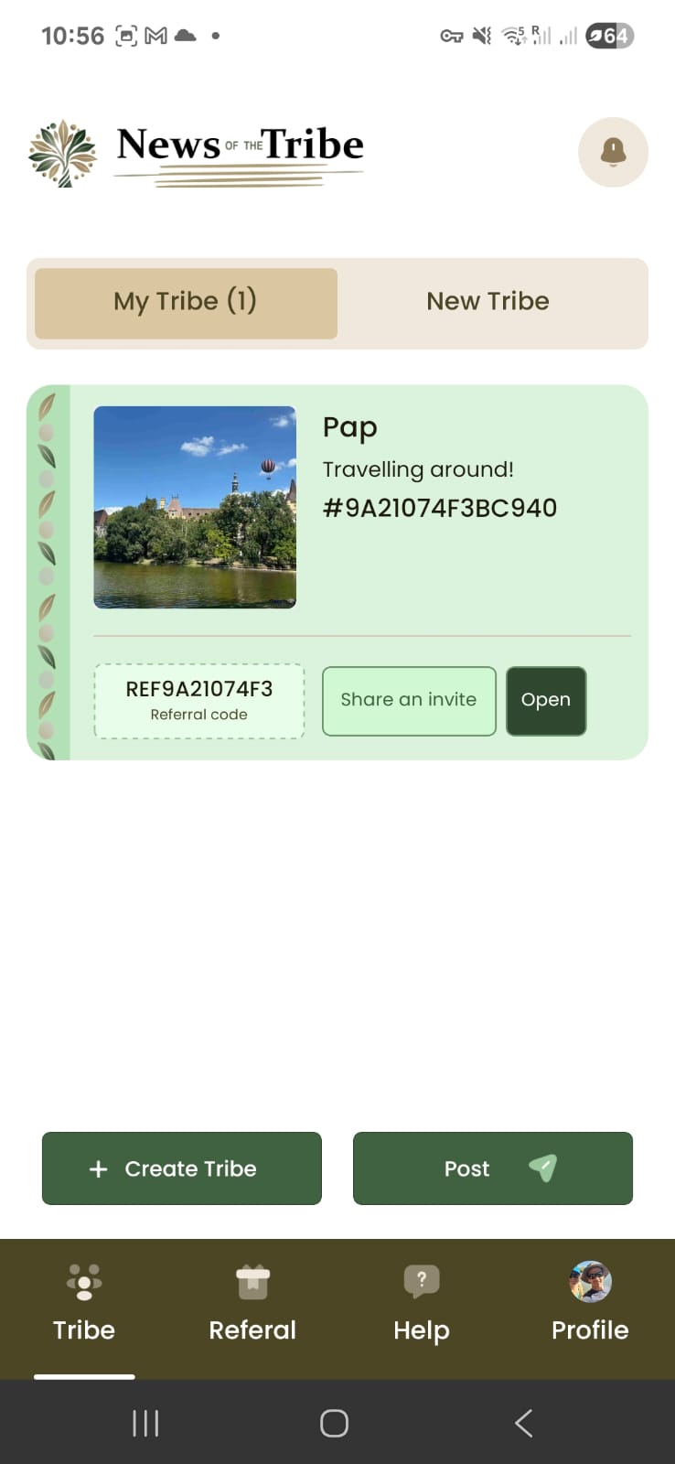
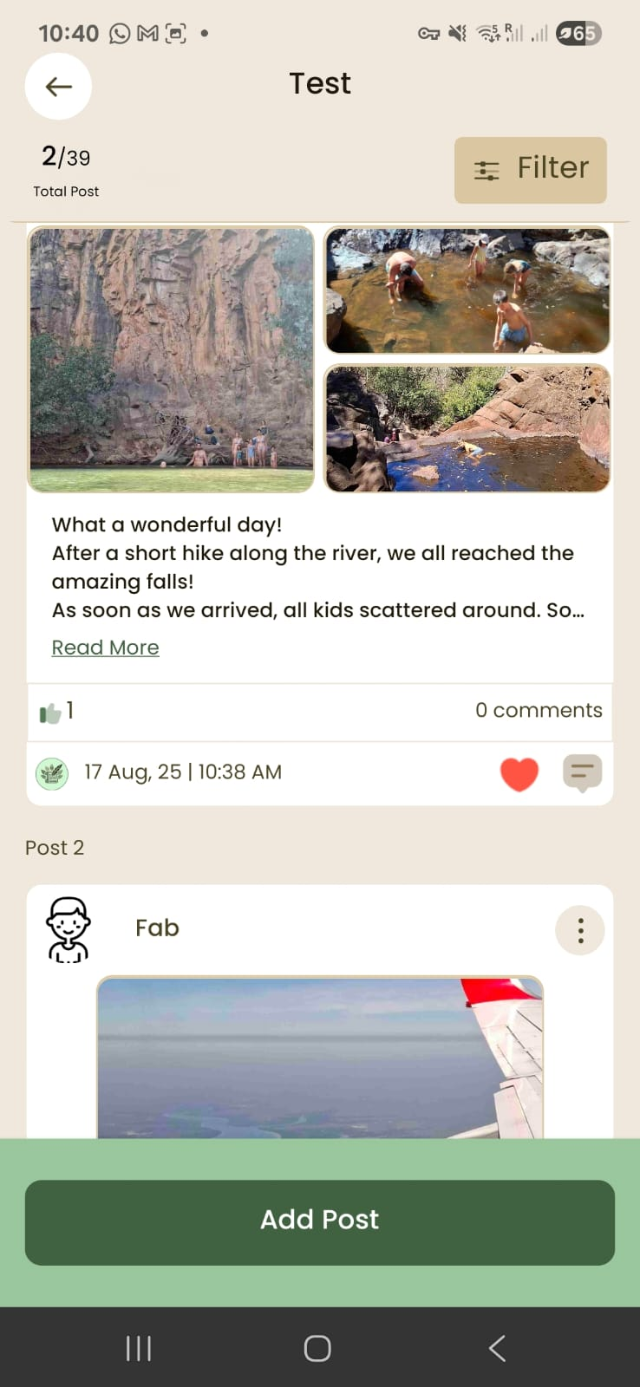

Slide 2















1 App
1 Newspaper
1 Tribe
1 Tribe

Slide 3
1 Newspaper
1 App
1 happy
Grandad
1 Tribe

Slide 4

1 Newspaper
1 App
1 happy
Grandad
1 Tribe

Slide 5
1 App
1 Newspaper
1 happy
Grandad
1 Tribe

Slide 6
