Slide 1

LINFO-2347: Computer System Security
Network Attacks & Firewall Security in Enterprise Environment
Final Project Presentation
BOTTON David 20262410
AISSOU Ammar 22812410
Instructor: Pr. Sadre Ramin
Program: MS Cybersecurity
Due Date: May 2025

Slide 2
Mininet Security Posture
Basic Firewall Ruleset
Attacks: ARP Cache Poisoning
Port Scan
Reflected DDos
SYN flooding
& Firewall Mitigations

Slide 3
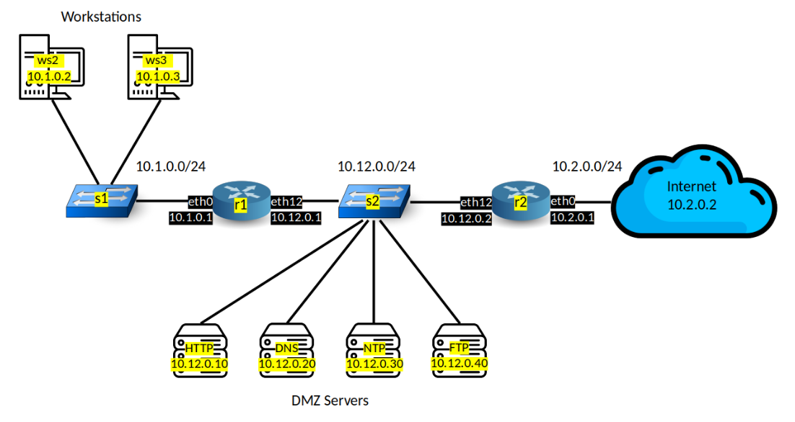
Mininet Security Posture
*
*

Slide 4
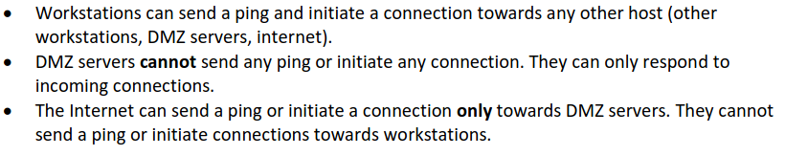
Basic Firewall Ruleset

Slide 5
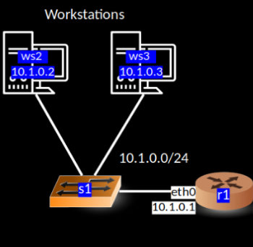

Slide 6
Router r1:
# Workstations → Any
iifname "r1-eth0" ip saddr 10.1.0.0/24 ct state new accept
# Any → Workstations
iifname "r1-eth12" ip daddr 10.1.0.0/24 ct state established,related accept
Router r2:
# Workstations → Internet
iifname "r1-eth0" ip saddr 10.1.0.0/24 ct state new accept
# DMZ → Workstations (returns)
iifname "r2-eth12" ip saddr 10.12.0.0/24 ip daddr 10.1.0.0/24 ct state established,related accept
# Internet → Workstations (returns)
iifname "r2-eth0" ip saddr 10.2.0.0/24 ip daddr 10.1.0.0/24 ct state established,related accept

Slide 7


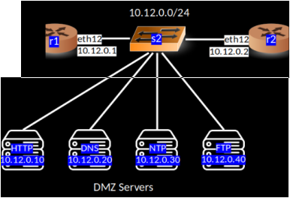
Router r2:
# DMZ → Internet (returns)
iifname "r2-eth12" ip saddr 10.12.0.0/24 ip daddr 10.2.0.0/24 ct state established,related accept
# DMZ → Workstations (returns)
iifname "r2-eth12" ip saddr 10.12.0.0/24 ip daddr 10.1.0.0/24 ct state established,related accept
Each DMZ server:
chain output {
type filter hook output priority 0; policy drop;
# Allow response traffic only
ct state established,related accept
}

Slide 8
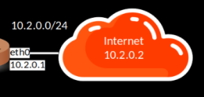
Router r2:
type filter hook forward priority 0; policy drop;
# Internet → DMZ
iifname "r2-eth0" ip saddr 10.2.0.0/24 ip daddr 10.12.0.0/24 ct state new accept
# Internet → Workstations (returns)
iifname "r2-eth0" ip saddr 10.2.0.0/24 ip daddr 10.1.0.0/24 ct state established,related accept

Slide 9
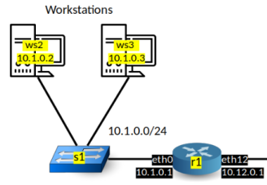


ARP Cache Poisoning
Man-in-the-Middle attack that manipulates ARP tables
Attacker intercepts traffic between hosts by falsifying MAC address mappings
Common attack vector in internal networks
Overview
Targets workstation ws3 (10.1.0.3) and gateway router r1 (10.1.0.1)
Redirects all traffic through attacker's machine (ws2)
Allows monitoring and modification of victim's network traffic
Attack vector in trusted LAN segment (10.1.0.0/24)
Method
Resolves MAC addresses via ARP broadcasts
Sends continuous spoofed ARP replies (1/second) to:
- Tell target the attacker is the gateway
- Tell gateway the attacker is the victim
Intercepts all ws3 traffic to DMZ (10.12.0.0/24) and Internet

Slide 10
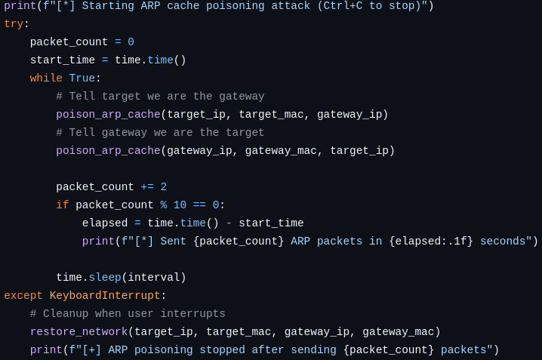
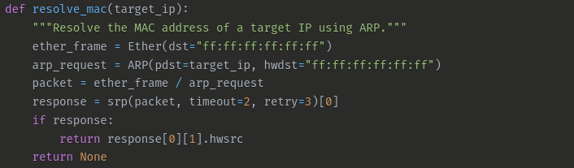
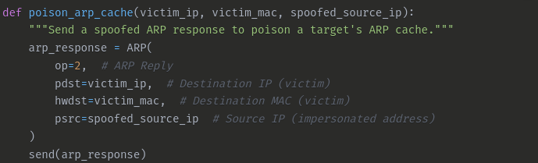
ARP Cache Poisoning

Slide 11
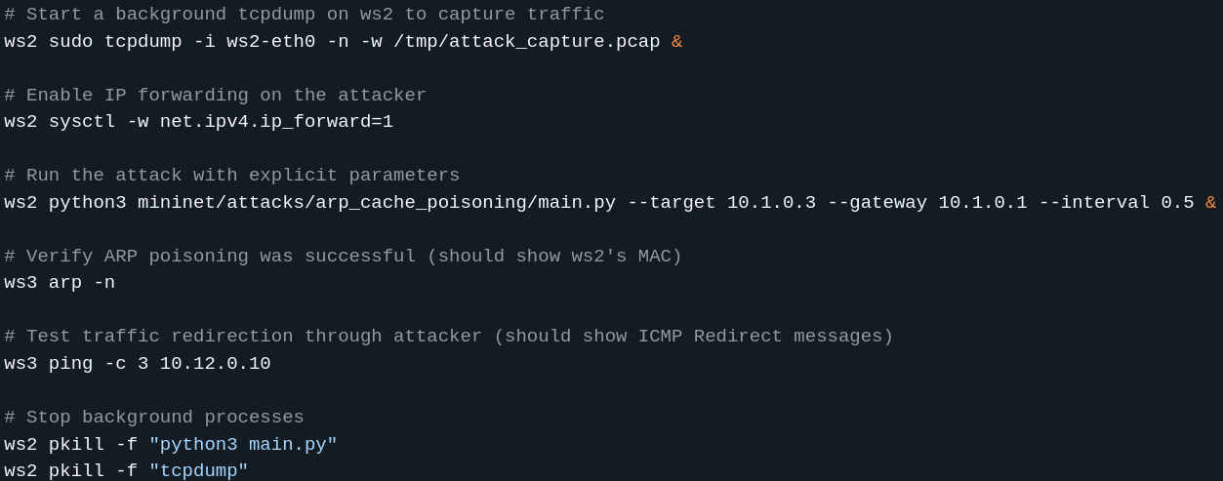
ARP Cache Poisoning

Slide 12
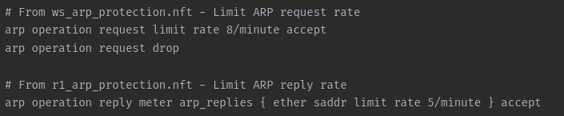
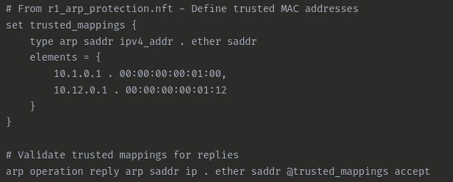
ARP Vector Firewall Mitigation
Rate limiting: Restrict ARP requests/replies (5-10/minute)
MAC validation: Enforce static mappings for critical devices

Slide 13
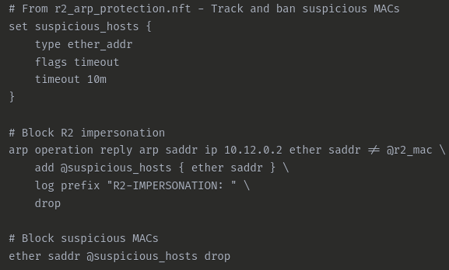
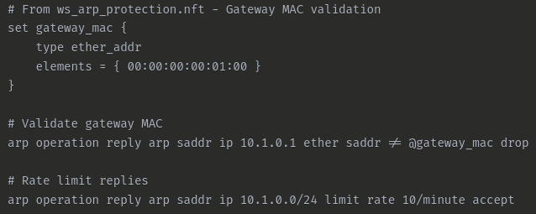
ARP Vector Firewall Mitigation
Suspicious host tracking: Ban MACs attempting gateway impersonation
Logging: Monitor and record potential ARP spoofing events

Slide 14
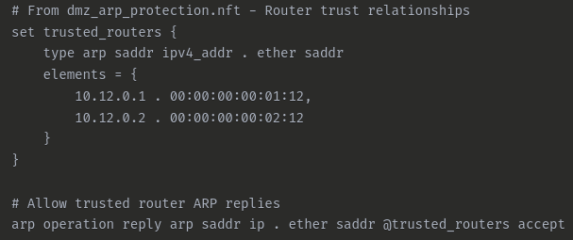
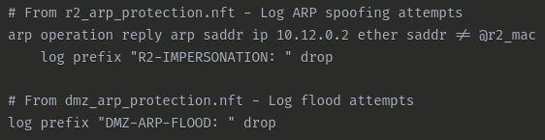
ARP Vector Firewall Mitigation

Slide 15
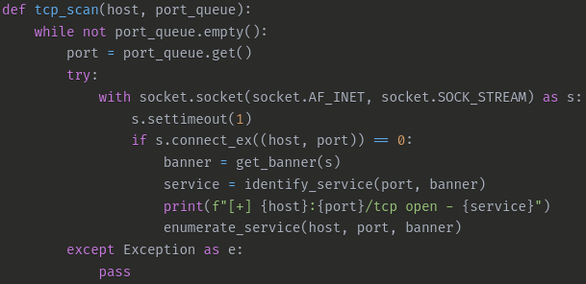
Network Port Scanning
TCP Port Scanning
Multi-threaded approach (100 threads)
Default scan range: ports 1-1000 (expandable to all 65535 ports)
Attempts service banner retrieval on each open connection
Service-specific enumeration: extracts HTTP headers, FTP banners
Identifies running services by combining port numbers and banner information
Operation from Internet position can scan DMZ but is limited by router filtering

Slide 16
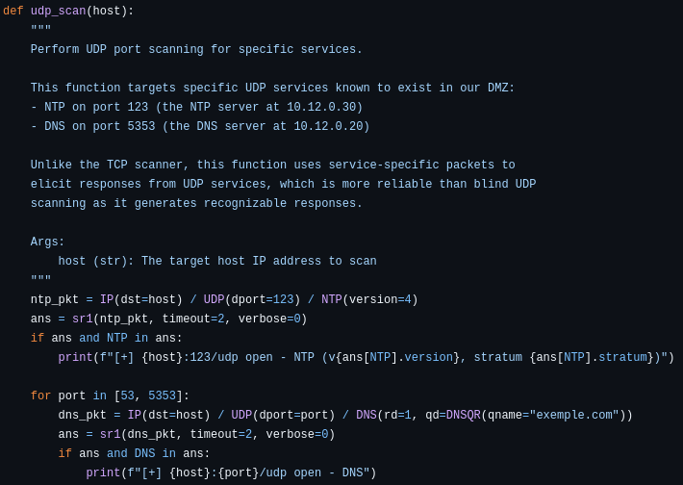
Network Port Scanning
UDP Port Scanning
Targeted approach focusing on service-specific UDP ports
Uses crafted protocol packets rather than empty datagrams
NTP scan: Sends NTPv4 packets to port 123, extracts version and stratum level
DNS scan: Queries on ports 53/5353, validates responses
More effective than blind UDP scanning due to application-layer validation
Runs sequentially after TCP scan completes on each target
Can identify misconfigured services even with limited router access

Slide 17
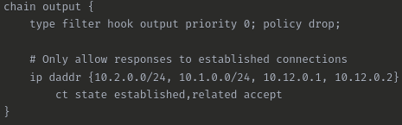
Port Scan Firewall Mitigation
Network Port Scan Protection Strategy
Multi-layered defense targeting different network segments
DMZ servers: Restrict outbound connection initiation
Router R1: Filter traffic between workstations and DMZ/Internet
Router R2: Implement rate limiting and dynamic IP blacklisting
Combined approach prevents reconnaissance from all potential attack vectors
Comprehensive Protection
DMZ servers cannot initiate scans due to output restrictions
Workstations can scan but are protected from external scanning
Internet hosts get blacklisted when attempting port scans
Legitimate service access remains unaffected
Defense-in-depth approach effectively blocks reconnaissance
Protection mechanisms survive router reboots via persistent nftables rules
DMZ Server Protections
Default output policy: DROP - prevents servers from initiating connections
Only permits established/related traffic to specific networks
Prevents compromised DMZ servers from becoming scan platforms
Simple but effective protection using connection state tracking

Slide 18
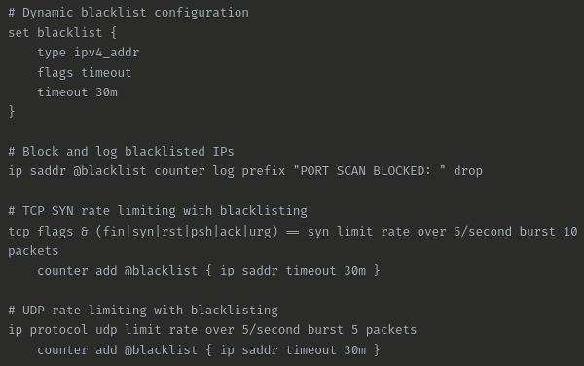
Port Scan Firewall Mitigation
Internet Router r2 Protections
Implements dynamic IP blacklisting with 30-minute timeout
Rate-based detection for TCP and UDP scan attempts
Threshold-based: >5 SYN packets/second or >5 UDP packets/second
Automatically blocks detected scanners for 30 minutes
Logs blocked scan attempts for security monitoring
Maintains legitimate traffic flows while blocking scan attempts

Slide 19
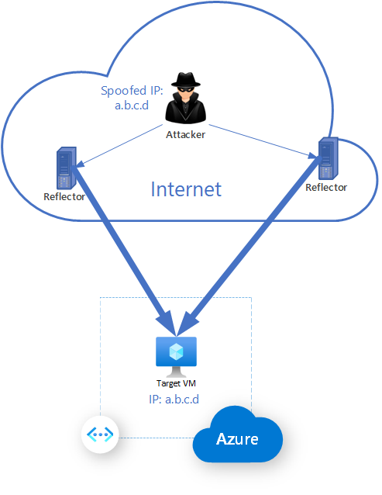
Reflected ddos
Overview
A Reflected DDoS attack exploits public services like DNS or NTP to amplify traffic and overwhelm a target.
The attacker sends small, spoofed requests that trigger large responses from these services, all directed toward the victim’s IP address.
This amplification effect can flood the target’s bandwidth and cause service disruption.
Commonly abused protocols include DNS (port 53/5353) and NTP (port 123), which respond with much larger data than the initial query size.

Slide 20
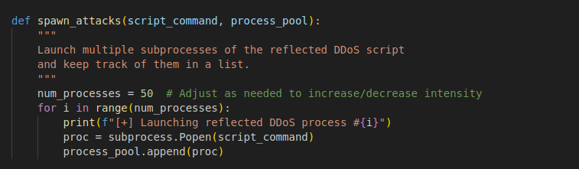
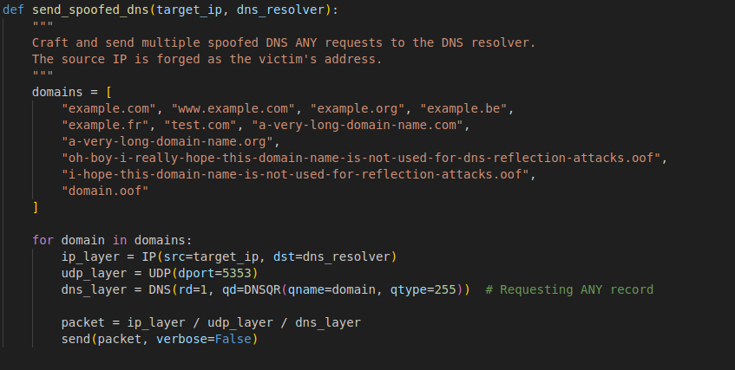
Reflected ddos
Sends spoofed DNS queries to open DNS resolvers, with the source IP address forged as the victim’s IP with the send_spoofed_dns method .
Uses Udp protocol and 5353 port
Sends a dns query of type any(255), which returns a large response
Scales up the attack by launching multiple parallel processes of the send_spoofed_dns()

Slide 21
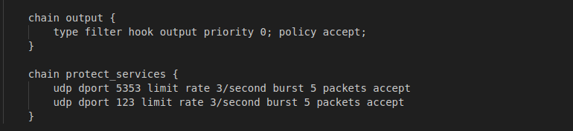
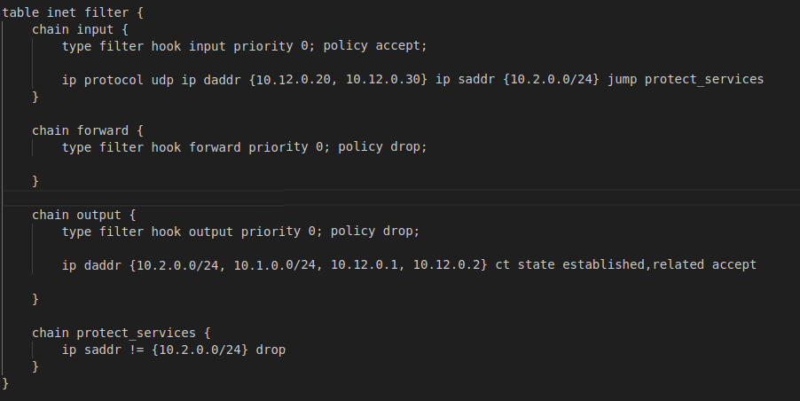
Reflected ddos
Protection :
The firwall rules help mitigate the reflected ddos attack :
On router r2, applying rate-limiting by only allowing 3 DNS requests per second from the Internet and drops any excess
On Dmz servers, we drop unsolicited incoming traffic, this prevents spoofed DNS responses from reaching Dmz hosts unless they originated from internal networks

Slide 22
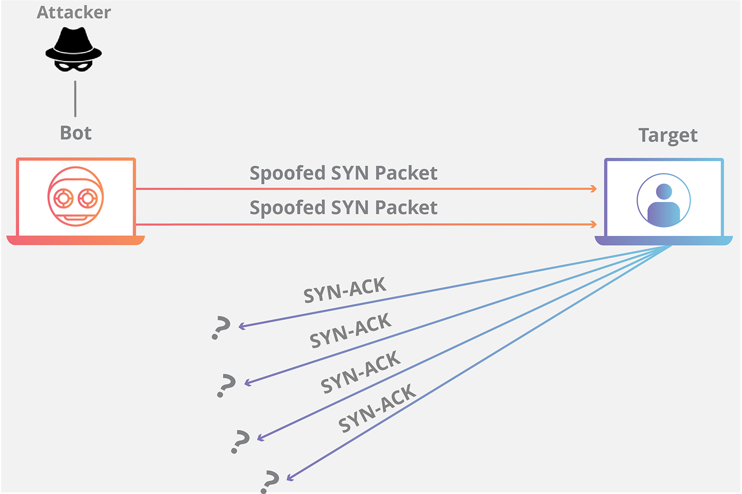
SYN flooding
Overview
A SYN flood is a typs of Dos that exploits the TCP handshakes process to overwhelm a server
The attacker sends many SYN packets( connection requests) to a target server
Each Syn packet has a spoofed source IP address, so the server cannot complete the handshake
The server responds with a SYN-ACK and waits for the final ACK from the client --- which never comes
The server keeps these halp-open connections in memory eventually exhausting ressources

Slide 23
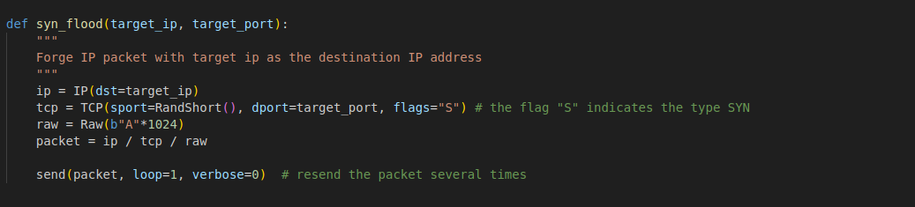
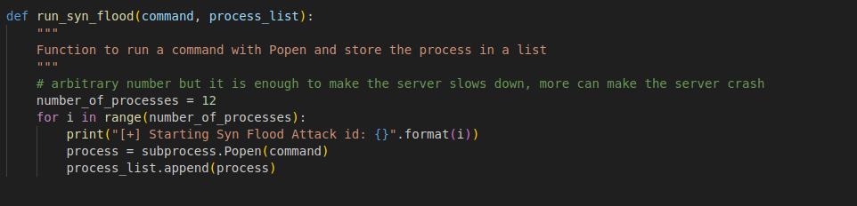
SYN flooding
Syn_flood function attack by crafting spooned TCP SYN packets to a target server
It use the “S” flag for SYN packets to send TCP requests from random sender port to the source destination port
Run_syn_flood function execute the syn_flood method in multiple process ( we can add more process if we want
Each process sends its own stream of SYN packets , amplifying the overall attack volume

Slide 24
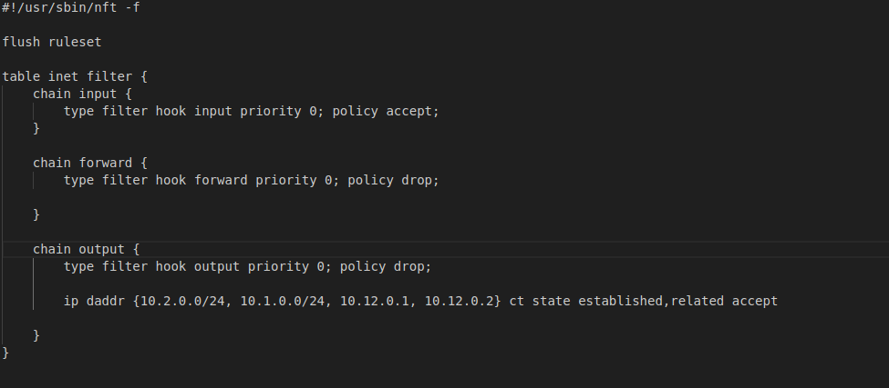
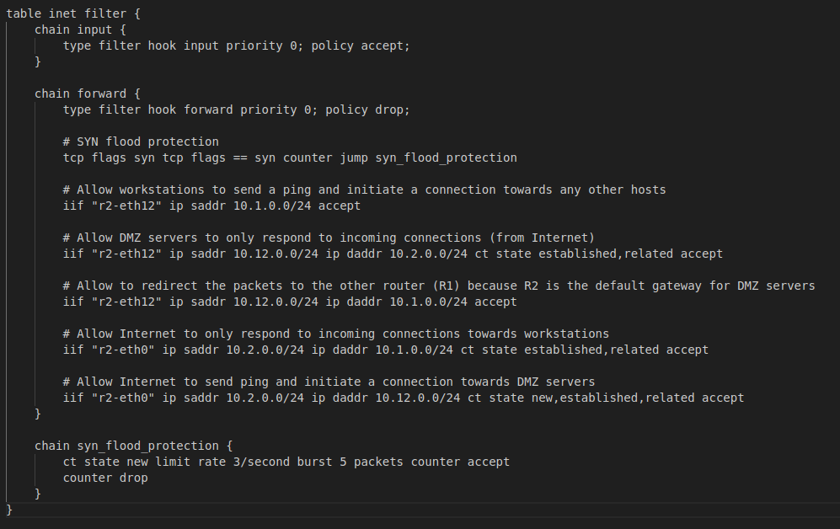
SYN flooding
Protection :
The firwall rules help mitigate the SYN flooding attack :
On router r2, applying matched packets with the tcp flag set and redirects them to the syn_flood_protection chain for rate limiting
Syn_flood_protection chain limits new TCP connections to 3 per second with a burst allowance of 5 packets
On Dmz servers output policy is set to drop , which prevent compromised server from initiating unauthorized outbound traffic

