Slide 1

Dirty COW Exploitation on Android
ELEC-H550 - Embedded System Security
Student: BOTTON David
Professor: MÜHLBERG T.
M-SECUC:1
2024-2025

Slide 2
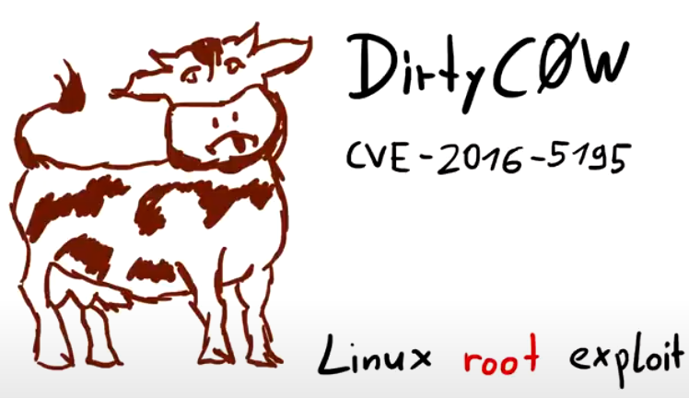
Dirty COW Overview
→ History
→ Impact
Copy-On-Write
→ Purpose
→ Race Condition
Demonstration
→ Set & Settings
→ Code
Android Defenses

Slide 3
Dirty COW – History
Made Public by: Phil Oester in 2016, after analyzing HTTP traffic during a live attack.
Origins: A race condition introduced unintentionally in 2007 as part of a Linux kernel optimization.
Hidden in Plain Sight: Lurked undetected for nearly a decade in Linux’s Copy-On-Write mechanism.
Exploitation: Allowed attackers to modify read-only files, escalating privileges.
<number>/9

Slide 4
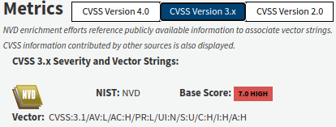
Dirty COW – Impact
Ubiquity: Affected almost every Linux system including Android and Apple devices, IoT, corporate systems, you name it.
Severity: Exploitable with minimal code, providing fast, reliable privilege escalation.
Patch Reaction: Applied quickly after discovery, but billions of systems were vulnerable during nine years.
CVE-2016-5195
AV:L/AC:H/PR:L/UI:N/S:U/C:H/I:H/A:H
<number>/9

Slide 5
Copy-On-Write – Purpose
A memory optimization that delays copying shared data until a process modifies it.
How: Processes share read-only memory pages. On modification, the kernel creates a private writable copy.
Why: Saves memory and improves performance.
Example:
When a process tries to modify a page, the kernel:
1. Creates a private writable copy (copy-on-write).
2. Updates the process's memory mapping to the private copy.
<number>/9

Slide 6
Copy-On-Write – Race Condition
The COW process (copy – update - write) is not atomic, allowing race condition in Linux kernel versions 2.6.22 through 4.8.3.
Step 1: Attacker maps a read-only file with the MAP_PRIVATE flag.
Step 2: Start looping with the write() function and
madvise(MADV_DONTNEED) to invalidate private copy.
Step 3: Write lands on the original memory.
Result: Write access to read-only memory (critical files).
<number>/9

Slide 7
Demonstration – Set & Settings
Android Studio with AVD (Android Virtual Device) 25 emulating a 32-bit Android 7, kernel 3.10.0, Nexus 5X device.
NDK Toolchain for cross-compiling the exploit and replacement binaries.
ADB (Android Debug Bridge) for pushing and executing binaries on the target system.
<number>/9

Slide 8
Demonstration – Code
Key Files:
dcow: main function of the attack, takes source file and destination file as arguments, is placed in writable userspace.
dirtycow: COW race condition, low-level implementation.
run-as: Crafted binary to overwrite half of ADB’s native run-as and trigger a root shell.
Makefile: Automates build, test and deployment.
<number>/9

Slide 9
Android Defenses
A bunch of additional security controls diminishing greatly Dirty COW’s impact in a privilege escalation scenario on Android.
Application Sandbox, isolating programs in UID-based containers.
SELinux MAC, restricting root actions to strict policies.
Verified Boot, preventing persistent exploitation of the system partition.
Read-only partition enforcement even for root.
Flush mechanism, reverting configurations and binaries at boot or runtime.
Proprietary implementations of memory management.
ASLR, NX, Privileged Process Isolation,..
A root shell on Android does not grant full control over the system like on a plain Linux install...
<number>/9

