Slide 1


nottsjs.org
#9 WebRTC intro and workshop
12th July 2016
Twitter: @nottsjs #nottsjs #JavaScript
Gitter: nottsjs/discuss
WiFi: JH Guest Network / weloveguests112015
Organised by:
Ian Crowther, Graham Smith, Joe McKie, Chris Kemp, Greg Bowler, Jonathan Kingston and David Wood

Slide 2
nottsjs.org
Information
Twitter: @nottsjs #nottsjs #JavaScript
Gitter: nottsjs/discuss
WiFi: JH Guest Network / weloveguests112015
- Fire exits
- Food & Drinks
- Toilets
- Announcements

Slide 3



nottsjs.org
nottsjs.org
Sponsors
Twitter: @nottsjs #nottsjs #JavaScript
Gitter: nottsjs/discuss
WiFi: JH Guest Network / weloveguests112015

Slide 4


nottsjs.org
This month
“Intro to WebRTC”
Mark Goodwin
“WebRTC workshop”
Mark Goodwin + robots
Twitter: @nottsjs #nottsjs #JavaScript
Gitter: nottsjs/discuss
WiFi: JH Guest Network / weloveguests112015

Slide 5
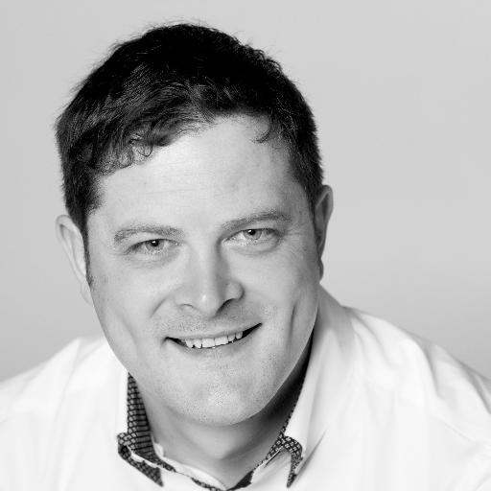
nottsjs.org
Intro to WebRTC
Mark Goodwin
@mr_goodwin
~7 – 7:30pm
Twitter: @nottsjs #nottsjs #JavaScript
Gitter: nottsjs/discuss
WiFi: JH Guest Network / weloveguests112015

Slide 6
nottsjs.org
Pizza & Drinks
Resume at ~8pm
Twitter: @nottsjs #nottsjs #JavaScript
Gitter: nottsjs/discuss
WiFi: JH Guest Network / weloveguests112015

Slide 7
nottsjs.org
WebRTC workshop
~8 - 8:30pm
Mark Goodwin
@mr_goodwin
Twitter: @nottsjs #nottsjs #JavaScript
Gitter: nottsjs/discuss
WiFi: JH Guest Network / weloveguests112015

Slide 8
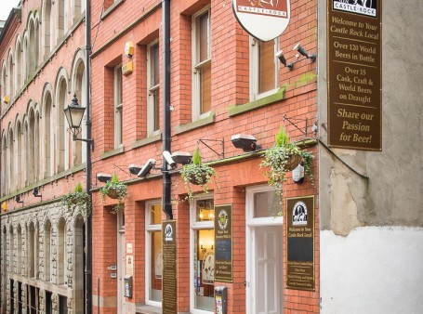
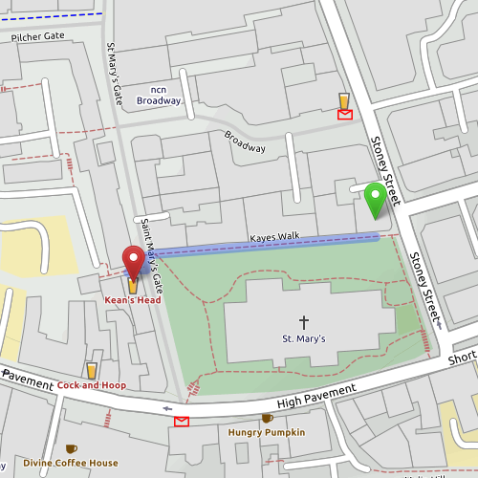
nottsjs.org
Next time...
9th August 2016
Social drinks
Round the corner to the Keans Head
Twitter: @nottsjs #nottsjs #JavaScript
Gitter: nottsjs/discuss

