Slide 1
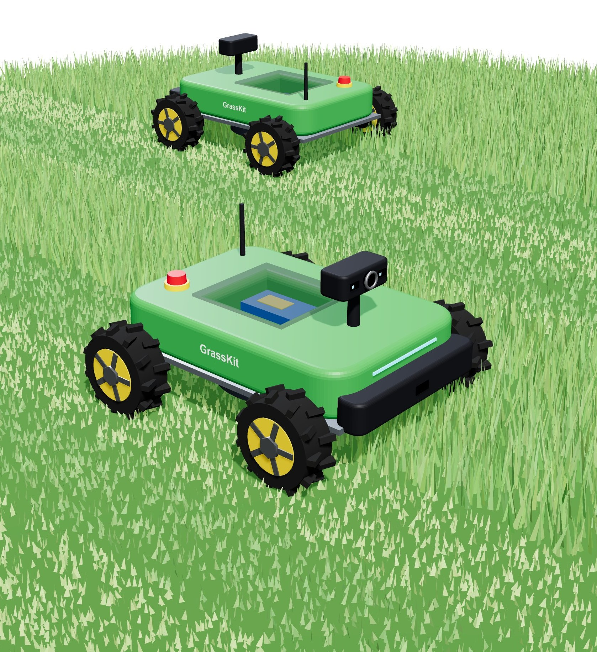
IRIS 7.0 Challenge:
GrassKit – Autonomous Twin-Rover Lawn Mower
Team [13]: [Sameeksha R], [Srihar PANDE], [Sukrit CHOPRA], [Samrath AGARWAL]
Mentor: [Akanksha ATTRI] | Status review, 28/10/2026
Notes:
GrassKit: two small rovers that scan a lawn in 3D, split it between them and mow it on their own. Fill in the team number, member names and mentor name (yellow fields).

Slide 2
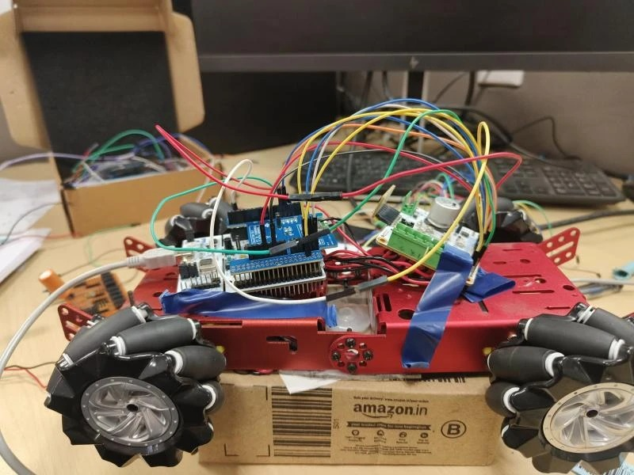
Team Idea Description
Scope
  What: two low-cost rovers that mow any lawn on their own – no boundary wire, no RTK base station, nobody steering
  Scan first, cut next: STM32N657L0HxQ (NUCLEO) + X-NUCLEO-67W61M1 + camera + ST VL53L9 dToF sensors build a 3D depth map; the lawn is then split between the two rovers
  Why innovative: a ₹2.8k off-the-shelf trimmer becomes the cutting head, one battery powers everything, ST silicon end to end
  End users: homes and villas, office and college campuses, schools, parks, gated communities
Objectives & deliverables
  Goal: two rovers that map, split and mow a real lawn patch with no human input
  Milestones: drive base (done) → wireless control → odometry + 3D scan → lawn map and split → cutter on v2 chassis → two-rover demo
  Deliverables: 2 working rovers, firmware + mapping code on GitHub, live mowing demo
  Challenge: outdoor sensing (sunlight, featureless grass), maps too big for a small microcontroller, two-robot coordination, safe cutting
Working today
Prototype #1: STM32 NUCLEO-L073RZ + X-STM32MP-RBT01 motor driver (2× STSPIN948) + wireless shield on a 4-wheel mecannum chassis, driven from a browser over WiFi
Notes:
Scope: autonomous lawn mowing with two cooperating rovers. Innovation: scan-then-cut with a 3D depth map, reusing a cheap cordless trimmer as the cutter, single battery. The photo is prototype #1 as it stands today.

Slide 3
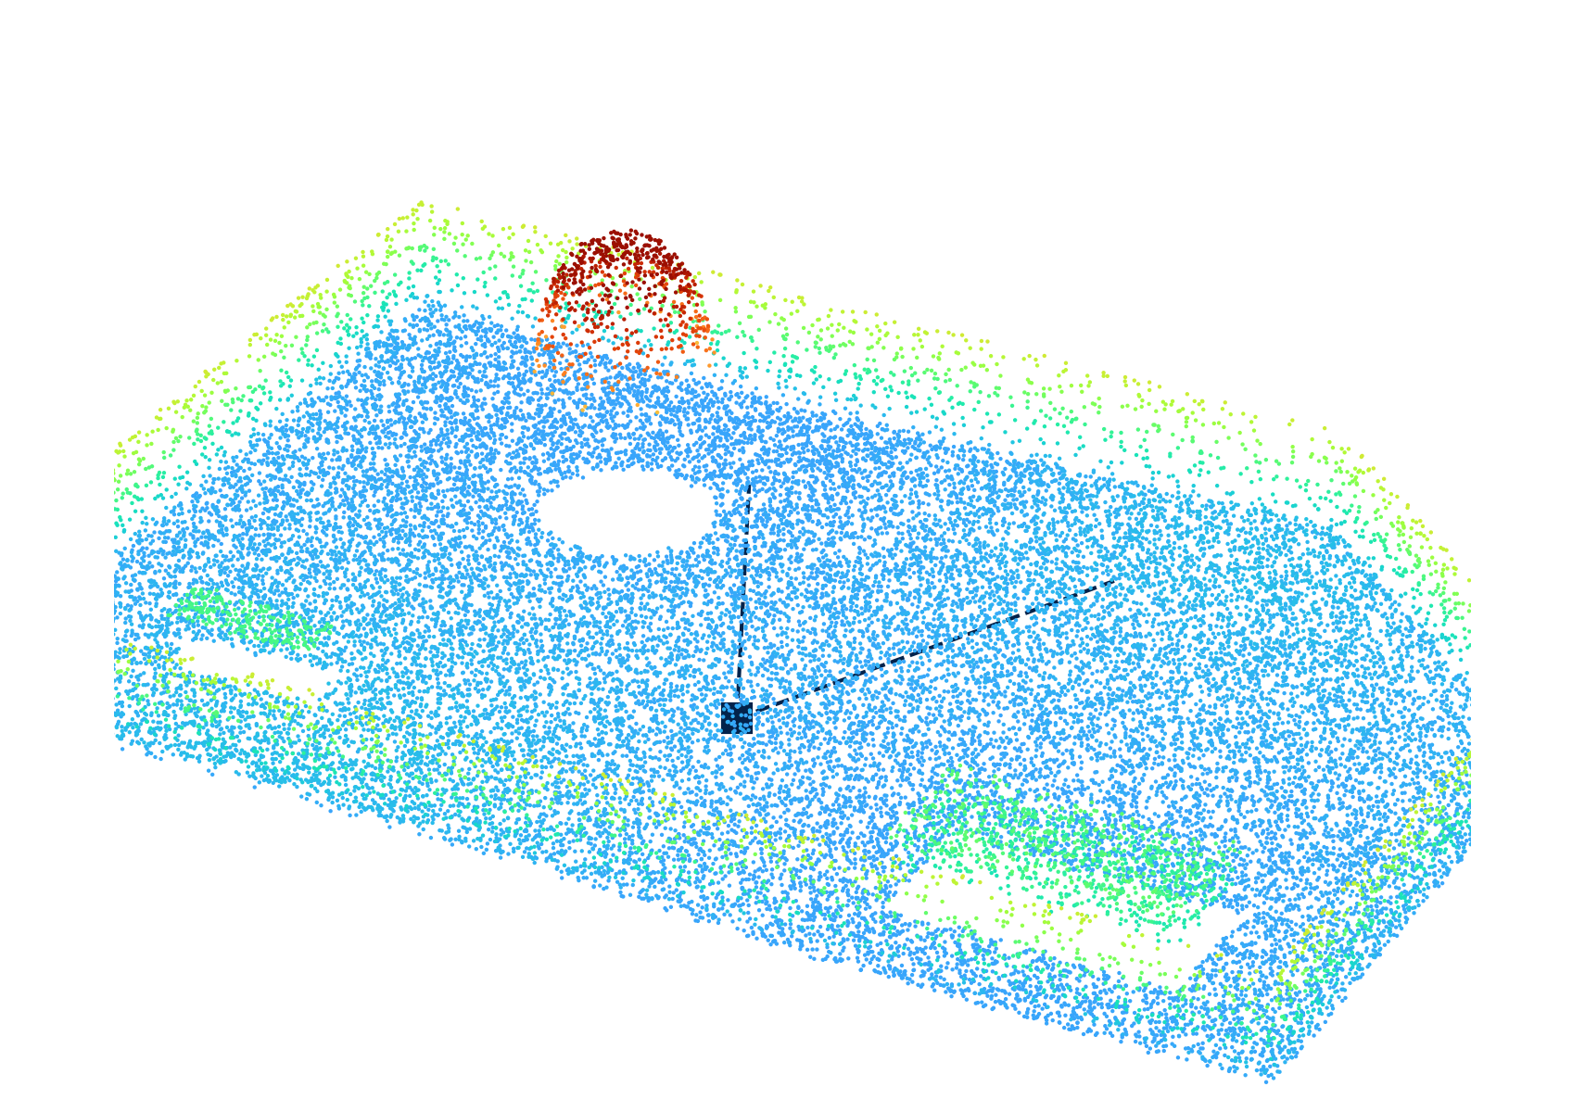
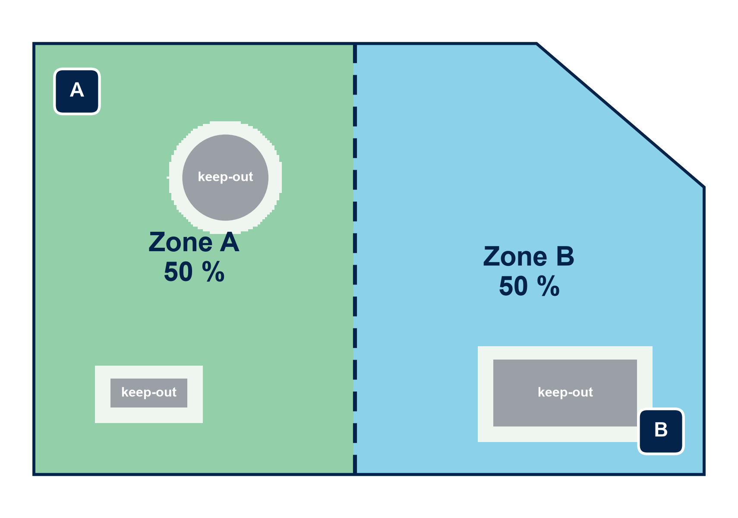
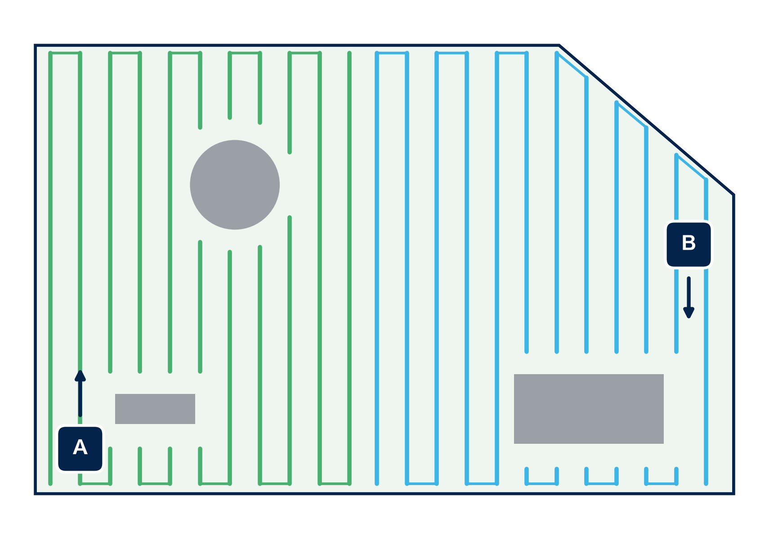
How It Works: Scan First, Cut Next
1
Scan Build a 3D map of the lawn
2
Split Divide the work fairly
3
Cut Mow in clean stripes
Camera + VL53L9 dToF (54×42 zones, up to 10 m) + wheel/IMU odometry
One drive around and across the lawn
Output: 3D point cloud → height map of grass, edges, obstacles
Boundary and keep-out zones (trees, beds) come from the map
Area cut into two equal zones, one per rover
Zones shared over Wi-Fi so the rovers never cross
Back-and-forth stripes at the 25 cm cutter width, with overlap
Both rovers mow at once → about half the time
Live ToF view stops the cutter for people, pets, toys
Notes:
1 Scan: one rover drives the lawn once; camera + VL53L9 direct-ToF (2.3k zones, 54x42, up to 10 m per ST's product page) plus wheel odometry and IMU give a 3D point cloud. 2 Split: the map gives the boundary and keep-outs; the free area is split into two equal zones. 3 Cut: each rover mows its zone in stripes at the cutter width; both work at the same time. The images are illustrations of the planned output, not yet real scans.

Slide 4
Existing Solutions vs GrassKit
Solution (where we found it) | Price | How it finds its way | What's missing
Corded push mower – Black+Decker BEMW451BH (Amazon.in) | ₹8,999 | A person pushes it | Needs a person every time; 12 m cable
48 V cordless grass trimmer (Amazon.in, Flipkart) | ₹2,600–3,000 | Hand-held | Manual labour; slow on big lawns
Boundary-wire robots – Husqvarna, Gardena, Worx | US$580–2,500 abroad; wire kit ₹15,633 | Buried perimeter wire, random bounce | Wire install; random coverage; only spares on Amazon.in
Wire-free RTK robot – ECOVACS GOAT O800 RTK (Amazon.in) | ₹1,09,999 | RTK-GPS + lidar + camera | Costly; RTK weak near buildings and trees; one robot
Wire-free vision robot – LawnMaster OcuMow MAX (Amazon.in) | ₹1,20,037 | Camera | Imported; small lawns only
GrassKit (ours) | ≈₹XXk per rover (est.) | Camera + VL53L9 3D map; scan, split, cut | Two rovers share one lawn
Why GrassKit wins
3D
More correct
Maps the real lawn in 3D before cutting, then mows planned stripes: no missed patches, no random bounce, no wire or RTK base station.
₹
Cheaper
Two rovers ≈ ₹45k vs ₹1.1 lakh+ for one robot mower. The cutter is a ₹2.8k trimmer; parts from Amazon and Robu.
×2
Better
Two rovers split the lawn → about half the mowing time. One battery runs drive, cutter and sensors. Big treaded wheels for Indian lawns.
Prices from Amazon.in, Flipkart and Robu.in searches on 27 Oct 2026; boundary-wire robots are not sold on Amazon.in, so US retail prices are shown. GrassKit cost is our estimate.
Notes:
Sources checked 27 Oct 2026. Amazon.in: ECOVACS GOAT O800 RTK Rs 1,09,999 (MRP 1,71,999); LawnMaster OcuMow VBRM601YCM MAX Rs 1,20,037; Gardena 150 m boundary wire Rs 15,633; Black+Decker BEMW451BH Rs 8,999; 48V cordless edge cutter / trimmer Rs 2,599-2,999; Husqvarna Automower: only spares (replacement battery Rs 17,306). Flipkart: no robotic mowers, trimmers from Rs 2,634. Robu.in: no lawn-mower results; Makita UR3501 trimmer Rs 11,649; JGB37-555 geared motor Rs 829. Abroad: Husqvarna 115H US$599 to 430XH US$2,499 (US retail); Worx Landroid US$579-899 (US, 2024); Segway Navimow i2 EUR 949-1,199 (Europe, not in India). Why RTK is weak here: it needs a clear view of the sky, which buildings and trees block.

Slide 5
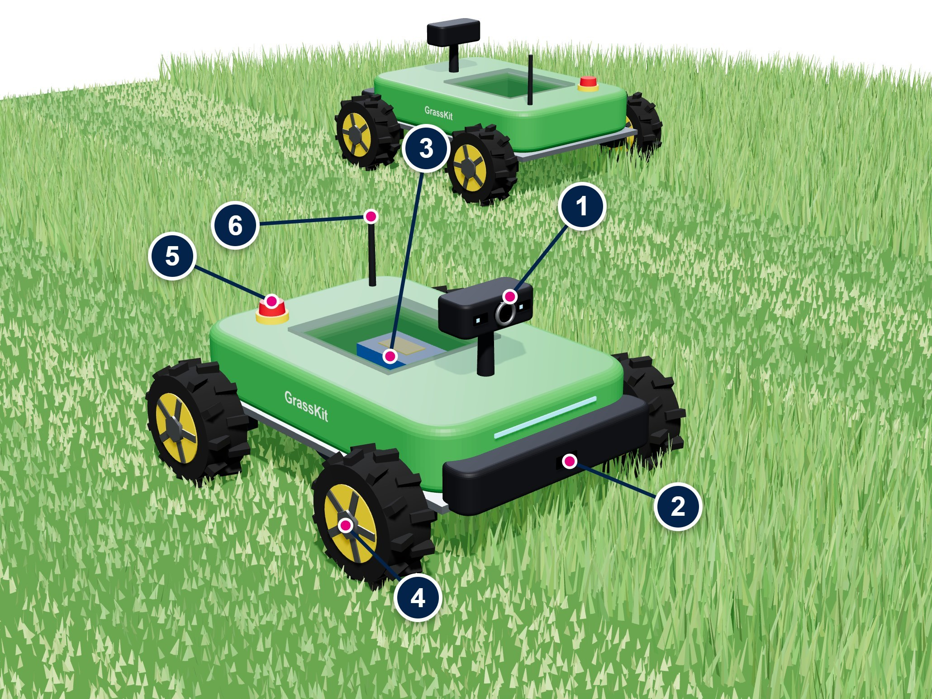
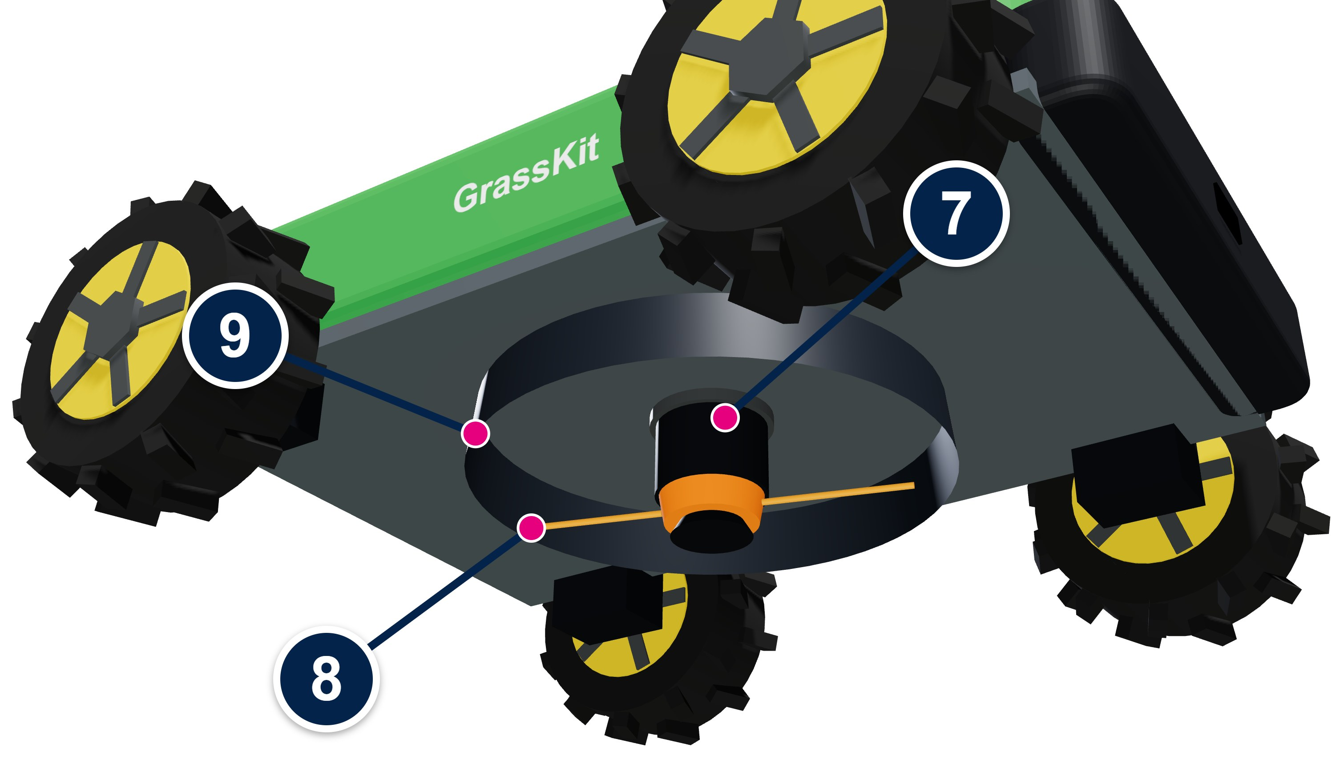
Concept: GrassKit Rover v2
On top
1
Sensor head: STM32N657L0HxQ + camera + 2× VL53L9 dToF for 3D scanning
2
Front VL53L9: live obstacle stop
3
One Li-ion pack + STM32, RBT01 motor driver, Wi-Fi 6
4
Bigger 180 mm treaded wheels for grip on grass
5
Emergency stop: cuts wheels and cutter
6
Wi-Fi 6 antenna: rover ↔ rover ↔ phone
Underneath
7
Trimmer motor from a ₹2.8k cordless cutter
8
Nylon string head, 25 cm cut
9
Guard ring + lift/tilt stop
≈₹XXk
per rover (estimate)
1 battery
drive + cutter + sensors
25 cm
cut width per pass
Concept render: rover A mows its zone while rover B mows the other half
Notes:
Plan: buy a ~Rs 2.8k 48V cordless grass trimmer, take its motor and string head, mount it under a bigger, lighter chassis with bigger treaded wheels, and run everything from one battery. Estimated bill of materials per rover: trimmer Rs 2,800 (Amazon.in); 4x JGB37-555 12V geared motors Rs 3,300 (Robu, Rs 829 each); 4x 180 mm treaded wheels Rs 2,000 (est.); aluminium/ACP chassis + printed shell Rs 2,500 (est.); Li-ion pack + BMS + DC-DC Rs 3,500 (est.); Nucleo + RBT01 + Wi-Fi shield Rs 5,000 (est.); camera + VL53L9 modules Rs 3,000 (est.). Total about Rs 22,000 per rover, Rs 45,000 for the pair.

Slide 6
Review Feedback: What We Changed
1
System architecture
2
Purpose of the hardware
3
Board & battery: ESD protection
One diagram of the whole rover: computers, sensors, motors, radio and power.
Each block, its job and why we chose it, plus a final BOM with order links.
TVS on the battery bus, ESD arrays on every external cable, keyed anti-spark plug, fuses, E-stop relay.
See slide 7
See slide 8
See slide 9
4
Cutter: wear of line and motors
5
ST67W61: Wi-Fi vs motor noise
6
Gazebo simulation + micro-ROS
Brushless cutter on an ST FOC drive: current, speed, vibration and temperature tell us when the line is short or a motor is wearing.
Noise fixed at the source, the path and the receiver; RSSI and SNR measured in dB with motors off and on.
A digital twin of both rovers in Gazebo; the MCUs join ROS 2 through micro-ROS, so one code base runs in sim and on the rover.
See slide 10
See slide 11
See slide 12
Notes:
Summary of the six review comments and where each one is answered in this deck. The full bill of materials with order links is in GrassKit_Rover_Final_BOM_2026-11-04.xlsx on GitHub.

Slide 7
System Architecture
Rover A (rover B is identical)
Off-board
STM32MP257F-DK Linux + ROS 2
Lidar SLAM · lawn map · zone split · stripe planning (Nav2) · micro-ROS agent
USB
LD19 lidar
360° DTOF, 12 m, works in sunlight
Phone / browser
Start, stop, live status
micro-ROS (USB serial)
micro-ROS (UART)
NUCLEO-N657X0-Q
Camera AI on the NPU
micro-ROS node
NUCLEO-G474RE real-time
Wheels + cutter loops · safety watchdog
micro-ROS node
SPI
X-NUCLEO-67W61M1
ST67W611M1 Wi-Fi 6 + BLE 5.4
Laptop
ROS 2 + Gazebo, logs
MIPI CSI · I²C
PWM · DIR · I²C
PWM / UART
B-CAMS-IMX camera
VL53L9 3D ToF (front scan)
X-STM32MP-RBT01
2× STSPIN948 + IMU
B-G431B-ESC1
FOC cutter drive
Safety inputs
E-stop · bumpers · lift · 4× VL53L8CX ToF
Rover B
Shares its zone, pose and heartbeat
Encoders + IMU → G474 → /odom → MP2 plans the stripe → /cmd_vel → G474
4× gearmotor + encoder
BLDC cutter + line head
Wi-Fi 6 links (dashed = development only)
Power 4S 14.8 V 10 Ah Li-ion + BMS → XT90-S → switch → E-stop relay → fuses: cutter 20 A · drive 10 A · 5 V logic 5 A (TVS + ESD protected)
Notes:
One rover shown; rover B is identical. The STM32MP257F-DK runs Linux and ROS 2 (mapping, zone split, coverage planning, micro-ROS agent). The NUCLEO-N657X0-Q runs the camera model on its NPU. The NUCLEO-G474RE closes the real-time loops (wheels, cutter, safety inputs) and owns the Wi-Fi link, so a radio loss or E-stop stops the rover even if Linux hangs. Both MCUs appear in ROS 2 as micro-ROS nodes. One 4S Li-ion pack powers everything through an E-stop relay and fused branches.

Slide 8
Purpose of Each Hardware Block
Block | Part | Purpose
Navigation computer | STM32MP257F-DK | Linux + ROS 2: builds the lawn map, splits it between rovers, plans the stripes
Perception MCU | NUCLEO-N657X0-Q + B-CAMS-IMX | Camera AI on the NPU: lawn edge, flower beds, people and pets
Motion & safety MCU | NUCLEO-G474RE | Real-time wheel and cutter control, encoders, safety inputs; micro-ROS node
Motor driver | X-STM32MP-RBT01 (2× STSPIN948) | Drives the 4 wheel motors; onboard IMU + magnetometer give heading
Radio | X-NUCLEO-67W61M1 (ST67W611M1) | Wi-Fi 6 + BLE: phone control, rover-to-rover zone sharing, heartbeat
Cutter drive | B-G431B-ESC1 + 3536 BLDC motor | Holds cutter speed with FOC; its current and speed reveal line and motor wear
Lidar | LDRobot LD19 (DTOF) | 360° map and obstacle scan that works in sunlight
3D depth | VL53L9 (STEVAL-VL53L9) | Front 3D scan of grass height, edges and low obstacles
Safety ring | 4× VL53L8CX, bumpers, lift sensor | Stops the cutter for toys, pets and feet, or if the rover is lifted
Drive | 4× 36 mm planetary motor + encoder, 130 mm treaded wheels | Grip and torque for grass and 15° slopes; wheel odometry
Power | 4S 14.8 V 10 Ah Li-ion + BMS | One pack for drive, cutter and electronics
Protection | E-stop relay, fuses, TVS, ESD arrays | Cuts motor power safely; shields boards from spikes and static
≈₹1.0 lakh
per rover at list price, incl. ST kits
≈₹46k
per rover, shop-bought parts only
≈ 50 min
mowing per charge (148 Wh pack)
≈ 150 m²/h
per rover at 0.3 m/s, 20 cm swath
Estimates from the final BOM (70 lines, order links) on GitHub: GrassKit_Rover_Final_BOM_2026-11-04.xlsx
Notes:
Every block on the rover with its job. Prices and order links for all 70 lines are in the BOM workbook (documentation/00_Project_Status/GrassKit_Rover_Final_BOM_2026-11-04.xlsx). Cost tiles are estimates from that workbook: ST evaluation kits at distributor list price; the shop-bought figure assumes ST kits come through IRIS.

Slide 9
Board & Battery Protection: ESD and Power
Power path: every branch protected
4S Li-ion + BMS
Cuts off on over-charge, over-discharge and short circuit
XT90-S plug
Keyed, so no reverse polarity; anti-spark on plug-in
Main switch
Whole rover off
E-stop relay
Cuts wheels + cutter; logic stays on to log the fault
Fuses
Cutter 20 A · drive 10 A · logic 5 A
Loads
RBT01 · cutter ESC · 5 V buck (LC-filtered)
On the bus: ST SM15T22A TVS clamps spikes · 1000 µF low-ESR at the ESC and RBT01 inputs · cutter soft-start, so the 5 V rail never browns out
ESD
ESD on every external cable
LAB
Safe handling and testing
IP
Outdoor protection
ST USBLC6-2SC6 arrays at encoder, bumper, ToF and USB connectors
Shielded encoder and I²C cables, shield grounded at one end
Star ground: motor current never flows through logic ground
Plastic body: the star point is the only ground
ESD mat + wrist strap for all board work
First power-up from a current-limited bench supply
Meter boards with the pack unplugged; insulated probe tips
Each board checked 3V3-GND and VS-GND before power
Printed body: sealed windows, capped vents
Conformal coating against dew and grass moisture
NTC sensors on battery and motors; stop above limits
Rain sensor pauses mowing (optional)
Notes:
Power path from the pack to the loads, with the protection at each step. ST parts: SM15T22A TVS on the battery bus and USBLC6-2SC6 ESD arrays at every connector that leaves a board. The E-stop drops a relay that feeds the motor branches only, so the logic stays powered and can report what happened.

Slide 10
Cutter Health: Line and Motor Wear
Signal | Measured by | Tells us | Action
Current at set speed | B-G431B-ESC1 (FOC) | Line worn or snapped (current drops) | Alert: feed or replace line
Speed dip / stall | ESC speed loop | Line tangled, thick grass, blocked head | Stop cutter, back up, retry
No-load current trend | ESC, logged every start | Bearing wear, motor ageing (creeps up) | Plan motor service
Vibration | RBT01 IMU (FFT at spin rate) | Unbalanced head: one line broken | Stop cutter, alert
Temperature | NTC on cutter + drive motors | Overload or worn bearings | Derate, then stop
Drive current vs speed | RBT01 shunts + encoders | Gearbox wear or a jammed wheel | Flag the wheel
Run hours | G474 log | Line and motor life used | Service every N hours
A 10 % shorter line needs about a third less drag torque
Drag torque grows with tip radius⁴ at a fixed speed. The ESC holds ~7,000 rpm, so the drop shows up directly in its current. Thresholds come from a new-line baseline logged at start-up.
Why a brushless cutter No brushes to wear out or spark, and the ST ESC already measures speed and current, so wear sensing needs no extra parts. Line and motor alerts go to the phone page.
Notes:
Air drag on a spinning line grows with roughly the fourth power of its tip radius at a fixed speed. The ESC holds the set speed, so a worn or snapped line shows up as a clear drop in cutter current. A baseline is logged with a new line at start-up and thresholds are set from it. Motor wear shows up the other way: no-load current creeping up over weeks, more vibration and higher temperature. The values in the chart are the model, not measurements.

Slide 11
Wi-Fi vs Motor Noise: Keeping the ST67W61 Link
1
Source stop noise where it starts
2
Path keep it off the radio's supply
3
Receiver make the link tolerant
Brush arcing and fast PWM edges in the drive motors and the cutter drive
Noise rides the shared 5 V and ground, and radiates from long motor wires
Higher noise floor → lower SNR → retries and dropped commands
100 nF across each motor + each terminal to its case
Twisted motor leads, ferrite on each lead
Slower switching edges (STSPIN948 slew-rate setting)
Brushless cutter: no brush arcing at all
Own 5 V buck + LC filter for logic and Wi-Fi
Star ground: motor current away from logic ground
Shielded encoder cables, short motor leads
Motor wiring routed away from the antenna
Plastic body: no metal around the Wi-Fi antenna
Quietest 2.4 GHz channel picked at start-up
10 Hz heartbeat; rover stops safely if it is lost
Short UDP packets with sequence numbers
How we measure it (targets)
Test plan
Read RSSI from the module and a phone Wi-Fi analyser; log packet loss and round-trip time.
Distances 1, 10, 30 m × motors off / drive on / drive + cutter.
Repeat after each fix to see how many dB it bought.
≤ 3 dB
SNR loss, motors on vs off
≥ 20 dB
SNR margin at 30 m
< 1 %
packet loss at 30 m
Notes:
Brush arcing and fast PWM edges make broadband noise. It reaches the ST67W611M1 through the shared supply and ground and by radiation from long motor leads, raising the 2.4 GHz noise floor and cutting SNR. We fix it in three places and measure it in dB: RSSI, noise floor / SNR and packet loss at 1, 10 and 30 m with motors off, drive on, and drive plus cutter. The three tiles are pass targets, not results yet. Today the firmware stops the motors after 1.5 s without a packet.

Slide 12
Simulation: Gazebo Digital Twin + micro-ROS
Simulation laptop
Gazebo Harmonic
Lawn world: slopes, trees, flower beds
Rover model built from the OpenSCAD parts (URDF + STL)
Simulated lidar, IMU, camera, wheel odometry
Two rovers in one world
ros_gz_bridge → the same ROS 2 topics
Same ROS 2 stack Jazzy
SLAM Toolbox: lawn map
robot_localization: odometry + IMU fusion
Nav2 + coverage planner: stripes per zone
Zone split + coordinator for 2 rovers
Safety monitor: people, link loss, lift
Real rover micro-ROS
micro-ROS agent on the STM32MP2
G474 node: publishes /odom /imu /battery /safety, subscribes /cmd_vel /cutter
N6 node: publishes /detections and /tof/depth
LD19 driver: /scan
Serial transport today, UDP possible
What we use it for
1
Split + coordination
2
Tune the stripes
3
Safety scenarios
4
Sim-to-real
Test the lawn split and two-rover hand-off before rover 2 is built
Turns, overlap and slope behaviour without wearing out hardware
A person walks in, the link drops, the rover is lifted
Same launch files on the rover: swap Gazebo for micro-ROS
Notes:
The navigation software is written once against ROS 2 topics. In simulation Gazebo Harmonic provides the lawn, both rovers and their sensors through ros_gz_bridge. On the real rover, micro-ROS puts the NUCLEO-G474RE and NUCLEO-N657X0-Q on the same topics through the micro-ROS agent on the STM32MP2. Switching between the two is a launch-file change. This lets the team test the lawn split and two-rover coordination before rover 2 exists.

Slide 13
Status: 28/10/2026
Completed till October
4WD rover driven from a browser (USB)
Pin map verified vs ST manuals; safety stops
Wi-Fi 6 (ST67W61) control firmware built
STM32 NUCLEO-L073RZ used
December – January Plan
Scan a lawn, split it, plan stripes
Trimmer cutter on bigger v2 chassis
Build rover #2; two-rover demo
November Plan
Fix wheel directions; run on battery
Wheel encoders + IMU odometry
VL53L9 + camera bring-up, first depth maps
STM32N657L0HxQ used
Stage tracker
Drive base
Done
Wireless control
In progress
Odometry + 3D scan
Nov
Lawn map + split
Dec
Cutter + v2 chassis
Dec – Jan
Two-rover demo
Jan
Notes:
Done: drive base on STM32 Nucleo-L073RZ + X-STM32MP-RBT01 with 20 kHz PWM, ramping, mecanum mixing, command timeout, latched e-stop and driver-fault detection; pin map rebuilt from ST UM3482 and the STSPIN948 datasheet; Wi-Fi 6 SoftAP + TCP control firmware for the X-NUCLEO-67W61M1 builds (83.9 KB). Next: wheel-direction fix, battery, odometry, depth sensing, then mapping and the cutter.

Slide 14
Status: 27/10/2026
Team members update – who is doing what
  Firmware & motor control: [Sukrit Chopra]
  Wireless (BLE → Wi-Fi 6): [Sameeksha R]
  Sensing & 3D mapping: [Samrath Agarwal]
  Chassis & cutter: [Srihar Pande]
Mentor name: [Akanksha Attri]
Meetings with mentor: [2] held so far
Source code: github.com/nottysukku/GrassKit_Rover
  16_RaceCar_MotorDriver_Bluetooth_Audio – BLE build
  17_Rover_MotorDriver_WiFi_ST67W61 – Wi-Fi build
Design documents:
  Project status report (28 Oct 2026)
  Pin map and wiring schematic (RBT01 ↔ NUCLEO)
  43 ST manuals and datasheets, indexed
Any challenges – and what we are doing
Challenge | Action
Bluetooth shield never carried commands | Moved to Wi-Fi 6 (X-NUCLEO-67W61M1); firmware built
Wi-Fi shield uses PB4 (CHIP_EN), a motor PWM pin | Motor 1 PWM moved to PC6 (TIM3)
Some drive moves go the wrong way | Per-motor direction flags in firmware; re-test due
Mecanum wheels slip on grass | Bigger treaded wheels on the v2 chassis
20 KB-RAM MCU cannot build depth maps | Mapping on a Linux board using a combination of (STM32MP2) and STM32N657L0HxQ or laptop acting as an access point.
VL53L9 is still in preview at ST | Request samples of L9; VL53L5CX (8×8) on RBT01 as fallback
Sunlight and plain grass hurt ToF and SLAM | Fuse camera + ToF + wheel odometry + IMU
Notes:
Fill in names, mentor and meeting counts (pink fields). Challenges come from the project status report and the Wi-Fi build notes.

