Slide 1

Detection Of Deepfakes Using OpenCV
School of Computer Science and Engineering
Department of Computer Science and Engineering
Submitted By:
Vidur Gupta
23FE10CSE00481
Supervised By:
Dr. Rishi Kumar Srivastava

Slide 2

Outline
Introduction
Literature Review
Problem Statement
Proposed Solution
Objectives
Results

Slide 3
Introduction
Deepfake technology has rapidly evolved, making it possible to generate highly realistic synthetic human faces. While this technology has creative uses, it poses major risks in misinformation, identity fraud, and digital manipulation.
This project focuses on detecting whether an image is real or fake using computer vision and a Convolutional Neural Network trained on real and AI-generated facial images.

Slide 4
Introduction
The system uses OpenCV for image preprocessing and TensorFlow/Keras for CNN-based classification.
The workflow includes dataset preparation, model training, evaluation using multiple metrics, and real-time prediction. The goal is to build a lightweight, accurate model that performs well on unseen images.

Slide 5


Literature Review
Afchar et al. (MesoNet, 2018): Proposed a lightweight CNN for deepfake detection but had limited performance on diverse manipulation methods.
Du et al. (2020): Introduced Locality-Aware AutoEncoder for better generalization, though accuracy dropped on unseen datasets.

Slide 6
Literature Review
Jevnisek & Avidan (2022): Developed per-layer feature aggregation for robustness, but required high computational resources.
Korshunov & Marcel (2020): Human vs machine study showed humans struggle with detecting deepfakes, proving need for automated systems.
Verdoliva (2020): Overview of deepfake challenges such as dataset bias, generalization issues, and evolving manipulation techniques.

Slide 7
Literature Review
Summary: Existing models struggle with generalization and explainability. A lightweight, effective, and interpretable solution is still needed.

Slide 8

Problem Statement
Deepfakes are becoming increasingly realistic, making them hard to detect.
Current models lack accuracy, speed, and generalization.
There is a need for a lightweight CNN model that can quickly and reliably classify real vs fake faces and work well on diverse images.

Slide 9
Objectives
To design a CNN model that classifies facial images as real or fake.
To preprocess images using OpenCV for consistent model inputs.
To evaluate performance using accuracy, confusion matrix, F1 score, and ROC AUC.
To build a complete prediction pipeline for real-time detection.

Slide 10
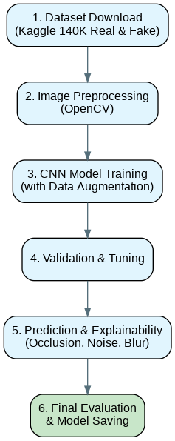
Proposed Methodology
Dataset download from Kaggle (140K Real & Fake Faces)
Image preprocessing using OpenCV
CNN model training with data augmentation
Validation & tuning
Prediction and explainability (occlusion, noise, blur)
Final evaluation and saving the model

Slide 11
Dataset Description
Dataset Used
Kaggle – “140K Real and Fake Faces”
Real images: High-quality actual human faces.
Fake images: GAN-generated synthetic faces.
Balanced sampling of real and fake images used for training.

Slide 12
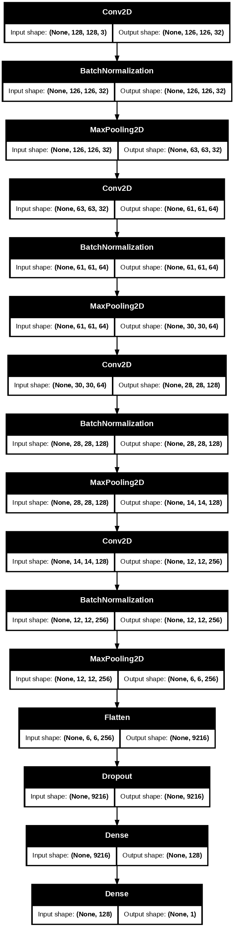
Model Architecture
Layers Used:
Conv2D (features extraction) + MaxPooling (size reduction)
Batch Normalization (stable and fast training)
Flatten(2D to 1D vector) + Dense Layers (final decision)
Dropout for regularization and prevent overfitting
Sigmoid activation for binary classification

Slide 13

Training Procedure
Training performed on Google Colab (T4 GPU)
Data augmentation applied (rotation, flipping, zoom)
Early stopping + ReduceLROnPlateau used to avoid overfitting.
Model saved in .keras format for deployment

Slide 14

Testing Procedure
Test set loaded using ImageDataGenerator
Predictions evaluated using threshold 0.5
Model performance measured using:
Confusion Matrix
Precision, Recall, F1 Score
ROC Curve & AUC
Explainability applied using occlusion and noise sensitivity

Slide 15
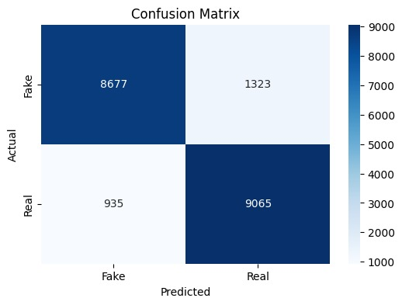
Results (Confusion Matrix)

Slide 16
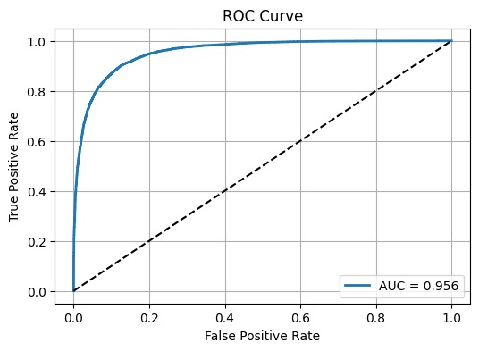
Results (ROC Curve)
AUC = 0.956 indicates the model has strong discriminatory power and detects deepfakes with high accuracy.

Slide 17
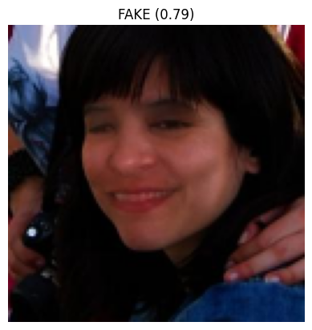
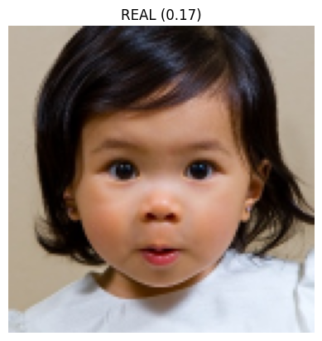
Sample Predictions
Fake Image (0.79):
Model detects synthetic facial patterns; high confidence in fake classification.
Real Image (0.17):
Model identifies natural facial features; predicted as real.

Slide 18
Outcome
Current Outcome
Developed a working deepfake detection model
Achieved reliable performance using CNN
Implemented prediction pipeline for image-based detection
Future Outcome
Real-time deployment of the model
Build a simple interface for live deepfake detection
Optimize model for fast and lightweight execution

Slide 19
References
Afchar, D., Nozick, V., Yamagishi, J., & Echizen, I. (2018). MesoNet: A Compact Facial Video Forgery Detection Network. IEEE International Workshop on Information Forensics and Security (WIFS).
Du, M., Jia, R., & Song, D. (2019). Towards Generalization of Deepfake Detection via Locality-Aware Autoencoder. arXiv preprint arXiv:1910.09154.
Jevnisek, R., & Avidan, S. (2022). Deepfake Detection by Aggregating Per-Layer Features. Proceedings of the IEEE/CVF Conference on Computer Vision and Pattern Recognition.
Korshunov, P., & Marcel, S. (2020). Deepfake Detection: Humans vs. Machines. Proceedings of the European Signal Processing Conference (EUSIPCO).
Verdoliva, L. (2020). Media Forensics and DeepFakes: An Overview. IEEE Journal of Selected Topics in Signal Processing.
Kaggle. (2020). 140K Real and Fake Faces Dataset. Retrieved from https://www.kaggle.com/datasets/xhlulu/140k-real-and-fake-faces
Chollet, F. (2015). Keras: The Python Deep Learning Library. https://keras.io
Bradski, G. (2000). OpenCV. Dr. Dobb’s Journal of Software Tools.

Slide 20
Thank You

