Slide 1

SMART INDIA HACKATHON 2026
TRACESETU
Problem Statement ID – PS26182
Problem Statement Title – Automated Attribution of Unknown Cryptocurrency Wallets to Nearest Virtual Asset Service Providers (VASPs) through Blockchain Intelligence APIs
Theme – Blockchain & Cybersecurity
PS Category – Software
Team ID – 170835
Team Name – ANANTHA
Notes:
TraceSetu is Team ANANTHA’s submission for the MHA / I4C cryptocurrency VASP-attribution problem. The problem statement ID PS26182 and team ID 170835 are retained from the team’s supplied submission metadata. The exact problem title is retained on the cover. VASP means Virtual Asset Service Provider. The intended users are law-enforcement investigators and reviewers; the system supports identification of the service to approach lawfully, not public disclosure of a customer’s identity. Bitcoin is a cryptocurrency/network, not an exchange.

Slide 2
TRACESETU
ANANTHA
THE INVESTIGATOR’S PROBLEM
OFFICER WORKFLOW
Officers often start with a wallet address, not a service name.
Funds may cross several wallets before reaching an exchange.
They need to know which service to approach with a lawful request.
1 Open a case
Wallet, chain, time window
THE ADDRESS WE NEED MAY BE ONE STEP EARLIER
2 Acquire and analyse
Transfers + service evidence
Reported wallet
Unlabelled wallet
Known exchange
collection wallet
3 Inspect the evidence
Service lead + path + gaps
Is the middle wallet already an exchange deposit address?
PROPOSED SOLUTION
4 Review and export
Signed evidence + request package
Trace transfers and check public/provider service labels.
Test possible deposit wallets, then return the first supported
custodian on each path, with the evidence and missing links.
SAHYOG access is pending.
Current exports remain NOT_SENT.
OUR FOCUS
Explain the recipient. Challenge the evidence. Choose the next useful check.
VASP = exchange or crypto custodian
Notes:
An investigator starts with a reported wallet, blockchain and case scope. The task is to establish the first evidenced service custody boundary on each reachable branch, with the associated address, role and source. A named hot wallet can be farther away than an unlabelled deposit address. The diagram is illustrative, not a live case or ownership finding. The current prototype traces sourced labels, records gaps, generates a bounded nearestness certificate, supports source-family exclusion and budgeted acquisition, and packages a reviewed request. Naming a company requires outside identity evidence: provider/public service assertions with provenance, or independently reviewed service responses. A transfer alone cannot establish who controls its recipient. Requests require permissions, a verified recipient and payload-bound independent review. The current installation has no approved SAHYOG connection and exports remain NOT_SENT. It cannot obtain customer KYC from a public graph, compel VASP cooperation or itself freeze assets.

Slide 3
TECHNICAL APPROACH
ANANTHA
CHAIN-AWARE TRACING
DEPOSIT CANDIDATE [1, 2]
1 Acquire a bounded case snapshot
Separate research module
sweep
Possible
deposit
wallet
Known service
collection
wallet
Bitcoin
Spent-output links
Allocation kept separate
ETH / BNB / Polygon
Tron / Solana
Native + token events
Cross-chain hop
Matched protocol proof
Or an unresolved gap
Service
fee wallet
Receive tokens,
fund fees, then
sweep to the service.
2 Search time-valid paths [3]
Follow ledger order. Stop each branch at supported custody.
Match dated service anchors.
Check complete history, receipts
and balances across repeated cycles.
A match stays unconfirmed.
3 Rank by fewest transfers within the recorded scope.
An unlabelled wallet may still be a nearer custodian.
TECH STACK: EACH TOOL HAS A SPECIFIC JOB
FastAPI / Python: APIs + graph rules • React / TypeScript / Cytoscape: investigator review + graph view
PostgreSQL + workers: queued jobs • SQLite: local demo • SHA-256 / Ed25519: export integrity
Notes:
The implemented tracing engine preserves chain-qualified identities, exact integer amounts, event order, sources and bounded case scope. Bitcoin uses observed spent-output links; input-to-output allocation is a separate assumption. Account-based and token parsers cover Ethereum, BNB Chain, Polygon, Tron and Solana, subject to provider access and coverage. Cross-chain continuation requires matched proof; the current CCTP V2 native-USDC Ethereum/Polygon workflow has training-proof validation only. Unsupported bridges, swaps and mixers remain gaps. The nearest result means minimum observed transfers within the recorded scope, not globally nearest actual custody. Reachability in an account graph does not prove that the same units of money traversed a multi-hop path. The right-hand diagram describes the separate, unintegrated research reference: one plain token and an isolated account window, repeated receive–fee funding–sweep cycles, complete attested history, receipts and balances. Both feeder and collection-wallet roles need dated source assertions for the same service. Three cycles are an uncalibrated toy threshold. The detector does not independently prove completeness, identify the holder of the key, or make a new trusted seed. Victor’s forwarding heuristic motivates candidate generation [1]; Brechlin et al. report service-specific fee-funding behaviour and use Evonax records to confirm roles [2]. Our adaptation is narrower and is not an exact reproduction. Wu et al. motivate time-respecting rather than static paths [3]. Sources: https://www.ifca.ai/fc20/preproceedings/31.pdf ; https://onlinelibrary.wiley.com/doi/10.1002/nem.2325 ; https://www.vldb.org/pvldb/vol7/p721-wu.pdf
Technology rationale: FastAPI provides the typed API boundary; Python implements inspectable graph/evidence rules. React and TypeScript support the review interface; Cytoscape renders the graph, it is not an attribution oracle. SQLite serves the local demo; the foundation supports PostgreSQL and separate workers for concurrent queued jobs. SHA-256 detects evidence changes and Ed25519 signs export manifests; neither proves wallet ownership. Framework choice alone does not establish scalability. Official deployment guidance: https://fastapi.tiangolo.com/deployment/concepts/ ; PostgreSQL queue-lock semantics: https://www.postgresql.org/docs/current/sql-select.html

Slide 4
FEASIBILITY AND VIABILITY
ANANTHA
FEASIBILITY: A 36-HOUR DELIVERY PLAN
PRACTICALITY: MINISTRY DEPLOYMENT
Scoped sprint using our existing code foundation
Foundation already built
0–6 h
Scope case + acquire Bitcoin history
Separate API/workers, PostgreSQL job claims,
case permissions, audit history and signed exports.
6–16 h
Trace + stop at sourced custody
Scale-up design
16–24 h
Show gaps + challenge a source
Bound each trace; cache data; add worker capacity.
Shared quotas and agency fairness still need work.
24–30 h
Cap queries + review/export evidence
30–36 h
Test failures + rehearse a live-data case
Load tests, SSO/MFA and SAHYOG access: pending.
EVIDENCE THAT THE CORE IS BUILDABLE
REAL-WORLD BOTTLENECKS & CONTROLS
Public Bitcoin check: 2 transactions, 3 outputs.
Transfers reproduced; no VASP established.
Free APIs have limits → budget calls and show gaps.
National coverage needs governed data access.
Research module: 64 synthetic checks pass.
Integration and independent live accuracy are pending.
Labels may be wrong → retain sources; review claims.
Patterns alone cannot prove wallet ownership.
Six adapters exist; six-chain field validation is staged.
Pilot first; measure queue delay, cost and error rates.
Notes:
Working scope is recorded in the repository’s PRODUCT_FOUNDATION_VERIFICATION and complete handover. Public/free APIs are the current constraint. All six adapters exist; this does not establish six-chain live attribution. The bounded historical WannaCry Bitcoin check acquired two transactions and three outputs from BlockCypher; exact same-provider reference matches and signed replay check data handling, not independent ownership accuracy. No VASP was established. The 64 synthetic reference tests were rerun on 3 October 2026 and passed. These are adversarial/functional checks, not a measured attribution-accuracy percentage. Worker separation, PostgreSQL claims, migrations and readiness checks exist in the foundation; production-scale operation and independent service-labelled evaluation remain pending. No paid or official intelligence access is assumed. A customer may replicate the entire fee/sweep pattern. Such an output remains an unconfirmed candidate even when every pattern condition passes. Sourced risk tags support triage, not a finding of criminal conduct. Chain reorganisation and confirmation status, stale labels and provider limits remain relevant operational concerns. Customer disclosure and freezing depend on lawful authority, service cooperation and actual official integration.
The 36-hour sequence is a proposed delivery sprint using the existing code foundation, not a claim that all historic research, six-chain coverage, independent evaluation and national deployment can be built from nothing in 36 hours. Scope is one bounded public Bitcoin case plus the existing reproducible research experiment; live outcomes may be unresolved. Definition of done: acquire actual data without synthetic fallback, inspect paths and sources, exercise a failure/gap, review and export a verifiable package. Additional chains and official integration are staged after the hackathon. Ministry practicality requires horizontal API/worker capacity, bounded searches, caching, shared provider quotas, agency fairness, SSO/MFA, protected evidence storage, restoration testing and load/fault tests. Existing code supplies only part of that path. No national-scale throughput is claimed. Public/free APIs alone do not guarantee national coverage.

Slide 5
IMPACT AND BENEFITS
ANANTHA
NOVELTY: THE DECISION METHOD
CONTROLLED EXAMPLE: AN EARLIER DEPOSIT LEAD
Bounded first-custody search
Fictional path: reported wallet → possible deposit → known hot wallet.
Comparison from the separate research experiment, not a live accuracy result.
Find first custody per path and expose
nearer gaps in an inspectable certificate.
Evidence available | Label-only search | Candidate method
Complete toy pattern | Known hot wallet 2 transfers away | Possible deposit 1 transfer; unconfirmed
Missing fee evidence | Known hot wallet Still reachable | Unresolved candidate Ask for more evidence
Customer imitates pattern | Cannot prove control | Cannot prove control Keep it unconfirmed
Let missing evidence guide queries
Prioritise unresolved nearer branches
within a fixed request budget.
Challenge and recompute the result
Remove a source; retain previous results.
Review signed feedback before relabelling.
OFFICER OUTCOME: A SUPPORTED RECIPIENT OR A SPECIFIC NEXT CHECK
SUPPORTED SERVICE
Verify recipient; prepare the request.
DEPOSIT CANDIDATE
Seek independent confirmation.
UNRESOLVED
Get more evidence or record the gap.
TEST THE CONTRIBUTION AGAINST LABEL-ONLY TRACING [5]
Known graph methods; our workflow must earn its value in recipient accuracy, coverage, query cost and officer time.
Notes:
The controlled comparison is reproduced from research/method-review-20260929/reference: entirely synthetic addresses, assets, service anchors and events. The label-only baseline reaches an asserted hot wallet at two transfers. With the complete toy pattern the separate candidate frontier flags the predecessor at one transfer, as an UNCONFIRMED possible deposit. If required feeder evidence is missing it leaves the assessed boundary unresolved instead of claiming the farther wallet is the nearest deposit. An adversary who reproduces the exact public observations cannot be distinguished on graph evidence alone; the passing test ensures the detector never upgrades that pattern to proven ownership. No accuracy or speed gain is inferred from this toy example. The prototype’s differentiation combines a bounded custody frontier, inspectable nearestness certificate, source-family challenge, budgeted next-query planning and reviewed signed service feedback. These are testable workflow contributions, not a world-first claim. The next evaluation must use independent service-confirmed deposits and realistic negative cases, measuring recipient/role precision, missed deposits, abstention and answer coverage, provider calls and investigator time. Lubbertsen et al. show why independent ground truth and address roles matter [5]. Source: https://www.usenix.org/system/files/usenixsecurity25-lubbertsen.pdf
The novelty claim is an investigator decision workflow under incomplete attribution evidence: bounded custody stops, a scope/gap certificate, source exclusion with recomputation, budgeted next-query selection and reviewed feedback. The temporal-graph and clustering ingredients are published prior art. Case CRUD and graph visualisation are supporting interface capabilities, not the proposed contribution. Independent comparative evaluation is necessary before claiming superior performance or scientific novelty.

Slide 6
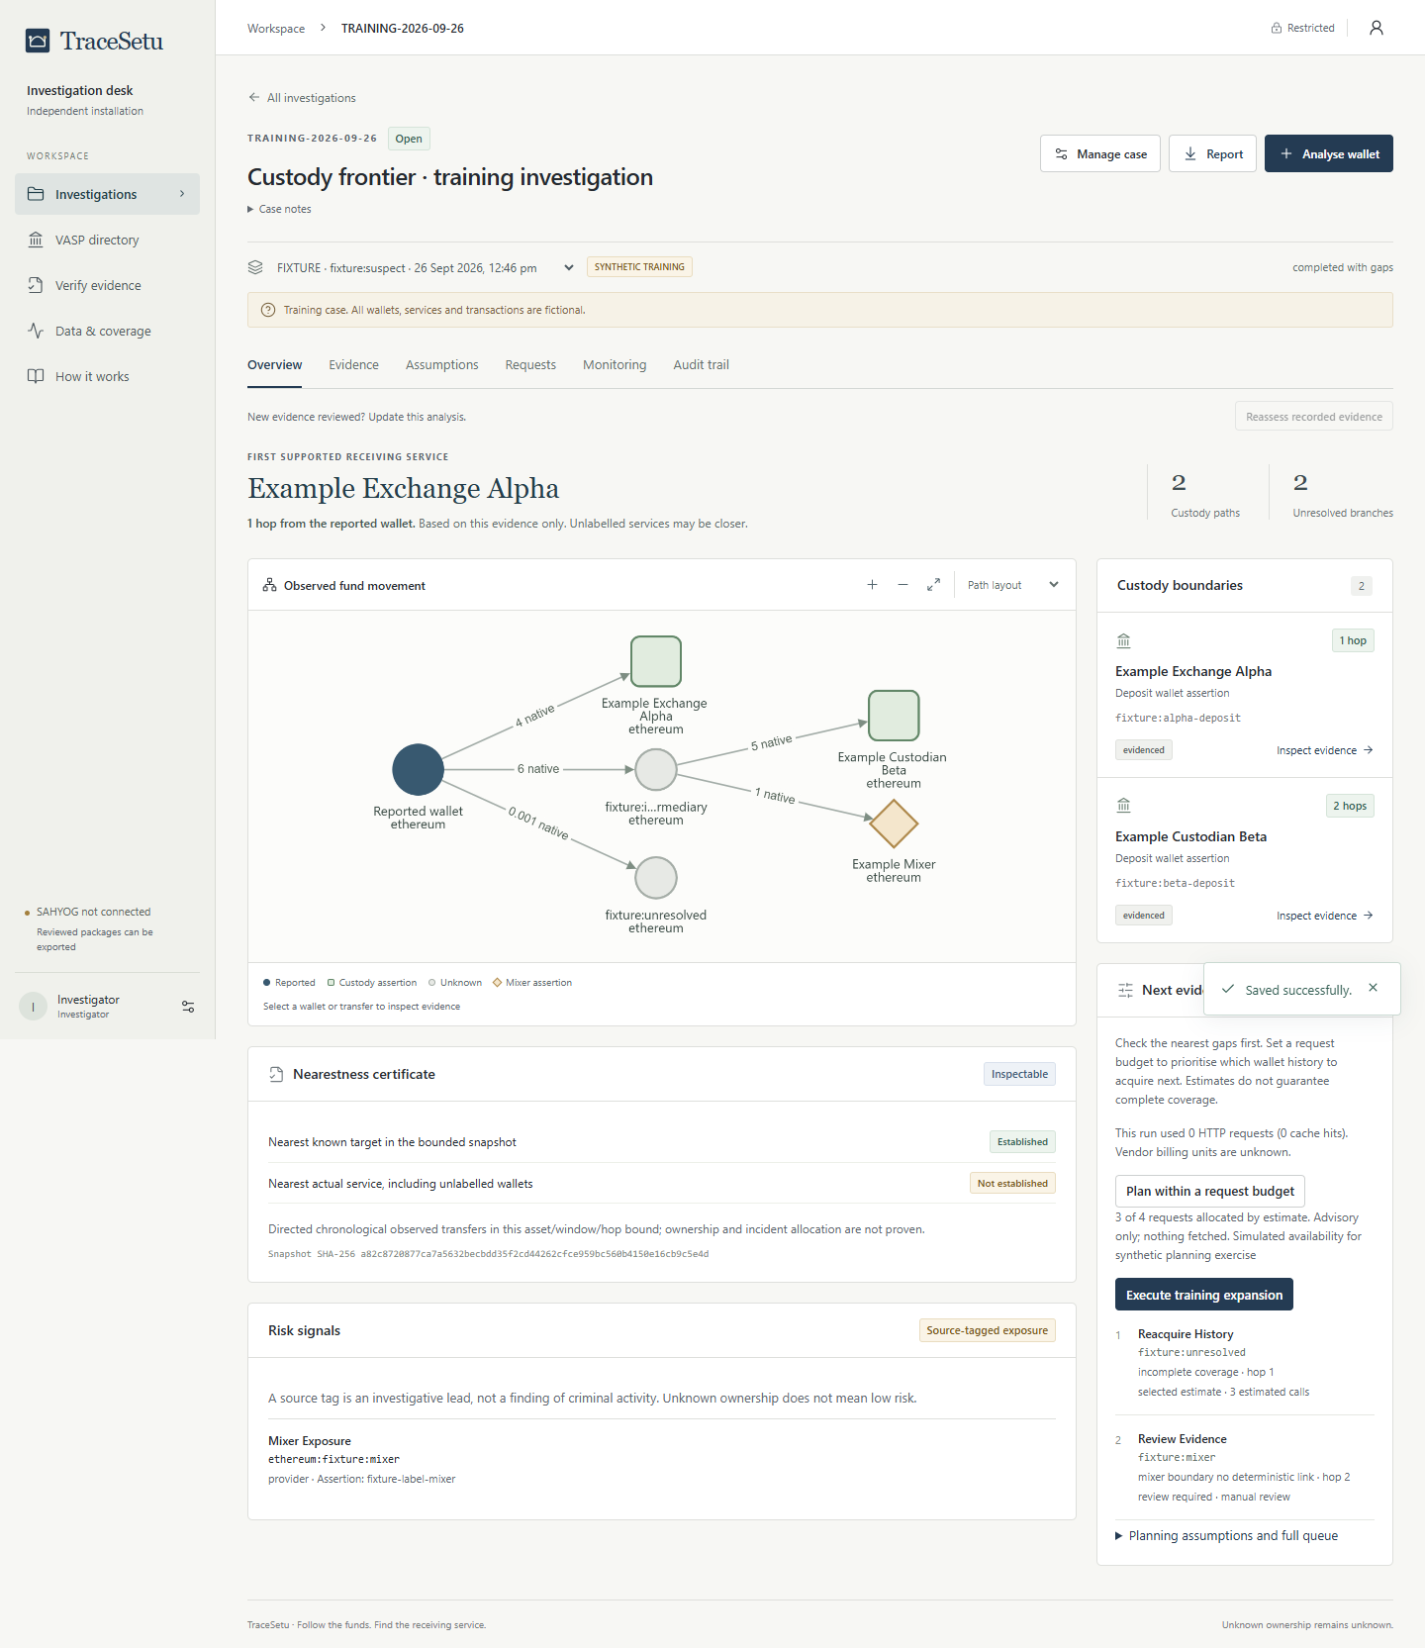
RESEARCH AND REFERENCES
ANANTHA
RESEARCH USED IN THE DESIGN
[1] Victor · FC 2020
Deposit-address forwarding: a clue requiring known service anchors.
[2] Brechlin et al. · 2025
Service fee funding + collection; Evonax confirmed roles using service records.
[3] Wu et al. · PVLDB 2014
Temporal graphs: reject transfer paths that run backwards in time.
[4] Kappos et al. · 2022
Bitcoin peel-chain clustering: a guarded future extension.
[5] Lubbertsen et al. · 2025
Evaluate attribution against independent ground truth and address roles.
ACTUAL PROTOTYPE: OBSERVED TRANSFERS, SERVICE EVIDENCE AND NEXT ACTIONS
Public source code & research
github.com/notvinayaks/TraceSetu
Complete work: product/live-foundation
Watch the prototype walkthrough
youtube.com/watch?v=V_qB6dL934w
Screenshot: fictional training case in the real app.
Public Bitcoin testing is reported on slide 4.
The video demonstrates the existing prototype.
Notes:
Primary sources: [1] Friedhelm Victor, Address Clustering Heuristics for Ethereum, Financial Cryptography 2020: https://www.ifca.ai/fc20/preproceedings/31.pdf. [2] Alexander Brechlin, Jochen Schäfer and Frederik Armknecht, Buy Crypto, Sell Privacy: An Extended Investigation of the Cryptocurrency Exchange Evonax, International Journal of Network Management 2025: https://onlinelibrary.wiley.com/doi/10.1002/nem.2325. [3] Huanhuan Wu et al., Path Problems in Temporal Graphs, PVLDB 2014: https://www.vldb.org/pvldb/vol7/p721-wu.pdf. [4] George Kappos et al., How to Peel a Million: Validating and Expanding Bitcoin Clusters, USENIX Security 2022: https://www.usenix.org/system/files/sec22-kappos.pdf. [5] Lubbertsen et al., Ghost Clusters, USENIX Security 2025: https://www.usenix.org/system/files/usenixsecurity25-lubbertsen.pdf. Published research informs the method; TraceSetu does not claim to have invented temporal graph search or exchange clustering. Screenshot is the actual TraceSetu workspace captured on 26 September 2026, with fictional training addresses/services and explicitly labelled here. It is cropped only for composition. The public-data check is separately described on slide 4. Repository: https://github.com/notvinayaks/TraceSetu/tree/product/live-foundation. Main preserves the original MVP; product/live-foundation contains completed research and foundation work. Team-supplied prototype video: https://www.youtube.com/watch?v=V_qB6dL934w. The video predates integration of the separate deposit detector, which remains pending.

