Slide 1

SMART INDIA HACKATHON 2026
TRACESETU
Problem Statement ID – PS26182
Problem Statement Title – Automated Attribution of Unknown Cryptocurrency Wallets to Nearest Virtual Asset Service Providers (VASPs) through Blockchain Intelligence APIs
Theme – Blockchain & Cybersecurity
PS Category – Software
Team ID – 170835
Team Name – ANANTHA
Notes:
— title page
**TRACESETU**
Problem Statement ID – PS26182
Problem Statement Title – Automated Attribution of Unknown Cryptocurrency Wallets to Nearest Virtual Asset Service Providers (VASPs) through Blockchain Intelligence APIs
Theme – Blockchain & Cybersecurity
PS Category – Software
Team ID – 170835
Team Name – ANANTHA
Presenter note: these identifiers come from the team's supplied deck; they have not been independently matched to the official portal. Keep the exact supplied PS title. Do not invent official endorsement.
Source template: user-supplied SIH2026-IDEA-Presentation-Format (10).pptx. Screenshot: actual TraceSetu UI, captured 26 September 2026, unchanged investigation design verified against current code. Synthetic training case, not a live attribution result. Public repository verified anonymously on 30 September 2026. Complete current work is on product/live-foundation; main preserves the published MVP.
Implemented read-only parsers: Bitcoin, Ethereum, BNB Chain, Polygon, Tron and Solana. Access and live coverage vary. A bounded public Bitcoin check returned no established VASP. Production evaluation, label coverage and official SAHYOG connectivity remain open. In-app requests export as NOT_SENT. Guards hold unsupported mixer and cross-chain paths. The limited CCTP proof workflow covers reviewed V2 native USDC Ethereum/Polygon training proofs.
Primary links:
https://fc20.ifca.ai/preproceedings/31.pdf
https://doi.org/10.1002/nem.2325
https://www.vldb.org/pvldb/vol7/p721-wu.pdf
https://www.usenix.org/system/files/sec22-kappos.pdf
https://www.usenix.org/system/files/usenixsecurity25-lubbertsen.pdf
Repository: https://github.com/notvinayaks/TraceSetu/tree/product/live-foundation
Prototype video supplied by team: https://www.youtube.com/watch?v=V_qB6dL934w

Slide 2
TRACESETU
ANANTHA
Find the first receiving crypto service
THE PROBLEM
Wallet + case scope
Transfers reveal addresses, but rarely
the company behind them. The first
deposit wallet may have no label.
Trace and test evidence
OUR SOLUTION
Trace to the first supported exchange
or custodial service on each path.
Service lead + gaps
OUR DIFFERENCE
Officer-reviewed request
Test earlier deposit candidates. Show
the evidence gap and the next check.
VASP = exchange or custodial service
Notes:
— IDEA TITLE
**TraceSetu: find the first receiving crypto service**
**THE PROBLEM**
Officers can see transfers, but an address rarely tells them which exchange controls it. The first deposit address may have no label.
**OUR SOLUTION**
Trace transfers, test deposit-address patterns and build an evidence-backed lead for a reviewed VASP request.
**WHAT MAKES IT USEFUL**
Find a possible earlier deposit point. Show why it is suspected, what is missing and which evidence to collect next.
**Officer → Wallet + time window → TraceSetu → Service candidate + evidence → Review**
Presenter notes: A VASP is a service such as a crypto exchange or custodial wallet business. The product supports an investigator's recipient decision; it cannot reveal private customer records or freeze funds. The core tracing and review workflow exists. Automated deposit discovery is a separate research reference, not integrated into the current MVP. A hot wallet's identity alone does not establish that every preceding address is controlled by that service. “Evidence-backed” does not mean every assertion is independently proven.
Source template: user-supplied SIH2026-IDEA-Presentation-Format (10).pptx. Screenshot: actual TraceSetu UI, captured 26 September 2026, unchanged investigation design verified against current code. Synthetic training case, not a live attribution result. Public repository verified anonymously on 30 September 2026. Complete current work is on product/live-foundation; main preserves the published MVP.
Implemented read-only parsers: Bitcoin, Ethereum, BNB Chain, Polygon, Tron and Solana. Access and live coverage vary. A bounded public Bitcoin check returned no established VASP. Production evaluation, label coverage and official SAHYOG connectivity remain open. In-app requests export as NOT_SENT. Guards hold unsupported mixer and cross-chain paths. The limited CCTP proof workflow covers reviewed V2 native USDC Ethereum/Polygon training proofs.
Primary links:
https://fc20.ifca.ai/preproceedings/31.pdf
https://doi.org/10.1002/nem.2325
https://www.vldb.org/pvldb/vol7/p721-wu.pdf
https://www.usenix.org/system/files/sec22-kappos.pdf
https://www.usenix.org/system/files/usenixsecurity25-lubbertsen.pdf
Repository: https://github.com/notvinayaks/TraceSetu/tree/product/live-foundation
Prototype video supplied by team: https://www.youtube.com/watch?v=V_qB6dL934w

Slide 3
TECHNICAL APPROACH
ANANTHA
1 READ SOURCES
2 PATTERNS [1, 2]
3 TRACE [3]
4 REVIEW
Transfers, receipts
and sourced service
wallets
Token collection
plus service-funded
transaction fees
Fewest steps in
time order. Stop at
first custodian.
Inspect paths,
sources and gaps
before acting.
Service fee
wallet
Proposed deposit pattern on token chains
Reported
wallet
Possible
deposit wallet
Known exchange
collection wallet
Repeated collection + service fee funding suggest a role, not ownership.
Python / FastAPI React / TypeScript SQLite Cytoscape graph view
Notes:
— TECHNICAL APPROACH
**1. Acquire** — Read transfers, receipts and sourced service-wallet labels.
**2. Suggest deposits [1, 2]** — Look for repeated token collection into a known exchange wallet, with transaction-fee funding from that service. Keep matches as hypotheses.
**3. Trace in time order [3]** — Search for the fewest transfer steps to the first supported custodian; expose earlier unresolved candidates.
**4. Review** — Return the path, sources and gaps for an officer's decision.
**Python / FastAPI · React / TypeScript · SQLite · Cytoscape**
Diagram to draw natively, with short labels:
```text
Reported wallet → Possible deposit → Known exchange wallet
↑
Service fee wallet
```
Diagram caption: “Repeated pattern suggests a deposit role; it does not prove ownership.”
Presenter notes: This is seeded service-cluster discovery followed by time-respecting first-custody tracing. Service names come from externally sourced identity anchors, not graph shape. Keep observed transfer edges separate from service-control assertions. The proposed detector checks exact asset units, event order, transaction sender/fee payer, matching hot-wallet and gas-feeder service roles, boundary balances, coverage and contradictions. Its narrow reference uses three repetitions as a demonstration policy; that number is not calibrated. A customer can imitate the pattern, so independent confirmation remains necessary. Search state includes arrival event/time, chain and asset rather than a single visited flag per address. “Nearest” means fewest recorded transfer steps within the acquired snapshot and stated limits. The existing Bitcoin parser follows spent output links; guarded common-input/change/peel-chain expansion is a proposed extension [4], with CoinJoin and ambiguous-change handling required. No claim of exact victim-unit allocation through mixed balances. Unsupported cross-chain movements remain gaps; the existing limited CCTP proof scope is distinct from this account-based reference.
Source template: user-supplied SIH2026-IDEA-Presentation-Format (10).pptx. Screenshot: actual TraceSetu UI, captured 26 September 2026, unchanged investigation design verified against current code. Synthetic training case, not a live attribution result. Public repository verified anonymously on 30 September 2026. Complete current work is on product/live-foundation; main preserves the published MVP.
Implemented read-only parsers: Bitcoin, Ethereum, BNB Chain, Polygon, Tron and Solana. Access and live coverage vary. A bounded public Bitcoin check returned no established VASP. Production evaluation, label coverage and official SAHYOG connectivity remain open. In-app requests export as NOT_SENT. Guards hold unsupported mixer and cross-chain paths. The limited CCTP proof workflow covers reviewed V2 native USDC Ethereum/Polygon training proofs.
Primary links:
https://fc20.ifca.ai/preproceedings/31.pdf
https://doi.org/10.1002/nem.2325
https://www.vldb.org/pvldb/vol7/p721-wu.pdf
https://www.usenix.org/system/files/sec22-kappos.pdf
https://www.usenix.org/system/files/usenixsecurity25-lubbertsen.pdf
Repository: https://github.com/notvinayaks/TraceSetu/tree/product/live-foundation
Prototype video supplied by team: https://www.youtube.com/watch?v=V_qB6dL934w

Slide 4
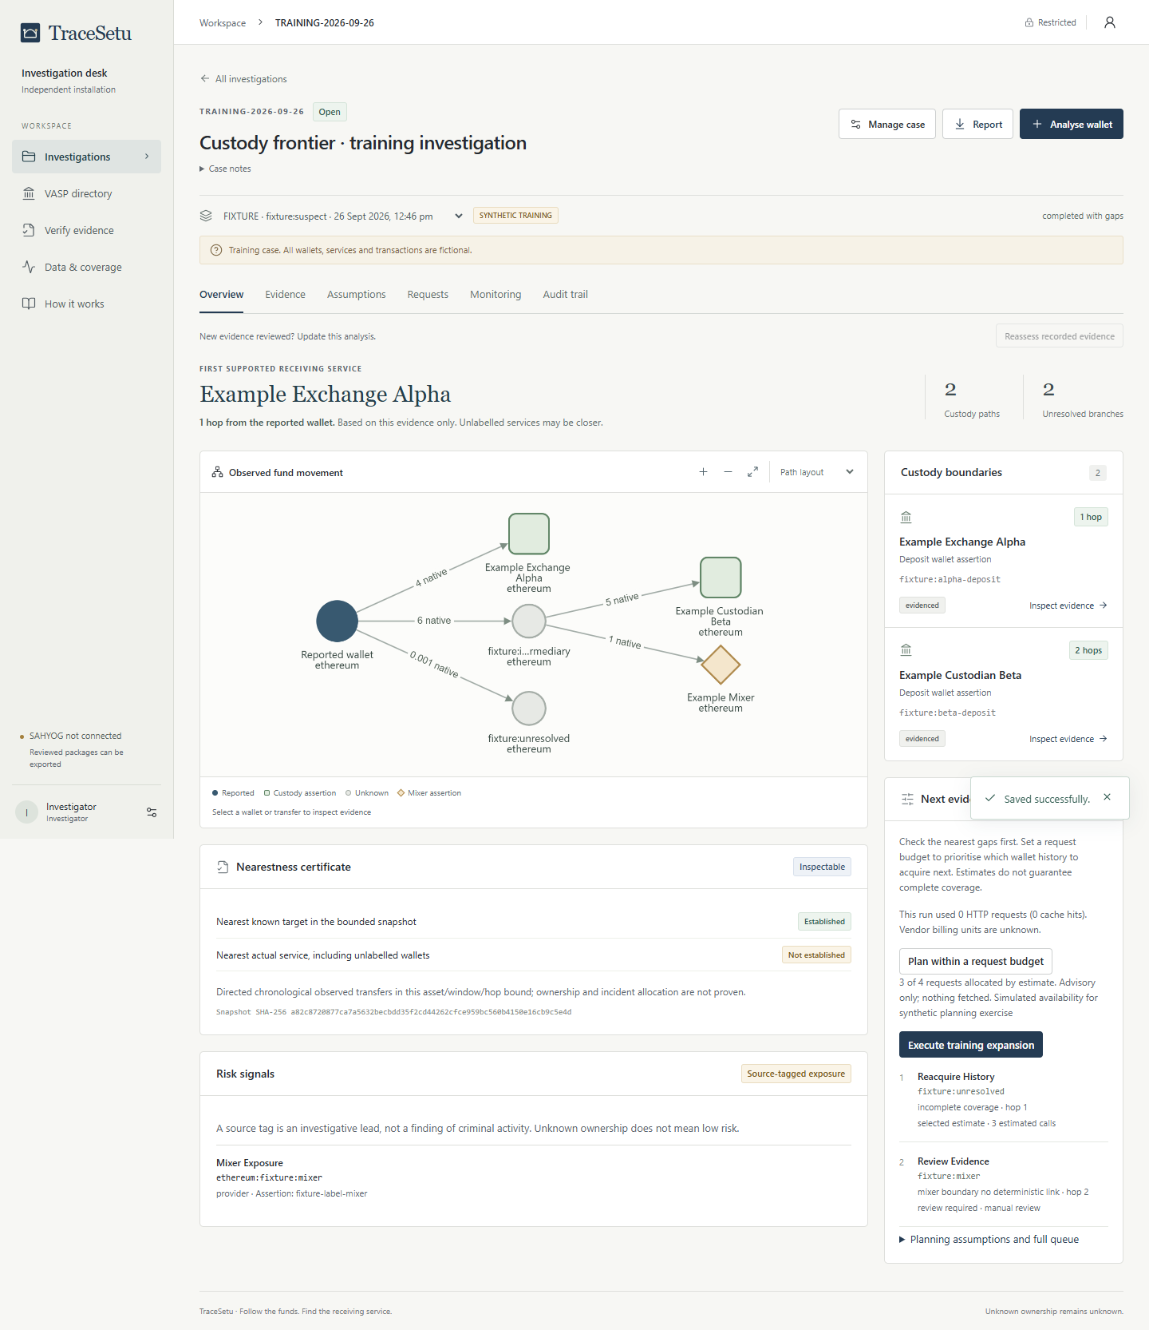
FEASIBILITY AND VIABILITY
ANANTHA
WORKING PROTOTYPE
BUILT AND TESTED
Case tracing, source challenge,
query budgets and signed
evidence export.
RESEARCH CHECK
Separate detector: 64 synthetic
tests pass. MVP integration and
independent live validation pending.
RISK AND CONTROL
Customers can imitate deposits.
Retain a hypothesis until
independently confirmed.
Actual interface. Synthetic training case.
BTC / ETH / BNB / Polygon / Tron / Solana adapters. Public/free APIs. SAHYOG not connected.
Notes:
— FEASIBILITY AND VIABILITY
**WORKING PROTOTYPE**
Case workspace, transfer graph, source challenge, query budgets and signed evidence export.
**METHOD CHECK**
64 synthetic reference tests passed. Deposit inference is separate from the MVP; independent live accuracy is not established.
**PRACTICAL BUILD**
Public/free API approach. Six read-only chain adapters; access and coverage vary.
**KEY RISK → CONTROL**
A customer can imitate a deposit pattern → retain a hypothesis and seek confirmation.
Screenshot: use the current prototype, not a mock-up. Caption according to the actual capture: “Current TraceSetu prototype — synthetic training case” or “Current TraceSetu prototype — bounded public Bitcoin sample; no VASP established.”
Presenter notes: Six parsers/adapters cover Bitcoin, Ethereum, BNB Chain, Polygon, Tron and Solana; this is not six-chain live attribution validation. A recorded bounded Bitcoin check returned two transactions and three outputs and no VASP. The existing published MVP recorded 116 backend tests plus browser checks. The isolated detector has 64 functional/adversarial synthetic checks, not 64 real investigations or an accuracy percentage. Public APIs lower initial entry cost but quotas, indexing and data licences limit production use. Missing pages, conflicting labels, unknown token semantics and incomplete receipts cause an unresolved result. Service records or authorised deposits are needed for independent truth. Official SAHYOG API access is pending; current exports are NOT_SENT. Production hosting, security/load evaluation and governance remain separate work.
Source template: user-supplied SIH2026-IDEA-Presentation-Format (10).pptx. Screenshot: actual TraceSetu UI, captured 26 September 2026, unchanged investigation design verified against current code. Synthetic training case, not a live attribution result. Public repository verified anonymously on 30 September 2026. Complete current work is on product/live-foundation; main preserves the published MVP.
Implemented read-only parsers: Bitcoin, Ethereum, BNB Chain, Polygon, Tron and Solana. Access and live coverage vary. A bounded public Bitcoin check returned no established VASP. Production evaluation, label coverage and official SAHYOG connectivity remain open. In-app requests export as NOT_SENT. Guards hold unsupported mixer and cross-chain paths. The limited CCTP proof workflow covers reviewed V2 native USDC Ethereum/Polygon training proofs.
Primary links:
https://fc20.ifca.ai/preproceedings/31.pdf
https://doi.org/10.1002/nem.2325
https://www.vldb.org/pvldb/vol7/p721-wu.pdf
https://www.usenix.org/system/files/sec22-kappos.pdf
https://www.usenix.org/system/files/usenixsecurity25-lubbertsen.pdf
Repository: https://github.com/notvinayaks/TraceSetu/tree/product/live-foundation
Prototype video supplied by team: https://www.youtube.com/watch?v=V_qB6dL934w

Slide 5
IMPACT AND BENEFITS
ANANTHA
A better-supported decision about whom to approach
INVESTIGATOR
See the receiving-service lead, its path and missing evidence.
REVIEWER
Remove a disputed source. Recompute without rewriting history.
NEXT ACTION
Prioritise useful queries. Prepare a request for a verified recipient.
HOW WE WILL MEASURE VALUE [5]
Deposit-role precision, false links, answer coverage, API calls and officer time.
Compare with label-only tracing using independent service-confirmed records.
Notes:
— IMPACT AND BENEFITS
**FOR INVESTIGATORS**
One case view of the receiving-service lead, transaction path and missing evidence.
**FOR REVIEWERS**
Remove a disputed source and recompute. Preserve the earlier result and its reasons.
**FOR THE NEXT ACTION**
Prioritise evidence that could change the answer; prepare a request for a verified recipient.
**HOW WE WILL MEASURE VALUE [5]**
Compare against label-only tracing: deposit-role precision, answer coverage, false links, API calls and officer review time.
**Goal: less manual tracing, better-supported requests. Savings remain to be measured.**
Presenter notes: Our proposed differentiation is the integrated decision workflow: find a possible earlier custody boundary, expose the evidence gap, challenge a source without rewriting history, then spend the next query on what could resolve that gap. Graphs, multi-chain tracing, risk scores and PDF reports already exist in competing systems; they are not novel by themselves. Evaluate held-out service-confirmed deposits and ordinary customer addresses, freeze evidence at a historical cutoff and keep source families separate so ground truth is independent. Do not promise recovery: the VASP receives and acts on a lawful request, and assets may no longer remain there. The complete intended system also includes role-specific labels, mixer/bridge visibility limits, verified cross-chain links, risk alerts and authorised SAHYOG connectivity; these are not all production-complete.
Source template: user-supplied SIH2026-IDEA-Presentation-Format (10).pptx. Screenshot: actual TraceSetu UI, captured 26 September 2026, unchanged investigation design verified against current code. Synthetic training case, not a live attribution result. Public repository verified anonymously on 30 September 2026. Complete current work is on product/live-foundation; main preserves the published MVP.
Implemented read-only parsers: Bitcoin, Ethereum, BNB Chain, Polygon, Tron and Solana. Access and live coverage vary. A bounded public Bitcoin check returned no established VASP. Production evaluation, label coverage and official SAHYOG connectivity remain open. In-app requests export as NOT_SENT. Guards hold unsupported mixer and cross-chain paths. The limited CCTP proof workflow covers reviewed V2 native USDC Ethereum/Polygon training proofs.
Primary links:
https://fc20.ifca.ai/preproceedings/31.pdf
https://doi.org/10.1002/nem.2325
https://www.vldb.org/pvldb/vol7/p721-wu.pdf
https://www.usenix.org/system/files/sec22-kappos.pdf
https://www.usenix.org/system/files/usenixsecurity25-lubbertsen.pdf
Repository: https://github.com/notvinayaks/TraceSetu/tree/product/live-foundation
Prototype video supplied by team: https://www.youtube.com/watch?v=V_qB6dL934w

Slide 6
RESEARCH AND REFERENCES
ANANTHA
1 Deposit-address patterns
Victor, FC 2020
2 Service fee funding + collection
Brechlin et al., 2025
3 Time-respecting graph paths
Wu et al., PVLDB 2014
4 Bitcoin clustering (planned)
Kappos et al., USENIX 2022
5 Independent attribution evaluation
Lubbertsen et al., USENIX 2025
PUBLIC SOURCE CODE + RESEARCH
WATCH THE PROTOTYPE
github.com/notvinayaks/TraceSetu
youtube.com/watch?v=V_qB6dL934w
Published methods guide the design. Synthetic tests do not establish real-world accuracy.
Notes:
— RESEARCH AND REFERENCES
**METHOD → SOURCE**
1. Deposit-address inference — Victor, FC 2020.
2. Service fee funding and collection — Brechlin et al., 2025.
3. Time-respecting graph paths — Wu et al., PVLDB 2014.
4. Guarded Bitcoin clustering — Kappos et al., USENIX 2022.
5. Independent attribution evaluation — Lubbertsen et al., USENIX 2025.
**PROJECT RESOURCES**
**Source code + research** · **Prototype walkthrough**
Published research motivates the method. Our synthetic tests verify rule behaviour, not real-world accuracy.
Hyperlink targets:
- [1] https://fc20.ifca.ai/preproceedings/31.pdf
- [2] https://doi.org/10.1002/nem.2325
- [3] https://www.vldb.org/pvldb/vol7/p721-wu.pdf
- [4] https://www.usenix.org/system/files/sec22-kappos.pdf
- [5] https://www.usenix.org/system/files/usenixsecurity25-lubbertsen.pdf
- Source code + research: https://github.com/notvinayaks/TraceSetu/tree/product/live-foundation
- Prototype walkthrough (team-supplied): https://www.youtube.com/watch?v=V_qB6dL934w
Presenter notes: Do not inherit reported performance from any paper. Victor gives historical exchange-seeded account clustering with false positives. Brechlin describes one service, not a universal pattern. Wu supplies temporal-path foundations; our transfer-hop objective is an adaptation. Kappos supports a proposed Bitcoin extension rather than implemented reference scope. Ghost Clusters motivates independent role-specific evaluation. Additional complete references, assumptions, tests and the paper are in the repository research folder. Make the resource labels clickable in both PPT and exported PDF. The product branch contains current research/foundation; main preserves the working MVP. Only label the repository public after anonymous access is verified. The existing video demonstrates the earlier prototype; do not describe it as a live demonstration of the new detector.
Source template: user-supplied SIH2026-IDEA-Presentation-Format (10).pptx. Screenshot: actual TraceSetu UI, captured 26 September 2026, unchanged investigation design verified against current code. Synthetic training case, not a live attribution result. Public repository verified anonymously on 30 September 2026. Complete current work is on product/live-foundation; main preserves the published MVP.
Implemented read-only parsers: Bitcoin, Ethereum, BNB Chain, Polygon, Tron and Solana. Access and live coverage vary. A bounded public Bitcoin check returned no established VASP. Production evaluation, label coverage and official SAHYOG connectivity remain open. In-app requests export as NOT_SENT. Guards hold unsupported mixer and cross-chain paths. The limited CCTP proof workflow covers reviewed V2 native USDC Ethereum/Polygon training proofs.
Primary links:
https://fc20.ifca.ai/preproceedings/31.pdf
https://doi.org/10.1002/nem.2325
https://www.vldb.org/pvldb/vol7/p721-wu.pdf
https://www.usenix.org/system/files/sec22-kappos.pdf
https://www.usenix.org/system/files/usenixsecurity25-lubbertsen.pdf
Repository: https://github.com/notvinayaks/TraceSetu/tree/product/live-foundation
Prototype video supplied by team: https://www.youtube.com/watch?v=V_qB6dL934w

