Slide 1


SMART INDIA HACKATHON 2026
TRACESETU
Blockchain investigation with evidence at every step
Problem Statement ID: 26182
Problem Statement Title
Automated Attribution of Unknown Cryptocurrency Wallets to Nearest Virtual Asset Service Providers (VASPs) through Blockchain Intelligence APIs
Theme: Blockchain & Cybersecurity
PS Category: Software
Team ID: 170835
Team Name: ANANTHA
Notes:
Team ANANTHA, team ID 170835. PS ID 26182 and exact title supplied by the team. Software category and Blockchain & Cybersecurity theme are from TraceSetu_COMPLETE_SKILL.md. Opening: The investigator has a suspect wallet, but needs the first supported receiving service and a reviewable route for a lawful request. TraceSetu is an independent local SIH prototype.
Visual assets: Lucide icons from the installed official lucide package, ISC license, https://github.com/lucide-icons/lucide . Original SIH artwork and template are supplied by the team.
Team name, Team ID 170835 and PS ID 26182 are retained from the user-supplied deck. They are submission metadata, not independently verified official endorsement. TraceSetu combines English trace with Sanskrit setu (bridge).

Slide 2

TRACESETU
ANANTHA
IDEA & SOLUTION
SYSTEM WORKFLOW: WALLET TO REVIEWED ACTION
TraceSetu helps officers trace a reported wallet to supported receiving services and inspect the evidence before action.
CASE INPUTS
ACQUISITION AND EVIDENCE SNAPSHOT
CASE SCOPE
1 ACQUIRE
2 VALIDATE & ORDER
3 ENRICH EVIDENCE
Wallet + blockchain
Time and asset window
Case ID + query limits
Bitcoin: Esplora / BlockCypher
EVM: Etherscan V2
TronGrid / Solana RPC
Exact units + ledger order
Bitcoin outpoint links
Status / time / content hash
Source-backed service labels
Role + period of validity
CCTP proof where supported
Every result shows its sources,
search limits and unresolved gaps.
Worker: reserve calls, cache replies, save checkpoints.
FIRST CUSTODY
CHAIN ADAPTERS
CUSTODY ATTRIBUTION ENGINE
Stop each branch at the first
supported exchange or custodian.
Bitcoin
Ethereum / BNB Chain
Polygon
Tron / Solana
NEARESTNESS CERTIFICATE
6 RETURN RESULTS
5 CHECK EVIDENCE
4 FIND FIRST CUSTODY
Show which gaps can hide
a nearer receiving service.
VASP candidates + wallets
Paths + evidence gaps
Next query to run
Nearestness within snapshot
Remove source + recompute
Source grade + separate risk
Chronological paths
First custody per branch
Keep unresolved gaps
SOURCE CHALLENGE
Bitcoin sample verified.
Other chains: live checks
and access pending.
Remove a disputed source and
recompute without losing history.
BUDGETED ACQUISITION
HUMAN REVIEW, EXPORT AND FEEDBACK
Prioritise nearer missing evidence.
Reserve API calls before dispatch.
CASE STORAGE
Official SAHYOG access pending. Request export does not send a notice.
REVIEWED FEEDBACK
SQLite WAL / SQLAlchemy
Evidence hashes + audit log
7 REVIEW ACTION
8 EXPORT & VERIFY
9 REVIEW FEEDBACK
Review an authenticated service
reply before promoting its claim.
Verify recipient + request
Independent review
PDF + signed ZIP
Request JSON: NOT_SENT
Import scoped signed reply
Review before using its labels
@SIH Idea submission- Template
2
Notes:
Six chain adapters are implemented; broad live validation is incomplete. A receiving wallet is not necessarily an exchange deposit address. Custody requires a source-qualified assertion. Independent request review is separate from recipient review. PDF/ZIP evidence can be exported independently; reviewed action is a JSON package and remains NOT_SENT. BlockCypher is explicitly selectable as a Bitcoin provider; no synthetic fallback.

Slide 3























TECHNICAL APPROACH
ANANTHA
Implementation flow
How attribution works
Technology stack
Causal transaction paths
INTERFACE & GRAPH
Wallet + chain + time window
1
Order by ledger position. Bitcoin continuation
must spend the preceding outpoint.
React
TypeScript
Vite
Cytoscape.js
Lucide
Source-qualified service labels
API & VALIDATION
Acquire, validate and normalise
2
Bind entity, chain, wallet role and validity
interval to inspectable source evidence.
Python
FastAPI
Uvicorn
Pydantic
HTTPX
First-custody termination
STORAGE & EVIDENCE
3
Transfer
paths
Service
assertions
Bridge
proofs
Keep the first custodian on every branch.
Do not infer unrelated exchange withdrawals.
SQLite WAL
SQLAlchemy
ReportLab
cryptography
Ethereum tools
Scoped nearestness
TESTING & BUILD
4
A shallower unresolved branch limits the
answer within the acquired graph.
pytest
Playwright
Ruff
Prettier
pnpm
Chronological first-custody search
5
Confidence and risk separation
LOCAL RUNTIME
EVIDENCE STANDARDS
Categorical evidence grades, not probabilities.
Risk reasons remain separate from attribution.
Python worker + SQLite
Node.js
Ed25519
SHA-256
6
Scoped cross-chain verification
Candidates + certificate + gaps
CCTP V2 USDC: Ethereum–Polygon only.
Synthetic tests passed; live proof pending.
PROTOTYPE: [paste public URL]
REPOSITORY: [paste repository URL]
Notes:
Implementation details are from supplied solution sections 5–8. No attribution ML/LLM is implemented. Confirmed account transfers use ledger ordering; Bitcoin continuation requires the actual previous outpoint in a later input set. Candidate ordering uses hop count and evidence status, not numerical confidence. Numerical calibrated confidence needs independent ground truth and remains future work. CCTP is original V2 Ethereum–Polygon native USDC, synthetically exercised; signature/receipt validation alone does not identify a VASP. Technical marks are authentic Devicon assets from https://github.com/devicons/devicon (MIT). Diagram colours are original Office theme accents. The prototype link and QR remain empty for the team. Research foundations for chain-specific label caution and transaction analysis are cited on slide 6; the MVP does not claim to implement the cited clustering systems.
Visual assets: Lucide icons from the installed official lucide package, ISC license, https://github.com/lucide-icons/lucide . Original SIH artwork and template are supplied by the team.
Actual local stack: React, TypeScript, Cytoscape, FastAPI, SQLAlchemy, SQLite WAL, local worker/files and ReportLab. No Neo4j/Temporal/PostgreSQL deployment is running. Evidence grades are categorical, not calibrated accuracy probabilities. CCTP V2 Ethereum–Polygon is synthetically tested; live proof remains unvalidated.

Slide 4

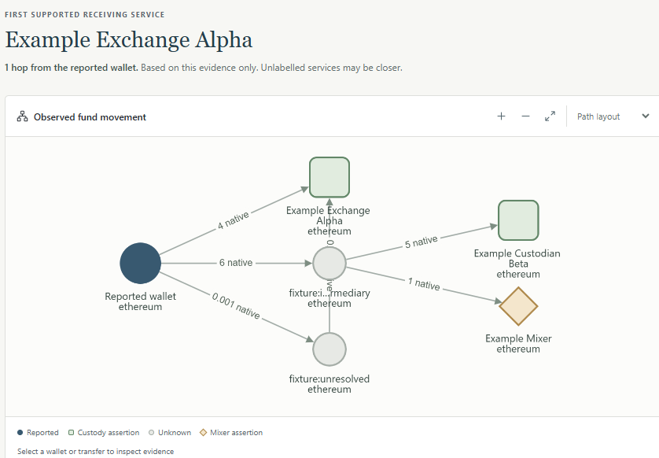

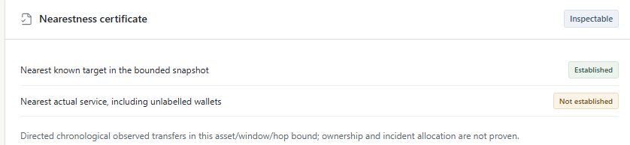
FEASIBILITY AND VIABILITY
ANANTHA
FEASIBILITY ANALYSIS
CURRENT PROTOTYPE
VIABILITY & CONTROLS
TECHNICAL FEASIBILITY
Actual prototype / labelled synthetic custody exercise
Risk | Control
Stale labels | Source challenge and independent review
History / quota gaps | Explicit stops, checkpoints and a hard cap
Official integration | Pending: approved SAHYOG contract
Agency operations | Future: agency identity and security validation
Working local MVP
React / FastAPI case workspace.
Causal tracing, PDF reports and replay.
Six chain adapter parsers implemented.
107-test baseline + 8 new provider tests.
Live data alone does not establish ownership.
OPERATIONAL VIABILITY
Review remains with officers
Investigators inspect paths and sources.
An independent reviewer approves requests.
SAHYOG delivery needs approved access.
Pilot requires licensed labels, known recipients
and independent first-VASP ground truth.
Staged adoption
COST & DEPLOYMENT
1 Agency pilot
Open-source core, explicit costs
Verified labels, approved recipients and
independent first-service evaluation.
API quotas and licensed labels drive cost.
Cache responses and cap each acquisition.
Current: SQLite and local files.
2 Validated scale-up
Agency deployment remains future work.
Security, scale and restore validation required.
Agency identity, storage and orchestration
after security, load and restore testing.
Notes:
Recorded test evidence comes from the handover and existing test files, not a new run. tmp/backend-junit.xml recorded 107 tests without failures/errors; four browser workflow checks and six adapter parser implementations are recorded. A bounded live Bitcoin sample dated 25 September 2026 returned one event, zero VASP candidates and COMPLETED_WITH_GAPS. These checks are not accuracy/coverage benchmarks. Screenshots are actual local application crops from output/ui-review/03-custody-workspace.png, with fictional wallets and services. The first-custody graph and nearestness certificate are two different areas of the same recorded application view. Proposed 36-hour milestones extend the current MVP. Agency adoption and scaled PostgreSQL/Temporal/encrypted storage remain proposals subject to data access, security, live validation, official contracts and operational acceptance.
Visual assets: Lucide icons from the installed official lucide package, ISC license, https://github.com/lucide-icons/lucide . Original SIH artwork and template are supplied by the team.
Current custody screenshot is explicitly synthetic. The 107 backend tests are the prior baseline; eight BlockCypher contract tests were added on 25 September. This is not an accuracy benchmark. Official SAHYOG integration and real authenticated service responses remain external gates.

Slide 5







IMPACT AND BENEFITS
ANANTHA
WHY THIS PROBLEM MATTERS
Public context and the prototype’s contribution
₹1,646 cr
First custody
35 VASPs
Crypto seized in a fraud case [9]
A bounded decision for officers
Onboarded on SAHYOG [6]
ED reported a ₹1,646 crore crypto seizure
in the BitConnect fraud investigation.
Official release, 15 February 2025.
Show the first supported receiving service
on each path, with sources and gaps.
Unknown wallets remain unknown.
Official parliamentary reply, 23 July 2025.
A service network for agency coordination.
Access and integration still need approval.
HOW TRACESETU CAN SUPPORT INVESTIGATORS
Less tracing effort
Support asset action
Expose uncertainty
Verifiable handoff
Automate the path to a
supported receiving VASP.
Prepare evidence for lawful
disclosure or freezing requests.
Surface gaps and disputed
labels before recipient approval.
Share signed case evidence
with deterministic replay.
EXISTING APPROACHES AND TRACESETU’S CONTRIBUTION
Dimension | Explorer + SAHYOG workflow | Chainalysis Reactor [8] | TraceSetu MVP
Tracing | Officer follows transfers | Automated graph / entity tracing | First custody on each supported path
Evidence | Manual case assembly | Entity intelligence and reports | Source challenge + evidence certificate
Handoff | Officer selects recipient | Case investigation tooling | Reviewed export; SAHYOG API proposed
Intended benefits require operational evaluation. TraceSetu has no validated recovery amount or official SAHYOG connection.
@SIH Idea submission- Template
5
Notes:
The outcome diagram maps implemented case mechanisms to intended stakeholder value. Current request output is a reviewed export; no notice is sent and no assets are frozen. The purpose is supported recipient review rather than autonomous attribution of a real person or criminality. Commercial baseline: https://www.chainalysis.com/product/reactor/ accessed 25 September 2026. Public descriptions list entity intelligence, transaction graphs, broad cross-chain tracing and reporting. No absence of undocumented competitor capabilities, superior accuracy, savings or recovery rate is asserted. Manual explorer/SAHYOG is the workflow given by PS 26182, not an audit of the portal. Pilot measurement should use independent truth, entity/time-disjoint evaluation and matched API entitlements, measuring first-service precision, abstention, false routes, time to a supported recipient, reviewer time and cost. Agency operation with licensed data is the proposed sustainability route.
Visual assets: Lucide icons from the installed official lucide package, ISC license, https://github.com/lucide-icons/lucide . Original SIH artwork and template are supplied by the team.
[9] https://enforcementdirectorate.gov.in/sites/default/files/latestnews/Press%20Release-Search-%20Bitconnect-15.02.2025.pdf
[6] https://www.mha.gov.in/MHA1/Par2017/pdfs/par2025-pdfs/RS23072025/399.pdf
[8] https://www.chainalysis.com/product/reactor/
The 35-VASP figure is dated 23 July 2025 and is not a current total. Competitor comparison lists public features, not exclusive novelty or superiority. Removed the unrelated ₹221.50 crore statistic.

Slide 6
RESEARCH AND REFERENCES
ANANTHA
Technology / research | Research insight | Role in TraceSetu | Paper / primary reference
[1] Bitcoin service attribution | Shared-control heuristics connect address activity with service evidence. | Design basis for sourced assertions. Ownership remains evidence-dependent. | Meiklejohn et al., IMC 2013 A Fistful of Bitcoins doi.org/10.1145/2504730.2504747
[2] Ethereum address clustering | Deposit-address patterns are specific to account-based chains. | Guides chain-specific label caution. MVP does not implement this clustering. | Victor, Financial Cryptography 2020 Address Clustering Heuristics for Ethereum Paper: fc20.ifca.ai/preproceedings/31.pdf
[3] Blockchain graph analysis | BlockSci describes specialised transaction data structures and analysis. | Performance reference for future scaling and baseline evaluation. | Kalodner et al., USENIX Security 2020 BlockSci: Design and applications Paper: usenix.org/system/files/sec20-kalodner.pdf
[4] Cross-chain protocol evidence | CCTP links a USDC burn and mint through a message and attestation. | Scoped V2 Ethereum–Polygon verifier. Synthetic proof tests in the MVP. | Circle, CCTP documentation Messages, attestations and protocol flow developers.circle.com/cctp
[5] Signed, replayable evidence | Ed25519 authenticates signed bytes. Hashes detect changed artifacts. | Signed manifest + deterministic replay. Integrity does not establish ownership. | Josefsson & Liusvaara, RFC 8032 (2017) Edwards-Curve Digital Signature Algorithm rfc-editor.org/rfc/rfc8032
PRIMARY SOURCES AND IMPLEMENTATION REFERENCES
[6] MHA / SAHYOG, Q.399 (2025)
[7] Esplora API
[8] Chainalysis Reactor
[9] ED: BitConnect seizure, 15 February 2025
Notes:
All reference links verified 25 September 2026. [1] Meiklejohn et al., A Fistful of Bitcoins: Characterizing Payments Among Men with No Names, IMC 2013, https://conferences.sigcomm.org/imc/2013/papers/imc182-meiklejohnA.pdf , DOI 10.1145/2504730.2504747. Research supports the distinction between public transfers, service labels and private custodial activity. [2] Friedhelm Victor, Address Clustering Heuristics for Ethereum, Financial Cryptography 2020, https://fc20.ifca.ai/preproceedings/31.pdf , DOI 10.1007/978-3-030-51280-4_33. The MVP does not claim this heuristic is implemented. [3] Kalodner et al., BlockSci: Design and applications of a blockchain analysis platform, USENIX Security 2020, https://www.usenix.org/system/files/sec20-kalodner.pdf . Cited as a performance/design reference, not a bundled dependency or a reproduced benchmark. [4] https://developers.circle.com/cctp . Current implementation is a narrow synthetically tested V2 USDC verifier and does not cover generic bridges/swaps. [5] Josefsson and Liusvaara, RFC 8032, January 2017, https://www.rfc-editor.org/rfc/rfc8032 . Signatures authenticate bytes relative to a key; trusted signer identity and legal admissibility are separate. [6] https://www.mha.gov.in/MHA1/Par2017/pdfs/par2025-pdfs/RS23072025/399.pdf reports 35 VASPs onboarded at that historical date; no official crypto API schema is supplied by it. [7] https://github.com/Blockstream/esplora/blob/master/API.md . [8] https://www.chainalysis.com/product/reactor/ . Team implementation evidence: TraceSetu_COMPLETE_SKILL.md and its exact project test/screenshot references.
Visual assets: Lucide icons from the installed official lucide package, ISC license, https://github.com/lucide-icons/lucide . Original SIH artwork and template are supplied by the team.
Additional current API documentation: https://www.blockcypher.com/dev/bitcoin/#address-full-endpoint
Real-case source for the separate video: CERT-In WannaCry alert, page 4, https://www.csk.gov.in/documents/WannacryWannaCryptRansomware_CRITICAL_ALERT_CERT-In.pdf
Existing source citations in the table remain applicable.

