Slide 1


SMART INDIA HACKATHON 2026
TRACESETU
Temporal tracing and evidence-based deposit discovery
Problem Statement ID: 26182
Problem Statement Title
Automated Attribution of Unknown Cryptocurrency Wallets to Nearest Virtual Asset Service Providers (VASPs) through Blockchain Intelligence APIs
Theme: Blockchain & Cybersecurity
PS Category: Software
Team ID: 170835
Team Name: ANANTHA
Notes:
Research revision, 29 September 2026. This deck preserves the supplied six-slide design. Problem ID 26182 and team metadata are retained from the supplied deck, not independently verified official endorsement. This is a research-backed method proposal plus an isolated executable reference experiment, not a claim that the running MVP implements every method. The exact user problem is cryptocurrency receiving-VASP attribution, not the separate ATM hotspot problem. The application UI has not been changed.

Slide 2

TRACESETU
ANANTHA
IDEA & SOLUTION
PROPOSED METHOD WITH EXISTING REVIEW WORKFLOW
Proposed method: discover deposit candidates from service wallet patterns, then trace the first receiving VASP.
CASE INPUTS
ACQUISITION AND EVIDENCE SNAPSHOT
CASE SCOPE
1 ACQUIRE
2 VALIDATE & ORDER
3 SERVICE ANCHORS
Wallet + blockchain
Time and asset window
Case ID + query limits
Bitcoin: Esplora / BlockCypher
EVM: Etherscan V2
TronGrid / Solana RPC
Exact units + ledger order
Bitcoin outpoint links
Status / time / content hash
Named hot / gas wallets
Source + role + valid dates
Missing identity = unknown
Core tracing runs in the MVP.
New inference: research experiment.
Deposit inference: isolated experiment. Live integration is pending.
DEPOSIT DISCOVERY
CHAIN ADAPTERS
CUSTODY ATTRIBUTION ENGINE
Match sweeps and service gas.
Keep roles as hypotheses.
Bitcoin
Ethereum / BNB Chain
Polygon
Tron / Solana
TWO EVIDENCE GRAPHS
6 RETURN RESULTS
5 CHECK EVIDENCE
4 DISCOVER & TRACE
Transfers show movement.
Control claims need separate support.
Service + deposit candidate
Evidence, conflicts and gaps
Next bounded query
Challenge source or link
Recompute scoped paths
Grades now; calibrate later
Sweep / funding candidates
Time-respecting path search
Custody or unresolved stop
SOURCE CHALLENGE
Six adapters implemented.
Uneven live coverage.
Bitcoin sample checked.
Remove a disputed source and
recompute without losing history.
BUDGETED ACQUISITION
HUMAN REVIEW, EXPORT AND FEEDBACK
Prioritise nearer missing evidence.
Reserve API calls before dispatch.
CASE STORAGE
Official SAHYOG access pending. Request export does not send a notice.
REVIEWED FEEDBACK
SQLite WAL / SQLAlchemy
Evidence hashes + audit log
7 REVIEW ACTION
8 EXPORT & VERIFY
9 REVIEW FEEDBACK
Review an authenticated service
reply before promoting its claim.
Verify recipient + request
Independent review
PDF + signed ZIP
Request JSON: NOT_SENT
Import scoped signed reply
Review before using its labels
@SIH Idea submission- Template
2
Notes:
The earlier MVP uses source-qualified labels and a bounded temporal search. The new research contribution under investigation is discovery of previously unlabelled deposit candidates from a small set of named service anchors. Keep a transfer graph and a separate service-control evidence graph. Transfers never automatically become ownership links. The initial reference experiment covers a strict account-based token sweep/gas motif on explicit synthetic data; it does not implement generic clustering or Bitcoin expansion in the running MVP. A seed needs chain, address, operator, role, validity interval, retrieval time and source. A payer to an exchange is not necessarily exchange-controlled. Repeated forwarding plus gas funding remains a hypothesis, not proof. Source challenge and reviewed evidence export are existing application features. Official SAHYOG is not connected. References: [1] https://fc20.ifca.ai/preproceedings/31.pdf [2] https://doi.org/10.1002/nem.2325 [4] https://www.vldb.org/pvldb/vol7/p721-wu.pdf

Slide 3























TECHNICAL APPROACH
ANANTHA
Method workflow
Proposed methods
Technology stack
Separate movement and control
INTERFACE & GRAPH
Wallet + asset + cutoff time
1
Ledger events define the transfer graph.
Service links retain sources and conditions.
React
TypeScript
Vite
Cytoscape.js
Lucide
EVM deposit candidates [1, 2]
API & VALIDATION
Acquire events + service anchors
2
Repeated sweeps to a named hot wallet.
Service gas funding adds corroboration.
Python
FastAPI
Uvicorn
Pydantic
HTTPX
Bitcoin hypotheses [3, 6]
STORAGE & EVIDENCE
3
Transfer
graph
Service
links
Proofs /
gaps
Co-spend and unique peel continuation.
Hold ambiguous change / shared spends.
SQLite WAL
SQLAlchemy
ReportLab
cryptography
Ethereum tools
Temporal first-custody search [4]
TESTING & BUILD
4
Minimise transfer steps in ledger order.
Stop at custody; retain nearer unknowns.
pytest
Playwright
Ruff
Prettier
pnpm
Time-respecting first-custody search
5
Confidence needs validation [5]
LOCAL RUNTIME
EVIDENCE STANDARDS
Evidence grades now; no invented percent.
Calibrate only on independent cases.
Python worker + SQLite
Node.js
Ed25519
SHA-256
6
Cross-chain evidence [7]
Service + deposit role + evidence
Match protocol or service evidence.
Uncertain bridge and mixer links stop.
LOCAL MVP: http://127.0.0.1:8787
REPO (PRIVATE): github.com/notvinayaks/TraceSetu
Notes:
Proposed algorithm: preserve ledger-order events, build candidate service links separately, then search states carrying address/output, asset, ledger position and hop budget. In a time-expanded representation, waiting edges have cost zero and recorded transfer edges have cost one; 0-1 BFS is one implementation option. The current app already has bounded chronological traversal; the reference experiment uses an event-aware minimum-hop search. Bitcoin continuation must preserve spent outpoints. Input-to-output amount allocation and account pooled balances remain ambiguous. Bitcoin shared-input/change/peel heuristics are future guarded extensions, not newly deployed features. Excluding obvious CoinJoin does not prove single ownership. Gas sponsors and customer withdrawals are confounders. Cross-chain matches need supported protocol/service evidence; matching time and amount alone is insufficient. Current CCTP scope is V2 native USDC Ethereum/Polygon, synthetic validation only. Risk and ownership scores are different tasks. Numeric probabilities require independent calibration; a rule score is not an ownership probability. References: [1] https://fc20.ifca.ai/preproceedings/31.pdf
[2] https://doi.org/10.1002/nem.2325
[3] https://www.usenix.org/system/files/sec22-kappos.pdf
[4] https://www.vldb.org/pvldb/vol7/p721-wu.pdf
[5] https://www.usenix.org/system/files/usenixsecurity25-lubbertsen.pdf
[6] https://cseweb.ucsd.edu/~smeiklejohn/files/imc13.pdf
[7] https://www.usenix.org/system/files/sec19-yousaf_0.pdf

Slide 4

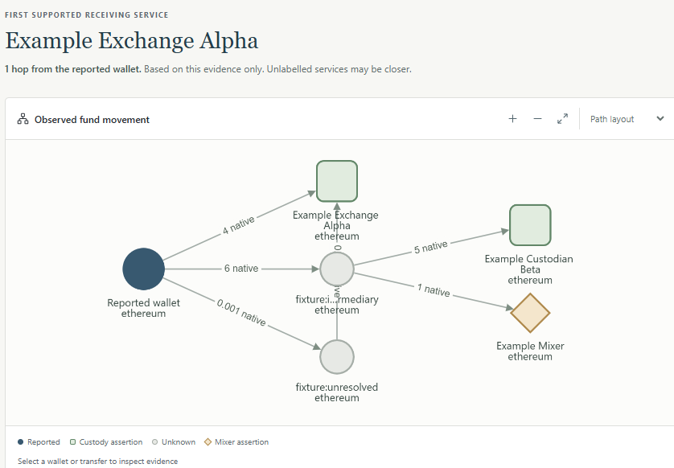

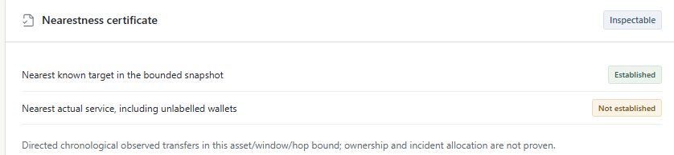
FEASIBILITY AND VIABILITY
ANANTHA
FEASIBILITY ANALYSIS
CURRENT PROTOTYPE
VIABILITY & CONTROLS
VERIFIED MVP
Existing MVP: synthetic custody case, not the new inference method
Risk | Control
Customer looks like deposit | Require corroboration; keep hypothesis
Wrong service seed | Source challenge and validity checks
Missing history | Abstain; show unexpanded branches
Operational access | Independent review; SAHYOG pending
Existing investigation workflow
Case workflow, temporal trace and replay.
Six parsers; uneven live chain coverage.
Real Bitcoin acquisition: no VASP found.
116 tests in the published MVP release.
New method evaluated separately.
REFERENCE EXPERIMENT
Synthetic rule checks only
Repeated sweeps and service gas motif.
Conflicts and missing history stop inference.
No real-world accuracy result.
Not integrated into the running MVP.
Independent deposit truth is required.
Validation before deployment
COST & DEPLOYMENT
1 Independent evaluation
Open-source core, explicit costs
Hide deposit labels; test time and wallet splits.
Measure precision, coverage and review time.
Public seeds offer limited coverage.
History indexing and API quotas add cost.
Cache and cap each investigation.
2 Guarded MVP integration
Calibrated scores need labelled cases.
Security and scale validation remain open.
Integrate only after false-match evaluation.
SAHYOG and agency deployment need approval.
Notes:
Status is split deliberately. Published MVP verification: 116 backend tests, frontend and browser workflow; newer foundation branch separately recorded 130 PostgreSQL checks. Real bounded Bitcoin acquisition retrieved two transactions/three outputs; no receiving VASP established. Six parser adapters are not six-chain live attribution validation. The new reference experiment is isolated from app code and live cases and uses synthetic fixtures. Its positive pattern remains a hypothesis even when every rule matches. An imitation case demonstrates the identifiability limit. The primary empirical evaluation still requires independently confirmed deposit roles and negative customer examples. Use chronological and wallet-family splits; hold out queried deposit labels. Compare exact-label-only, temporal exact-label tracing, sweep-only and corroborated inference under common data/budgets. Report false attributions, deposit-role precision, coverage, abstention, latency, calls and review time, with sample sizes and uncertainty. No figures are claimed for benefits yet. [5] https://www.usenix.org/system/files/usenixsecurity25-lubbertsen.pdf

Slide 5







IMPACT AND BENEFITS
ANANTHA
WHAT THE METHOD ADDS
Research proposal with explicit evaluation gates
Beyond labels
First custody
Testable
Deposit-role hypotheses
A bounded receiving-service decision
Independent accuracy and coverage
Known service wallets can support
new deposit-address candidates.
Private customer records stay off-chain.
Keep the first supported service per route.
Retain nearer unresolved candidates.
Missing identity limits the conclusion.
Hide deposit labels before evaluation.
Compare methods on the same cases.
Report false answers and abstention.
PRACTICAL INVESTIGATOR BENEFITS TO MEASURE
More candidates
Fewer false routes
Bounded API use
Reviewable evidence
Test deposit inference beyond
existing address labels.
Challenge a service link
before recipient selection.
Prioritise missing evidence
that could change the result.
Retain sources and assumptions
in a reproducible case package.
BASELINES AND THE PROPOSED RESEARCH CONTRIBUTION
Comparison | Exact-label tracing | Proposed inference | Evaluation requirement
Address role | Only pre-labelled service addresses | Sweeps plus service-operation evidence | Hold out deposit labels and test negatives
Chronology | Follow recorded transfers | Time-respecting first-custody search | Reject backward-time and broken links
Decision | Return reached known service | Candidate role, source challenge and gaps | Report precision, coverage and abstention
No measured accuracy or efficiency gain yet. New inference is experimental; official SAHYOG remains disconnected.
@SIH Idea submission- Template
5
Notes:
Differentiation hypothesis: add conservative deposit discovery to bounded first-custody search, source/heuristic challenge, query budgeting and replayable review. The ingredients are published methods; neither graph dashboards nor entity clustering alone are novel. Test whether the integration gives a better investigator outcome than simpler baselines. Customer identity and internal exchange ledgers remain outside public-chain observation. The service association at a hot wallet does not establish a preceding deposit role automatically. No automatic notice delivery or asset freeze occurs. The benefits shown are evaluation objectives, not measured improvements. A missing seed or ambiguous service must remain unknown.

Slide 6
RESEARCH AND REFERENCES
ANANTHA
Method / paper | Research finding | Proposed TraceSetu use | Primary reference
[1] Deposit-address inference | Forwarding patterns can reveal unlabelled deposit candidates. | Seeded sweep detection. One payment does not prove control. | Victor, Financial Cryptography 2020 Address Clustering Heuristics for Ethereum fc20.ifca.ai/preproceedings/31.pdf
[2] Service-operation patterns | Token sweeps and gas funding co-occur in an exchange case study. | Corroborate deposit hypotheses. Service-specific; needs validation. | Brechlin et al., IJNM 2025 Buy Crypto, Sell Privacy: Evonax doi.org/10.1002/nem.2325
[3] Bitcoin peel-chain expansion | Wallet fingerprints can restrict candidate change continuation. | Guarded Bitcoin extension, planned. Ambiguity stops cluster expansion. | Kappos et al., USENIX Security 2022 How to Peel a Million usenix.org/system/files/sec22-kappos.pdf
[4] Temporal graph paths | Static shortest paths can violate the order of recorded events. | Event-state search for minimum hops. Path validity is not wallet ownership. | Wu et al., PVLDB 2014 Path Problems in Temporal Graphs doi.org/10.14778/2732939.2732945
[5] Independent attribution evaluation | Address roles and flow coverage need independent service records. | Test deposit-role precision and coverage; never reuse seeds as truth. | Lubbertsen et al., USENIX Security 2025 Ghost Clusters USENIX Security 2025 paper (linked)
ADDITIONAL PRIMARY PAPERS AND OPEN RESOURCES
[6] Meiklejohn et al., IMC 2013
[7] Yousaf et al., USENIX 2019
[8] GraphSense and public TagPacks
[9] Weber et al., 2019: fraud classification is a different task
Notes:
Primary literature anchors and limitations. [1] Victor 2020, section 5.1 and Algorithm 1; use service deposit inference, not customer identity merging. Historical thresholds must not be copied as contemporary guarantees. [2] Brechlin, Schaefer and Armknecht 2025, section 5.1/Figure 4: one service-specific gas/sweep motif, not a universal rule; we do not collect exposed customer data. [3] Kappos et al. 2022, sections 5 and 7: conservative peel continuation; published FDR is not TraceSetu accuracy. [4] Wu et al. 2014, sections 2-5: temporal paths; define our hop objective separately from their weighted-distance definitions. [5] Ghost Clusters 2025, sections 3, 5-10: independent service data, role coverage, historical-label limitations. [6] Meiklejohn et al. 2013: identity anchors plus clustering and false super-cluster warning. [7] Yousaf et al. 2019: cross-ledger matches depend on service evidence, not time/amount alone. [8] GraphSense Public TagPacks provides sourced public assertions, not independent truth; review per-source rights and default against unvalidated cluster-wide propagation. [9] Weber et al. 2019 studies licit/illicit transaction classification, not exchange identity.
[1] https://fc20.ifca.ai/preproceedings/31.pdf
[2] https://doi.org/10.1002/nem.2325
[3] https://www.usenix.org/system/files/sec22-kappos.pdf
[4] https://www.vldb.org/pvldb/vol7/p721-wu.pdf
[5] https://www.usenix.org/system/files/usenixsecurity25-lubbertsen.pdf
[6] https://cseweb.ucsd.edu/~smeiklejohn/files/imc13.pdf
[7] https://www.usenix.org/system/files/sec19-yousaf_0.pdf
[8] https://github.com/graphsense/graphsense-tagpacks
[9] https://arxiv.org/abs/1908.02591

