Slide 1
MPOWER: A quantitative analysis
Team 10
Xiaozhuo Yu
Samuel Benedict
Robert Chen
Andrew Chen

Slide 2
Executive Summary

Slide 3
Background Information
In 2005, the WHO coordinated the ratification of the Framework Convention on Tobacco Control (FCTC) treaty and, in 2008, implemented 6 measures to reduce tobacco usage, abbreviated MPOWER.
Since then, they have collected biennial data on its member countries’ executions on its measures. We aim to examine its effectiveness.

Slide 4
Questions to solve
Is the impact of MPOWER measures consistent across the world?
What factors affect the effectiveness of MPOWER?

Slide 5
Main Findings
In general, good execution of MPOWER’s measures had a reliable depressive effect on tobacco sales
This effect is consistent when accounting for geographic location and GDP.
Our framework also allows for the identification of outliers such as Turkey, of which further qualitative analysis is needed

Slide 6
Technical Discussion

Slide 7
Datasets
We used the following provided datasets:
GHDX: Death rates per 100,000 due to smoking
ISS: Sales per day of tobacco product
We also used an external dataset:
MPOWER: WHO-recorded values estimating how well MPOWER policies were implemented

Slide 8
Overview
Feature Engineering: MPOWER entries were averaged to create an indicator for overall MPOWER policy adherence
Clustering: Groups of countries with similar geography / economics were clustered together
Analysis: Trends within country clusters were analyzed using causal inference with Bayesian structural time-series models

Slide 9
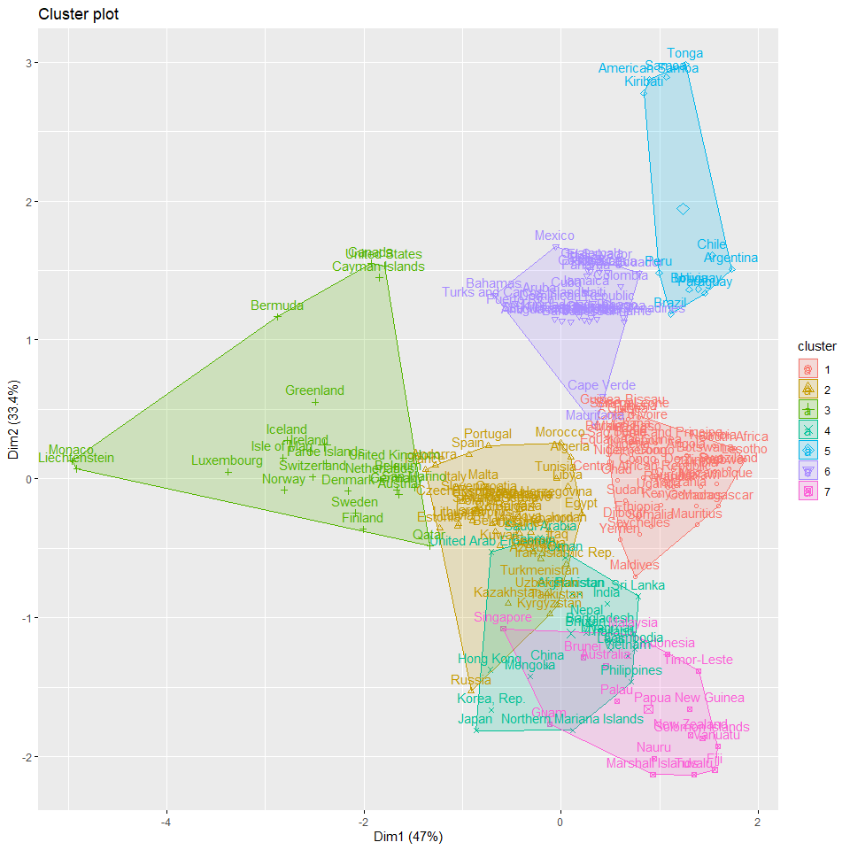
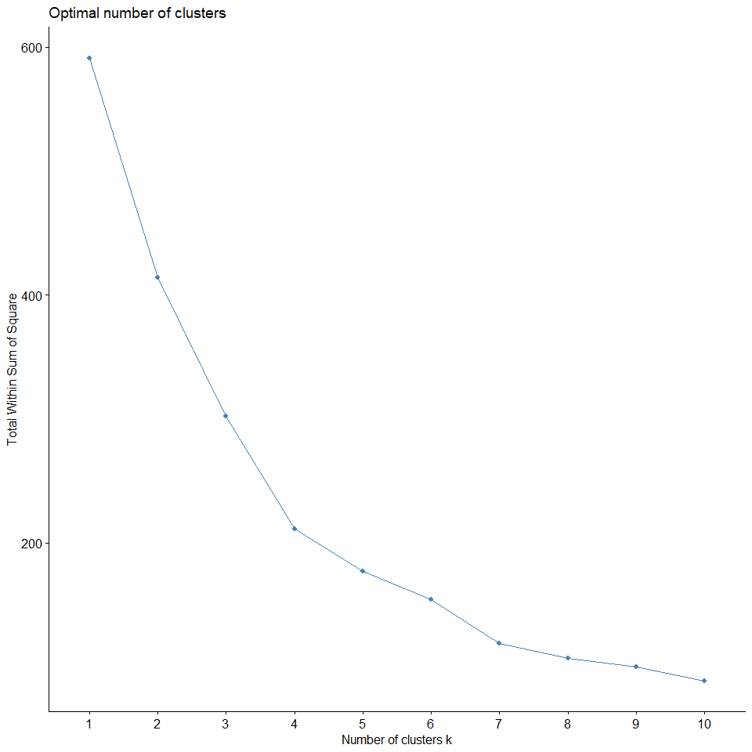
Clustering
Clustering was performed on three features:
Latitude
Longitude
GDP per capita
Cross validation tests revealed that the optimal number of clusters is 7

Slide 10
Findings

Slide 11
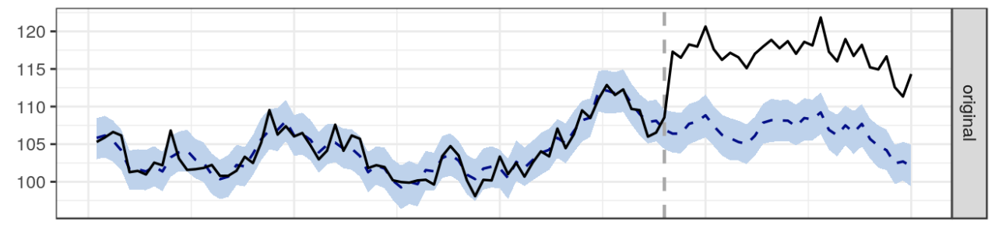
Cluster 1: Mauritius & Somalia (Sales)
Mauritius and Somalia have the highest and lowest MPOWER indexes respectively in Cluster 1.
A causal impact analysis suggests that in Cluster 1, MPOWER serves as a reliable indicator.
Tobacco sales vs Time:
Black: Mauritius
Dotted: Somalia

Slide 12
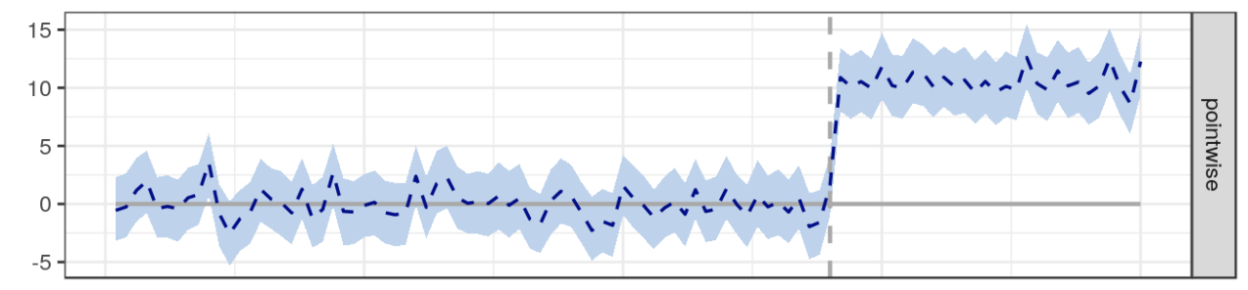
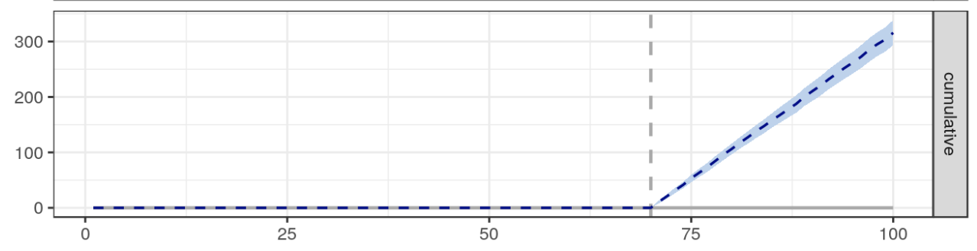
Cluster 1: Cont
Pointwise causal effect
Cumulative causal effect
As shown, there is a significant estimated causal effect

Slide 13
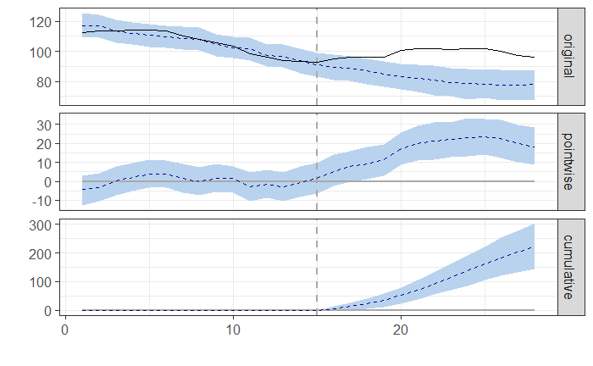
Cluster 7: Indonesia vs Thailand (Deaths)
Indonesia has highest MPOWER, Thailand has lowest.
MPOWER has a significant, although offset, effect on death rates as well.

Slide 14
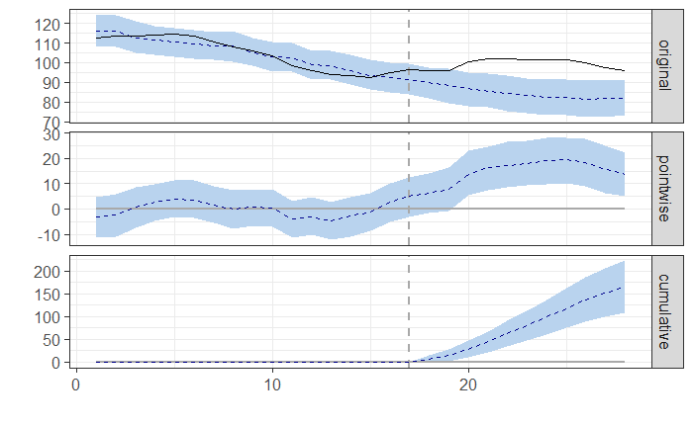
Outliers: Turkey & Iraq (Production)
Turkey has the strictest MPOWER implementation whereas Iraq has lowest
However, post-MPOWER policy implementation, Turkey tobacco production surged

Slide 15
Future Work
We were unable to explore other clusters in detail due to time constraints
Future work could involve clustering with respect to additional features and analyzing additional clusters

