Slide 1
INTELLIGENT DECISION ENGINE & DIGITAL TWIN
Visual Risk AI
AI-Based Visual Risk & Compliance Intelligence System
A deterministic mathematical simulation engine, autonomous circadian schedule planner, and multi-modal conversational copilot backed by MongoDB persistence.
Author: notysozu <lifegamer2050@gmail.com> | Platform: React 19 + FastAPI + MongoDB

Slide 2
PROBLEM STATEMENT & VALUE PROPOSITION
Executive Summary: The Mission of Visual Risk AI
THE PROBLEM
- Fragmented Life Telemetry
Health trackers, bank apps, and calendars operate in isolated silos without holistic risk awareness.
- Hidden Compounding Friction
A minor daily sleep reduction or impulse purchase cascades into 5-year compounding milestone delays.
- Static Unresponsive Tools
Traditional planners require tedious manual scheduling and fail to compensate for biological sleep debt or burnout.
- Lack of Stochastic Modeling
Spreadsheets assume linear outcomes, failing to model real-world market volatility and probabilistic risk.
THE VISUAL RISK AI SOLUTION
- Unified Digital Twin State
Real-time mathematical aggregation of biometrics, study sprints, cashflows, and long-term milestones.
- 500-Run Monte Carlo Engine
Geometric Brownian Motion simulation providing probabilistic percentile bounds (P10, P50, P90).
- Autonomous Circadian Planner
Auto-schedules daily focus blocks aligned with peak cortisol curves (08:30-11:30 AM) and sleep debt.
- 4-Stage Agentic Copilot
Conversational AI that computes mathematical tradeoffs and yields 1-click executable actions into MongoDB.

Slide 3
SYSTEM TOPOLOGY & INTEGRATION
End-to-End Multi-Tier System Architecture
Tier 1: Client Layer
React 19 + TypeScript + Vite
- Interactive Digital Twin Dashboard
- Visual Risk Copilot (/chat) with Voice STT
- Decision Sandbox with Dual Sliders
- Autonomous Planner with Timeline Visuals
- Habit Analytics with Correlation Graphs
Tier 2: Backend Gateway
FastAPI + Motor + Beanie ODM
- Asynchronous High-Throughput REST API
- Argon2id/Bcrypt + JWT & Rotating Cookies
- Token Family Theft & Replay Protection
- Unified Multi-Role Authentication
- Structured Pydantic v2 Request Validation
Tier 3: Intelligence Engine
Groq LLMs + NumPy Simulation
- 4-Stage Agentic Reasoning Pipeline
- 500-Trial Stochastic Monte Carlo Engine
- Circadian Cortisol & Alertness Modeler
- Dynamic Markdown Schedule Table Parser
- Groq 120B/20B/27B with Rule Fallback
Tier 4: Persistence Layer
MongoDB + Local Snapshot Store
- Beanie Document ODM Collections
- Embedded Messages for Atomic Dialogue
- Automatic Snapshotting on All Mutations
- data/mongodb_persistence.json Store
- Zero-Loss Session Recovery Across Logins

Slide 4
ADAPTIVE INTELLIGENCE & ROLE PERSONALIZATION
Target Personas & Dynamic Telemetry Profiles
COLLEGE STUDENT — Age 20 | Exam Readiness
Coursework mastery, study sprint planning, budget control, and consistent sleep cutoff.
WORKING PROFESSIONAL — Age 29 | Senior Promotion
Deep work focus sprints, career velocity, liquid portfolio growth, and burnout prevention.
FREELANCER / CREATOR — Age 26 | Revenue Smoothing
Irregular cashflow buffering, client milestone time-boxing, and vitality recovery.
ENTREPRENEUR / FOUNDER — Age 32 | Venture Scaling
Cash runway optimization, investor pitch sprint scheduling, and high-stress resilience.
ACTIVE RETIREE — Age 62 | Capital Preservation
Stochastic longevity modeling, health maintenance, estate planning, and lifestyle vitality.

Slide 5
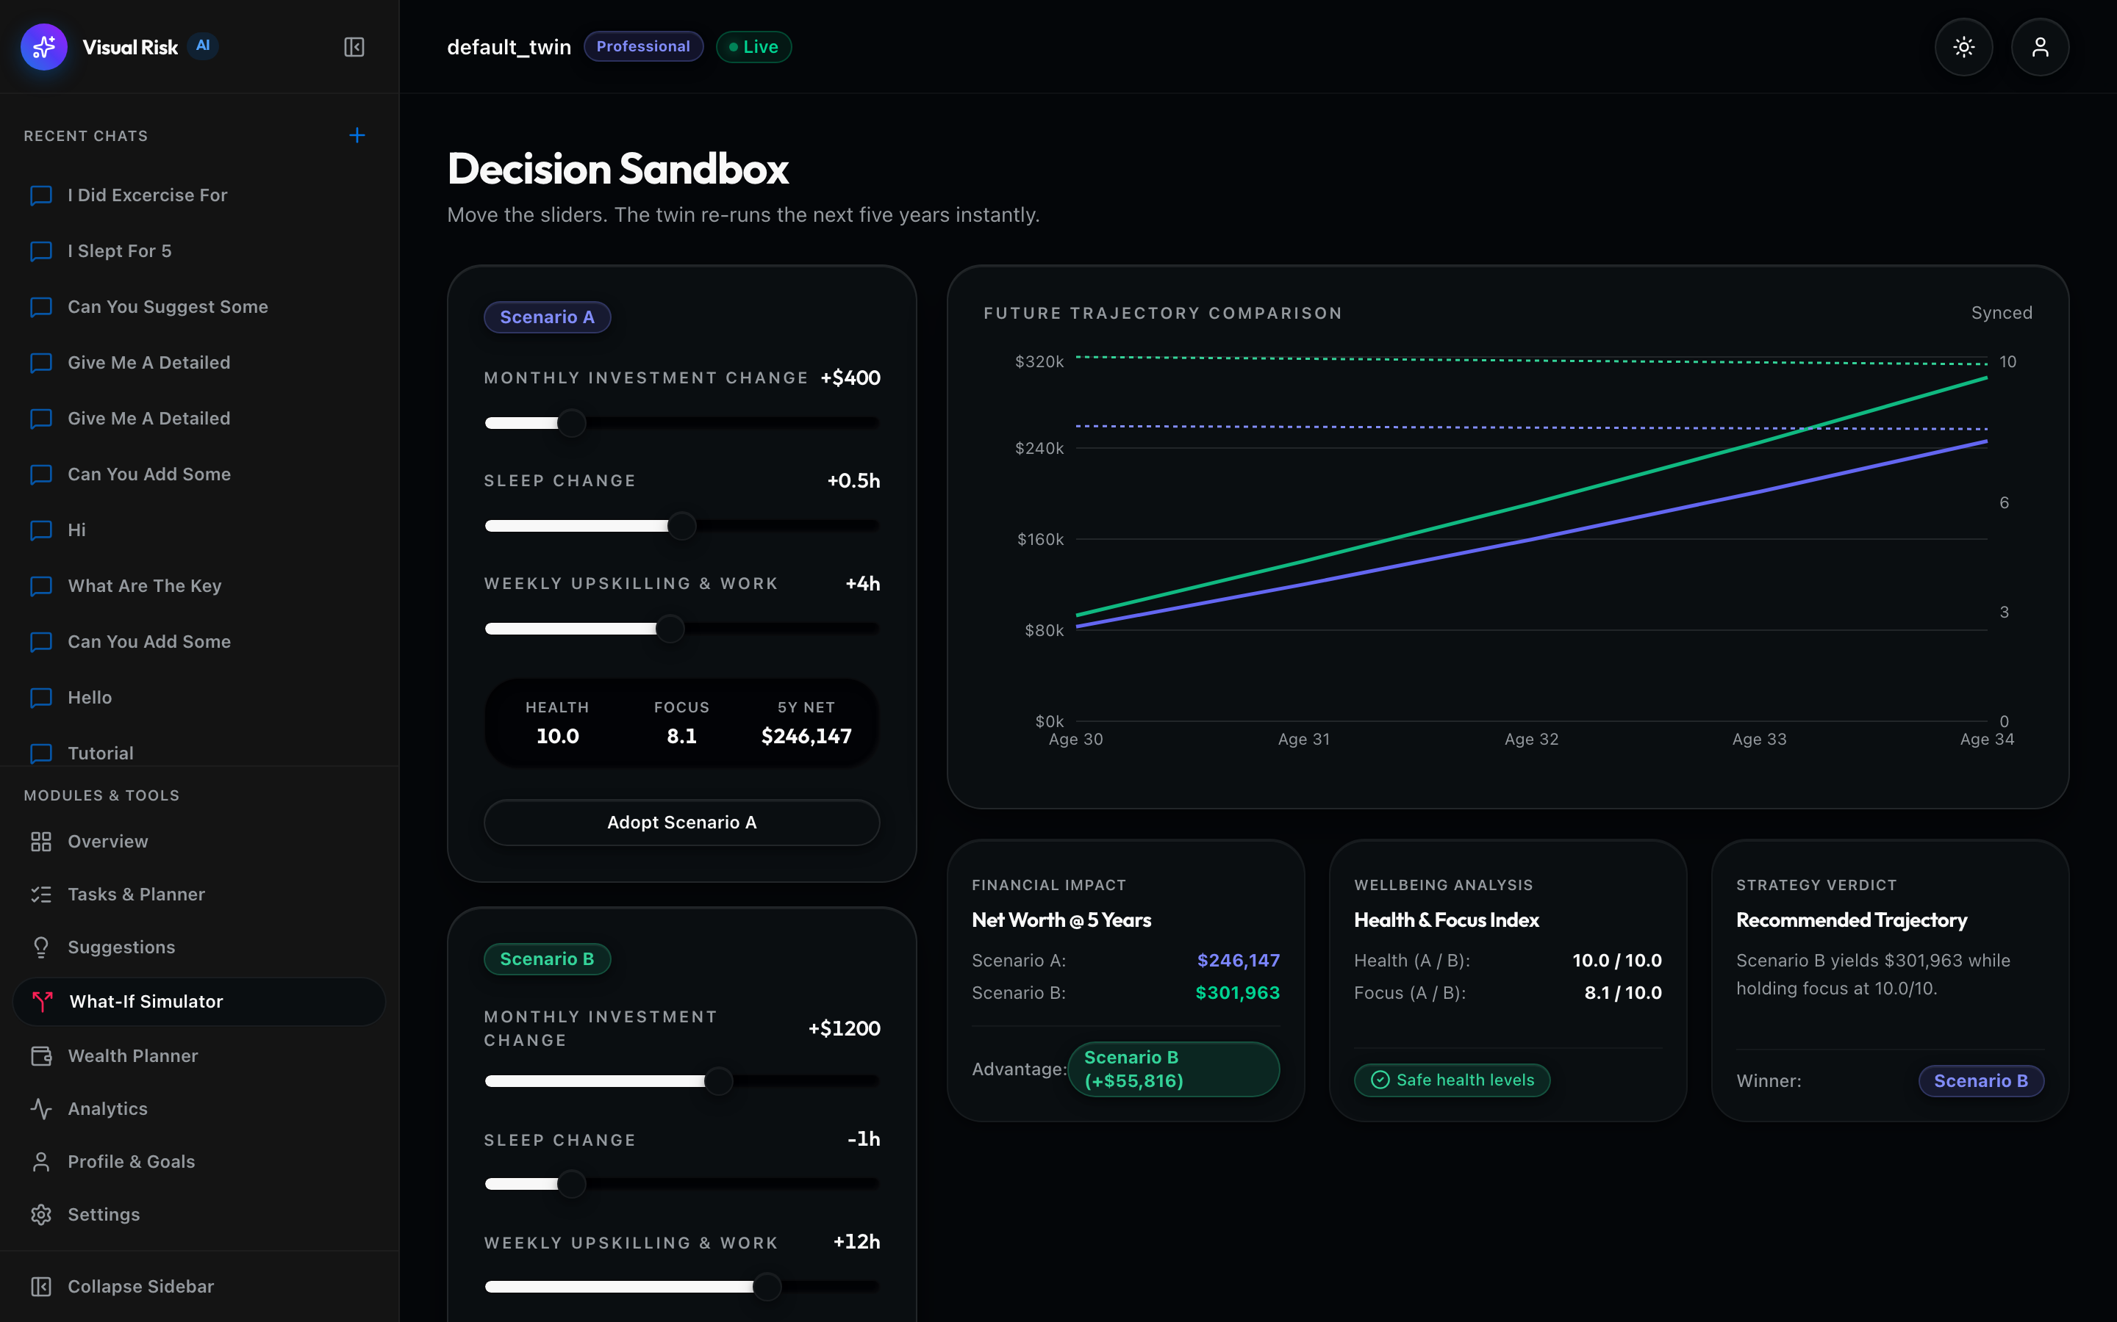
STRESS-TESTING & BIOLOGICAL FEEDBACK
Decision Sandbox: Real-Time What-If Tradeoff Engine
DUAL SCENARIO STRESS-TESTING
- Scenario A vs Scenario B
Compares live baseline against simulated adjustments across Sleep, Study, and Monthly Savings.
- Non-Linear Vitality Modeling
Reductions in sleep below baseline invoke an exponential penalty on daytime cognitive focus.
- Compound Capital Opportunity Cost
Models monthly savings deltas compounded at 8% CAGR over 1, 3, and 5-year investment horizons.
- 1-Click Scenario Preset Adoption
Seamlessly commits validated What-If scenario presets into MongoDB UserDoc profile settings.

Slide 6
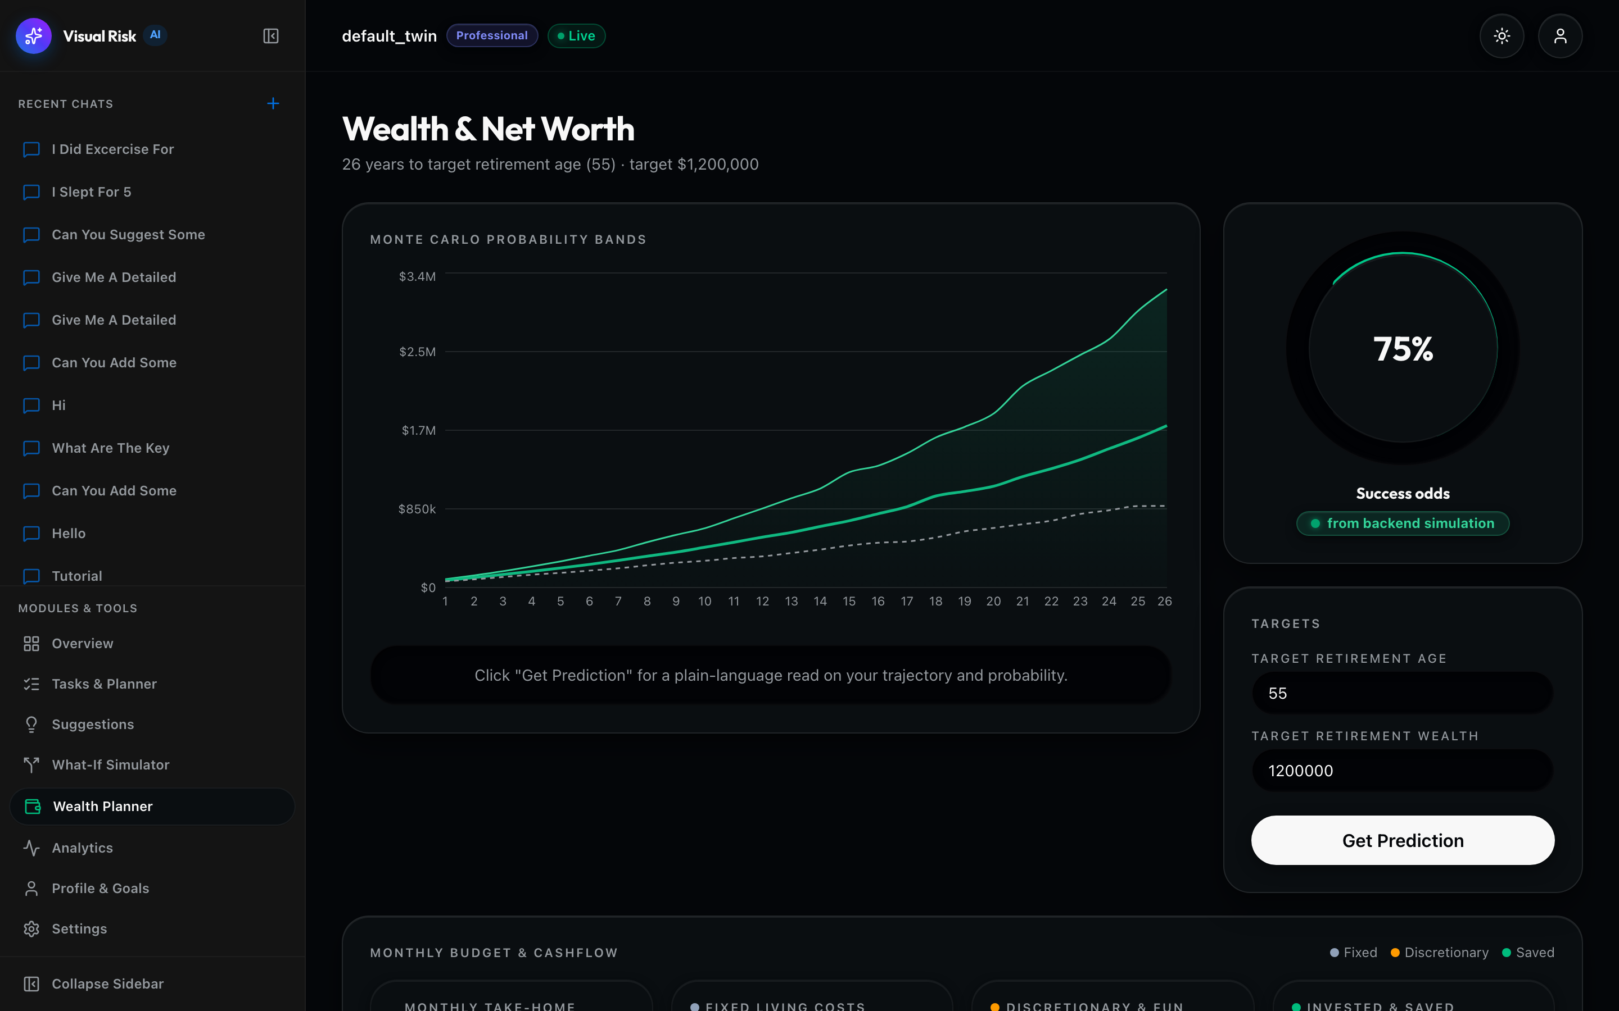
FINANCIAL ENGINE & PROBABILISTIC ROADMAP
Stochastic Wealth Planner: 500-Run Monte Carlo Simulation
GEOMETRIC BROWNIAN MOTION (GBM)
- 500 Stochastic Simulation Paths
Simulates annual portfolio drift and market volatility across 500 distinct trials to target retirement age.
- Percentile Bounds (P10, P50, P90)
Computes realistic worst-case floor (10th percentile), median trajectory (50th), and optimistic upside (90th).
- Goal Attainment Probability
Calculates exact percentage confidence score of exceeding net worth target by goal age.
- Deterministic vs Stochastic Comparison
Exposes variance risk between static linear savings models and market volatility reality.

Slide 7
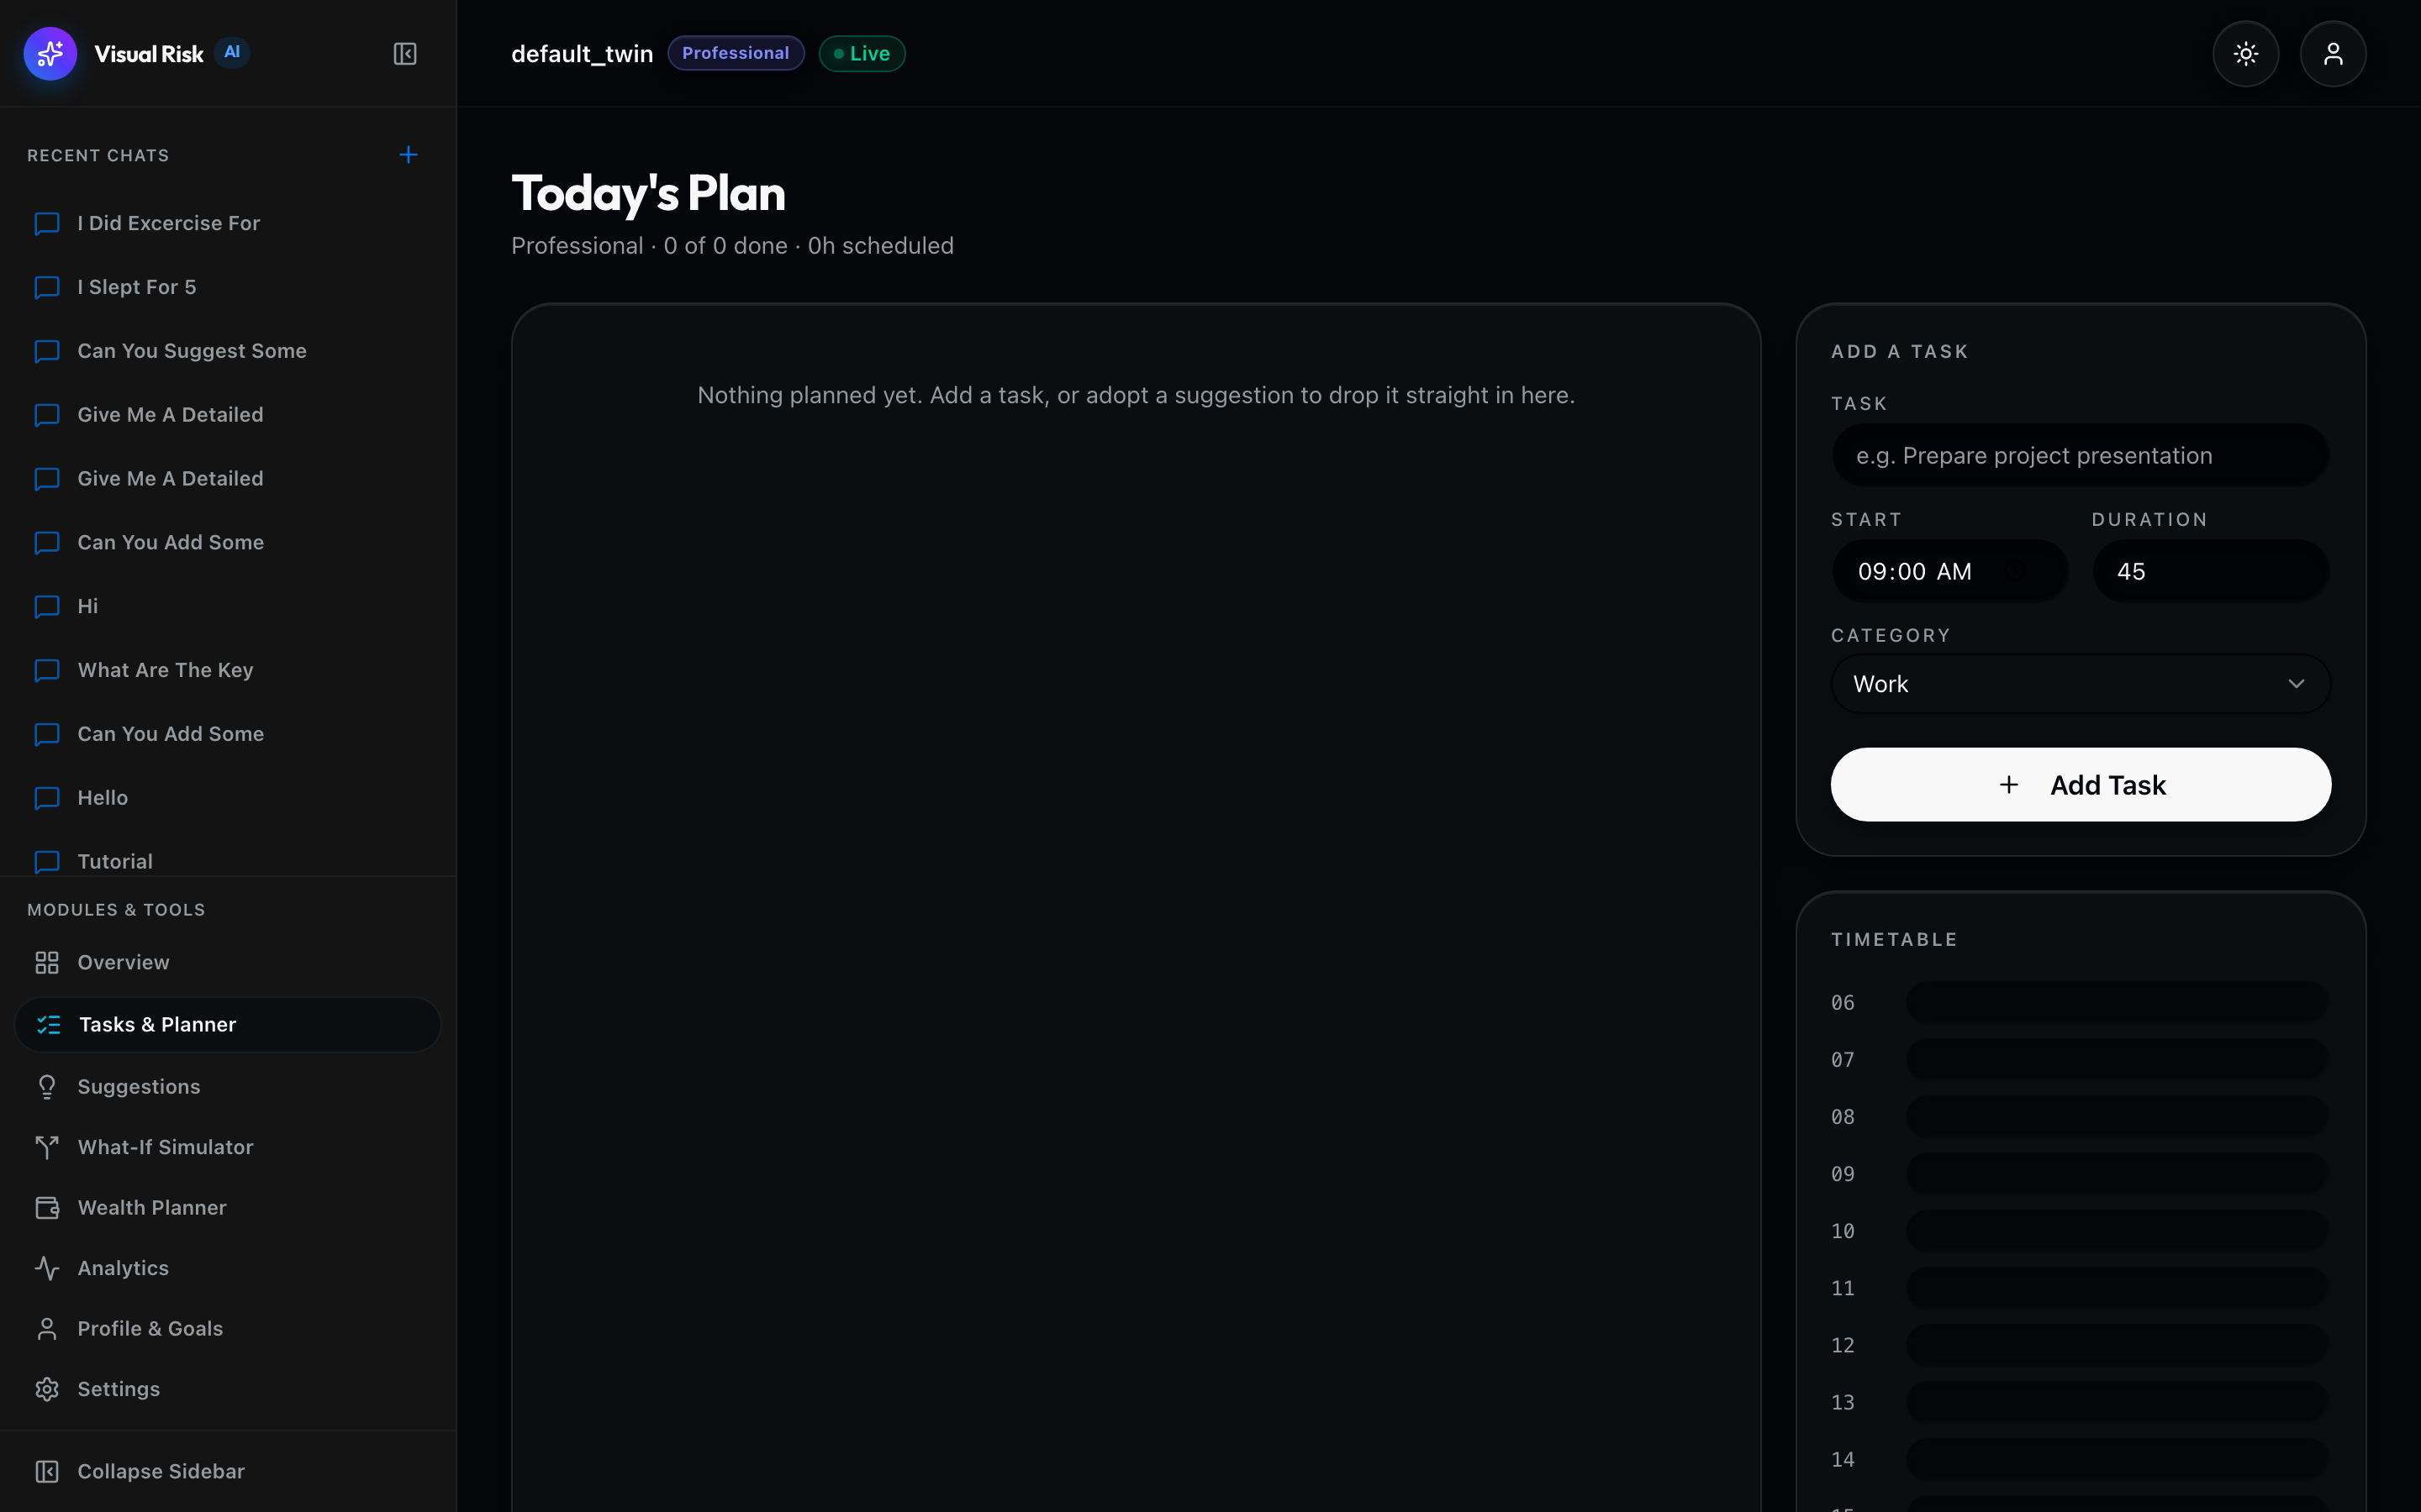
CIRCADIAN FOCUS ALIGNMENT & TASK SYNTHESIS
Autonomous Circadian Daily Planner & Governance
CIRCADIAN TIME-BLOCKING ENGINE
- Peak Cortisol Alignment (08:30-11:30)
Automatically places deep work and difficult academic coursework into prime cognitive focus windows.
- Sleep Debt Compensation
Dynamically evaluates 7-day rolling sleep debt; lightens sprint density on sleep-deprived mornings to prevent burnout.
- 3-Tier Autonomy Governance
Supervised (Manual approval required), Semi-Autonomous (Auto-executes safe tasks), Full-Autonomous (Proactive scheduling).
- Morning AI Briefings
Synthesizes contextual daily briefings with scheduled focus blocks and biometric readiness scores.

Slide 8
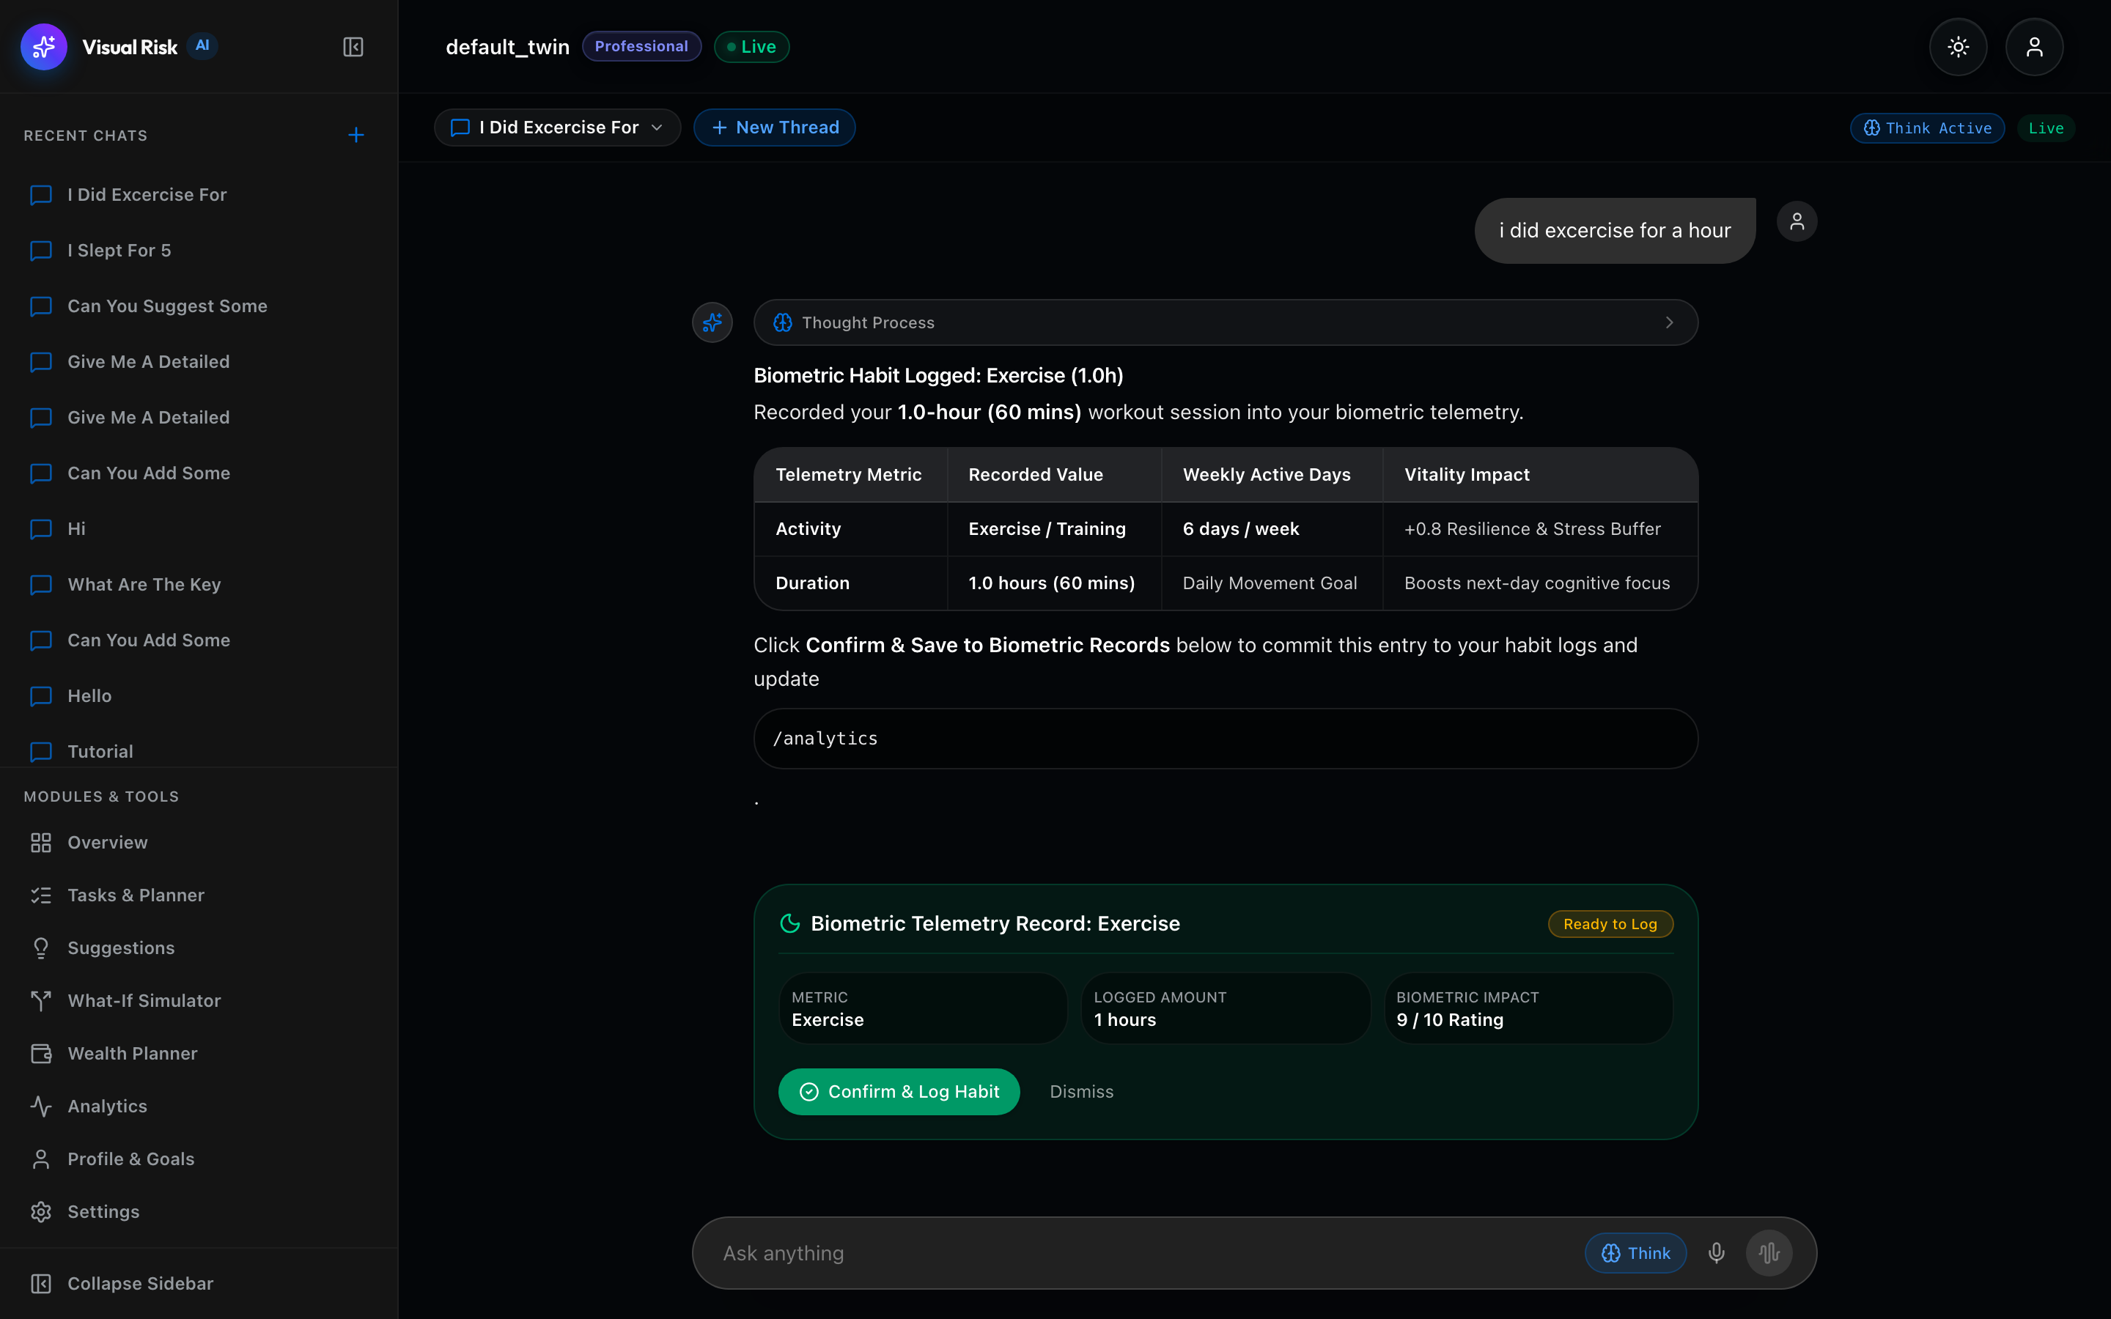
MULTI-MODAL CONVERSATIONAL INTELLIGENCE
Visual Risk Copilot: 4-Stage Agentic Reasoning
4-STAGE REASONING PIPELINE
- Step 1: Goal Definition
Decomposes user inquiry into explicit optimization targets and friction domains.
- Step 2: Telemetry Gathering
Queries MongoDB for live habit records, study logs, cashflow surplus, and goal progress.
- Step 3: Multi-Criteria Analysis
Evaluates biological elasticity, circadian cortisol curves, and stochastic forecasts.
- Step 4: Strategic Plan & Action Card
Generates reasoning tree (<think>), markdown table, and 1-click executable action proposal.

Slide 9
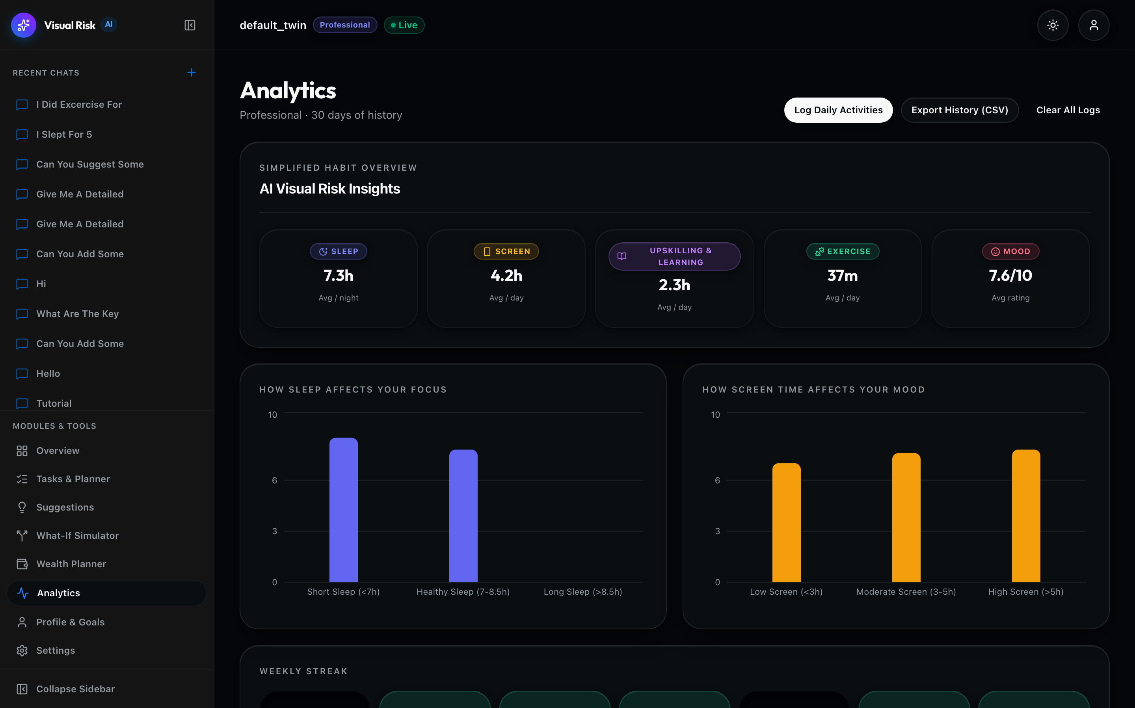
BIOMETRIC TELEMETRY & PATTERN RECOGNITION
Habit Analytics & Predictive Correlation Modeling
ANALYTICS CAPABILITIES
- Grouped Correlation Analysis
Models cross-impact between Sleep Duration, Screen Time, Exercise Frequency, and Focus Scores.
- Automated 12:00 PM Reflection
Daily noon cron that synthesizes 24-hour retrospective insights cached in MongoDB AppCache.
- Vitality & Focus Elasticity
Quantifies marginal focus gains per additional hour of sleep or reduction in late-night screen time.
- Habit Consistency Tracking
30-day historical time series visualization with dynamic trend lines and standard deviation bands.

Slide 10
SPACED REPETITION & EXAM FORECASTING
Academic & Coursework Productivity Intelligence
7-Day Pomodoro Sprints
AI Study Plan Synthesis
- Synthesizes customized 7-day revision timetables based on active enrolled courses.
- Allocates 45-min Pomodoro sprints with 15-min cognitive recovery intervals.
- Prioritizes high-weight and under-studied subjects automatically.
Spaced Repetition Engine
Memory Decay Mitigation
- Applies Ebbinghaus forgetting curve intervals to reinforce key syllabus concepts.
- Tracks focus ratings per study session to identify cognitive fatigue thresholds.
- Logs coursework hours into MongoDB StudyRecordDoc collections.
Exam Score Forecaster
Probabilistic Grade Modeling
- Predicts expected exam performance and variance based on cumulative study hours.
- Visualizes readiness radar across core modules and topics.
- Provides 1-click study sprint scheduling into the Daily Planner.

Slide 11
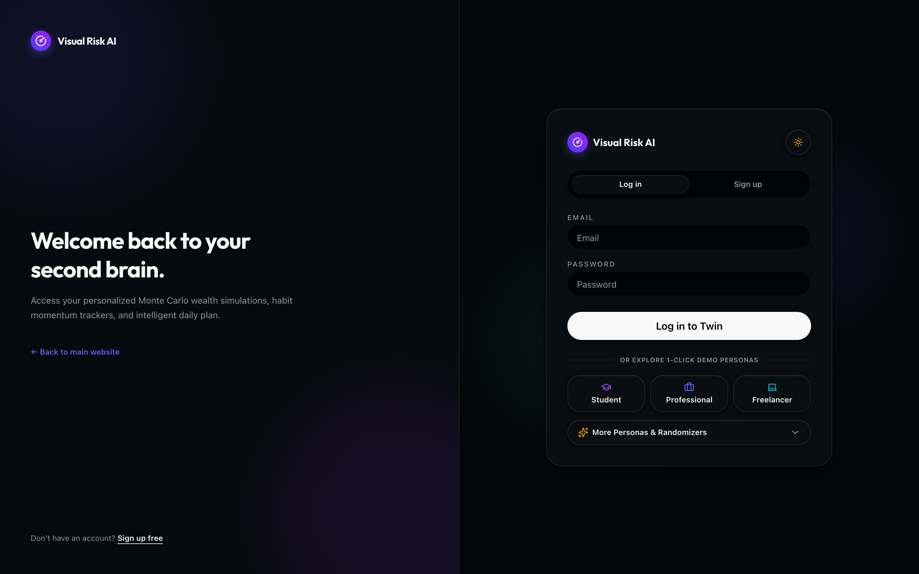
ZERO-TRUST SECURITY & TOKEN GOVERNANCE
Multi-Session Authentication & Cryptographic Security
CRYPTOGRAPHIC PROTOCOLS
- Stateless JWT + Rotating Refresh Cookies
Short-lived access tokens (15 mins) paired with HttpOnly SameSite rotating refresh cookies (7 days).
- Token Family Theft Detection
Maintains token family trees in MongoDB. If a revoked token is re-submitted, the entire family is revoked immediately.
- Argon2id & Bcrypt Password Hashing
Cryptographically secure password hashing with cost factor 12 and salt isolation.
- Enumeration-Safe Generic Auth
Consistent generic error responses prevent account enumeration on login and password recovery.
- Single-Use Random Recovery Tokens
Cryptographically generated 48-byte URL-safe tokens with strict TTL expiration.

Slide 12
DATA DURABILITY & EMBEDDED ENGINE
MongoDB Document Architecture & Disk Persistence
BEANIE DOCUMENT COLLECTIONS
- UserDoc: Profiles, targets, net worth, tasks_json, autonomy_mode, and slider presets.
- ChatSessionDoc: Conversational threads with embedded ChatMessageDoc lists for atomic fetch.
- HabitRecordDoc: Biometric sleep, screen time, exercise, and daily vitality logs.
- StudyRecordDoc: Academic coursework, focus ratings, and subject sprint logs.
- FinancialRecordDoc: Income and expense transactions categorized for cashflow analysis.
- UserSuggestionDoc: AI-generated recommendations with adoption states and impact scores.
LOCAL SNAPSHOT PERSISTENCE ENGINE
- Synchronous Mutation Sync
Every database write operation automatically triggers save_persistence_snapshot().
- Atomic Temporary File Swap
Writes to data/mongodb_persistence.json.tmp before atomic OS replace to eliminate corruption.
- Lossless Session Recovery
Tutorial threads, user custom chats, and action states are completely preserved across logins and reboots.
- Embedded Engine Fallback
Allows 100% offline standalone operation with zero external cloud dependencies.

Slide 13
100% PASS RATE & RIGOROUS VERIFICATION
Quality Assurance, Testing & Automated Verification
21 / 21 Tests Passing
Pytest Suite (100%)
Comprehensive test coverage spanning mathematical simulation formulas, Pydantic schemas, auto-planner algorithms, and multi-turn table parsers.
0 Build Errors
TypeScript + Vite
Clean frontend compilation across React 19, Radix UI primitives, Lucide icons, and Tailwind styling with zero type warnings.
Lossless Rehydration
End-to-End Verified
Full lifecycle verification across user registration, message appending, disk snapshotting, in-memory purging, and persistent rehydration.
Multi-Persona Integrity
5 Personas Calibrated
Realistic 30-day telemetry baselines and tailored suggestions verified for Student, Professional, Freelancer, Founder, and Retiree.

Slide 14
PROJECT IMPACT & NEXT-GENERATION CAPABILITIES
Key Innovation Highlights & Future Roadmap
CORE INNOVATION HIGHLIGHTS
- Deterministic & Stochastic Fusion
Combines linear biological feedback modeling with 500-run Monte Carlo stochastic uncertainty.
- Autonomous Circadian Orchestration
Transitions productivity from static calendars to intelligent, sleep-debt-aware schedule synthesis.
- Agentic Reasoning with 1-Click Execution
Eliminates conversational dead-ends by turning AI reasoning directly into database mutations.
- Zero-Data-Loss Embedded Durability
Delivers enterprise-grade reliability with JSON disk snapshots and MongoDB Beanie ODM.
FUTURE PRODUCT ROADMAP
- Wearable Biometric Sensor Sync
Direct real-time Bluetooth and API synchronization with Apple Watch, Oura, and Garmin devices.
- Multi-Agent Collaborative Simulations
Simulating multi-party financial negotiations, corporate risk modeling, and team sprints.
- On-Device Local Neural Inference
WebGPU-accelerated local SLMs for zero-latency private biometric analysis.
- Automated Banking & Open Banking Ingestion
Plaid API integration for real-time transaction reconciliation and spending categorization.

Slide 15
THANK YOU
Visual Risk AI
Empowering Intelligent Decisions Through Mathematical Simulation & Circadian AI
Project Repository: AI-Based-Visual-Risk-and-Compliance-Intelligence-System Author & Maintainer: notysozu <lifegamer2050@gmail.com> Core Stack: React 19, FastAPI, Motor/Beanie, MongoDB, NumPy, Groq API

