Slide 1
PROJECT PROPOSAL
Dengue Outbreak
Risk Prediction
Predicting subzone-level dengue cluster risk 2 weeks ahead
using Singapore government open data — NEA, LTA & SingStat
330+
7 yrs
100%
SG Subzones scored
Real cluster data
Gov open data
CS611 MLE — Group Project | Week 6 Proposal

Slide 2
The business problem
01
⚠
Reactive, not proactive
35,000+
NEA declares clusters only after cases accumulate. Fogging teams are deployed too late — the outbreak is already spreading.
dengue cases
in Singapore
2020 alone
🦟
Mosquito breeding cycle = 2 weeks
Aedes aegypti eggs hatch in 7–14 days. A 2-week advance prediction window is exactly what's needed to intervene before transmission.
Largest outbreak
in recorded history
🎯
The opportunity
MAS mandates
proactive pest mgmt
Predict which subzones will have active clusters in the next 14 days — so NEA or pest control operators can pre-deploy fogging teams proactively.
$8.6B economic
cost (WHO est.)
Goal: Predict dengue cluster risk per subzone for the next 14 days — enabling proactive fogging deployment before the outbreak forms.
CS611 MLE — Group Project | Business Problem

Slide 3
The dataset
02
ANCHOR
AUXILIARY 1
SGCharts Dengue Cluster Snapshots
NEA Weather API
May 2013 → Nov 2020 · 250+ bi-weekly snapshots · Community-maintained CSV
Real-time + historical · Free government API
• Lat/long cluster boundaries + case counts per snapshot
• Rainfall, temperature, humidity by weather station
• 7 years of real spatial cluster data
• 2-week rainfall lag = strongest dengue predictor (mosquito breeding)
• Covers 2020 record outbreak (35k+ cases) — key drift event
• Rolling 4-week temperature mean as secondary feature
• Treated as primary training signal: cluster present/absent per subzone per week
AUXILIARY 2
LABEL (Proxy)
LTA MRT Tap Volumes + SingStat Population
Synthetic Subzone Grid + Binary Label
LTA DataMall API · data.gov.sg
Documented assumption — fully transparent
• Nearby MRT tap-in/out as neighbourhood activity proxy
• 330 SG subzones gridded from URA planning boundaries
• SingStat subzone population density — exposure risk weighting
• Label: cluster present in subzone in next 14 days (1/0)
• OneMap API: geocode subzones, compute spatial proximity features
• Derived from SGCharts cluster coordinates + spatial join
✓ Follows prof's formula: real anchor (SGCharts) + real auxiliaries (NEA, LTA, SingStat) + synthetic labels only where no public data exists
CS611 MLE — Group Project | The Dataset

Slide 4
Users and how they use the system
03
🏛
NEA Operations Team
When
Receives
Action
Weekly — every Monday morning
Risk map: 330 subzones colour-coded Low/Med/High for coming 14 days
Pre-deploy fogging teams to High-risk subzones before clusters form
ℹ Primary user — system built for their operational planning cycle
🐛
Pest Control Operators
When
Receives
Action
Weekly — before scheduling fogging rounds
Ranked list of high-risk subzones with confidence scores
Prioritise fogging contracts, allocate teams to predicted hotspots
ℹ Secondary user — commercial pest control companies (Rentokil, PestBusters)
📊
Data / Ops Team
When
Receives
Action
Ongoing — weekly monitoring
Model performance dashboard: precision, recall, drift alerts
Reviews weekly prediction quality; triggers retraining when Gini drops
ℹ Internal tooling only — monitors pipeline health
CS611 MLE — Group Project | Users & System Use

Slide 5
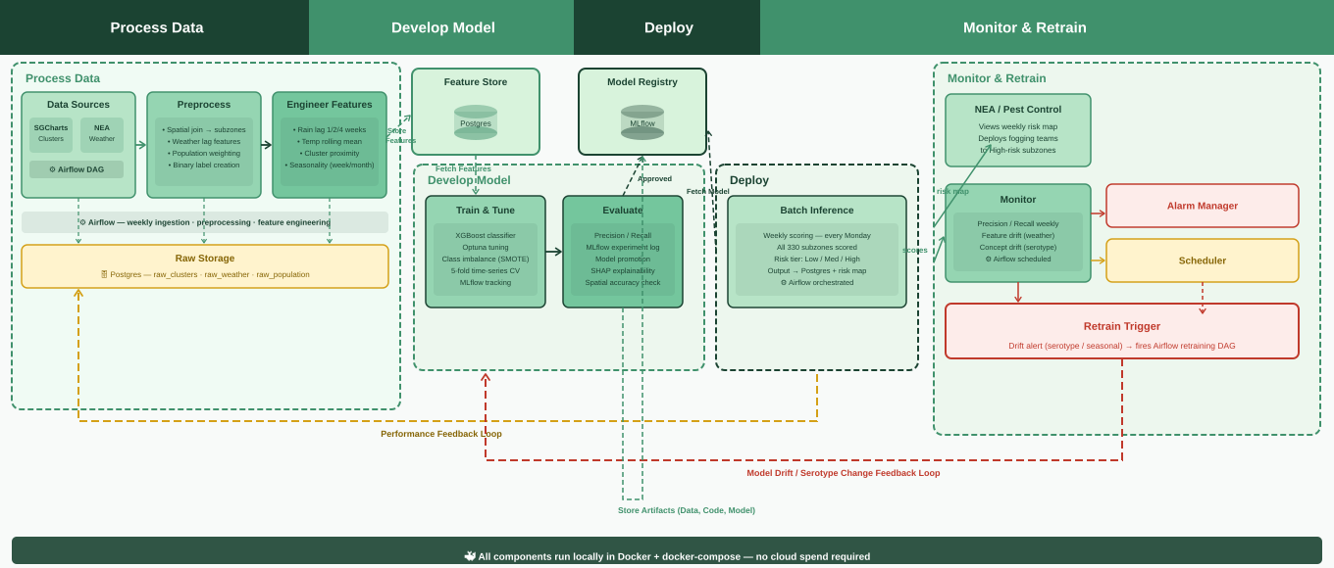
High-level architecture
04
CS611 MLE — Group Project | Architecture

Slide 6
Process Data
Develop Model
Deploy
Monitor & Retrain
Process Data
Feature Store (Gold)
Model Registry
Monitor & Retrain
Data Sources
NEA / Pest Control
SGCharts
Clusters
NEA
Weather
• Views weekly risk map
Postgres
MLflow
• Deploys fogging teams
Fetch Model
• High-risk subzones
⚙ Airflow DAG
Fetch Features
Model
Approved
Develop Model
Deploy
Monitor
Alarm Manager
Medallion Architecture
Train & Tune
Evaluate
risk tiers
Batch Inference
• Precision/Recall weekly
🥉 Bronze
🥈 Silver
🥇 Gold
• XGBoost
• Precision/Recall
• Weekly (Monday)
• Feature drift (weather)
• Concept drift (serotype)
Scheduler
• Optuna HPT
• MLflow log
• 330 subzones
Store Features
(Gold)
• ⚙ Airflow scheduled
Raw Integration
Filtered & Cleaned
Feature Store
• 5-fold TS CV
• Promotion
• Low/Med/High
• Lineage tracker
scores
• Raw ingest
• Schema enforced
• Lag features
• SMOTE
• SHAP
• → Postgres map
Retrain Trigger
• No schema
• Nulls handled
• Spatial join
• MLflow
• Spatial acc.
• ⚙ Airflow
Drift alert (serotype / seasonal) → fires Airflow retraining DAG
• Landing zone
• Joined tables
• ML-ready
⚙ Airflow — weekly ingest · preprocess · feature engineering
Raw Storage (Bronze)
🗄 Postgres — raw_clusters · raw_weather · raw_population
Store Artifacts (Data, Code, Model)
Performance Feedback Loop
Model Drift / Serotype Change Feedback Loop
🐳 All components containerised via Docker + docker-compose — runs fully locally · deployable to any cloud with same tooling

Slide 7
Design choices & open questions
05
Design choices — rationale
Open questions — seeking feedback
Batch over real-time inference
?
SGCharts data ends 2020 — how to handle post-2020?
NEA plans fogging schedules weekly — not in milliseconds. Batch is operationally correct.
Option A: train on 2013–2020 and demo drift. Option B: synthesise 2021–2025 using published NEA yearly totals.
XGBoost over deep learning
?
Subzone vs planning area granularity?
Tabular spatial + temporal data; interpretable for public health reporting; faster iteration.
330 subzones is fine-grained but sparse. 55 planning areas is coarser but data-rich. Which level for prediction?
Time-series cross-validation
?
Precision vs Recall tradeoff?
Standard k-fold leaks future data into training — temporal CV prevents data leakage.
False negatives (missed outbreaks) are costly. Should we optimise recall at cost of precision — over-deploying fogging teams?
Weekly cadence tied to Airflow
?
Google Popular Times as auxiliary footfall signal?
Mosquito breeding cycle is 7–14 days. Weekly prediction matches the intervention window.
Adds mobility context. But scraping ToS may be an issue. Worth pursuing or too risky for a course project?
CS611 MLE — Group Project | Design Choices & Open Questions

