Slide 1







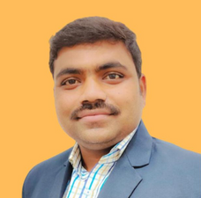
The Team
Member Picture
GiGoIndia
Member Picture
Team Leader Picture
Sagar Shinde
Team Leader
CEO
Aman Uchitkar
CTO
Sangmeshwar Gurushete
COO
Empowering India's Informal Workforce
Member Picture
Mentor/ Guide Picture
JAYRAJ GAVDE
CMO
Dr. Navin Khandare
Guide / Mentor

Slide 2
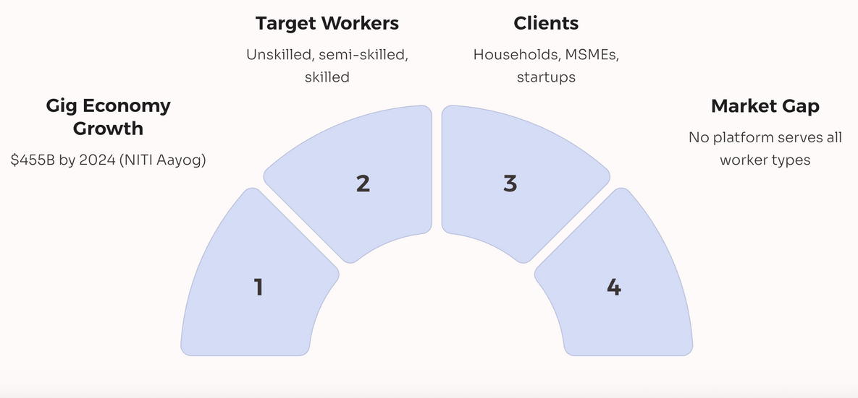
The Problem Identified / Problem Statement
Problem
Market size & Workforce
450 million unorganized workers
(unskilled, semi-skilled, and skilled)
Lack of Accessible Jobs for Unskilled and Semi-Skilled Workers
Exploitation by Middlemen and Contractors
Absence of a Tech Platform for the Informal Workforce
No Assured Minimum Wage or Work Transparency
Limited Flexibility for Workers and Employers
High Unemployment in Semi-Urban and Rural Areas
Lack of Verified, On-Demand Manpower for Employers
Underutilization of India’s Gig Economy Potential
in India:-

Slide 3
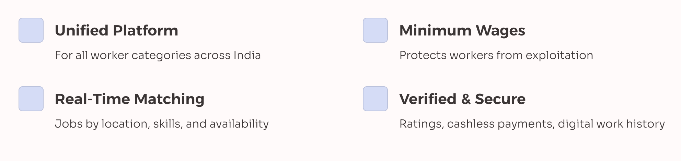
The Solution / Idea
GiGoIndia- “Empowering India's Informal Workforce”
Financial Empowerment & Digital Inclusion
Integrated Skill Development schemes (skill india mission, etc)
Multilingual Support & Offline Assistance
1. Bridges the massive unemployment & underemployment gap f
or India's 90%+ informal workforce.
3. Government scheme-friendly—
aligns with Digital India, Skill India, and ASIIM initiatives.
4. Adapts global gig principles for India’s vast informal economy with added social impact.

Slide 4
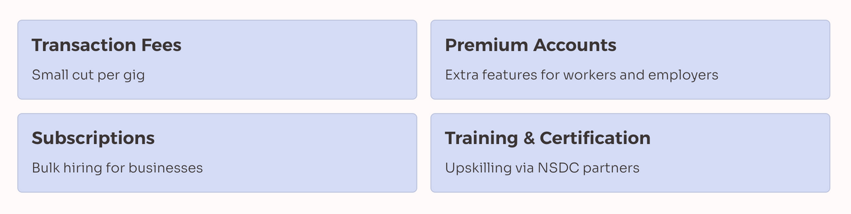
Target Customers and Revenue Model
Target Audiance
Business Model
1. Job Seekers (Workers)
Unskilled: Laborers, helpers, domestic workers.
Semi-skilled: Drivers, electricians, delivery agents.
Skilled: Carpenters, masons, technicians, freelancers.
Students: Looking for part-time or gig-based jobs.
Women: Housewives seeking local, flexible work.
2. Job Providers (Employers)
Households: Domestic help, tutors, repair services.
SMEs & Startups: Temporary staff, delivery, logistics.
Construction Firms: Daily wage workers, masons, cleaners.
Events & Hospitality: Waiters, decorators, support staff.
E-commerce/Logistics: Delivery boys, warehouse workers.
3. Institutions
Government/NGOs: Employment, skilling, and livelihood programs.

