Slide 1
Netflix Database ETL & Analytics Project
Nouf Yahya
Portfolio Project
From Raw Data to Strategic Insights

Slide 2
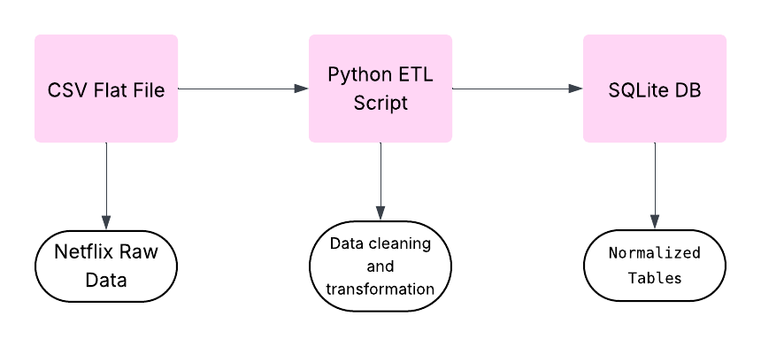
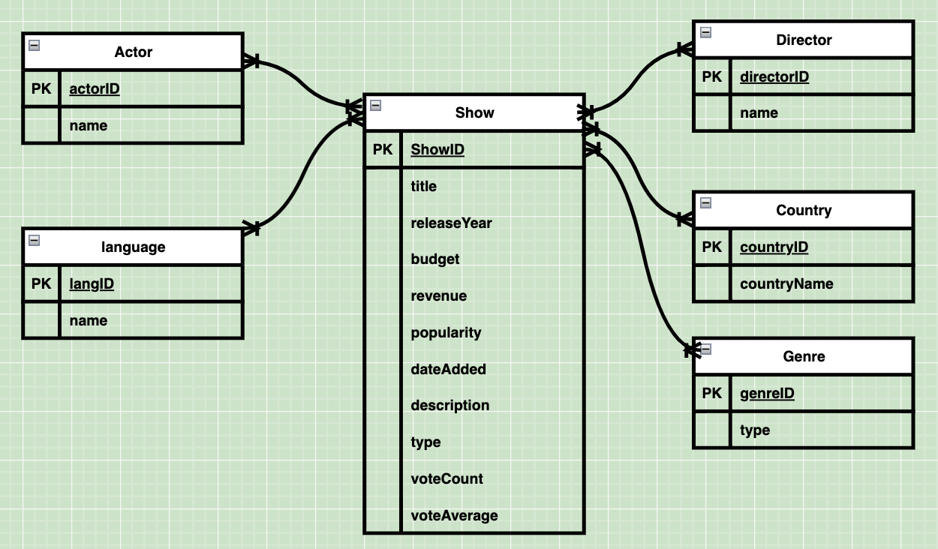
The Process
Problem: Flat and messy CSV file.
Solution: clean data and ready SQL DB to draw insights and help the buzniess.
Method: designed an ETL pipeline.

Slide 3
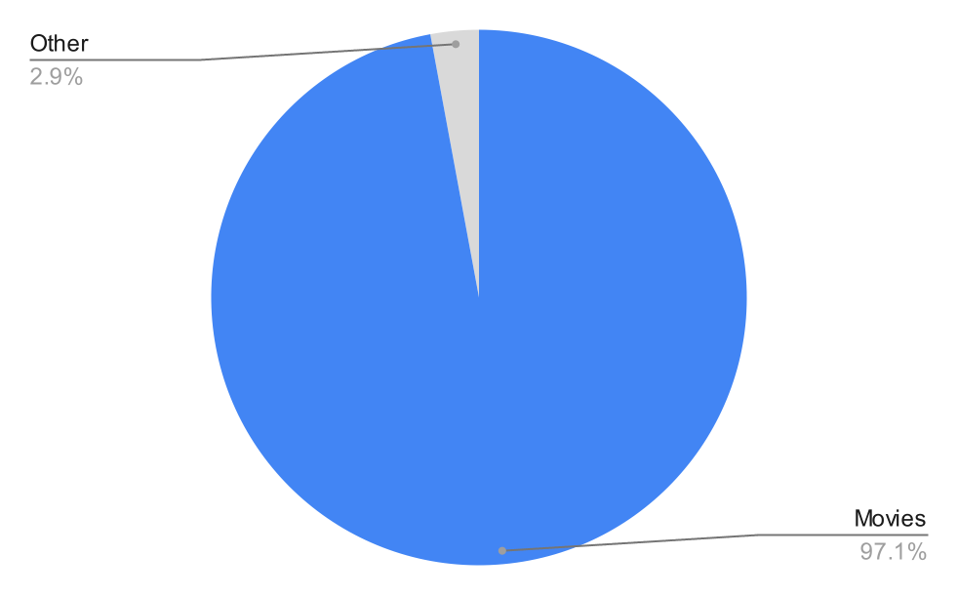
Movie vs others
Movies represent almost all the dataset

Slide 4
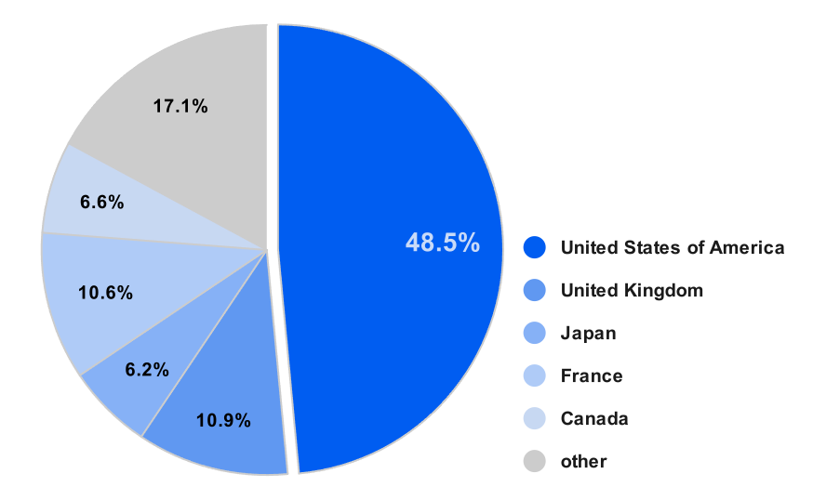
America produced half of the movies

Slide 5
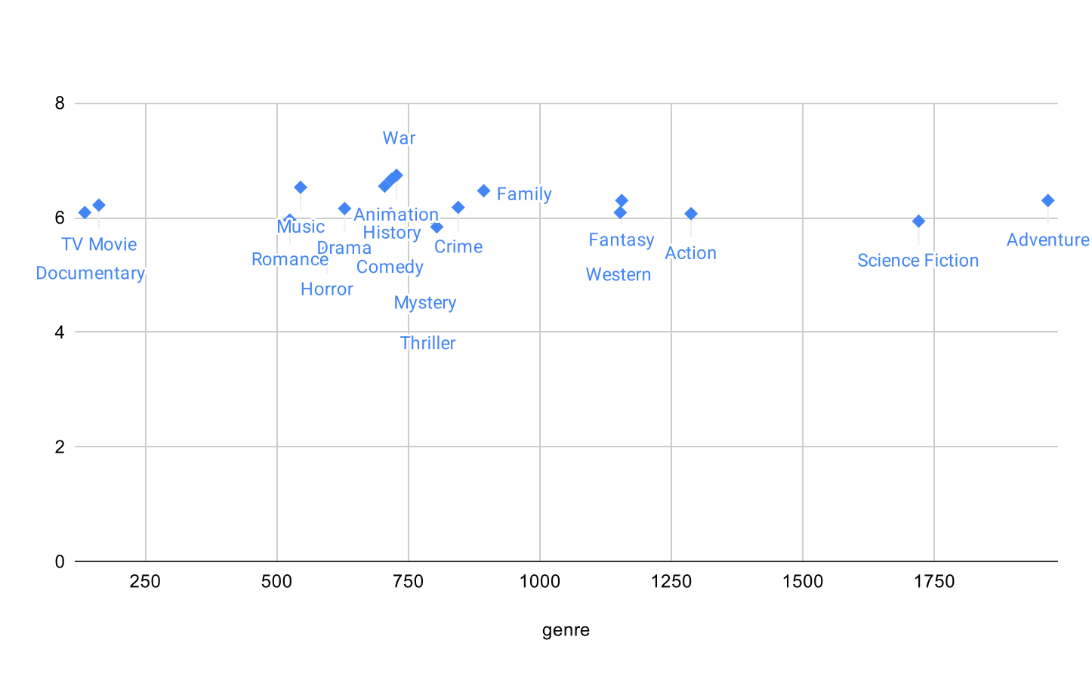
Staisfaction vs engagment
High popularity ≠ high rating
Rating
Popularity

Slide 6
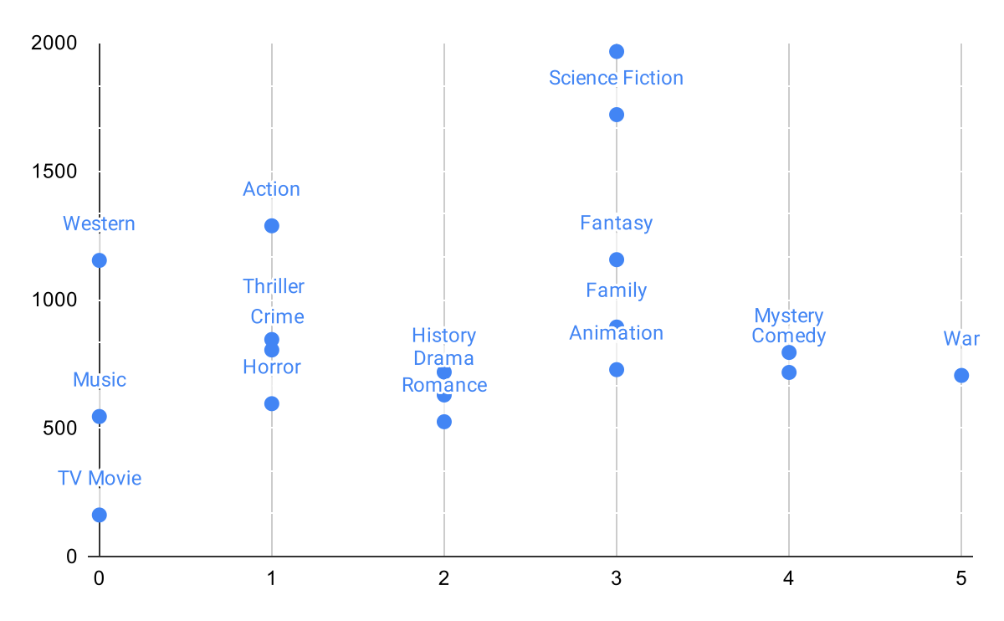
High popularity ≠ high profit
Popularity
ROI

