Slide 1





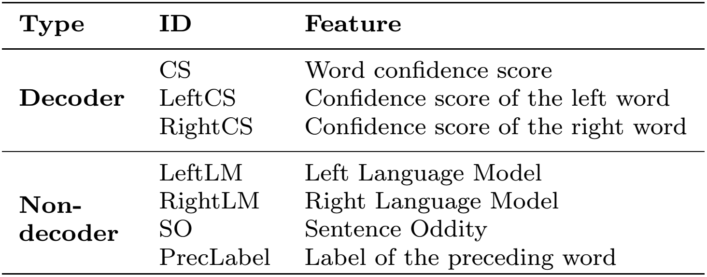
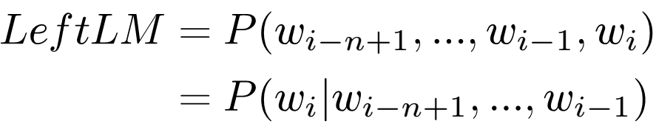
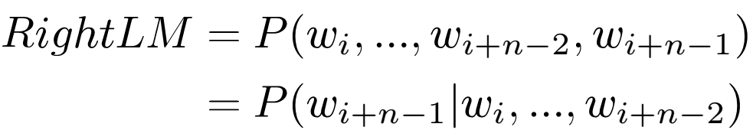
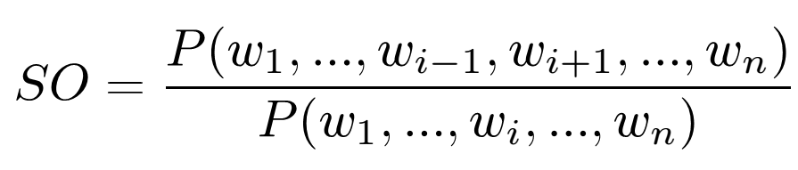



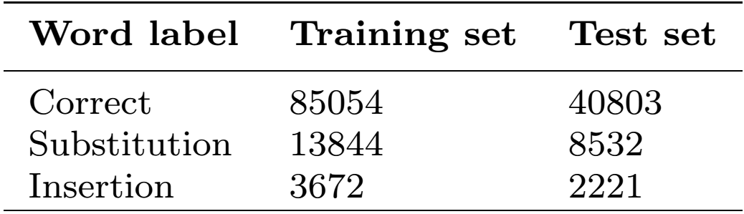
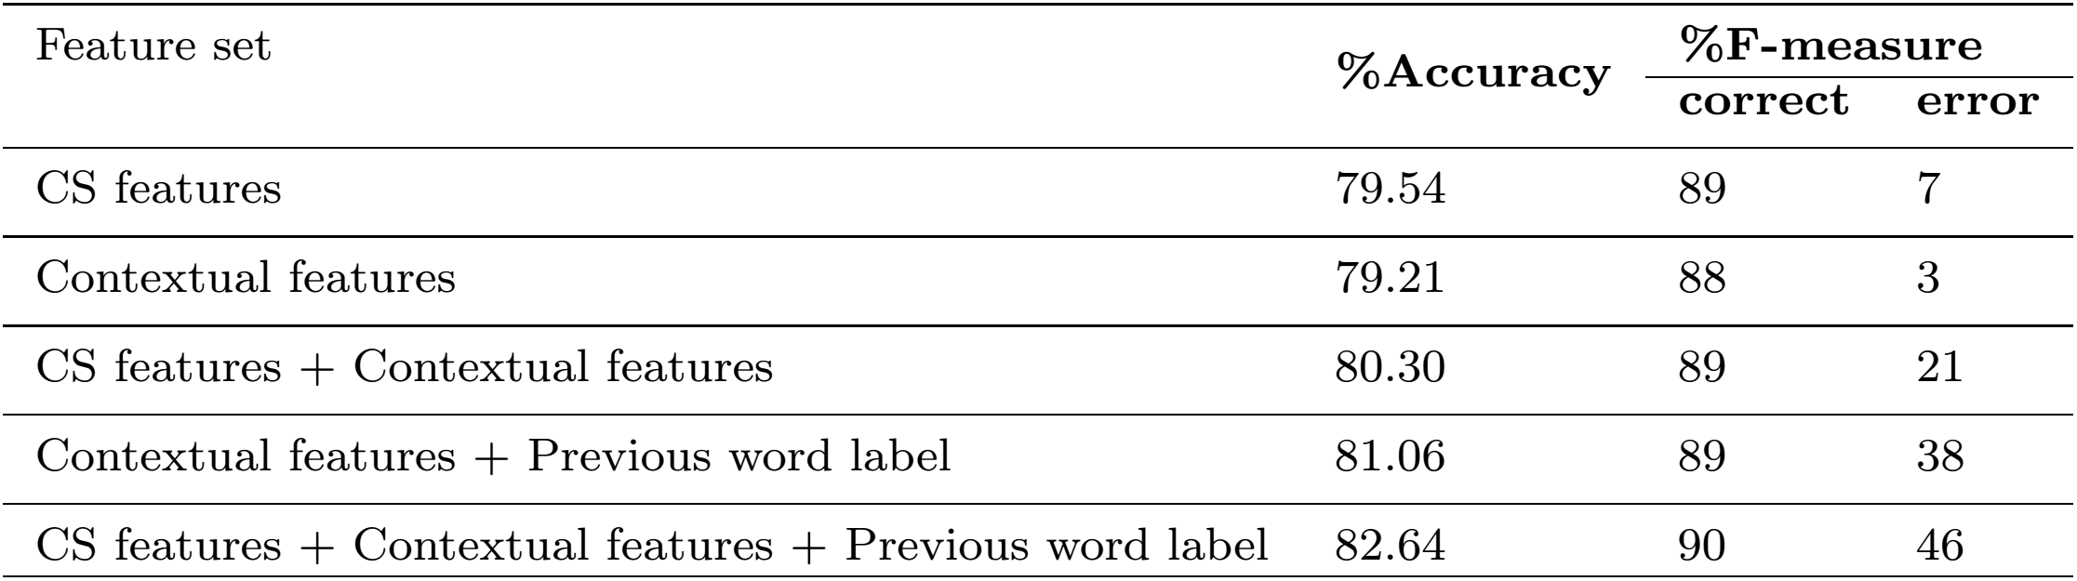
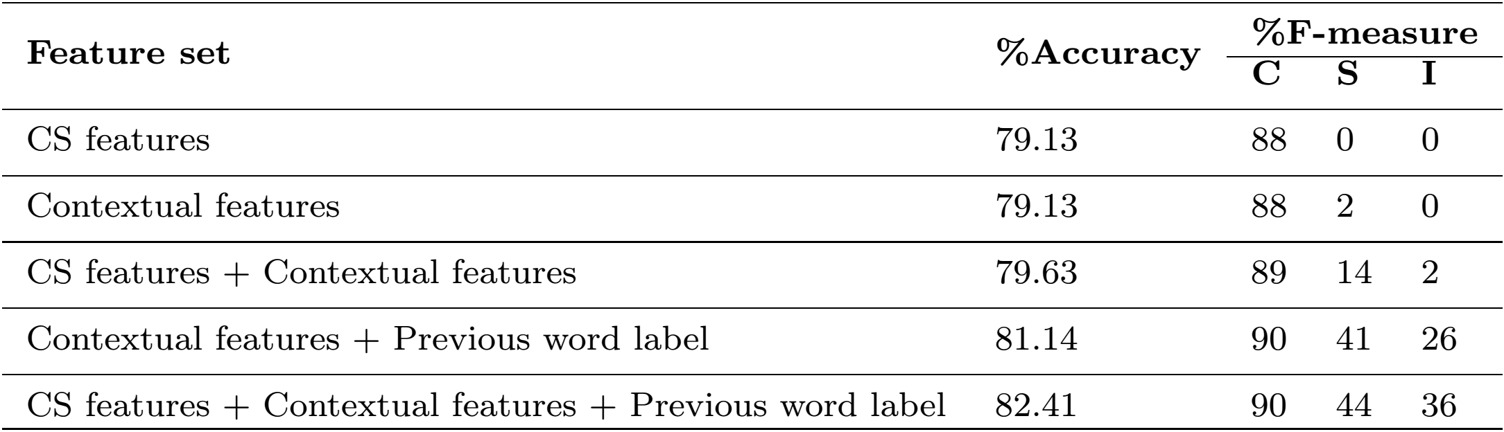
Efficacy of Decoder versus Non-Decoder Features for ASR
Errors Detection and Classification: A Comparative Study
⁺Laboratory of Information Technologies, University of Chouaib Doukkali, Morocco
*Speech and Hearing Research Group, University of Sheffield, Sheffield, UK
{errattahi.r, elhannani.a, ouahmane.h}@ucd.ac.ma, t.hain@sheffield.ac.uk
Background
Proposed Workflow
Speech recognition has made remarkable advances :
++Satisfactory performance under restrictive conditions (i.e. limited vocabulary, reading speech, and noise-free environment).
---Height error rate when handling various phenomena, including e.g. acoustic conditions (noise, competing speakers, channel conditions), out of vocabulary words, and pronunciation variations...
It is extremely important to be able to make an appropriate and reliable judgement based on the error-prone ASR results.
Speech
Data
ASR decoding
Text alignment
ASR
ASR Hypo.
Labeled Data
Features Extraction
Detection
Model
W₀ W₁ W₂
Reference
Reference
Training Data
ѵ
ѵ
Training
Language
model
Aims and Objectives
Contextual features
This poster addresses errors in continuous speech recognition output in two stages:
Errors detection (Correct/ Error)
Errors type classification (Correct/ Substitution / Insertion)
Experimental Setup
Speech
Recognition
Errors
detection
  Speech data: Multi-Genre Broadcast (MGB) corpus [2].
          BBC broadcasts and subtitles
          7 shows with 28 hours of audio (70% for Training and
          30% for the Test)
  Transcription: the 2015 Sheffield's ASR system [3].
  Language Model: Microsoft Web N-gram corpus [4].
  Classifier: Support Vector Machines.
Applications perspective to the proposed approach :
Decide at run-time whether a given input signal has been properly recognized (e.g. if a user spoken utterance needs to be repeated in a dialogue application),
Decide if an automatic transcription is acceptable as it is (e.g. if manual revision is needed in an automatic subtitling application),
Select the best transcription among options from multiple ASR systems,
A preliminary step towards an automatic ASR error correction system.
Results
  ASR Errors Detection Results
Three categories
of ASR Error
detection
methods [1]
Related Works
Posterior probability based
Posterior probability of the word given the acoustic signal is regarded as the confidence measure
  ASR Errors Type Classification Results
Statistical hypothesis testing
Treats error detection as a statistical hypothesis testing problem
Featured based
Builds a classifier using features generated from an ASR decoder during the recognition process
In this work, we mainly focus on classifier-based ASR errors detection approach:
We investigate the efficacy of decoder versus non-decoder features for ASR errors detection and classification.
Conclusion & Future Works
This work addresses ASR errors detection and classification. Experimental results using SVMs and different combination of features showed:
    Encouraging results with only 7 features on a very challenging dataset.
    Competitive performance when using only non-decoder-based as compared to decoder-based features.
    Positive influence of both N-gram and SO features on the system performance.
    Better results when considering the label of the previous word in addition to the contextual features.
Future Works:
    Adding supplementary information sources, such as lexical and semantic features.
    Using advanced deep learning techniques.
    Including the accuracy estimation by considering the deletion errors.
    Generalizing on other ASR systems and speech corpora.
References
[1]. Jiang H (2005) Confidence measures for speech recognition: A survey. Speech communication 45(4):455--470
[2]. Bell P, Gales M, Hain T, Kilgour J, Lanchantin P, Liu X, McParland A, Renals S, Saz O, Webster M, et al (2015) The MGB challenge: Evaluating multi-genre broadcast media transcription. In: ASRU
[3]. Saz O, Doulaty M, Deena S, Milner R, Ng RW, Hasan M, Liu Y, Hain T (2015) The 2015 Sheffield system for transcription of Multi -Genre Broadcast Media. In: ASRU
[4]. Wang K, Thrasher C, Viegas E, Li XL, Hsu BJP (2010) An overview of Microsoft Web N-gram corpus and applications

