Slide 1


Slide 2

AGENDA:
“Implement automated service level backup using AWS Backup”

Slide 3
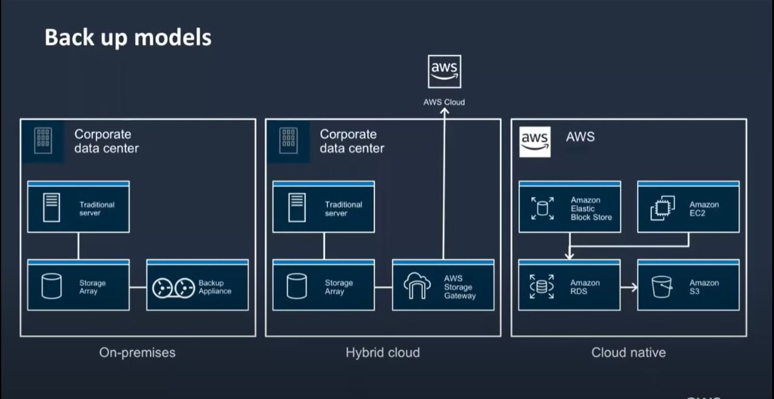
Backup models

Slide 4
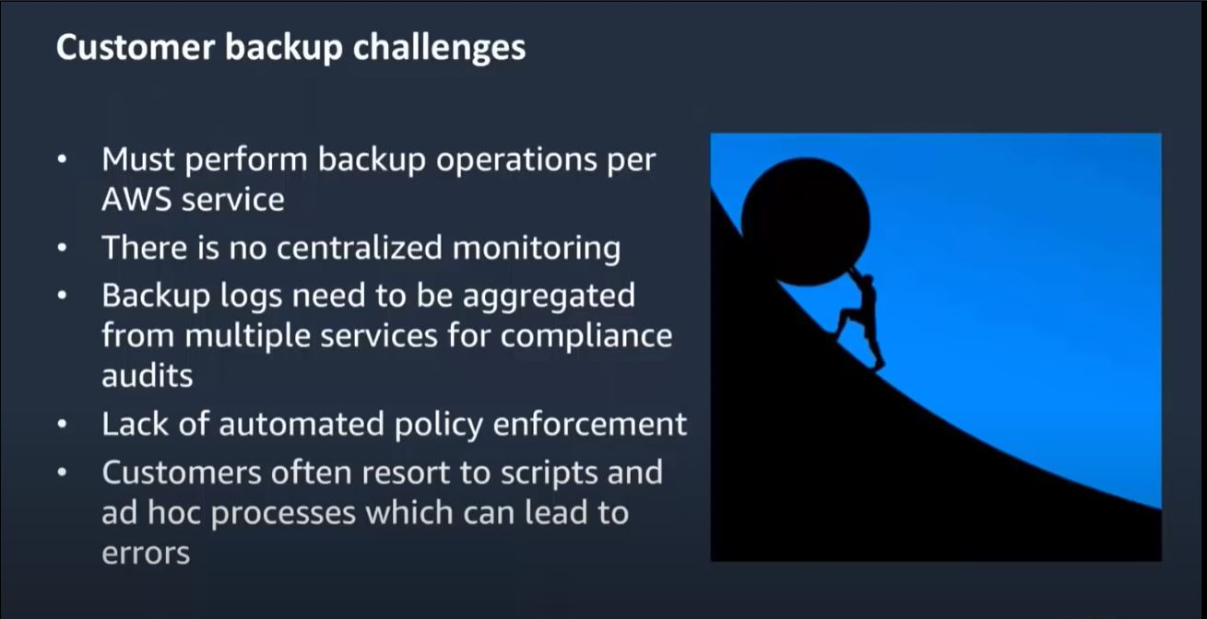
Challenges

Slide 5
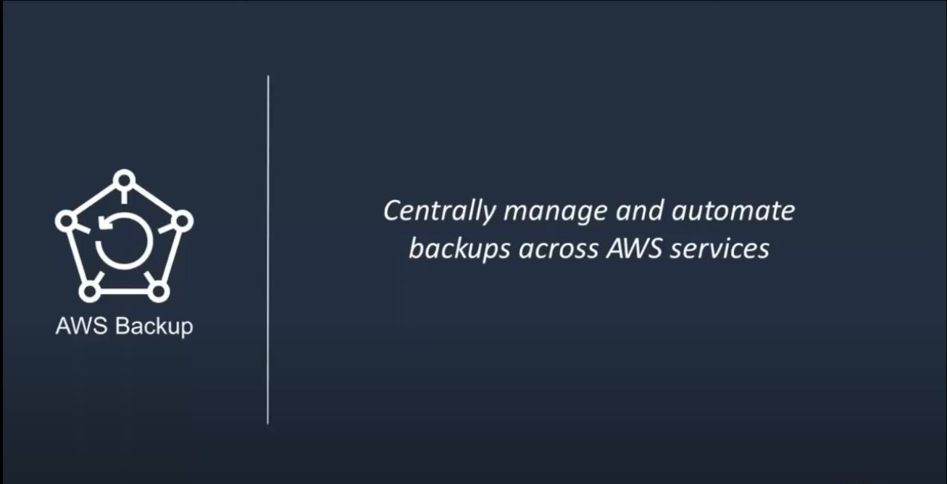
AWS Backup

Slide 6
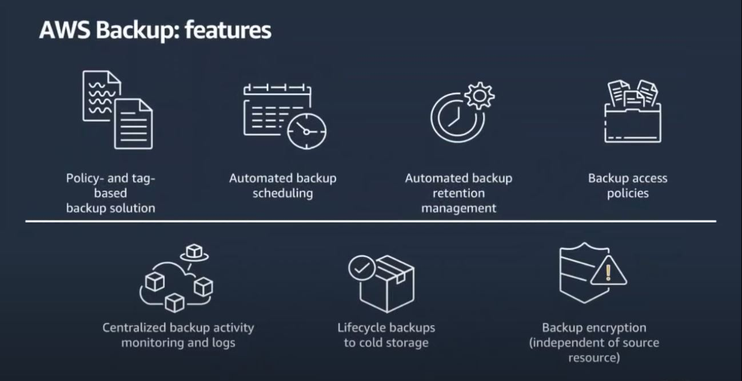
AWS Backup

Slide 7
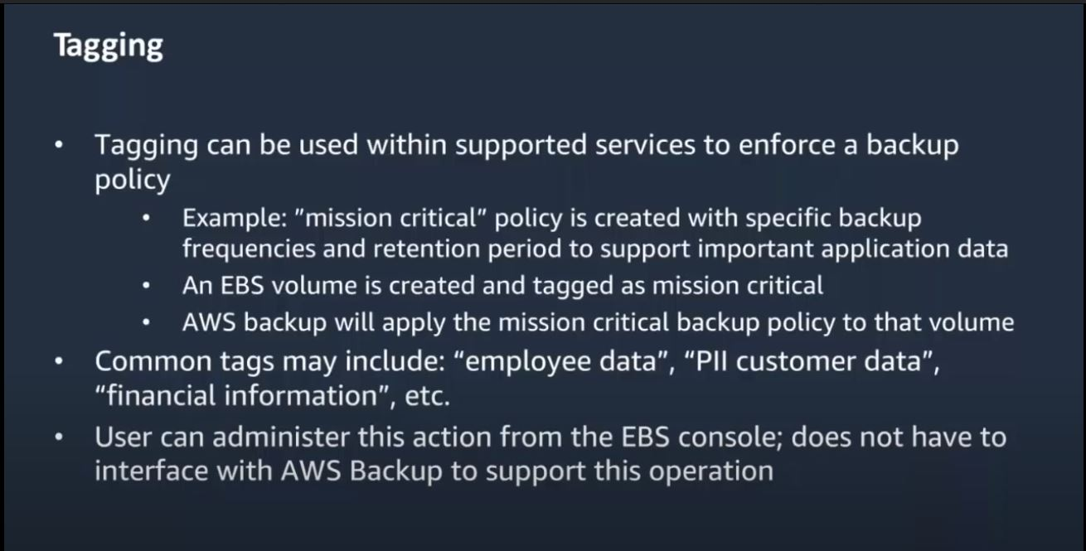
AWS Backup

Slide 8
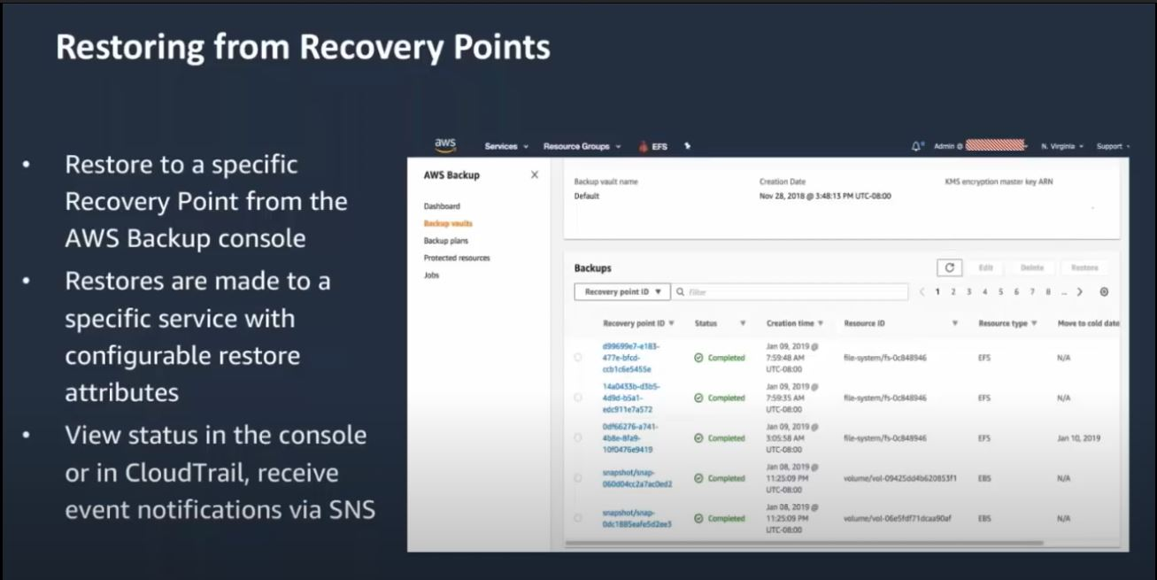
AWS Backup

Slide 9
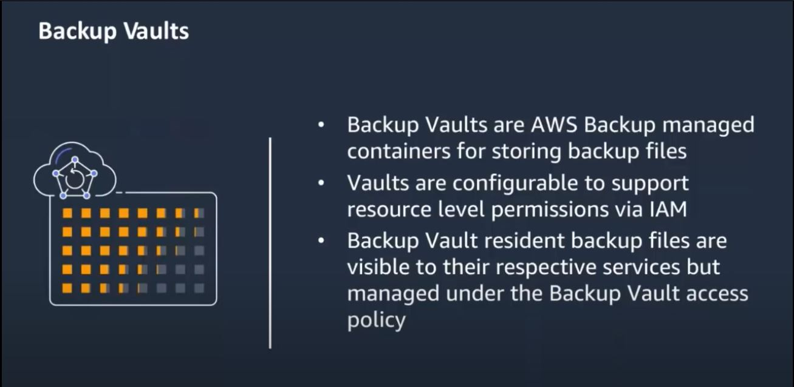
AWS Backup

Slide 10


Demo…

Slide 11

THANK YOU

