Slide 1


Slide 2

AGENDA:
“Implement patch management using Systems Manager”

Slide 3
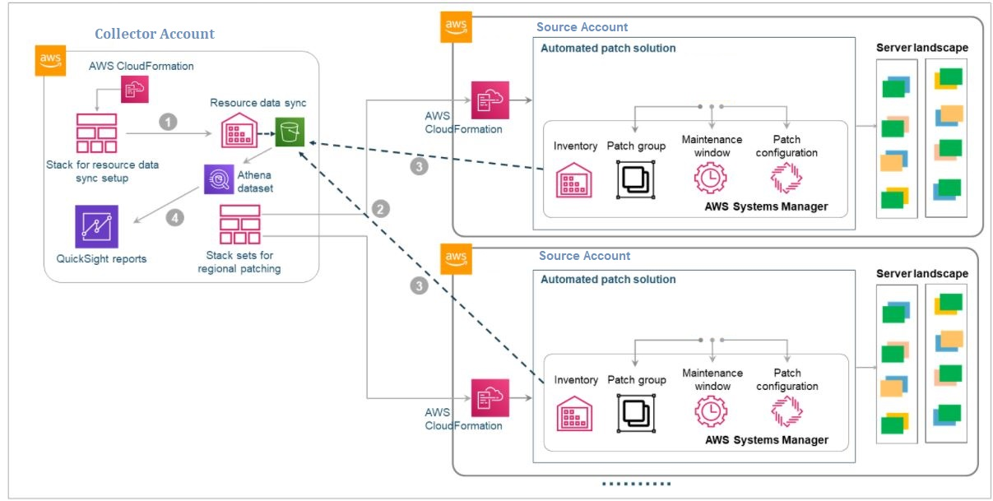
Solution Design

Slide 4
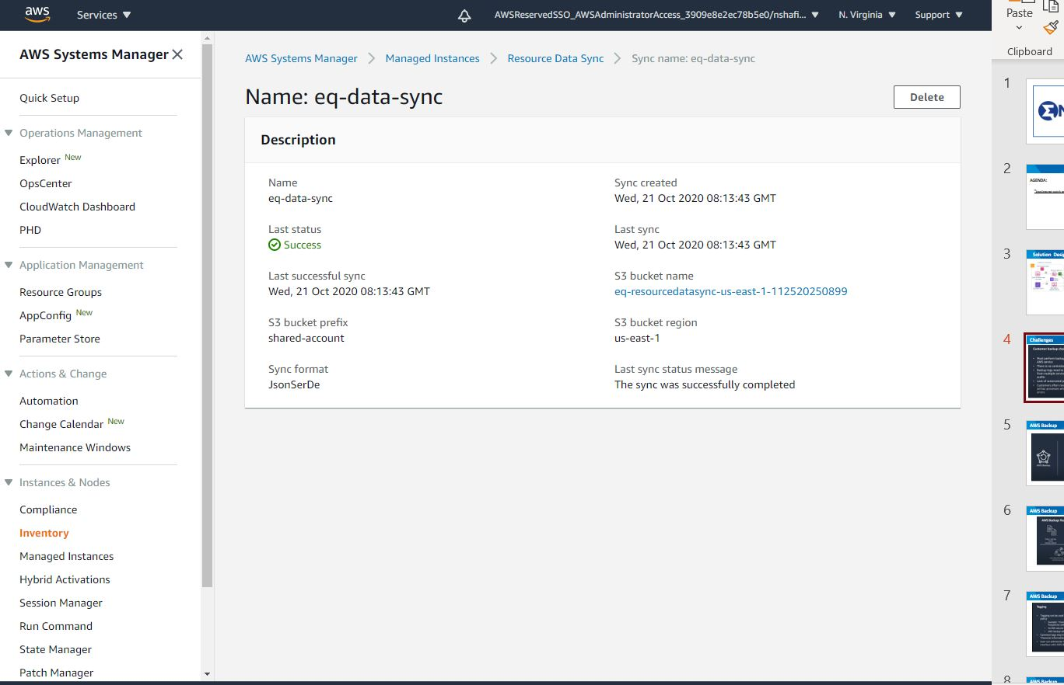
Resource Data Sync

Slide 5
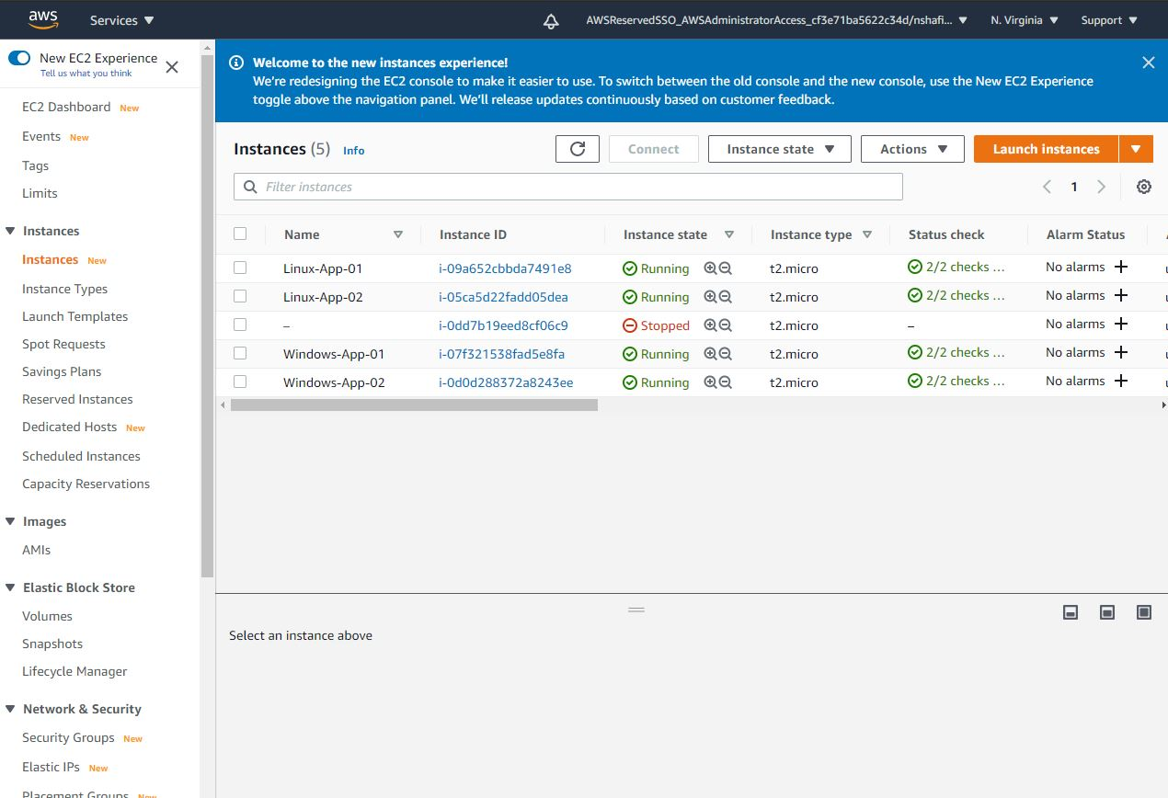
Instances Fleet

Slide 6
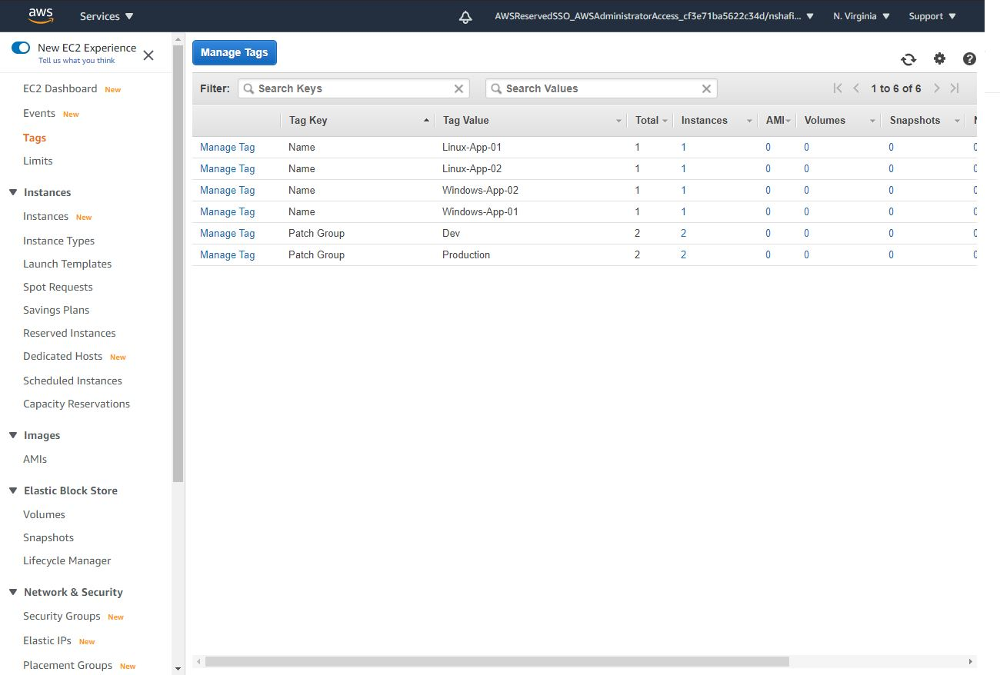
Patch Group

Slide 7
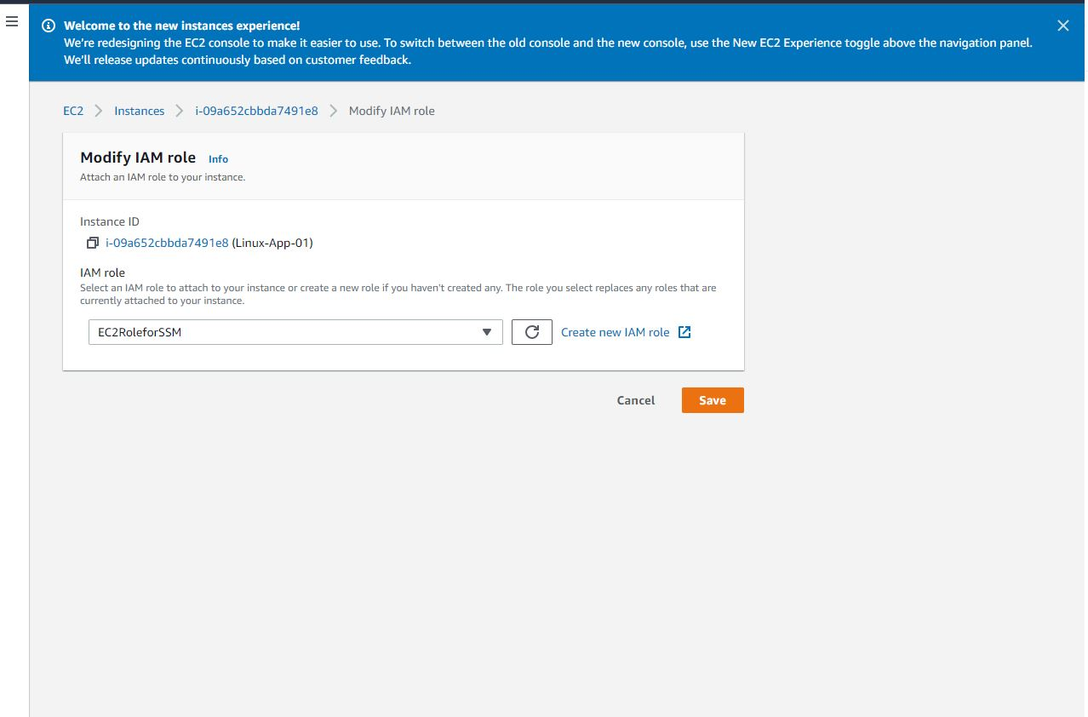
IAM Role

Slide 8
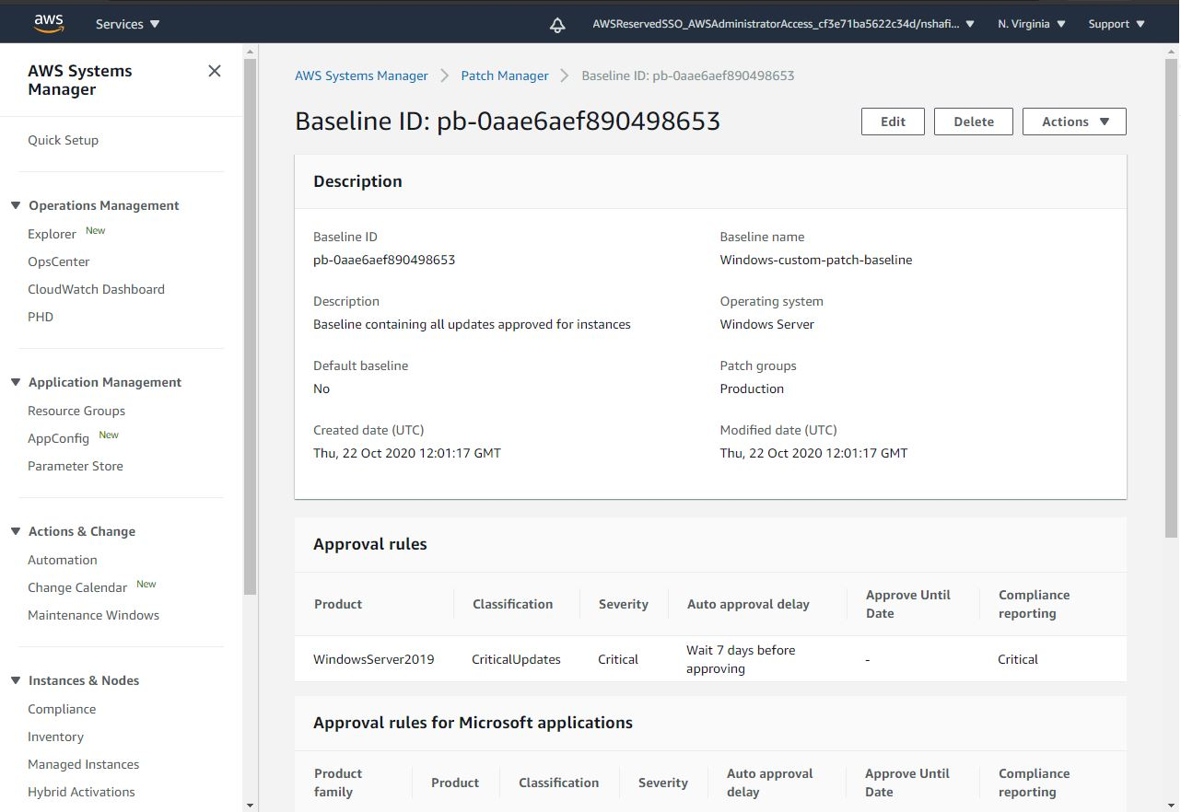
Custom Patch Baseline

Slide 9
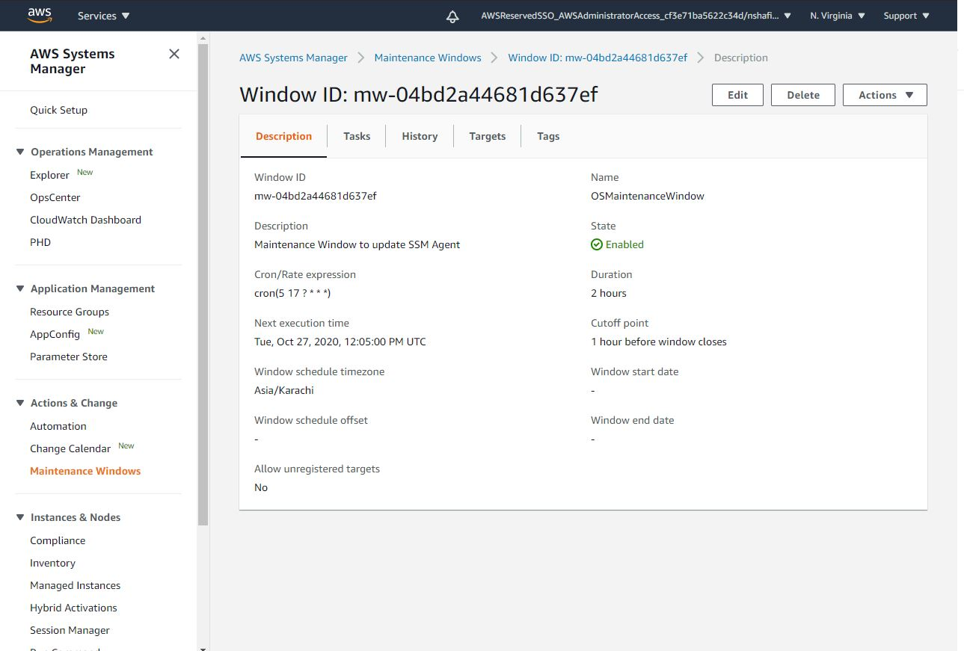
Maintenance Windows

Slide 10
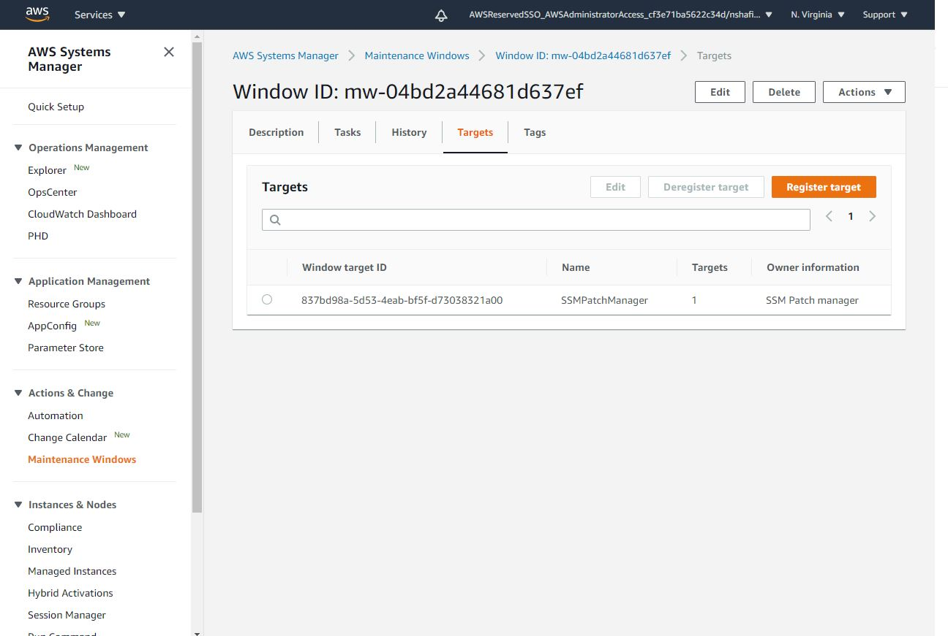
Maintenance Windows Targets

Slide 11
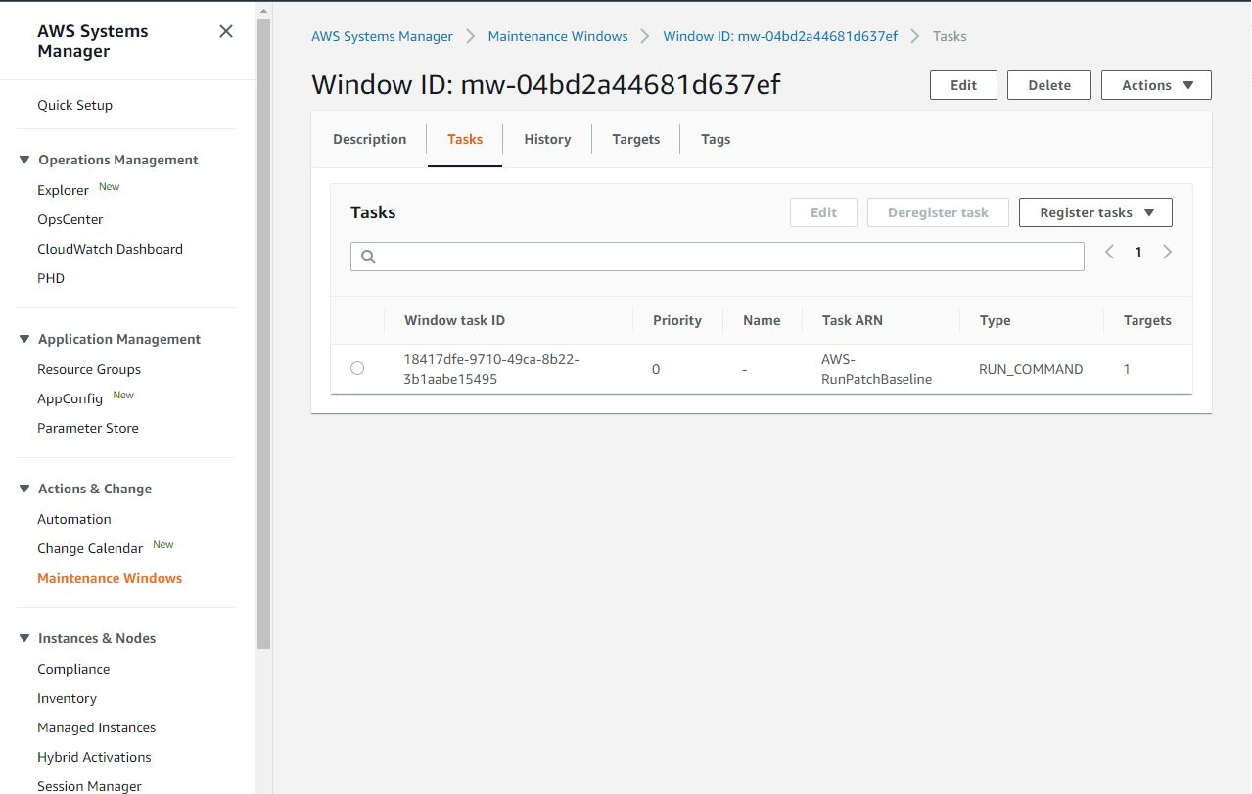
Maintenance Windows Tasks

Slide 12
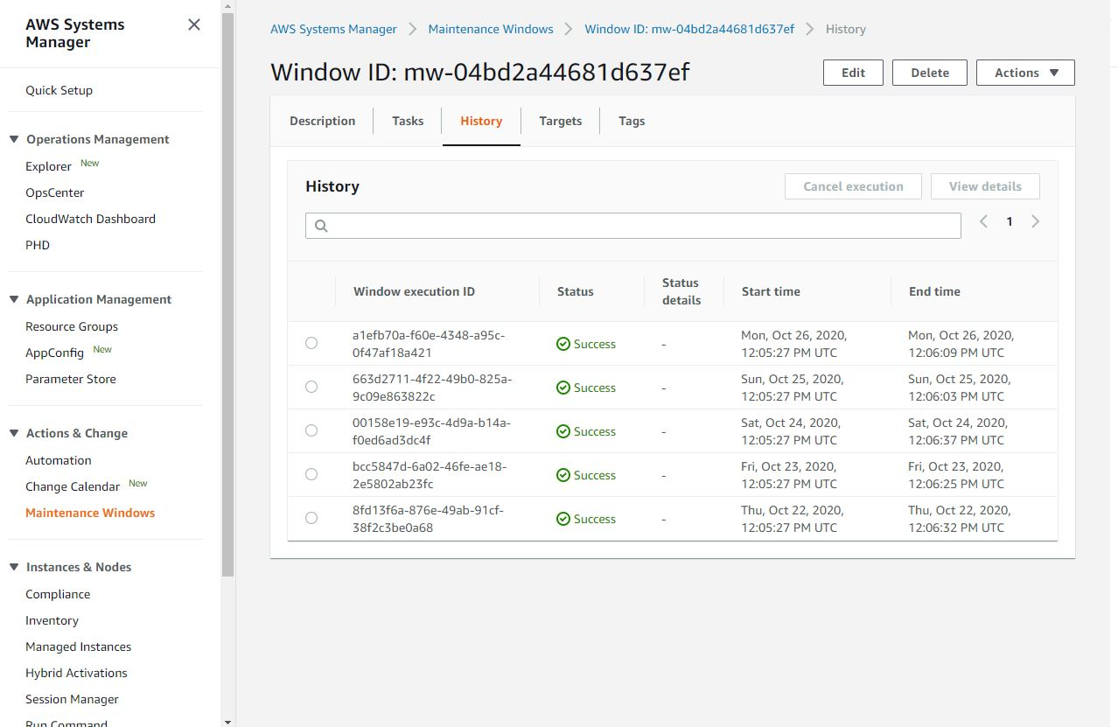
Maintenance windows History

Slide 13
Maintenance windows History

Slide 14
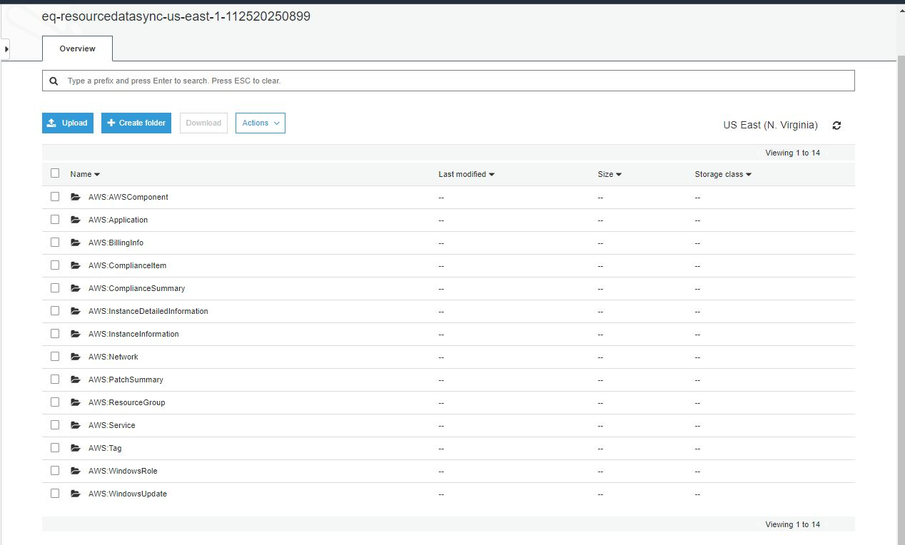
Inventory Data in Central Bucket

Slide 15
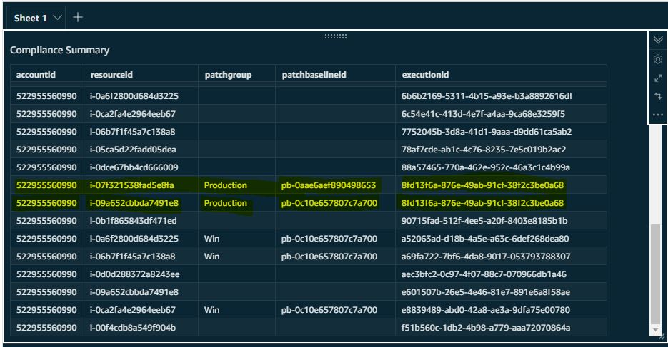
Quick Sight View

Slide 16
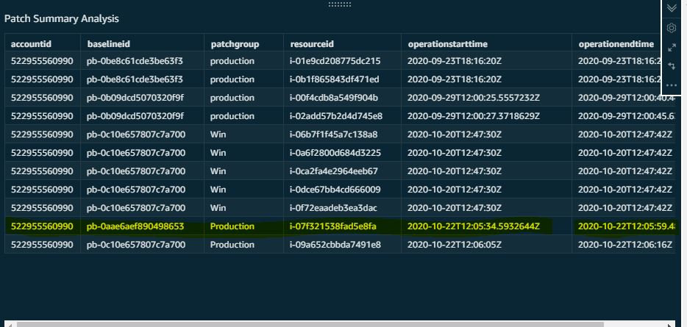
Quick Sight View

Slide 17
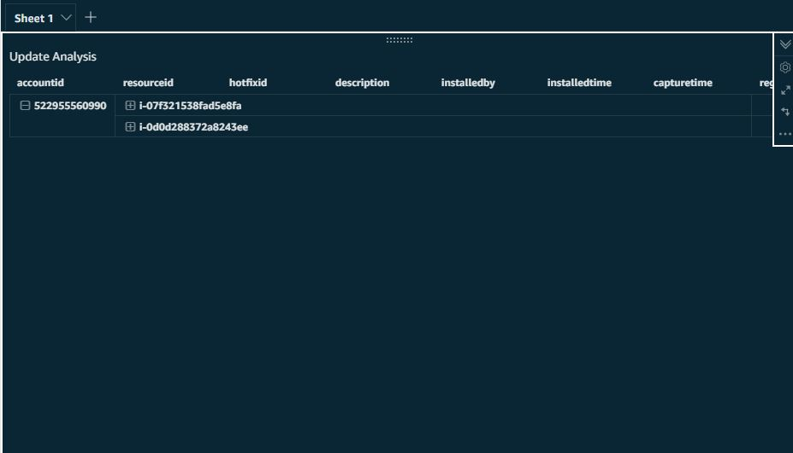
Quick Sight View

Slide 18
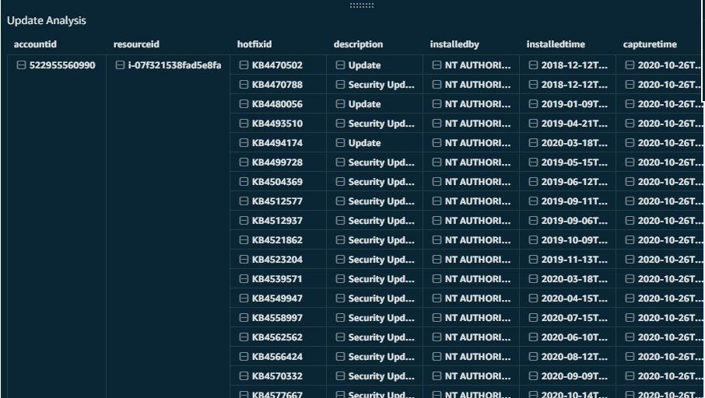
Quick Sight View

Slide 19

THANK YOU

