Slide 1

Analyzing New York Stock Exchange

Slide 2
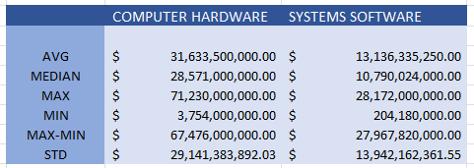
OPERATING PROFIT OF COMPUTER HARDWARE & SYSTEMS SOFTWARE
The mean of total operating income for companies categorized under Information Technology, Computer Hardware ($31,633,500,000 ) was higher compared to the mean total operating income of Systems Software Industries
($ 13,136,335,250). It looks like companies in the Computer Hardware industry have a higher total revenue on average than all industries categorized under Systems Software.
The Median total revenue for companies categorized under the Computer Hardware($28,571,000,000) was higher compared to median total revenue for all Systems Software Industries($10,790,024,000). It looks like that 50% of the companies in the Computer hardware have a higher total revenue on average than 50% of the companies categorized under the Systems Software.
The standard deviation of total operating income for companies categorized under the Computer Hardware industry ($ 29,141,383,892.03) was higher than the standard deviation of operating income for all Systems Software($ 13,942,162,361.55).

Slide 3
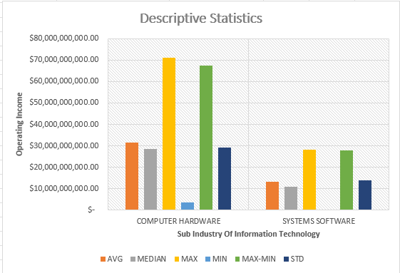
What is the variability of Total operating income in the Computer Hardware industry compared to System Software industries?
Both the range and the standard deviation give you an idea about the variability of your data, or how much each value differs from the mean. The smaller your range or standard deviation, the lower and better your variability.
It looks like companies in the Computer Hardware sector have more significant variability in the total operating income they receive because their range is more spread out.

