Slide 1

FAST-NUCES • FINAL YEAR PROJECT • 2025-2026
CORAL
Consensus-Based Refinement and Output Realignment
for Low-Resource Urdu ASR Post-Processing
A five-stage post-processing pipeline reducing Urdu ASR WER by up to 46.5% relative — without retraining any acoustic model.
46.5%
22.3%
500K
5
Rel. WER ↓
Conversational
Rel. WER ↓
Common Voice
Word Urdu
Corpus
Pipeline
Stages
Project Team
Ali Irfan 21I-2572 • Nouman Hafeez 21I-0416 • Rafay Khattak 21I-0423

Slide 2


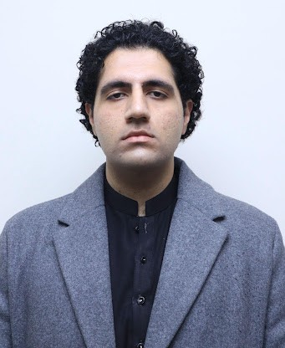
MEET THE TEAM
Three engineers. One Urdu ASR mission.
Ali Irfan
Nouman Hafeez
Rafay Khattak
21I-2572
21I-0416
21I-0423
Pipeline architect • Backend & deployment
Corpus + retrieval • Web app • LLM strategy
Research pitch • Evaluation lead
Stage 1 weighted split-merge alignment
FastAPI orchestrator • HuggingFace Space deployment
Stage 2 BK-tree + 500K n-gram corpus
Full web app redesign • System architecture
LLM research & integration strategy
Pitched the original CORAL research idea
Evaluation methodology • C0→C7 ablation
Residual-error analysis • WER/CER reporting
SUPERVISORS • ARTIFICIAL INTELLIGENCE & DATA SCIENCE
Ms. Kainat Iqbal
Ms. Saira Qamar
Supervisor
Co-Supervisor
CORAL | Consensus-Based Refinement and Output Realignment
2 / 32

Slide 3
AGENDA
What we will cover today
01
The Urdu ASR Problem
02
Research Hypothesis
Why does Urdu still hurt at 18-20% WER?
Five algorithmic levers, zero retraining.
03
From FYP-1 to FYP-2
04
The CORAL Pipeline
What survived. What we dropped. And why.
Stages 0-4 end-to-end.
05
System Architecture
06
Empirical Results
Kaggle GPUs → FastAPI → Next.js.
Common Voice + Conversational Urdu.
07
Ablation & Residuals
08
Conclusion & Future Work
Which component buys which percentage?
Where CORAL goes next.
CORAL | Consensus-Based Refinement and Output Realignment
3 / 32

Slide 4
THE PROBLEM
Urdu remains a severely under-resourced ASR language
Foundation ASR models hit sub-5% WER on English.
230 M+
13-20%
Yet on Urdu — the national language of Pakistan, written in Nastaliq script — Whisper, MMS and SeamlessM4T still hover between 13% (read speech) and 20% (conversational). Critical domains — healthcare, legal, accessibility, education — remain blocked.
speakers worldwide
WER for SOTA models
0
1
Why is Urdu hard?
• Limited training data — Urdu is a minority of multilingual mixtures
• Arabic ↔ Urdu Unicode conflation (U+0643 vs U+06A9, etc.)
• Word-boundary disagreement across architectures
• Rampant Urdu ↔ English code-switching in conversation
production-grade
Urdu post-processors
FYP team that took it on
CORAL | Consensus-Based Refinement and Output Realignment
4 / 32

Slide 5
RESEARCH HYPOTHESIS
Five algorithmic levers — no fine-tuning needed
“
Combining (i) Urdu-specific Unicode normalisation, (ii) weighted split-merge-aware alignment, (iii) hybrid OOV detection with BK-tree fuzzy lookup ranked by an n-gram LM, (iv) conservative position-wise voting, and (v) targeted LLM refinement of the voted output —
is sufficient to substantially reduce WER over the strongest single-model baseline, on both read-speech and conversational Urdu, without any fine-tuning of the acoustic models.
0
Normalize
1
Align
2
OOV+BK-tree
3
Vote
4
LLM Refine
CORAL | Consensus-Based Refinement and Output Realignment
5 / 32

Slide 6
EVOLUTION
From FYP-1 Generate-and-Refine → FYP-2 five-stage pipeline
FYP-1 • GENERATE-AND-REFINE
FYP-2 • FIVE-STAGE POST-PROCESSING
2-stage architecture
Compositional algorithmic pipeline
Stage 1
Confidence-annotated multi-model ASR
Stage 0
Urdu normalisation (Unicode, diacritics, tatweel)
Stage 2
Alif-1.0-8B LLM arbitrates between hypotheses
Stage 1
Weighted split-merge alignment (SAME/SPLIT/MERGE/NOISE)
Eval
20-sample synthetic dataset, 3 calibration regimes
Stage 2
BK-tree OOV + n-gram ranking
Metric
WER + ECE (Expected Calibration Error)
Stage 3
Position-wise voting, conservative tie-break
Result
Whisper-Large baseline 17.76% WER · LLM 18.15%
Stage 4
Frontier LLM refinement (Gemini / Claude / GPT)
CORAL | Consensus-Based Refinement and Output Realignment
6 / 32

Slide 7
WHAT WE DROPPED
Five FYP-1 elements removed or repositioned for FYP-2
Word-level confidence extraction
→ now: Replaced with static, model-quality based weighting only at the LLM stage.
× was: Whisper/Wav2Vec2 raw confidences live on incompatible scales — proved unreliable in practice.
Expected Calibration Error (ECE)
→ now: FYP-2 reports WER + CER only. ECE retained as historical context.
× was: Useful for FYP-1 confidence-quality comparison, but tangential to deployed pipeline.
Synthetic 20-sample evaluation
→ now: Replaced with 2 995 Common Voice + 500 Conversational Urdu clips.
× was: Three calibration regimes × three error types ignored Urdu-specific failures.
Alif-1.0-8B-Instruct LLM
→ now: Replaced with client-side Gemini / OpenRouter (Claude, GPT-4o).
× was: Heavy GPU + weaker instruction following than commercial frontier models.
Two-stage Generate-and-Refine framing
→ now: Reframed as 5 sequential stages with LLM as the LAST refinement step.
× was: Treated LLM as primary fusion mechanism — wrong abstraction for Urdu.
CORAL | Consensus-Based Refinement and Output Realignment
7 / 32

Slide 8
THE CORAL PIPELINE
Five stages, end-to-end
INPUT • raw multi-model ASR hypotheses
OUTPUT • corrected Urdu transcript
0
1
2
3
4
Normalize
Align
Detect OOV
Vote
LLM Refine
Urdu Unicode
diacritics, tatweel,
ASCII strip
Weighted split-merge
Levenshtein
SAME/SPLIT/MERGE/NOISE
BK-tree fuzzy +
bi/tri-gram rank
on 500K vocab
Position-wise majority
conservative tie-break
OOV substitution
Fluency, code-switch,
named-entity recovery
(Gemini/Claude/GPT)
Server-side Stages 0-3 • Browser-side Stage 4 • Audio → /transcribe → /align → /oov → /correct → LLM
CORAL | Consensus-Based Refinement and Output Realignment
8 / 32

Slide 9
STAGE 0 • NORMALISATION
Strip the noise — make Urdu look like Urdu
Diacritics
Strip U+0610–U+061A, U+064B–U+065F, U+0670 (superscript alef)
EXAMPLE / before → after
Raw: سلامؐ علیکم، ﻛیسے ہیں — ٹھیک؟
Arabic → Urdu
7 canonical character maps: ك→ک, ي→ی, ة→ت, ﻻ→لا …
↓
Tatweel
Remove U+0640 elongation character
Norm: سلام علیکم کیسے ہیں ٹھیک
Punctuation
Drop Arabic + Urdu + ASCII punctuation + ZWJ/ZWNJ
Why Stage 0 matters
A large fraction of apparent ASR errors are NOT recognition failures —
they are Unicode-variant mismatches against the reference. Stage 0 dissolves
this measurement artefact before any downstream voting decision.
Whitespace
Collapse to single spaces · NFC normalise
Effect
1.9 WER points ↓ on Conversational Urdu — for free.
CORAL | Consensus-Based Refinement and Output Realignment
9 / 32

Slide 10
STAGE 1 • SPLIT-MERGE ALIGNMENT
Word boundaries are first-class citizens
The Core Insight
Alignment input — three model attempts
Different ASR models disagree on WHERE word boundaries fall. One model emits a phrase as a single token; another splits it in two; a third merges across syllables. ROVER mis-reads this as substitution.
whisper-L · src
A
B-C
D
E
seamless-L
A
B
C
D
E
wav2vec2
A
BC
D
E
Per-chunk metadata produced
SAME
tokens align 1:1
Per-chunk classification
SPLIT
one source token → many target
SAME
SPLIT
MERGE
SAME
SAME
MERGE
many source → one target
A=A=A
B-C ↔ B,C
B-C ↔ BC
D=D=D
E=E=E
NOISE
neither side aligns reliably
→ 36.5% of all alignment events on Conversational Urdu are SPLIT or MERGE.
→ Existing fusion methods (ROVER) lose this signal entirely.
CORAL | Consensus-Based Refinement and Output Realignment
10 / 32

Slide 11
STAGE 2 • OOV DETECTION + BK-TREE
Find the rare words. Correct them with context.
OOV criterion (FR3.1)
Token stream
OOV
Flag a token as OOV iff it appears in EXACTLY ONE model's output
AND its corpus frequency is below 2 000.
سلام
آپ
بازر
کیسے
ہیں
↓
BK-tree fuzzy lookup
BK-tree
Burkhard-Keller tree over a ~500K-word Urdu vocabulary corpus.
Length-adaptive edit-distance threshold. >10× faster than linear scan.
~500K-word Urdu corpus
Candidates · ranked (edit · uni · tri · bi · freq)
بازار
edit=1 · top-1
Ranking signals (lexicographic)
★
1. Edit distance
2. Unigram presence
3. Trigram-context hits
4. Bigram-context hits
5. Corpus frequency
بازی
edit=1 · uni-hit
بزرگ
edit=2 · weak
Selected
بازار
CORAL | Consensus-Based Refinement and Output Realignment
11 / 32

Slide 12
STAGE 3 • CONSENSUS VOTING
Position-wise majority — but conservative
▸
For each non-OOV source position
VOTING EXAMPLE
Collect votes from companion models. Skip insertion-aligned slots.
Position 4
▸
Plurality wins — uniquely
Seamless
کتاب
Replace the source word only if there is a UNIQUE plurality winner.
کتاب
Whisper-L
▸
Tie-break = preserve
ﮐﺗﺎب
Conservative: on ties, retain the source word. No silent substitutions.
Whisper-M
For each OOV position
Wav2Vec
کتاب
▸
Replace the source word with the top-ranked BK-tree candidate.
▸
Output
Winner: کتاب (4 / 4)
Corrected sentence + source + position-indexed diff.
CORAL | Consensus-Based Refinement and Output Realignment
12 / 32

Slide 13
STAGE 4 • LLM REFINEMENT
Fluency, code-switching, named entities — handled last, in-browser
What the LLM handles
Google
Anthropic
• Restore sentence-level fluency lost during voting
• Recover code-switched English tokens stripped by Stage 0
• Resolve grammar agreement that spans many words
• Disambiguate named entities & proper nouns
• Operate under explicit authority limits — can NOT add new content
Gemini 1.5 Pro
Gemini 2.0 Flash
Claude 3.5 Sonnet
Claude 3 Opus
OpenAI
Meta
Why client-side?
GPT-4o
GPT-4o-mini
Llama 3.1 405B
via OpenRouter
• User-supplied API keys never leave the browser
• No GPU cost on our backend
• Easy provider switch — Gemini / OpenRouter / Claude / GPT-4o
PROMPT = voted transcript + align metadata + OOV candidates
CORAL | Consensus-Based Refinement and Output Realignment
13 / 32

Slide 14
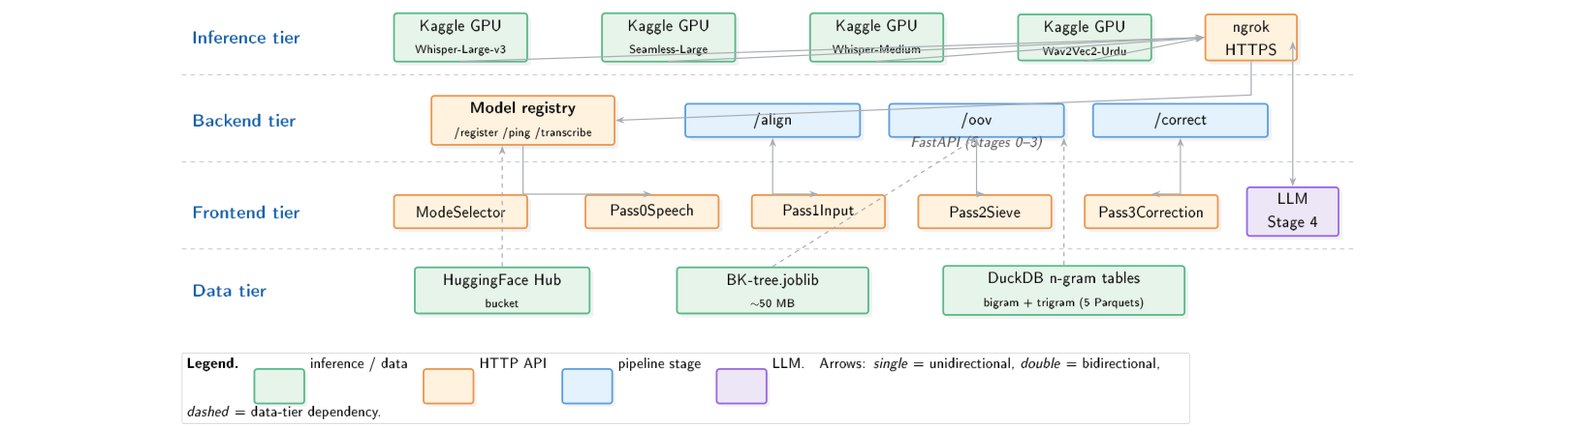
SYSTEM ARCHITECTURE
Four tiers, one rendezvous registry
Inference Tier
Kaggle GPU notebooks
+ ngrok HTTPS tunnels
Backend Tier
FastAPI · /align /oov /correct
+ Model registry
Frontend Tier
Next.js · React · 4-pass UI
Client-side LLM call
Data Tier
HuggingFace Hub
+ DuckDB n-gram tables
CORAL | Consensus-Based Refinement and Output Realignment
14 / 32

Slide 15
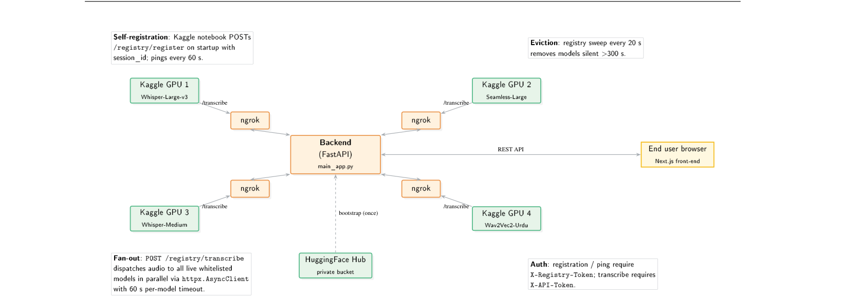
SYSTEM TOPOLOGY
Self-registration · heartbeats · async fan-out
Self-registration
Kaggle notebooks POST /registry/register on boot · ping every 60 s
Fan-out
POST /registry/transcribe dispatches audio to every live model in parallel · httpx.AsyncClient · 60 s timeout
Eviction
Registry sweep every 20 s drops sessions silent for >300 s
Auth
X-Registry-Token for register/ping · X-API-Token on transcribe
Each ASR model runs on its own Kaggle GPU notebook behind a private ngrok HTTPS tunnel; the backend registry is the rendezvous point. The browser talks only to the backend (and, for Stage 4, directly to the LLM provider).
CORAL | Consensus-Based Refinement and Output Realignment
15 / 32

Slide 16
TECHNOLOGY STACK
Modern, lean, production-ready
Backend
Frontend
Inference
Evaluation
• FastAPI 0.109 · uvicorn 0.23
• rapidfuzz 3.6 (Levenshtein)
• joblib 1.3 (BK-tree)
• duckdb 0.10 + pyarrow 14
• huggingface_hub 0.20
• httpx 0.26 (async)
• HuggingFace Spaces deploy
• Docker (port 7860)
• Next.js 16 · App Router
• React 19 · TypeScript 5
• TailwindCSS v4
• Multi-page R&D site
• Dark cinematic theme · aurora
• Animated waveform · particles
• MediaRecorder API · localStorage
• GPT-OSS chat endpoint
• transformers (HF) · torch
• librosa · soundfile
• Kaggle GPU notebooks (T4)
• ngrok HTTPS tunnels
• Whisper-Large-v3
• SeamlessM4T-v2-Large
• Wav2Vec2-Urdu
• Model registry auto-register
• jiwer (WER/CER)
• Common Voice Urdu (2,995)
• Conversational Urdu (500)
• 8-step ablation (C0→C7)
• Residual error annotation
• matplotlib + seaborn
• LaTeX + TikZ (this report)
• Reproducible eval TSV
CORAL | Consensus-Based Refinement and Output Realignment
16 / 32

Slide 17
EVALUATION SETUP
Two benchmarks, four configurations, every component
Common Voice Urdu
2,995 read-speech utterances
Public, Mozilla-curated, read passages.
Pipeline configurations evaluated
untouched
norm_baseline
alignment
Raw ASR output, no post-processing
Stage 0 normalisation only
Stages 0–3 (normalise + align + OOV + vote)
CORAL | Consensus-Based Refinement and Output Realignment
17 / 32

Slide 18
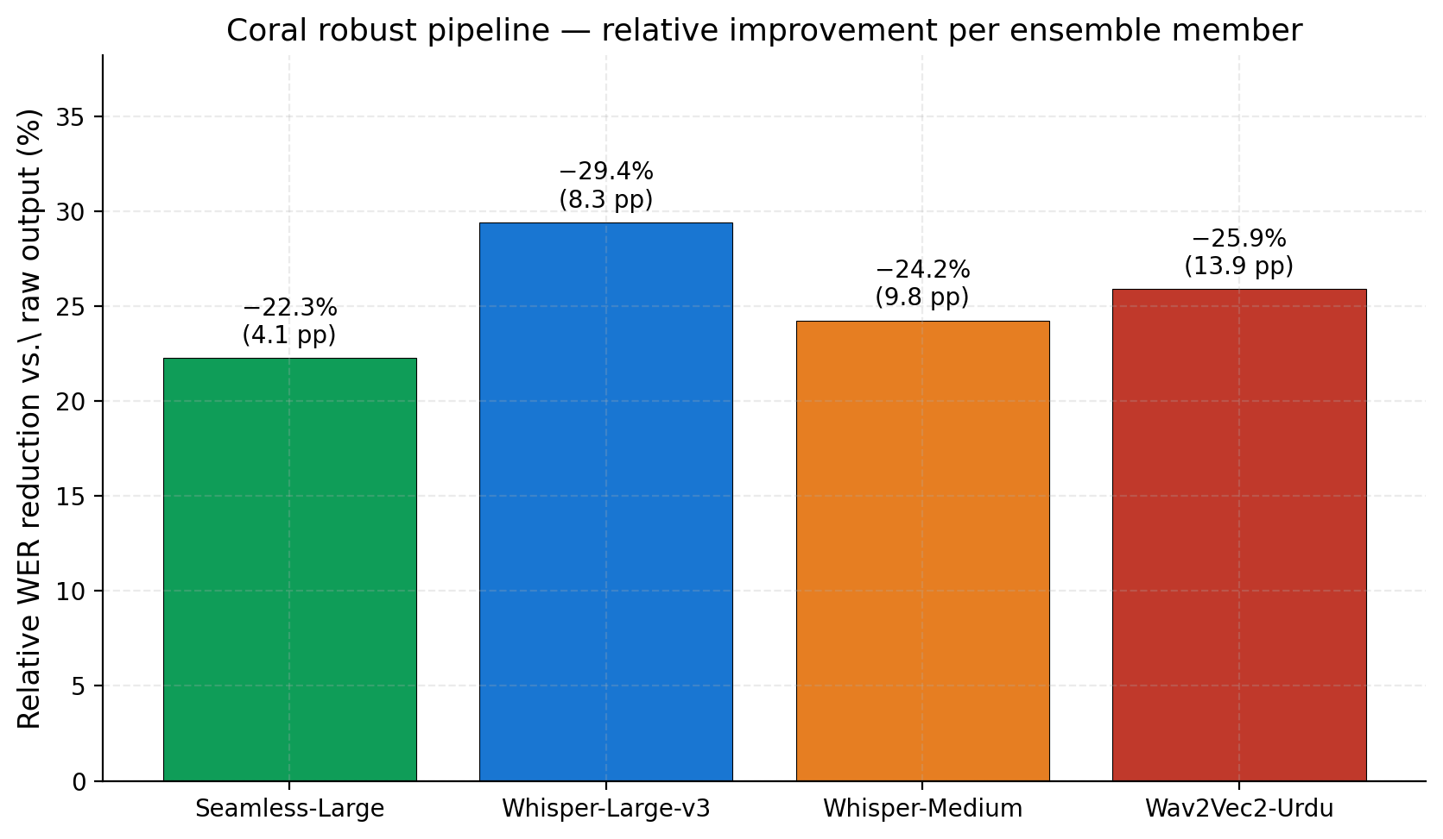
RELATIVE WER REDUCTION
Per Model WER after Normalization?
29.4%
Whisper-Large
25.9%
Wav2Vec2-Urdu
24.2%
Whisper-Med
22.3%
Seamless-L
The weaker the underlying ASR, the more headroom CORAL captures —
but even Seamless-Large (state-of-the-art) gains 4 absolute WER points.
CORAL | Consensus-Based Refinement and Output Realignment
20 / 32
Notes:
This is the basline word error rate for each model

Slide 19
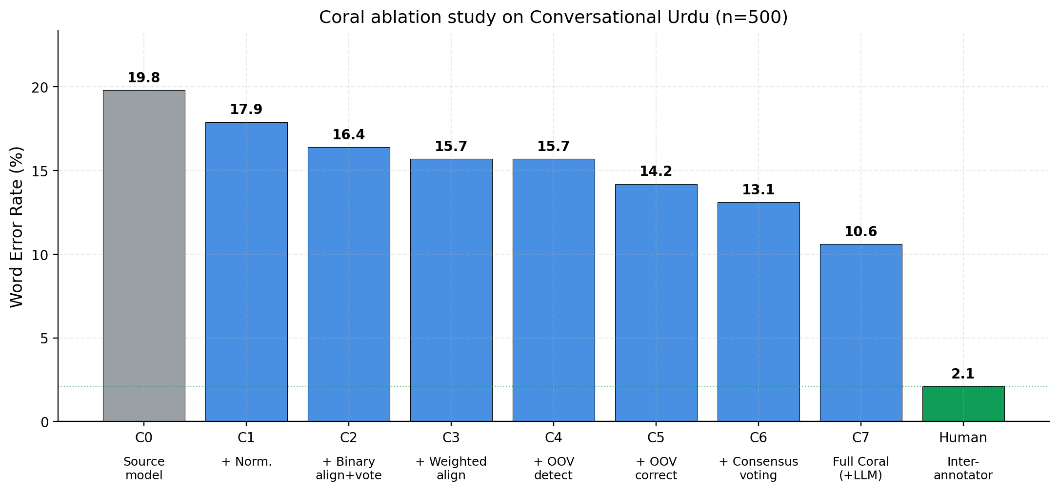
ABLATION · CONVERSATIONAL URDU (500 CLIPS)
C0 → C7 · every stage adds independent value
Per-stage WER contribution
Stage 0 normalise
-1.9 pts
Stage 1 alignment
-1.1 pts
Stage 2 OOV+BK-tree
-1.2 pts
Stage 3 voting
-1.5 pts
Stage 4 LLM
-2.5 pts
Total · 19.8% → 10.6% WER
CORAL | Consensus-Based Refinement and Output Realignment
21 / 32

Slide 20
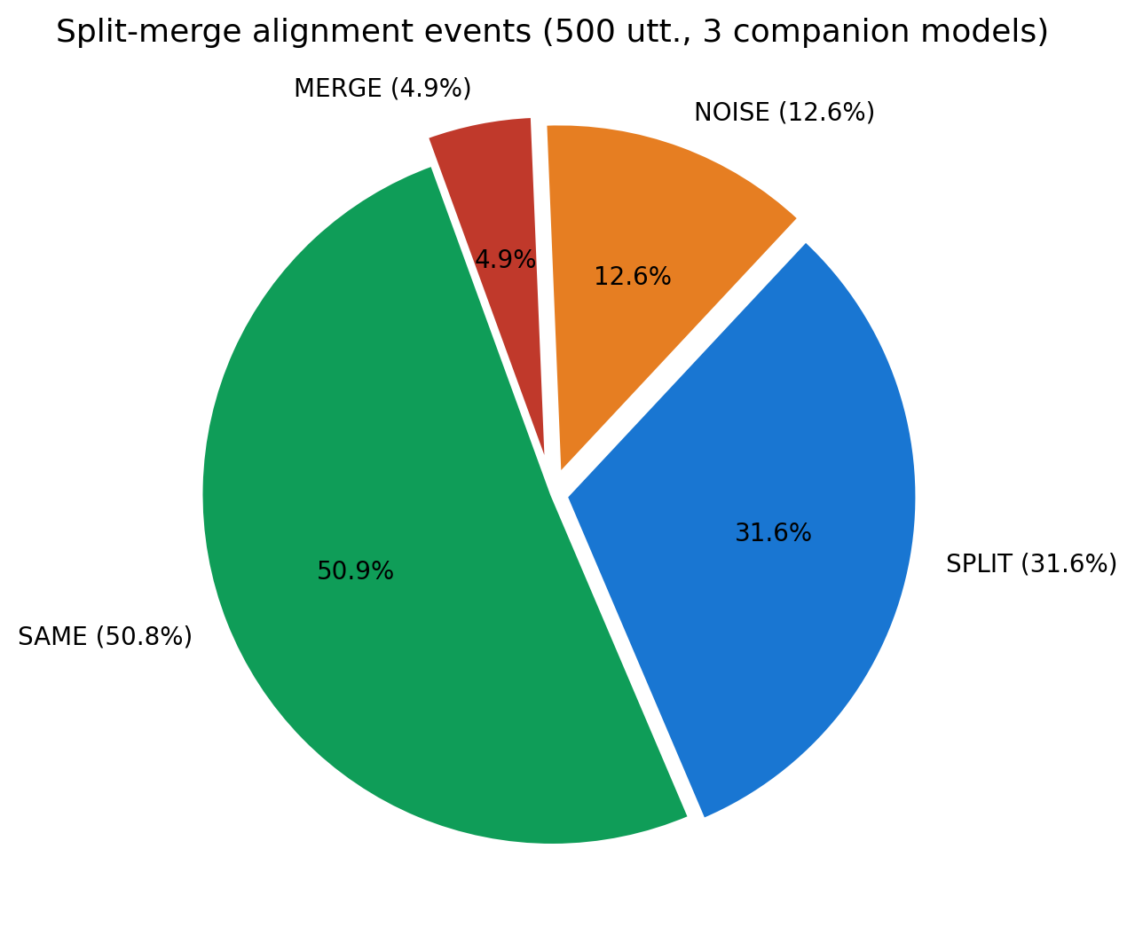
THE SPLIT/MERGE PHENOMENON
36.5% of inter-model events are word-boundary disagreement
What this chart shows
Across all alignment events on the 500-clip Conversational Urdu sample, SPLIT and MERGE together exceed any single substitution type.
Why ROVER struggles
ROVER's WCN edit-distance treats SPLIT as substitution-then-insertion and MERGE as deletion. The voting signal degrades exactly where it matters most.
CORAL's answer
Character-level secondary alignment recovers SAME/SPLIT/MERGE/NOISE labels explicitly — Stage 3 then treats them with appropriate semantics.
CORAL | Consensus-Based Refinement and Output Realignment
23 / 32
Notes:
This is the distribution of our split-merge algorithm on the samples that we used.

Slide 21
KEY ACHIEVEMENTS
Seven concrete wins from CORAL
Novel Algorithm
SOTA Beat
First Urdu-aware split-merge alignment with weighted Levenshtein.
10.6% WER on Conversational Urdu — beats Multi-ASR+SpeechLLM (11.3%).
Zero Retraining
Reproducible Eval
All gains delivered at inference time. No acoustic-model fine-tune.
Open TSV with 16 (model × config) WER+CER rows.
Deployed System
Compositional
FastAPI + Next.js, with Kaggle-GPU registry & ngrok fan-out.
Every stage adds independent, additive WER reduction.
CORAL | Consensus-Based Refinement and Output Realignment
26 / 32

Slide 22
LIVE DEMO
From audio to corrected Urdu.
In 4 user-facing passes.
1. Speech upload → 2. Alignment scan → 3. OOV sieve animation → 4. Voting / LLM diff

Slide 23
FRONTEND — R&D PRODUCT
Five-page Next.js platform · dark cinematic theme
/
/pipeline
/research
/team
/app
Landing
Pipeline
Research
Team
Demo
Hero · waveform
KPIs · pipeline
results · stack
Stage 00 → 04
examples + metrics
flow diagram
Hypothesis
ablation chart
residuals · future
Members + supervisors
FAST School of Computing
photos + socials
3-pass interactive
file · speech · manual
LLM refinement
Interactive demo — 3-pass workflow
Pass 1
Alignment
Pass 2
OOV Sieve
Pass 3
Correction
Input audio (mic / MP3) or
pre-aligned TSV → /align
Animated 4-phase BK-tree
scan + n-gram re-rank
Voting · LLM (GPT-OSS)
side-by-side diff
Dark cinematic theme • animated waveform hero • aurora gradients • particle field • staggered reveals • localStorage state
CORAL | Consensus-Based Refinement and Output Realignment
29 / 32
Notes:
This is our frontend endpoints, the landing page page, pipeline, research, team and the interactive demo passes endpoint

Slide 24
DELIVERABLES
Everything shipped with CORAL
Pipeline
Frontend
Kaggle ASR
Registry
5-stage Python pipeline
FastAPI + Docker
Next.js + React app
File + Speech modes
GPU notebooks (Whisper-L, Seamless-L)
self-register via ngrok
60-s heartbeats
300-s eviction
Evaluation
Data
Docs
Repository
WER + CER · 4 configs × 4 models
ensemble_correction_eval.tsv
BK-tree.joblib + n-gram Parquet
HF-hosted
97-page LaTeX report
+ FYP-1 & FYP-2 PDFs
Open code + permissive licence
CORAL | Consensus-Based Refinement and Output Realignment
30 / 32
Notes:
Everything is maintained on the DevOps platform that we used – GitHub!

Slide 25
Thank you.
Questions, comments, or constructive disagreement — all welcome.
CORAL • CORAL-Urdu-ASR repository
Ali Irfan 21I-2572 • Nouman Hafeez 21I-0416 • Rafay Khattak 21I-0423
Dept. of Computer Science · FAST School of Computing · FAST-NUCES Islamabad
Supervised by Ms. Kainat Iqbal · co-supervised by Ms. Saira Qamar (AI & Data Science)
Notes:
At last, we thank our supervisors for this continuous guidance and the panel members as well for this continuous feedback

