Slide 1
CS3012 · FUNDAMENTALS OF DATA VISUALIZATION · SPRING 2026
AI JOB MARKET
INTELLIGENCE
Salaries · Roles · Global Hiring Trends · 2022 – 2025
147,348 records · 87 countries · 15 role categories · 10 Tableau worksheets
GROUP 8
FAST-NUCES Islamabad
Instructor: Dr. Atif Mughees

Slide 2
AI JOB MARKET INTELLIGENCE · CS3012 · GROUP 8
02 / 28
Agenda
What we will cover today
01
Group & Work Division
02
Project Overview
Who built what
Goals and the 5 guiding questions
03
About the Dataset
04
Preprocessing Pipeline
Source, properties, authenticity
5 stages from 151,445 to 147,348
05
Exploratory Data Analysis
06
Tableau Master Dashboard
20 figures across the market
10 worksheets · 5 KPIs · 4 insights
07
Story the Dashboard Tells
08
Key Insights
Narrative that the visuals deliver
What the data revealed
09
How Tableau Helped
10
Conclusion
From static figures to a tool
Wrap up & takeaways
FAST-NUCES Islamabad · Spring 2026 · Dr. Atif Mughees
Source: aijobs.net (CC0)

Slide 3
AI JOB MARKET INTELLIGENCE · CS3012 · GROUP 8
03 / 28
Group 8 — Team & Work Division
Three contributors, one dashboard
MN
MA
SJ
Muhammad Nouman Hafeez
Muhammad Asim
Sara Jabeen
21i-0416
21i-0852
21i-0623
Project Lead & Tableau Engineering
Data Engineering & Preprocessing
EDA & Visual Story
● Designed master dashboard layout and forest emerald palette
● Built all 10 Tableau worksheets and KPI tiles
● Authored Final_Project_Report.tex and dashboard build plan
● Wired filter actions, calculated fields, sorting
● Wrote 5-script Python preprocessing pipeline
● Cleaned 151,445 → 147,348 rows; engineered 12 columns
● Mapped 406 raw job titles to 15 standardized categories
● Produced summary CSVs and dataset documentation
● Built EDA notebook, generated 20 matplotlib/seaborn figures
● Authored narrative analysis and 8 insight callouts
● Verified data authenticity with 4 source-platform screenshots
● Co-wrote final report and presentation deck
FAST-NUCES Islamabad · Spring 2026 · Dr. Atif Mughees
Source: aijobs.net (CC0)

Slide 4
AI JOB MARKET INTELLIGENCE · CS3012 · GROUP 8
04 / 28
Project Overview
From raw crowdsourced salaries to an interactive Tableau master dashboard
What we built
147,348
$147,000
An end-to-end data visualization project that converts a real, first-party salary dataset (147,348 records · 87 countries · 2022–2025) into an interactive Tableau dashboard. The work spans a Python preprocessing pipeline, twenty exploratory figures, ten coordinated Tableau worksheets, and a 40-page report. The deliverable lets a stakeholder click a country on the map and watch every other panel re-scope.
TOTAL RECORDS
MEDIAN SALARY
87
10
COUNTRIES
WORKSHEETS
4
1.91×
Objectives
YEARS COVERED
EXEC vs ENTRY
◆ Data Integrity — Clean and normalise crowdsourced salaries
◆ Feature Engineering — Add 12 derived columns for richer encodings
◆ Exploratory Analysis — 20 matplotlib/seaborn figures profiling every facet
◆ Dashboarding — 10 worksheets + 5 KPIs + 4 insights, 1200×1500 canvas
FAST-NUCES Islamabad · Spring 2026 · Dr. Atif Mughees
Source: aijobs.net (CC0)

Slide 5
AI JOB MARKET INTELLIGENCE · CS3012 · GROUP 8
05 / 28
Five Guiding Questions
What the dashboard is engineered to answer
01
Which AI/ML/Data Science roles pay the most?
→ ML Eng. / MLOps leads at $194K — 81% above Data Analyst.
02
How does salary grow from Entry Level to Executive?
→ Entry $103K → Mid $140K → Senior $170K → Exec $196K (1.91×)
03
How has remote work changed year over year?
→ Remote dropped from 53.5% (2022) to 20.3% (2025).
04
Which countries lead global AI hiring?
→ US captures 90.4% of submissions; North America $159K avg.
05
What does the salary distribution look like?
→ $100K–$200K holds 55% of all records; $260K+ holds 7.3%.
FAST-NUCES Islamabad · Spring 2026 · Dr. Atif Mughees
Source: aijobs.net (CC0)

Slide 6
AI JOB MARKET INTELLIGENCE · CS3012 · GROUP 8
06 / 28
About the Dataset
Real, crowdsourced AI/ML/Data Science salary survey · CC0 Public Domain
What it is
Headline properties
Global Salaries in AI, ML, Data Science and Big Data — a crowdsourced compensation survey published by aijobs.net (the same first-party organisation that runs the live job board). Every row is a single anonymous salary submission covering 2022–2025. We standardise 406 free-text job titles into 15 categories and add 12 engineered analytical columns, ending at 147,348 rows × 27 columns.
Records (cleaned)
147,348
Original raw rows
151,445
Time period
2022 – 2025
Countries
87
Role categories
15 (from 406 raw)
Salary range
$37,974 – $385,000
What each row carries
Median / Mean salary
$147,000 / $156,237
WHEN
WHO
WHAT
HOW
Skewness
0.68 (right-skewed)
● work_year
● experience_level
● job_title
● salary_in_usd
● exp_label
● title_group
● remote_ratio
Final columns
27 (11 raw + 4 label + 12 engineered)
● employee_residence
● company_size
● work_mode
License
CC0 1.0 Public Domain
FAST-NUCES Islamabad · Spring 2026 · Dr. Atif Mughees
Source: aijobs.net (CC0)

Slide 7
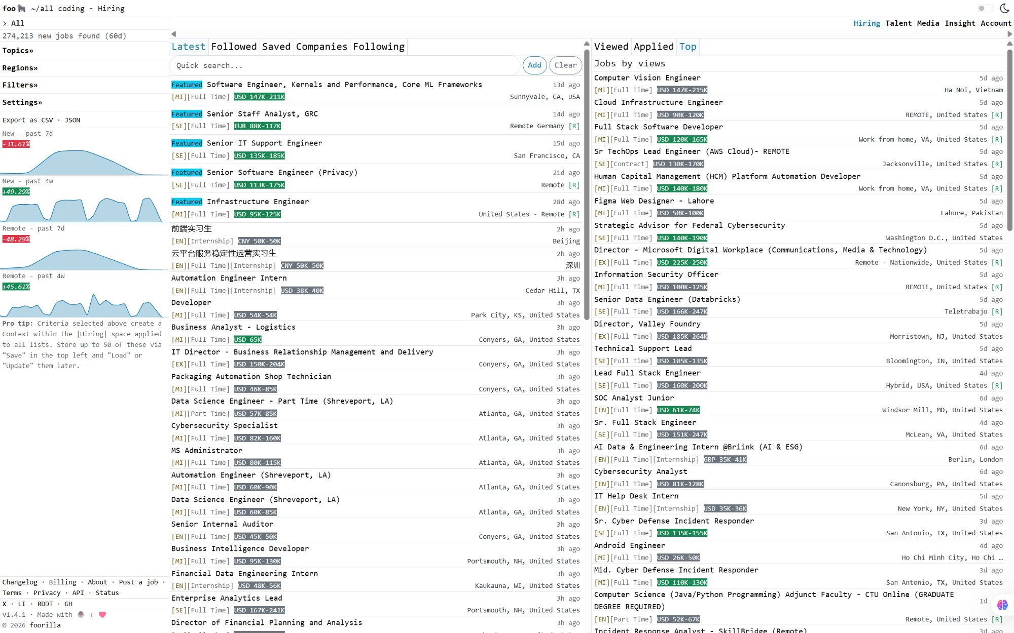
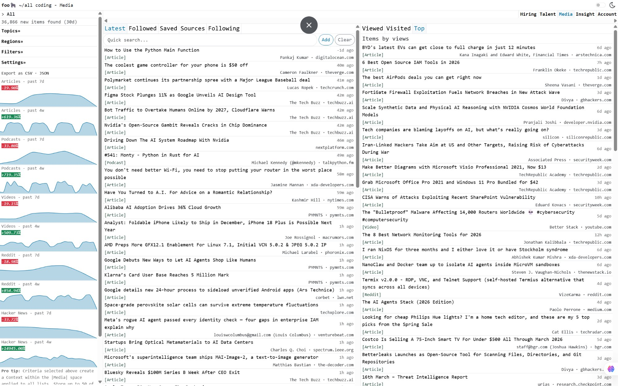
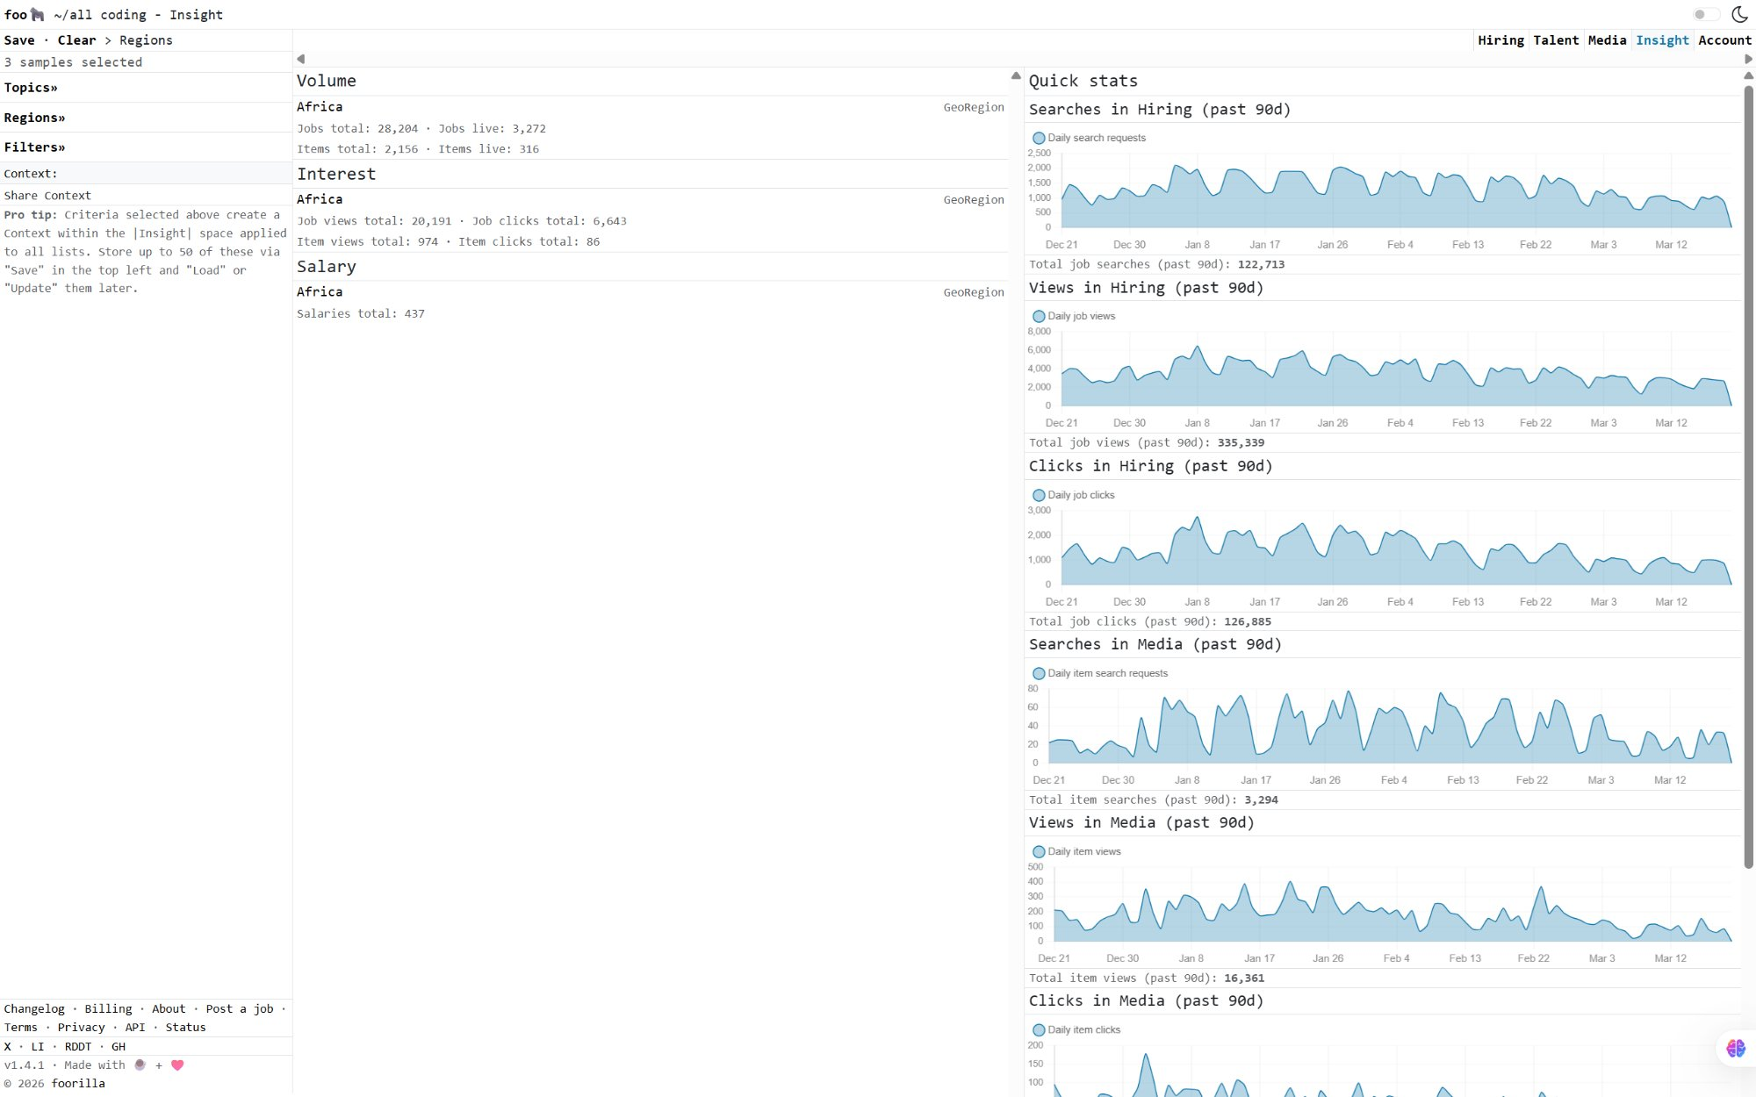
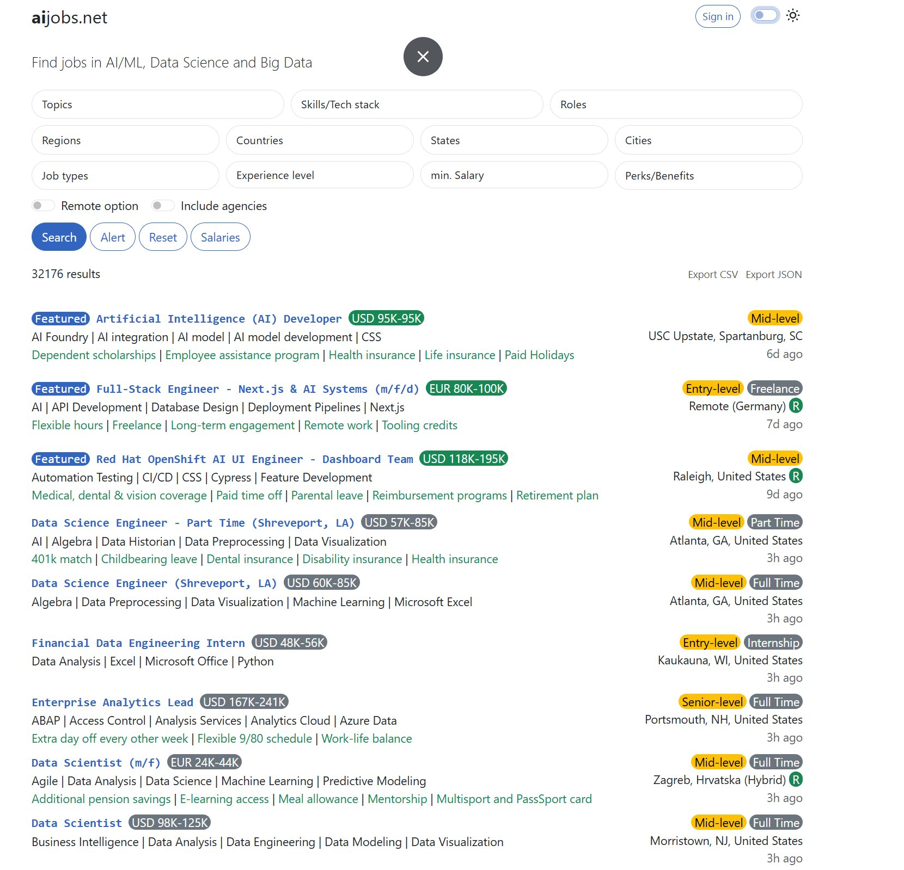
AI JOB MARKET INTELLIGENCE · CS3012 · GROUP 8
07 / 28
Why This Dataset Is Real
Authenticity markers we verified before any preprocessing
Foorilla hiring platform
Media + industry recognition
Internal market insight tools
aijobs.net live search UI
● First-party Kaggle release — published by the official aijobs organisation account
● Real-world distribution: US 90.4% of submissions matches public hiring statistics
● Right-skewed salary distribution (skewness 0.68) — characteristic of real labour markets
● 406 distinct raw job-title strings reflect genuine free-text variation, not synthetic data
● Updated weekly by the platform that runs the live aijobs.net job board
● 99.4% full-time employment ratio matches industry averages
✦ Conclusion: every row in our final salaries_enhanced.csv is a real salary submission. No synthetic data is introduced at any stage of the pipeline.
FAST-NUCES Islamabad · Spring 2026 · Dr. Atif Mughees
Source: aijobs.net (CC0)

Slide 8
AI JOB MARKET INTELLIGENCE · CS3012 · GROUP 8
08 / 28
Preprocessing Pipeline
Five Python scripts: 151,445 rows in → 147,348 × 27 cols out
01 · EXPLORE
02 · CLEAN
03 · STANDARDIZE
04 · SUMMARIZE
05 · ENGINEER
01_explore.py
02_clean.py
03_title_grouping.py
04_summary_stats.py
05_feature_engineering.py
Profile shape · nulls · skew
FT-only · 2022-25 · 1-99 pct
406 raw titles → 15 groups
10 KPI / category CSVs
12 derived analytical cols
✓ DONE
✓ DONE
✓ DONE
✓ DONE
✓ DONE
151,445
150,541
150,264
147,348
147,348 × 27 cols
RAW
FT only
2022-25
Outlier-free
FINAL
We removed 4,097 rows total (2.7%): 904 non-full-time + 277 outside 2022–2025 + 2,916 outliers below the 1st or above the 99th percentile.
FAST-NUCES Islamabad · Spring 2026 · Dr. Atif Mughees
Source: aijobs.net (CC0)

Slide 9
AI JOB MARKET INTELLIGENCE · CS3012 · GROUP 8
09 / 28
Stages 1 & 2 — Explore · Clean
Why the cleaning rules exist
01 · EXPLORE
02 · CLEAN
Purpose
Keep Full-Time
−904
Profile the raw 151,445-row CSV before touching it. Confirm shape, datatypes, missing values, salary distribution, skewness, and the spread of unique values per column.
151,445 → 150,541
Removes contractor / part-time noise so the salary scale is comparable.
Keep 2022 – 2025
−277
Why it matters
150,541 → 150,264
Surfaced the right-skew (0.68), 0 missing values, 99.4% full-time, and 406 unique title strings — the evidence base for every later cleaning decision.
Pre-2022 sample is too small (~1k records) to draw stable trend lines.
Outlier removal (1–99%)
−2,916
150,264 → 147,348
Bounds: $37,974 – $385,000. Trims data-entry errors and extreme top-of-market.
Final salary range after cleaning: $37,974 to $385,000 · 4,097 rows removed total (2.7% of raw)
FAST-NUCES Islamabad · Spring 2026 · Dr. Atif Mughees
Source: aijobs.net (CC0)

Slide 10
AI JOB MARKET INTELLIGENCE · CS3012 · GROUP 8
10 / 28
Stage 3 — Title Grouping
406 raw free-text titles → 15 standardized categories
Technique · keyword string matching
Example mappings
Each free-text title is lowercased and searched for category-specific keyword sets. "ML Eng.", "Machine Learning Engineer", and "MLOps Engineer" all collapse into one canonical category: ML Engineer / MLOps.
"machine learning engineer"
→
ML Engineer / MLOps
"mlops engineer"
→
ML Engineer / MLOps
"applied scientist"
→
Data Scientist
Why it matters
"data engineering manager"
→
Data Engineer
Without grouping, the role bar chart would be unreadable (406 categories) and statistical comparisons would be diluted. The 15-bucket schema preserves real signal — ML Engineer ($194K) is genuinely distinct from Data Analyst ($107K) — while keeping every chart legible.
"bi analyst"
→
Data Analyst
"deep learning researcher"
→
AI / ML Researcher
"head of analytics"
→
Manager / Director
Outcome: ML Engineer / MLOps $194,303 → Software Engineer $180,027 → Data Analyst $107,465
FAST-NUCES Islamabad · Spring 2026 · Dr. Atif Mughees
Source: aijobs.net (CC0)

Slide 11
AI JOB MARKET INTELLIGENCE · CS3012 · GROUP 8
11 / 28
Stages 4 & 5 — Summarize · Engineer 12 columns
From flat data to analysis-ready features for Tableau
04 · SUMMARIZE
05 · ENGINEER (12 derived columns)
Output
◆ CATEGORICAL BINS
10 summary CSVs in notebooks/outputs/
salary_band · salary_quartile
● summary_year_trend.csv
◆ GEOGRAPHIC
● summary_by_role.csv
region · is_us
● summary_by_experience.csv
● summary_by_country.csv
◆ ROLE FAMILY
● summary_by_region.csv
is_ai_core
● summary_us_vs_row.csv
● summary_ai_core_vs_tech.csv
◆ SORT KEY
● summary_remote_trend.csv
exp_order
● summary_salary_bands.csv
◆ YEAR-RELATIVE
● analysis_summary.csv
year_avg_salary · salary_vs_year_avg · …pct
◆ ROLE-RELATIVE
role_avg_salary · salary_vs_role_avg · …pct
FAST-NUCES Islamabad · Spring 2026 · Dr. Atif Mughees
Source: aijobs.net (CC0)

Slide 12
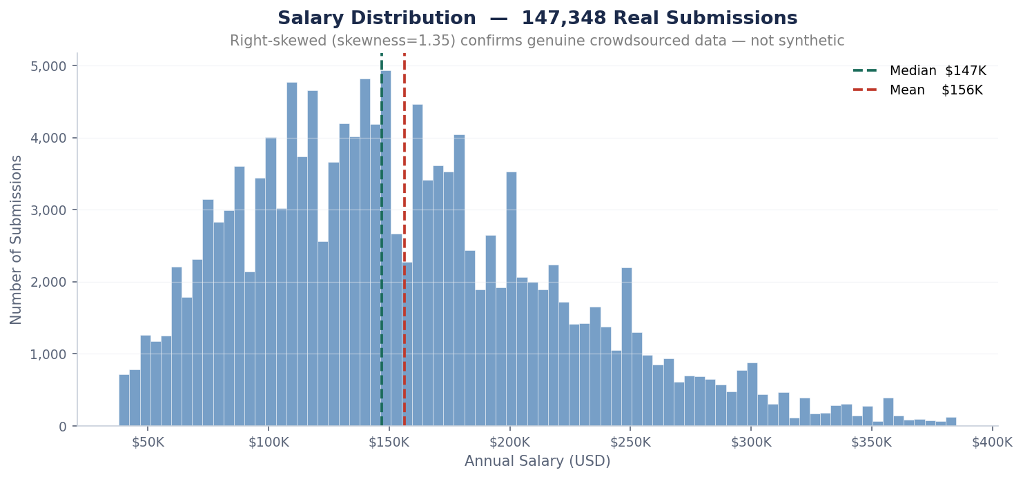
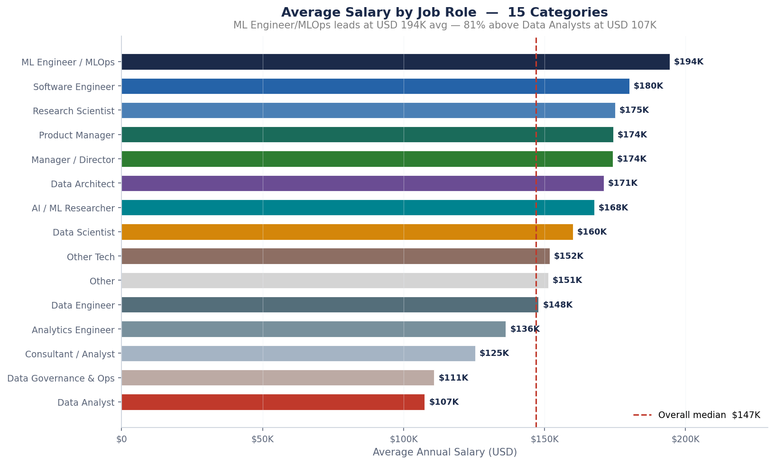
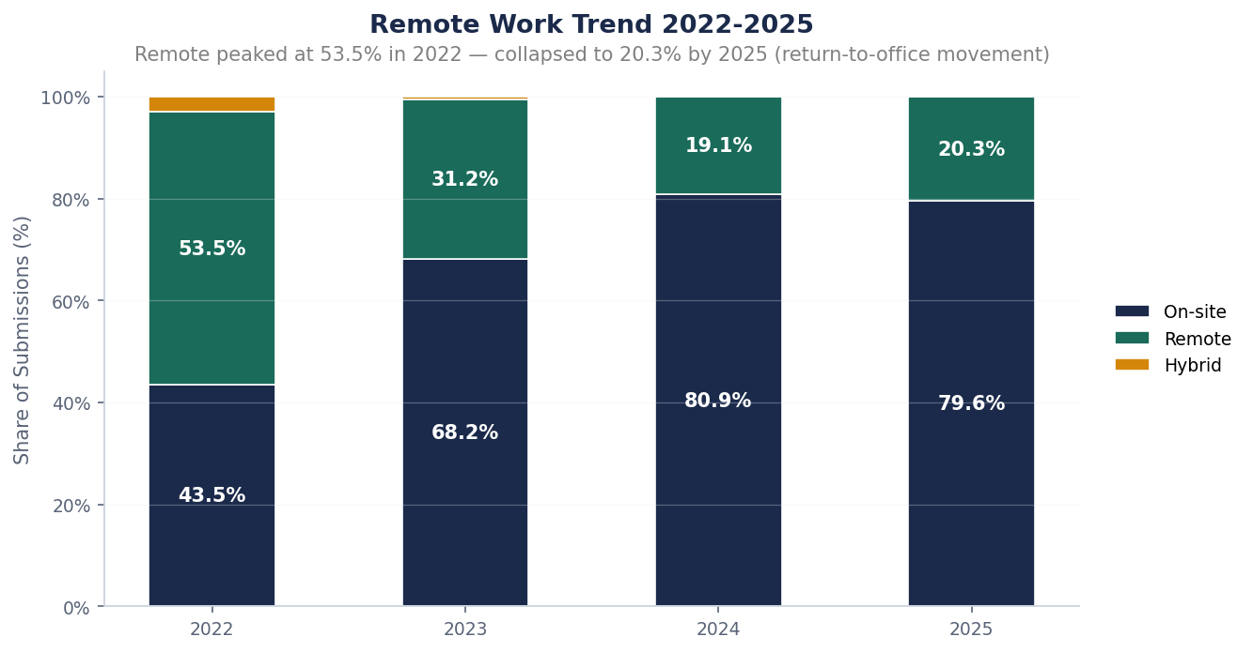
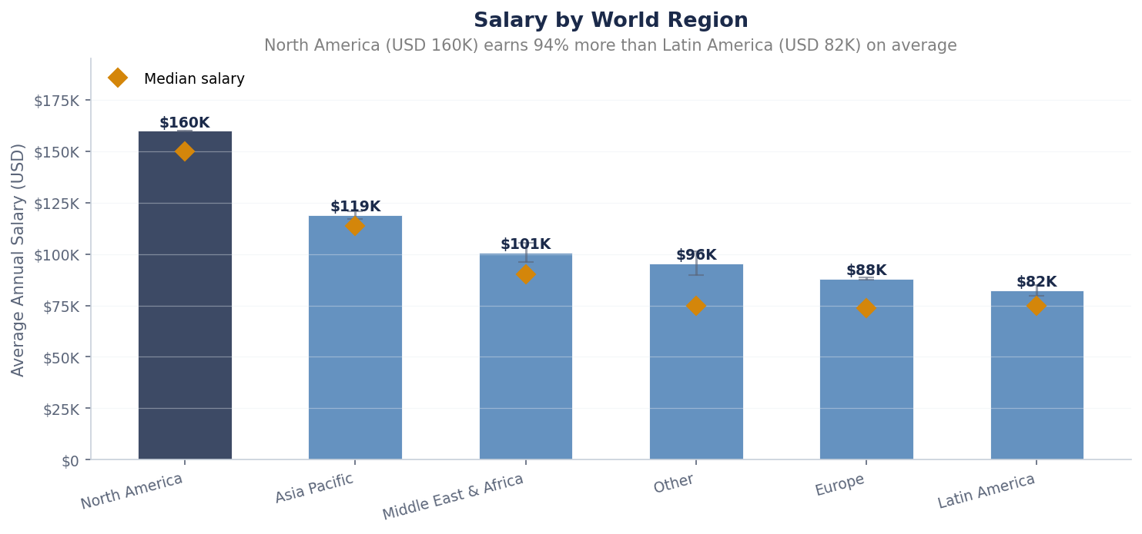
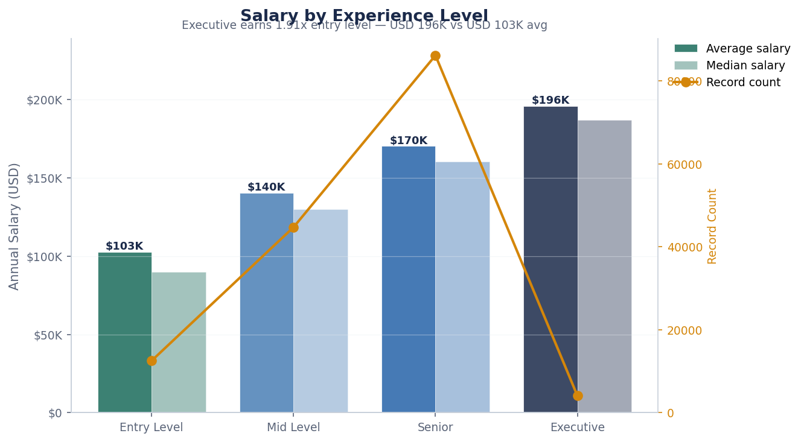
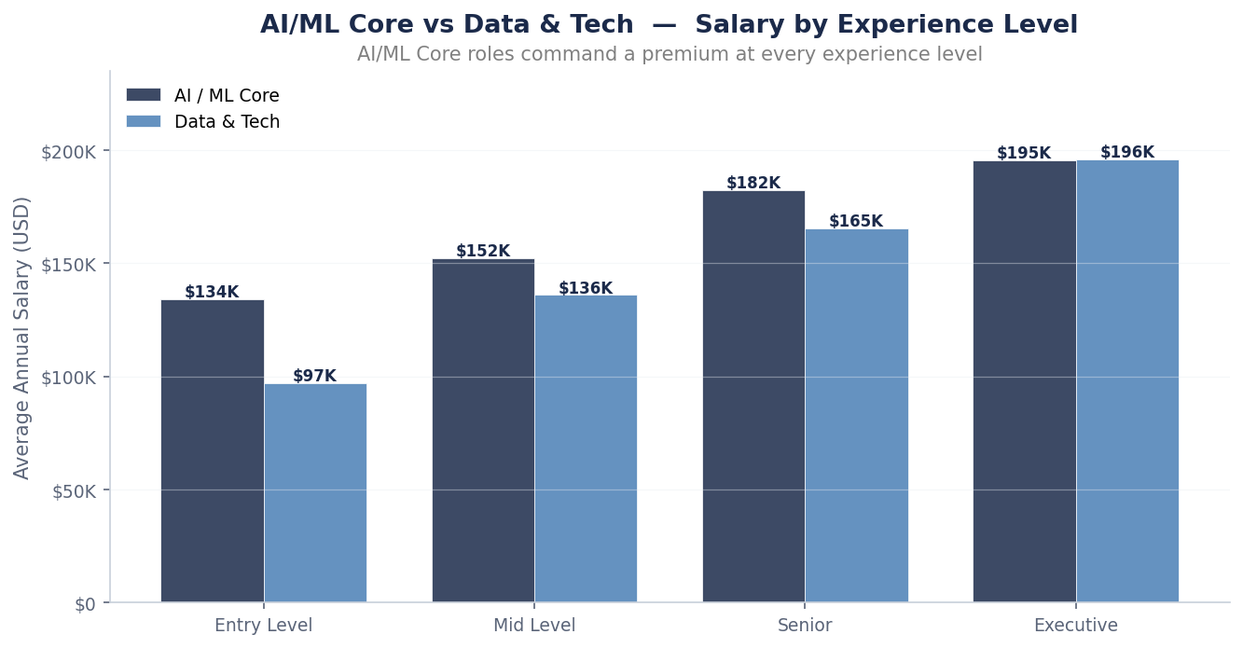
AI JOB MARKET INTELLIGENCE · CS3012 · GROUP 8
12 / 28
Exploratory Data Analysis
20 figures across 7 themes — built in Python before designing Tableau
Salary distribution
Top-paying roles
Remote-work collapse
Regional pay gap
Career progression
AI Core premium
FAST-NUCES Islamabad · Spring 2026 · Dr. Atif Mughees
Source: aijobs.net (CC0)

Slide 13
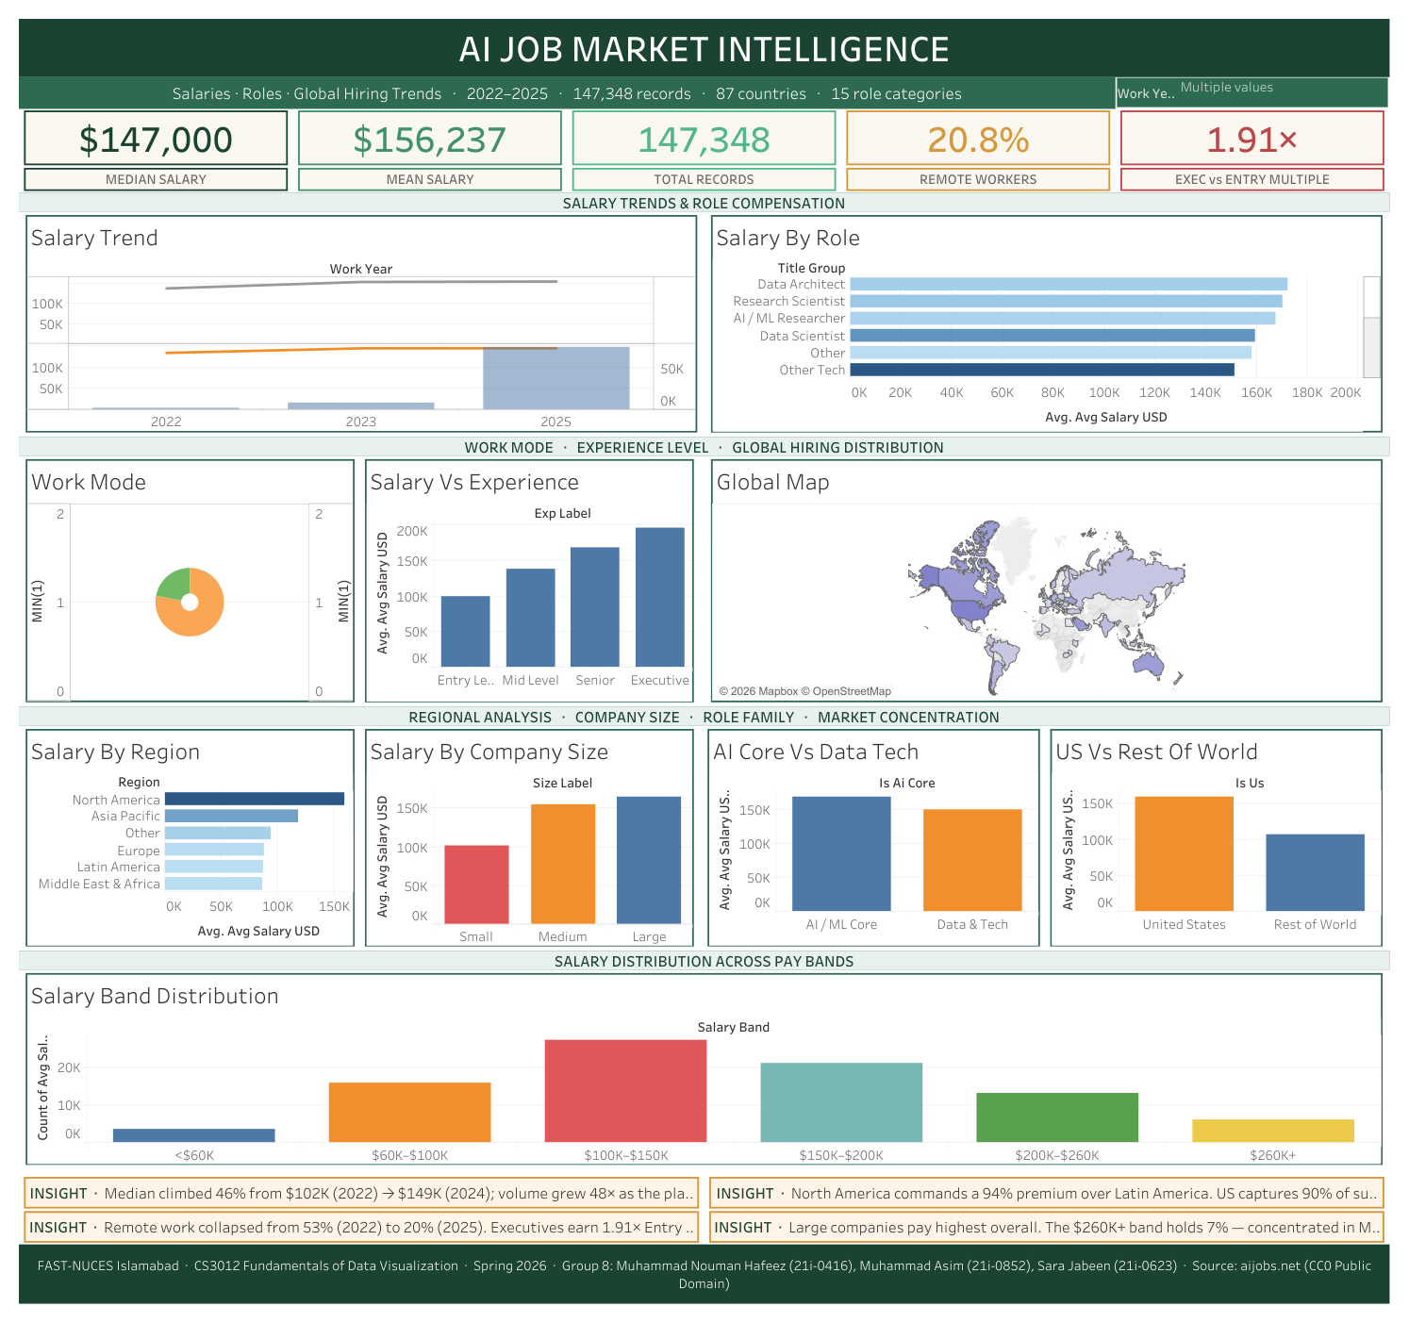
AI JOB MARKET INTELLIGENCE · CS3012 · GROUP 8
13 / 28
Tableau Master Dashboard
1200 × 1500 · 10 worksheets · 5 KPI tiles · 4 insight callouts
✦ Forest emerald palette
Top-down narrative grid →
✦ Click-to-filter actions
Section bands group sheets →
✦ 5 colour-coded KPI tiles
Mint section headers →
✦ 4 insight callouts
Forest title + footer bars →
FAST-NUCES Islamabad · Spring 2026 · Dr. Atif Mughees
Source: aijobs.net (CC0)

Slide 14
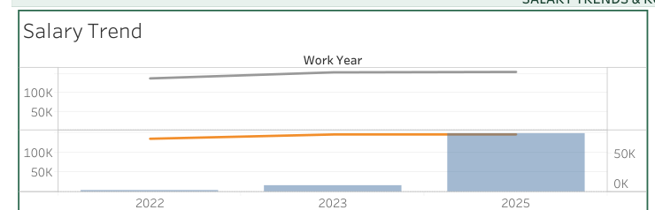
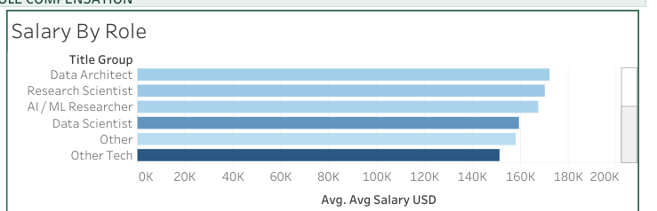
AI JOB MARKET INTELLIGENCE · CS3012 · GROUP 8
14 / 28
Section 1 — Salary Trends & Role Compensation
Sheet 1 — Salary Trend · Sheet 2 — Salary By Role
Salary Trend (2022 – 2025)
Salary By Role (Top 10)
ANALYSIS · Median climbed 46% from $102K (2022) → $149K (2024). Submission volume grew 48× as the platform matured.
ANALYSIS · ML Engineer / MLOps leads at $194K — 81% above Data Analyst. Top six roles all clear the $170K mark.
FAST-NUCES Islamabad · Spring 2026 · Dr. Atif Mughees
Source: aijobs.net (CC0)

Slide 15
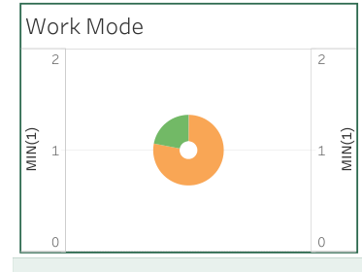
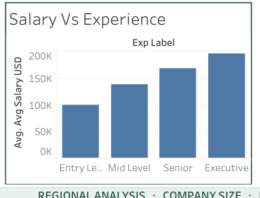
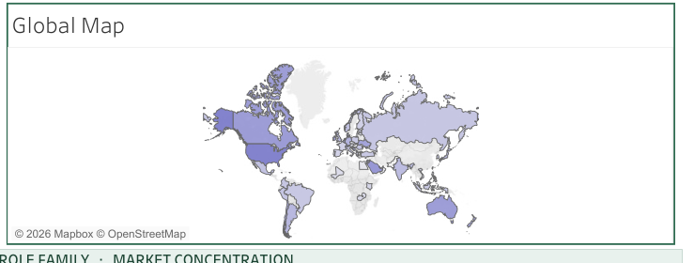
AI JOB MARKET INTELLIGENCE · CS3012 · GROUP 8
15 / 28
Section 2 — Work Mode · Experience · Geography
Sheets 3, 4, 5 — Work Mode donut, Experience bars, World choropleth
Work Mode (Donut)
Salary vs Experience
Global Hiring Map
ANALYSIS · On-site dominates at ~74%. Remote shrunk; hybrid is gone.
ANALYSIS · $103K → $140K → $170K → $196K (1.91× from Entry to Exec).
ANALYSIS · US dominates volume. Click any country to filter every other panel.
FAST-NUCES Islamabad · Spring 2026 · Dr. Atif Mughees
Source: aijobs.net (CC0)

Slide 16
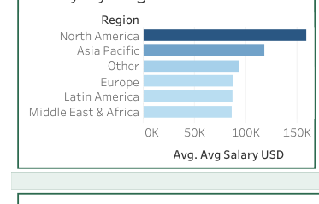
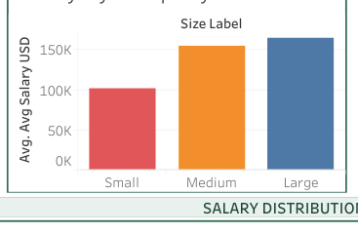
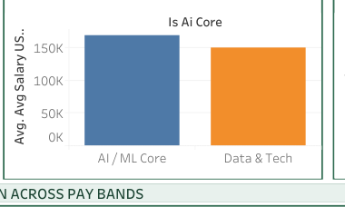
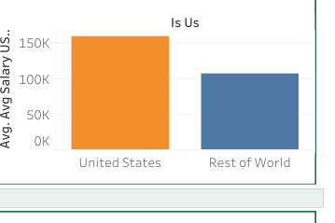
AI JOB MARKET INTELLIGENCE · CS3012 · GROUP 8
16 / 28
Section 3 — Regional · Company Size · Role Family · Market Concentration
Sheets 6, 7, 8, 9 — four comparative panels added in the latest rev
By Region
By Company Size
AI Core vs Data&Tech
US vs Rest of World
● North America $159K dominates. 94% premium over Latin America.
● Small $103K → Medium $155K → Large $165K. The big jump is Small→Medium.
● AI/ML Core $171K vs Data&Tech $151K — a 13% "AI tax" premium.
● US $161K vs RoW $108K — 49% premium per record (133K vs 14K rows).
FAST-NUCES Islamabad · Spring 2026 · Dr. Atif Mughees
Source: aijobs.net (CC0)

Slide 17
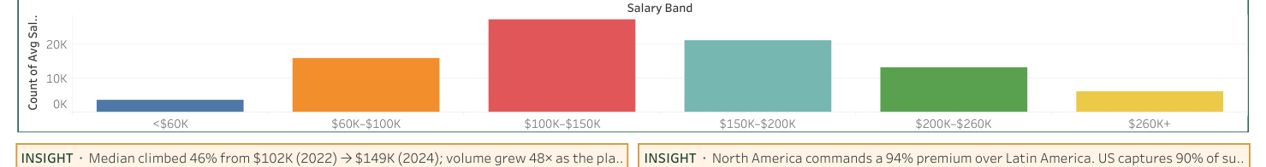
AI JOB MARKET INTELLIGENCE · CS3012 · GROUP 8
17 / 28
Section 4 — Salary Distribution Across Pay Bands
Sheet 10 — full-width histogram of every record across 6 bands
<$60K
$60K–$100K
$100K–$150K
$150K–$200K
$200K–$260K
$260K+
3.9%
18.0%
31.0%
24.3%
15.5%
7.3%
5,742 rows
26,572 rows
45,617 rows
35,738 rows
22,901 rows
10,778 rows
✦ Insight · 55% of all records sit in the $100K–$200K window. Modal class is $100K–$150K with 31% / ~46K rows. The top tier $260K+ holds a non-trivial 7.3% / 10,778 rows.
FAST-NUCES Islamabad · Spring 2026 · Dr. Atif Mughees
Source: aijobs.net (CC0)

Slide 18
AI JOB MARKET INTELLIGENCE · CS3012 · GROUP 8
18 / 28
The Story Our Dashboard Tells
A four-act narrative running top-to-bottom on the canvas
ACT 1
The market is broadening, not inflating
REFERS TO
Volume jumps 48× while median salary plateaus near $146K.
Sheets 1, 2
ACT 2
Career level matters more than work mode
REFERS TO
$103K → $196K from Entry to Exec, while remote retreats to 20%.
Sheets 3, 5
ACT 3
Geography concentrates the money in North America
REFERS TO
US 90% of submissions at $161K; world average drops to $108K.
Sheets 4, 6, 9
ACT 4
Direct AI/ML exposure is rewarded
REFERS TO
AI Core premium of 13%; ML Engineer / MLOps tops the pay table.
Sheets 7, 8, 10
→ The reader can interrogate any act by clicking a country, picking a year, or selecting a role bar.
FAST-NUCES Islamabad · Spring 2026 · Dr. Atif Mughees
Source: aijobs.net (CC0)

Slide 19
AI JOB MARKET INTELLIGENCE · CS3012 · GROUP 8
19 / 28
Key Insights — Part 1
What the data revealed (1 / 2)
01
ML Engineering is the highest-paid AI/ML track
02
Compensation grows nearly 2× from Entry to Executive
ML Engineer / MLOps leads at $194,303 — 81% above Data Analyst. Software Engineer ($180K) and Research Scientist ($175K) follow.
Entry $102,743 → Mid $140,382 → Senior $170,351 → Executive $195,935. The EX/EN ratio is exactly 1.91×.
03
Remote work has collapsed since 2022
04
The US dominates volume — and the premium is everywhere
Remote dropped from 53.5% (2022) to 20.3% (2025). On-site nearly doubled from 43.5% to 79.6%. Hybrid effectively vanished.
United States supplies 90.4% of submissions (133,143 rows) at $161,381 average. Rest of World averages $108,024.
FAST-NUCES Islamabad · Spring 2026 · Dr. Atif Mughees
Source: aijobs.net (CC0)

Slide 20
AI JOB MARKET INTELLIGENCE · CS3012 · GROUP 8
20 / 28
Key Insights — Part 2
What the data revealed (2 / 2)
05
Salaries are concentrated in $100K–$200K
06
AI/ML Core commands a 13% premium
55% of all records sit in the $100K–$200K window (31% in $100K–$150K + 24% in $150K–$200K). Top tier $260K+ holds 7.3%.
AI/ML Core averages $171,009 vs $150,685 for Data & Tech. Direct AI/ML exposure earns ~$20K extra per year.
07
Company size matters — but only past Small
08
The market is maturing — volume up, pay flat
Small $103K → Medium $155K → Large $165K. The biggest jump is Small→Medium (+50%); Medium→Large is only $10K.
Submission volume grew 48× from 2022 (1,587) to 2025 (76,424). Median salary trajectory plateaus after 2024 ($149K → $146K).
FAST-NUCES Islamabad · Spring 2026 · Dr. Atif Mughees
Source: aijobs.net (CC0)

Slide 21
AI JOB MARKET INTELLIGENCE · CS3012 · GROUP 8
21 / 28
How Tableau Helped (1 / 2)
From static figures to a tool that stakeholders can interrogate
01 · Single Interactive Canvas
02 · Click-to-Filter Actions
The 20 Python figures each told one story. Tableau merged the strongest 10 into a unified 1200×1500 dashboard with cross-filtering — investigate any cohort without producing a new figure.
A single Filter action on the Global Map propagates the selected country into every other worksheet — synchronised cross-analysis impractical to replicate in matplotlib.
03 · Custom Calculated Fields
04 · Geographic Intelligence
Avg Salary USD, Median Salary USD, EX/EN Ratio, custom shelf sorts on salary_band and title_group. Consistent metrics across every worksheet.
Tagging company_location with Country/Region role auto-resolved 87 ISO-2 codes into a world choropleth — no GIS code required.
FAST-NUCES Islamabad · Spring 2026 · Dr. Atif Mughees
Source: aijobs.net (CC0)

Slide 22
AI JOB MARKET INTELLIGENCE · CS3012 · GROUP 8
22 / 28
How Tableau Helped (2 / 2)
From explore to communicate — Tableau's compounding advantages
05 · Tooltips Beat Static Legends
06 · KPI Strip for At-A-Glance Reading
Every panel has a custom tooltip (count, avg, median, deviation). Hovering replaces the need for legends — every chart self-documents.
Five colour-coded KPI tiles ($147K · $156K · 147,348 · 20.8% · 1.91×) sit under the title bar — readers grasp the market in two seconds.
07 · Visual Encoding Richness
08 · Reproducibility via Packaged .twb
Sequential color (choropleth · role bar), categorical palettes (Work Mode · Salary Band), dual-pane on Trend (median line + volume bars) — all from one tool.
Entire dashboard is a single Dashboard.twb XML file. Anyone with Tableau Desktop can repoint the data and reproduce every chart — no hidden state.
✦ In one sentence · Tableau converted our static findings into a tool. Without it the report is a deck of charts; with it, the report has a companion artefact that the reader can manipulate.
FAST-NUCES Islamabad · Spring 2026 · Dr. Atif Mughees
Source: aijobs.net (CC0)

Slide 23
AI JOB MARKET INTELLIGENCE · CS3012 · GROUP 8
23 / 28
Design System · Forest Emerald
Color palette and visual language used across dashboard and report
Forest
Emerald
Jade
#1B4332
#2D6A4F
#40916C
Primary · title bar, footer, KPI #1
Subtitle, all panel borders (2px)
KPI #2 · Mean salary
Sage
Honey
Rust
#52B788
#D8973C
#BC4749
KPI #3 · Total records
KPI #4 · Remote workers, insight border
KPI #5 · EX/EN multiple
Cream
Mint Mist
Warm Peach
#FAF8F0
#E8F1ED
#FFF4E5
Card / chart background
Section header bands
Insight callout backgrounds
Why this palette? — Distinctive (most dashboards default to blue), accessible (strong contrast), and earthy (signals the maturity of the AI labour market).
FAST-NUCES Islamabad · Spring 2026 · Dr. Atif Mughees
Source: aijobs.net (CC0)

Slide 24
AI JOB MARKET INTELLIGENCE · CS3012 · GROUP 8
24 / 28
Tech Stack & Deliverables
What is in the repository
DATA
salaries.csv · salaries_clean_final.csv · salaries_enhanced.csv
PYTHON
5 preprocessing scripts · pandas · numpy · scipy
EDA
AI_Job_Market_EDA.ipynb · 20 figures · 10 summary CSVs
TABLEAU
Dashboard.twb (10 worksheets) · Dashboard.pdf · build plan
REPORT
Final_Project_Report.tex / .pdf · 40 pages · 9 chapters
PRESENT
Group8_Final_Presentation.pptx (this deck)
FAST-NUCES Islamabad · Spring 2026 · Dr. Atif Mughees
Source: aijobs.net (CC0)

Slide 25
AI JOB MARKET INTELLIGENCE · CS3012 · GROUP 8
25 / 28
Conclusion & Takeaways
What we built and why it matters
END-TO-END
EVIDENCE-BASED
From raw 151,445 rows to an interactive 10-worksheet Tableau dashboard, with a Python pipeline and a 40-page report tying it all together.
Every claim in the dashboard is backed by a real CC0 record. No synthetic data introduced anywhere in the pipeline.
INTERACTIVE
REPRODUCIBLE
Click any country to re-scope every panel. KPI strip gives a 2-second read. Hover for tooltip-level detail.
Single .twb file + 5 Python scripts + a CSV. Anyone can clone, repoint, and regenerate.
FIVE GUIDING QUESTIONS · ALL ANSWERED:
ML Engineer at $194K · 1.91× from Entry to Exec · Remote 53% → 20% · US 90% of submissions · 55% in $100–$200K band
FAST-NUCES Islamabad · Spring 2026 · Dr. Atif Mughees
Source: aijobs.net (CC0)

Slide 26
Q & A
THANK YOU
We welcome your questions on data, methodology, or the dashboard.
GROUP 8 · CS3012 · FAST-NUCES Islamabad · Spring 2026
Muhammad Nouman Hafeez (21i-0416) · Muhammad Asim (21i-0852) · Sara Jabeen (21i-0624)
Repository: github.com/noumanic/ai-job-market-analytics · Source: aijobs.net (CC0)

