Slide 1
A
AutoWorks
AutoWorks
Workshop Management System
An end-to-end platform to run an automotive workshop — customers, vehicles, work orders, and invoicing in one place.
Stakeholder Demo · Phase 1 MVP

Slide 2
A
AutoWorks
OVERVIEW
What is AutoWorks?
A modern web application that digitizes the day-to-day operations of an automotive repair workshop.
• Replaces paper job cards and spreadsheets
• Single source of truth for customers & vehicles
• Tracks every job from intake to payment
• Generates invoices automatically from completed work
• Real-time revenue & operations dashboard
5
Core modules
100%
Web-based
JWT
Secure access
AutoWorks — Workshop Management System
2

Slide 3
A
AutoWorks
UNDER THE HOOD
Architecture & Technology
Frontend
Angular 19 · Angular Material · responsive SPA
REST API
ASP.NET Core · Clean Architecture · FluentValidation
Security
ASP.NET Identity · JWT auth · role-based access
Data
Entity Framework Core · PostgreSQL 16
AutoWorks — Workshop Management System
3

Slide 4
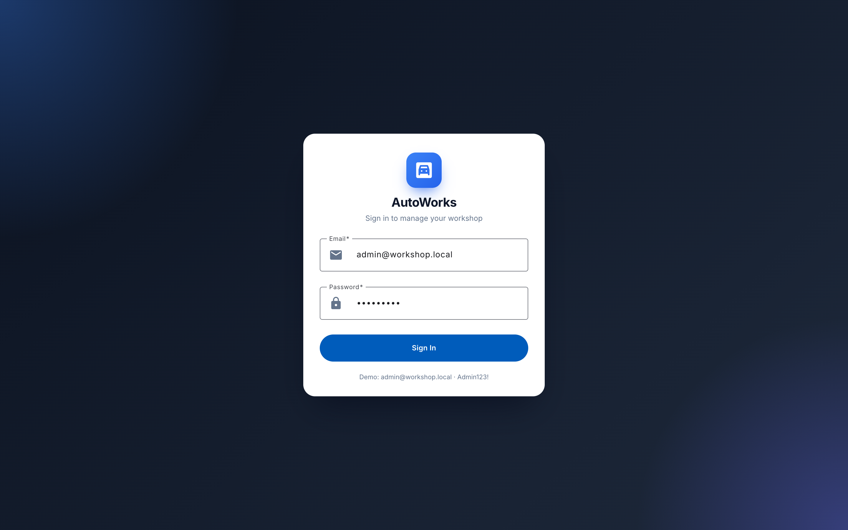
A
AutoWorks
ACCESS
Secure Login
• Email + password authentication
• JWT tokens issued on sign-in
• Role-based access (Admin, Manager, Technician)
• Clean, branded entry point
AutoWorks — Workshop Management System
4

Slide 5
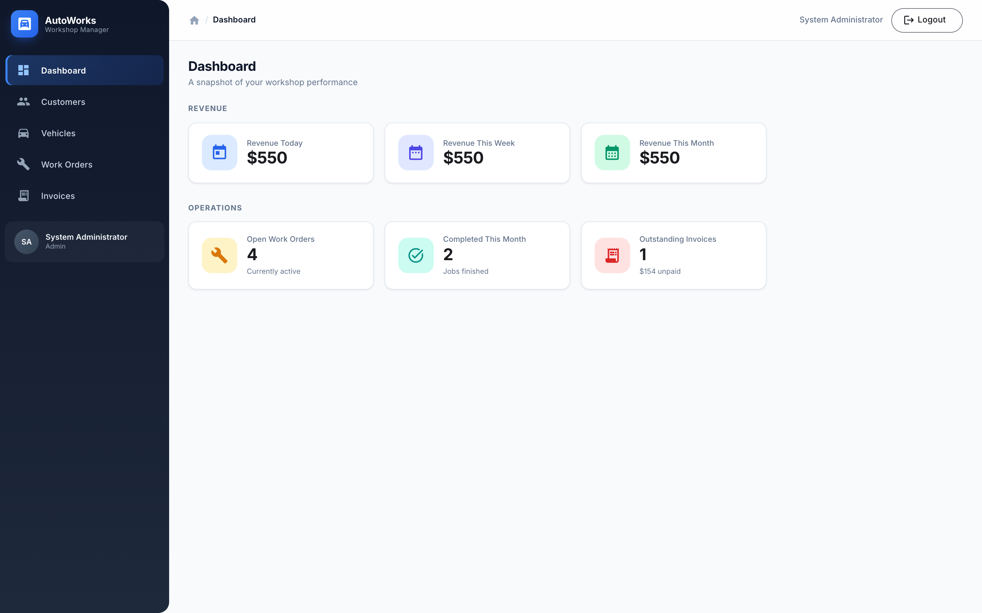
A
AutoWorks
AT A GLANCE
Operations Dashboard
• Revenue today / this week / this month
• Open work orders in progress
• Jobs completed this month
• Outstanding (unpaid) invoice totals
• Live KPIs the moment you log in
AutoWorks — Workshop Management System
5

Slide 6
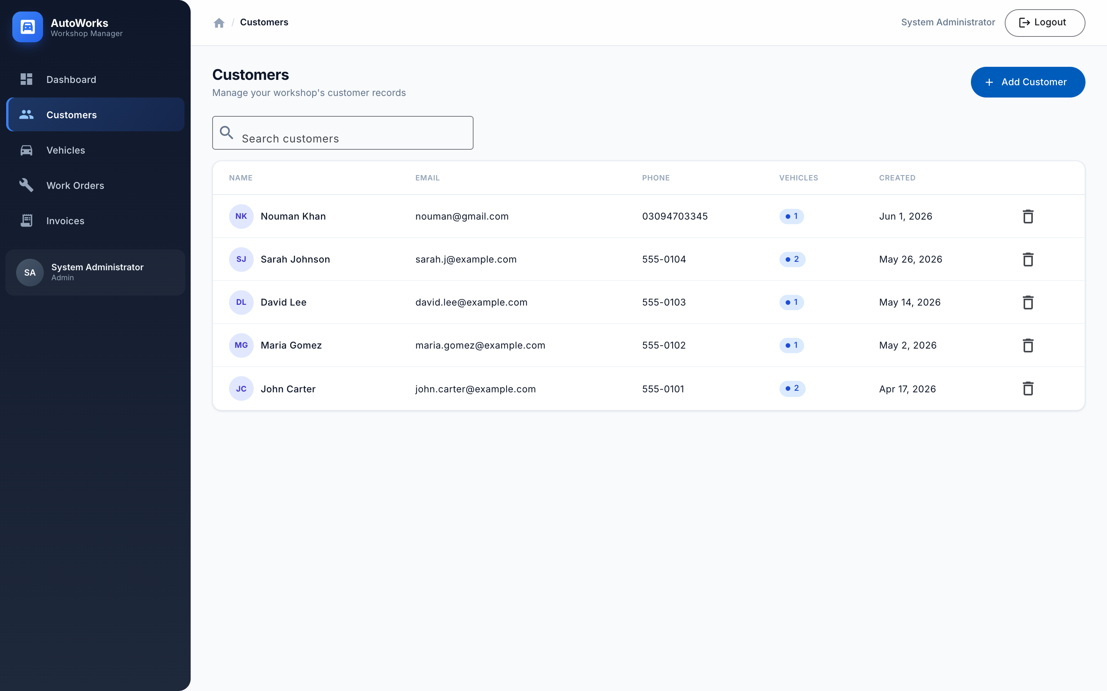
A
AutoWorks
MODULE
Customers
• Searchable customer directory
• Add new customers in seconds
• Contact details & vehicle counts
• Foundation for jobs and billing
AutoWorks — Workshop Management System
6

Slide 7
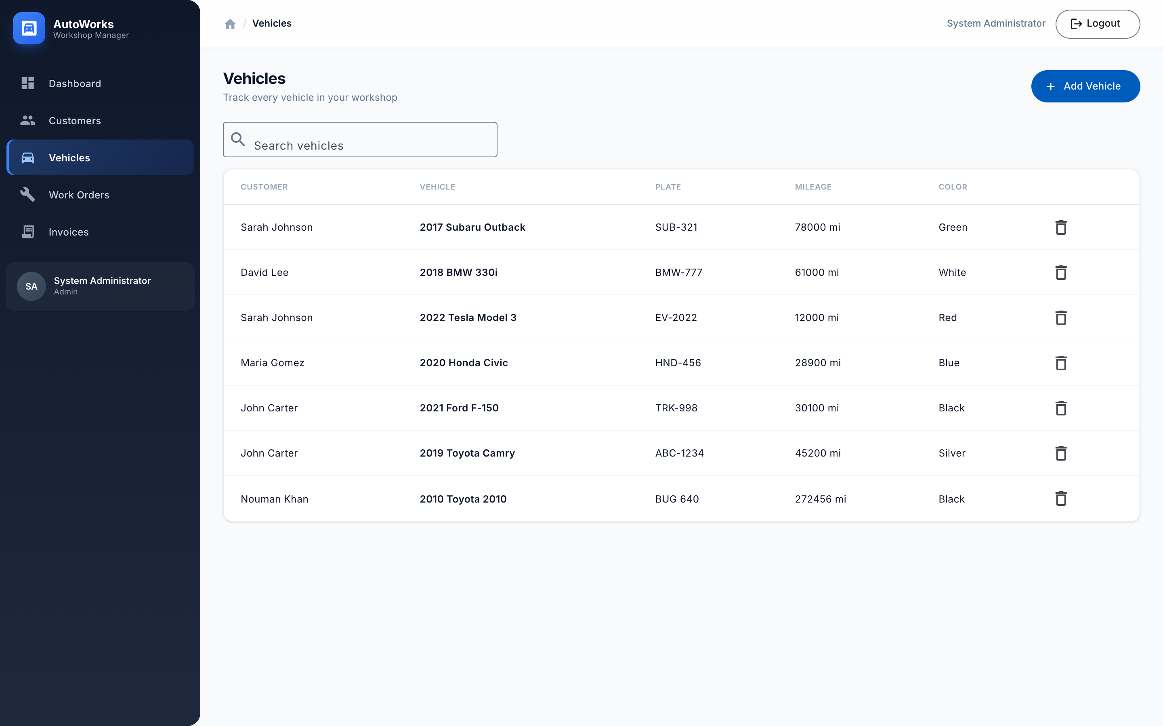
A
AutoWorks
MODULE
Vehicles
• Every vehicle linked to its owner
• Make, model, year, plate, mileage, VIN
• Quick search across the fleet
• Add vehicles via guided form
AutoWorks — Workshop Management System
7

Slide 8
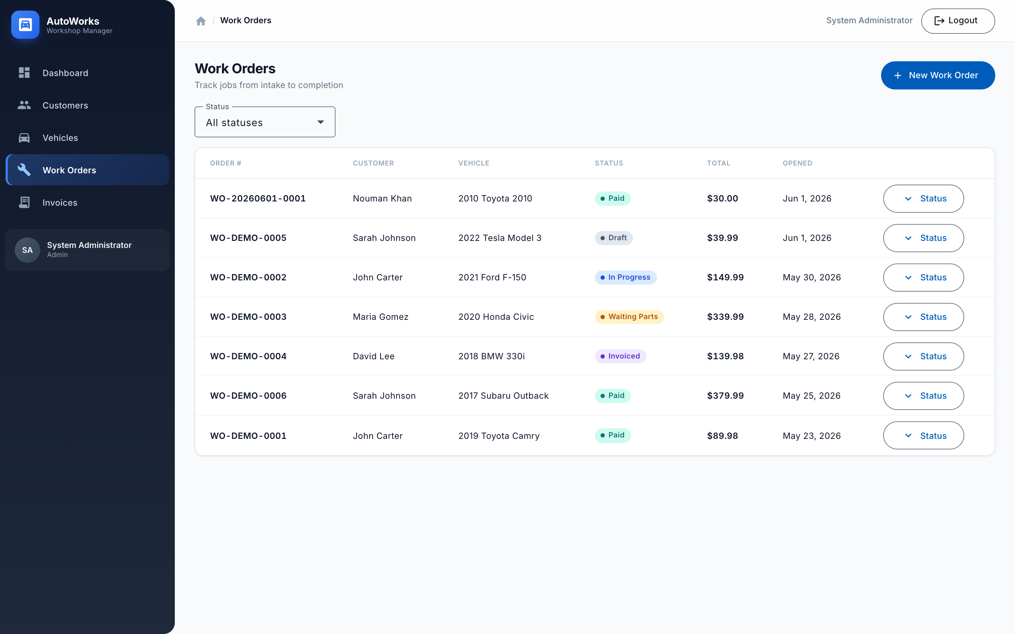
A
AutoWorks
MODULE
Work Orders
• Track jobs from intake to completion
• Color-coded status workflow
• Filter by status
• One-click status updates
• Line-item pricing per job
AutoWorks — Workshop Management System
8

Slide 9
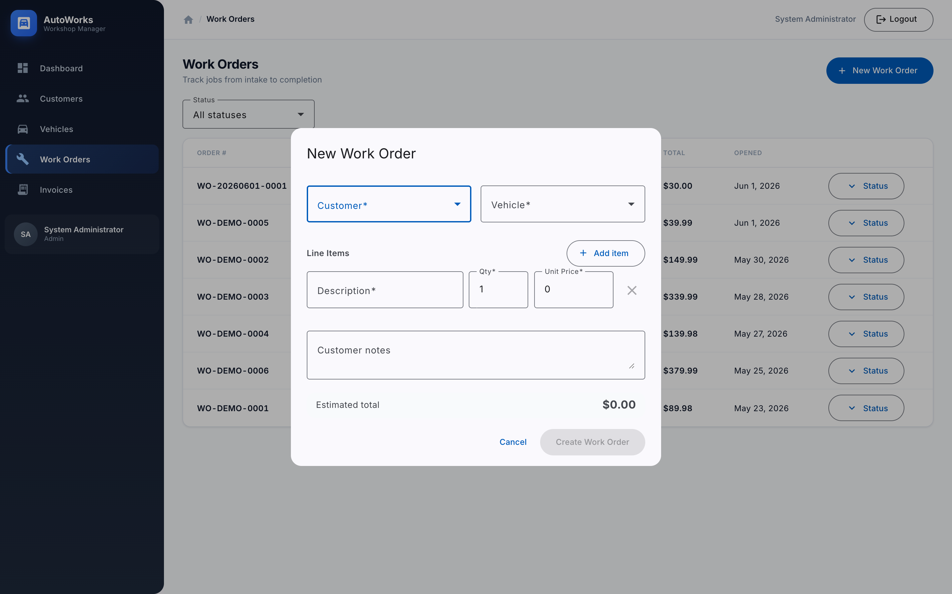
A
AutoWorks
WORKFLOW
Creating a Work Order
• Pick customer, then their vehicle
• Add unlimited service line items
• Live estimated total as you type
• Capture customer notes
• Fast, validated data entry
AutoWorks — Workshop Management System
9

Slide 10
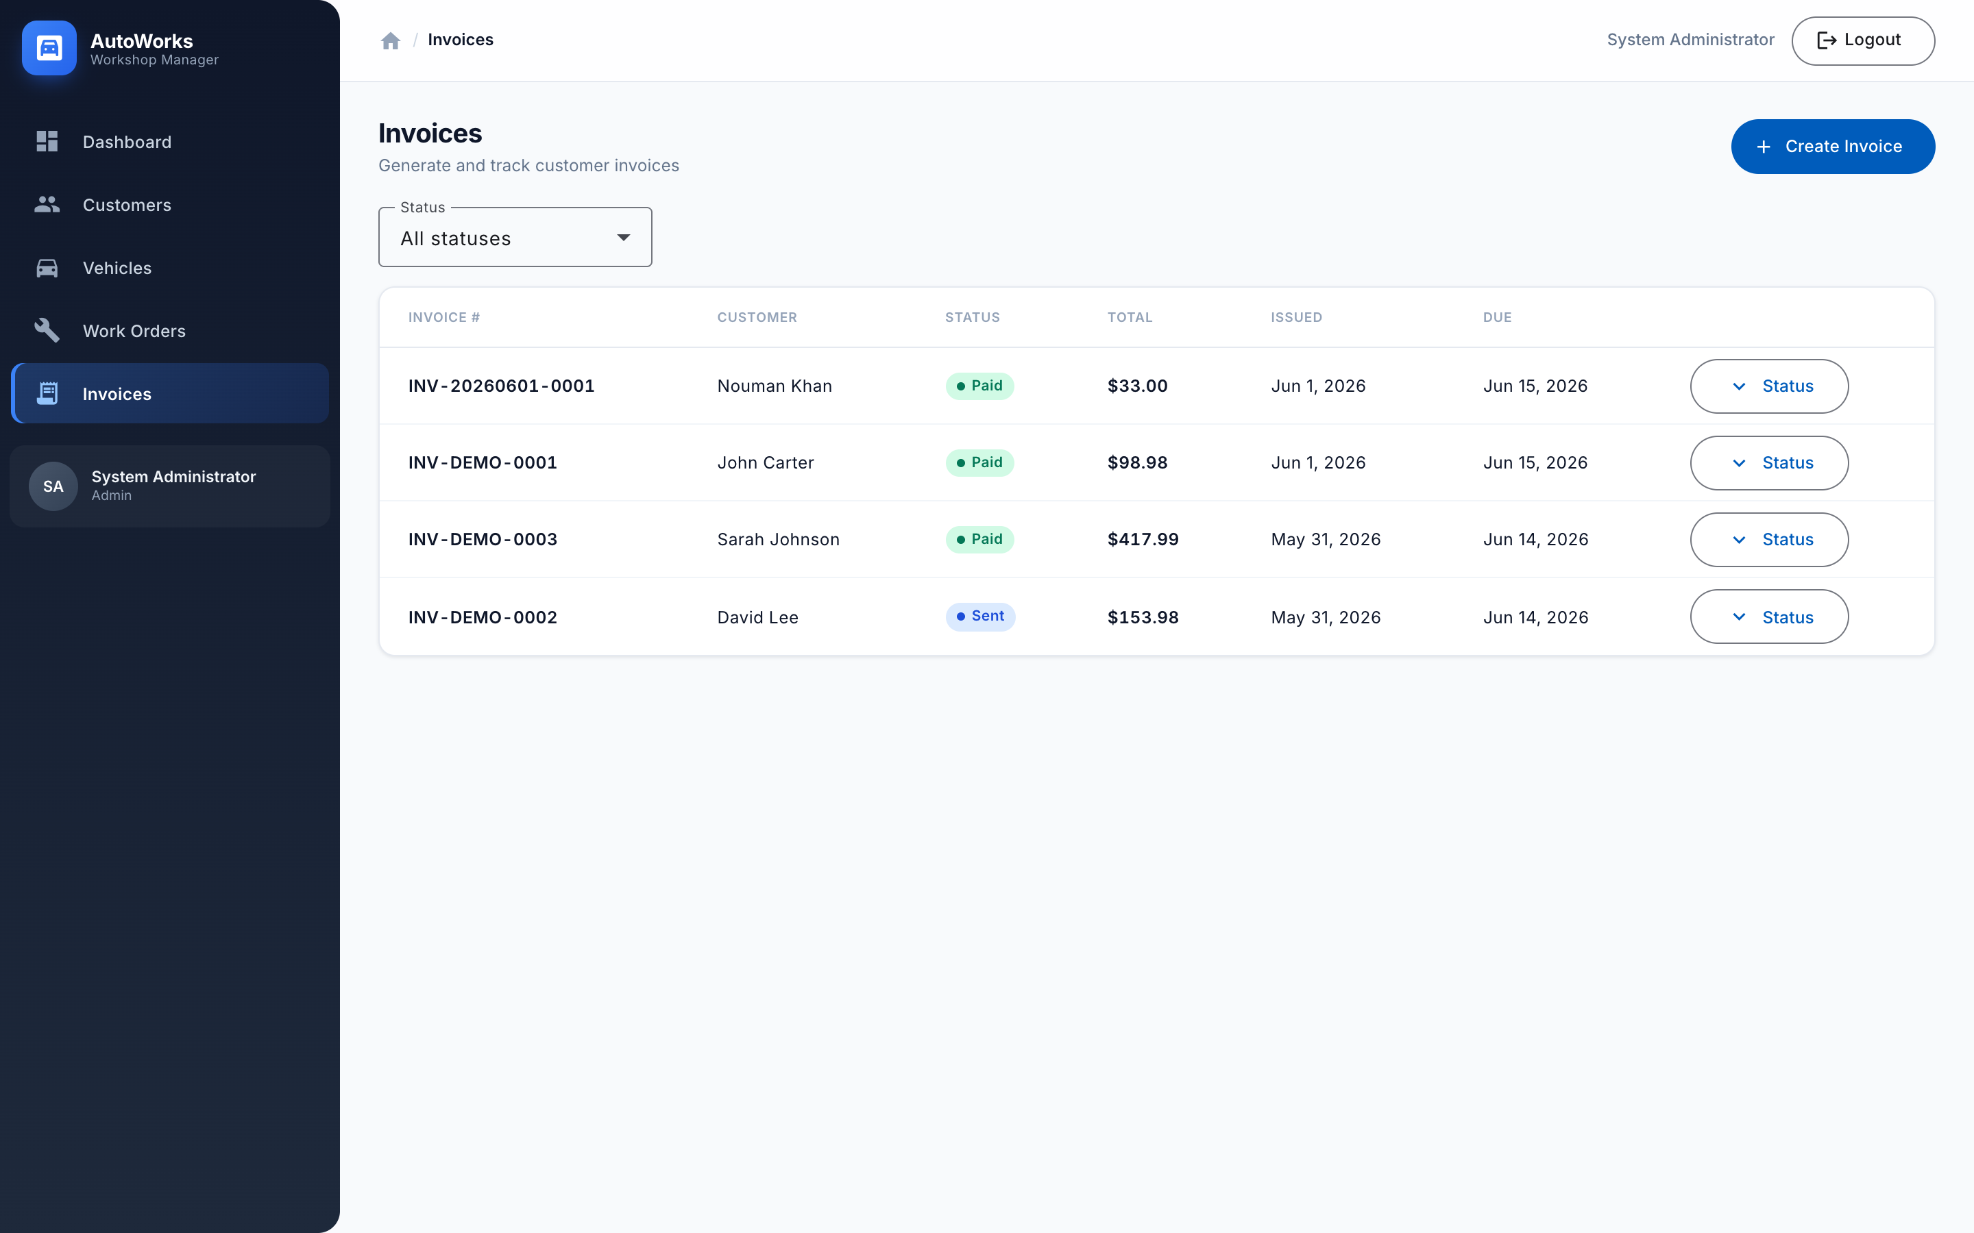
A
AutoWorks
MODULE
Invoices
• Generate invoices from completed jobs
• Automatic tax calculation
• Status lifecycle: Draft → Sent → Paid
• Track due dates & outstanding balances
AutoWorks — Workshop Management System
10

Slide 11
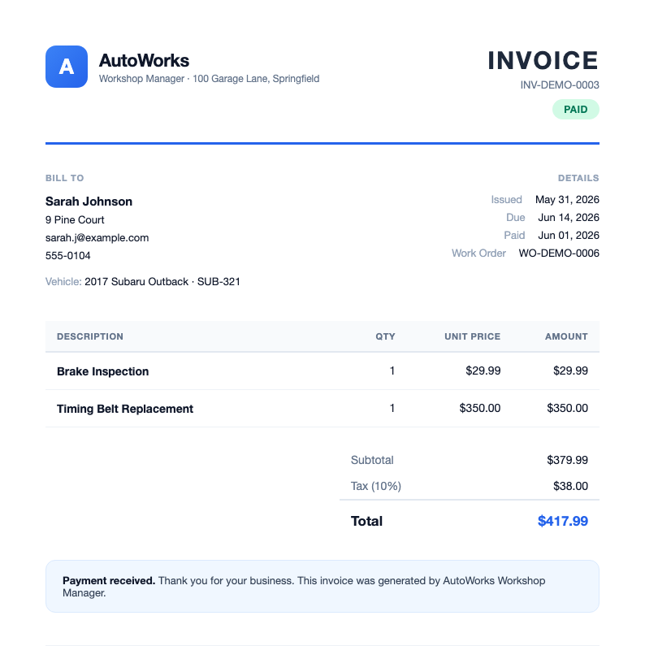
A
AutoWorks
DELIVERABLE
Invoice Document
A print-ready invoice generated automatically from work-order data — branded, itemized, with tax and totals.
• Customer & vehicle details
• Itemized lines, subtotal, tax, total
• Payment status & due dates
• One-click generation from a completed job
The real PDF is embedded in this slide — double-click the invoice to open it.
AutoWorks — Workshop Management System
11

Slide 12
A
AutoWorks
DESIGN
UI Proposal & Visual Theme
COLOR PALETTE
TYPOGRAPHY
COMPONENTS
Inter
Geometric, highly legible UI typeface
Heading — 600
Subheading — 500
Body copy is set at a comfortable 14px with relaxed line-height for scanning dense data.
CAPTION / META · 11px
Paid
In Progress
Primary
#2563EB
Primary Dark
#1D4ED8
Waiting Parts
Overdue
+ Primary
Secondary
Sidebar / Ink
#0F172A
Success
#059669
$12,480
KPI card · rounded 12px · soft shadow
Warning
#D97706
Surface
#F8FAFC
8-px spacing grid
Card-based surfaces
12px rounded corners
Soft elevation shadows
Fully responsive
AutoWorks — Workshop Management System
12

Slide 13
A
AutoWorks
WHAT'S NEXT
Roadmap
SHIPPED (Phase 1 MVP)
PLANNED (Next sprints)
• Customer & vehicle management
• Work-order workflow & statuses
• Invoice generation + tax
• Analytics dashboard
• JWT security & roles
• PDF export & email delivery
• Inline editing of records
• Technician scheduling / calendar
• Parts & inventory tracking
• Customer self-service portal
AutoWorks — Workshop Management System
13

Slide 14
A
AutoWorks
Thank you
Questions & live walkthrough
Demo login admin@workshop.local / Admin123!

