Slide 1

This is the new title
This is the new description

Slide 2
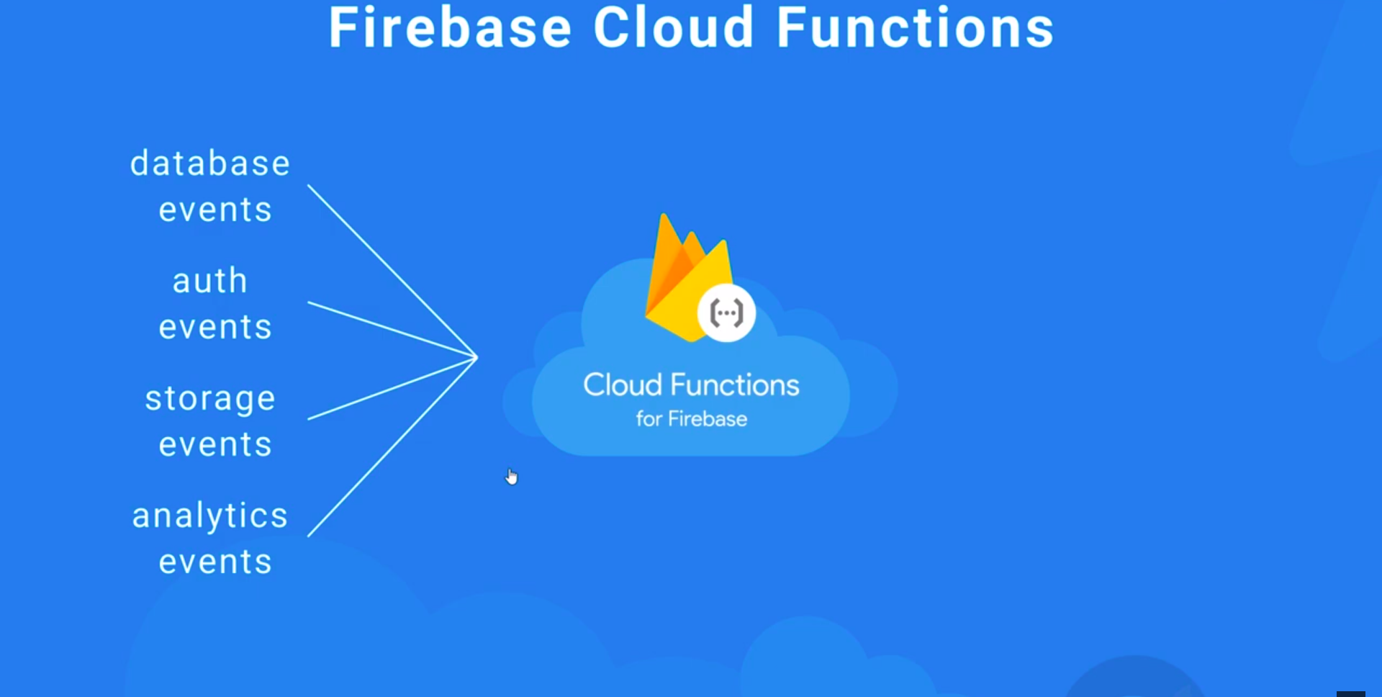
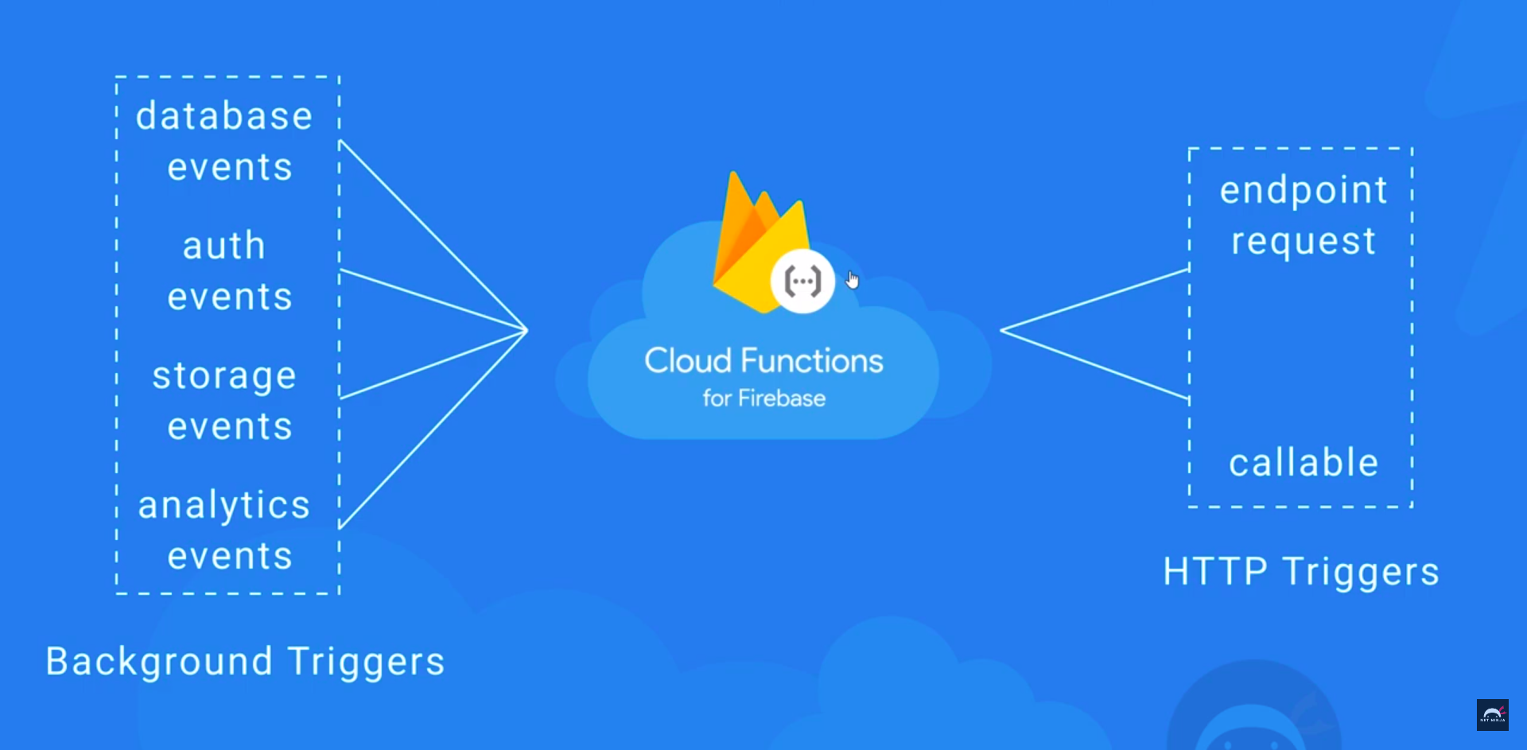
This is the new description

