Slide 1


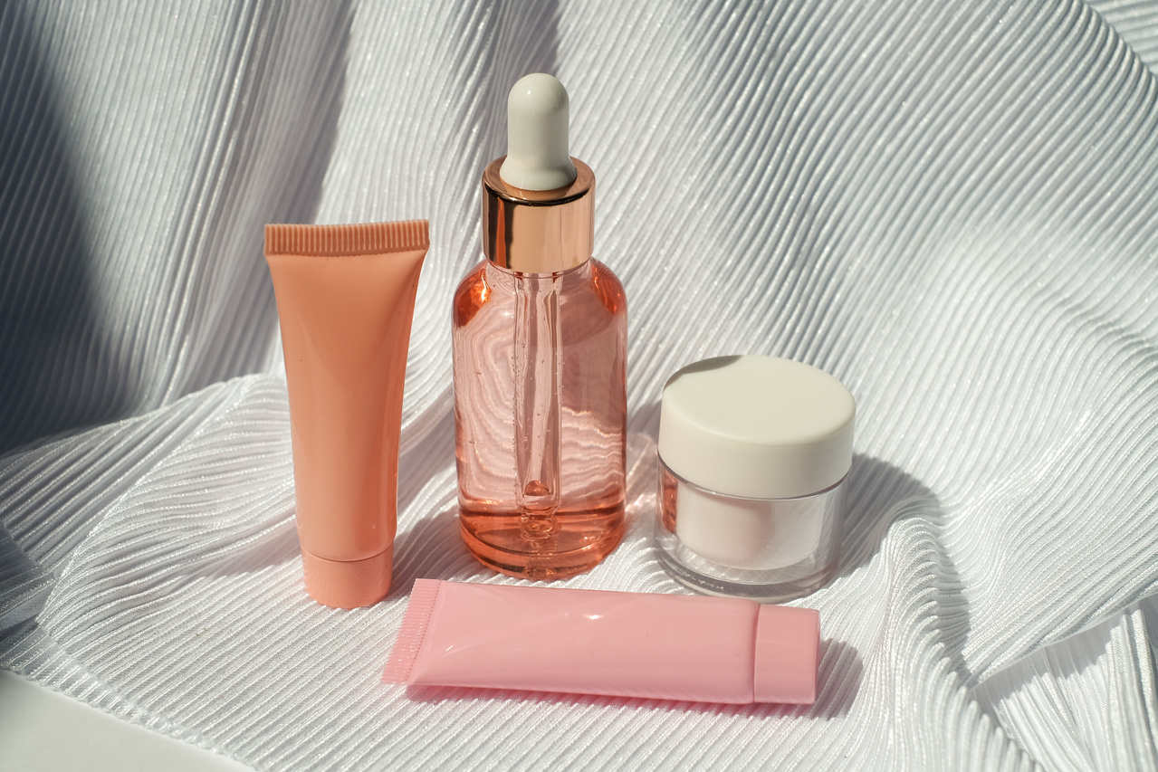
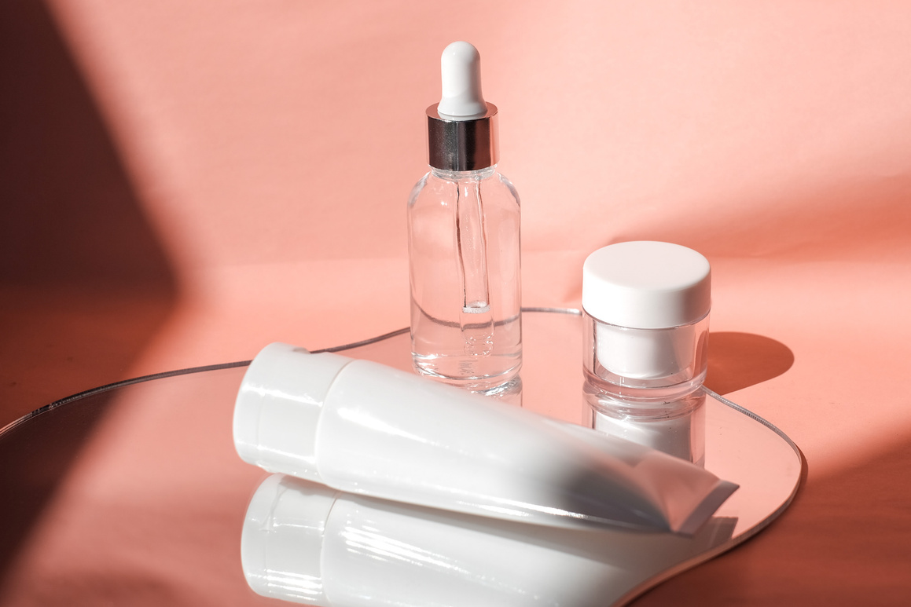

Glow up
by Nour mohammed

Slide 2
Project Idea
Glow Up is an online store for girls to explore and purchase beauty and skincare products

Slide 3
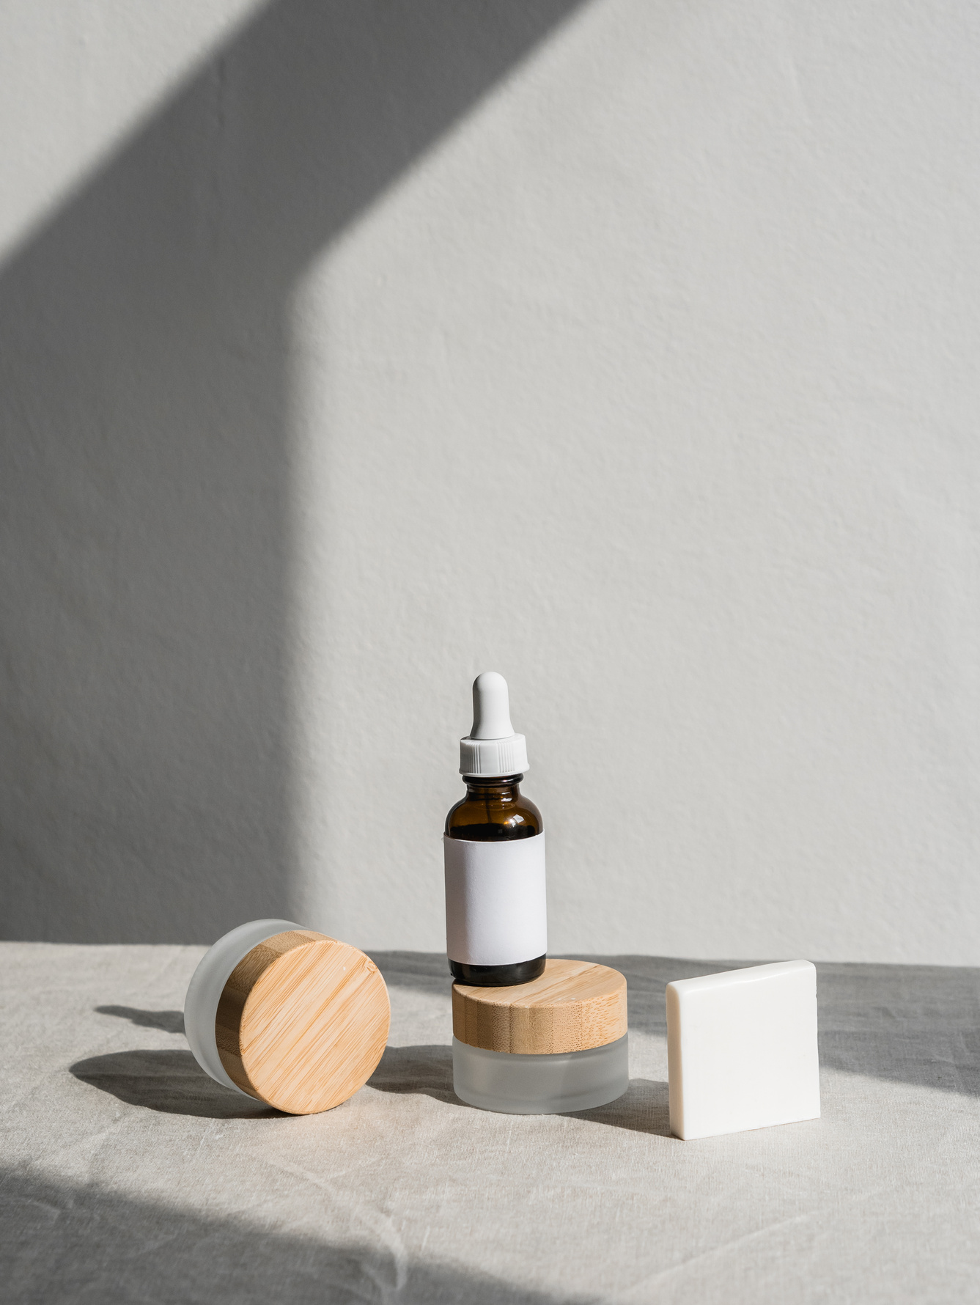
Design
•Modern UI
•Responsive design
•Simple navigation
•Attractive layout

Slide 4

Technologies Used
•HTML
•CSS
•JavaScript
•PHP
•MySQL
•Local Storage
•GitHub Pages

Slide 5
Key Features
•User Login
•Display products
Product details
•Cart system
•Order system
•Admin panel

Slide 6
User Flow
•Login/Register → Browse products → Select product → Add to cart → Checkout → Order saved

Slide 7
Project Link
https://nour-abdalrhman.github.io/Glow-Up/

Slide 8
Conclusion
•Complete e-commerce project combining frontend and backend with real functionalities.

