Slide 1
Mental Health Detection
from Reddit Posts
Comparing Machine Learning Models using NLP
Université Saint-Joseph de Beyrouth — MSc Data Science
Presented by: Jad Bayda, Nour Hmadeh and Hayfa Rustom
Course: Machine learning

Slide 2
Presentation Roadmap
01
Introduction & Problem
05
Models & Training
Why mental health detection matters
6 models across 3 categories
02
Dataset Overview
06
Advanced ML Techniques
Source, size, categories & class distribution
Cross-validation, hyperparameter tuning, significance testing
03
Data Preprocessing & Cleaning
07
Results & Final Comparison
Removing noise, encoding labels, splitting data
Leaderboard, confusion matrix, insights
04
Feature Engineering
08
Conclusion
TF-IDF, tokenization, word embeddings
Key findings & future work

Slide 3
Introduction & Problem
What is This Project?
5,810
Detect mental health signals from Reddit posts
Classify each post into 5 categories
Use NLP + Machine Learning models
Reddit posts analyzed
5
Mental health categories
People often share struggles online before seeking help
Early detection can support faster intervention
Helps understand how mental health appears in language
Can act as an early warning system
Why Does It Matter?
6
Models tested
83.91%
Best Accuracy (RoBERTa)

Slide 4
Dataset Overview
Data Source: Reddit (via HuggingFace)
Total dataset: 151K posts
Sample used: 10,000 posts
ADHD
OCD
Aspergers
Depression
PTSD
Dataset is relatively balanced, with OCD having the highest number of posts

Slide 5
Data Preprocessing & Cleaning
1
2
3
4
5
Load Data
Clean text
Keep relevant data
Label Encoding
Train/Test Split
Reddit dataset from HuggingFace
Sampled 10,000 posts
Removed deleted/empty posts
Dropped missing values
Convert categories into numbers
(ADHD, OCD, etc.)
80% Training
20% Testing
Text → body
Label → subreddit
After Cleaning
10,000 → 5,810 usable posts
Many posts were deleted or empty (~42%)
Data split is balanced across categories
Slight imbalance: OCD highest, Aspergers lowest

Slide 6
Feature Engineering : Text to Numbers
We convert text into numbers so models can understand it
TF-IDF (Classical Models)
WordPiece (BERT / RoBERTa)
Word Index (LSTM)
Converts text into numerical vectors
Important words get higher weight
Common words get lower weight
Example: “feeling sad” → important signal
Splits words into smaller parts
Handles unknown words better
Uses pre-trained vocabulary
Captures context in sentences
Each word → number (ID)
Sentences become sequences of numbers
Shortened or padded to fixed length
Different models require different text representations

Slide 7
Models Used
Category 1 — Classical ML
Classical Models
Logistic Regression
Simple baseline
Fast and effective for text
Naive Bayes
Works well with word frequencies
Very fast
SVM (LinearSVC)
Finds the best boundary between classes
Works well with high-dimensional text data
Strong and stable performance
Transformers
DistilBERT
Faster, lightweight BERT
Good performance with less cost
RoBERTa
Improved version of BERT
Best performing model
Deep Learning
BiLSTM
Understands sequence of words
Captures context from both directions
Category 2 — Deep Learning
Category 3 — Transformers

Slide 8
Model Training
Loss decreases steadily → models are learning effectively
Training Configuration
Parameter | Value
Batch Size | 16
Learning Rate | 2e-5
Epochs | 3
Max Token Length | 128
Other Models
Classical models trained very fast (no GPU needed)
LSTM trained for multiple epochs on sequences
Transformer models required more computation but gave better results

Slide 9
Advanced Techniques
01
5-Fold Cross Validation
02
Hyperparameter Tuning (Grid Search)
03
Statistical Significance Testing
Data split into 5 parts
Model trained and tested
multiple times
Results are consistent
(low variation)
Ensures reliable results
Tested multiple parameter
combinations
Improved performance
of classical models
Default settings are
not always optimal
Turning significantly improved
results
Compared models
using statistical tests
Results are statistically
significant
RoBERTa consistently
outperforms others
Performance consistently
Outperforms others

Slide 10
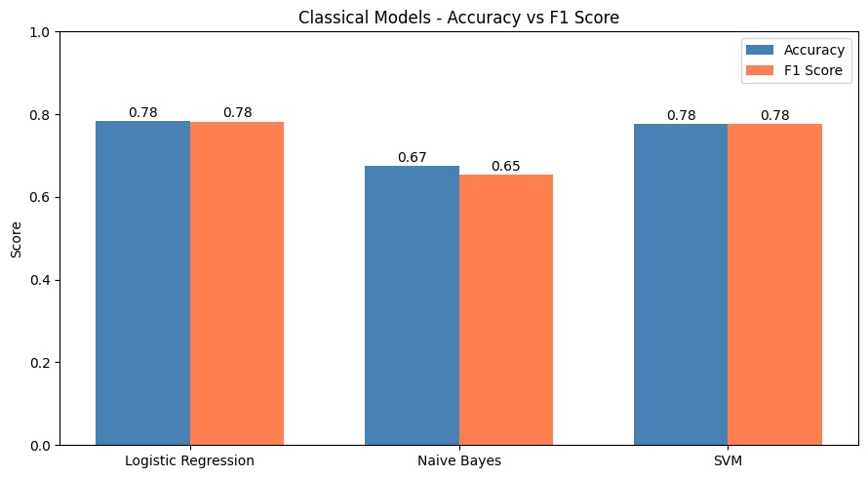
Classical Models — Results
Model | F1 Score | After Tuning (F1)
Logistic Regression | 78.23% | 78.08%
Naive Bayes | 65.39% | 72.89% (+7.5%!)
SVM (LinearSVC) | 77.63% | 78.93%
Key Takeaways
Logistic Regression: strong and simple baseline
Naive Bayes: improved the most after tuning
SVM: best and most stable classical model

Slide 11
Deep Learning & Transformer Results
LSTM
DistilBERT
RoBERTa 🏆
Accuracy
Accuracy
Accuracy
53.79%
77.88%
83.91%
F1 Score
F1 Score
F1 Score
53.20%
77.97%
83.89%
Underperformed on small dataset
Good performance, faster model
Best overall performance (+6%)
Transformer models clearly outperform classical and LSTM models

Slide 12
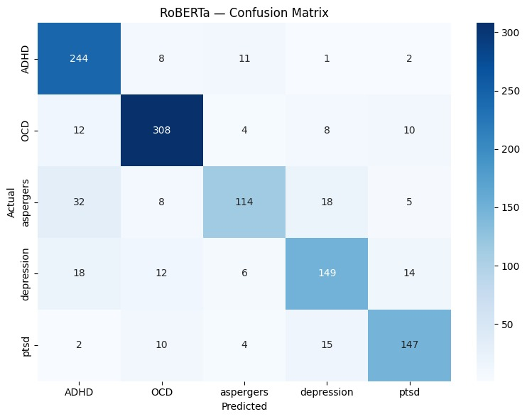
RoBERTa — Confusion Matrix
How well the model predicts each mental health
category
Key Observations:
Strong diagonal → most predictions are correct
OCD and PTSD are predicted very accurately
Aspergers is the most confused class (often mixed with ADHD & Depression)
RoBERTa
SVM Tuned
Log. Reg.

Slide 13
Final Model Comparison
Performance Comparison Across All Models
Transformer models outperform all others, with RoBERTa leading
🥇 1st
🥈 2nd
🥉 3rd
RoBERTa
SVM Tuned
Log. Reg.
83.91%
79.09%
78.31%

Slide 14
Key Insights
🏆
RoBERTa Dominates
😮
Classical Models Still Strong
Best model (83.9%) — understands context better than TF-IDF
Logistic Regression (~78%) performs surprisingly well
📉
LSTM Underperformed
🔍
OCD Easiest to Detect
Needs more data — not suited for small datasets
Distinct vocabulary makes classification easier
⚠️
🎛️
Aspergers Hardest
Tuning Matters
Overlaps with ADHD → harder to distinguish
Simple tuning improved performance significantly

Slide 15
Conclusion
What We Proved & What We Learned
RoBERTa is the clear winner
83.91% accuracy on a 5-class mental health classification task — statistically proven (p < 0.0001).
Transformers > Classical for NLP
Pre-trained language models understand context, making them superior for complex text classification.
Hyperparameter tuning is essential
Naive Bayes improved by 7% simply by tuning alpha — default settings are rarely optimal.
Dataset size matters
With more data (50k+), LSTM and transformers would show an even larger gap over classical models.

Slide 16
Thank you

