Slide 1
A deep learning system for differential diagnosis of skin diseases
DLS to provide a differential diagnosis of skin condition.
Using 16114 de-identified cases and 26 common skin condition.
Deep learning system (DLS) with two major components:
Variable number of conventional neural network to process input images.
Shallow model to process metadata such(medical history, demographic info and..)
DLS has integrated data from images and metadata.
To insure the DLS not biased against different skin tones, DLS accuracy was evaluate by skin type and self-reported race.

Slide 2
Creation and validation of a chest X-ray dataset with eye-tracking and report dictation for AI development
1083 Chest X-ray images
Data contains(CXR image, transcribed radiology report text, radiologist’s dictation audio and eye gaze coordinates data)
The Data set tend to help researchers in explainable and multimodal deep learning/machine learning methods.
Temporal heatmaps experiment: demonstrated performance improvements over baselines, originating from the use of temporal fixation heatmaps on a simple network architecture.
The baseline model consists of the aforementioned image representation layer, combined with a final linear output layer that produces the classification prediction
Static heatmaps experiment: CNN decoder part of the network runs deconvolution layers to predict the static eye gaze fixation heatmaps.

Slide 3
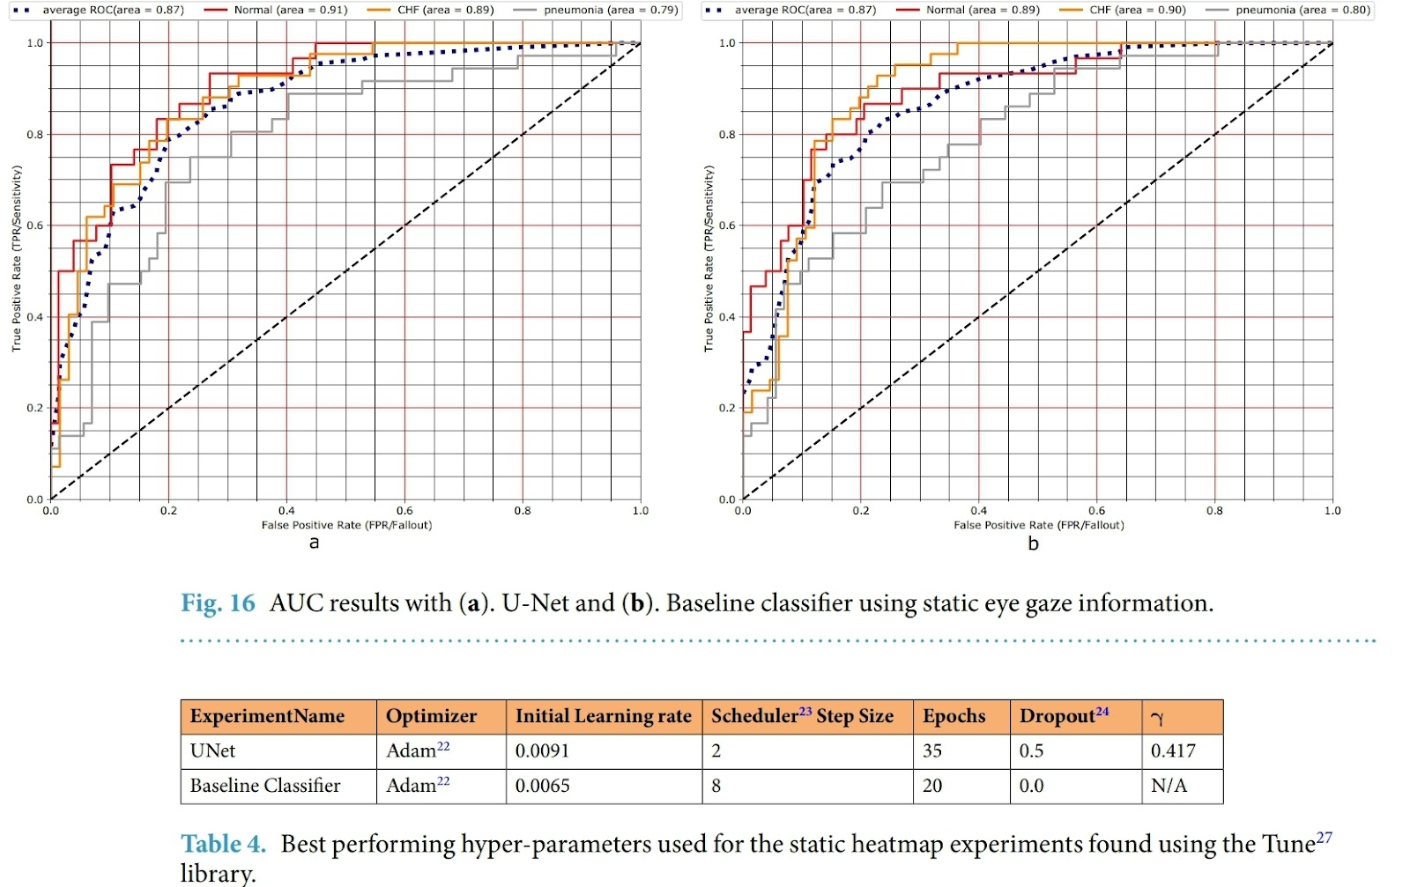
Te hyperparameter tuning for both the U-Net and the baseline classifier was performed using the Tune library and the resulting best performing hyperparameter combination is shown in Table 4. Figure 16 shows the U-Net and baseline AUCs. Both had similar performance.

