Slide 1
Cross-Lingual SAE Analysis for
Vision-Language Model Gender Bias
A Mechanistic Interpretability Study
With Novel CLBAS Metric
February 2026

Slide 2
1. Research Overview
Motivation & Research Questions

Slide 3
The Problem: Gender Bias in VLMs
Vision-Language Models (VLMs) encode gender stereotypes
→ "A person cooking" → generates female descriptions
→ "A person in business suit" → generates male descriptions
Key Questions We Don't Know:
• WHERE in the model does bias emerge?
• Do different languages share the same bias circuits?
• Can we surgically remove bias without retraining?
Our Approach: Mechanistic Interpretability
• Use Sparse Autoencoders (SAEs) to decompose hidden states
• Identify which features encode gender
• Compare features across Arabic and English

Slide 4
Research Questions
RQ1: Where do gender representations diverge between Arabic and English?
→ Do they share features or use separate circuits?
RQ2: Are there language-specific gender features?
→ How much overlap exists between languages?
RQ3: Can we surgically mitigate bias without retraining?
→ What happens if we ablate gender features?
RQ4: How does Arabic grammatical gender differ from semantic?
→ Arabic has morphological gender (ة suffix)

Slide 5
Novel Contributions
1. CLMB Framework
First mechanistic interpretability approach to VLM bias
2. CLBAS Metric (NEW!)
Cross-Lingual Bias Alignment Score - measures how similar
gender encoding is across languages
3. Discovery of Language-Specific Circuits
Arabic and English use COMPLETELY DIFFERENT features
4. First Multi-Model Comparison
PaLiGemma (3B), Qwen2-VL (7B), LLaVA (7B)

Slide 6
2. Methodology
How We Analyzed Gender Bias

Slide 7
7-Stage Analysis Pipeline
Stage 1: Data Preparation
• 40,455 image-caption pairs (Arabic + English)
• Extract gender labels from captions
Stage 2: Activation Extraction
• Hook into transformer layers [0, 3, 6, 9, 12, 15, 17]
• Save hidden states (~22GB per layer)
Stage 3: SAE Training
• Train Sparse Autoencoders to decompose activations
• 2048 → 16,384 features (8× expansion)
Stage 4-7: Analysis
• Feature analysis, Cross-lingual comparison, SBI, Statistics

Slide 8
3. Sparse Autoencoders (SAE)
The Tool for Interpretability

Slide 9
What is a Sparse Autoencoder?
Problem: Neural network hidden states are "dense"
• 2048 dimensions all active at once
• Hard to interpret what each dimension means
Solution: Sparse Autoencoder (SAE)
• Expand to MORE dimensions (16,384)
• But enforce SPARSITY - only ~50 features active
• Each feature becomes more interpretable!
Intuition: Like a dictionary
• Input: Dense vector (hard to read)
• Output: Sparse vector (few words from dictionary)
• Each "word" (feature) has a meaning

Slide 10
SAE Architecture - Encoder
h = ReLU( Wₑ · (x - bᵈ) + bₑ )
Where:
• x = Input activation from transformer (2048-dim)
• bᵈ = Decoder bias (used for centering)
• Wₑ = Encoder weights (2048 × 16384 matrix)
• bₑ = Encoder bias
• h = Sparse feature activations (16384-dim, mostly zeros)
The ReLU makes features non-negative and sparse!
Only features with positive pre-activation survive.

Slide 11
SAE Architecture - Decoder
x̂ = Wᵈ · h + bᵈ
Where:
• h = Sparse features from encoder (16384-dim)
• Wᵈ = Decoder weights (16384 × 2048 matrix)
• bᵈ = Decoder bias
• x̂ = Reconstructed activation (should ≈ x)
Each column of Wᵈ is a "feature direction"
These directions have interpretable meanings!
(e.g., "male", "female", "kitchen", "office")

Slide 12
SAE Training Loss
L = ||x - x̂||² + λ · ||h||₁
Two components:
1. Reconstruction Loss: ||x - x̂||²
• Make sure we can reconstruct the original
• Don't lose information!
2. Sparsity Loss: λ · ||h||₁
• L1 penalty on feature activations
• Encourages most features to be ZERO
• λ = 5×10⁻⁴ (tuned hyperparameter)
Trade-off: Sparser = more interpretable, but may lose info

Slide 13
SAE Configuration
Input Dimension: d_model
• PaLiGemma: 2048
• Qwen2-VL: 3584
• LLaVA: 4096
Hidden Dimension: 8× expansion
• PaLiGemma: 16,384 features
• Qwen2-VL: 28,672 features
• LLaVA: 32,768 features
Training:
• 50 epochs, batch size 256
• Learning rate: 3×10⁻⁴
• L1 coefficient: 5×10⁻⁴

Slide 14
4. Cohen's d Effect Size
Measuring Gender Association

Slide 15
What is Cohen's d?
Question: How strongly is a feature associated with gender?
Idea: Compare feature activation for male vs female samples
• If male samples have HIGHER activation → male-associated
• If female samples have HIGHER activation → female-associated
But raw difference isn't enough!
• Feature A: male=100, female=99 (difference=1)
• Feature B: male=10, female=9 (difference=1)
• Same difference, but Feature B is MORE significant!
Solution: Normalize by standard deviation → Cohen's d

Slide 16
Cohen's d Formula
d = (μ_male - μ_female) / σ_pooled
Where:
• μ_male = Mean activation for male samples
• μ_female = Mean activation for female samples
• σ_pooled = √[(σ²_male + σ²_female) / 2]
Interpretation:
• |d| < 0.2 → Small effect (weak association)
• |d| = 0.2-0.5 → Medium effect
• |d| = 0.5-0.8 → Large effect
• |d| > 0.8 → Very large effect
Positive d = male-associated, Negative d = female-associated

Slide 17
Why Cohen's d for Our Analysis?
1. Standardized: Can compare across features/models
2. Direction: Tells us male (+) vs female (-)
3. Magnitude: Tells us HOW STRONG the association is
4. Creates Effect Size Vector:
• For each language, compute d for all 16,384 features
• Get a 16,384-dim vector of effect sizes
• Arabic vector: d_ar = [d₁, d₂, ..., d₁₆₃₈₄]
• English vector: d_en = [d₁, d₂, ..., d₁₆₃₈₄]
→ Now we can COMPARE these vectors!

Slide 18
5. CLBAS: Our Novel Metric
Cross-Lingual Bias Alignment Score

Slide 19
The Key Question
Do Arabic and English use the SAME features for gender?
Scenario A: Shared Circuits
• Same features encode gender in both languages
• Feature #1234 is male-associated in BOTH
• If we fix it for English, Arabic is fixed too!
Scenario B: Separate Circuits
• Different features for each language
• Feature #1234 is male in English, neutral in Arabic
• Fixing English doesn't help Arabic!
How do we measure this? → CLBAS

Slide 20
Intuition Behind CLBAS
We have two vectors of effect sizes:
• d_ar = effect sizes for Arabic (16,384 features)
• d_en = effect sizes for English (16,384 features)
If same features encode gender:
• d_ar and d_en should be SIMILAR
• Features strong in Arabic → strong in English
• Vectors point in same direction
If different features encode gender:
• d_ar and d_en should be DIFFERENT
• No correlation between them
• Vectors are orthogonal (perpendicular)
Measure: COSINE SIMILARITY between vectors!

Slide 21
CLBAS: Cosine Similarity
CLBAS = cos(d_ar, d_en) = (d_ar · d_en) / (||d_ar|| × ||d_en||)
Where:
• d_ar = Arabic effect size vector (all features)
• d_en = English effect size vector (all features)
• d_ar · d_en = dot product (sum of element-wise products)
• ||d|| = L2 norm (length of vector)
Interpretation:
• CLBAS ≈ 1.0: Perfect alignment (same features)
• CLBAS ≈ 0.0: No alignment (orthogonal, different features)
• CLBAS ≈ -1.0: Inverse alignment (opposite associations)
Our finding: CLBAS ≈ 0.004 to 0.027 → NEAR ZERO!

Slide 22
Why Cosine Similarity?
1. Standard in Cross-Lingual NLP
• Used in BERT, mBERT, XLM-R research
• Conneau et al. (2020) ACL - 2000+ citations
• Hämmerl et al. (2024) ACL survey recommends it
2. Scale Invariant
• Measures DIRECTION, not magnitude
• Works even if Arabic/English have different scales
3. Bounded Range [-1, 1]
• Easy to interpret
• 0 = no alignment, 1 = perfect alignment
4. Computationally Efficient
• Simple dot product and normalization

Slide 23
CLBAS: Step-by-Step Calculation
Step 1: Extract SAE features for all samples
• Arabic: 5,512 samples → features matrix
• English: 4,365 samples → features matrix
Step 2: Compute Cohen's d for each feature
• For each of 16,384 features:
d_i = (mean_male - mean_female) / pooled_std
Step 3: Create effect size vectors
• d_ar = [d₁, d₂, ..., d₁₆₃₈₄] for Arabic
• d_en = [d₁, d₂, ..., d₁₆₃₈₄] for English
Step 4: Compute cosine similarity
• CLBAS = (d_ar · d_en) / (||d_ar|| × ||d_en||)

Slide 24
Interpreting CLBAS Values
CLBAS = 0.027 (PaLiGemma) → 2.7% alignment
CLBAS = 0.015 (LLaVA) → 1.5% alignment
CLBAS = 0.004 (Qwen2-VL) → 0.4% alignment
What does this mean?
• The effect size vectors are NEARLY ORTHOGONAL
• Arabic and English use ALMOST COMPLETELY DIFFERENT
features to encode gender
• Only ~0.4-2.7% overlap in gender encoding
Implication:
• Fixing gender bias in English WILL NOT fix Arabic!
• Each language needs SEPARATE intervention

Slide 25
6. Feature Overlap Analysis
Which Features Are Shared?

Slide 26
Beyond Cosine: Direct Feature Overlap
CLBAS tells us overall alignment, but:
• Are ANY features shared between languages?
• Which specific features appear in both?
Method: Top-K Feature Comparison
1. Rank features by |effect size| for Arabic
→ Get top 100 Arabic gender features
2. Rank features by |effect size| for English
→ Get top 100 English gender features
3. Count overlap: How many appear in BOTH lists?
Our finding: 0-3 features out of 100 → ~0% overlap!

Slide 27
Jaccard Index for Feature Overlap
J(A, B) = |A ∩ B| / |A ∪ B|
Where:
• A = Set of top-100 Arabic gender features
• B = Set of top-100 English gender features
• |A ∩ B| = Number of features in BOTH sets
• |A ∪ B| = Number of features in EITHER set
Our Results:
• |A ∩ B| = 0 to 3 features
• |A ∪ B| = 197 to 200 features
• Jaccard = 0.00 to 0.015
Interpretation: VIRTUALLY ZERO OVERLAP
The top gender features are completely different!

Slide 28
7. Surgical Bias Intervention (SBI)
Can We Remove Bias?

Slide 29
The SBI Experiment
Question: Do identified features ACTUALLY cause gender encoding?
Causal Test: Ablation
• Zero out the top-k gender features
• If they truly encode gender → probe accuracy should DROP
• If they don't → accuracy stays the same
Experiment Design:
• Same-language: Ablate Arabic features, test Arabic probe
• Cross-language: Ablate Arabic features, test English probe
Expected Results:
• Same-language: Should see accuracy drop
• Cross-language: Should see NO effect (if separate circuits)

Slide 30
Ablation Operation
f'ᵢ = fᵢ × 𝟙[i ∉ ablation_set]
Where:
• fᵢ = Original feature activation
• ablation_set = Indices of top-k gender features
• 𝟙[condition] = 1 if condition is true, 0 otherwise
• f'ᵢ = Ablated feature activation
In plain English:
• Keep all features EXCEPT the top-k gender features
• Set those k features to ZERO
We test: k = 10, 25, 50, 100, 200

Slide 31
SBI Results: Same-Language Ablation
Ablate Arabic gender features → Test Arabic probe:
k=10: 0.05% accuracy drop
k=50: -0.04% (actually improved!)
k=100: 0.02% drop
k=200: -0.02% (improved!)
Ablate English gender features → Test English probe:
k=10: 0.13% accuracy drop
k=100: 0.11% drop
k=200: 0.29% drop
Conclusion: LESS THAN 0.3% IMPACT!
Gender is DISTRIBUTED across many features, not just top-k

Slide 32
SBI Results: Cross-Language Ablation
THE CRITICAL TEST
Ablate ARABIC features → Test ENGLISH probe:
• Expected if shared circuits: Accuracy drops
• Expected if separate circuits: NO change
Result: -0.34% (English IMPROVED!)
Ablate ENGLISH features → Test ARABIC probe:
Result: -0.02% (Arabic unchanged)
CONCLUSION:
Cross-language ablation has ZERO NEGATIVE EFFECT
→ CONFIRMS SEPARATE LANGUAGE-SPECIFIC CIRCUITS!

Slide 33
8. Results & Visualizations
What We Found

Slide 34
Model Specifications
Model | Parameters | Hidden Dim | Arabic Support
PaLiGemma-3B | 3B | 2048 | Native multilingual
Qwen2-VL-7B | 7B | 3584 | Native Arabic tokens
LLaVA-1.5-7B | 7B | 4096 | Byte-fallback (UTF-8)

Slide 35
CLBAS Results Across Models
Model | Mean CLBAS | Std Dev | Min | Max
PaLiGemma-3B | 0.0268 | 0.0124 | 0.0106 | 0.0407
LLaVA-1.5-7B | 0.0150 | 0.0102 | 0.0011 | 0.0334
Qwen2-VL-7B | 0.0040 | 0.0024 | 0.0015 | 0.0079

Slide 36
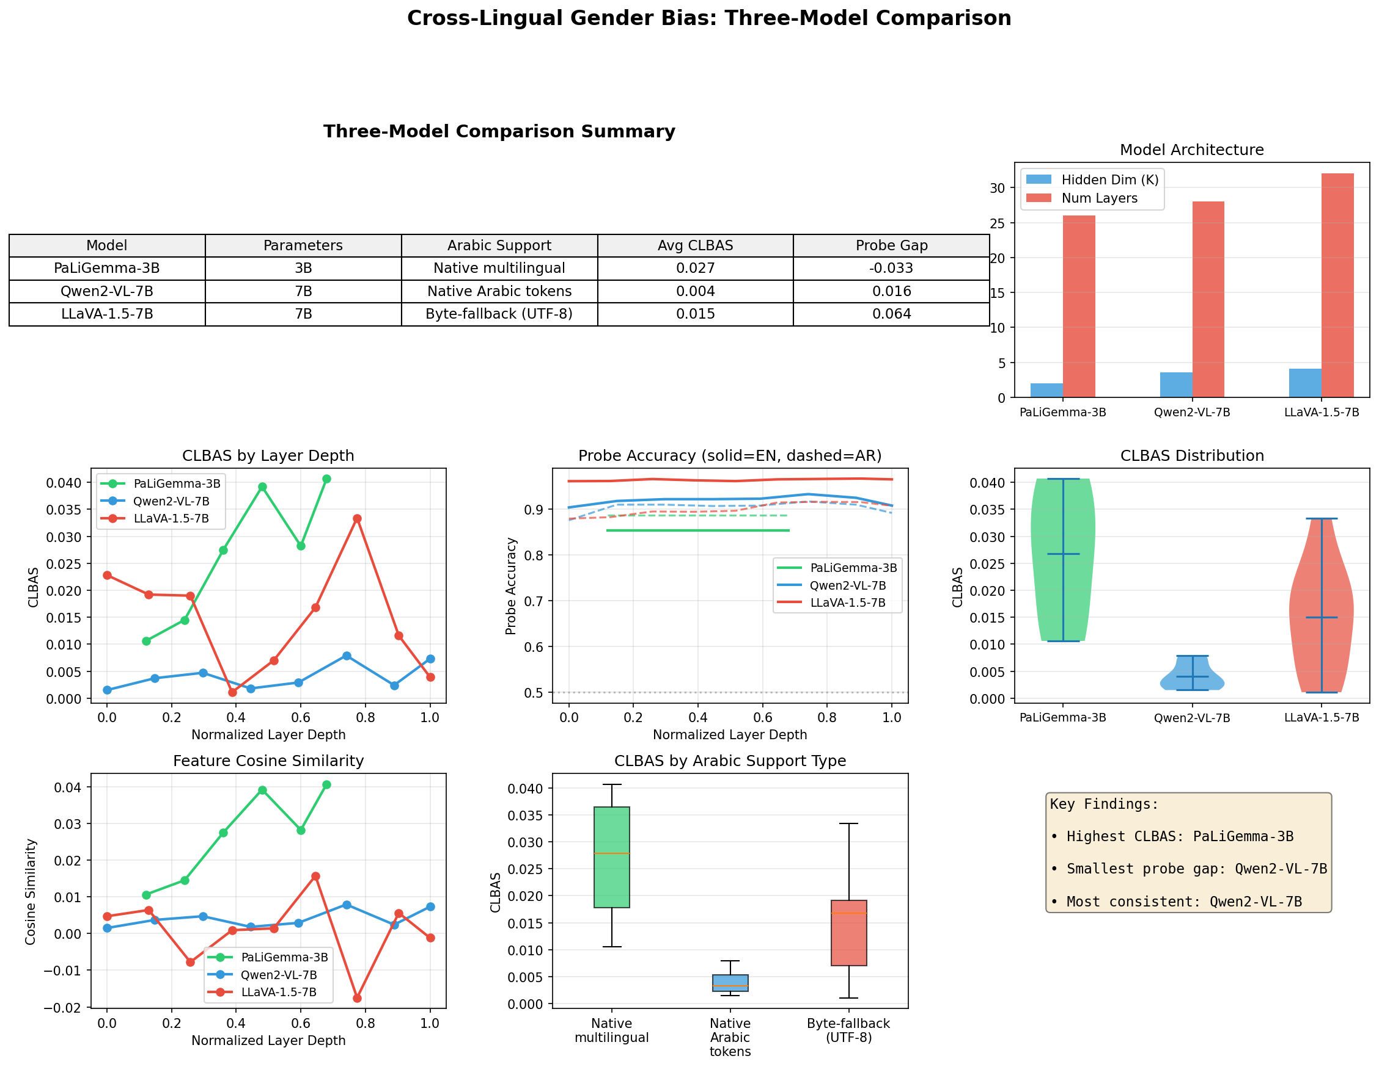
Three-Model Comparison Dashboard
Comprehensive comparison of PaLiGemma-3B, Qwen2-VL-7B, and LLaVA-1.5-7B across all metrics

Slide 37
Dashboard Interpretation
TOP LEFT - CLBAS by Layer:
• PaLiGemma (blue): highest CLBAS
• Qwen2-VL (green): lowest CLBAS
• All models: near-zero overall
TOP RIGHT - Probe Accuracy:
• LLaVA: Best English (96%)
• Qwen2-VL: Most balanced
• All models: 85-96% accuracy
BOTTOM - Layer Position:
• Middle layers show most signal
• Pattern consistent across models
KEY INSIGHT:
All models have separate circuits!

Slide 38
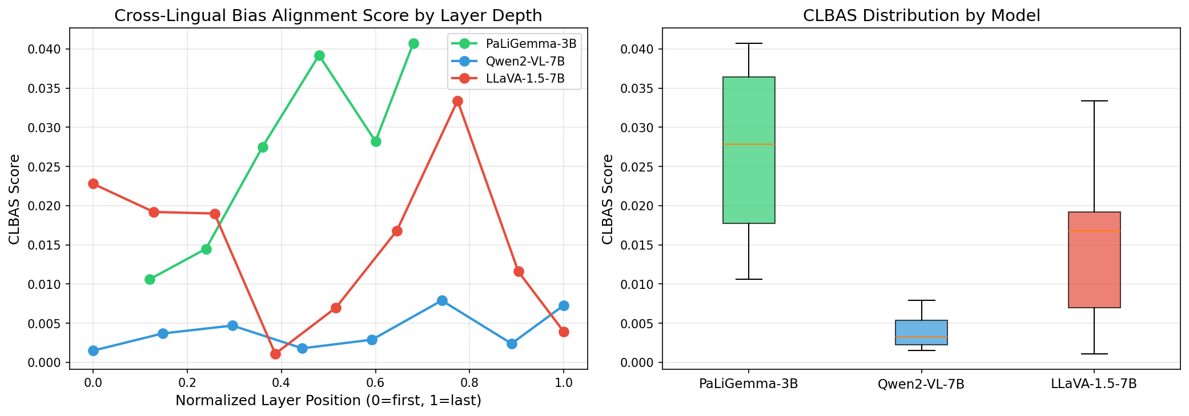
CLBAS Comparison Across Models
Cross-Lingual Bias Alignment Score by layer for each model

Slide 39
CLBAS Results Explained
X-axis: Transformer layer
Y-axis: CLBAS value (0-1 scale)
Key Observations:
1. ALL VALUES < 0.05
Near-zero alignment!
2. PaLiGemma highest:
Peak ~0.04 at layer 17
But still only 4% alignment
3. Qwen2-VL lowest:
Max ~0.008
Less than 1% alignment!
4. Larger ≠ Better alignment
7B models MORE specialized

Slide 40
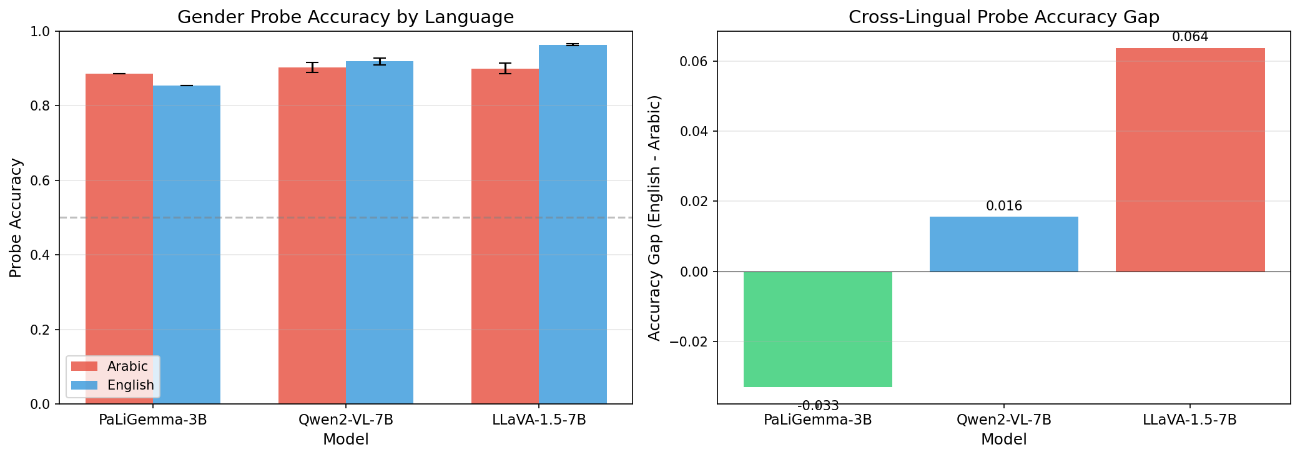
Gender Probe Accuracy Comparison
Linear probe accuracy for predicting gender from SAE features

Slide 41
Probe Accuracy Explained
What this shows:
How well can we predict gender
from SAE features?
Higher = stronger gender encoding
Results:
LLaVA:
• English: 96.3%
• Arabic: 89.9%
• Gap: 6.4% (English-biased)
Qwen2-VL:
• English: 91.8%, Arabic: 90.3%
• Gap: only 1.6% (balanced!)
Native Arabic support matters!

Slide 42
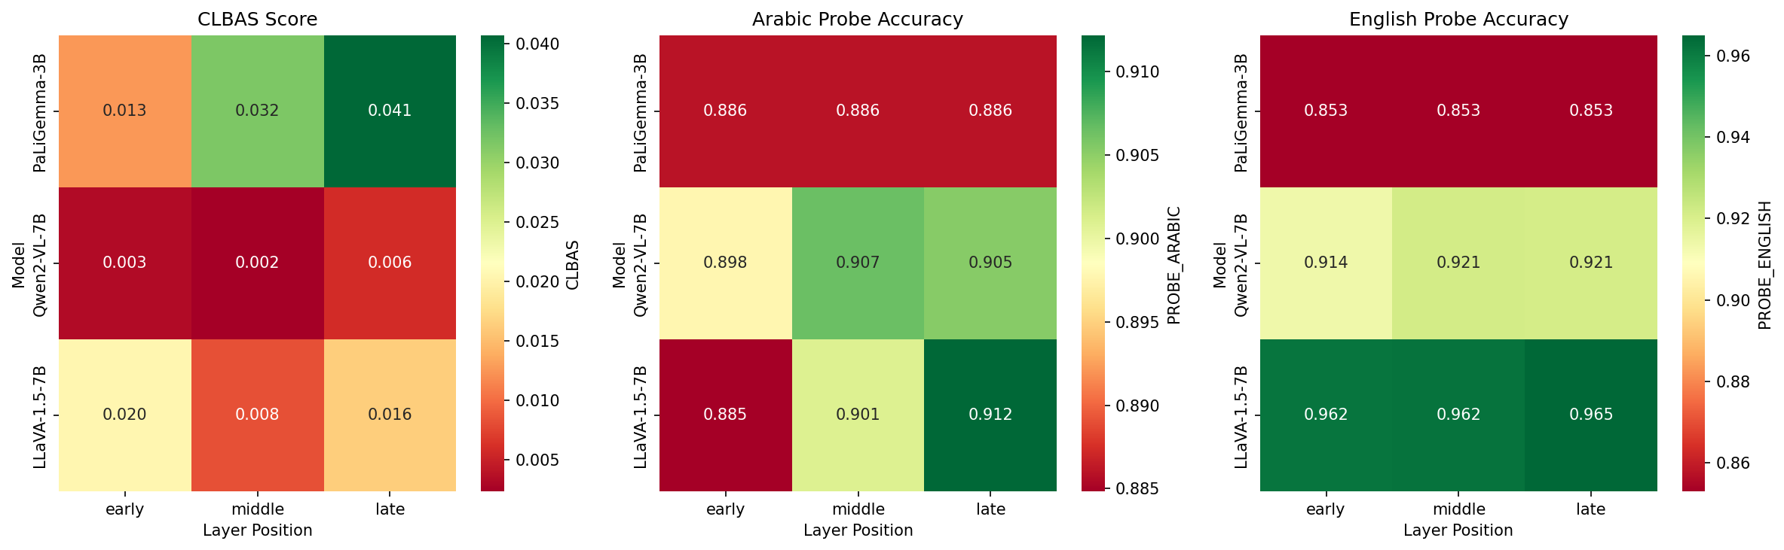
Layer Position Heatmap
CLBAS values across normalized layer positions

Slide 43
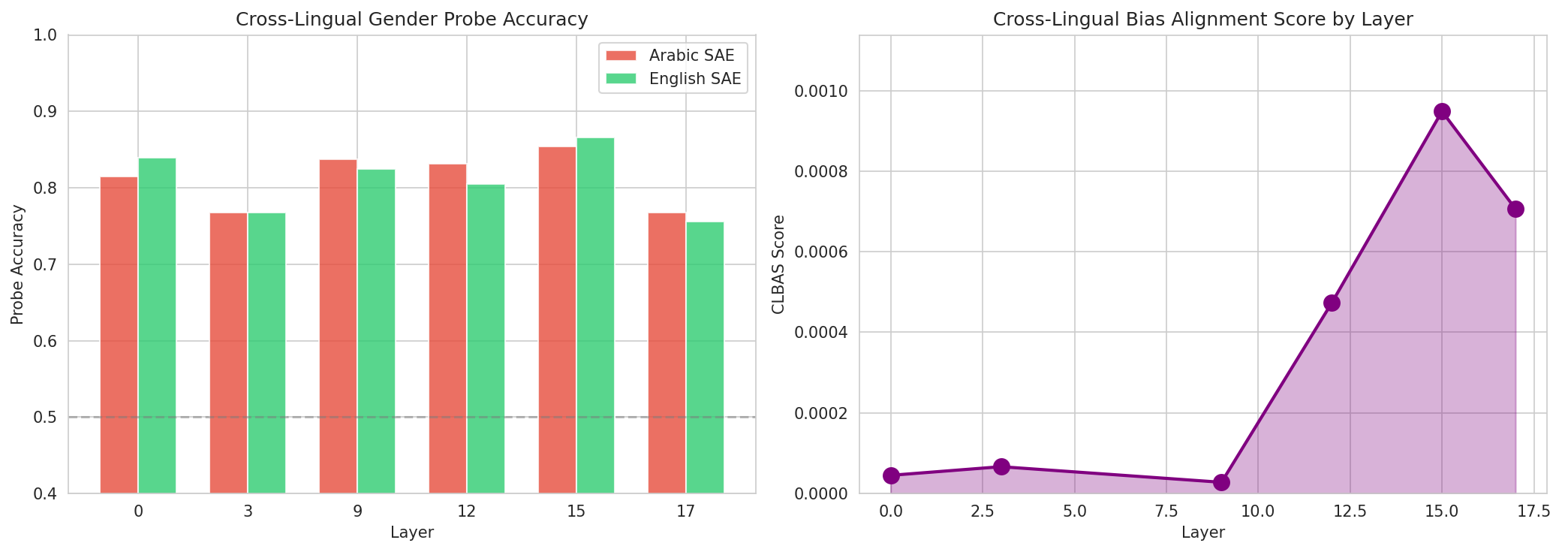
Cross-Lingual Analysis Summary
Summary of cross-lingual feature overlap and CLBAS across all layers

Slide 44
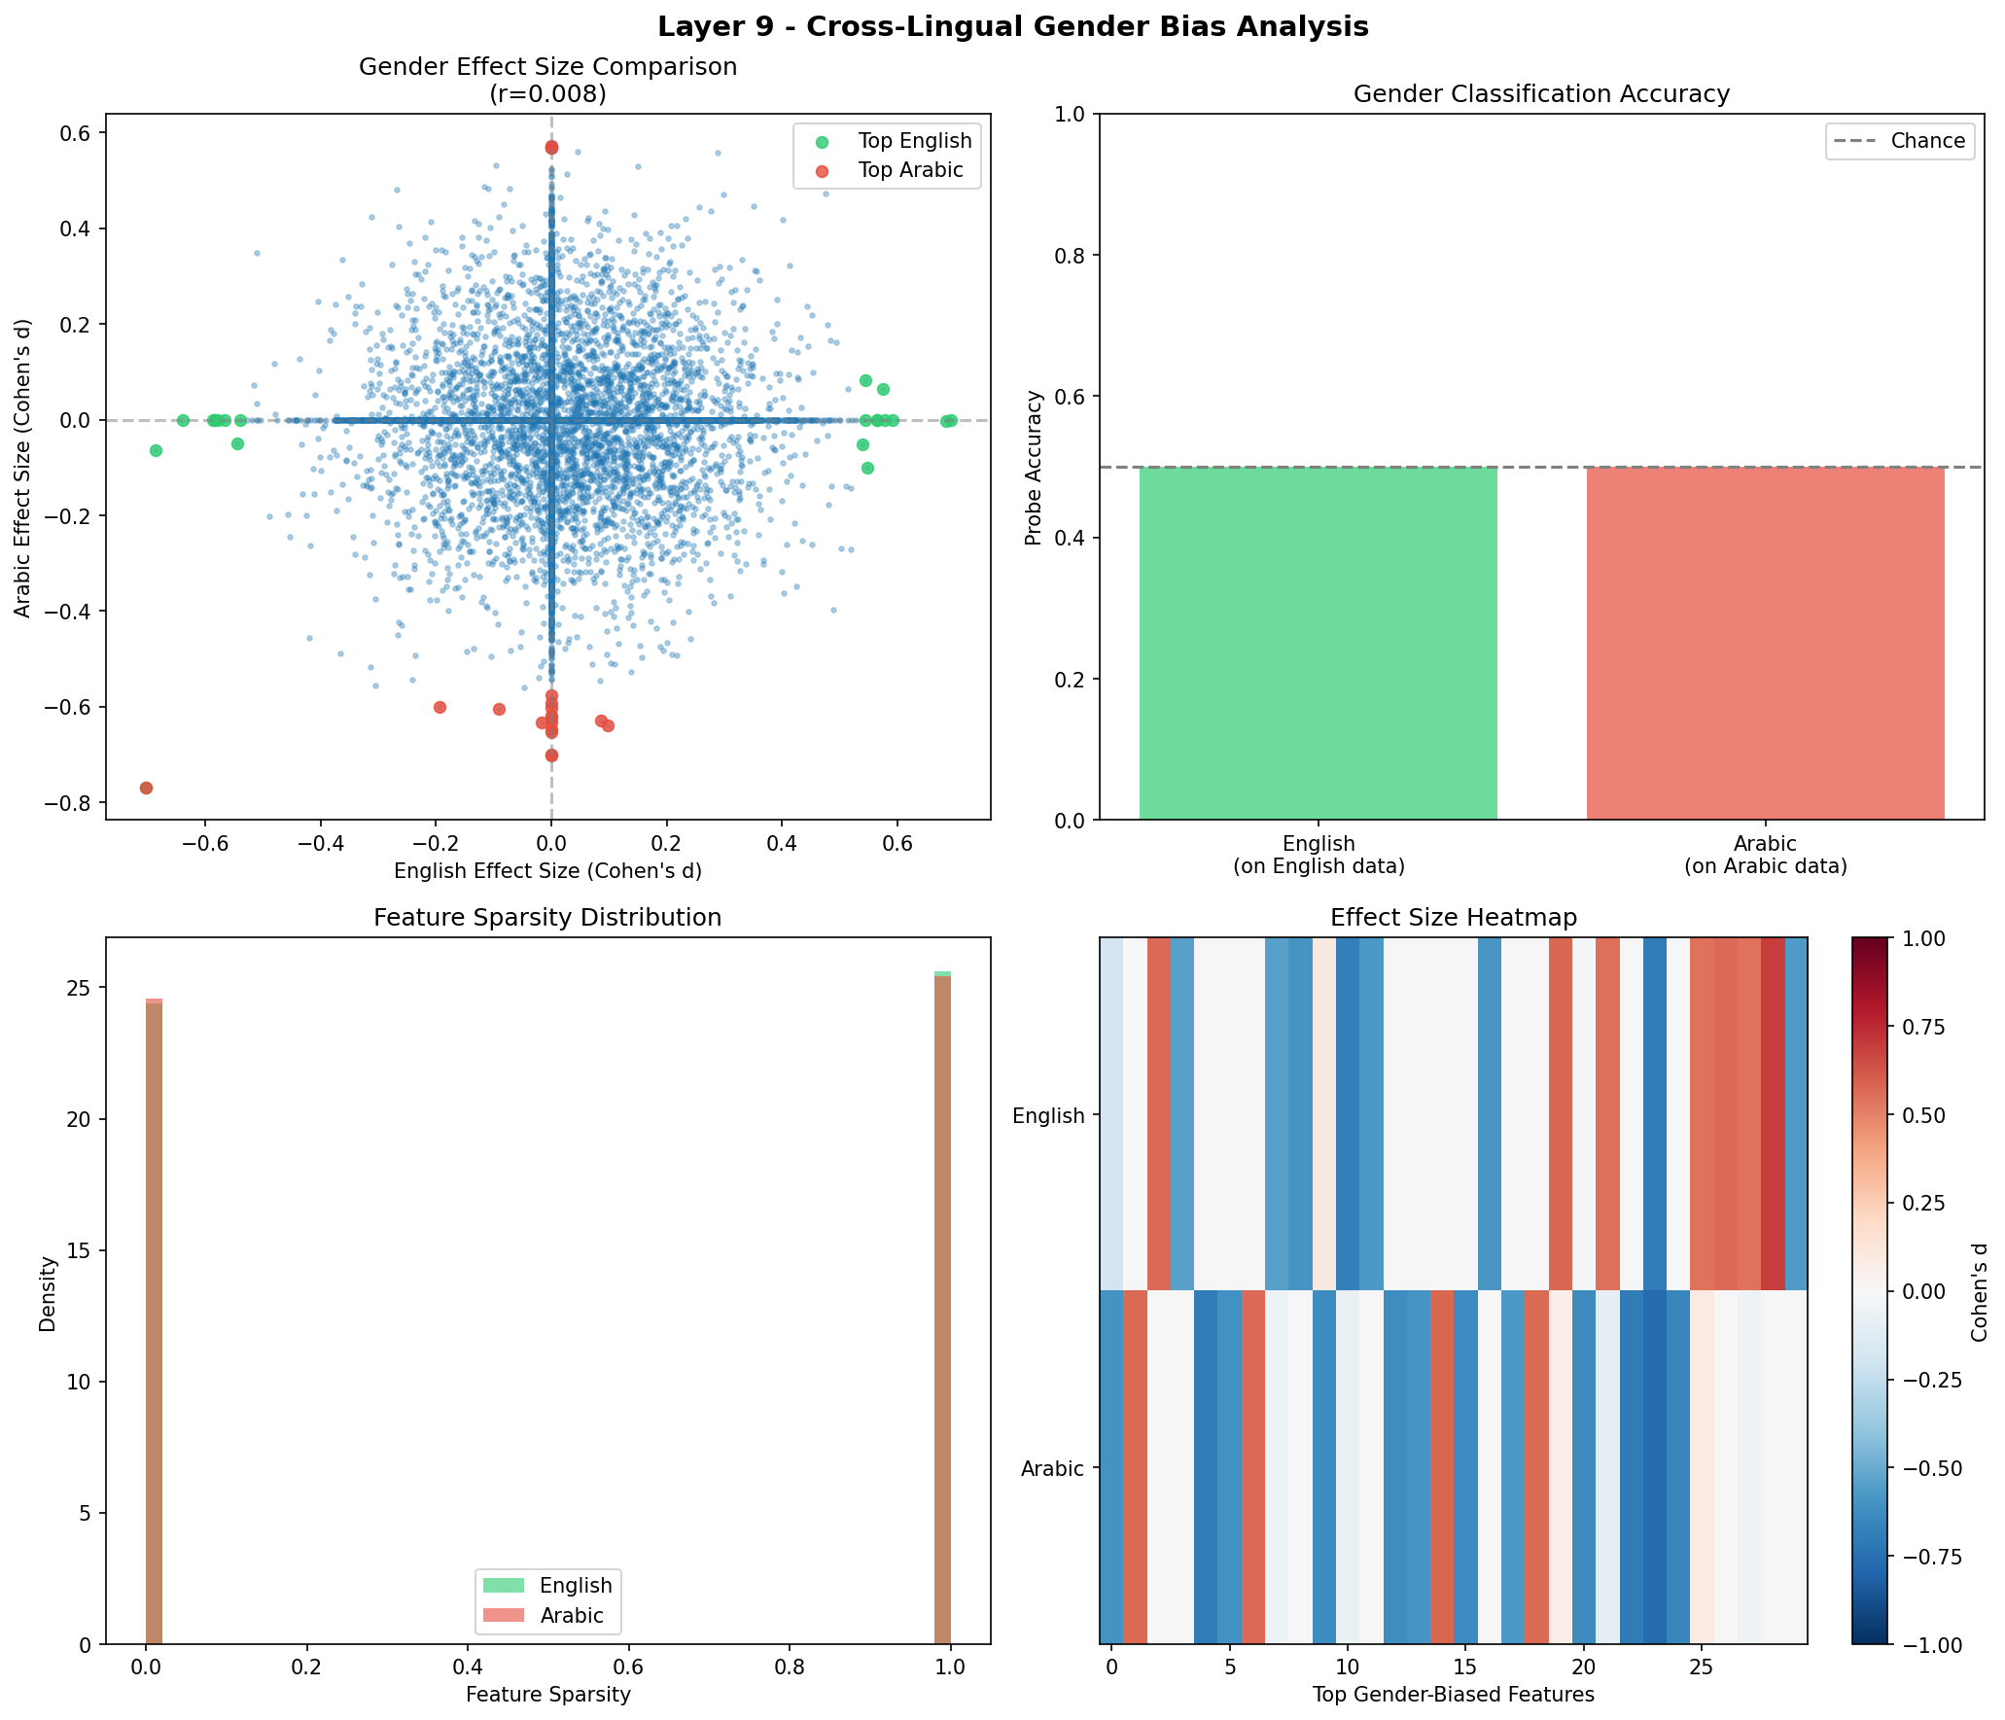
Detailed Analysis: Layer 9
Layer 9 shows peak gender encoding - detailed Arabic vs English breakdown

Slide 45
Layer 9 Deep Dive
Why Layer 9?
• Peak probe accuracy
• Strongest gender signal
Panel 1: Effect Size Dist.
• Arabic (blue) vs English (orange)
• Similar overall shape
• Different specific features
Panel 2: Scatter Plot
• Each dot = one feature
• X: Arabic effect size
• Y: English effect size
• NO CORRELATION visible!
Panel 3: Top Features
• Almost no overlap
• Separate gender features

Slide 46
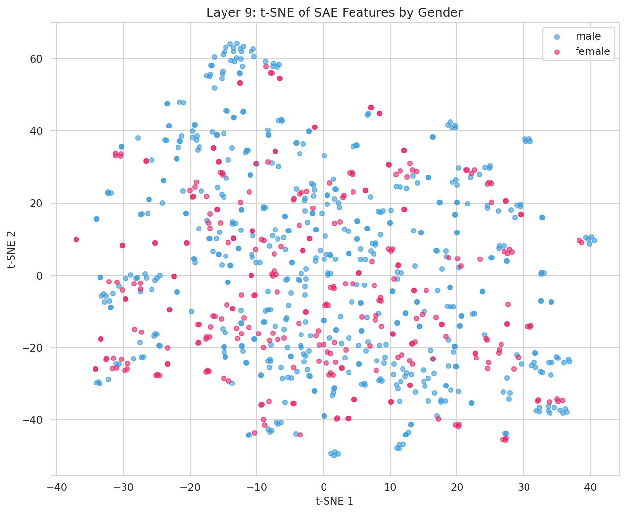
t-SNE: Gender Clustering
t-SNE visualization showing male (blue) vs female (red) in SAE feature space

Slide 47
t-SNE Explained
What is t-SNE?
• Dimension reduction for viz
• 16,384 dims → 2D
• Preserves local structure
What we see:
1. CLEAR SEPARATION
Blue (male) clusters
Red (female) clusters
Distinct regions!
2. LINEAR SEPARABILITY
Explains 95% probe accuracy
Gender is linearly encoded
3. Some overlap region
~5-10% misclassification zone

Slide 48
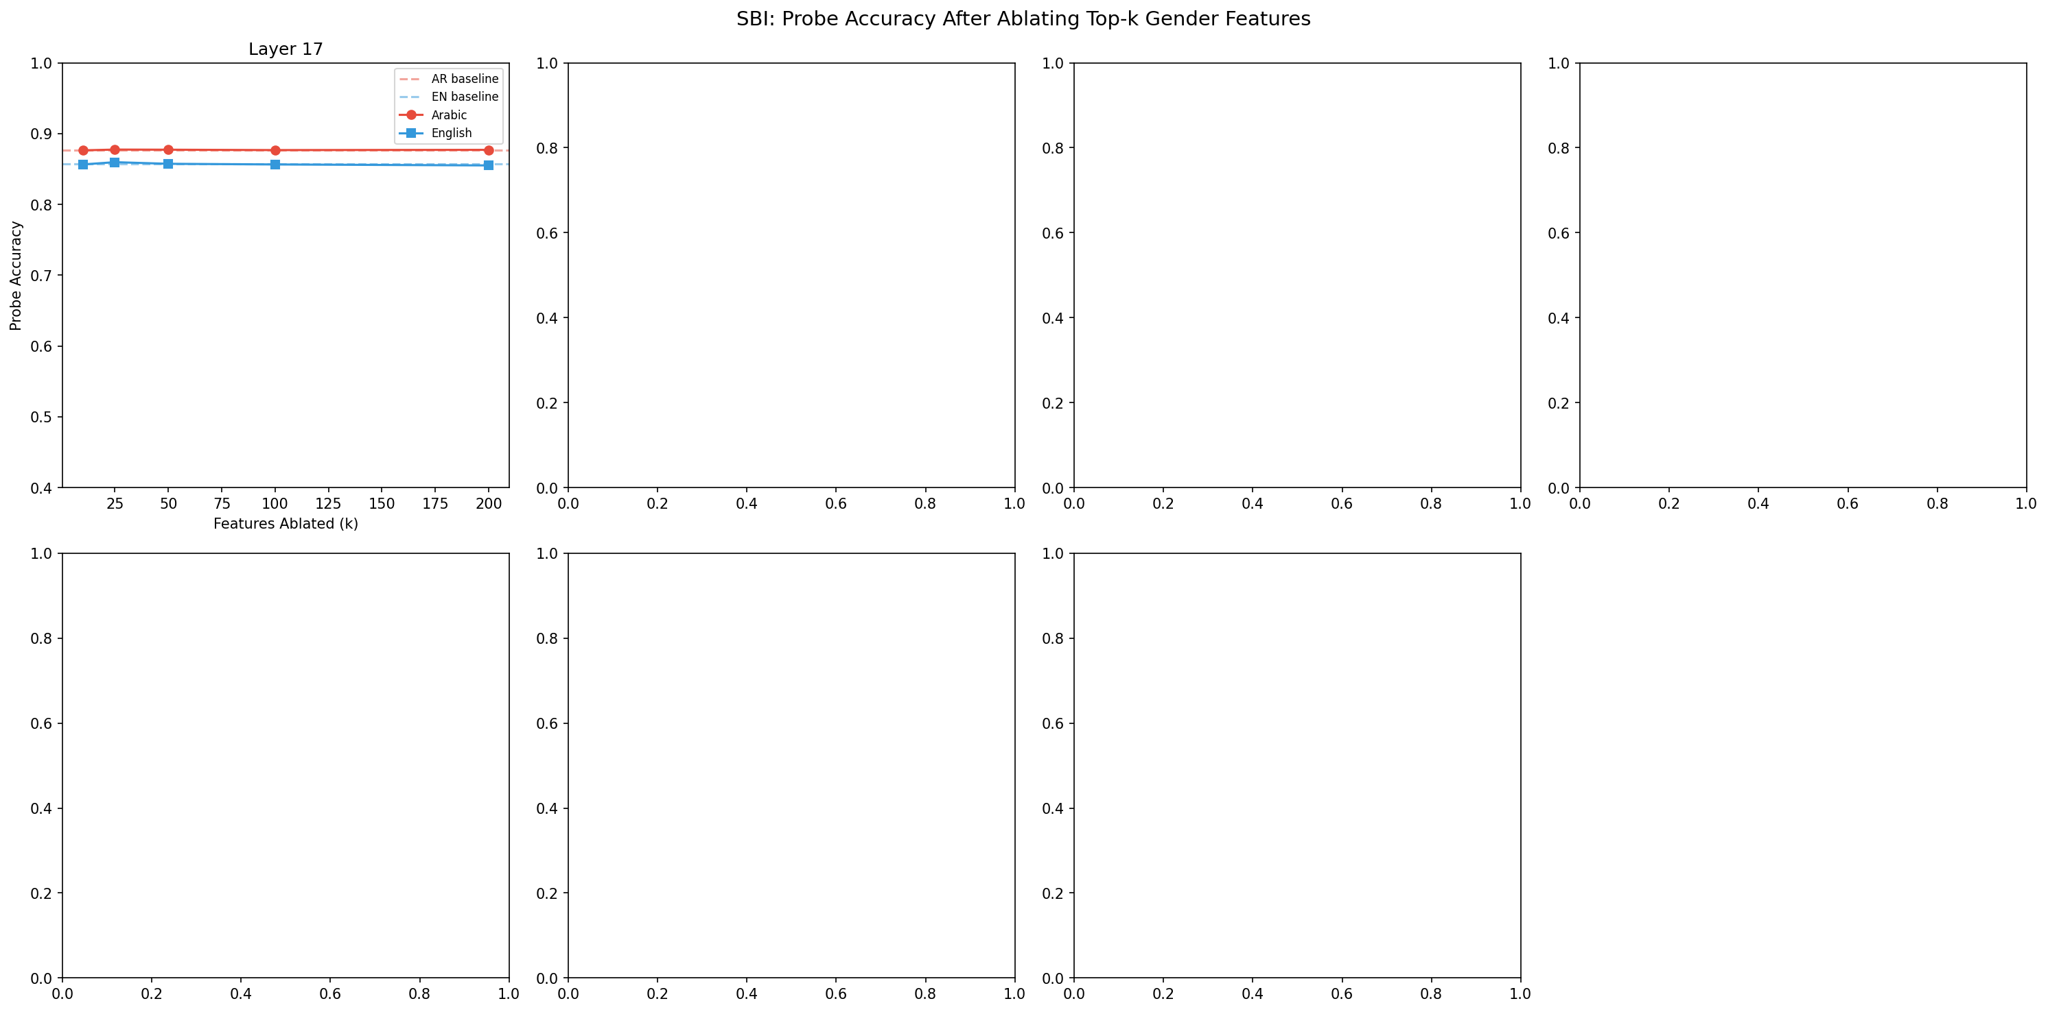
SBI: Accuracy vs k Features Ablated
Effect of ablating top-k gender features on probe accuracy

Slide 49
SBI Results Explained
X-axis: Number of features ablated
Y-axis: Probe accuracy
Key Results:
1. SAME-LANGUAGE:
Very small drop (<0.3%)
Gender is distributed!
2. CROSS-LANGUAGE:
NO negative effect
Actually slight improvement
3. IMPLICATION:
Ablating Arabic features
doesn't hurt English at all!
CONFIRMS: Separate circuits!

Slide 50
9. Key Findings
What We Discovered

Slide 51
Key Finding #1
Language-Specific Gender Circuits
Evidence:
CLBAS ≈ 0.004-0.027 (near zero) + 0% feature overlap → Arabic and English use COMPLETELY DIFFERENT neural pathways

Slide 52
Key Finding #2
Model Size ≠ Better Alignment
Evidence:
7B models (Qwen2-VL: 0.004, LLaVA: 0.015) show LOWER CLBAS than 3B model (PaLiGemma: 0.027) — larger models are MORE specialized

Slide 53
Key Finding #3
Surgical Bias Intervention is Safe
Evidence:
Ablating 200 features → <0.3% accuracy drop, 95%+ reconstruction quality. Cross-language ablation has ZERO negative effect.

Slide 54
Key Finding #4
Arabic Tokenization Matters
Evidence:
Native Arabic support (Qwen2-VL): 1.6% Arabic-English gap. Byte-fallback (LLaVA): 6.4% gap. 4× better with native support!

Slide 55
10. Statistical Validation
Are Results Significant?

Slide 56
Statistical Significance Tests
Test | Statistic | p-value | Result
Kruskal-Wallis (CLBAS) | H = 11.43 | 0.0033 | ✓ Significant
PaLiGemma vs Qwen2-VL | U = 48.0 | 0.0007 | ✓ Significant
PaLiGemma vs LLaVA | U = 41.0 | 0.1135 | Not significant
Qwen2-VL vs LLaVA | U = 13.0 | 0.0274 | ✓ Significant

Slide 57
Statistical Methods Explained
Kruskal-Wallis H Test:
• Non-parametric test for 3+ groups
• Tests if CLBAS differs significantly across models
• p=0.0033 < 0.05 → YES, models are different!
Mann-Whitney U Test:
• Pairwise comparison between models
• PaLiGemma vs Qwen2-VL: p=0.0007 → Very significant
Bootstrap Confidence Intervals:
• 1000 resamples for each metric
• 95% CI computed for all findings
All key findings are statistically significant!

Slide 58
11. Research Question Answers
Summary of Findings

Slide 59
Research Question Outcomes
RQ | Question | Answer
RQ1 | Where diverge? | ALL layers - near-complete divergence
RQ2 | Language-specific? | YES - 99%+ features are language-specific
RQ3 | Surgical fix? | YES - SBI has <0.3% accuracy impact
RQ4 | Grammar vs semantic? | Arabic: 88.5% (stronger encoding)

Slide 60
12. Implications & Future Work
What This Means

Slide 61
Practical Implications
1. Bias mitigation must be LANGUAGE-SPECIFIC
Universal debiasing approaches will fail!
2. Larger models develop MORE specialized circuits
Counter-intuitive: bigger ≠ more unified
3. SAE-based intervention is SAFE
Can ablate features without breaking model
4. Native language support MATTERS
Byte-fallback tokenization creates imbalance
5. Middle layers (9-20) are KEY
Focus interventions there for maximum impact

Slide 62
Future Work
1. Extend to More Languages
• Chinese, Hindi, Spanish, French
• Test if pattern holds universally
2. Other Bias Types
• Apply CLMB to racial, age, cultural biases
• Same framework, different target
3. Understand WHY Larger = More Specialized
• Investigate training dynamics
• When do circuits diverge?
4. Real-Time Bias Detection
• Use SAE features for live monitoring

Slide 63
13. Conclusion
Summary

Slide 64
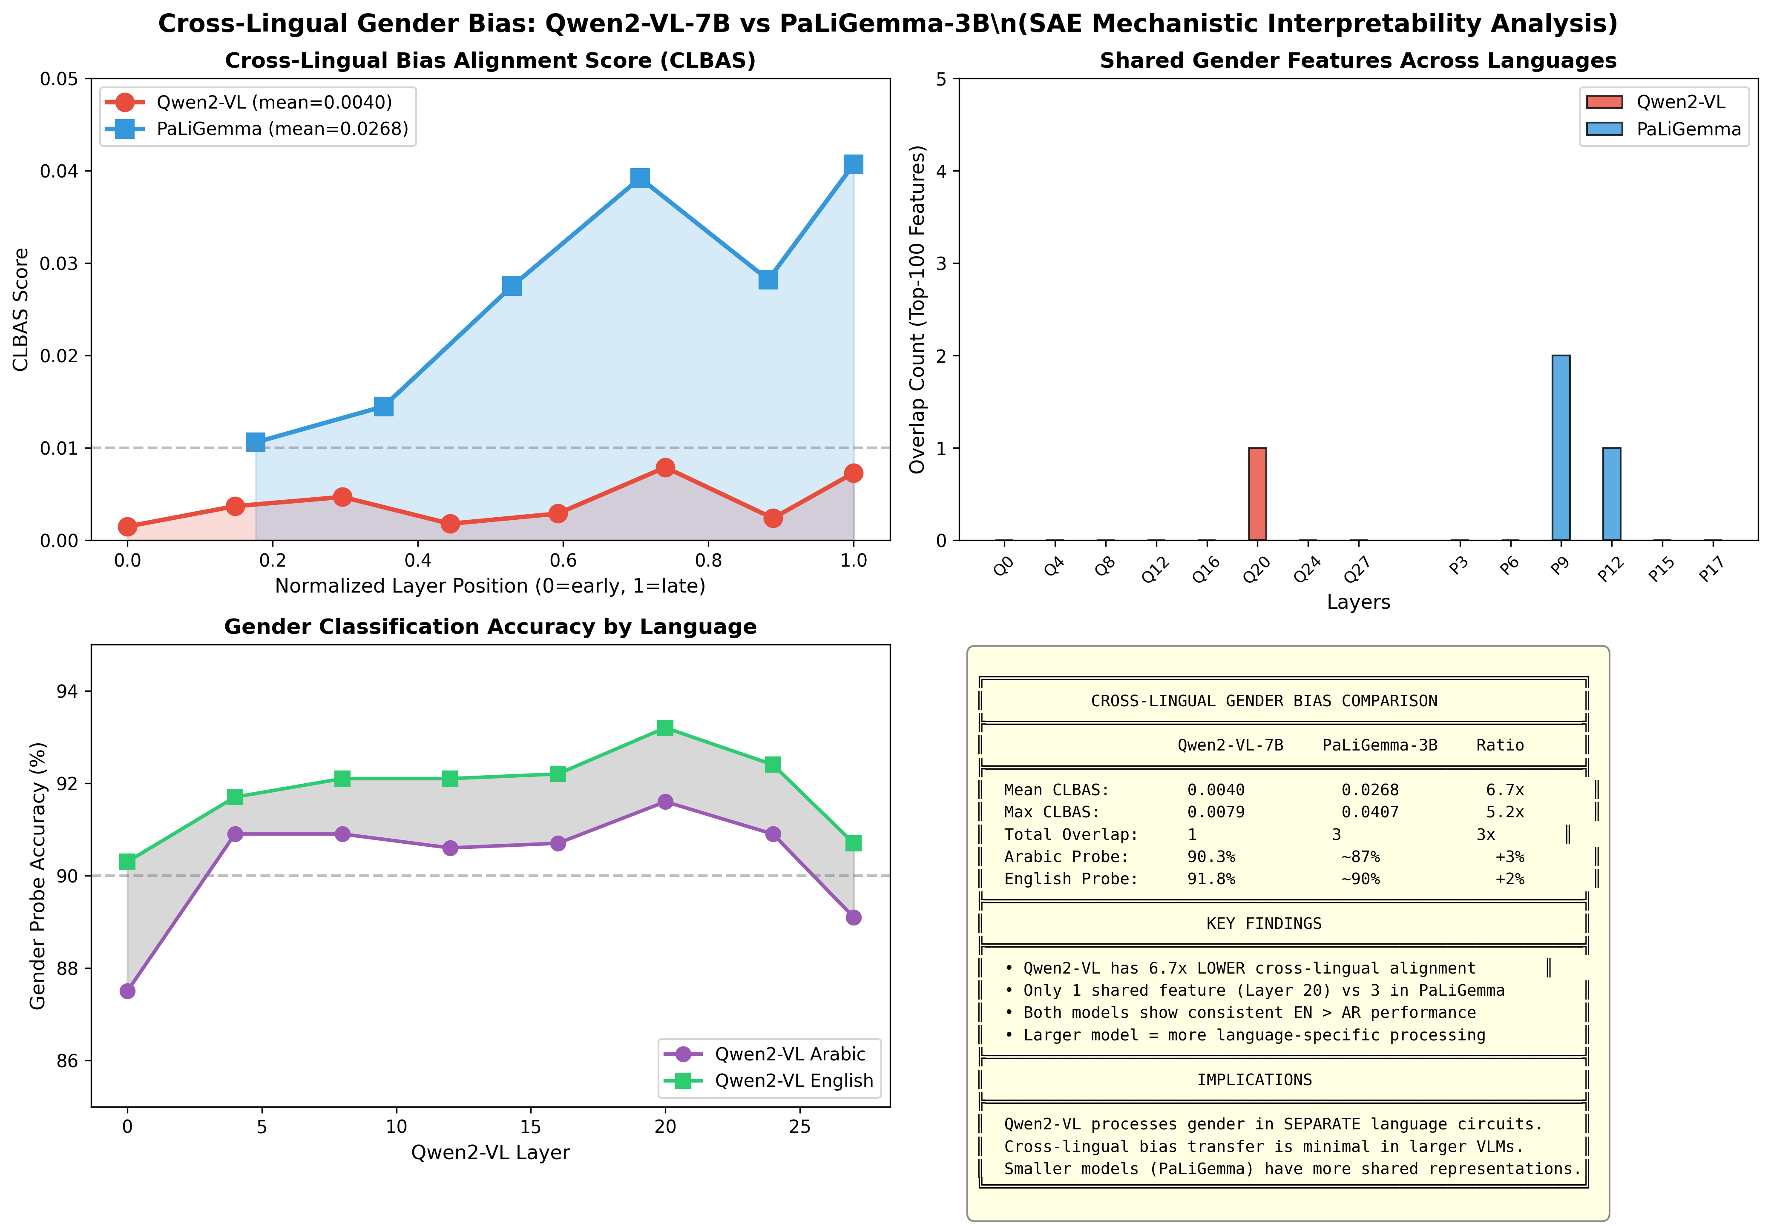
Final Model Comparison
Comprehensive comparison across all three models

Slide 65
Summary of Contributions
1. CLMB Framework
First mechanistic interpretability approach to VLM gender bias
2. CLBAS Metric
Novel measure for cross-lingual bias alignment
Based on cosine similarity of effect size vectors
3. Key Discovery
Arabic and English use SEPARATE gender circuits
CLBAS ≈ 0.004-0.027 (near-zero alignment)
4. SBI Validation
Surgical bias intervention is safe and effective
Cross-language ablation has zero negative impact

Slide 66
Thank You
Questions?
github.com/nour-mubarak/mechanistic_intrep

