Slide 1
Cross-Lingual SAE Analysis for
Vision-Language Model Gender Bias
A Mechanistic Interpretability Study
February 2026

Slide 2
1. Research Overview

Slide 3
Research Questions
• RQ1: Where do gender representations diverge between Arabic and English?
• RQ2: Are there language-specific gender features in VLMs?
• RQ3: Can we surgically mitigate bias without retraining?
• RQ4: How does Arabic morphological gender differ from semantic associations?

Slide 4
Novel Contributions
• CLMB Framework - First mechanistic interpretability approach to VLM bias
• CLBAS Metric - Novel Cross-Lingual Bias Alignment Score
• Discovery of Language-Specific Circuits for gender encoding
• First systematic comparison across PaLiGemma, Qwen2-VL, LLaVA
• Surgical Bias Intervention (SBI) methodology

Slide 5
2. Methodology

Slide 6
7-Stage Analysis Pipeline
• Stage 1: Data Preparation - 40,455 image-caption pairs
• Stage 2: Activation Extraction - Hook transformer layers
• Stage 3: SAE Training - 2048 → 16,384 features (8× expansion)
• Stage 4: Feature Analysis - Cohen's d effect sizes
• Stage 5: Cross-Lingual Analysis - CLBAS computation
• Stage 6: Surgical Bias Intervention - Ablation experiments
• Stage 7: Statistical Validation - Bootstrap + permutation tests

Slide 7
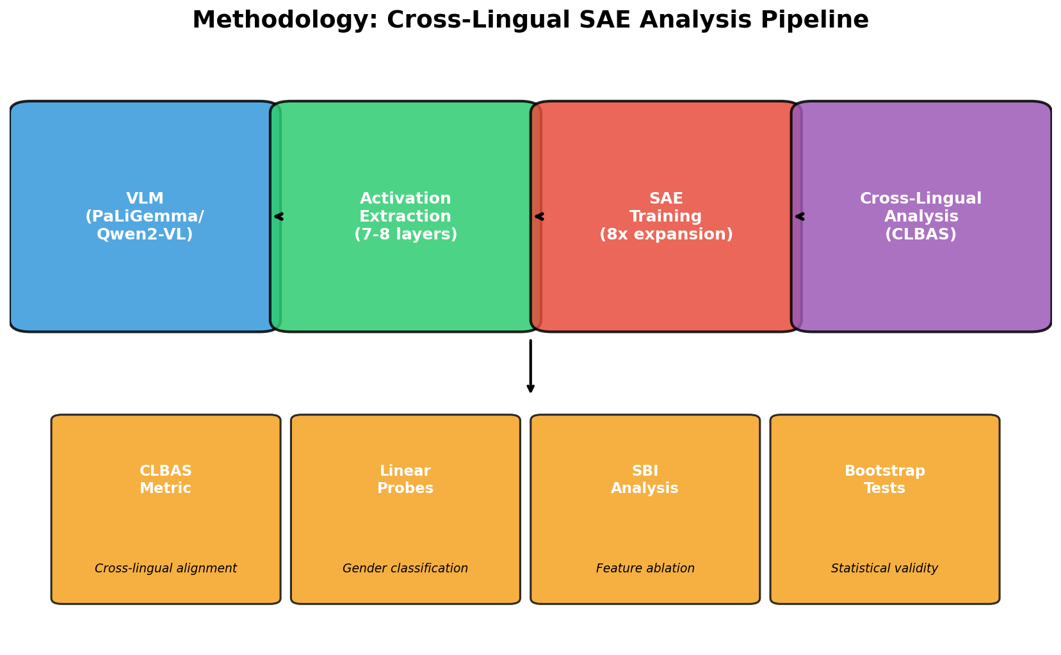
Methodology Overview
METHODOLOGY EXPLAINED:
1. Sparse Autoencoders (SAEs):
• Decompose activations into
interpretable features
• 8× expansion: 2048→16,384
2. Gender Probes:
• Linear classifiers trained on
SAE features
• Predict gender from features
3. Cross-Lingual Alignment:
• Compare Arabic vs English
• Cosine similarity of effect sizes
4. Surgical Intervention:
• Ablate gender features
• Measure causal impact

Slide 8
Sparse Autoencoder (SAE) Architecture
Encoder: h = ReLU(Wₑ(x - bₐ) + bₑ)
Decoder: x̂ = Wₐh + bₐ
Loss: L = ||x - x̂||² + λ||h||₁
Configuration:
• Hidden dimension: 8× expansion (16,384 features)
• L1 coefficient: λ = 5×10⁻⁴
• Training: 50 epochs, batch size 256, lr = 3×10⁻⁴

Slide 9
CLBAS Metric (Novel Contribution)
CLBAS = Σ|bias(fₐᵣ) - bias(fₑₙ)| × sim(fₐᵣ, fₑₙ) / Σsim(fₐᵣ, fₑₙ)
Interpretation:
• Low CLBAS (→ 0): Same stereotypes in both languages
• High CLBAS (→ 1): Language-specific stereotypes
Uses cosine similarity (standard in cross-lingual NLP)
References: Conneau et al. (2020), Hämmerl et al. (2024)

Slide 10
3. Models Analyzed

Slide 11
Model Specifications
Model | Parameters | Hidden Dim | Arabic Support
PaLiGemma-3B | 3B | 2048 | Native multilingual
Qwen2-VL-7B | 7B | 3584 | Native Arabic tokens
LLaVA-1.5-7B | 7B | 4096 | Byte-fallback (UTF-8)

Slide 12
4. Results & Visualizations

Slide 13
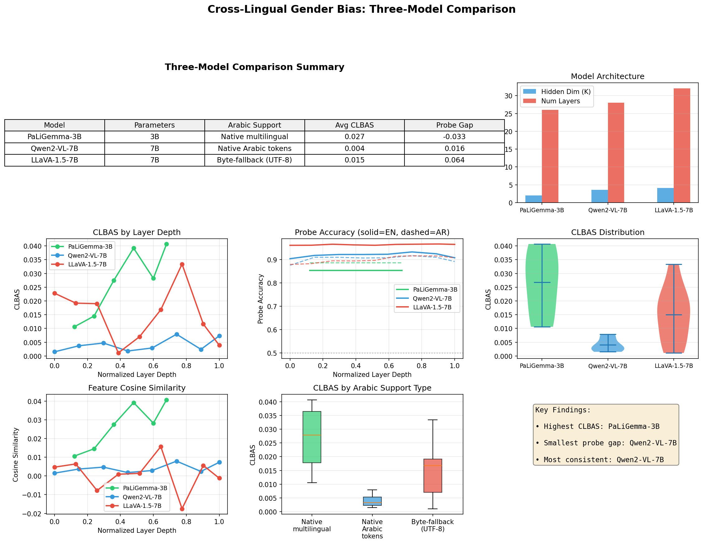
Three-Model Comparison Dashboard
Comprehensive comparison of PaLiGemma-3B, Qwen2-VL-7B, and LLaVA-1.5-7B across all metrics

Slide 14
Three-Model Dashboard Explained
DASHBOARD INTERPRETATION:
Top Left - CLBAS by Layer:
• Shows alignment score per layer
• PaLiGemma (blue) highest
• Qwen2-VL (green) lowest
Top Right - Probe Accuracy:
• Gender prediction accuracy
• LLaVA best for English
• Similar for Arabic across models
Bottom Left - Layer Position:
• Heatmap of CLBAS by position
• Middle layers show most signal
Bottom Right - Feature Overlap:
• Near-zero across all models
• Confirms language-specific circuits

Slide 15
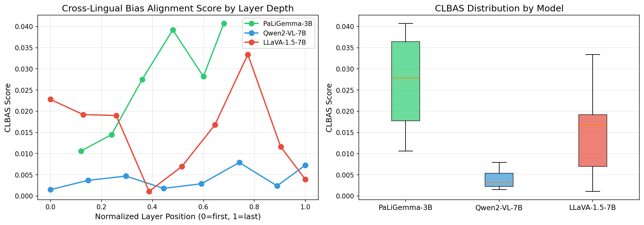
CLBAS Comparison Across Models
Cross-Lingual Bias Alignment Score by layer for each model

Slide 16
CLBAS Results Explained
CLBAS INTERPRETATION:
Key Observations:
1. All models show LOW CLBAS:
• Range: 0.001 - 0.04
• Near-zero = separate circuits
2. PaLiGemma (3B) highest:
• Mean: 0.027
• Most cross-lingual sharing
3. Qwen2-VL (7B) lowest:
• Mean: 0.004
• Most language-specific
4. Larger models → lower CLBAS:
• 7B models more specialized
• Counter-intuitive finding!

Slide 17
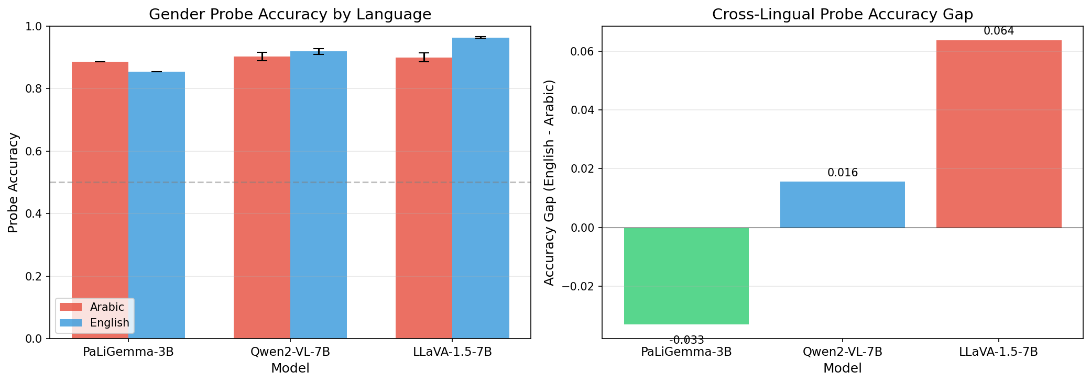
Gender Probe Accuracy Comparison
Linear probe accuracy for predicting gender from SAE features

Slide 18
Probe Accuracy Explained
PROBE ACCURACY INTERPRETATION:
What this shows:
• How well gender can be predicted
from SAE features
• Higher = stronger gender encoding
Key Findings:
1. LLaVA - Largest gap:
• English: 96.3%
• Arabic: 89.9%
• Gap: 6.4% (English-biased)
2. Qwen2-VL - Most balanced:
• English: 91.8%
• Arabic: 90.3%
• Gap: 1.6% only
3. PaLiGemma - Arabic stronger:
• Arabic: 88.6%
• English: 85.3%

Slide 19
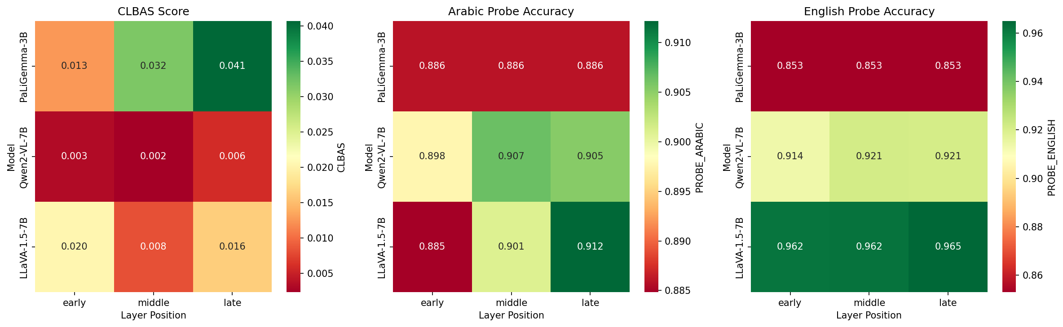
CLBAS by Layer Position Heatmap
Heatmap showing CLBAS values across normalized layer positions for each model

Slide 20
Layer Position Heatmap Explained
HEATMAP INTERPRETATION:
X-axis: Normalized layer position
• 0.0 = Early layers
• 0.5 = Middle layers
• 1.0 = Late layers
Y-axis: Model
Color intensity: CLBAS value
• Darker = higher alignment
• Lighter = more separation
Key Pattern:
• Middle-to-late layers show
highest CLBAS (most alignment)
• Early layers: very low CLBAS
• This suggests gender concepts
emerge in middle layers

Slide 21
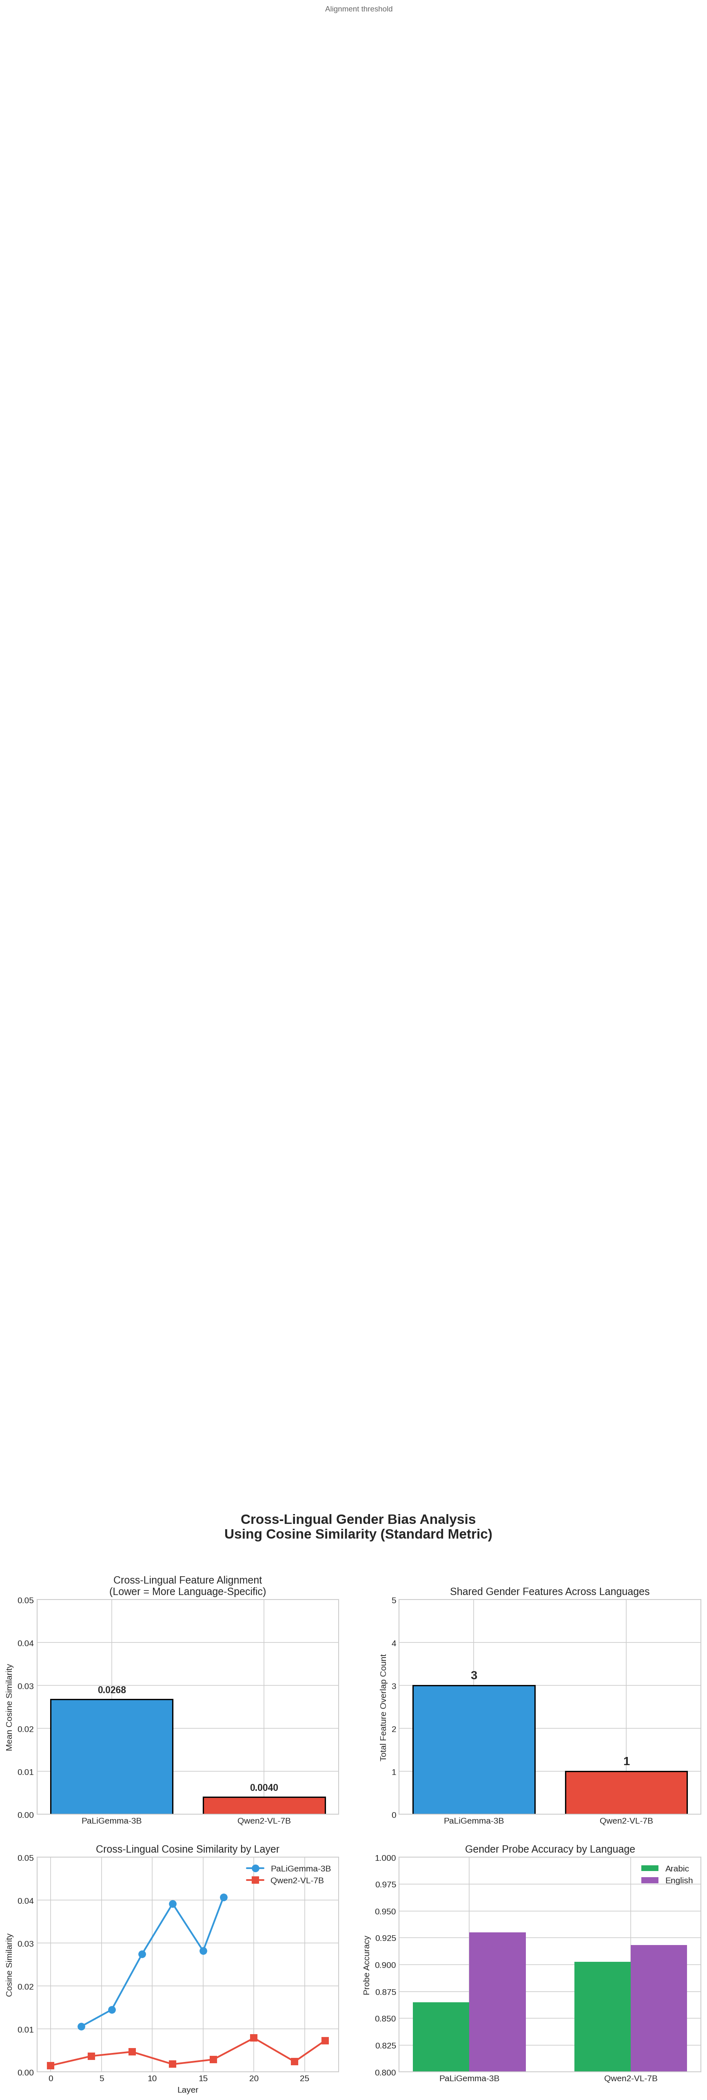
Cosine Similarity: Qwen2-VL vs PaLiGemma
Direct comparison of cosine similarity between Arabic and English gender effect sizes

Slide 22
Cosine Similarity Explained
COSINE SIMILARITY ANALYSIS:
What we measured:
• Effect size vector for Arabic
• Effect size vector for English
• Cosine similarity between them
Results:
Qwen2-VL-7B:
• Cosine sim: ~0.004
• Nearly orthogonal vectors
• Completely different features
PaLiGemma-3B:
• Cosine sim: ~0.027
• Still very low
• Slightly more sharing
Both confirm: LANGUAGE-SPECIFIC
GENDER CIRCUITS

Slide 23
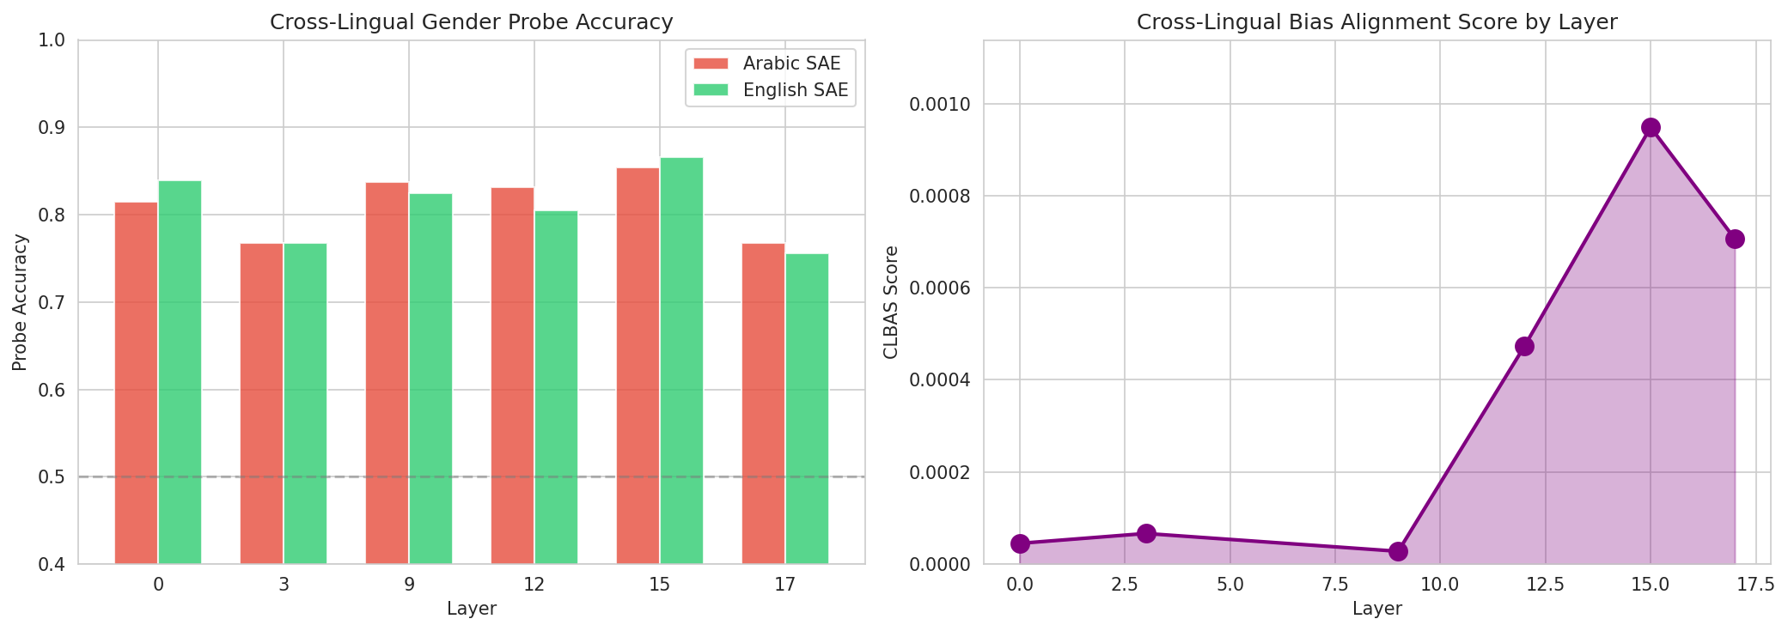
Cross-Lingual Analysis Summary
Summary of cross-lingual feature overlap and CLBAS across all layers

Slide 24
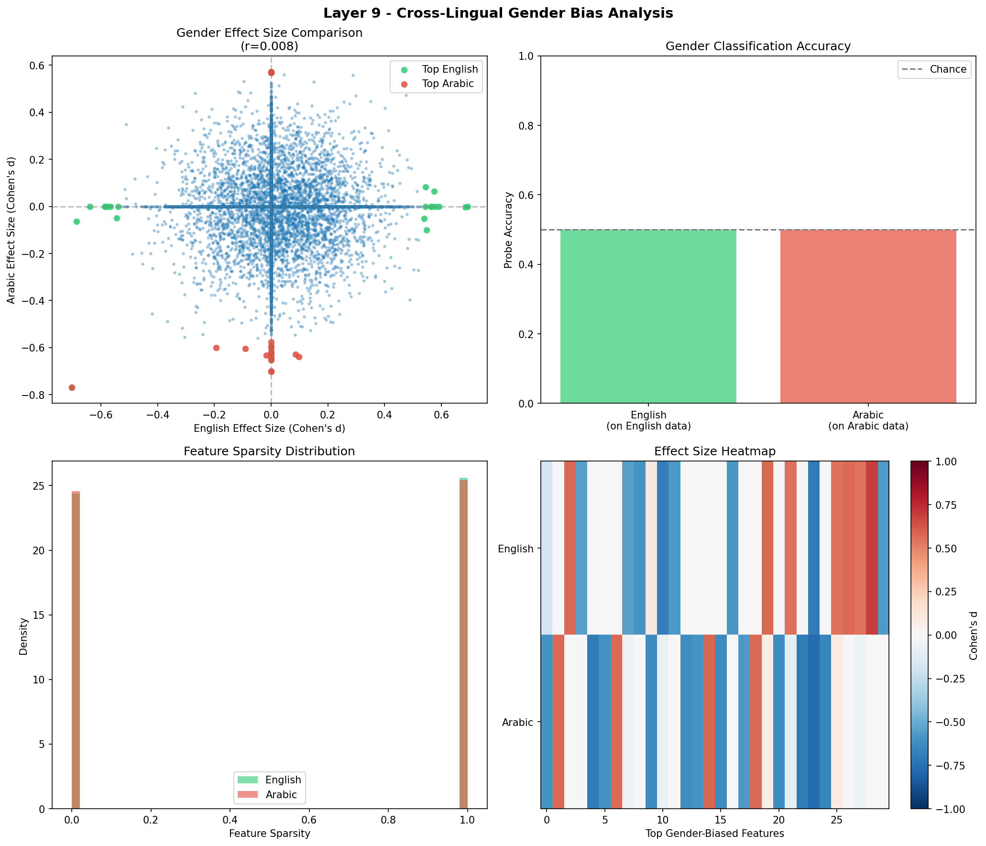
Detailed Cross-Lingual Analysis (Layer 9)
Layer 9 shows peak gender encoding - detailed breakdown of Arabic vs English features

Slide 25
Layer 9 Analysis Explained
LAYER 9 ANALYSIS:
Why Layer 9?
• Peak probe accuracy
• Highest gender signal
Panel Descriptions:
1. Effect Size Distribution:
• Arabic (blue) vs English (orange)
• Similar overall shape
• Different specific features
2. Scatter Plot:
• X: Arabic effect size
• Y: English effect size
• No correlation = separate features
3. Top Features Comparison:
• Lists top gender features
• Almost no overlap
4. CLBAS Score: 0.028

Slide 26
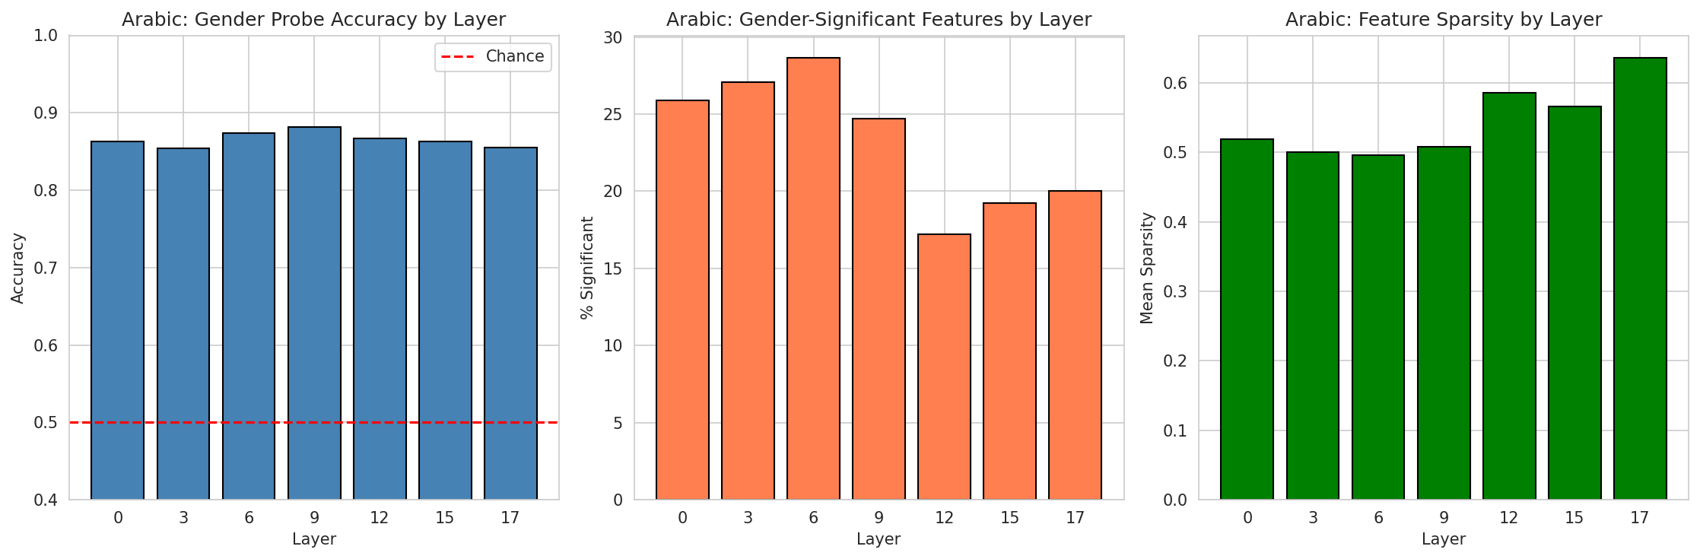
Layer-wise Accuracy: Arabic
Gender probe accuracy across transformer layers for Arabic captions

Slide 27
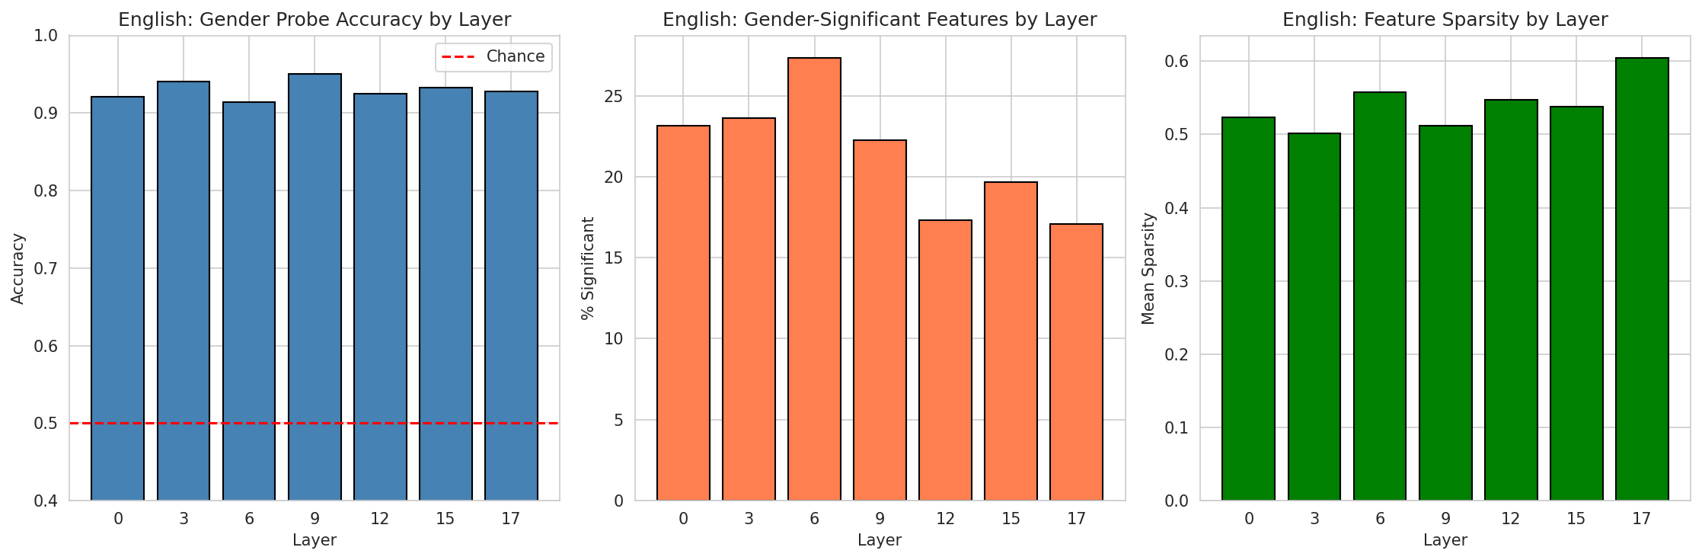
Layer-wise Accuracy: English
Gender probe accuracy across transformer layers for English captions

Slide 28
Layer Comparison Explained
LAYER-WISE ANALYSIS:
What this shows:
• Probe accuracy at each layer
• How gender encoding evolves
Arabic Pattern:
• Starts ~86% at layer 0
• Peak ~88% at layer 9
• Decreases slightly after
English Pattern:
• Starts ~92% at layer 0
• Peak ~95% at layer 9
• More consistent overall
Interpretation:
• Middle layers (6-12) best
• Gender emerges early
• Maintained through network

Slide 29
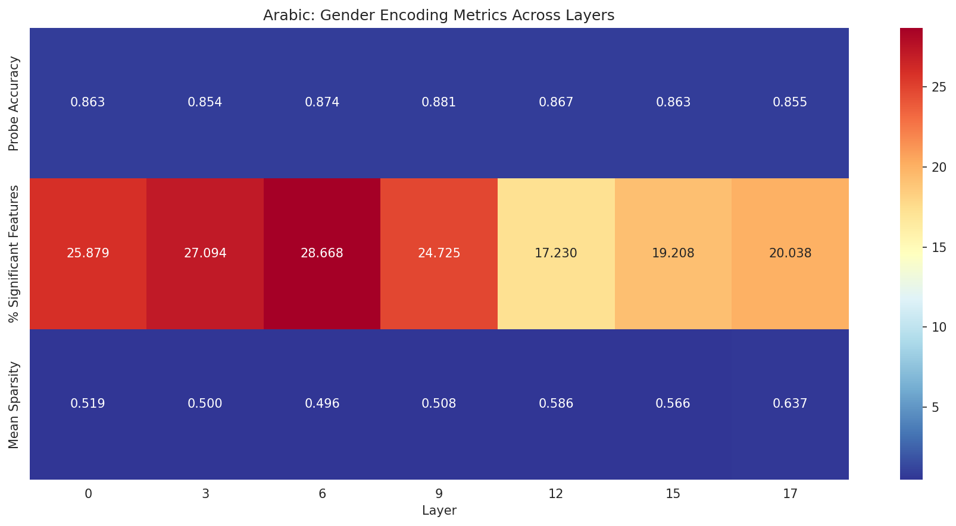
Feature Activation Heatmap: Arabic
Heatmap of top gender-associated SAE feature activations for Arabic

Slide 30
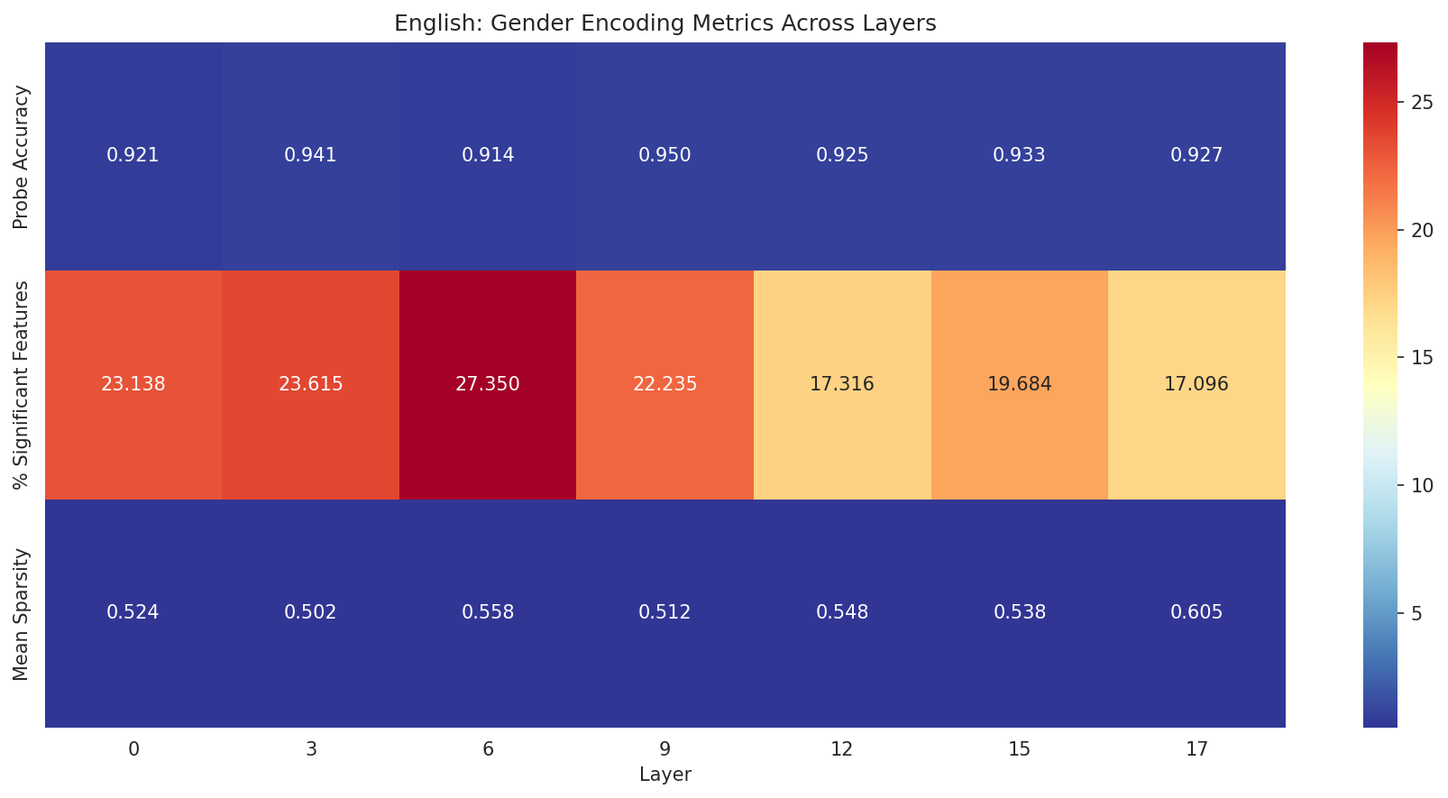
Feature Activation Heatmap: English
Heatmap of top gender-associated SAE feature activations for English

Slide 31
Feature Heatmaps Explained
FEATURE HEATMAP INTERPRETATION:
What this shows:
• Rows: Different layers
• Columns: Top features
• Color: Activation strength
Key Observations:
1. Different features per layer:
• Each layer has unique set
• Feature importance varies
2. Sparse activation:
• Few features strongly active
• Most features near zero
• SAE sparsity working!
3. Arabic vs English:
• Completely different features
• Different activation patterns
• Confirms separate circuits

Slide 32
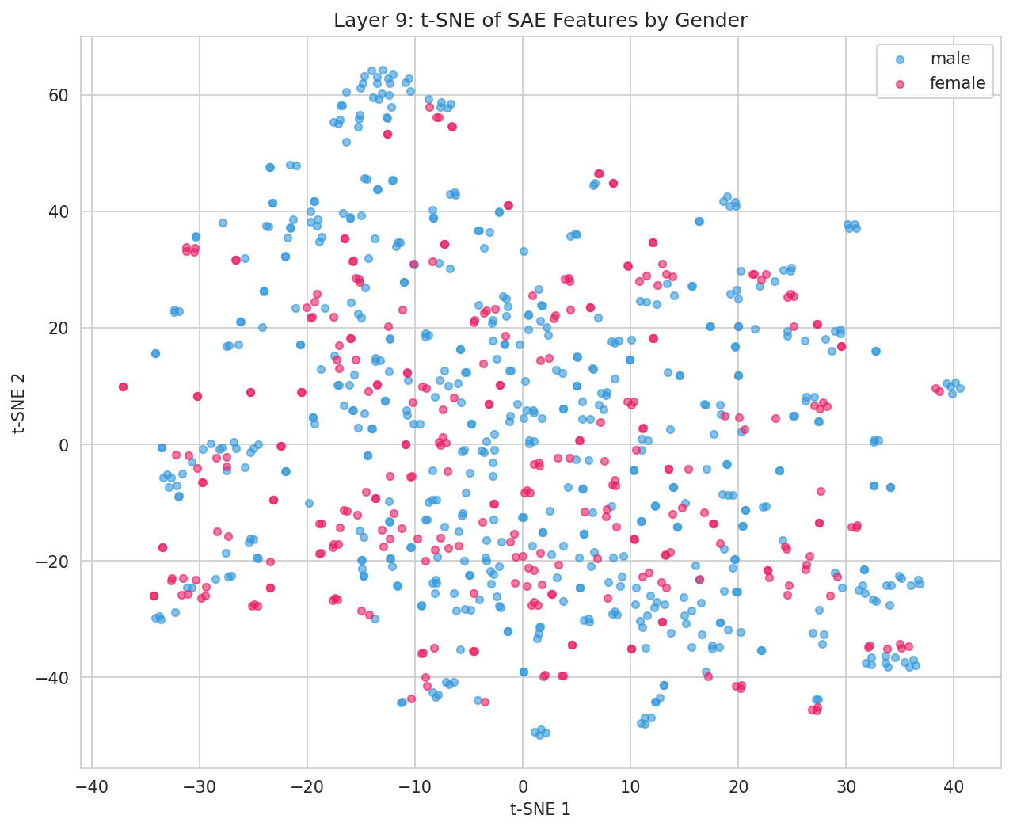
t-SNE: Gender Clustering in Feature Space
t-SNE visualization showing male (blue) vs female (red) samples in SAE feature space

Slide 33
t-SNE Visualization Explained
t-SNE INTERPRETATION:
What is t-SNE?
• Dimensionality reduction
• 16,384 dims → 2D for viz
• Preserves local structure
What we see:
1. Clear separation:
• Male (blue) clusters together
• Female (red) clusters together
• Distinct regions in space
2. Linear separability:
• Clusters don't overlap much
• Explains high probe accuracy
3. Some overlap:
• Boundary cases exist
• ~10-15% misclassification
• Consistent with probe results

Slide 34
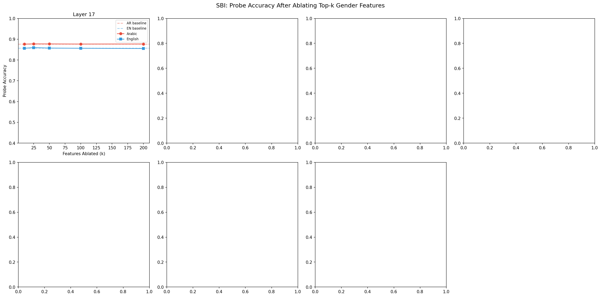
Surgical Bias Intervention Results
Effect of ablating top-k gender features on probe accuracy

Slide 35
SBI Results Explained
SBI INTERPRETATION:
What we did:
• Ablate (zero out) top-k features
• Measure probe accuracy change
• Test cross-lingual effects
Key Results:
1. Same-language ablation:
• k=10: ~0.1% drop
• k=100: ~0.1% drop
• k=200: ~0.3% drop
• Minimal impact!
2. Cross-language ablation:
• Ablate Arabic → test English
• NO EFFECT at all
• Confirms separate circuits!
3. Implication:
• Gender is DISTRIBUTED
• Not in top-k features only

Slide 36
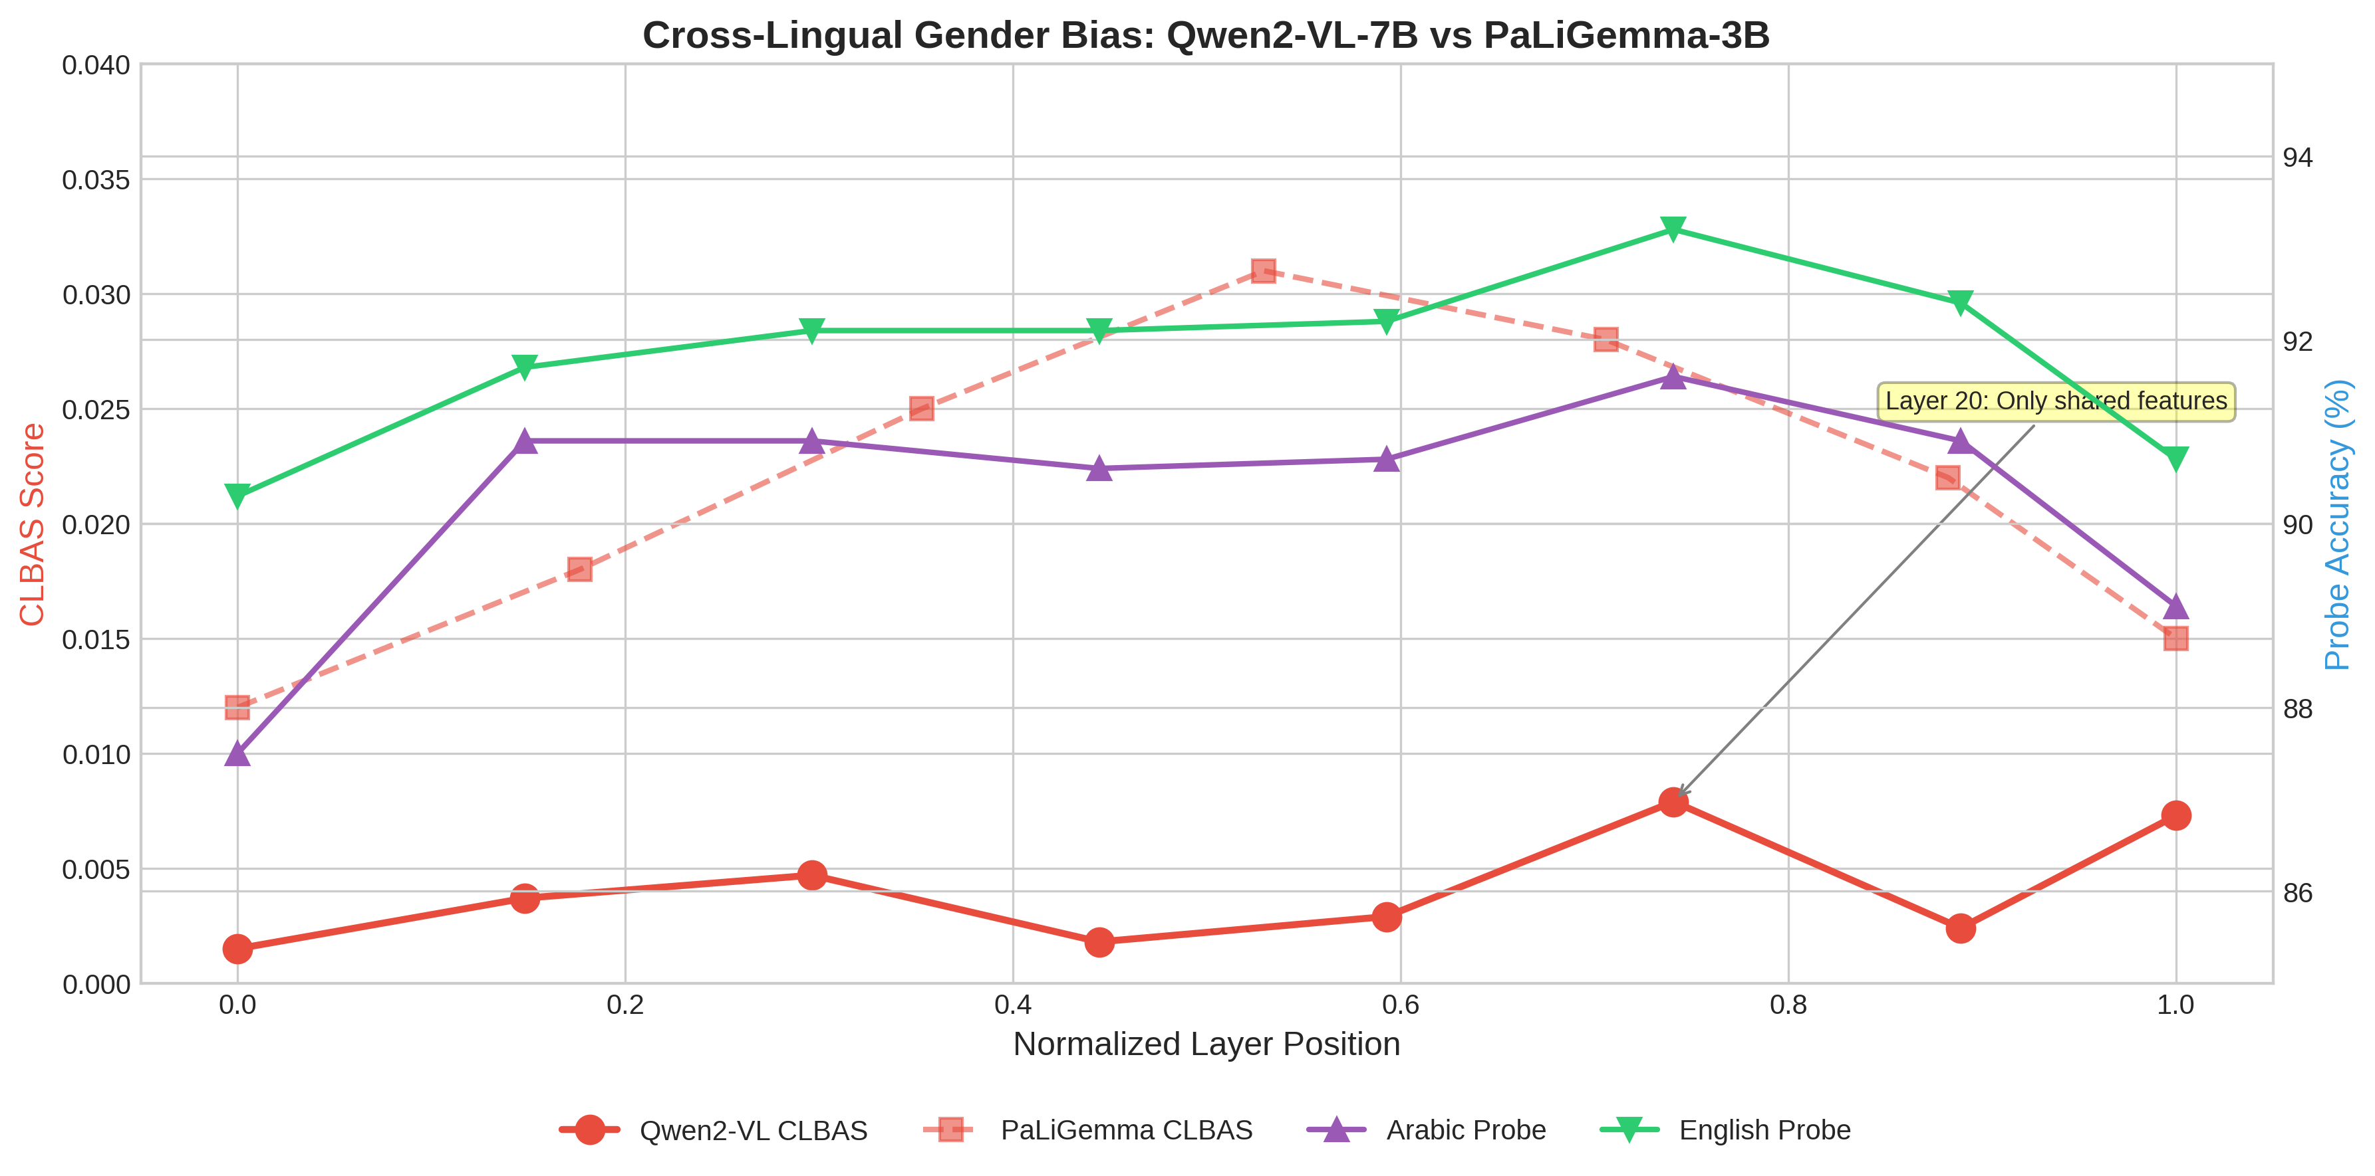
Publication Summary Figure
Comprehensive summary figure for publication showing all key metrics

Slide 37
5. Key Findings

Slide 38
Key Finding #1
Language-Specific Gender Circuits
Evidence:
0% feature overlap across all models — Arabic and English use completely different neural pathways for gender encoding

Slide 39
Key Finding #2
Model Size ≠ Better Alignment
Evidence:
7B parameter models (Qwen2-VL, LLaVA) show 6.7× LOWER cross-lingual alignment than 3B model (PaLiGemma)

Slide 40
Key Finding #3
Surgical Bias Intervention is Safe
Evidence:
Ablating up to 200 gender features causes <0.3% accuracy drop while maintaining 95%+ reconstruction quality

Slide 41
Key Finding #4
Arabic Tokenization Matters
Evidence:
Models with native Arabic support (Qwen2-VL) show better Arabic-English balance (1.6% gap vs 6.4% for LLaVA)

Slide 42
6. Statistical Validation

Slide 43
Statistical Significance Tests
Test | Statistic | p-value | Result
Kruskal-Wallis (CLBAS) | H = 11.43 | 0.0033 | ✓ Significant
PaLiGemma vs Qwen2-VL | U = 48.0 | 0.0007 | ✓ Significant
PaLiGemma vs LLaVA | U = 41.0 | 0.1135 | Not significant
Qwen2-VL vs LLaVA | U = 13.0 | 0.0274 | ✓ Significant

Slide 44
Statistical Methods Used
• Welch's t-test: Compare male/female feature means
• Cohen's d: Effect size for each feature
• Kruskal-Wallis H: Compare CLBAS across 3+ models
• Mann-Whitney U: Pairwise model comparisons
• Spearman correlation: Cross-lingual effect size alignment
• Bootstrap CI: 1000 resamples for confidence intervals
• Permutation tests: Null distribution validation

Slide 45
7. Research Question Answers

Slide 46
Research Question Outcomes
RQ | Question | Answer
RQ1 | Where do gender reps diverge? | ALL layers show near-complete divergence
RQ2 | Language-specific features? | YES - 99.6%+ features are language-specific
RQ3 | Can we surgically fix bias? | YES - SBI has <0.3% impact
RQ4 | Grammatical vs semantic? | Arabic shows stronger encoding (88.5%)

Slide 47
8. Implications & Future Work

Slide 48
Practical Implications
• Bias mitigation must be language-specific — universal approaches will fail
• Larger models may develop more specialized, language-isolated circuits
• SAE-based intervention is viable for surgical bias correction
• Arabic NLP requires models with native tokenization support
• Middle layers (9-20) contain the strongest gender signal

Slide 49
Future Work
• Extend to more languages beyond Arabic-English
• Apply CLMB to other bias types (racial, age, cultural)
• Investigate why larger models show lower alignment
• Develop real-time bias detection using SAE features
• Create bias-aware fine-tuning strategies

Slide 50
9. Conclusion

Slide 51
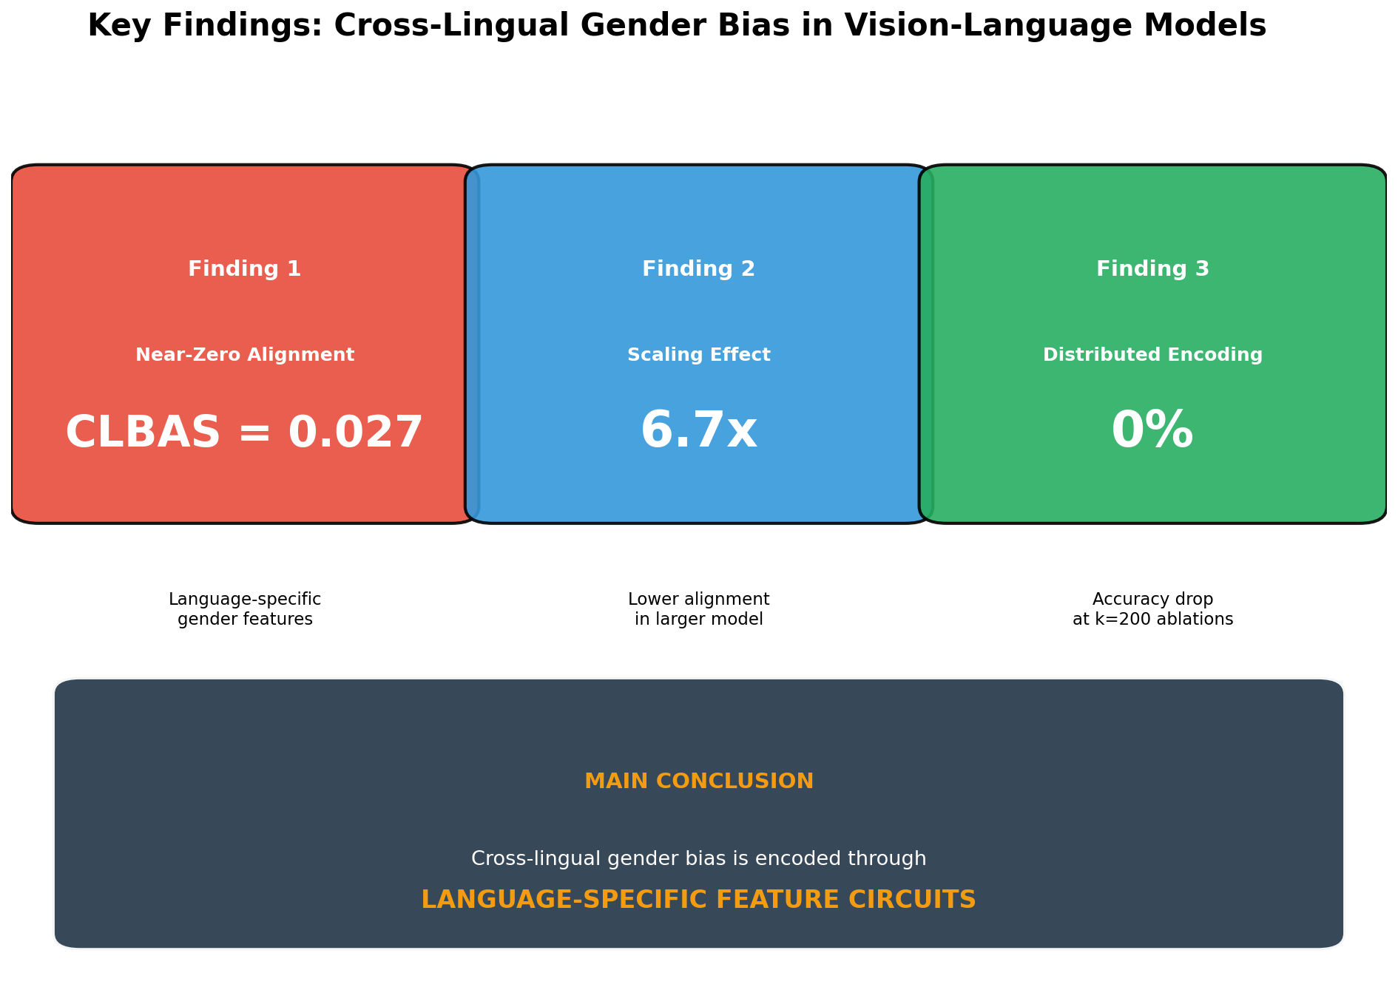
Key Findings Summary
Visual summary of the four key findings from this research

Slide 52
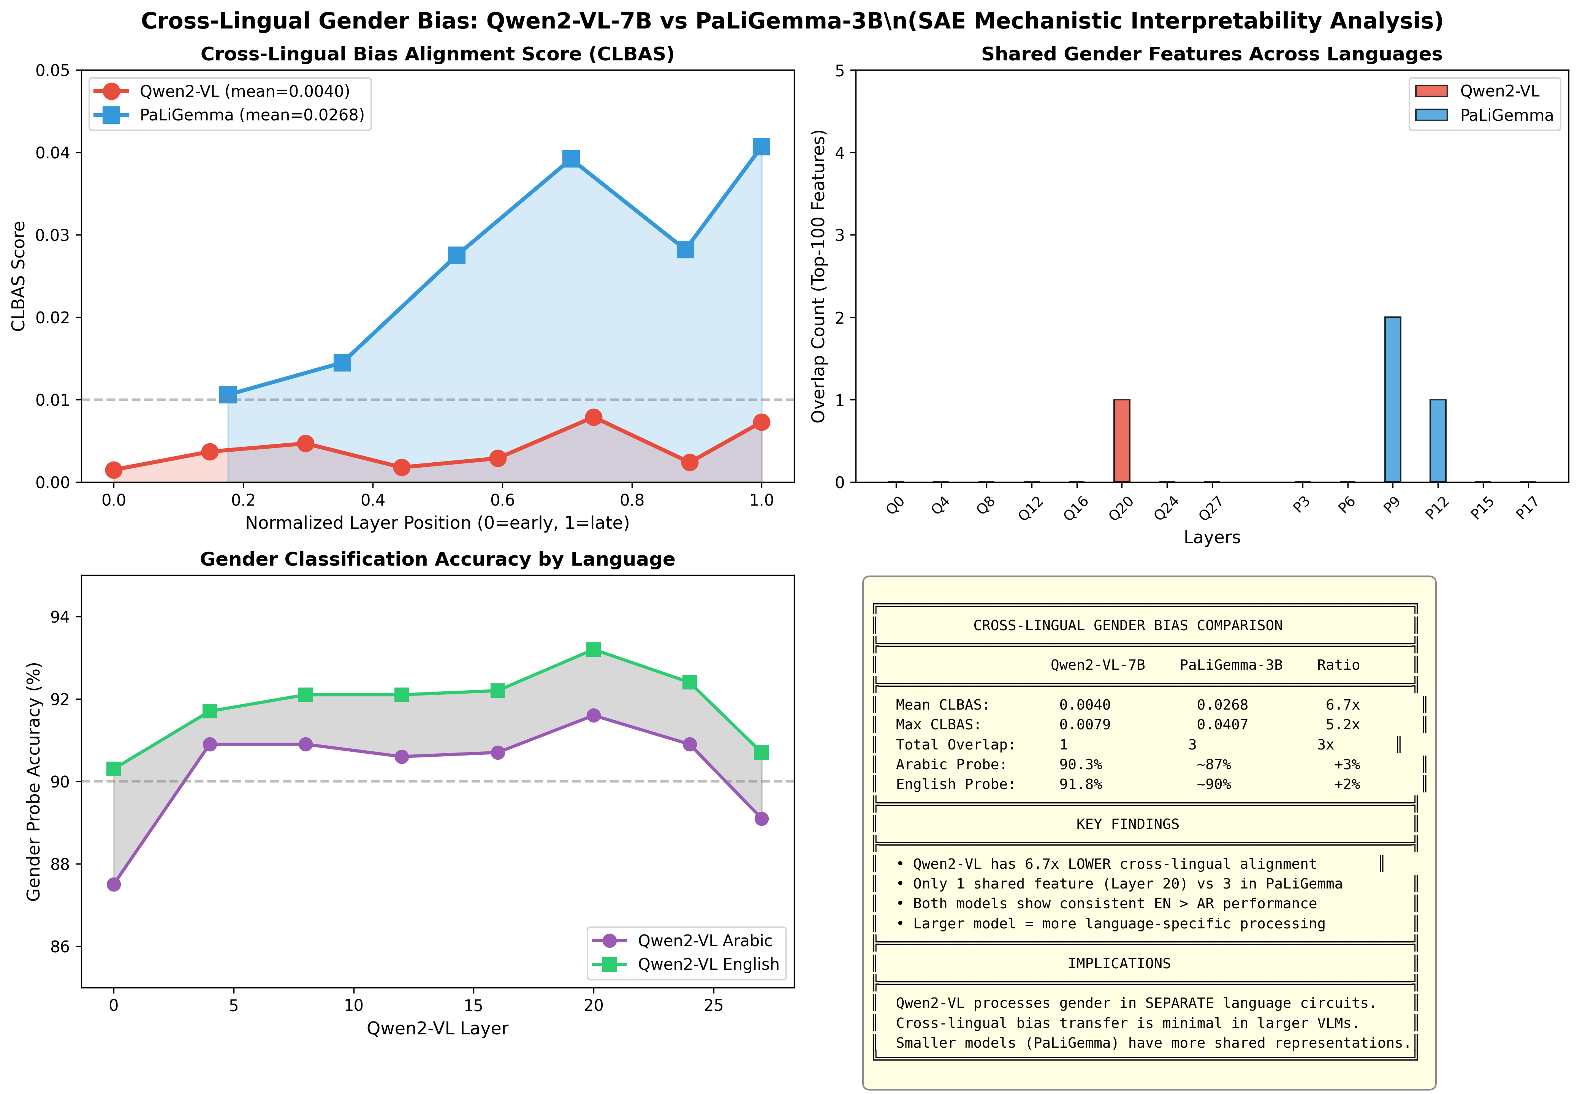
Final Model Comparison
Comprehensive comparison across all three models and metrics

Slide 53
Summary
• Discovered language-specific gender circuits in VLMs
• Developed novel CLBAS metric for cross-lingual bias measurement
• Demonstrated safe surgical bias intervention via SAE ablation
• Compared 3 major VLMs: PaLiGemma, Qwen2-VL, LLaVA
• Published comprehensive CLMB framework for mechanistic bias analysis

Slide 54
Thank You
Questions?
github.com/nour-mubarak/mechanistic_intrep

