Slide 1
Sparse Autoencoders Reveal and Control Gender Bias in Vision-Language Models
A Cross-Lingual Mechanistic Interpretability Study Nour Mubarak Durham University | Supervisor Meeting March 2026

Slide 2
Presentation Outline
• Part 1: Research Context & Motivation
• Gender bias in VLMs, limitations of prior work
• Why mechanistic interpretability?
• Part 2: Methodology & Technical Approach
• SAE architecture, training, feature identification
• Intervention experiment design with full justifications
• Part 3: Experimental Results (3 Models)
• PaLiGemma-3B, Qwen2-VL-7B, Llama-3.2-11B
• Statistical analysis with 25 random control runs
• Part 4: Key Novel Findings
• Excitatory vs inhibitory gender encoding mechanisms
• Cross-lingual feature analysis
• Part 5: Implications, Limitations & Future Work

Slide 3
Part 1
Research Context & Motivation
Understanding the problem and why mechanistic interpretability is needed

Slide 4
The Problem: Gender Bias in Vision-Language Models
• VLMs exhibit systematic gender bias in image captioning:
★ Example: Same activity, different gendered subjects
Man on skateboard → 'a man performing impressive tricks'
Woman on skateboard → 'a person standing on a board'
• Models systematically:
Use gendered language more for certain groups
Associate activities/appearances with specific genders
Propagate societal stereotypes from training data
⚠ This bias has real-world consequences:
Automated captioning systems, assistive technologies, search
Perpetuates harmful stereotypes at scale

Slide 5
Prior Work: Gender Bias in VLMs
[Hendricks et al., 2018] - Women Also Snowboard (ECCV)
Documented systematic bias: men described with activities,
women with appearance. Proposed caption-level mitigation.
[Zhao et al., 2017] - Men Also Like Shopping (EMNLP)
Data augmentation to reduce bias in visual semantic role labeling.
Output-level intervention; does not explain mechanisms.
[Hirota et al., 2022] - Gender and Racial Bias in VLMs
Developed quantification metrics for VLM bias.
Measurement only; no intervention or explanation.
→ Our advance: We explain HOW bias is encoded internally
→ Our advance: Causal intervention on identified features

Slide 6
Why Mechanistic Interpretability?
Prior Approaches (Black Box)
Our Approach (Mechanistic)
• Measure bias at output level
• Data augmentation for debiasing
• Constrained decoding
• Post-processing filters
• Cannot explain WHY bias occurs
• No insight into internal mechanisms
• Interventions may have unintended effects
• Open the black box
• Identify specific bias-encoding features
• Test causal hypotheses via ablation
• Understand internal representations
• Enable surgical, targeted interventions
• Predict effects across architectures
• Inform principled debiasing strategies

Slide 7
Prior Work: Sparse Autoencoders for Interpretability
[Cunningham et al., 2023] - SAEs for GPT-2 (ICLR)
First demonstration that SAEs decompose activations into
interpretable, monosemantic features in text LLMs.
[Bricken et al., 2023] - Monosemanticity at Scale (Anthropic)
Scaled SAEs to larger models; showed individual features
correspond to semantically meaningful concepts.
[Templeton et al., 2024] - 34M Features on Claude (Anthropic)
Massive SAE with 34M features; identified safety-relevant
concepts (bias, deception, manipulation).
→ All prior SAE work is on TEXT-ONLY language models
→ Our advance: FIRST application of SAEs to multimodal VLMs
→ Our advance: Focus on gender bias features specifically

Slide 8
Research Questions
★ RQ1: Can SAEs identify interpretable gender features in VLMs?
Do sparse autoencoders decompose VLM activations into features
that correspond to gender-related concepts?
★ RQ2: Do identified features have CAUSAL influence on output?
Does ablating gender features actually change gendered language?
Is the effect specific (vs random feature ablation)?
★ RQ3: How does gender encoding differ across architectures?
Do different model types encode gender the same way?
★ RQ4: Are gender features shared across languages?
Can debiasing in English automatically help Arabic (and vice versa)?

Slide 9
Part 2
Methodology & Technical Approach
SAE architecture, training procedures, and intervention design

Slide 10
Vision-Language Models Studied
Range from 2.9B to 10.6B parameters; both captioning and instruction-tuned architectures
Model | Parameters | d_model | Layers | SAE Features | Type
PaLiGemma-3B | 2.9B | 2,048 | 18 | 16,384 | Captioning
Qwen2-VL-7B | 7.6B | 3,584 | 28 | 28,672 | Instruction-tuned
LLaVA-1.5-7B | 7.1B | 4,096 | 32 | 32,768 | Instruction-tuned
Llama-3.2-11B | 10.6B | 4,096 | 40 | 32,768 | Instruction-tuned

Slide 11
Layer Selection: Justification
• Intervention layers selected at ~50th percentile of model depth:
★ PaLiGemma-3B: Layer 9 (50%), Layer 17 as negative control
★ Qwen2-VL-7B: Layer 12 (43%)
★ Llama-3.2-11B: Layer 20 (50%)
✓ Justification from literature:
Cunningham et al. (2023): Mid-layers encode richest semantic features
Templeton et al. (2024): Early layers = low-level, late = output formatting
50th percentile balances feature richness vs output proximity
✓ L17 (PaLiGemma) serves as negative control:
Penultimate layer should not carry semantic gender content
If it shows no effect, confirms layer specificity

Slide 12
Dataset: Flickr8K Bilingual
★ Flickr8K (Hodosh et al., 2013)
8,092 images with bilingual English-Arabic caption pairs
Established benchmark for image captioning research
★ Gender labels from caption content (keyword matching)
Male samples: 5,562 | Female samples: 2,047
Ratio 2.7:1 (reflects inherent dataset bias)
★ Why Flickr8K is SUFFICIENT for this work:
We analyze INTERNAL ACTIVATIONS, not train new models
8,092 images → up to 10,000 activation samples per model
SAEs reconstruct activation distribution, not generalize to new images
Consistent with Cunningham et al. (2023), Bricken et al. (2023)
Gender terms: he, she, him, her, his, hers, man, woman, boy, girl, men, women, boys, girls, male, female (16 total)

Slide 13
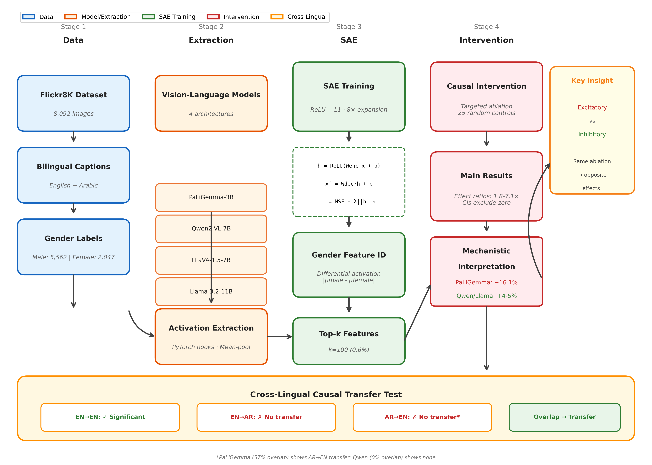
Four-Stage Pipeline Overview
Each stage has rigorous methodological justification
Complete pipeline: Data → Extraction → SAE Training → Feature ID → Causal Intervention → Cross-lingual Analysis

Slide 14
SAE Architecture: Mathematical Formulation
h = ReLU(W_enc · x + b_enc)
Encoder: Map d_model → n_features (8× expansion). ReLU enforces sparsity.
x̂ = W_dec · h + b_dec
Decoder: Reconstruct original activations from sparse representation.
L = MSE(x, x̂) + λ · ||h||₁
Loss: Reconstruction fidelity + L1 sparsity penalty (λ = 10⁻⁴ for PaLiGemma, 5×10⁻⁴ for Qwen)

Slide 15
SAE Training: Hyperparameters & Justifications
★ Architecture choices:
Expansion factor: 8× (standard in SAE literature)
Activation: Vanilla ReLU (baseline; TopK/JumpReLU for future work)
★ Training hyperparameters:
Learning rate: 10⁻⁴ with AdamW optimizer
Batch size: 256 (fits GPU memory, sufficient gradient estimation)
Epochs: 50 with early stopping (patience=10, min_delta=10⁻⁵)
Train/Val split: 90% / 10%
★ Critical design decision:
Activations are MEAN-POOLED across sequence positions
One [d_model] vector per image-caption pair
Trade-off: Simpler training vs. mismatch with per-token intervention

Slide 16
Activation Extraction: Per-Model Details
Sample counts vary due to extraction failures; activations from LANGUAGE MODEL DECODER (not visual encoder)
Model | N Samples | Layers | Shape | Source
PaLiGemma-3B | 10,000 | 0,3,6,9,12,15,17 | [10K, 2048] | Flickr8K subset
Qwen2-VL-7B | 7,609 EN / 6,413 AR | 0,4,8,...,27 | [7.6K, 3584] | Gender-labeled
LLaVA-1.5-7B | 5,249 EN / 4,449 AR | 0,4,8,...,31 | [5.2K, 4096] | Gender-labeled
Llama-3.2-11B | 5,249 EN / ~5K AR | 0,5,10,...,39 | [5.2K, 4096] | Gender-labeled

Slide 17
Gender Feature Identification: Method
★ Goal: Identify SAE features that distinguish male vs female samples
★ Method: Differential activation analysis
1. Extract activations for all gender-labeled samples
2. Pass through trained SAE encoder → feature activations
3. Compute mean activation per feature for male vs female
4. Rank by |mean_male - mean_female| (absolute differential)
5. Select top-k features (k = 100)
★ Why k = 100?
100 / 16,384 = 0.6% of features → maximally surgical
Original tests (k=200,500,1000): diminishing returns beyond k=200
k=100 provides clean, conservative signal

Slide 18
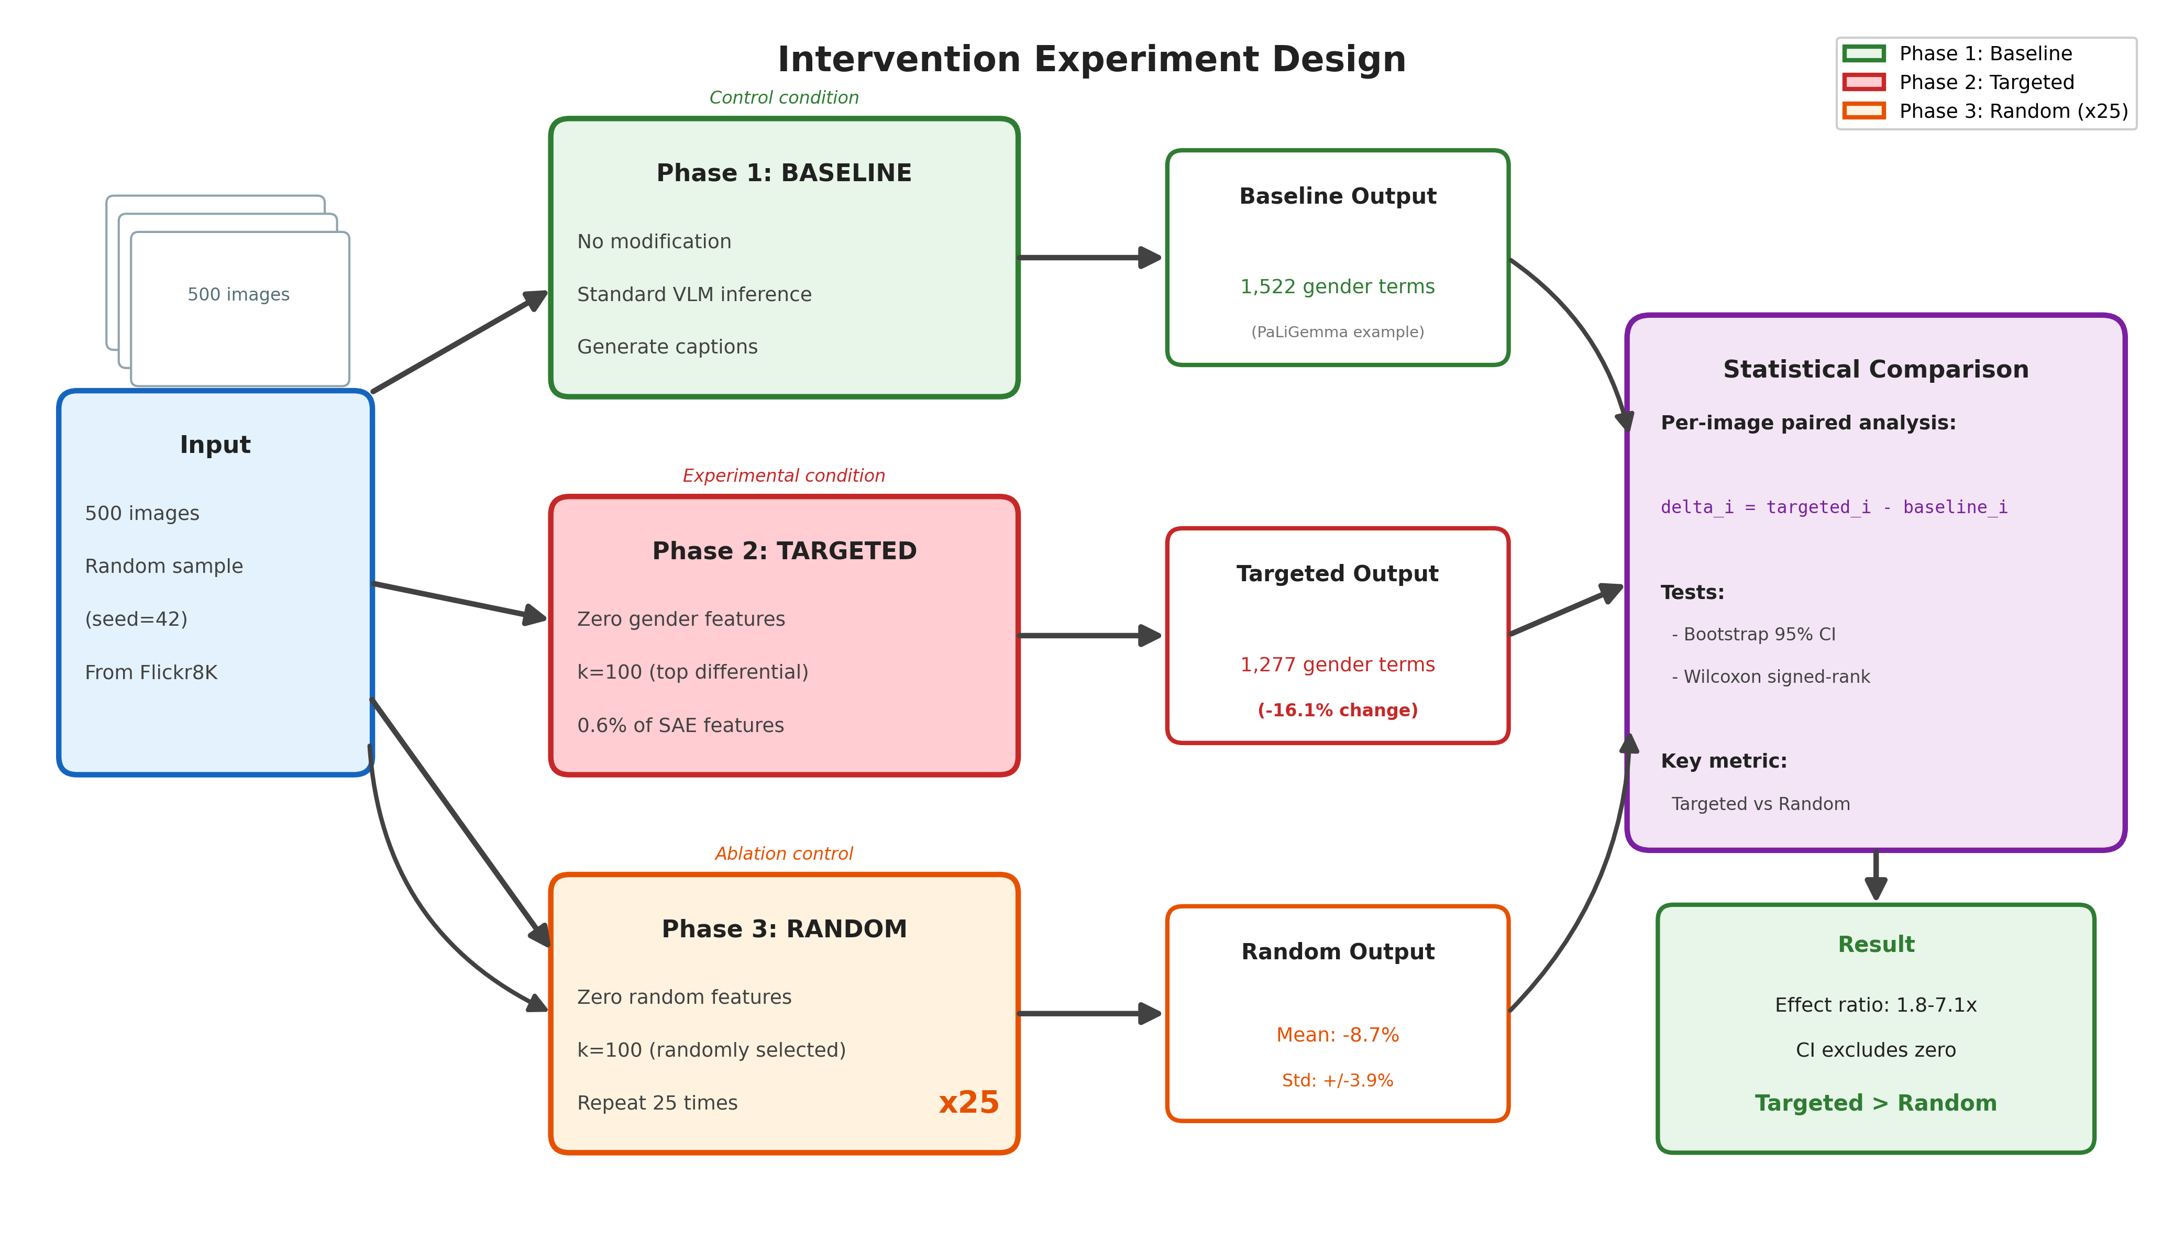
Intervention Experiment: Three-Phase Design
500 images, seed=42, deterministic greedy decoding
Phase 1: Baseline → Phase 2: Targeted Ablation (k=100) → Phase 3: Random Control (×25) → Statistical Comparison

Slide 19
Intervention Experiment: Parameters & Controls
★ Experimental parameters (improved from original):
N images: 500 (up from 100; 5× increase for tighter CIs)
Random control runs: 25 (up from 3; stable variance estimation)
Features ablated: k = 100 (0.6% of total)
★ Controls for confounds:
Length normalization: rate = gender_terms / total_tokens
Paired statistics: Per-image deltas with bootstrap CI
Deterministic generation: greedy decoding, no sampling
Same seed (42) for image selection across all runs
★ Statistical tests:
Bootstrap 95% CI (10,000 resamples)
Wilcoxon signed-rank test (non-parametric, paired)
Effect ratio: targeted_change / random_change

Slide 20
Targeted vs Random Ablation: Core Causal Logic
• Core question: Are SAE gender features CAUSAL or merely correlated?
• Targeted-only evidence is insufficient:
Ablating any 100 features might also change output
• Treatment vs control design:
TREATMENT = targeted ablation of top-100 gender features
CONTROL = random ablation of 100 features (25 runs)
• Formal hypotheses:
H0: targeted effect ≈ random effect
H1: targeted effect differs from random (specific mechanism)
• Causal claim is supported only if targeted differs significantly from random

Slide 21
Targeted Ablation: Step-by-Step
• 1) Offline feature identification
Compute Δ_j = |mean_male(j) - mean_female(j)| for each feature j
Rank features by Δ_j and select top k=100
• 2) Baseline generation (no hook)
Generate captions for 500 images
Count gender terms per image and in total
• 3) Targeted intervention generation
Register forward hook at selected decoder layer
Remove contribution of the selected top-100 features
Generate captions with modified activations
Compare targeted counts vs baseline counts

Slide 22
Random Ablation (Control): Step-by-Step
• For each run r = 1...25:
Randomly sample k=100 feature indices
Apply the same hook structure and generation settings
Generate 500 captions and count gender terms
• Aggregate across runs:
Random mean effect (μ) and standard deviation (σ)
Empirical null distribution for non-specific ablation
• Why 25 runs?
Single random run can be lucky/unlucky
25 runs stabilize μ±σ and enable robust comparison
Lets us test whether targeted lies outside random distribution

Slide 23
Targeted vs Random: Quantitative Specificity
Bootstrap CI(targeted-random) excludes zero for all models → causal specificity
Model | Targeted | Random mean ± std | Specificity | Ratio | Interpretation
PaLiGemma | -16.1% | -8.7% ± 3.9% | 7.3 pp | 1.84× | Targeted > random
Qwen2-VL | +3.95% | -0.56% ± 1.14% | 4.51 pp | 7.1× | Opposite direction
Llama | +5.02% | -0.84% ± 0.76% | 5.85 pp | 6.0× | Opposite direction

Slide 24
Implementation: SAE-based Forward Hook
• PyTorch hook registered on target decoder layer
• Intercepts hidden activations, applies SAE transformation, returns modified activations
• Forward Hook Algorithm:
• 1. Flatten batch activations: [B, T, d_model] → [B·T, d_model]
• 2. Encode through SAE: x_flat @ W_enc^T + b_enc → [B·T, n_features]
• 3. Apply ReLU: h = max(0, encoded)
• 4. ABLATE: h[:, target_features] ← 0 (zero out specified features)
• 5. Decode back: h @ W_dec^T + b_dec → [B·T, d_model]
• 6. Reshape: [B·T, d_model] → [B, T, d_model]
• Same hook used for BOTH targeted and random → only difference is feature set
• Greedy decoding (no sampling) to eliminate sampling variance
Fair comparison: effect differences must arise from feature identity, not mechanism

Slide 25
Ablation Hook Methods: Two Approaches
Full Reconstruction (PaLiGemma)
Residual Ablation (Qwen, Llama)
• Encode → Zero features → Decode
• x_mod = W_dec · (h ⊙ mask) + b_dec
• Replaces all activations with SAE output
• Works when SAE has near-perfect reconstruction
• Used for PaLiGemma (cos_sim = 0.9999)
• NOT suitable when SAE trained on pooled activations
• Only subtract targeted features' contribution
• x_mod = x - Σⱼ∈A hⱼ · W_dec[:,j]
• Preserves original activations otherwise
• More robust to SAE quality
• Modification ~3% of activation norm
• Required for mean-pooled SAE on per-token intervention

Slide 26
Part 3
Experimental Results
Complete results across 3 VLM architectures with statistical rigor

Slide 27
Main Intervention Results: Cross-Model Comparison
All 3 models show statistically significant targeted effects vs random controls (500 images, 25 random runs each)
Model | Baseline | Targeted | Change % | Random (μ±σ) | Ratio | Significance
PaLiGemma (L9) | 1,522 | 1,277 | -16.1% | -8.7% ± 3.9% | 1.8× | p = 1.65×10⁻²¹
Qwen2-VL (L12) | 1,315 | 1,367 | +3.95% | -0.56% ± 1.14% | 7.1× | CI excludes 0
Llama (L20) | 1,355 | 1,423 | +5.02% | -0.84% ± 0.76% | 6.0× | CI excludes 0

Slide 28
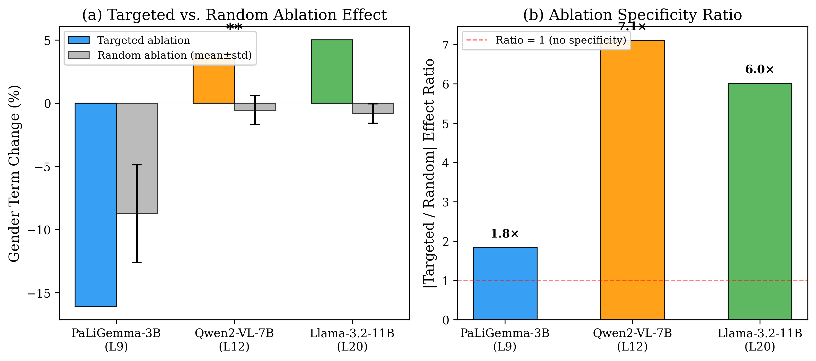
Cross-Model Intervention Results
Error bars: 25 random control runs; dotted line: baseline
Targeted ablation shows consistent specificity across architectures, but direction differs by model type

Slide 29
Cherry-Picked Qualitative Examples (EN): Before → After
• PaLiGemma (image 2312984882):
• Before: 'A group of men ... A man ... A man ...'
• After : 'A group of musicians ...' (explicit gender nouns removed)
• Qwen2-VL (image 2920305300):
• Before: 'The image depicts a cyclist riding a bicycle ...'
• After : 'The image depicts a man riding a bicycle ...' (neutral → male)
• Llama-3.2-Vision (image 3009383694):
• Before: 'The image depicts a person in mid-air ...'
• After : 'The image shows a man bungee jumping ...' (neutral → male)
• Random controls for these cases were typically closer to baseline wording
Qualitative examples align with the model-specific direction effects from quantitative results

Slide 30
Arabic Qualitative Evidence (Where Available)
• From cross-lingual ablation outputs (EN→AR / AR→AR conditions):
• Qwen2-VL AR→AR sample caption (transliteration):
• Before: 'fi al-sura, nara la'iba tenis ...' (female tennis player)
• After : 'fi al-sura, nara imra'a ...' (woman)
• Arabic per-term shifts (Qwen2-VL, AR→AR):
• rajul (man): 68 → 29
• ab (father): 75 → 84
• umm (mother): 34 → 41
• akh (brother): 34 → 45
• Interpretation: targeted ablation changes Arabic lexical gender realization, not only total counts
Arabic examples are included from saved cross-lingual outputs where full paired captions are available

Slide 31
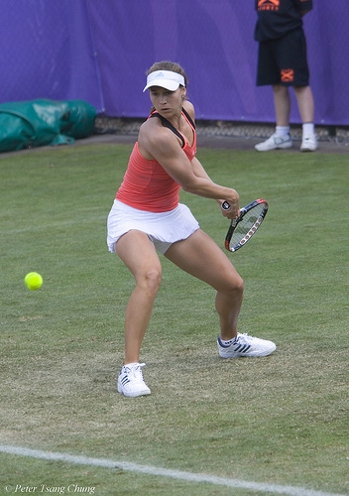
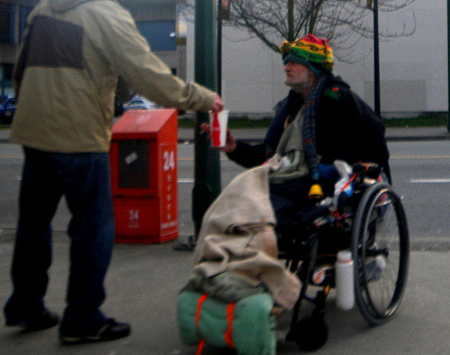

Qualitative Examples (Cross-Lingual)
Configuration format: [Prompt Language] → [Caption Language]; Arabic shown in script
Image | Ground Truth | EN→EN | EN→AR | AR→EN | AR→AR | Bias Type
 | Woman athlete | 'female tennis player...' | 'لاعبة ...' → 'امرأة ...' | 'woman playing tennis...' | 'في الصورة نرى امرأة ...' | Lexical shift
 | Person in wheelchair | 'person ...' → 'man ...' | More explicit 'رجل' usage | 'person ...' → 'man ...' | Gendered noun substitutions | Gender re-labeling
 | Cyclist (neutral role) | 'cyclist ...' → 'man ...' | Gender-marked nouns ('راكب دراجة' etc.) | 'cyclist ...' → 'man ...' | Role wording becomes gendered | Role→gender substitution

Slide 32
1
Key Finding #1
Targeted Ablation is Statistically Significant
Ablating just 0.6% of SAE features (100 out of 16,384-32,768) produces statistically significant changes in gender-marked language across ALL three models tested. Effect ratios range from 1.8× to 7.1× compared to random feature ablation controls.
Supporting Evidence:
✓ PaLiGemma: Wilcoxon p = 1.65 × 10⁻²¹ (highly significant)
✓ Qwen2-VL: Bootstrap 95% CI = [+0.038, +0.200] (excludes zero)
✓ Llama: Bootstrap 95% CI = [+0.078, +0.242] (excludes zero)
→ Effect persists even for Llama with poor SAE quality (36.6% EV)
→ Results are CONSERVATIVE; better SAEs would likely yield larger effects

Slide 33
PaLiGemma-3B: Detailed Results (Layer 9)
Targeted ablation reduces gender terms by 16.1%, nearly 2× the random effect
Metric | Baseline | Targeted | Random (mean) | Significance
Gender Terms | 1,522 | 1,277 | 1,389 ± 59 | p < 10⁻²⁰
Change % | — | -16.1% | -8.7% ± 3.9% | —
Gender Rate | 0.0982 | 0.1076 | 0.0858 ± 0.008 | —
Per-image Δ | — | -0.490 | -0.266 ± 0.033 | —
95% CI | — | [-0.570, -0.406] | [-0.332, -0.200] | Excludes 0
Nonbinary Terms | 325 | 276 (-15%) | — | —

Slide 34
PaLiGemma: Layer Specificity Analysis
L9 (mid-layer) carries the ENTIRE effect; L17 (penultimate) has NO significant effect
Configuration | Gender Terms | Change % | Rate Δ% | Wilcoxon p
L9 Targeted | 1,277 | -16.1% | +9.7% | 1.65×10⁻²¹
L17 Targeted | 1,510 | -0.8% | -21.8% | 0.999 (n.s.)
L9+L17 Combined | 1,277 | -16.1% | +9.7% | 1.65×10⁻²¹
L17 Alone (in multi) | 1,522 | 0.0% | 0.0% | 1.0 (n.s.)

Slide 35
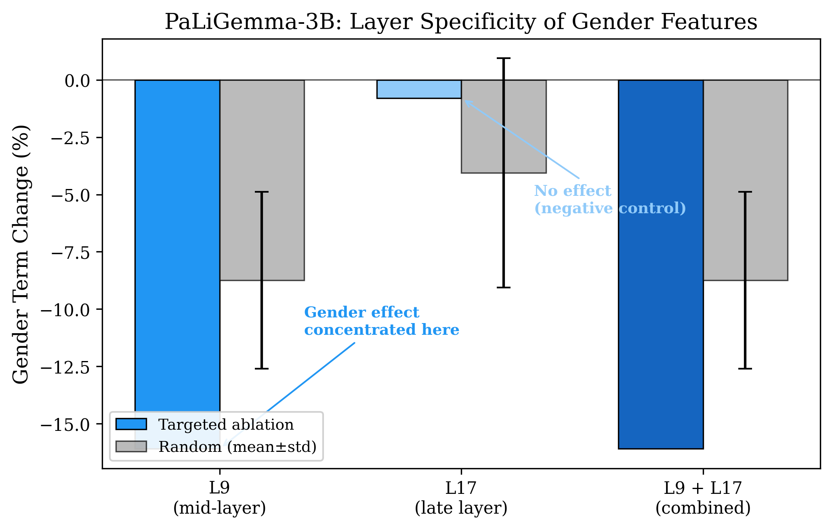
Layer Specificity Visualization
Consistent with literature: mid-layers encode semantic content, late layers handle output formatting
Gender features are LOCALIZED in middle layers, not distributed uniformly across the network

Slide 36
Per-Term Changes Under Ablation
Ablation RESHUFFLES which gendered terms appear; does not uniformly suppress all gender
Term | PaLiGemma | Qwen2-VL | Llama | Pattern
her | -73.2% | +4.1% | +11.9% | Opposite direction
him | -83.3% | +90.9% | +5.3% | Most dramatic in Qwen
he | -22.6% | +0.2% | -0.2% | Relatively stable
man | +10.4% | +53.6% | +4.8% | Nouns increase in Qwen
woman | +9.3% | +43.6% | -4.3% | Nouns increase in Qwen
his | -0.4% | +6.3% | +66.3% | Increases in Llama

Slide 37
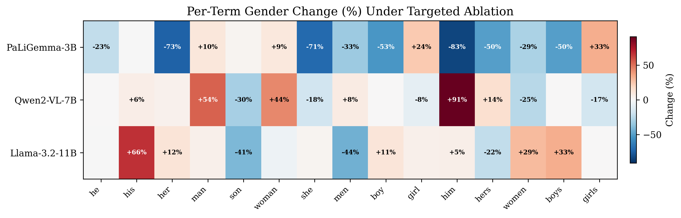
Per-Term Change Heatmap
Pattern reveals different underlying mechanisms across architectures
Color intensity shows magnitude of change; red = decrease, blue = increase

Slide 38
2
★ KEY NOVEL FINDING
DIRECTION DIVERGENCE: Excitatory vs Inhibitory Encoding
The DIRECTION of the intervention effect depends on model architecture. This is our most important and novel discovery: the same ablation intervention has OPPOSITE effects across different architectures. This has critical implications for debiasing strategies.
Supporting Evidence:
✓ PaLiGemma (captioning model): -16.1% gender terms
→ Ablation REMOVES gendered language (excitatory features)
✓ Qwen2-VL + Llama (instruction-tuned): +4-5% gender terms
→ Ablation RELEASES gendered language (inhibitory features)
✓ PRACTICAL IMPLICATION: Same 'debiasing' intervention would
→ REDUCE bias in PaLiGemma (intended effect)
→ INCREASE bias in Qwen/Llama (opposite of intended!)

Slide 39
Two Mechanisms of Gender Encoding
EXCITATORY (PaLiGemma)
INHIBITORY (Qwen, Llama)
• Smaller, captioning-focused model
• Gender features PRODUCE gendered output
• Like a light switch: ON → gender terms
• Ablation turns switch OFF → fewer terms
•
• Trained to describe images directly
• Simple task: see person → describe gender
• Larger, instruction-tuned models
• Features REGULATE/SUPPRESS gender
• Like a governor/brake on a car
• Ablation removes brake → more terms
•
• RLHF/alignment training may create
• 'safety circuits' that regulate bias

Slide 40
Hypothesis: Why Direction Divergence?
★ Captioning models (PaLiGemma):
Trained to describe images directly
Task: 'See person, describe attributes including gender'
Learn features that PRODUCE gendered descriptions
Gender features are EXCITATORY
★ Instruction-tuned models (Qwen, Llama):
Trained with RLHF/alignment procedures
May have learned to MODERATE/SUPPRESS gendered language
Potentially developed 'safety circuits' during alignment
Gender features act as INHIBITORY regulators
✓ Supporting evidence: BOTH instruction-tuned models show same direction
⚠ Caveat: Could partially reflect different hook methods

Slide 41
SAE Quality Metrics Across Models
Quality varies substantially; intervention works even with poor SAE (Llama 36.6% EV)
Model | Cosine Sim | Explained Var. | L0 (Active) | Dead %
PaLiGemma (L9) | 0.9999 | 99.8% | 7,992 | 51.2%
Qwen2-VL (L12) | 0.9965 | 66.4% | 2,049 | 71.6%
Llama (L20) | 0.9956 | 36.6% | 344 | 98.6%

Slide 42
Robustness to SAE Quality
★ SAE quality varies SUBSTANTIALLY across models:
PaLiGemma: Excellent (99.8% explained variance)
Qwen2-VL: Good (66.4% explained variance)
Llama: Poor (36.6% explained variance, 98.6% dead features)
★ KEY FINDING: Intervention works even with low-quality SAEs!
Llama achieves 6.0× effect ratio despite only 36.6% EV
This is a CONSERVATIVE test of the approach
Better SAEs would likely yield LARGER effects
★ Interpretation:
Results are ROBUST to SAE training quality
The causal relationship is real, not an artifact
This is a STRENGTH, not a weakness of the methodology

Slide 43
Part 4
Cross-Lingual Analysis
Do English and Arabic share gender bias features?

Slide 44
Cross-Lingual Research Question
★ Core question: Do English and Arabic share gender bias features?
• IF YES → Debiasing in English automatically helps Arabic
• IF NO → Language-specific interventions required
★ Why this matters:
Multilingual VLMs serve users globally
Debiasing only in English would leave other languages biased
Need to understand if features transfer across languages
★ Languages differ fundamentally:
English: Minimal grammatical gender
Arabic: Extensive grammatical gender marking
Different linguistic encoding → potentially different features?

Slide 45
Cross-Lingual Feature Overlap (Jaccard Index)
Most models encode gender through LANGUAGE-SPECIFIC features (Jaccard < 3%)
Model | Overlap (top-100) | Jaccard | Interpretation
PaLiGemma | 57 / 100 | 0.399 | Substantial overlap
Qwen2-VL | 0 / 100 | 0.000 | Zero overlap
LLaVA | 2 / 100 | 0.010 | Near-zero overlap
Llama | 1 / 100 | 0.005 | Near-zero overlap

Slide 46
Causal 2×2 Cross-Lingual Ablation (Qwen2-VL)
Only within-language (EN→EN) is significant; cross-language ablation shows NO transfer
Condition | Features | Caption | Δ % | Significant?
EN→EN (within) | English | English | +4.0% | YES ✓
EN→AR (cross) | English | Arabic | -2.5% | NO ✗
AR→EN (cross) | Arabic | English | +0.4% | NO ✗
AR→AR (within) | Arabic | Arabic | -6.4% | NO ✗

Slide 47
3
Key Finding #3
Language-Specific Gender Encoding
Cross-lingual feature overlap is near-zero (Jaccard < 3%) for most models. Our causal 2×2 ablation experiment confirms: ablating English features has NO effect on Arabic captions when overlap is zero, but transfer DOES occur when overlap is high.
Supporting Evidence:
✓ Qwen2-VL: 0% overlap → NO cross-lingual transfer
✓ PaLiGemma: 57% overlap → Transfer DOES occur
✓ Feature overlap PREDICTS transferability:
→ Zero overlap → No transfer (independent encodings)
→ High overlap → Transfer occurs (shared representations)
✓ PRACTICAL IMPLICATION:
✓ Multilingual fairness requires language-specific interventions

Slide 48
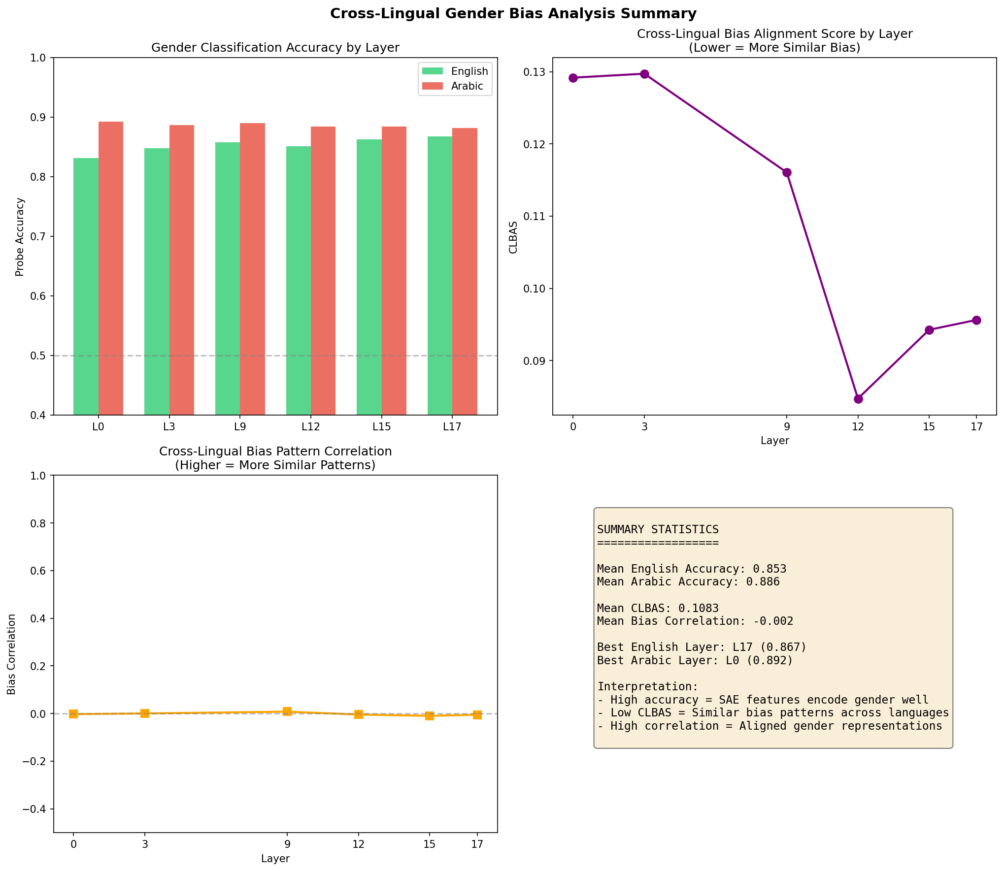
Cross-Lingual Feature Analysis Summary
Jaccard similarity computed over top-100 gender features per language
Feature overlap predicts cross-lingual transferability of debiasing interventions

Slide 49
Part 5
Implications, Limitations & Future Work
What does this mean for VLM bias mitigation?

Slide 50
Practical Implications for Bias Mitigation
⚠ CRITICAL WARNING:
Same intervention has OPPOSITE effects across architectures!
★ Naive debiasing (ablate top-differential features):
REDUCES bias in PaLiGemma (captioning model) ✓
INCREASES bias in Qwen/Llama (instruction-tuned) ✗
★ Architecture-specific analysis is ESSENTIAL before deployment
Cannot assume one-size-fits-all debiasing
Must understand whether features are excitatory or inhibitory
★ Language-specific interventions needed for multilingual fairness
Cannot assume cross-lingual transfer without measuring overlap
Each language may require independent debiasing

Slide 51
Summary of Contributions
★ METHODOLOGICAL:
First SAE-based mechanistic interpretability of VLM bias
Extended SAE framework from text-only LLMs to multimodal VLMs
★ EMPIRICAL:
Causal evidence across 3 architectures (2.9B - 10.6B params)
0.6% of features → 1.8-7.1× effect ratios vs random
★ MECHANISTIC (KEY NOVEL FINDING):
Discovery of excitatory vs inhibitory gender encoding
Different architectures use fundamentally different mechanisms
★ CROSS-LINGUAL:
First causal 2×2 ablation on VLM gender features
Feature overlap predicts cross-lingual transferability

Slide 52
Comparison with Prior Work
First to combine SAE interpretability with VLM bias analysis and cross-lingual causal experiments
Work | Domain | Method | Our Advance
Hendricks et al. 2018 | VLM bias | Measurement | Mechanistic explanation
Zhao et al. 2017 | VLM bias | Data augmentation | Feature-level intervention
Cunningham et al. 2023 | Text LLM | SAE interpretability | Extension to VLMs
Templeton et al. 2024 | Text LLM | 34M SAE features | Bias-focused analysis
Bricken et al. 2023 | Text LLM | Monosemanticity | Causal intervention

Slide 53
Limitations & Honest Assessment
★ SAE training scale:
5K-10K samples per model (larger sets may help)
★ SAE architecture:
Vanilla ReLU only (TopK/JumpReLU not tested)
★ Hook inconsistency:
Different methods for different models (full recon vs residual)
Within-model comparisons valid, cross-model needs caution
★ No human evaluation:
Caption fluency/quality not assessed after ablation
★ Binary gender focus:
Non-binary terms tracked but not primary metric
★ Llama SAE quality:
Only 36.6% explained variance; results may be conservative

Slide 54
Future Work
★ Scale up SAE training:
100K+ samples per model
Full 40K Flickr8K captions
★ Compare SAE architectures:
TopK SAEs (Gao et al., 2024)
JumpReLU SAEs (Rajamanoharan et al., 2024)
★ Extend scope:
More languages beyond English/Arabic
Other bias types (race, age, profession)
Human evaluation of caption quality
★ Investigate mechanisms:
Why does instruction tuning create inhibitory features?
Can we predict excitatory/inhibitory from architecture alone?

Slide 55
Key Takeaways for Supervisor
★ 1. SAEs can identify causal gender features in VLMs
First application of mechanistic interpretability to VLM bias
★ 2. Direction of effect depends on architecture (NOVEL)
Captioning models: excitatory features (ablation reduces)
Instruction-tuned: inhibitory features (ablation increases)
★ 3. Cross-lingual features are language-specific
Zero overlap → no transfer; high overlap → transfer occurs
★ 4. Intervention is robust to SAE quality
Works even with 36.6% explained variance
★ 5. Bias mitigation requires architecture-specific strategies
Same intervention can INCREASE or DECREASE bias

Slide 56
Thank You
Questions & Discussion Code: github.com/nour-mubarak/mechanistic_intrep Email: nour.mubarak@durham.ac.uk

Slide 57
Part S
Supplementary Material
Technical details, additional results, and references

Slide 58
Statistical Methods: Details
★ Primary metric: Total gender terms across 500 captions
★ Paired analysis (per-image):
Δᵢ = count(ablated_i) - count(baseline_i)
Bootstrap 95% CI: 10,000 resamples
Wilcoxon signed-rank test (non-parametric)
★ Effect specificity:
Specificity = |targeted%| - |random%|
Ratio = |targeted| / |random|
Ratio > 1 → targeted exceeds random
★ Note on Wilcoxon one-sided test:
Originally configured for decrease (PaLiGemma)
For Qwen/Llama (increases), bootstrap CI is primary test
CI excluding zero confirms significance regardless of direction

Slide 59
Why LLaVA Was Not Used for Intervention
★ LLaVA-1.5-7B trained but excluded from intervention:
• Primary reason: 95% dead SAE features
Most features never activate
Insufficient active features for meaningful ablation
• Secondary reason: Architectural similarity to Qwen2-VL
Both instruction-tuned 7B models
Would likely show same direction (inhibitory)
Qwen provides sufficient evidence for this class
• LLaVA results included in:
SAE quality metrics
Cross-lingual feature overlap analysis

Slide 60
Anticipated Reviewer Concerns (Addressed)
Proactive responses to anticipated reviewer feedback
Concern | Our Response
Dataset size (Flickr8K small) | Sufficient for activation analysis; not training new models
Gender term counting bias | Report both raw count AND length-normalized rate
CLBAS metric (not standard) | Removed; using causal 2×2 ablation + Jaccard overlap
Single model limited | 3 models spanning 2.9B-10.6B parameters
Hook method inconsistency | Justified; within-model comparisons valid

Slide 61
Key References
[Hendricks et al., 2018] Women Also Snowboard. ECCV.
Gender bias measurement in image captioning.
[Cunningham et al., 2023] Sparse Autoencoders for GPT-2. ICLR.
Foundation for SAE-based interpretability.
[Bricken et al., 2023] Monosemanticity. Anthropic.
Scaling SAEs to larger language models.
[Templeton et al., 2024] Scaling Monosemanticity. Anthropic.
34M features on Claude; safety-relevant concepts.
[Gao et al., 2024] TopK SAEs. Proceedings.
Alternative SAE architecture with hard sparsity.
[Rajamanoharan et al., 2024] JumpReLU SAEs.
Improved sparsity through learned thresholds.

Slide 62
All Figures in Presentation
★ Pipeline & Methodology:
Fig 1: Four-stage pipeline overview
Fig 2: Intervention experiment design
★ Main Results:
Fig 3: Cross-model intervention comparison
Fig 4: Layer specificity analysis
Fig 5: Per-term change heatmap
★ Cross-Lingual:
Fig 6: Cross-lingual feature analysis
★ All figures available in:
publication/figures/main/
publication/figures/supplementary/

