Slide 1
Sparse Autoencoders Reveal and Control Gender Bias in Vision-Language Models
A Cross-Lingual Mechanistic Interpretability Study Nour Mubarak | Durham University | March 2026

Slide 2
Project Overview
• First application of Sparse Autoencoders (SAEs) to VLMs for mechanistic interpretability
• Goal: Understand HOW gender bias is encoded, not just that it exists
• Cross-lingual analysis: English and Arabic
• 4 state-of-the-art VLM architectures studied
• Causal intervention experiments to validate findings
• Direct implications for bias mitigation strategies

Slide 3
Research Questions
• RQ1: Can SAEs identify interpretable gender-associated features in VLMs?
• RQ2: Do these features have CAUSAL influence on gendered output?
• RQ3: How does gender encoding differ across model architectures?
• RQ4: Are gender features shared across languages (English/Arabic)?
• RQ5: What are the implications for bias mitigation?

Slide 4
Section 1
Background & Motivation

Slide 5
The Problem: Gender Bias in VLMs
• Vision-Language Models exhibit systematic gender bias in captioning
• Example: Man on skateboard -> 'man performing tricks'
• Example: Woman on skateboard -> 'person standing on board'
• Models systematically deploy gendered language for some groups
• Prior work measures WHAT but not WHY or HOW
• Need to understand internal mechanisms for effective mitigation

Slide 6
Why Mechanistic Interpretability?
Prior Approaches (Black Box)
Our Approach (Mechanistic)
• Measure bias in outputs
• Data augmentation
• Constrained decoding
• Treat model as black box
• Cannot explain WHY bias occurs
• Open the black box
• Identify specific features
• Test causal hypotheses
• Understand internal encoding
• Enable surgical interventions

Slide 7
What are Sparse Autoencoders (SAEs)?
• Neural network that decomposes dense activations into sparse, interpretable features
• Architecture: Encoder -> Sparse hidden -> Decoder
• Equation: h = ReLU(W_enc * x + b_enc)
• Reconstruction: x_hat = W_dec * h + b_dec
• Loss: MSE(x, x_hat) + lambda*||h||_1 (reconstruction + sparsity)
• Each feature corresponds to a semantically meaningful concept
• Previously applied to text LLMs; we extend to multimodal VLMs

Slide 8
Section 2
Methodology

Slide 9
Vision-Language Models Studied
Model | Parameters | d_model | Layers | SAE Features | Type
PaLiGemma-3B | 2.9B | 2,048 | 18 | 16,384 | Captioning
Qwen2-VL-7B | 7.6B | 3,584 | 28 | 28,672 | Instruction-tuned
LLaVA-1.5-7B | 7.1B | 4,096 | 32 | 32,768 | Instruction-tuned
Llama-3.2-11B | 10.6B | 4,096 | 40 | 32,768 | Instruction-tuned

Slide 10
Dataset: Flickr8K Bilingual
• Flickr8K dataset (Hodosh et al., 2013)
• 8,092 images with bilingual English-Arabic caption pairs
• Gender labels derived from caption content (keyword matching)
• Male samples: 5,562 | Female samples: 2,047 (ratio 2.7:1)
• 16 binary gender terms tracked (he, she, him, her, man, woman, etc.)
• 18 gender-neutral terms tracked for comparison

Slide 11
Why Flickr8K is Sufficient
• QUESTION: Isn't Flickr8K small compared to modern datasets?
•
• ANSWER: We analyze INTERNAL ACTIVATIONS, not train new models
• -> 8,092 images yield up to 10,000 activation samples
• -> SAEs learn to reconstruct activation distribution
• -> Not generalizing to new images, just decomposing existing ones
•
• Consistent with prior mechanistic interpretability work:
• -> Cunningham et al. (2023): similar sample sizes
• -> Bricken et al. (2023): comparable SAE training data

Slide 12
Four-Stage Pipeline
• Stage 1: ACTIVATION EXTRACTION
• -> Extract LANGUAGE MODEL DECODER activations (NOT visual encoder)
• -> PyTorch forward hooks on text decoder layers
• -> Mean-pool across sequence positions
• Stage 2: SAE TRAINING
• -> Train sparse autoencoder (8x expansion factor)
• -> Vanilla ReLU + L1 sparsity (lambda = 10^-4)
• Stage 3: GENDER FEATURE IDENTIFICATION
• -> Differential activation analysis (male vs female)
• -> Select top-k features (k=100, 0.6% of total)
• Stage 4: CAUSAL INTERVENTION
• -> Ablate identified features during generation
• -> Compare to random ablation controls (25 runs)

Slide 13
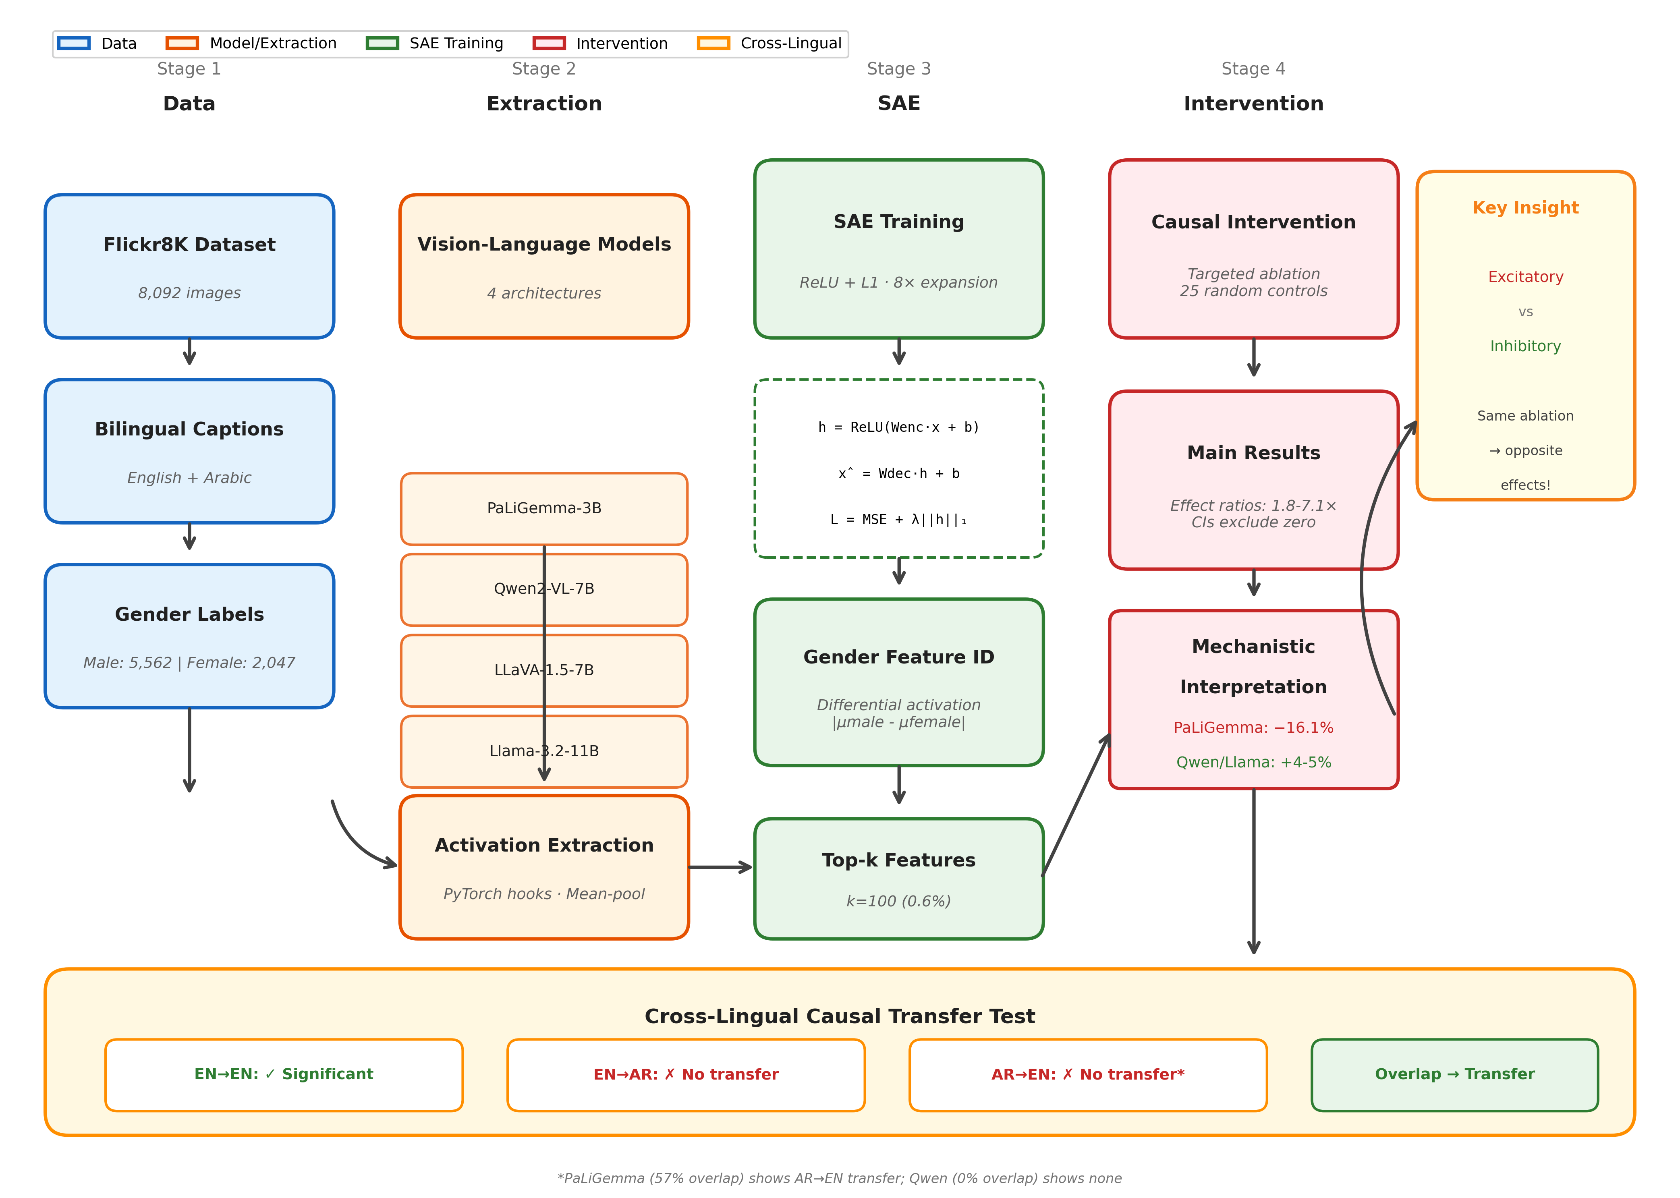
Pipeline Overview Figure
Complete pipeline: Data -> Extraction -> SAE Training -> Intervention -> Cross-lingual Analysis

Slide 14
Activation Extraction Details
Model | N Samples | Layers | Notes
PaLiGemma-3B | 10,000 | 0,3,6,9,12,15,17 | Flickr8K subset
Qwen2-VL-7B | 7,609 EN / 6,413 AR | 0,4,8,...,27 | Gender-labeled
LLaVA-1.5-7B | 5,249 EN / 4,449 AR | 0,4,8,...,31 | Gender-labeled
Llama-3.2-11B | 5,249 EN / ~5K AR | 0,5,10,...,39 | Gender-labeled

Slide 15
Why Sample Counts Vary
• Each model extracted independently with its own script
• Sample counts differ due to:
• -> Image loading failures (corrupted files)
• -> Out-of-memory errors on larger models
• -> Different tokenization producing invalid samples
• Key point: Activations are from LANGUAGE MODEL DECODER
• -> NOT visual encoder features
• -> NOT raw pixel representations
• -> The decoder layers encode linguistic gender for generation

Slide 16
SAE Architecture & Training
• Expansion factor: 8x (e.g., 2048 -> 16,384 features)
• Activation: ReLU (vanilla baseline architecture)
• Loss: MSE reconstruction + L1 sparsity penalty
• Optimizer: AdamW (lr = 10^-4)
• Batch size: 256
• Training: 50 epochs with early stopping (patience=10)
• Split: 90% train / 10% validation
• Note: TopK and JumpReLU are alternatives for future work

Slide 17
Causal Intervention Design
• 500 test images (seed=42 for reproducibility)
• BASELINE: Generate captions with no modification
• TARGETED: Zero contribution of top-100 gender features
• RANDOM CONTROL: 25 runs with randomly selected features
• Two hook variants used:
• -> Full reconstruction (PaLiGemma): Replace with SAE output
• -> Residual ablation (Qwen, Llama): Subtract feature contribution
• Deterministic generation: greedy decoding, no sampling

Slide 18
Evaluation Metrics
• PRIMARY: Raw gender term count change (%)
• -> count(targeted) vs count(baseline)
•
• CONTROL: Length-normalized gender rate
• -> rate = gender_terms / total_tokens
• -> Prevents criticism: 'shorter captions = fewer terms mechanically'
•
• STATISTICAL TESTS:
• -> Bootstrap 95% CI (10,000 resamples)
• -> Wilcoxon signed-rank (paired, per-image)
• -> Effect ratio: targeted_change / random_change

Slide 19
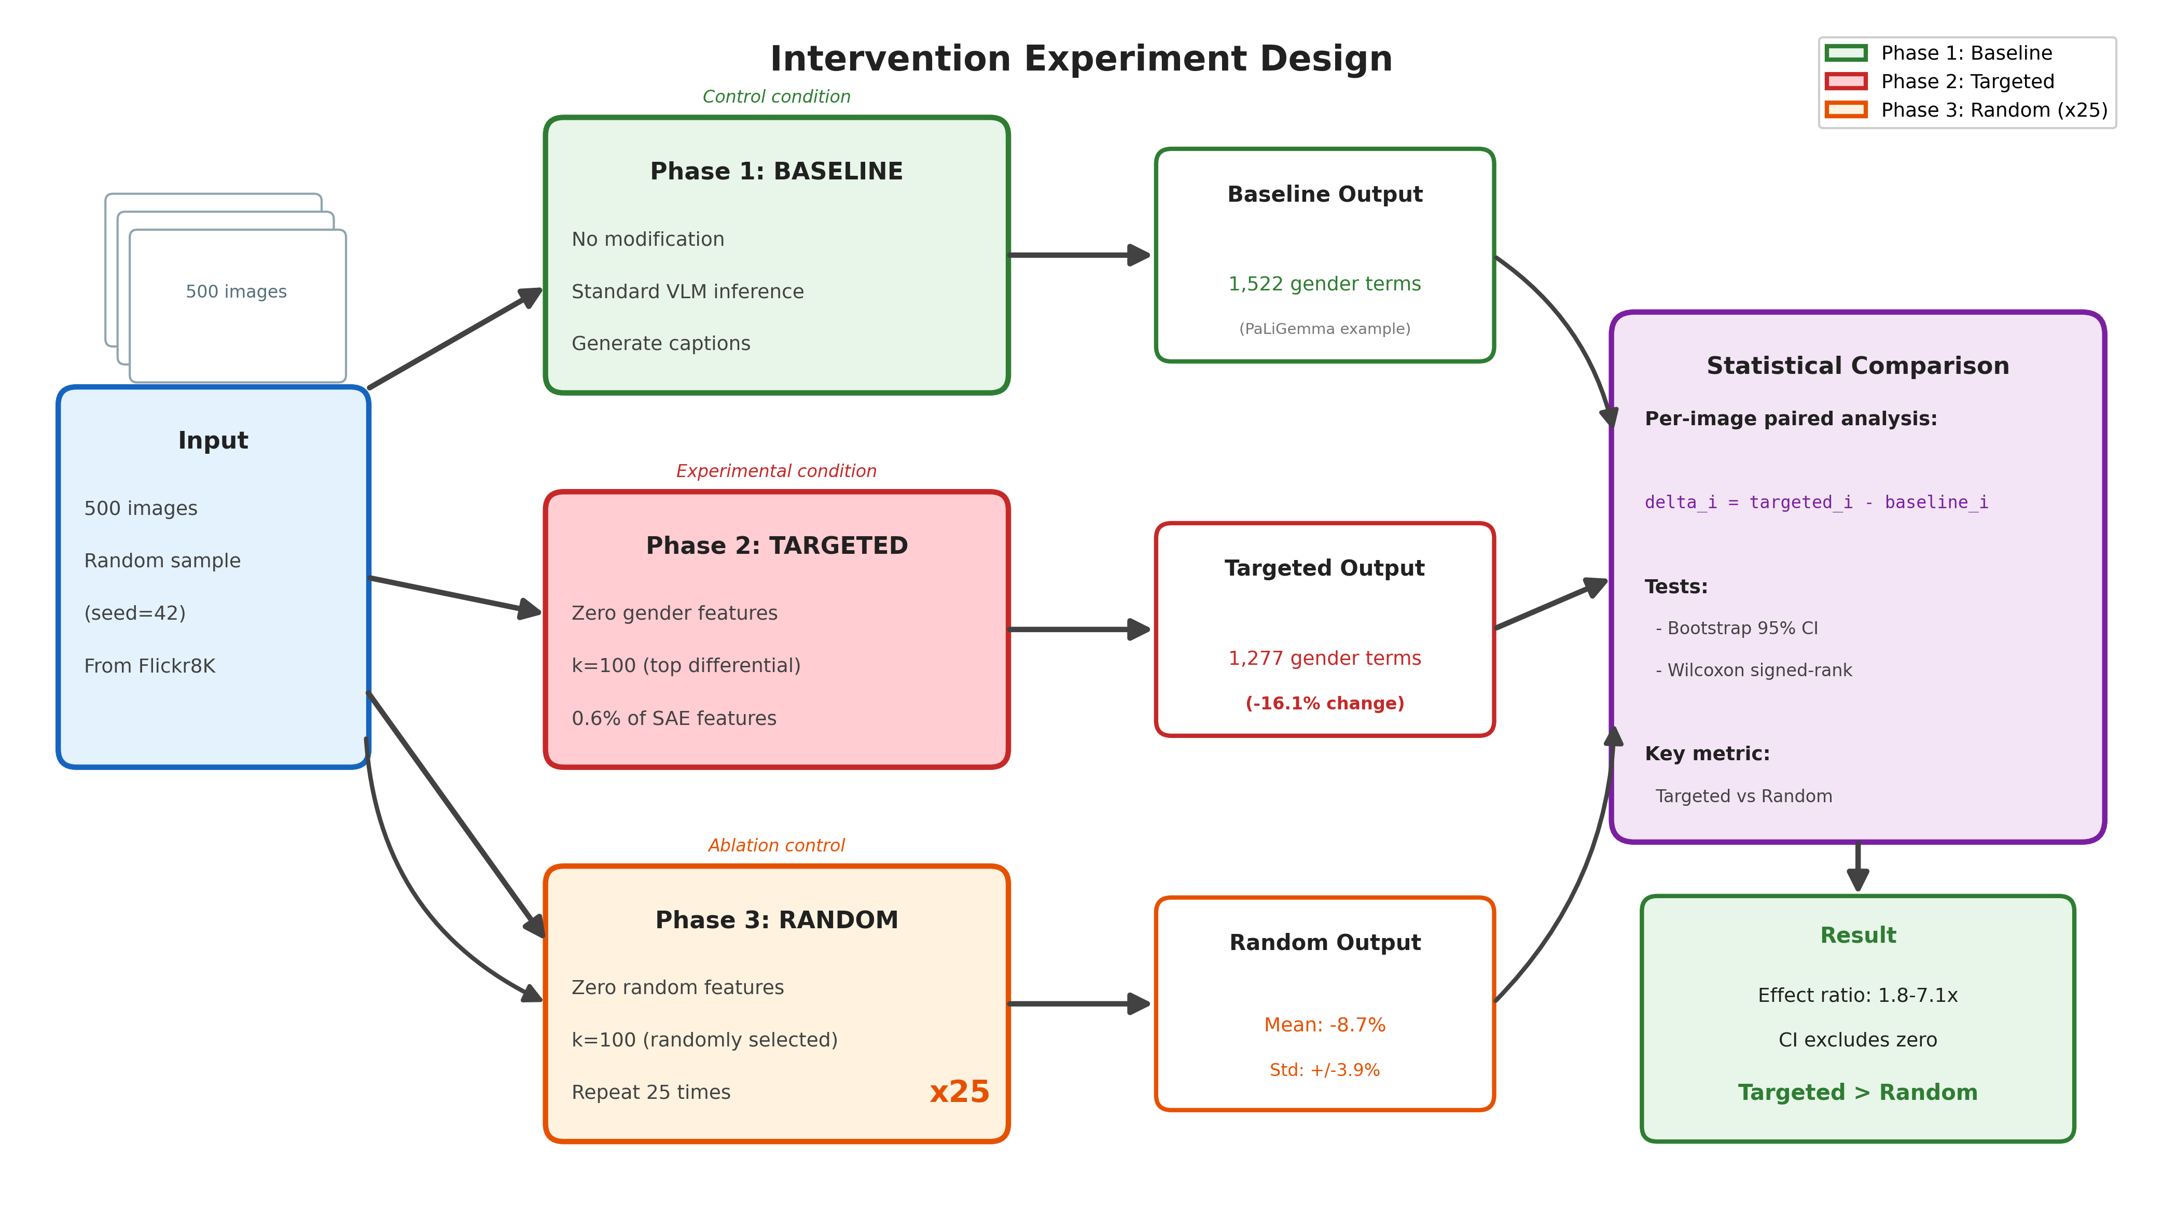
Intervention Experiment Design
Three-phase design: Baseline -> Targeted Ablation -> Random Control (x25) -> Statistical Comparison

Slide 20
Section 3
Results

Slide 21
Main Intervention Results
Model | Baseline | Targeted | Change | Random (mean+/-std) | Ratio
PaLiGemma (L9) | 1,522 | 1,277 | -16.1% | -8.7% +/- 3.9% | 1.8x
Qwen2-VL (L12) | 1,315 | 1,367 | +3.95% | -0.56% +/- 1.14% | 7.1x
Llama (L20) | 1,355 | 1,423 | +5.02% | -0.84% +/- 0.76% | 6.0x

Slide 22
1
Key Finding #1
Targeted Ablation Works
Ablating just 0.6% of SAE features (100 out of 16,384) produces statistically significant changes in gender-marked language across ALL three models tested. Effect ratios range from 1.8x to 7.1x compared to random controls.
Evidence:
Bootstrap 95% CIs exclude zero for all models
PaLiGemma: CI = [-0.274, -0.174]
Qwen2-VL: CI = [+0.038, +0.200]
Llama: CI = [+0.078, +0.242]
25 random control runs per model for statistical rigor

Slide 23
2
Key Finding #2
KEY NOVEL INSIGHT: Excitatory vs Inhibitory
The DIRECTION of the effect depends on model architecture. This is our most important discovery: the same ablation has OPPOSITE effects across architectures!
Evidence:
PaLiGemma (captioning): -16.1% gender terms (ablation REMOVES)
Qwen/Llama (instruction-tuned): +4-5% gender terms (ablation RELEASES)
HYPOTHESIS: Instruction tuning fundamentally changes encoding:
Captioning models: gender features PRODUCE gender
Instruction models: gender features REGULATE/SUPPRESS gender
PRACTICAL IMPLICATION: Same debiasing intervention would
REDUCE bias in some models, INCREASE it in others!

Slide 24
Two Mechanisms of Gender Encoding
Excitatory (PaLiGemma)
Inhibitory (Qwen, Llama)
• Smaller, captioning-focused model
• Gender features directly produce output
• Ablation REMOVES gendered language
• Effect: -16.1% gender terms
• Like turning off a light switch
• Larger, instruction-tuned models
• Features regulate/suppress gender
• Ablation RELEASES gendered language
• Effect: +4-5% gender terms
• Like removing a governor/brake

Slide 25
Layer Specificity (PaLiGemma)
• Gender features are LOCALIZED, not distributed uniformly
• L9 (mid-layer, ~50%): Carries the ENTIRE effect
• -> Targeted: -16.1%, Random: -8.7% +/- 3.9%, p = 1.65x10^-21
• L17 (penultimate, negative control): NO significant effect
• -> Targeted: -0.8%, Random: -4.1% +/- 5.0%, p = 0.999
• L9 + L17 combined: Same as L9 alone (no additional benefit)
• Conclusion: Middle layers encode semantic features like gender
• Justification: Consistent with prior SAE literature on text LLMs

Slide 26
Per-Term Changes Under Ablation
Term | PaLiGemma | Qwen2-VL | Llama
her | -73.2% | +4.1% | +11.9%
him | -83.3% | +90.9% | +5.3%
he | -22.6% | +0.2% | -0.2%
man | +10.4% | +53.6% | +4.8%
woman | +9.3% | +43.6% | -4.3%
his | -0.4% | +6.3% | +66.3%

Slide 27
Per-Term Analysis: Key Insight
• Ablation RESHUFFLES which gendered terms appear
• It does NOT uniformly suppress all gender terms
• PaLiGemma pattern:
• -> Pronouns dramatically reduced (her -73%, him -83%)
• -> Explicit nouns slightly increased (man +10%, woman +9%)
• -> Suggests features encode PRONOUN USAGE, not pure gender
• Qwen/Llama pattern:
• -> Nouns increased (man +54%, him +91%)
• -> Features appear to SUPPRESS explicit gendering
• Implication: Gender encoding is more complex than simple on/off

Slide 28
SAE Quality Across Models
Model | Cosine Sim | Explained Var. | L0 (Active) | Dead %
PaLiGemma | 0.9999 | 99.8% | 7,992 | 51.2%
Qwen2-VL | 0.9965 | 66.4% | 2,049 | 71.6%
Llama | 0.9956 | 36.6% | 344 | 98.6%

Slide 29
Robustness to SAE Quality
• SAE quality varies SUBSTANTIALLY across models
• PaLiGemma: Excellent (99.8% explained variance)
• Qwen2-VL: Good (66.4% explained variance)
• Llama: Poor (36.6% explained variance, 98.6% dead features)
• KEY FINDING: Intervention works even with low-quality SAEs!
• -> Llama achieves 6.0x effect ratio despite poor SAE
• -> Suggests approach is CONSERVATIVE
• -> Better SAEs would likely yield LARGER effects
• Justification: This is a strength - results are robust to SAE training

Slide 30
Section 4
Cross-Lingual Analysis

Slide 31
Cross-Lingual Research Question
• Do English and Arabic share gender bias features?
• If YES: Debiasing in English would automatically help Arabic
• If NO: Language-specific interventions are required
• Our approach:
• -> Compute Jaccard overlap of top-100 gender features
• -> Causal 2x2 ablation: Feature language x Caption language
• Languages differ fundamentally:
• -> English: Grammatical gender is minimal
• -> Arabic: Extensive grammatical gender marking

Slide 32
Cross-Lingual Feature Overlap (Jaccard Index)
Model | Overlap (k=100) | Jaccard | Interpretation
PaLiGemma | 57/100 | 0.399 | Substantial overlap
Qwen2-VL | 0/100 | 0.000 | Zero overlap
LLaVA | 2/100 | 0.010 | Near-zero overlap
Llama | 1/100 | 0.005 | Near-zero overlap

Slide 33
3
Key Finding #3
Language-Specific Gender Encoding
Cross-lingual feature overlap is NEAR-ZERO (Jaccard < 3%) for most models. Causal 2x2 ablation confirms: ablating English features has NO effect on Arabic captions when overlap is zero, but DOES transfer when overlap is high.
Evidence:
Qwen2-VL: 0% overlap -> NO cross-lingual transfer
PaLiGemma: 57% overlap -> Transfer DOES occur
Feature overlap PREDICTS transferability
Implication: Debiasing in English does NOT transfer to Arabic
Multilingual fairness requires language-specific interventions

Slide 34
Cross-Lingual Causal Ablation (Qwen2-VL)
Condition | Features | Caption | Delta% | Significant?
EN->EN (within) | English | English | +4.0% | YES
EN->AR (cross) | English | Arabic | -2.5% | NO
AR->EN (cross) | Arabic | English | +0.4% | NO
AR->AR (within) | Arabic | Arabic | -6.4% | NO

Slide 35
Cross-Lingual Causal Confirmation
• Qwen2-VL (0% feature overlap, Jaccard = 0.000):
• -> Only EN->EN is significant
• -> NO cross-lingual transfer in either direction
• -> CAUSAL confirmation of language-specific encoding
• PaLiGemma (57% feature overlap, Jaccard = 0.399):
• -> AR->EN IS significant (transfers!)
• -> High overlap predicts cross-lingual transfer
• Conclusion: Feature overlap PREDICTS transferability
• -> Zero overlap -> No transfer
• -> High overlap -> Transfer occurs

Slide 36
Section 5
Implications & Discussion

Slide 37
Practical Implications for Bias Mitigation
• CRITICAL: Same intervention has OPPOSITE effects across architectures!
• Naive debiasing (ablate top-differential features):
• -> REDUCES bias in PaLiGemma (checkmark)
• -> INCREASES bias in Qwen/Llama (warning)
• Architecture-specific analysis is ESSENTIAL before deployment
• Language-specific interventions needed for multilingual fairness
• Cannot assume cross-lingual transfer without measuring overlap
• SAE-based analysis should precede any mechanistic intervention

Slide 38
Hypothesis: Why Direction Divergence?
• Captioning models (PaLiGemma):
• -> Trained to describe images directly
• -> Learn features that PRODUCE gendered descriptions
• -> Gender features are excitatory
• Instruction-tuned models (Qwen, Llama):
• -> Trained with RLHF/alignment
• -> Learn features that REGULATE/SUPPRESS gender
• -> May have developed 'safety circuits'
• -> Gender features are inhibitory
• Supporting evidence: Both instruction-tuned models show same direction
• Alternative: Could partially reflect different hook methods

Slide 39
Limitations
• SAE training scale: 5K-10K samples (larger sets may help)
• SAE architecture: Vanilla ReLU only (TopK/JumpReLU not tested)
• Binary gender: Non-binary terms tracked but not primary metric
• Hook inconsistency: Different methods for different models
• No human evaluation: Caption fluency not assessed
• Feature polysemanticity: Features may encode multiple concepts
• Llama SAE quality: Only 36.6% explained variance
• No SAEBench evaluation: Standardized metrics not reported

Slide 40
Future Work
• Train larger-scale SAEs (100K+ samples)
• Compare SAE architectures (TopK, JumpReLU)
• Extend to more languages beyond English/Arabic
• Human evaluation of caption quality after ablation
• Apply to other bias types (race, age, profession)
• Develop architecture-aware debiasing strategies
• Investigate instruction tuning's role in creating regulatory features
• SAEBench evaluation for standardized comparisons

Slide 41
Section 6
Conclusions

Slide 42
Summary of Contributions
• METHODOLOGICAL: First SAE-based mechanistic interpretability of VLM bias
• EMPIRICAL: Causal evidence across 3 architectures
• -> 0.6% of features produce 1.8-7.1x effects
• MECHANISTIC: Discovery of excitatory vs inhibitory encoding
• -> Different architectures use fundamentally different mechanisms
• CROSS-LINGUAL: First causal 2x2 ablation on VLM gender features
• -> Feature overlap predicts cross-lingual transferability
• PRACTICAL: Architecture & language-specific analysis essential
• -> Same intervention can increase or decrease bias

Slide 43
Key Takeaways
• 1. SAEs can identify causal gender features in VLMs
• 2. Direction of effect depends on architecture
• -> Captioning models: excitatory features
• -> Instruction-tuned: inhibitory features
• 3. Cross-lingual features are language-specific
• -> Zero overlap -> no transfer
• -> High overlap -> transfer occurs
• 4. Intervention is robust to SAE quality
• 5. Bias mitigation requires architecture-specific strategies

Slide 44
Thank You
Questions? Code: github.com/nour-mubarak/mechanistic_intrep nour.mubarak@durham.ac.uk

Slide 45
Section S
Supplementary Material

Slide 46
SAE Mathematical Formulation
• Encoder: h = ReLU(W_enc * x + b_enc)
• -> Maps d_model -> n_features (8x expansion)
• -> ReLU enforces sparsity
• Decoder: x_hat = W_dec * h + b_dec
• -> Reconstructs original activations
• Loss: L = MSE(x, x_hat) + lambda*||h||_1
• -> Reconstruction fidelity + sparsity penalty
• -> lambda = 10^-4 (PaLiGemma), 5x10^-4 (Qwen)
• Feature identification: |mean(h_j^male) - mean(h_j^female)|
• -> Top-k features selected (k=100)

Slide 47
Ablation Hook Methods
• FULL RECONSTRUCTION (PaLiGemma):
• x_mod = W_dec * (h element-wise m) + b_dec
• -> m is binary mask (0 for ablated features)
• -> Replaces activations with SAE output
• -> Works when SAE has high reconstruction quality
• RESIDUAL ABLATION (Qwen, Llama):
• x_mod = x - Sum_{j in A} h_j * W_dec^(:,j)
• -> A is set of ablated feature indices
• -> Subtracts only targeted feature contribution
• -> Preserves original activations otherwise
• -> Needed when SAE trained on pooled but applied to per-token

Slide 48
Statistical Methods
• Primary metric: Total gender terms across 500 captions
• Percentage change from baseline reported
• PAIRED ANALYSIS:
• -> Per-image: Delta_i = count(ablated_i) - count(baseline_i)
• -> Bootstrap 95% CI (10,000 resamples)
• -> Wilcoxon signed-rank test
• EFFECT SPECIFICITY:
• -> Specificity = |targeted%| - |random%|
• -> Ratio = |targeted| / |random|
• -> Values > 1 indicate targeted effect exceeds random
• Significance: CI excluding zero confirms effect

Slide 49
Why LLaVA Was Not Used for Intervention
• LLaVA-1.5-7B trained but excluded from intervention experiments
• Reason: 95% dead SAE features
• -> Most features never activate
• -> Insufficient active features for meaningful ablation
• Secondary reason: Architectural similarity to Qwen2-VL
• -> Both are instruction-tuned 7B models
• -> Would likely show same direction (inhibitory)
• -> Qwen provides sufficient evidence for this class
• LLaVA results included in cross-lingual feature overlap analysis
• -> Confirms near-zero overlap pattern (Jaccard = 0.010)

Slide 50
Arabic Per-Term Changes (AR->AR Ablation)
Term (Transliteration) | Meaning | PaLiGemma | Qwen2-VL
rajul | man | +5.0% | -57.4%
imra'a | woman | -13.3% | -24.2%
huwa | he | +14.3% | +0.0%
hiya | she | -33.3% | -27.3%
ab | father | -42.1% | +12.0%
umm | mother | -9.5% | +20.6%
akh | brother | +0.0% | +32.4%

Slide 51
Related Work
• GENDER BIAS IN VLMs:
• -> Hendricks et al. 2018: Activity vs appearance bias
• -> Zhao et al. 2017: Data augmentation for debiasing
• -> Hirota et al. 2022: Bias quantification metrics
• MECHANISTIC INTERPRETABILITY:
• -> Cunningham et al. 2023: SAEs on GPT-2
• -> Bricken et al. 2023: Monosemanticity at scale
• -> Templeton et al. 2024: 34M features on Claude
• SAE ARCHITECTURES:
• -> Gao et al. 2024: TopK SAEs
• -> Rajamanoharan et al. 2024: JumpReLU SAEs
• -> Karvonen et al. 2025: SAEBench evaluation

