Slide 1

contact@softyeducation.com

Slide 2
Day 4

Slide 3
Content :
Operator precedence
Comparison operations
Logical operators
Special operators
Exercises

Slide 4

01
Operator precedence

Slide 5

01- Operator precedence
Python Operators Precedence Rule - PEMDAS
P – Parentheses.
E – Exponentiation.
M – Multiplication.
D – Division.
A – Addition.
S – Subtraction.
‹#›

Slide 6
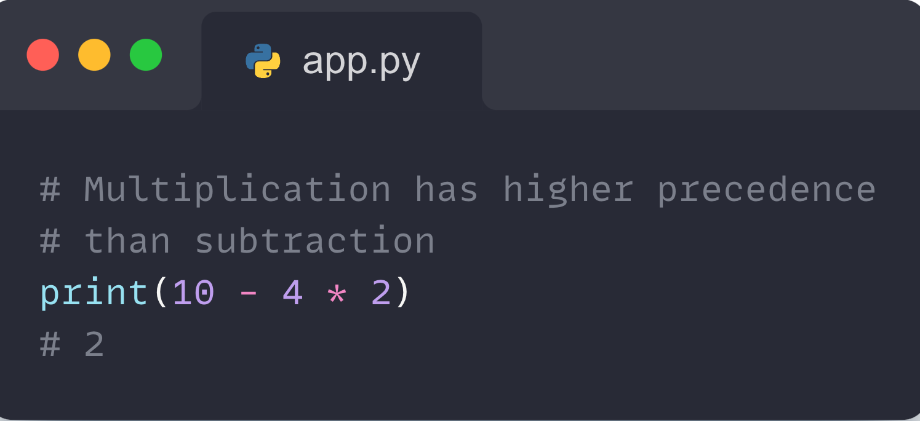
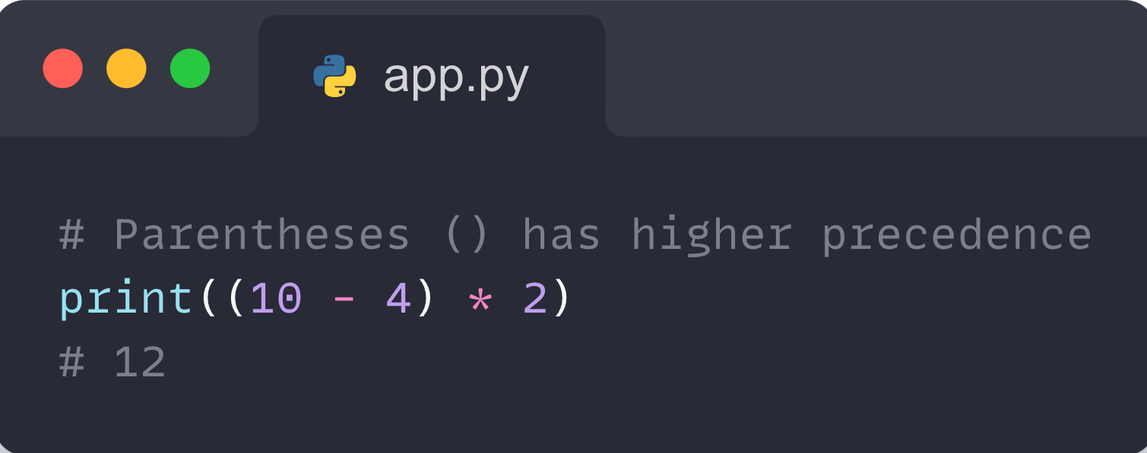
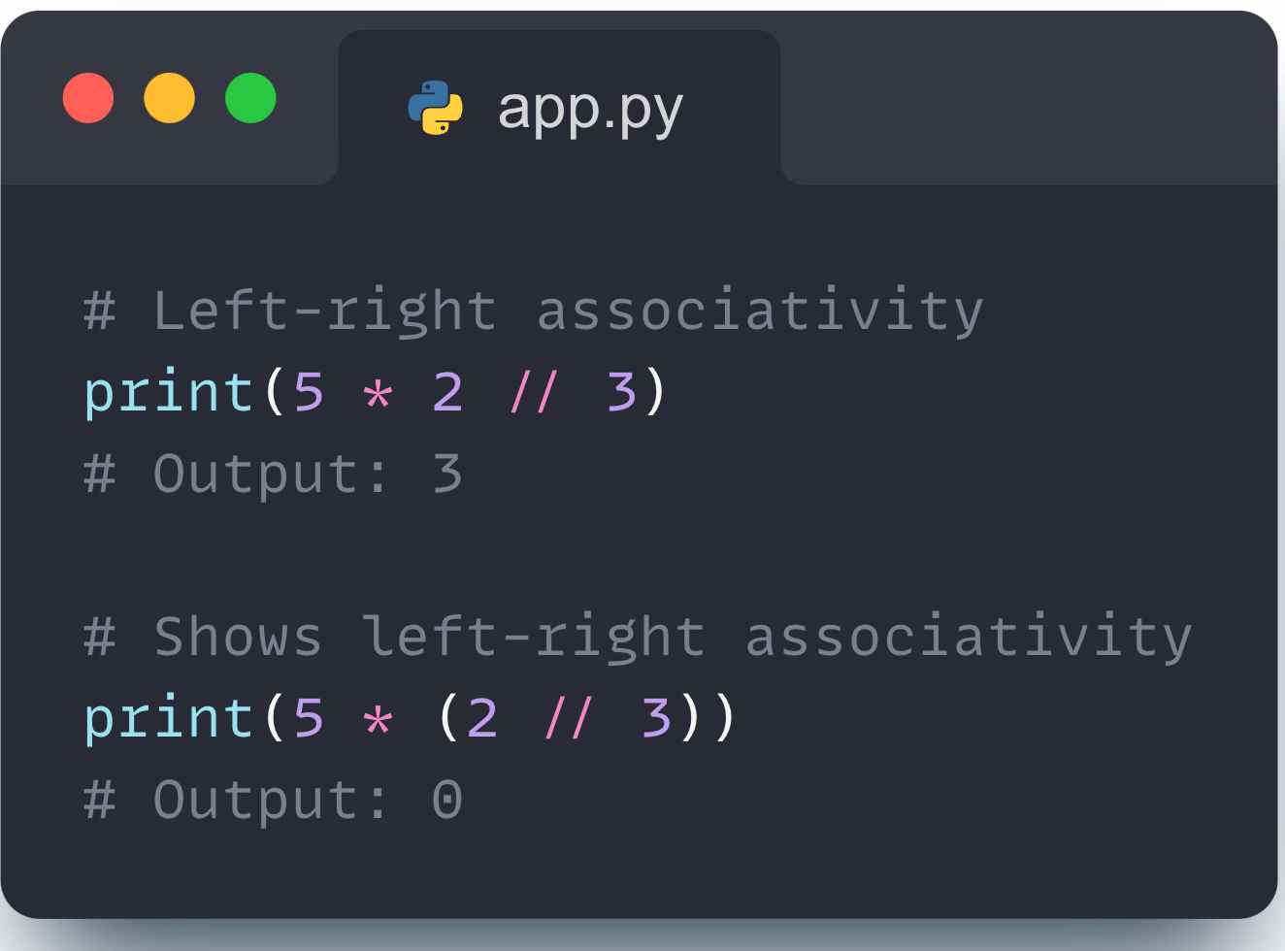
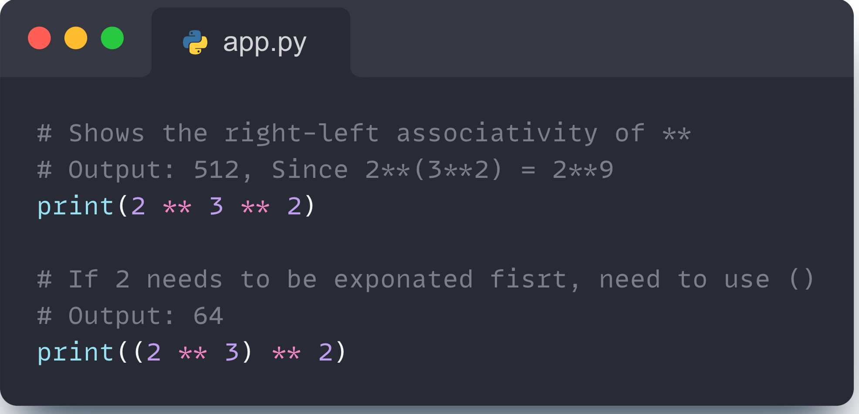
01- Operator precedence
‹#›

Slide 7
02
Comparison operations

Slide 8
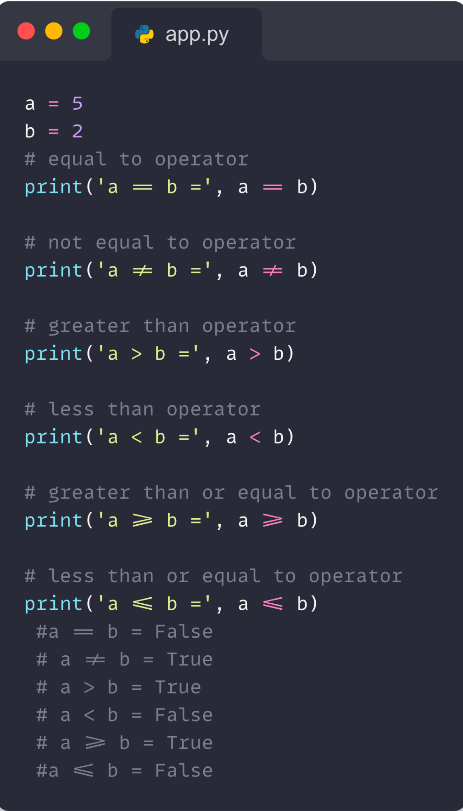
02- Comparison operations
Comparison operators compare two values/variables and return a boolean result: True or False. For example :
‹#›

Slide 9
03
Logical operators

Slide 10
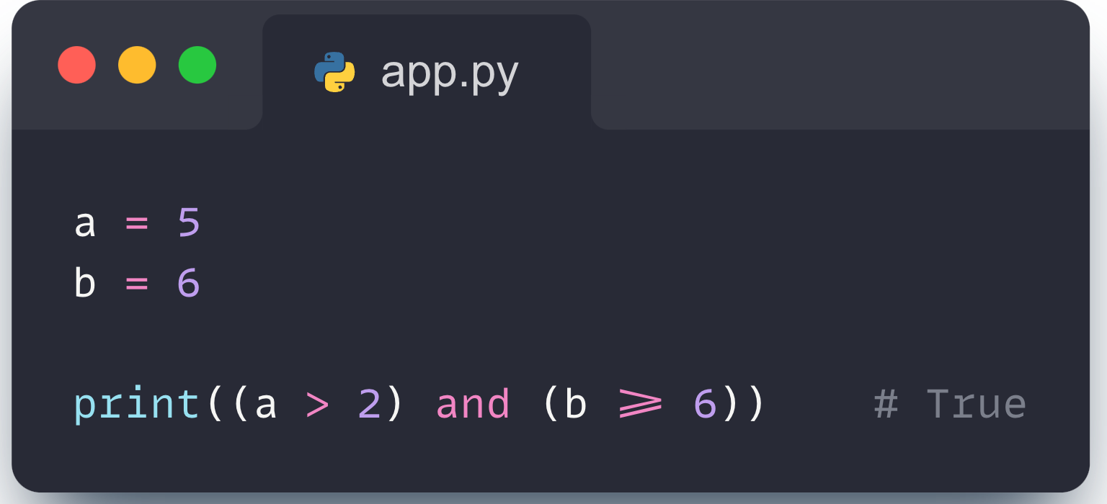
03- Logical operators
Logical operators are used to check whether an expression is True or False. They are used in decision-making. For example:
‹#›

Slide 11
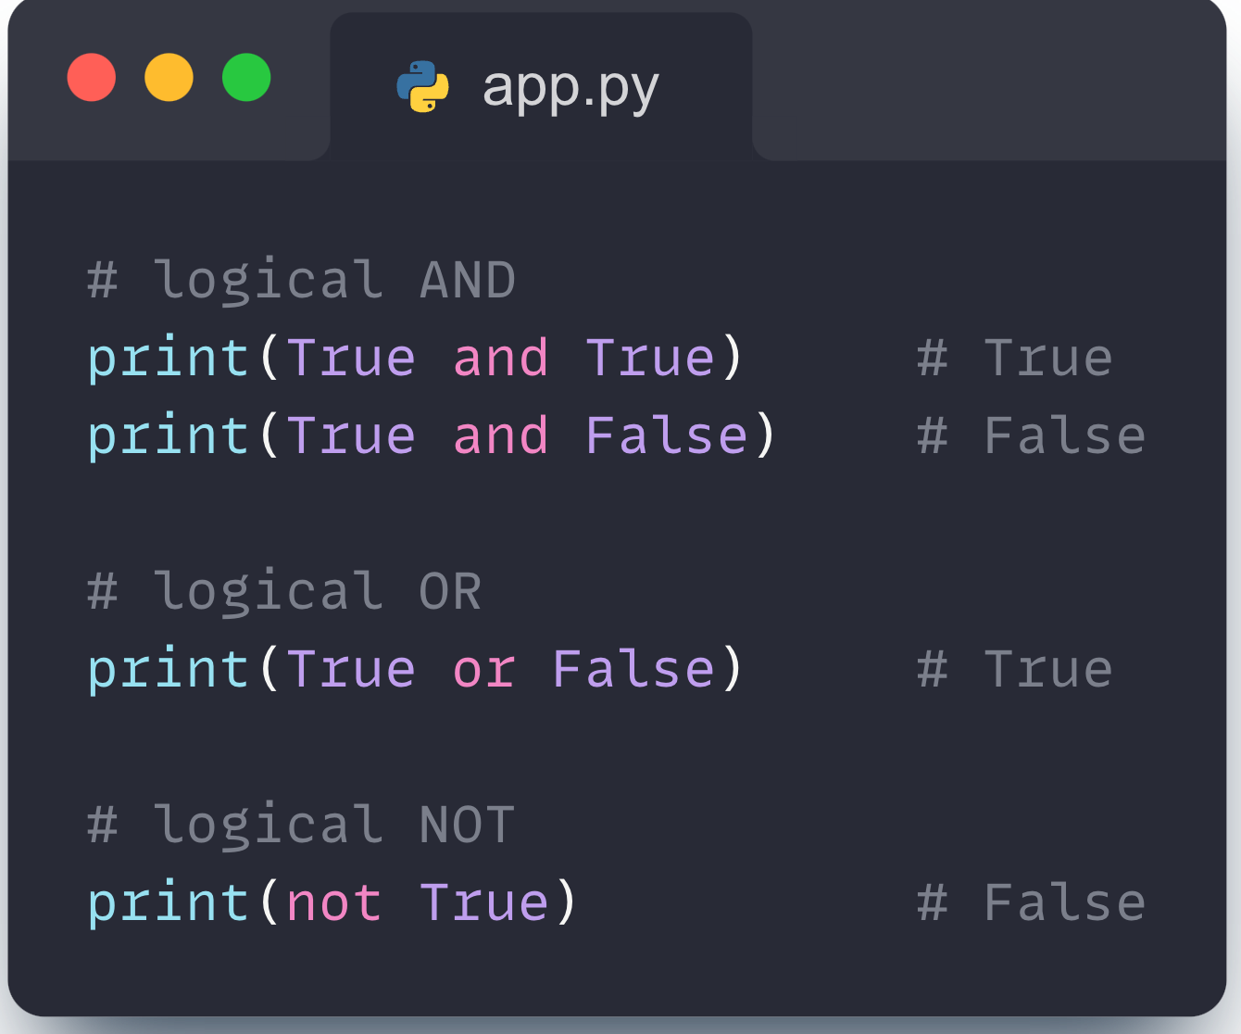
03- Logical operators
‹#›

Slide 12
04
Special operators

Slide 13
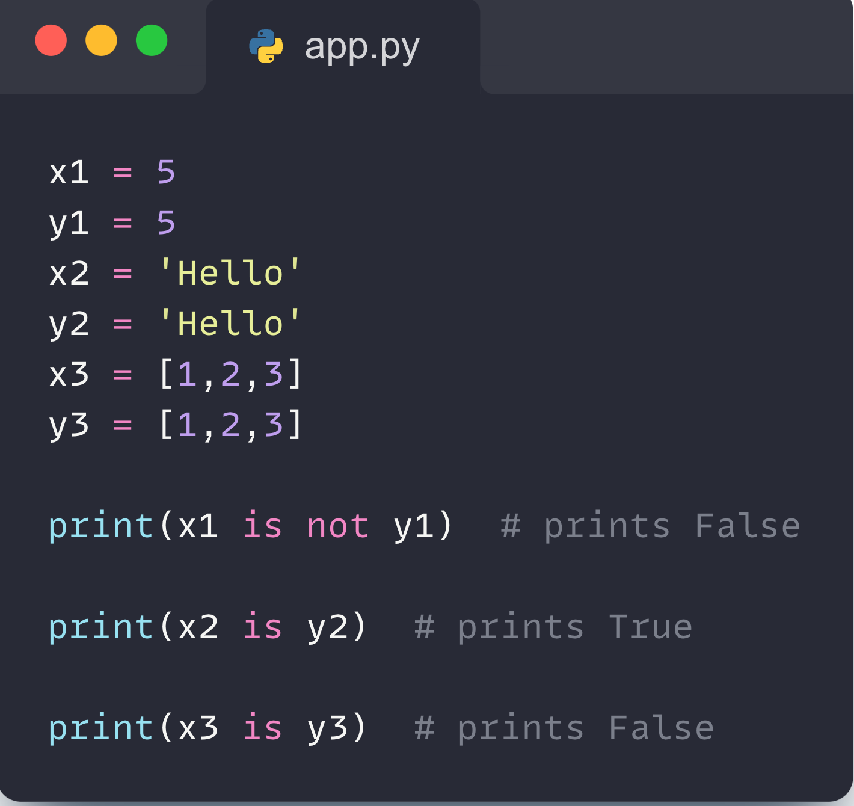
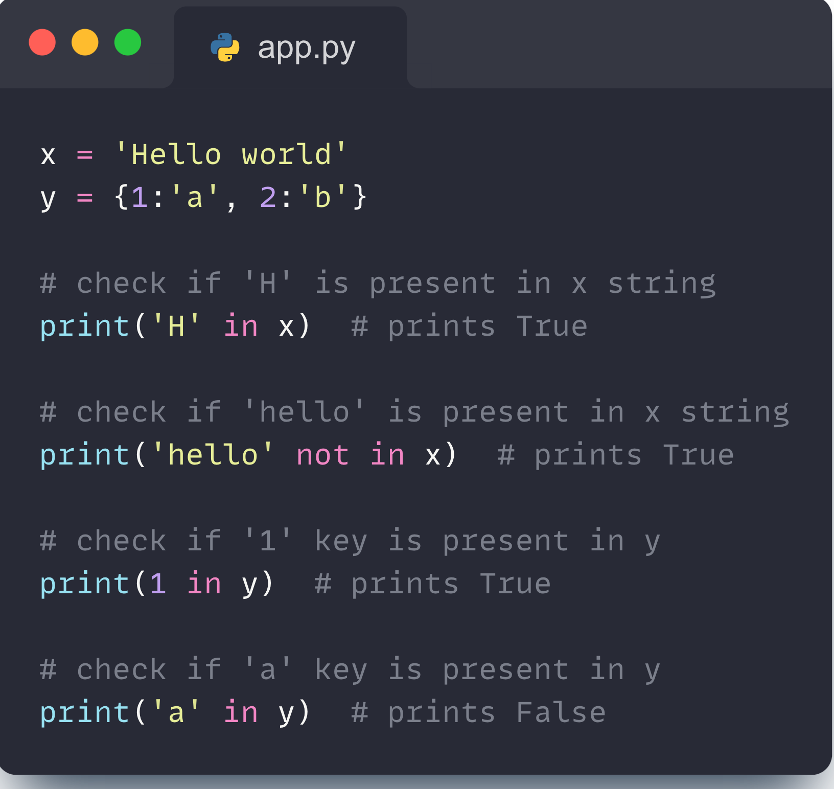
04- Special operators
‹#›

Slide 14
Thank you

