Slide 1
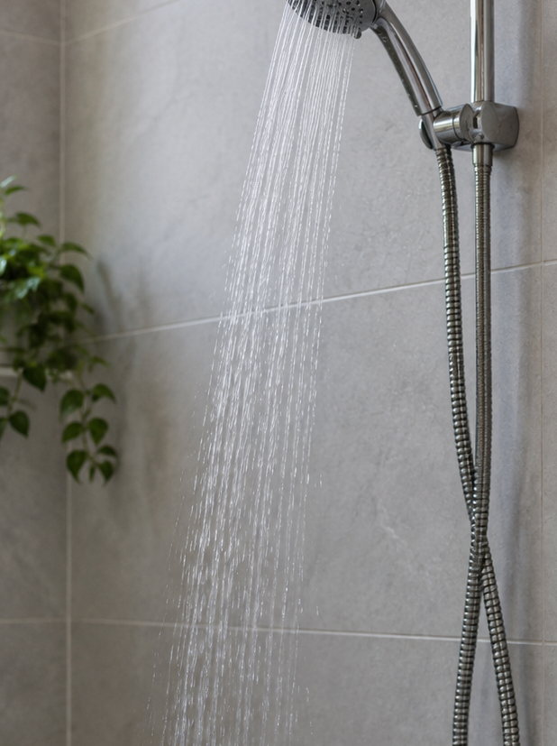
IEN301 · PROJECT 1: PROBLEM FRAMING
FIRST DROP
The water that runs
before the shower begins
TEAM
Omar Hanifa · Mohamed Alkaabi · Khaled Kittaneh
Nour Helal Yousifi · Mohamed Haque
Problem framing only. No intervention is proposed in this deck.
01
Notes:
Good morning. We are team First Drop, and this is our problem framing for IEN301. Our topic is a small moment everyone with a warm shower knows: the water is running, but nobody is washing yet. Today we will define who lives this moment, show what two interviewees told us about it, and explain why it persists.
Click: title and label appear with the slide. Click 1: subtitle. Click 2: team names.

Slide 2

THE MOMENT
Water is
flowing
Washing has
not begun
The interval we are investigating
02
Notes:
Picture turning on your shower. Water is flowing. Washing has not begun. That interval, between the tap and the first wash, is the whole of our project. Everything on the next slides is about what happens to the water and to the person during those minutes.
Click: 'Water is flowing' is visible on entry. Click 1: 'Washing has not begun'.

Slide 3
USER & CONTEXT DEFINITION
Adults in UAE homes
who shower with warm water
and wait 3–5 minutes for it to arrive
Situation: the tap is on, cold water runs to the drain, and they wait
Outside the bathroom (“I’m waiting outside” — Interviewee 1)
or standing by (“I just let the water run… and just sit there” — Interviewee 2)
Context: UAE homes; interviewed face-to-face, 27 Sept 2026
2 recorded interviews. UAE inferred from the setting, not stated. Home type, heating setup and tenure not asked — to confirm in interview 3.
03
Notes:
Our user is not 'people' or 'residents' in general. It is adults in UAE homes who shower with warm water and wait three to five minutes for it to arrive. Both were asked the same open question and answered in minutes without being offered a number: three to four, and three to five. The situation is the same for both: the tap is on, cold water runs to the drain, and they wait. How they wait differs, and that matters later.
Click: headline on entry. Click 1: situation line. Click 2: the two waiting behaviours and context.
Recording refs: I1 00:22 '3 to 4 minutes'; I2 00:16 '3 to 5 minutes'; I1 00:45; I2 00:40.

Slide 4
WHY WATER MAY RUN BEFORE USE
01
Waiting for hot water to arrive
Water in the hot water pipes cools between uses.
Hot water must travel from where it is heated to the shower.
02
The user is getting ready
Water may keep running after
a usable temperature arrives.
Background: EPA 2026. Duration and behaviour vary by system and user.
04
Notes:
Why does water run before use? First, the water sitting in the pipe has cooled since the last shower, and it has to clear before hot water arrives. Second, once the water is warm, the person may not be there to notice. Both intervals send clean water to the drain.
Click: stage 01 on entry. Click 1: stage 02.

Slide 5
ILLUSTRATIVE CALCULATION
30
4.35
seconds of flowing water
litres released
8.7 L/min × 0.5 min = 4.35 L
Interviews reported 3–5 minute waits, not 30 seconds.
8.7 L/min × 4 min = about 35 L per shower
Flow: RSB audit of 45 high-use villas, Abu Dhabi / Al Ain (2015), via ADDC/Tarsheed 2017.
30-second wait assumed. Local study rate, not a UAE average or measured shower loss.
05
Notes:
Before the interviews, we assumed a thirty-second wait. At the RSB flow rate of 8.7 litres a minute, that is 4.35 litres per shower. Then we listened. Mr Ali reported three to four minutes and Ryan three to five; at a four-minute wait the same flow rate gives about 35 litres per shower. The number is illustrative, but the order of magnitude changed.
Click: '30 seconds' on entry. Click 1: 4.35 litres and the formula. Click 2: the interview line.
Recording refs: I1 00:22; I2 00:16. 8.7 × 4 = 34.8 L.

Slide 6
EVIDENCE — HOW WE LISTENED
2
5:15
SAME 5 QUESTIONS
Warm or cold?
How long do you wait?
How much is lost?
What do you do meanwhile?
What happens to the water?
recorded interviews
27 Sept 2026
minutes of recording
face-to-face, phone-recorded
WHO WE INTERVIEWED
Interviewee 1 — “Mr Ali”: older man · warm showers · waits 3–4 min · waits outside the bathroom · nothing collected
Interviewee 2 — “Ryan”: young man · warm showers · waits 3–5 min · stays in the bathroom · nothing collected
Interviewee 3: recording (about 4 min) not received — nothing from it is used on these slides
Home type, water-heating setup and tenure were not asked. Recordings and timestamps are available for Q&A.
06
Notes:
Our evidence comes from two recorded, face-to-face interviews on 27 September, about two and a half minutes each, five minutes in total. We asked both people the same five questions. Mr Ali is an older man who waits outside the bathroom; Ryan is a young man who stays and waits. A third interview was recorded, but its file has not reached us, so nothing from it is on these slides.
Click: '2 interviews' on entry. Click 1: '5:15 minutes'. Click 2: the five questions. Click 3: who we interviewed.
Recording refs: Video files 16.41.50 (2:48) and 16.42.14 (2:27).

Slide 7
EVIDENCE — IN THEIR WORDS
Four things we heard
“
“
“About 3 to 4 minutes.”
“I just let the water run until it gets warm and just sit there.”
How long do you wait for warm water?
— Interviewee 1, older man · 00:22
What do you do while you wait?
— Interviewee 2, young man · 00:40
“
“
“I’m waiting outside.”
“No idea, but…
I would say at least a bucket.”
What do you do while you wait?
— Interviewee 1, older man · 00:45
How much water is lost?
— Interviewee 1, older man · 00:34
Verbatim from the recordings (Whisper transcript, cross-checked). Timestamps are mm:ss in each video.
07
Notes:
Here is what we heard, word for word. Mr Ali: about three to four minutes. Ryan: I just let the water run until it gets warm and just sit there. Mr Ali again: I'm waiting outside. And when we asked how much is lost: no idea, at least a bucket. Nobody measures the loss, and nobody is doing anything with the water.
Click: headline on entry. Click 1–4: one quote per click, left to right, top to bottom.
Recording refs: I1 00:22; I2 00:40; I1 00:45; I1 00:34. Also I2 00:16 '3 to 5 minutes', I1 00:56 'goes down the drain', I2 00:30 'probably a lot'.

Slide 8
EVIDENCE — WHAT WE DID NOT KNOW AT THE START
01
Minutes, not seconds
We had assumed about 30 seconds.
They said 3–4 and 3–5 minutes: six to ten times longer.
02
Nobody measures the loss
“No idea… at least a bucket.” “I don’t know the exact number…”
The run-off is invisible while it happens.
03
Waiting looks different in each home
One leaves the room (“I’m waiting outside”); one stays (“just sit there”).
Either way, the water goes down the drain.
Winter effect, home type and water-heating setup were not covered in the two recordings — to test in interview 3.
08
Notes:
Three things we did not know at the start. One: the wait is minutes, not seconds; our thirty-second assumption was off by six to ten times. Two: nobody measures the loss; both people could only guess. Three: waiting looks different in each home. Mr Ali leaves the bathroom; Ryan stays. In both cases the water goes down the drain.
Click: label on entry. Click 1–3: one finding per click.
Recording refs: I1 00:22, I2 00:16 (wait); I1 00:34, I2 00:30 (no idea); I1 00:45, I2 00:40 (behaviour); I1 00:56, I2 00:52 (drain).

Slide 9
KEY NUMBERS — ILLUSTRATIVE
One shower’s warm-up, scaled to a year
8.7 L/min × wait (min) × 1 shower/day × 365 days
9,500
12,700
15,900
litres per year
litres per year
litres per year
3 min wait
low end reported
26.1 L per shower
4 min wait
midpoint of 3–5 min
34.8 L per shower
5 min wait
high end reported
43.5 L per shower
For comparison, the 30-second wait we first assumed would be about 1,588 L per year.
Illustrative. Flow: RSB 2015 audit (via ADDC/Tarsheed 2017). Wait times: interviews 1–2. One shower/day assumed. Winter not measured.
09
Notes:
We replaced the unsourced yearly figures from our first draft with a calculation you can check on the slide. 8.7 litres a minute, times the reported wait, times one shower a day, times 365. Three minutes gives about nine and a half thousand litres a year; four minutes about twelve thousand seven hundred; five minutes about sixteen thousand. Our original thirty-second assumption would have been under sixteen hundred.
Click: formula on entry. Click 1–3: the three yearly figures. Click 4: the comparison line.
Recording refs: Wait times: I1 00:22, I2 00:16. Computation in evidence.md §4.

Slide 10
POINT OF VIEW
Adults in UAE homes who shower with warm water need a way to stop the 3–5 minute warm-up from sending clean water down the drain because the wait is passive time — they step out or wait it out — and nobody sees how much is lost.
Turn on the shower
Cold water to the drain
Wait 3–5 minutes
Shower
Grounded in interviews 1–2 (27 Sept 2026): waits of 3–4 and 3–5 min; “I’m waiting outside”; “just sit there”; “no idea… at least a bucket”.
10
Notes:
This brings us to our point of view. Adults in UAE homes who shower with warm water need a way to stop the three-to-five-minute warm-up from sending clean water down the drain, because the wait is passive time, they step out or wait it out, and nobody sees how much is lost. The sequence is always the same: turn on, cold water drains, wait, shower.
Click: label on entry. Click 1: the POV statement. Click 2–5: the four steps of the flow.
Recording refs: I1 00:22, 00:34, 00:45, 00:56; I2 00:16, 00:30, 00:40, 00:52.

Slide 11
CONSTRAINTS — WHY THE PROBLEM PERSISTS
Why the water keeps running
01
02
03
04
05
HABIT
COST SIGNAL
SYSTEMS
CLIMATE
ROUTINE
Turn it on, then wait — outside the room or standing by. The run-off is never handled.
Neither person could estimate the loss (“at least a bucket”). Nothing in the moment makes it visible.
Water is heated far from the shower; the pipe must clear every time. Changing the plumbing is rarely an option.
Colder inlet water in winter should lengthen the wait. Not covered in either interview.
The wait sits inside getting ready; extra steps compete with time. Not raised by either interviewee.
Interviews 1–2
Interviews 1–2 · context
EPA 2026 · to confirm
To verify — interview 3
Assumption — to verify
Elsewhere (scheduled supply in Jordan, RV tanks) the same wait draws on a finite reserve — context, not a finding about our users.
Background: EPA 2026 (hot-water delivery). Tags show where each constraint comes from.
11
Notes:
Why does this persist? Habit: you turn it on and wait; the run-off is never handled. Cost signal: nobody can see the loss, so nothing prompts a change. Systems: in a typical home the water is heated away from the shower, and re-plumbing is out of most residents' hands; we have not yet confirmed the setup in these two homes. Climate and routine are plausible constraints we still have to verify; we are honest about that on the slide.
Click: headline on entry. Click 1–5: one card per click. Click 6: the context footnote.
Recording refs: I1 00:45, 00:34, 00:56; I2 00:40, 00:30, 00:52.

Slide 12
WHAT USERS DO TODAY — AND WHY IT DOES NOT WORK
None of today’s options fits these users
What users do or could do
Why it doesn’t work for these users
Turn it on and walk away
Interviewee 1: “I’m waiting outside.”
Nobody is in the room when warm water arrives, so the run continues until they return.
Stand by and wait
Interviewee 2: “just sit there.”
Passive minutes with the water in view — and it still goes down the drain.
Collect it in a bucket
Interviewee 1: “it just goes down the drain.”
Neither interviewee does it. Extra handling and storage, and one user is not even in the room.
Thermostatic shut-off valve
Published approach (EPA 2026)
Stops the flow once warm water arrives; the cold slug still drains first, and it needs installing.
Recirculation loop
Published approach (EPA 2026)
Keeps the pipe warm, but it means re-plumbing the home (not an option for tenants; tenure not asked) and adds an energy cost.
Rows 1–3 from interviews 1–2. Rows 4–5 are published approaches (EPA 2026), listed as context, not as proposals.
12
Notes:
What do users do today? Mr Ali turns it on and walks away; Ryan stands by and waits. Neither collects the water; a bucket means handling, and one of them is not even in the room. The published options do not fit these users either: a shut-off valve still drains the cold slug first and needs installing, and a recirculation loop means re-plumbing the home, which a tenant cannot do; we did not ask about tenure.
Click: headers on entry. Click 1–5: one row per click.
Recording refs: I1 00:45, 00:56; I2 00:40, 00:52. EPA 2026 for rows 4–5.

Slide 13
REFLECTION — 01 / WHAT WE ASSUMED
We assumed a
30-second wait
…and a few litres lost: 4.35 L per shower.
A minor annoyance, not a routine.
Our starting assumption, before any interview (see slide 5).
13
Notes:
Now, what we learned about our own thinking. We started with one assumption: the wait is about thirty seconds, so the loss is a few litres. We treated it as a minor annoyance rather than a routine.
Click: headline on entry. Click 1: the two assumption lines.

Slide 14
REFLECTION — 02 / THE EVIDENCE THAT CHANGED IT
“About 3 to 4 minutes.”
— Interviewee 1 · 00:22
6–10×
“Three to five minutes.”
— Interviewee 2 · 00:16
longer than we assumed
3–5 min reported vs 30 s
“No idea… I would say at least a bucket.”
— Interviewee 1 · 00:34
“I’m waiting outside.” / “…and just sit there.”
— Interviewee 1 · 00:45 / Interviewee 2 · 00:40
Both interviews, 27 Sept 2026. Transcripts and timestamps: hidden appendix and evidence file.
14
Notes:
Four lines changed our mind. Three to four minutes. Three to five minutes. No idea, at least a bucket. And two different ways of waiting: outside the room, or sitting there. The reported wait is six to ten times longer than we assumed, and the loss is invisible to the people living it.
Click: label on entry. Click 1–4: one quote per click. Click 5: the '6–10×' number.
Recording refs: I1 00:22, 00:34, 00:45; I2 00:16, 00:40.

Slide 15
REFLECTION — 03 / HOW THE POV SHARPENED
BEFORE
AFTER
Residents waste water while waiting for hot water.
Adults in UAE homes who shower with warm water need a way to stop the 3–5 minute warm-up from sending clean water down the drain because the wait is passive time — they step out or wait it out — and nobody sees how much is lost.
Any resident, anywhere
No estimate of the wait
No reason it persists
Nothing a team could act on
Specific user · reported wait (3–5 min)
self-described behaviour · a reason it persists
Before: our v1 framing, paraphrased. After: grounded in interviews 1–2 (27 Sept 2026).
15
Notes:
Here is how the point of view sharpened. Before: residents waste water while waiting for hot water. Any resident, no measure, no cause. After: adults in UAE homes who shower with warm water need a way to stop the three-to-five-minute warm-up from sending clean water down the drain, because the wait is passive time and nobody sees how much is lost. Same moment, but now with a user, a reported wait, a described behaviour and a reason.
Click: 'Before' statement on entry. Click 1: its gaps. Click 2: the 'After' statement. Click 3: what it gained.

Slide 16
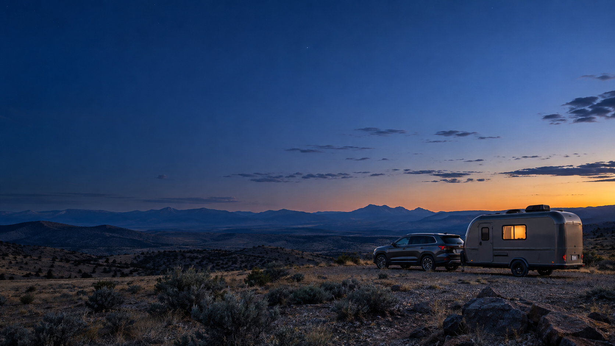
FIRST DROP · IEN301 PROJECT 1
Questions?
OUR POINT OF VIEW
Adults in UAE homes who shower with warm water need a way to stop the 3–5 minute warm-up from sending clean water down the drain because the wait is passive time — they step out or wait it out — and nobody sees how much is lost.
Omar Hanifa · Mohamed Alkaabi · Khaled Kittaneh · Nour Helal Yousifi · Mohamed Haque · Transcripts on request
16
Notes:
That is our problem framing. We leave the point of view on screen and welcome your questions. We have both recordings and the transcripts with timestamps if you want to check any quote.
Click: 'Questions?' on entry. Click 1: the POV in small text.

Slide 17
APPENDIX (HIDDEN) — CLAIM TO RECORDING MAP
Every on-slide claim, and where to hear it
Slides | Claim(s) on slide | Source | Time | Verbatim
3, 5, 6, 7, 8, 9, 10, 14 | Wait 3–4 min; Reported waits 3–5 min; about 35 L per shower at 4 min | Interview 1 | 00:22 | About 3 to 4 minutes.
7, 8, 10, 11, 14 | at least a bucket; Nobody measures the loss | Interview 1 | 00:34 | No idea, but I think it's about… I would say at least a bucket.
3, 6, 7, 8, 10, 11, 12, 14 | Waits outside the bathroom; waiting outside | Interview 1 | 00:45 | I'm waiting outside.
6, 8, 11, 12 | Water goes down the drain (both); nothing collected | Interview 1 | 00:56 | No, it just goes down the drain.
3, 5, 6, 8, 9, 10, 14 | Wait 3–5 min; Reported waits 3–5 min | Interview 2 | 00:16 | Three to five minutes.
8, 11 | Nobody measures the loss; cannot estimate the loss | Interview 2 | 00:30 | I don't know the exact number, but probably a lot.
3, 6, 7, 8, 10, 11, 12, 14 | Stays in the bathroom; let it run and sit there | Interview 2 | 00:40 | I just let the water run until it gets warm and just sit there.
6, 8, 11, 12 | Water goes down the drain (both); nothing collected | Interview 2 | 00:52 | Nothing, it just… / Yeah.
3, 6, 8, 9, 11, 12 | Winter, home type, heating setup, tenure, routine — NOT covered | — | — | Caveats in slide footers; evidence file §1
— | Interviewer-supplied figures (6–12 L/min; 30,000 L/yr) — NOT used | Interviews 1, 2 | 01:03; 00:58 | Said by the interviewer, unsourced
Hidden appendix for Q&A. Timestamps are mm:ss in each video. Full transcripts: interview_1.md, interview_2.md; evidence.md.
17
Notes:
Hidden appendix. Not presented; used during Q&A to point to the exact moment in each recording.
Click: no builds.

