Slide 1
Relational Database Concepts NOTE: You may review the slides first and then view the corresponding video or use the two assets simultaneously.
INST327 Database Design and Modeling

Slide 3
Textbook reference: page 5

Slide 4
Textbook reference: page 7
Notes:
Server software
Database management system (DBMS)
The DBMS does the back-end processing
Client software
Application software
Data access API (application programming interface)
The client software does the front-end processing
The SQL Interface
The application software communicates with the DBMS by sending SQL queries through the data access API.
When the DBMS receives a query, it provides a service like returning the requested data (the query results) to the client.
SQL stands for Structured Query Language, which is the standard language for working with a relational database.

Slide 5
A networked system that uses an application server
A web-based system
Textbook reference: page 9
Notes:
Other client/server components
Application servers store business components
Web servers store web applications and web services
How web applications work
A web browser on a client sends a request to a web server.
The web server processes the request.
The web server passes any data requests to the database server.
The database server returns results to web server.
The web server returns a response to the browser.

Slide 6
Textbook reference: page 13
Notes:
Terms to know
Relational database
Table
Column
Row
Cell
Primary key
Composite primary key
Non-primary key (unique key)
Index

Slide 7
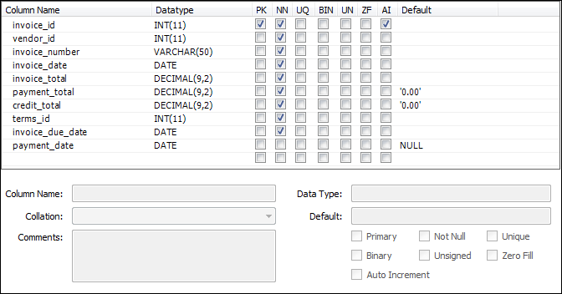
Textbook reference: page 15
Notes:
Terms to know
Data type
Null value
Default value
Auto increment column
Common MySQL data types
CHAR, VARCHAR
INT, DECIMAL
FLOAT
DATE

Slide 8
Textbook reference: page 13
Notes:
Terms to know
Foreign key
Referential integrity
One-to-many relationship
One-to-one relationship
Many-to-many relationship
http://database.guide/the-3-types-of-relationships-in-database-design/

Slide 9
Textbook reference: page 17

Slide 10
CRUD: Create, Read, Update, Delete
Notes:
DDL is used primarily by Database Administrators (DBA). “With great power comes great responsibility.” –Voltaire
DML is used by SQL programmers and users with restrictions defined by the DBA.

Slide 11
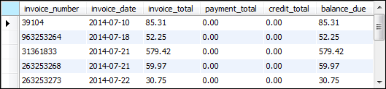
Textbook reference: page 27

Slide 12
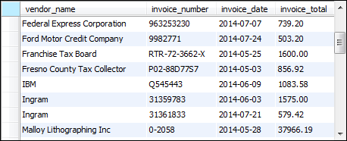
Textbook reference: page 29
Notes:
Terms to know
Query
Base table
Result table (result set)
Calculated value
Join
Inner join
Outer join

Slide 19
Action Items
Read Chapter 3, if you haven’t already
Complete installation of software and sample code. Attend office hours if you need assistance.
See this week’s module on ELMS for readings, videos, resources, and assignments.

