Slide 1
Is there a relationship between age and income?
No there is not a relationship

Slide 2
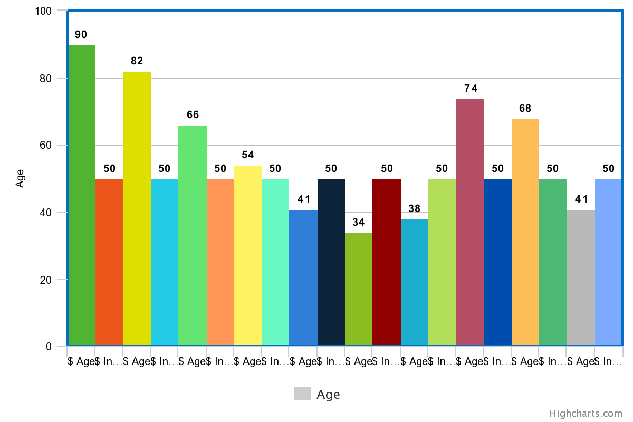

Slide 3
Can we say that we have achieved gender equality? No ,we did not achieve gender equality ,because by analyzing the data ,it was found that the income for females is significantly less than men.

Slide 4
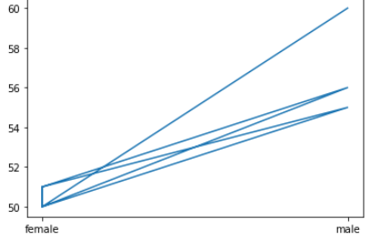

Slide 5
What other attribute/s could be an income predictor/s?
I think the number of children is likely to be affected.
I think housing type (ownership , rent)
I think Health status is likely to be affected , because he will surely have medicine from the state every period.

