Slide 1
Agenda for today's meeting
Solution Objective and timeline
User Journey
End-to-End Process Overview
Data & System Dependency Map
Multi-Dimension Analysis
Demo Objective and Timeline
QA

Slide 2
Solution Implementation Timeline
From scope alignment to launch readiness and post-launch stabilization
Main delivery stream
Decision gate
23rd Apr
10th Aug
31st Oct
Alignment & Scope
BRD end
Alpha Phase
Releases and stabilization
• Confirm business scope
• Define success KPIs
• Validate key assumptions
Prove the technical approach works end-to-end with core features only (no integrations)
Implement features and model improvements while stabilizing product
1
2
3
4
5
10th Jul
30st Sep
ProtoType Phase
Beta Phase
Validate UX/UI, planned features, and user journeys before building
Validate solution with live integrations including all agreed features
Key dependencies
Business owner availability | Data access approval | Integration API readiness | UAT user participation | Launch governance sign-off

Slide 3
Agenda for today's meeting
Solution Objective and timeline
User Journey
End-to-End Process Overview
Data & System Dependency Map
Multi-Dimension Analysis
Demo Objective and Timeline
QA

Slide 4
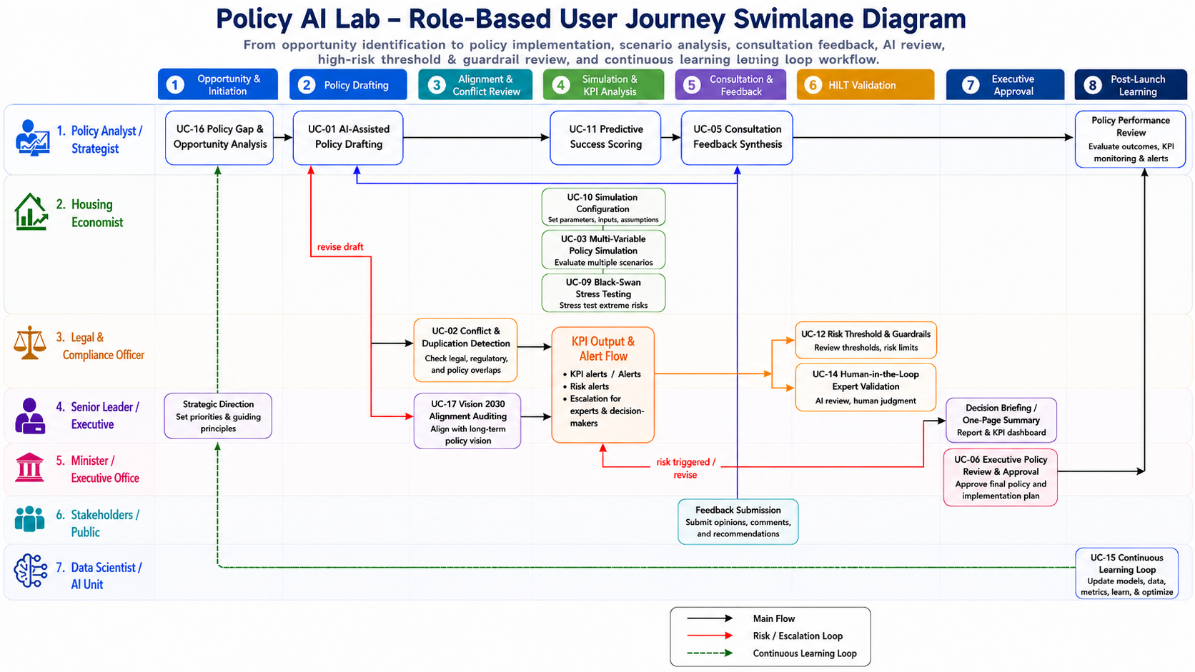

Slide 5
Agenda for today's meeting
Solution Objective and timeline
User Journey
End-to-End Process Overview
Data & System Dependency Map
Multi-Dimension Analysis
Demo Objective and Timeline
QA

Slide 6
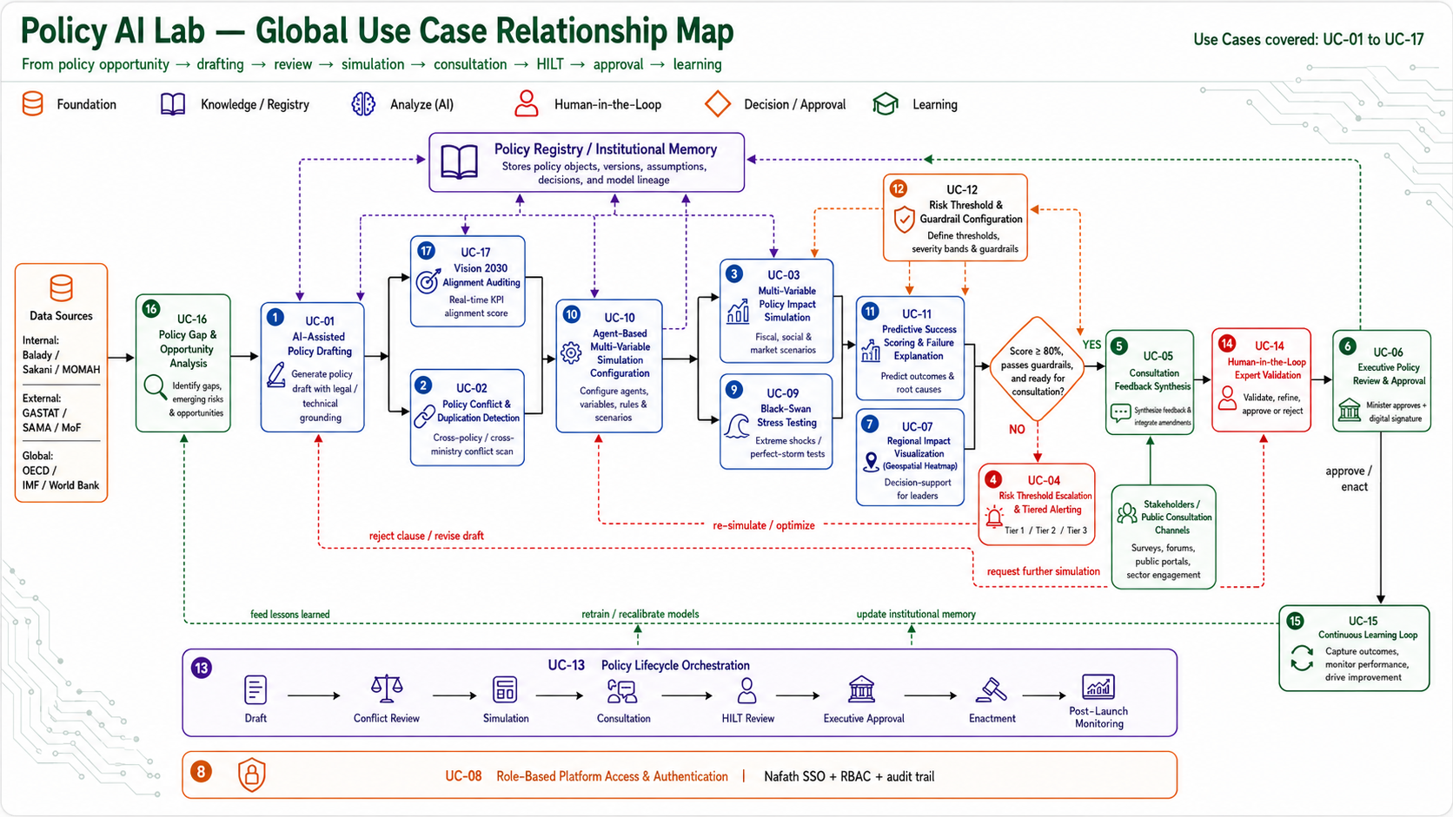
Policy AI Lab | Use Case Relationship Map

Slide 7
Agenda for today's meeting
Solution Objective and timeline
User Journey
End-to-End Process Overview
Data & System Dependency Map
Multi-Dimension Analysis
Demo Objective and Timeline
QA

Slide 8
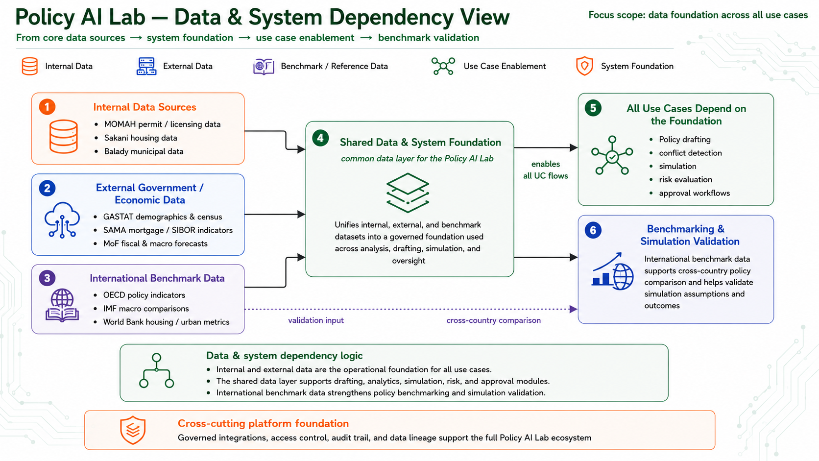

Slide 9
Agenda for today's meeting
Solution Objective and timeline
User Journey
End-to-End Process Overview
Data & System Dependency Map
Multi-Dimension Analysis
Demo Objective and Timeline

Slide 10
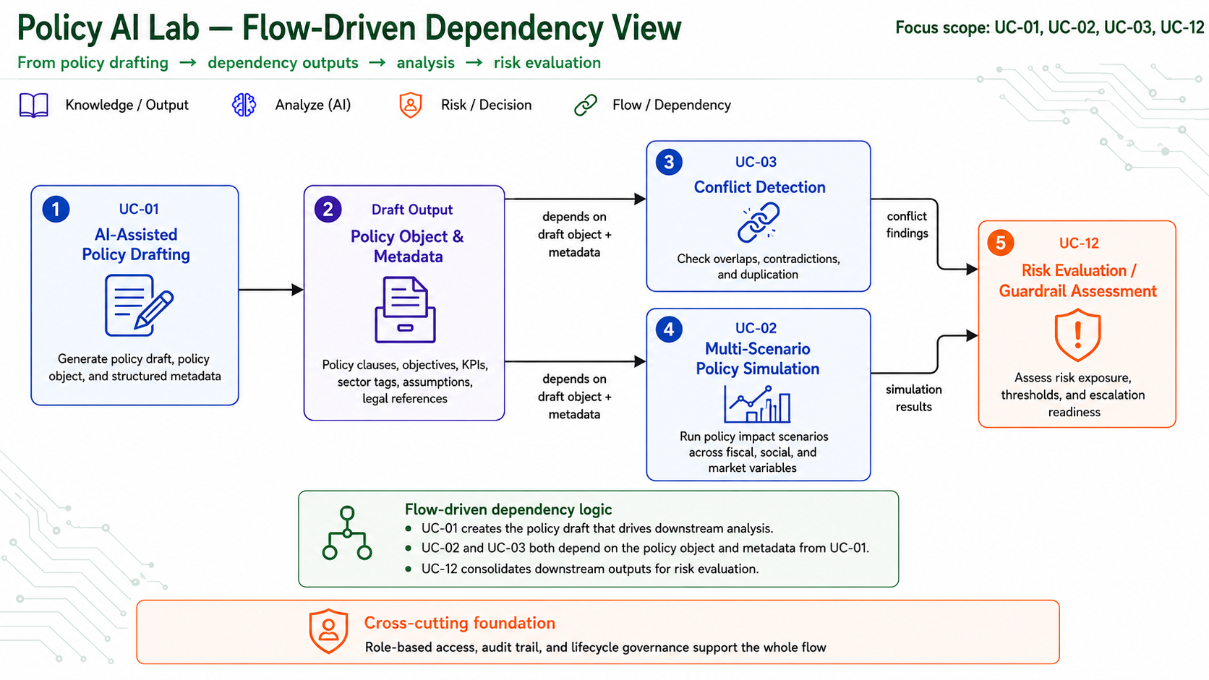

Slide 11
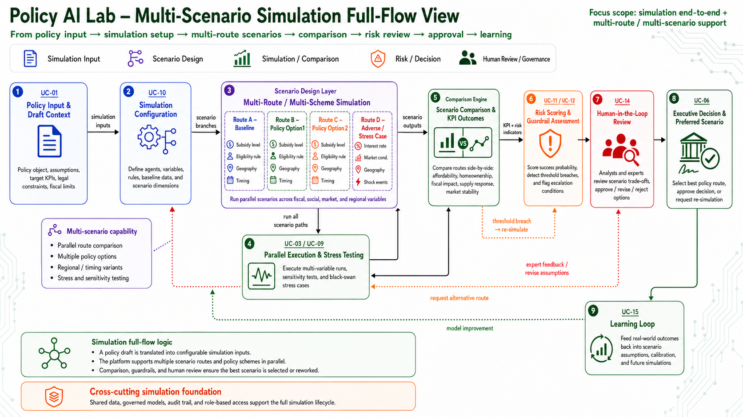

Slide 12
Agenda for today's meeting
Solution Objective and timeline
User Journey
End-to-End Process Overview
Data & System Dependency Map
Multi-Dimension Analysis
Demo Objective and Timeline
QA

Slide 13
Policy AI Lab Demo Timeline
Final target: 26th
“policy simulation” pipeline: Demonstrate the end-to-end policy simulation flow, from policy inputs and scenario combinations to ABM-based iterations, KPI projections, risk assessment, Monte Carlo stability checks, and backtesting evidence.
Milestones
13 May
19 May
21 May
25 May
26 May
Start Development
ABM Main Flow
Analysis Page
Multi-Scenario Demo
Demo Complete
Demo development kickoff
Complete core ABM simulation flow
Complete ABM simulation result analysis page
Complete multi-scenario simulation and demo case
Finalize demo package
Core ABM flow → Monte Carlo stability → result analysis → multi-scenario demo case → final demo package

Slide 14
Agenda for today's meeting
Solution Objective and timeline
User Journey
End-to-End Process Overview
Data & System Dependency Map
Multi-Dimension Analysis
Demo Objective and Timeline
QA List

Slide 15
Policy Simulation Clarification Questions
For customer alignment before finalizing HLSD and demo implementation assumptions
Objective: Confirm key design decisions for baseline scenarios, simulation variables, and data snapshot/versioning governance.
1.
Baseline Scenario
2.
Simulation Variables
3.
Data Snapshot & Versioning
Is the Baseline Scenario generated automatically by the system, or manually created / selected by the Economist?
Do variable default values come from data sources, expert configuration, or built-in system defaults?
Must every simulation run save a data snapshot?
Should the snapshot store a full data copy, or only source version, pull time, and parameter metadata?
Which data sources and business rules should be used to generate the default Baseline?
Who is authorized to modify variables and assumptions?
What retention, audit, and traceability requirements should apply?
Should the Baseline be locked for each simulation run or adjustable by authorized users?
Does any modification trigger re-approval before simulation execution?
Expected outcome: customer confirms governance choices so the HLSD can define the correct workflow, data model, approval logic, and audit trail.

