Slide 1
Policymaking framework
Policy development process and checklists
AUGUST 2025

Slide 2
Strategy, policy, and regulations have different functions
Strategy is an overall direction, setting the vision, objectives, the roadmap,
and KPIs
Policy is legally binding guiding framework, establishing overall principles
Focus of this document
Regulations are detailed, enforceable rules implementing specific laws or policies

Slide 3
Following the vision and objectives set in the strategy, a policy sets binding principles that are enforced through regulations
Aspect | Strategy | Policy | Regulation
Definition | Overall direction; aligned with Vision 2030 | Legally binding guiding framework | Detailed, enforceable rules
Purpose | Sets the vision, objectives, roadmap, and KPIs | Establishes overarching government principles and provides direction | Ensures mandatory compliance through specific laws
Approval authority | Council of Ministers or relevant ministries | Council of Ministers and ratified by Royal Decree (legally binding) | Issued by ministries or competent regulatory authorities, legally binding once officially published
Legal force | Not typically legally binding itself; provides roadmap for achieving policy intent | Legally binding if formally approved by Council of Ministers and Royal Decree | Always legally binding with specified compliance requirements and penalties
Examples (KSA) | Digital Government Strategy (2023) outlines the national digital transformation vision and goals | KSA Cloud First Policy (2019) mandates that government agencies prioritize cloud solutions | Cloud Computing Regulatory Framework (2018) provides rules for cloud service providers in the Kingdom
Focus of this document

Slide 4
Policies define a strategic framework that is legally binding
What policy is
What policy is not
  Strategic directive setting clear government intent and priorities
  High-level document approved by the Council of Ministers and ratified by Royal Decree
  Legally binding document once officially issued through proper channels
  Guiding framework for the development of detailed regulations
  General recommendation without
  authoritative approval
  Detailed operational procedure or manual
  Regulation detailing specific compliance mechanisms or penalties
  Standalone vision document without formal approval or Royal ratification
  Internally issued guideline in the ministries without Council of Ministers approval/Royal endorsement

Slide 5
Best practices for policy development follow 5 guiding principles
1
Process, responsibilities and timelines
of policy development should be
clearly defined and transparently communicated to the organization
2
Stakeholders should be engaged early and
their feedback considered to drive quality
and legitimacy of the policy
3
Policies should be aligned among them to avoid regulatory conflicts and potential implementation issues
4
Impact and feasibility assessment (incl. trade offs and implementation costs) should be part of policy development
5
Policy review should be phased out (i.e., split into phases) across the key steps of the policy development process to ensure alignment and buy-in throughout the process
Source: OECD, desktop research

Slide 6

The policy development process consists of eight key steps
0
1
2
3
4
5
6
7
Policy
identification
Direction
setting
Policy
development
Strategic Ali-
gnment review
Legal review
Budget review
Proposal
final check
Approval
Define if proposed solution to challenges faced consists of a new policy / an update to an existing policy is
Determine the key guidelines and outcomes that
each policy
should aim to address in line with the sector’s strategy
Develop the draft of the new policy and align it with relevant stakeholders priori initiation of review process
Ensure alignment of policy with national and cross sectoral strategic goals and objectives (incl. policy simulation)
Validate compliance with legal standards e.g., alignment with constitution and other
official mandates (as needed)
Evaluate the financial implications and feasibility of the policy (as needed)
Finalize proposal draft by ensuring all required alignments were obtained, conduct public consultation and update
as needed
Submit the draft to the approving body for approval and circulation

Slide 7
Each step of the policy development process should answer key questions
Non-exhaustive
0
1
2
3
4
5
6
7
Policy
definition
Direction
setting
Proposal development
Strategic Ali-
gnment review
Legal
review
Budget
review
Proposal
final check
Approval
  Does the proposed solution represent a legally binding guiding framework?
  Does the proposed solution need to be approved by the Council of Ministers and ratified by Royal Decree?
  Is the proposed solution a policy/update to existing policy?
  What is the rationale for proposing the policy / update to the existing policy?
  What challenges is the policy aiming to address?
  What are the intended outcomes or changes the policy seeks to achieve?
  How does the policy fit with other existing or planned policies?
  How will decision-making be split?
  What is the policy approach (e.g., spatial coverage, rate structure?
  What are the policy's financial and socio-economic impacts?
  What are the key policy enablers?
  What are the KPIs that will be monitored, how often, and by whom?
  Is the policy aligned with the Ministry’s priorities / strategic objectives or reform agenda?
  Does it complement existing policies and programs without causing conflict or duplication?
  Is the policy sustainable and adaptable to future changes in context or needs?
  Is the policy within
  MoMAH legal jurisdiction?
  Have necessary changes to regulations been factored in?
  Has the policy been reviewed and approved by Legal Deputyship?
  What budget is needed from the government to implement the policy?
  How is this budget going to be financed?
  Have stakeholders been consulted for input, including the public?
  Has all feedback been addressed?
  Is there a
  plan to communicate the policy and train or support those affected?
  Have all reviews been completed satisfactorily?
  Have all identified stakeholders' inputs been taken into account and reflected in the policy?
  Has the policy been approved by HEM and the governing body (if applicable)?

Slide 8
Existing capabilities in various areas of the organization should be leveraged to drive the different steps of policy development
Preliminary
0
1
2
3
4
5
6
7
Process
aspect
Policy
definition
Direction
setting
Proposal development
Strategic Ali-
gnment review
Legal
review
Budget
review
Proposal
final check
Approval
Central
responsi-
bilities
Provide input
on solution as needed
Provide input on potential policies for the sector and define minimum requirements/ guidelines for policy approval
Provide input on relevant areas of expertise (e.g. BIDSC socioeconomic studies)
Centralized review by relevant departments to ensure a comprehensive assessment at their level of expertise
Support update on relevant areas of expertise
Obtain a sign-in from all key decision-makers ensuring independency and alignment with requirements
Sector/
Deputyship
responsi-
bilities
Define if solution requires policy development / update to existing policy
Establish
policy goals, purpose, impact, and relevance, ensuring alignment with other policies
Develop policy for their sector leveraging sector expertise
and MOMAH resources
Technical expertise,
knowledge of context,
proximity to stakeholders
Update policy based on inputs received and prepares for public consultation
Step owner
Deputyship/ sector team, validated by Policy Committee
Deputyship/ sector team, validated by
Policy Committee
Deputyship/ sector team
SMO
Legal department
Finance and
budgeting department
Deputyship/
sector team
Policy Committee
Note: Policy Committee to supervise full process, regardless of step owner

Slide 9
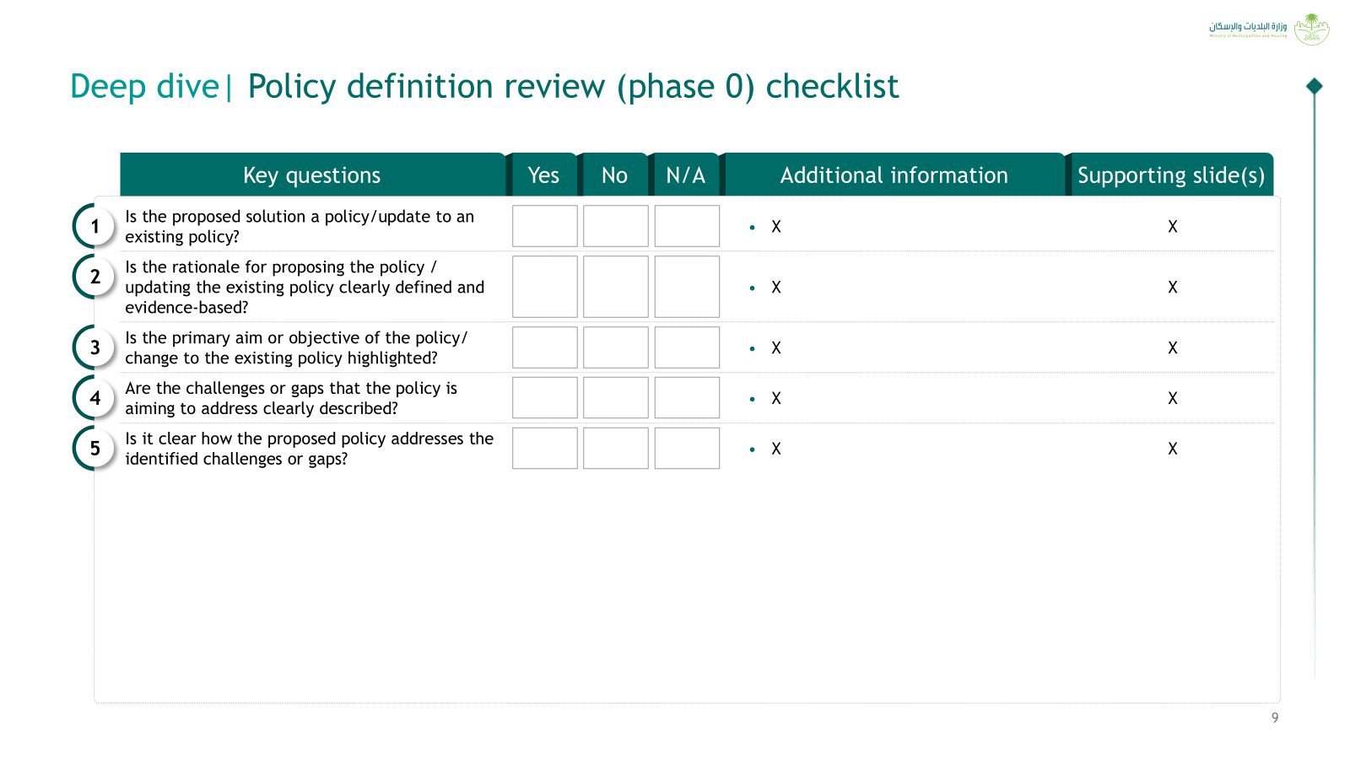
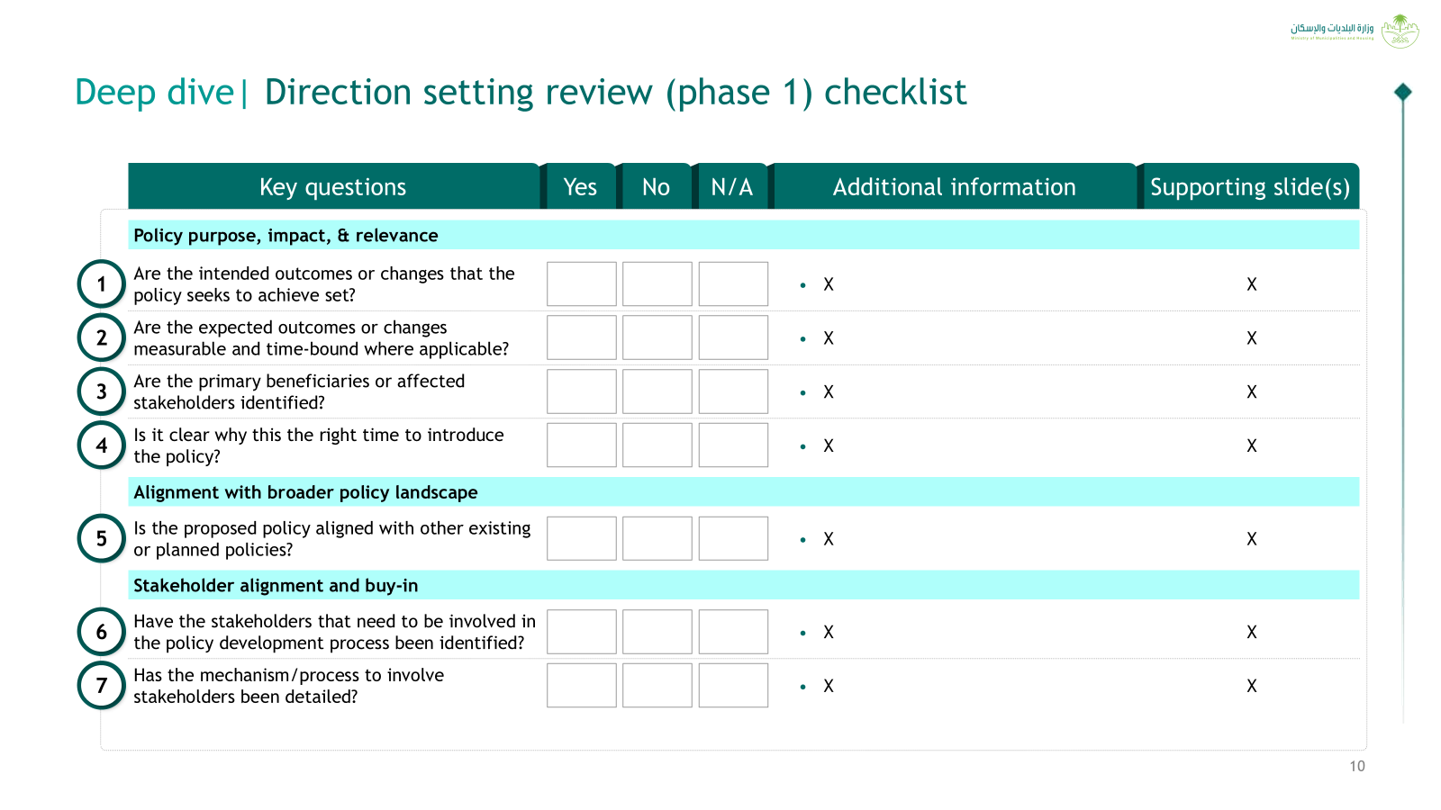
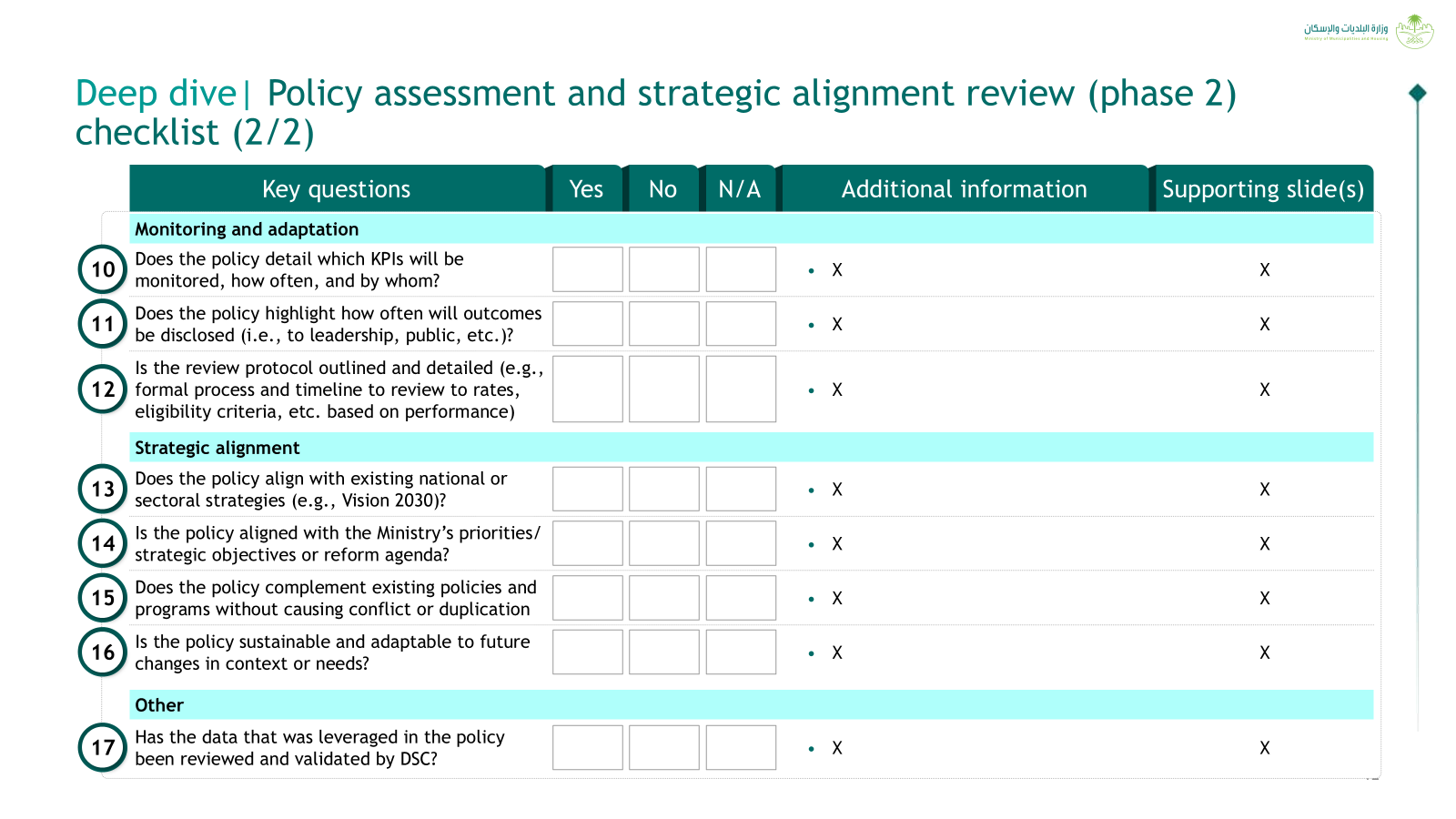
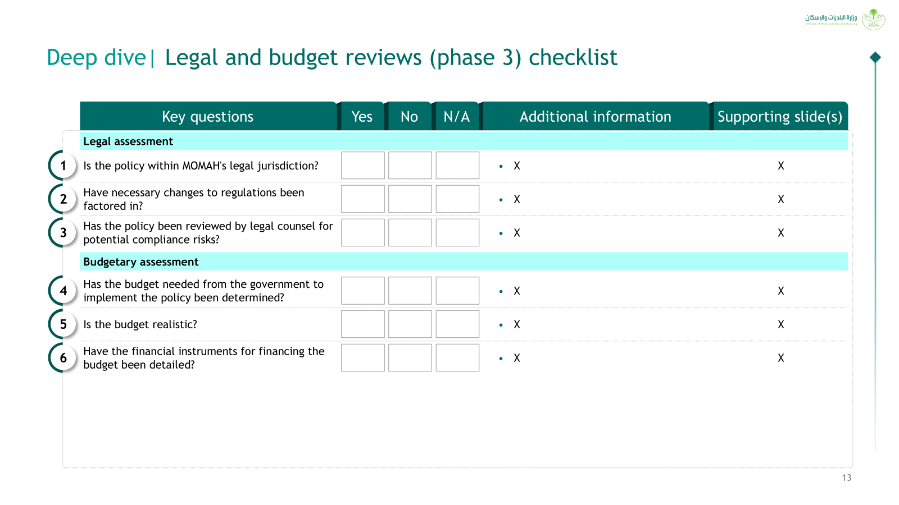
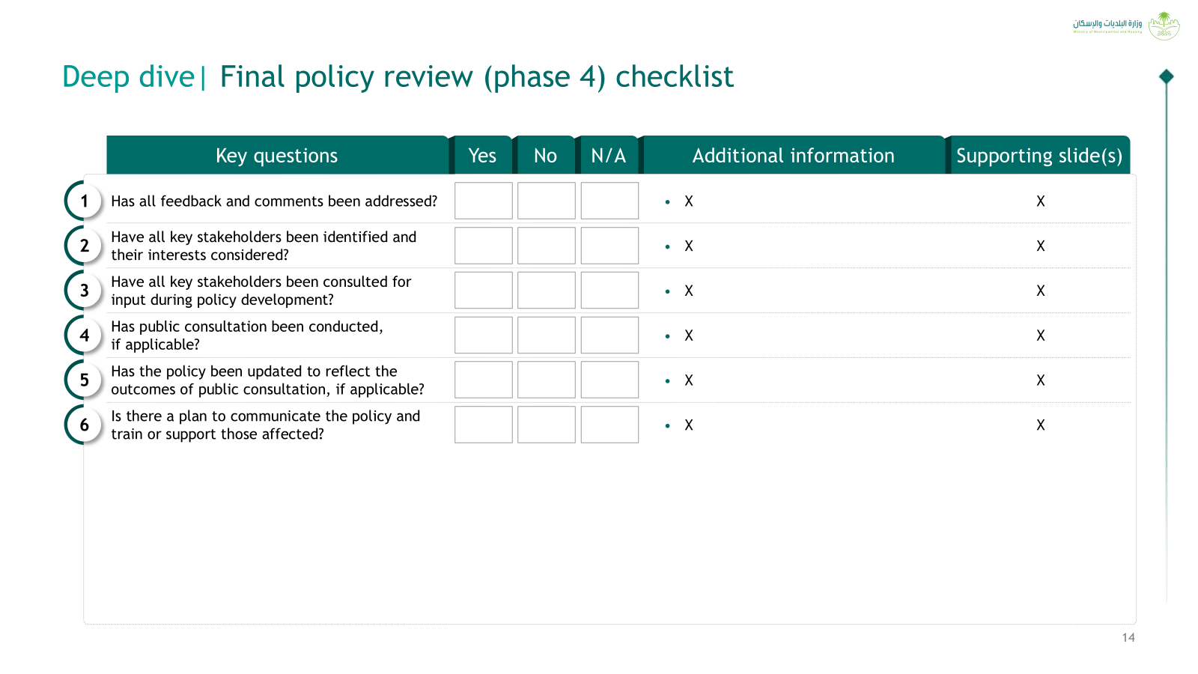
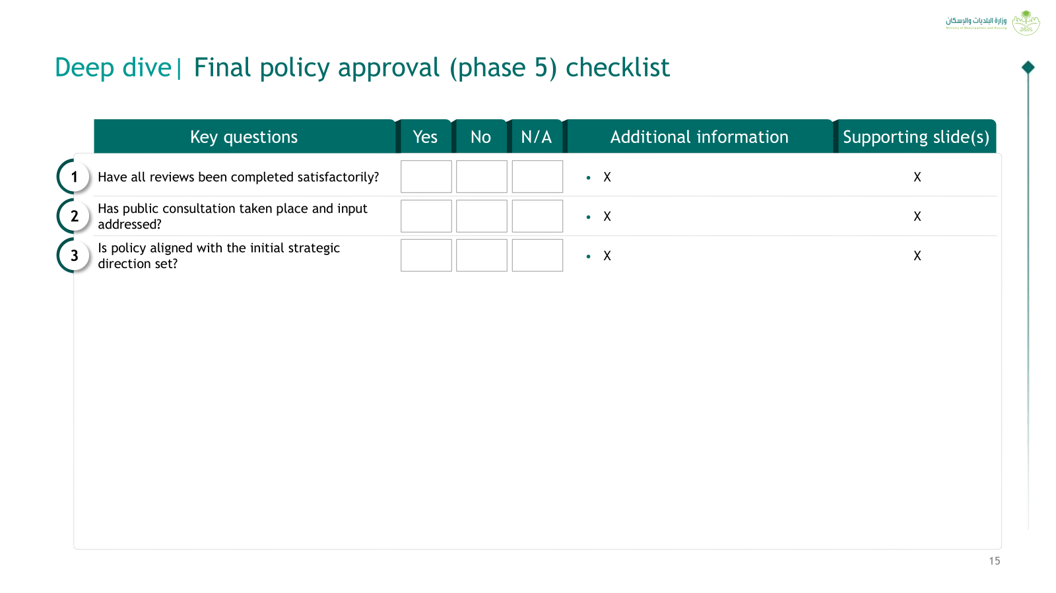
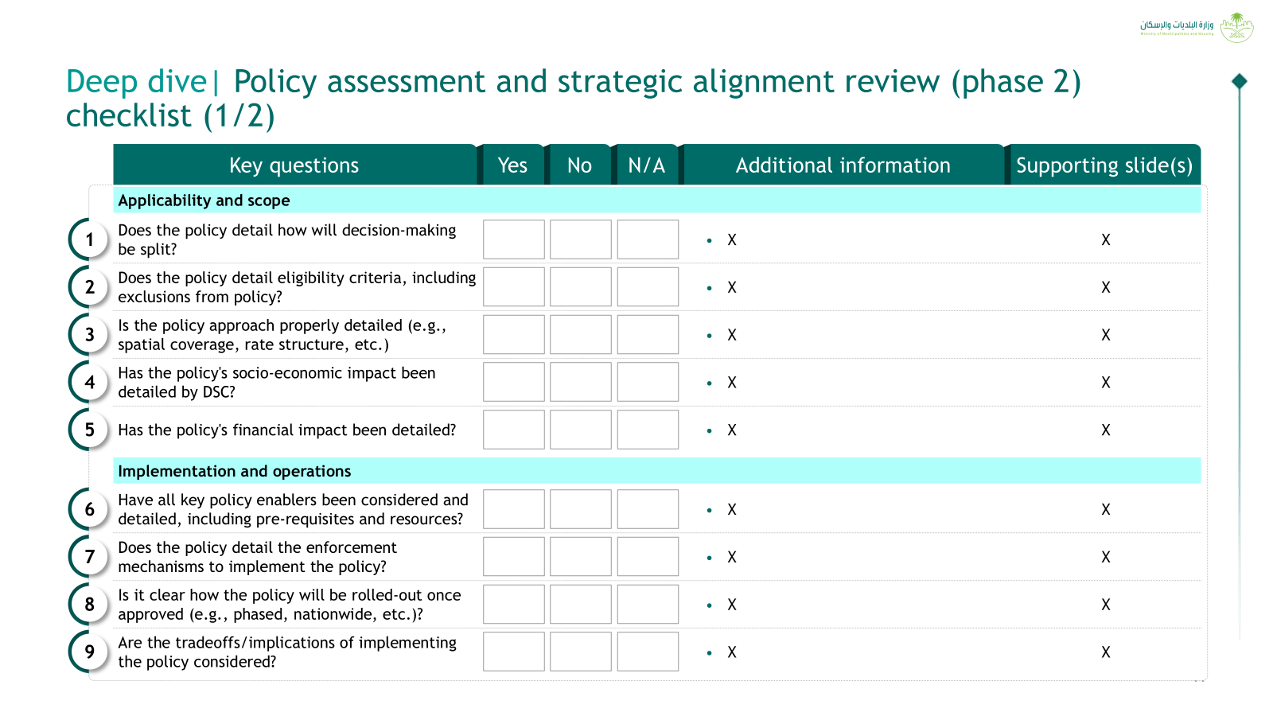
Policy development process should be phased out and supported with detailed checklists / guidelines to ensure proper review and approval
0
1
2
3
4
5
6
7
To ensure that policy development efforts are streamlined, each phase should kickstart once the previous phase is completed, reviewed, and approved based on the checklists/ guidelines
Policy development process
Policy
definition
Direction
setting
Proposal develop-ment
Strategic
Alignment
review
Legal
review
Budget
review
Proposal
final
check
Approval
Review/
approval
phases
Phase 0:
Policy definition review
Phase 1:
Direction setting review
Phase 2:
Policy assessment and strategic alignment review
Phase 3:
Legal and budget review
Phase 4:
Final policy review
Phase 5:
Final policy approval
Checklists/ guidelines
Deep dive next

Slide 10
Deep dive| Policy definition review (phase 0) checklist
Key questions
Yes
No
No
N/A
N/A
Additional information
Additional information
Supporting slide(s)
Supporting slide(s)
1
Does the proposed solution represent a legally binding guiding framework establishing overarching government principles and providing strategic direction / priorities?
  X
X
2
Does the proposed solution need to be approved by the Council of Ministers and ratified by Royal Decree?
  X
X
3
Does the proposed solution require to be translated into detailed regulations at a later stage?
  X
X
4
Based on the above, is the proposed solution a policy/update to an existing policy?
  X
X

Slide 11
Deep dive| Direction setting review (phase 1) checklist (1/2)
Key questions
Yes
No
N/A
Additional information
Supporting slide(s)
Policy purpose, impact, & relevance
1
Is the rationale for proposing the policy / updating the existing policy clearly defined and evidence-based?
  X
X
2
Is the primary aim or objective of the policy/ change to the existing policy highlighted?
  X
X
3
Are the challenges or gaps that the policy is aiming to address clearly described?
  X
X
4
Is it clear how the proposed policy addresses the identified challenges or gaps?
  X
X
5
Are the intended outcomes or changes that the policy seeks to achieve set?
  X
X
6
Are the expected outcomes or changes measurable and time-bound where applicable?
  X
X
7
Are the primary beneficiaries or affected stakeholders identified?
  X
X
8
Is it clear why this the right time to introduce
the policy?
  X
X

Slide 12
Deep dive| Direction setting review (phase 1) checklist (2/2)
Key questions
Yes
No
N/A
Additional information
Supporting slide(s)
Alignment with broader policy landscape
9
Is the proposed policy aligned with other existing or planned policies?
  X
X
Stakeholder alignment and buy-in
10
Have the stakeholders that need to be involved in the policy development process been identified?
  X
X
11
Has the mechanism/process to involve stakeholders been detailed?
  X
X
12
Is there a need to setup up a specific governance for this policy?
  X
X
13
If yes, has the governance been defined?
  X
X

Slide 13
Deep dive| Policy assessment and strategic alignment review (phase 2) checklist (1/2)
Key questions
Yes
No
N/A
Additional information
Supporting slide(s)
Applicability and scope
1
Does the policy detail how will decision-making be split?
  X
X
2
Does the policy detail eligibility criteria, including exclusions from policy?
  X
X
3
Is the policy approach properly detailed (e.g., spatial coverage, rate structure, etc.)
  X
X
4
Has the policy's socio-economic impact been detailed by DSC?
  X
X
5
Has the policy's financial impact been detailed if applicable?
  X
X
Implementation and operations
6
Have all key policy enablers been considered and detailed, including pre-requisites and resources?
  X
X
7
Does the policy detail the enforcement mechanisms to implement the policy?
  X
X
8
Is it clear how the policy will be rolled-out once approved (e.g., phased, nationwide, etc.)?
  X
X
9
Are the tradeoffs/implications of implementing
the policy considered?
  X
X

Slide 14
Deep dive| Policy assessment and strategic alignment review (phase 2) checklist (2/2)
Key questions
Yes
No
N/A
Additional information
Supporting slide(s)
Monitoring and adaptation
10
Does the policy detail which KPIs will be
monitored, how often, and by whom?
  X
X
11
Does the policy highlight how often will outcomes be disclosed (i.e., to leadership, public, etc.)?
  X
X
12
Is the review protocol outlined and detailed (e.g., formal process and timeline to review to rates, eligibility criteria, etc. based on performance)
  X
X
Strategic alignment
13
Does the policy align with existing national or sectoral strategies (e.g., Vision 2030)?
  X
X
14
Is the policy aligned with the Ministry’s priorities/ strategic objectives or reform agenda?
  X
X
15
Does the policy complement existing policies and programs without causing conflict or duplication?
  X
X
16
Is the policy sustainable and adaptable to future changes in context or needs?
  X
X
Other
17
Has the data that was leveraged in the policy been reviewed and validated by DSC?
  X
X

Slide 15
Deep dive| Legal and budget reviews (phase 3) checklist
Key questions
Yes
No
N/A
Additional information
Supporting slide(s)
Legal assessment
1
Is the policy within MOMAH's legal jurisdiction?
  X
X
2
Have necessary changes to regulations been factored in?
  X
X
3
Has the policy been reviewed and approved by Legal Deputyship?
  X
X
Budgetary assessment
4
Has the budget needed from the government to implement the policy been determined?
  X
X
5
Have the financial instruments for financing the budget been detailed?
  X
X

Slide 16
Deep dive| Final policy review (phase 4) checklist
Key questions
Yes
No
N/A
Additional information
Supporting slide(s)
1
Have all key stakeholders been consulted for input during policy development?
  X
X
2
Has public consultation been conducted,
if applicable?
  X
X
3
Has the policy been updated to reflect the outcomes of public consultation, if applicable?
  X
X
4
Has all feedback and comments been addressed?
  X
X
5
Is there a plan to communicate the policy and train or support those affected?
  X
X

Slide 17
Deep dive| Final policy approval (phase 5) checklist
Key questions
Yes
No
N/A
Additional information
Supporting slide(s)
1
Have all reviews been completed satisfactorily?
  X
X
2
Have all identified stakeholders' inputs been taken into account and reflected in the policy?
  X
X
3
Has the policy been approved by HEM?
  X
X
4
Has the policy been approved by the governing body, if applicable?
  X
X

