Slide 1
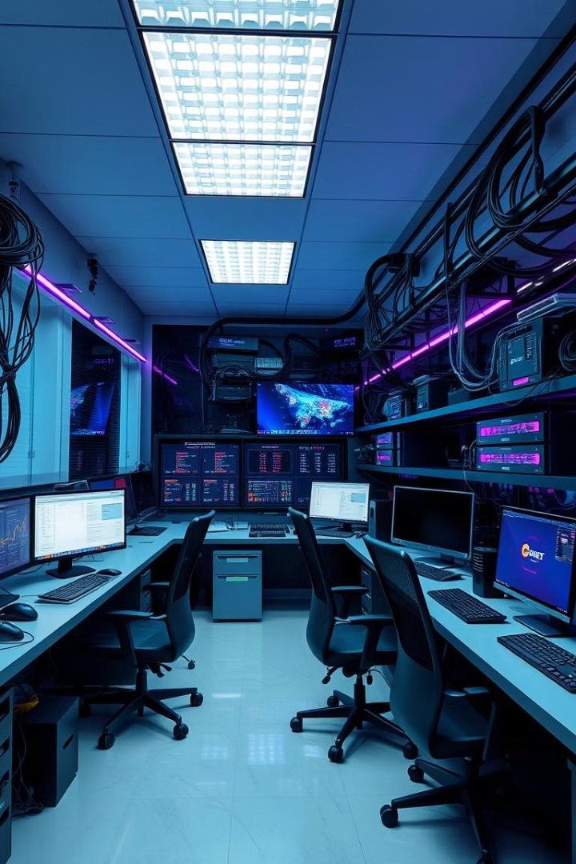
Building an International School Network
Presented by: Saif Mohamed Amera Sameh Ahmed Yasser Nour Ammar
Represented to: Eng. Wael Samir

Slide 2
Project Overview
The international school consists of two branches located a distance apart. The main branch houses three buildings:
Building A: Administrative departments (management, admin, finance, student affairs)
Building B: IT department and labs
Building C: Middle school and high school
The smaller branch hosts:
Building D: Primary school and kindergarten
Cloud Section: ensures that the school network can securely access external cloud services such as email. Through the use of routers and subnets, the cloud section isolates internal traffic from external services, enhancing both security and network performance.

Slide 3
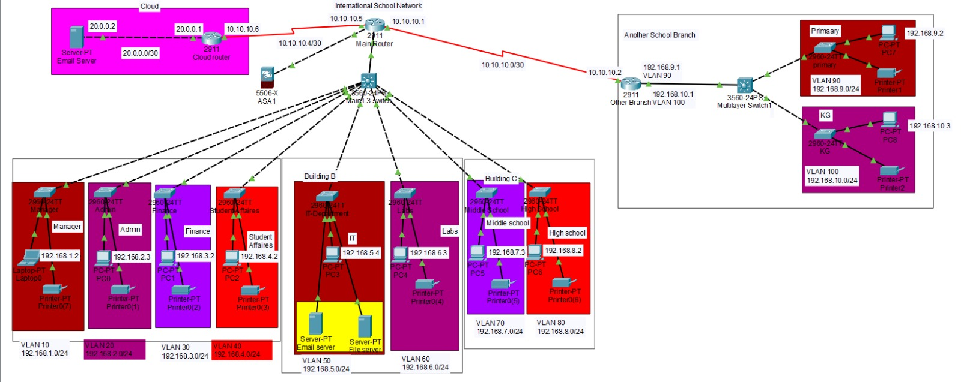
Final Form of Project

Slide 4
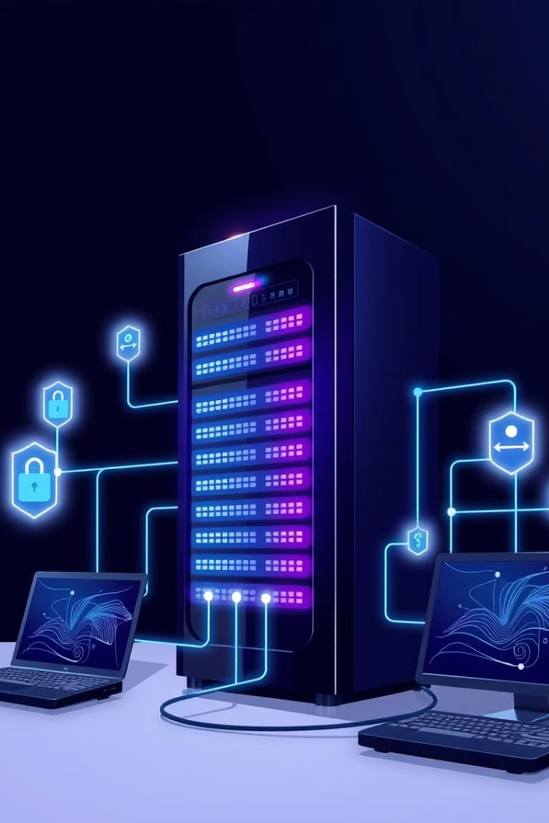
Goals and Objectives
1
Scalable Network Topology
2
Reliable Network Services
Accommodate future expansions, both for the main school and additional branches.
Configure DNS and DHCP for domain resolution and IP management, with redundancy for uptime.
3
Secure and Efficient Network Segmentation
Implement VLANs and ACLs to isolate departments and ensure data privacy.

Slide 5
Network Design and Architecture
Core Network
Edge Network
Cloud Integration
Reliable and high-performance backbone, incorporating redundant links and failover mechanisms.
Secure and efficient connectivity for end-users, with wireless access points and firewalls.
Seamless integration with cloud-based services and applications for enhanced collaboration and flexibility.

Slide 6

Project Timeline and Milestones
Network Design
First Week
Network Implementation
Second Week
Network Services
Third week
Network Management
Fourth week

Slide 7
Network Design
Hierarchical Topology Core Switch: Central connection point for the school’s entire network. Fiber Optic Cables: Connect core switches to distribution switches in each building for high-speed data transfer. IP Addressing and Subnetting Private IPs: Ensuring unique addresses for devices in each department. Subnetting: Allocating subnets to different departments to control traffic. VLAN Configuration: Defined for security and network management.
VLANs: 10 (Management), 20 (Admin), 30 (Finance), 40 (Student Affairs), 50 (IT), 60 (Labs), 70 (Middle School), 80 (High School), 90 (Primary), 100 (KG).
Security and Traffic Segmentation: Prevents unauthorized access between departments.

Slide 8
Network Implementation
Hardware Setup Routers & Switches: Installed in each building for core and distribution layers. End Devices: Connected to switches (PCs, printers, servers, etc.). Fiber Optic Connections: Established between buildings for high-speed links. Device Configuration Router Configuration: Configured for inter-VLAN routing, ensuring departments can communicate while remaining secure. Switch Configuration: Assigned VLANs to ports, ensuring traffic flows through the appropriate network paths. Testing: Ping and Traceroute: Used to verify that devices in each VLAN can communicate with each other. End-to-End Testing: Verifying network communication from classrooms, labs, and administrative offices.

Slide 9
Network Services
DHCP Setup: Dynamic IP Assignment: Automatically assigns IP addresses to devices, reducing manual configuration effort. IP Range Allocation: Each VLAN receives a unique IP range to avoid conflicts. DNS Configuration: Internal DNS: Resolves internal hostnames to IP addresses, making it easier for devices to communicate within the network. External DNS: Forwards unknown queries to an external DNS server for internet access. Wi-Fi Network Setup: Wi-Fi Access Points: Deployed for staff and students, with different SSIDs for each group. Firewall & ACLs Firewall: Set up to control traffic between VLANs and protect sensitive areas (e.g., Admin). ACLs: Restrict traffic between VLANs, ensuring students cannot access the administrative network.

Slide 10
Network Management
Troubleshooting: Tools: Ping, and packet capture (e.g., Wireshark) to diagnose and resolve connectivity issues. Common Issues: Handle IP conflicts, slow performance, and connectivity drops. Documentation: Network Diagrams: Detailed diagrams showing IP allocations, VLAN configurations, and device connections. Troubleshooting Guide: Documenting procedures to address common issues quickly.Configuration Backup: Backup all router, switch, DHCP, DNS, and ACLs settings for easy recovery.

Slide 11
Conclusion
Scalable and Secure Network: The project provides a reliable and future-proof infrastructure that supports seamless communication across all departments and buildings. Efficient Network Segmentation: VLANs and ACLs ensure data privacy and secure inter-department communication. Future-Proof Design: The network is designed for future expansions and upgrades, with high-speed connectivity and flexible infrastructure. Robust Security: Strong security measures like ACLs, and firewall. Ready for Growth: This network not only meets current needs but is also adaptable for future advancements in technology and educational requirements.

