Slide 1
Monthly Financial Dashboard
OLIST E-COMMERCE DATASET

Slide 2
Project Overview
Objective:
The goal of this project is to analyze monthly financial performance and delivery operations using the Olist E-Commerce datase
Key Business Questions:
What is the total revenue generated?
How do actual revenues compare to expected revenues?
What are the monthly order trends?
How efficient is the delivery process?
What are the main order statuses?

Slide 3
Data Preparation
Data Sources:
Orders Dataset
Order Items Dataset
Order Payments Dataset
Data Cleaning & Transformation:
Removed duplicates
Handled missing values
Created calculated columns
Built Payment Status
Calculated Delay Days
Created aggregated tables (ItemsNew & PaymentsNew)

Slide 4
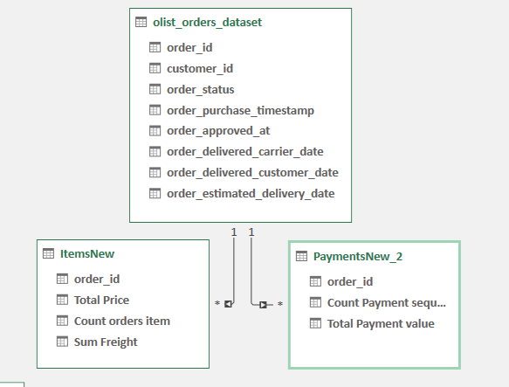
Data Modeling
Relationships:
Measures Created:
Total Revenue
Expected Revenue
Total Payments Received
Revenue Reconciliation %
Late Orders
Average Delay Days

Slide 5
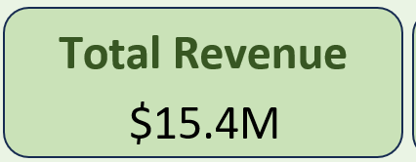

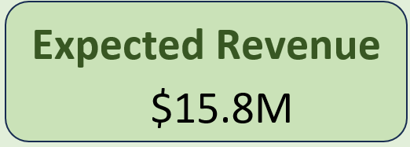

Dashboard KPIs
Financial Overview:
Key Insight:
Revenue collection is highly aligned with expected revenue, achieving over 97% reconciliation.

Slide 6
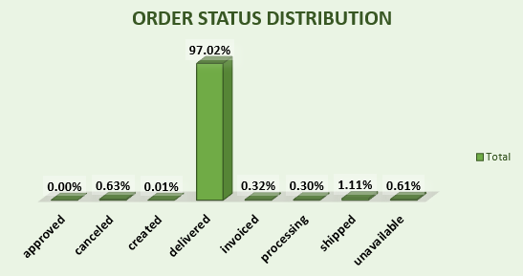
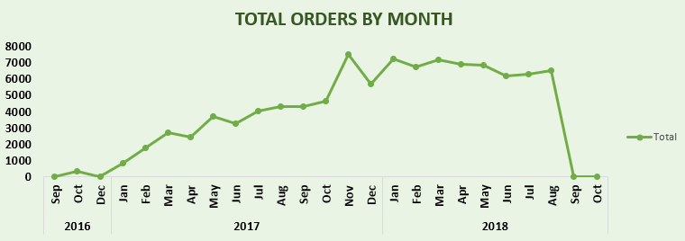
Order & Revenue Analysis
Findings:
Orders increased significantly during 2017–2018.
Delivered orders represent the majority of all orders.
Revenue showed consistent growth over time.
Average Order Value remained relatively stable.

Slide 7
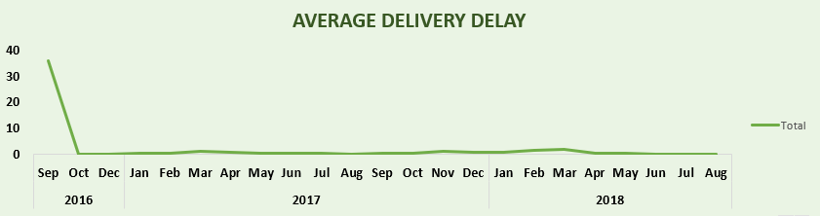
Delivery Insights
Findings:
Most orders were delivered on time.
Average delivery delay remained below one day.
Late deliveries represented a relatively small percentage of total orders.
Business Impact:
Efficient delivery performance contributes to customer satisfaction.

Slide 8
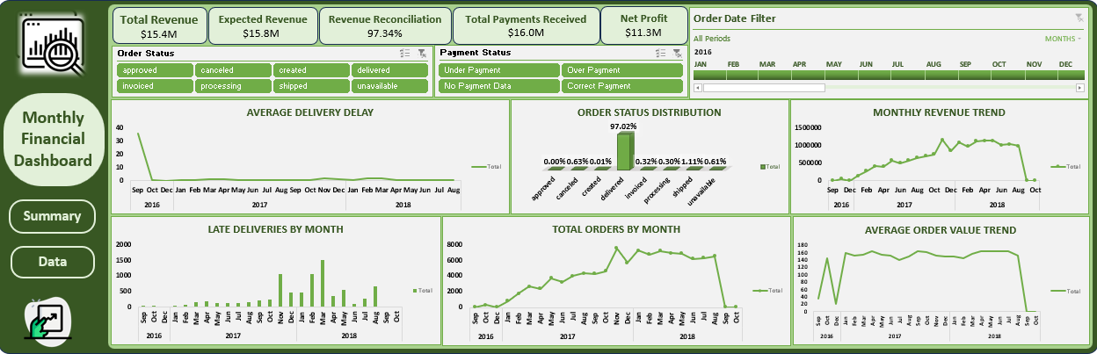
The Dashboard

Slide 9
Conclusion
Project Outcomes:
✅ Built an interactive financial dashboard
✅ Performed data cleaning and modeling
✅ Created KPIs and business insights
✅ Enabled filtering through slicers and timeline controls

Slide 10
Thank You

