Slide 1





BioServers Project
Supervised by
Dr.Heba Mohamed Zaki
TA.Noura Abdelhameed
Implemented by
20178030 | Fatma Hosny
20178031 | Kareem Hany
20178045 | Noura Samy
20178033 | Mazen Mostafa
Notes:
20176035
Mostafa Khattab
20178031
Kareem Hany
20176034
Nouran Ahmed

Slide 2
Project Idea :
The idea is to create a website have a biological background and can make several biological functions on an input DNA sequence.
By using these functions we can get some new data from our original DNA sequence eg:-
1-Protein sequence.
2-RNA.
3-The complement of the DNA.
4-The complement of reversed DNA.
5-The Percentage of GC.

Slide 3
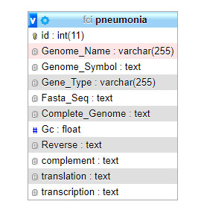
Our Database Schema :

Slide 4
Implemented biological function :
DNA Complement function: This function takes the DNA strand as an input from the user or from the Database and return the complement of each nucleotide in it as follows :
A --> T
T --> A
G --> C
C --> G
DNA Reverse Complement function : This function takes the DNA strand as an input from the user or from the Database and return the complement of each nucleotides in reversed way
(From right to left) as follows :
if we have original DNA sequence = ACGTAGGTCAAC.
So, this function will return the complement of the reverse of this DNA sequence = GTTGACCTACGT.

Slide 5
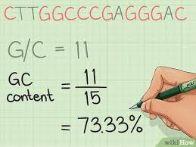
Implemented biological function :
GC Content function: This function takes the DNA strand as an input from the user or from the Database and returns the GC Percentage using the following equation
Count(G + C)/Count(A + T + G + C) * 100%
Eg:-

Slide 6
Implemented biological function :
DNA Transcription :This function takes the DNA strand as an input from the user or from the Database and covert it into mRNA by replacing All T nucleotides to U :
If Our DNA Sequence : ATAACAATGAACAGT
So, Our complementary mRNA will be : AUAACAAUGAACAGU
Protein translation: This function takes the DNA strand as an input from the user or from the Database and return it’s Protein complement as follows :
If Our DNA Sequence : ATAACAATGAACAGT
So, Our complementary protien sequence will be : I T M N S

Slide 7
Thank you!!
Any Questions
?

