Slide 1

Course Project
Milestone 3
Team members:
Habiba Hesham 43-0280 habiba.hesham@student.guc.edu.eg
Seleem Moftah 43-3339 seleem.saleh@student.guc.edu.eg
Nadeem Hesham 43- 3854 nadeem.ghaly@student.guc.edu.eg

Slide 2
Flow Chart
Input
Dataset Preprocessing
80%
Training ( CNN )
Testing
Output
20%

Slide 3
Dataset
Animals
Blood
Dancing
Talking
Football
Guitar
Gun
Piano
Swimming
Smoking
Each class contains 400 image, with total of 4000 image in the dataset.
The dataset is then labelled and categorized using an index vector. Example: an image in the ‘Animals’ class will have a vector of [1,0,0,0,0,0,0,0,0,0] while an image from the piano class will have a vector of [0,0,0,0,0,0,0,1,0,0].
The dataset was normalized (by dividing the values of the pixels by 255 so they range between 0 and 1) as a kind of preprocessing.

Slide 4
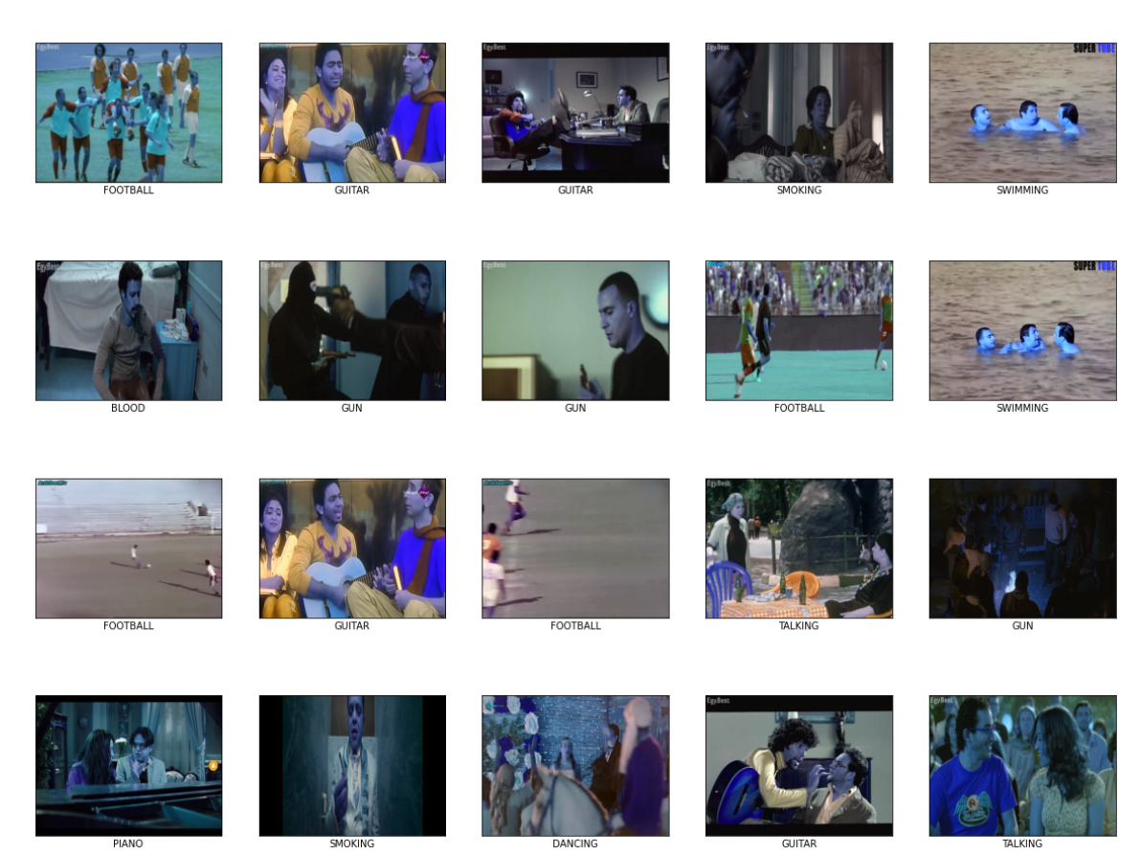
Dataset:

Slide 5
CNN Architecture
Filter Size: 3x3
Conv Kernel: 32
In: 480,640,3
Out: 478,638,32
Filter Size: 3x3
Conv Kernel:
In: 478,638,32
Out: 239,319,32
Filter Size: 3x3
Conv Kernel: 64
In: 239,319,32
Out: 235,315,64
Filter Size: 3x3
Conv Kernel:
In: 235,315,64
Out: 117,157,64
Filter Size: 3x3
Conv Kernel: 64
In: 117,157,64
Out: 111,151,64
Conv Layer
Max Pooling Layer
Conv Layer
Max Pooling Layer
Conv Layer
Output
Layer
FC Layer
(Softmax)
FC Layer
(Sigmoid)
Flatten
Neurons = 10
In: 64,1
Out: 10,1
Neurons = 64
In: 1072704,1
Out: 64,1
In: 111,151,64
Out: 1072704,1

Slide 6
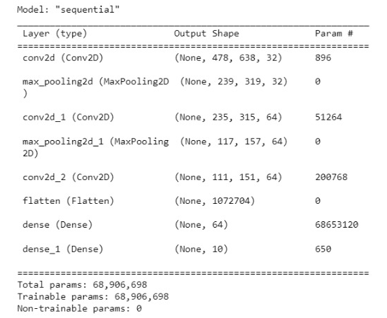
CNN Summary:

Slide 7
Code summary:
First, we initialized an array with size 4000 so this acts like our ground truth, for example the first 400 images belong to “ANIMAL” class. This class if the first class so we refer to it with index 0. So for the first 400 images the array contains 0 and so on for the 4000 images. This was achieved by using 2 nested loops
The next step is using the to_categorical method. This method takes each image and constructs an array of size 10 (number of classes) and has zeroes in every index of this array except the index of the class it belongs to. E.g.: image from class 4 (class “FOOTBALL”) should give array like [0,0,0,0,1,0,0,0,0,0].

Slide 8
Code summary:
The next step is dividing the data set to 80% training and 20% testing. This was done using the train_test_split method and adding test size = 0.2
Then we normalize the arrays we have so all the values range from 0 to 1.
Then we change all the array to be np array as some functions take np array as a parameter

Slide 9
Code summary:
For step 6, we add 3 sequential modes. All of them having activation function “relu”. For the first model we also state the size of the image and specify that it has 3 bands (RGB)
Then we add 2 layers which are the sigmoid and softmax layers to our model
Then we compile our model while using the optimizer called “adam” in order to check the accuracy of the code.

Slide 10

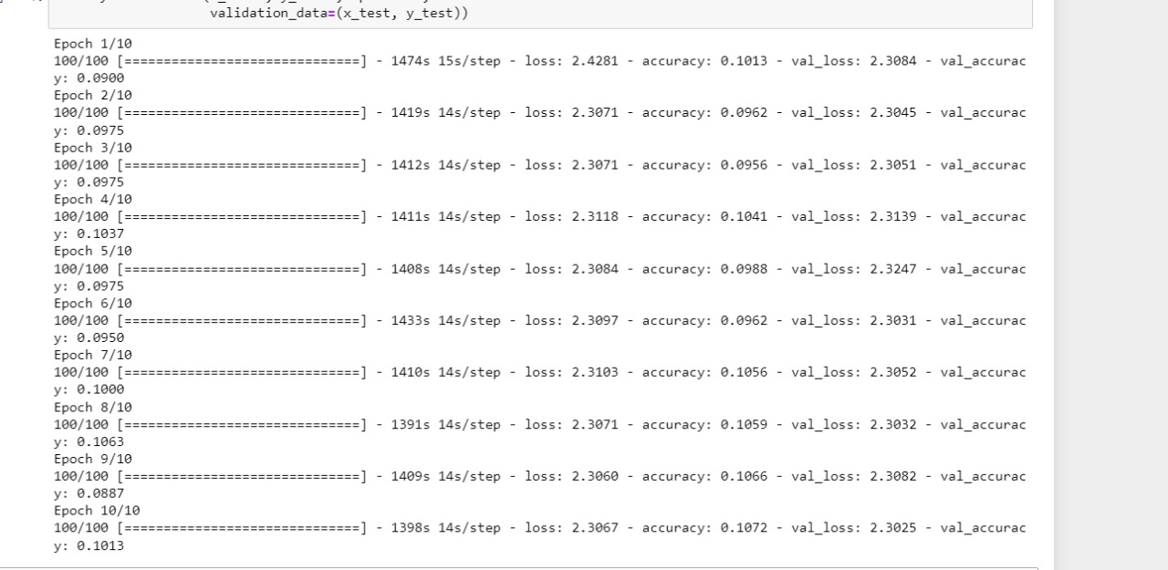
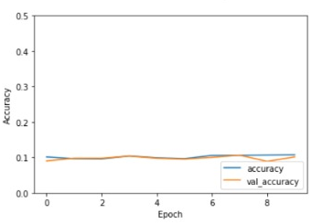
Accuracy:
Overall Accuracy
Extra Information
Run against Accuracy

Slide 11
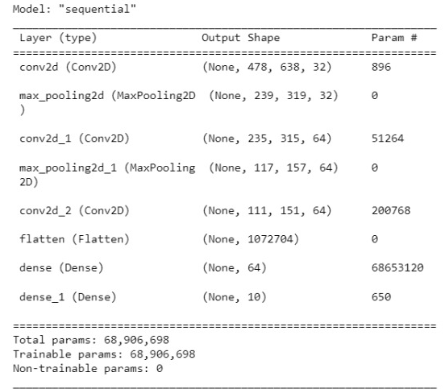
Model Summary

Slide 12
Comments:
For the accuracy obtained, we can notice that the results were not as good as expected and this was to due to several reasons including:
The dataset did not contain enough images
CNN requires very large amount of data in order to perform better
CNN is Expensive to train, takes a lot of time and computational power.
Requires classifiers to comprehend the output.
In order to obtain better results, we would suggest adding new layers and having a dataset consisting of at least 10,000 images.

Slide 13
Thank You.

