Slide 1
Predicting Individual Media Preferences and News Exposure: An Algorithmic Approach Using Demographic Data and Media Use Habits
Adiba, Dihan, Neeley, Nour

Slide 2


Motivation
Media plays a crucial role in shaping public opinion and political discourse (McCombs & Shaw, 1972)
Individuals have access to a wide range of media outlets, each with its own perspective and bias (Flaxman et al., 2016)
Essential for analyzing public opinion formation, issue salience, media bias, and voting behavior
Important to understand election behavior and policy perceptions
Who you vote for!
Policies

Slide 3
Applications in Political Science
“Receive-Accept-Sample” (RAS) model of public opinion formation (Zaller, 1992)
Media bias and polarization (Gentzkow & Shapiro, 2010; Prior, 2013)
Media agenda-setting and mass perceptions of issue salience (McCombs & Shaw, 1972)
Media influence and voting intentions

Slide 4

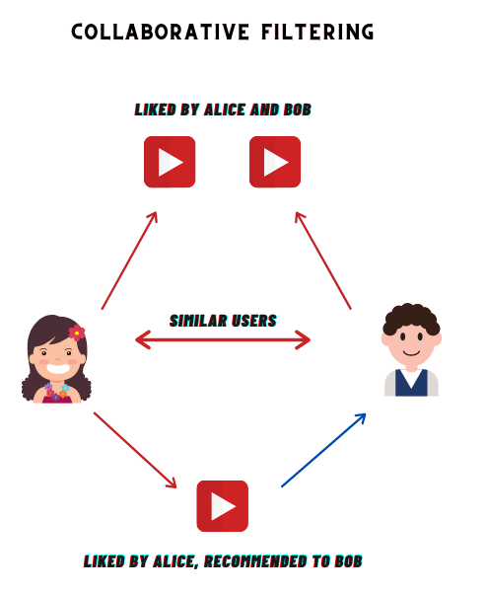
Prior Work on User Preference Prediction
Content filtering algorithms
Based on user’s past preferred documents
Collaborative filtering algorithms
Based on similar users’ preferred sources
Content filtering
Collaborative filtering
Karimi, M., Jannach, D., & Jugovac, M. (2018). News recommender systems–Survey and roads ahead. Information Processing & Management, 54(6), 1203-1227.,
https://www.analyticsvidhya.com/blog/2022/02/introduction-to-collaborative-filtering/
https://www.goguardian.com/glossary/what-is-content-filtering

Slide 5
Objectives
Previously: strong focus on what news individual people want
Our goal: What news sources individual people want
Methods: Try out different prediction algorithms to predict individual media preferences
Data: 2022 Cooperative Election Study (CES)
Input Features: Demographic data, Media use habits
Label of interest: News sources consumed

Slide 6
Research Questions
1a. What are different ways of predicting news source preferences based on user characteristics?
1b. How do these different ways perform in comparison to each other?
2. Which components of a user’s demographics and media use habits have the most impact in determining media preferences?

Slide 7
Research Questions
RQ1: What are different ways of predicting news source preferences based on user characteristics?
RQ2: How do these different ways perform in comparison to each other?

Slide 8

2022 Cooperative Election Study (CES)
Nationally representative survey of Americans
60,000 participants total
(22,179 with complete responses to outcome variables)
Data split into indicators for more features / binary indication
https://tischcollege.tufts.edu/research-faculty/research-centers/cooperative-election-study

Slide 9
Data cleaning
Demographic Information
Inputstate: location based on state
Birthyr: age
Gender4: gender
Educ: education attainment
Race: race
Industry: occupation category
Hispanic: hispanic
Employ: employment status
Faminc_new: annual family income
Media and Social Media Habits
CC22_300: media use past 24 hours
CC22_300a: news scale
CC22_300c: print scale
CC22_300d: recent social media use

Slide 10
Prediction Algorithms Tested
K Nearest Neighbor
Gradient Boosting
Logistic Regression
Cosine Similarity
XGBoost
Random Forests
Basic Neural Network
Transformer Model

Slide 11
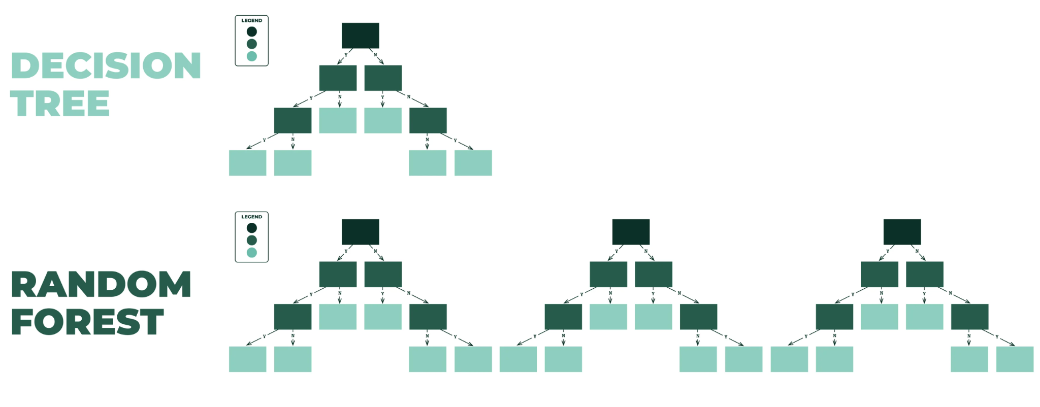
Preliminary Results
Random Forest tends to perform better in terms of accuracy
XGBoost comes close
Other models not so great
Fig: Concept of random forest
https://godatadrive.com/blog/random-forests

Slide 12
Results - Random Forest
 | 1.1 | 1.2 | 2.1 | 2.2 | 3.1 | 3.2 | 4.1 | 4.2 | 5.1 | 5.2 | 6.1 | 6.2 | 7.1 | 7.2
Accuracy | 0.83 | 0.79 | 0.85 | 0.82 | 0.84 | 0.80 | 0.86 | 0.82 | 0.84 | 0.80 | 0.90 | 0.86 | 0.94 | 0.92
Findings: Accuracy is pretty high
1. Media networks - ABC
2. Media networks - CBS
3. Media networks - NBC
4. Media networks - CNN
5. Media networks - Fox News
6. Media networks - MSNBC
7. Media networks - PBS
Predictions .1 : True
.2: False

Slide 13
Results - Random Forest
 | 1.1 | 1.2 | 2.1 | 2.2 | 3.1 | 3.2 | 4.1 | 4.2 | 5.1 | 5.2 | 6.1 | 6.2 | 7.1 | 7.2
Accuracy | 0.83 | 0.79 | 0.85 | 0.82 | 0.84 | 0.80 | 0.86 | 0.82 | 0.84 | 0.80 | 0.90 | 0.86 | 0.94 | 0.92
Findings: Accuracy is highest for predicting PBS
1. Media networks - ABC
2. Media networks - CBS
3. Media networks - NBC
4. Media networks - CNN
5. Media networks - Fox News
6. Media networks - MSNBC
7. Media networks - PBS
Predictions .1 : True
.2: False

Slide 14
Results - Random Forest
Macro Average: All classes equally contribute to the final averaged metric
 | 1.1 | 1.2 | 2.1 | 2.2 | 3.1 | 3.2 | 4.1 | 4.2 | 5.1 | 5.2 | 6.1 | 6.2 | 7.1 | 7.2
Accuracy | 0.83 | 0.79 | 0.85 | 0.82 | 0.84 | 0.80 | 0.86 | 0.82 | 0.84 | 0.80 | 0.90 | 0.86 | 0.94 | 0.92
Macro Average | 0.57 | 0.71 | 0.59 | 0.76 | 0.52 | 0.73 | 0.61 | 0.77 | 0.69 | 0.73 | 0.45 | 0.83 | 0.47 | 0.90
Findings: Macro Average performs relatively worse
1. Media networks - ABC
2. Media networks - CBS
3. Media networks - NBC
4. Media networks - CNN
5. Media networks - Fox News
6. Media networks - MSNBC
7. Media networks - PBS
Predictions .1 : True
.2: False

Slide 15
Results - Accuracy
 | 1.1 | 1.2 | 2.1 | 2.2 | 3.1 | 3.2 | 4.1 | 4.2 | 5.1 | 5.2 | 6.1 | 6.2 | 7.1 | 7.2
Random Forest | 0.83 | 0.79 | 0.85 | 0.82 | 0.84 | 0.80 | 0.86 | 0.82 | 0.84 | 0.80 | 0.90 | 0.86 | 0.94 | 0.92
XG Boost | 0.82 | 0.82 | 0.83 | 0.82 | 0.81 | 0.81 | 0.82 | 0.81 | 0.81 | 0.81 | 0.88 | 0.86 | 0.93 | 0.91
1. Media networks - ABC
2. Media networks - CBS
3. Media networks - NBC
4. Media networks - CNN
5. Media networks - Fox News
6. Media networks - MSNBC
7. Media networks - PBS
Predictions .1 : True
.2: False

Slide 16
Inspecting the Data
Dataset was uneven in amount of “consumed” vs. “not consumed”
Table of % “consumed” in data for each news source
Overpredicting on “not consumed” response → better user trust than the latter
ABC | CBS | NBC | CNN | Fox News | MSNBC | PBS
0.379 | 0.356 | 0.365 | 0.343 | 0.389 | 0.27 | 0.15

Slide 17
Future Work
Retrieve media content based on preference predictions
Summarize media content the individual is exposed to
Can help reduce belief in political misinformation

Slide 18
Future Work
Refine and validate the predictive algorithms
Incorporate additional datasets from diverse sources to enhance its generalizability
Integrate behavioral data, such as social media interactions and temporal consumption patterns
Employ multimodal data and contextual sentiment analysis to improve the accuracy of our insights
Field experiments and interdisciplinary collaborations
Keep ethical considerations, such as privacy, data security, and bias mitigation, in a priority throughout the research process

Slide 19
Thank you!
Nour Assili nassili@u.rochester.edu
Neeley Pate npate@ur.rochester.edu
Adiba Proma aproma@cs.rochester.edu
Dihan Shi dihan@wustl.edu dihan.org

