Slide 1


Angular
ALOUI Ali

Slide 2

What is Angular
Java Script Library ,Client side Framework
Single Page Application
Create By Google
V For MVC
Dynamic Web apps

Slide 3
What is Angular
Component
HTML

Slide 4
Component
APP Component
Component
Component
Component
Component

Slide 5
Passing Data
Value= {{UserName}} / {{GetUserName}}
[Value]= ”UserName”
HTML Template
Component
([NgModel])= ”UserName”

Slide 6
Forms
Template
Reactive
Model Binding

Slide 7
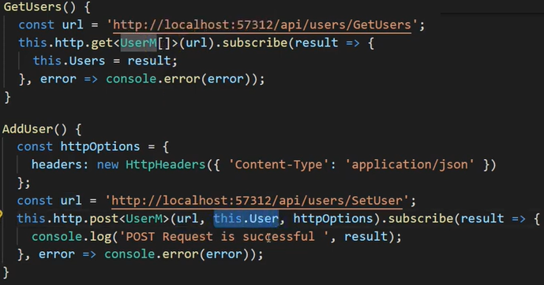
Web API

Slide 8
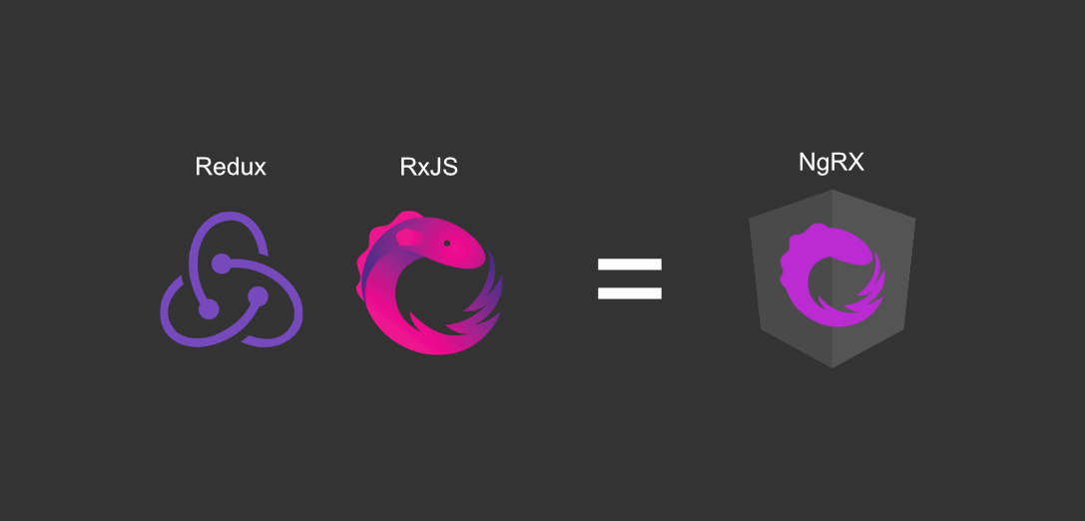
NGRX

Slide 9

Routing
</>
</>

Slide 10
Thank you for your
attention

