Slide 1


React JS
ALOUI Ali

Slide 2


What is React JS
Java Script Library For Building user interface
Single Page Application
Create By FaceBook
V For MVC
Dynamic Web apps

Slide 3



What is React JS
FaceBook
Whats-app
Instgram

Slide 4
Concept of React JS
Component
JSX
Virtual DOM

Slide 5
Component

Slide 6
JSX
JSX :
Java Script XML
Notes:
CDN
Babel

Slide 7
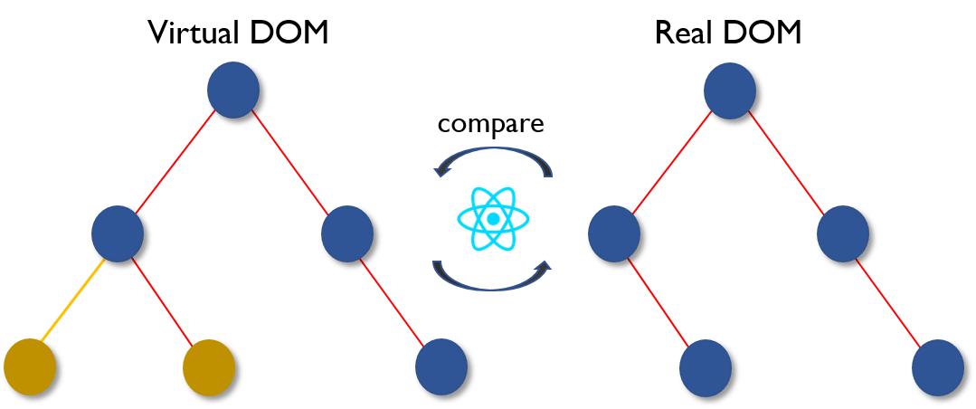
Virtual DOM

Slide 8
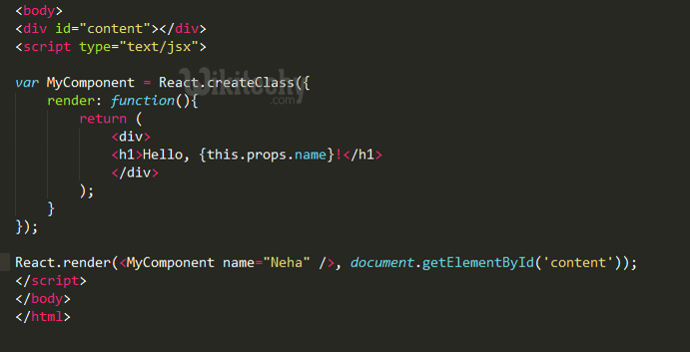
Passing Data
Props:
Notes:
تشبه الى حد ما attribut في html
ترسل من الاب الى الأبناء

Slide 9
Passing Data
Stats:
Java script Object
Notes:
خاصة ب كمبوننت معين
قابلة للتغيير

Slide 10
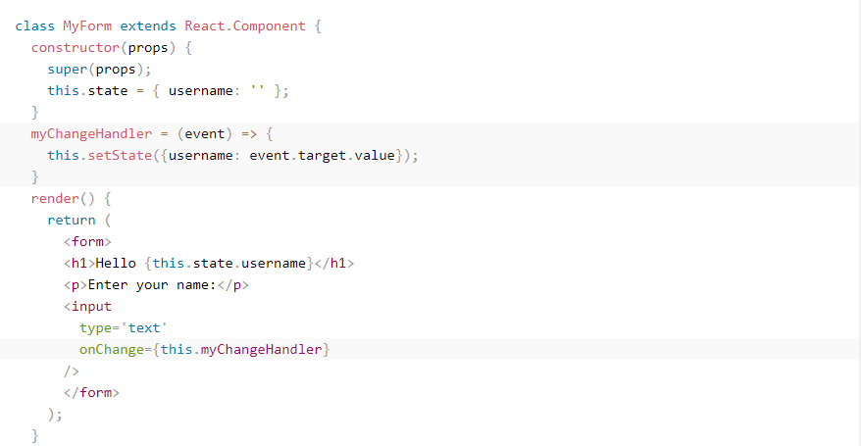
Forms

Slide 11
Web API

Slide 12
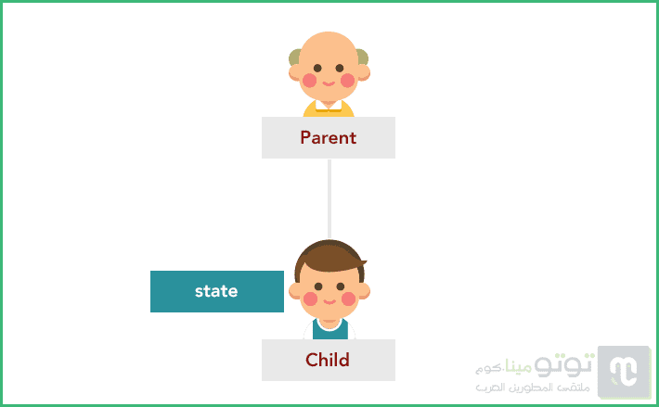
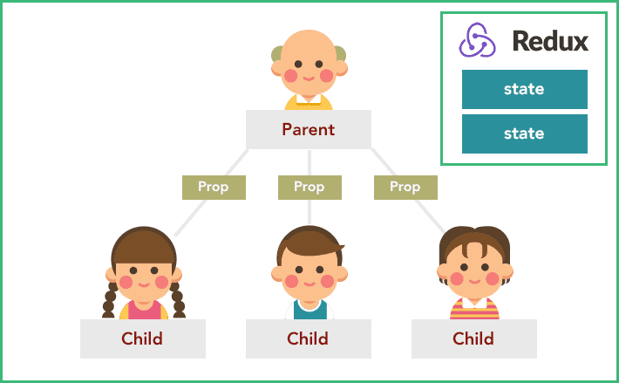

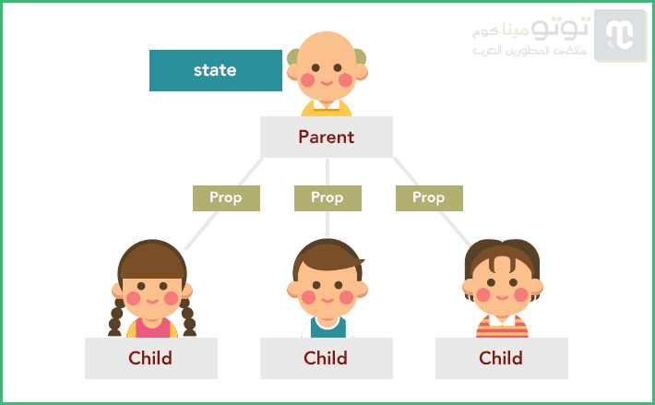
Redux

Slide 13

Routing
</>
</>

Slide 14
Thank you for your
attention

