Slide 1

Vue JS
ALOUI Ali

Slide 2
What is Vue JS
Java Script Library ,Client side Framework
Single Page Application
It was created by Evan You
LightWeight
V For MVVM
Dynamic Web apps

Slide 3
What is Vue JS
Component
HTML
Vertual DOM
Directive

Slide 4
Component

Slide 5
Passing Data

Slide 6
Passing Data
Props:
Notes:
تشبه الى حد ما attribut في html
ترسل من الاب الى الأبناء

Slide 7
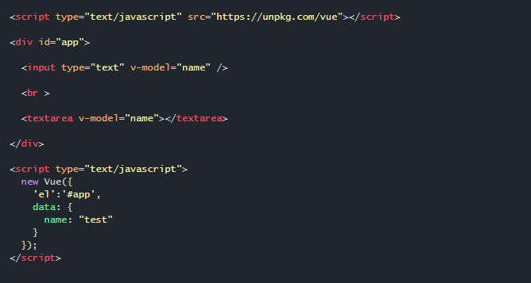
Forms

Slide 8
Web API

Slide 9
NGRX

Slide 10

Routing
</>
</>

Slide 11
Thank you for your
attention

