Slide 1



FerroFlux — Intelligent Steel Supply Chain Analytics Platform
CAPSTONE PROJECT PRESENTATION
Track / Job Profile:
AI — Big Data Engineering
Team:
Maram Mostafa, Nourhan Saber (Team Leader), Hager Elkahlawy, Haidy Nageh, Zeinab Elgabalawy
Supervisor:
Dr. Rania ElGohary (Supervisor) / Dr. Mohamed El Badawi (Track Head)
Submission:
June 2026

Slide 2
Agenda
01
The Problem
05
Impact & Market Opportunity
02
Our Solution — FerroFlux
06
Team
03
Live Demo & Results
07
Roadmap & Next Steps
04
How It Works (Architecture & Tech)
DiGiLiANS — Digital Pioneers Initiative | Capstone Project Defense 2026
2

Slide 3





Team Introduction
👤
👤
👤
👤
👤
Maram Mostafa
Nourhan Saber Shalaby
Hager Elkahlawy
Haidy Nageh
Zeinab Elgabalawy
Data Engineer —Dashboard
Data Engineer / BE, Forecasting
Data Engineer —Orchestration
Data Engineer — ETL
Data Engineer — Streaming
Golden Layer, Visualization
Backend, Forecasting Models, automation, data generation
Airflow DAGs
( Orchestration)
Data Preprocessing, Visualization
Bronze-layer ingestion
Supervisor / Track Head: Dr. Rania ElGohary / Dr. Mohamed El Badawi
DiGiLiANS — Digital Pioneers Initiative | Capstone Project Defense 2026
3

Slide 4
Problem Statement
Egyptian steel manufacturers rely on manual spreadsheets, disconnected ERP modules, and informal channels to manage pricing, production, demand, and supplier data.
Factory operators, procurement managers, and company executives at mid-size producers operating multiple factory plants.
No price forecasting, fragmented multi-factory data, reactive supplier management, retrospective KPI reporting, and no automated alerting.
Steel prices, production efficiency, and supplier reliability directly drive procurement cost and production downtime — delays of even one day cost millions of EGP.
Continued delayed decisions, missed cost-saving opportunities, and an inability to detect or respond to anomalies before they escalate into financial losses.
💡 FerroFlux directly targets these six interconnected gaps with real-time data, ML forecasting, and automated alerting.
DiGiLiANS — Digital Pioneers Initiative | Capstone Project Defense 2026
4

Slide 5
Objectives & Project Scope
SMART Objectives
What’s In Scope
O1 — Real-Time Ingestion: Kafka pipeline ingesting market & telemetry events with <5s end-to-end latency to the Gold layer.
O2 — Scalable Medallion ETL: Spark + Airflow Bronze → Silver → Gold pipeline with schema validation and idempotent re-runs.
O3 — Price Forecasting: R² above 0.90 and MAPE below 5% on a 60-day holdout (achieved R²=0.9578, MAPE=1.61%).
O4–O8 — Demand forecasting (R² above 0.75), supplier risk classification (Accuracy above 90%), n8n automated alerting, multi-tenant portal, and interactive dashboard.
FerroFlux delivers a complete multi-tenant analytics platform:
Kafka streaming ingestion + Spark medallion ETL (Bronze/Silver/Gold) orchestrated by Airflow
FastAPI multi-tenant portal: registration, JWT auth, factory management, Excel upload
Three Spark MLlib / XGBoost models: price forecasting, demand forecasting, supplier risk scoring
n8n automated email alerting for KPI threshold breaches
Streamlit dashboard (6 pages) for factory managers, admins, and executives
💡 Out of scope: live paid commodity-price APIs, native mobile apps, and direct ERP integration — identified as future work.
DiGiLiANS — Digital Pioneers Initiative | Capstone Project Defense 2026
5

Slide 6
Proposed Solution
FerroFlux is a multi-tenant, end-to-end big data analytics platform unifying real-time streaming, batch ETL, ML, and automated alerting for Egyptian steel manufacturers.
A complete platform: Kafka streaming pipeline + Spark/Airflow medallion ETL + 3 ML models + FastAPI portal + Streamlit dashboard + n8n alerting.
Real-time market & telemetry ingestion, Bronze→Silver→Gold transformation, price/demand/risk predictions, self-service tenant onboarding, and instant email alerts.
Unlike spreadsheets, disconnected ERPs, or generic BI tools, FerroFlux combines streaming, domain-specific ML, multi-tenant isolation, and automated alerting in one open-source platform.
Enterprise-grade analytics (R²=0.9578 price forecasting, 100% precision supplier risk flagging) built entirely on open-source tools at near-zero deployment cost.
A deployed multi-tenant portal, an interactive 6-page dashboard, 3 trained ML models, and an automated alert pipeline — reducing decision latency from days to minutes.
💡 Technical architecture details (Kafka, Spark, Airflow, PostgreSQL) are presented in the next slide.
DiGiLiANS — Digital Pioneers Initiative | Capstone Project Defense 2026
6

Slide 7
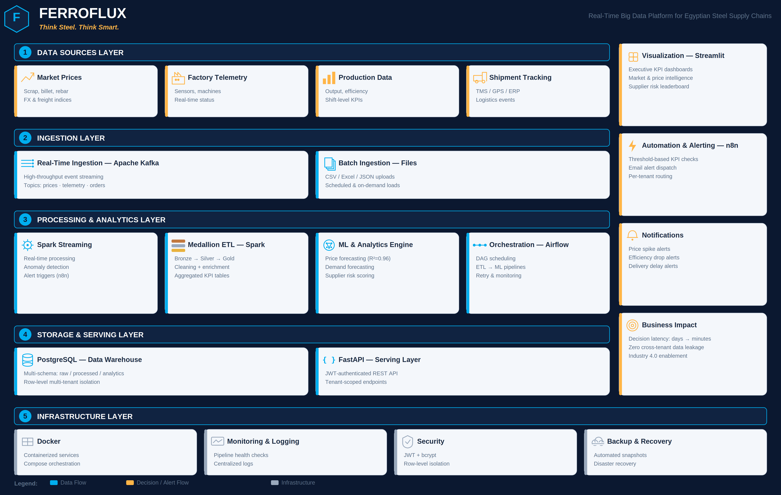
System Architecture
FerroFlux follows a 5-layer architecture: Data Sources → Ingestion (Kafka) → Processing & Analytics (Spark + Airflow + ML) → Storage & Serving (PostgreSQL + FastAPI) → Visualization & Alerting (Streamlit + n8n).
DiGiLiANS — Digital Pioneers Initiative | Capstone Project Defense 2026
7

Slide 8
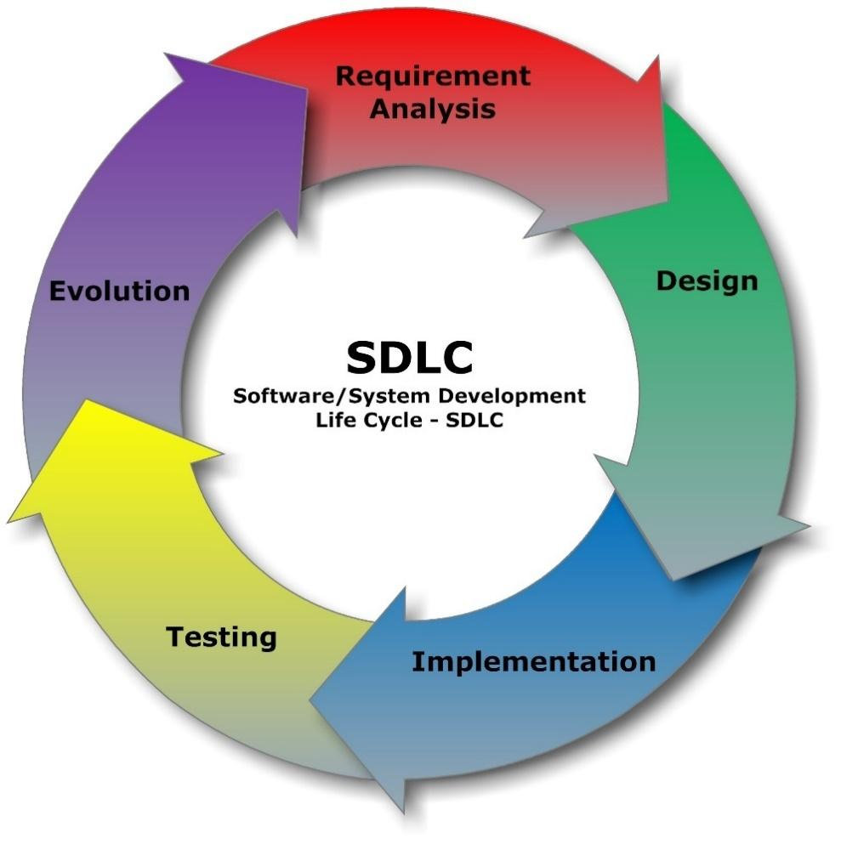
SYSTEM ANALYSIS And Design
"FerroFlux applied the full SDLC — from planning and analysis through design, implementation, testing, and zero-cost deployment on Hugging Face Spaces, Streamlit Cloud, and GitHub Pages."
DiGiLiANS — Digital Pioneers Initiative | Capstone Project Defense 2026
7

Slide 9
Technology Stack
Frontend
Backend
Database
Streamlit, Plotly
FastAPI, Uvicorn, SQLAlchemy
PostgreSQL (Neon Cloud, serverless)
AI / ML
Cloud & DevOps
Security
Apache Spark MLlib, XGBoost, Prophet
Docker, Hugging Face Spaces, Streamlit Cloud, GitHub Pages
JWT (HMAC-SHA256), bcrypt password hashing
DiGiLiANS — Digital Pioneers Initiative | Capstone Project Defense 2026
8

Slide 10
System Requirements
Functional Requirements
Non-Functional Requirements
FR1: Ingest real-time market prices and factory telemetry via Apache Kafka.
FR2: Transform raw data through Bronze → Silver → Gold (Spark + Airflow).
FR3: Allow companies to self-register and manage isolated factory workspaces.
FR4: Provide ML-based price, demand, and supplier risk predictions.
FR5: Dispatch automated email alerts on KPI threshold breaches (n8n).
Performance: dashboard loads <3s for 100K rows; API responses <500ms; ML inference <1s.
Security: bcrypt password hashing, HMAC-SHA256 JWT, row-level company_id isolation.
Scalability: horizontal Spark workers; n8n handles 50+ concurrent threshold checks.
Availability: deployed on free-tier managed cloud (Hugging Face Spaces, Neon, Streamlit Cloud).
Usability: registration completable in <3 minutes; responsive UI for screens ≥768px.
💡 All FR1–FR5 and NFRs above were implemented, tested, and validated end-to-end.
DiGiLiANS — Digital Pioneers Initiative | Capstone Project Defense 2026
9

Slide 11
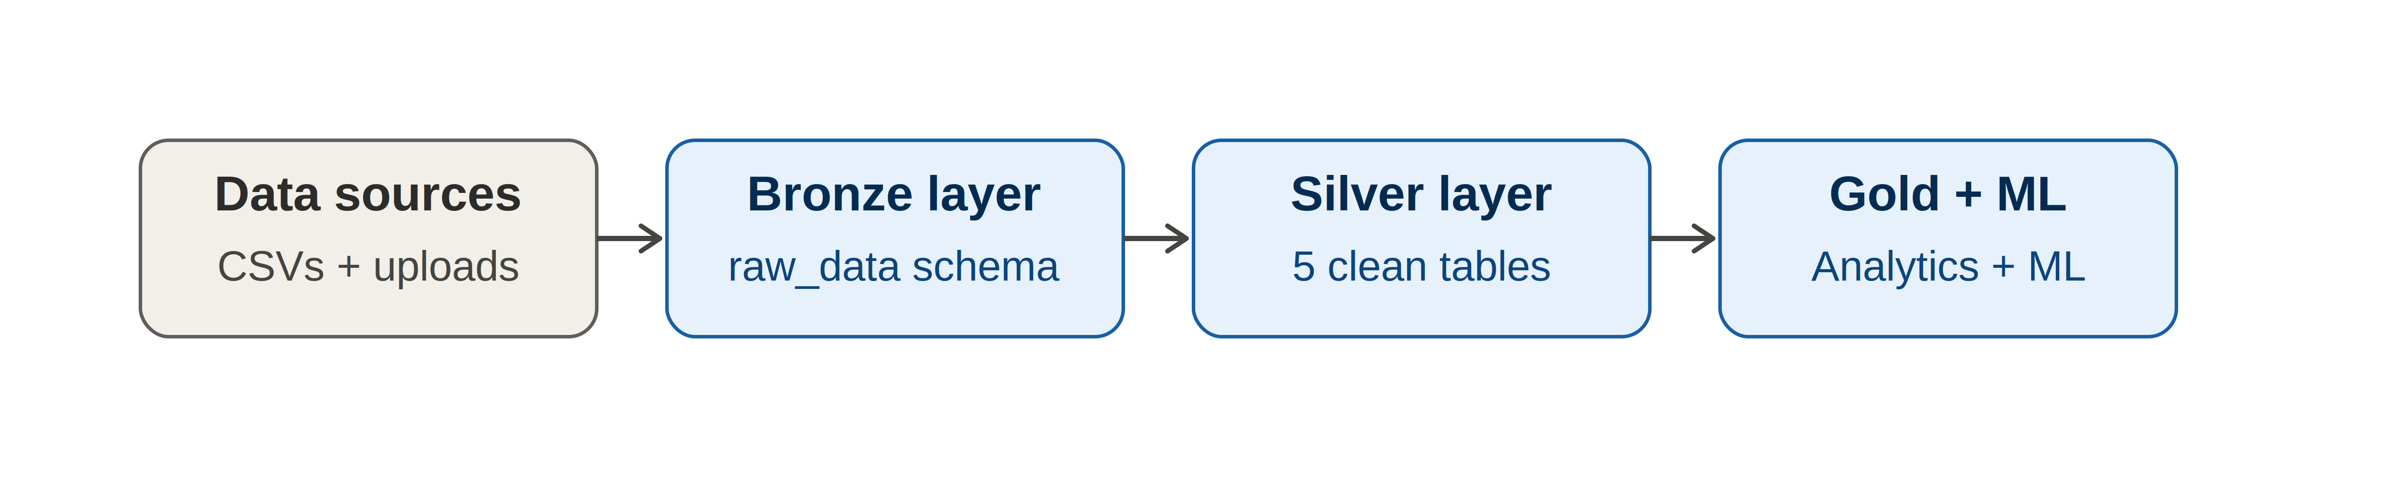
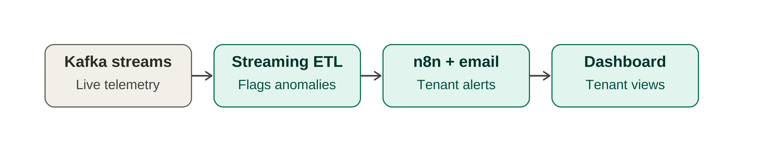
Workflow / Data Pipeline Diagram
Top: Batch ETL pipeline (data sources → Bronze → Silver → Gold + ML). Bottom: Streaming pipeline (Kafka → streaming ETL → n8n alerts → dashboard).
DiGiLiANS — Digital Pioneers Initiative | Capstone Project Defense 2026
10

Slide 12
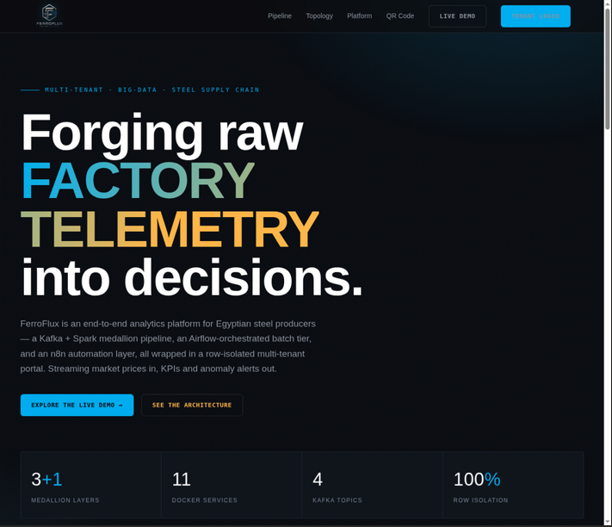
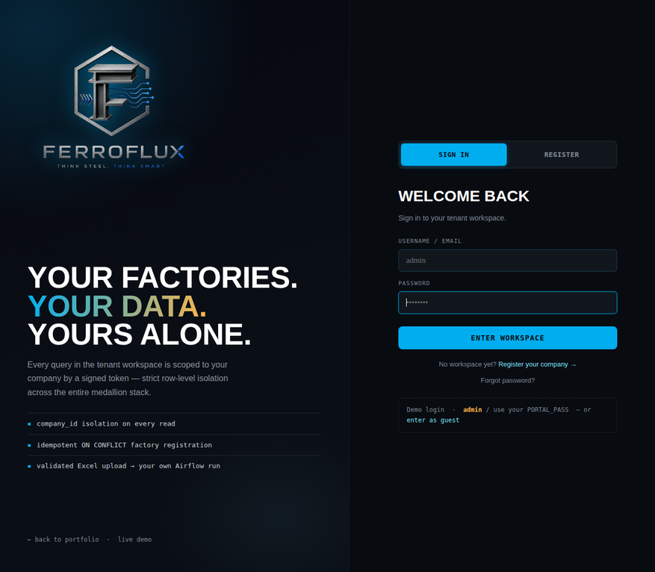

Implementation & Demo
FerroFlux Portal
[Portal screenshot — registration, login, factory overview, Excel upload]
Streamlit Dashboard
[Streamlit dashboard — Executive Summary, Market Intelligence, Supplier Risk]
Key highlights from the demo:
Live Demo Links:
Landing page: Kafka + Spark medallion pipeline, Airflow orchestration, n8n alerting (3+1 layers, 11 services, 4 Kafka topics)
Login: 100% row-level tenant isolation via signed company_id tokens
Onboarding: Excel upload auto-triggers Airflow ETL run
[QR Code
Here]
Portal: [Hugging Face Spaces link] | Dashboard: [Streamlit Cloud link]
DiGiLiANS — Digital Pioneers Initiative | Capstone Project Defense 2026
11

Slide 13
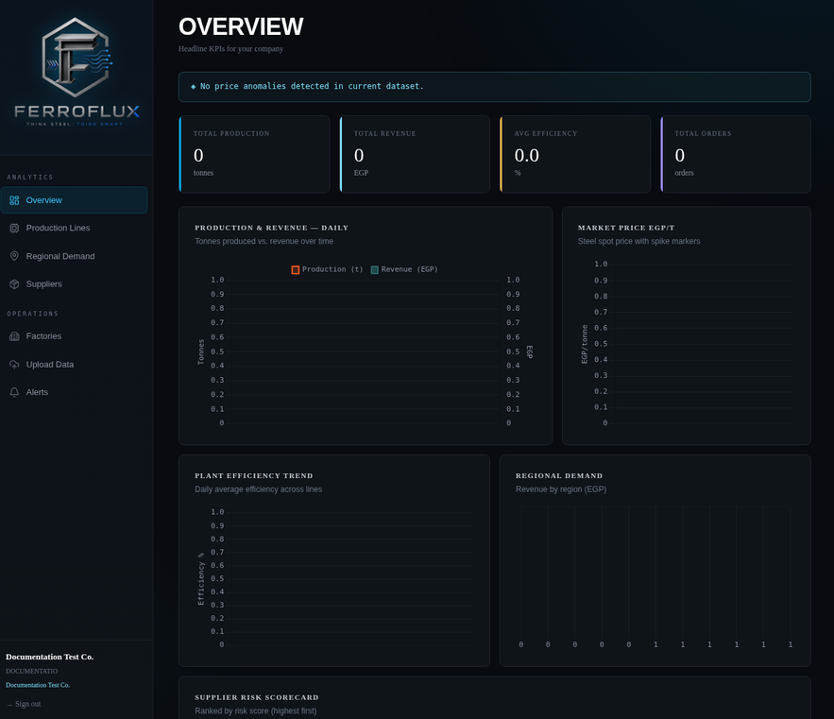
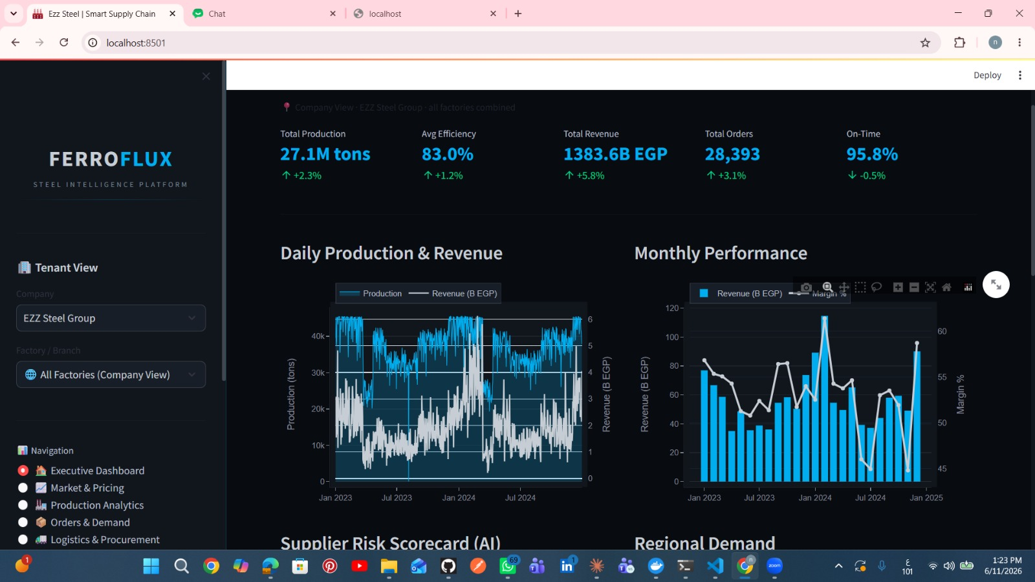
Implementation & Demo
FerroFlux Portal
[Portal screenshot — registration, login, factory overview, Excel upload]
Streamlit Dashboard
[Streamlit dashboard — Executive Summary, Market Intelligence, Supplier Risk]
Key highlights from the demo:
Tenant dashboard: live KPI overview per company (production, revenue, efficiency, orders)
Streamlit dashboard: 27.1M tons, 1383.6B EGP revenue, 95.8% on-time, with production & regional demand charts
AI Supplier Risk Scorecard ranks suppliers by risk
DiGiLiANS — Digital Pioneers Initiative | Capstone Project Defense 2026
11

Slide 14
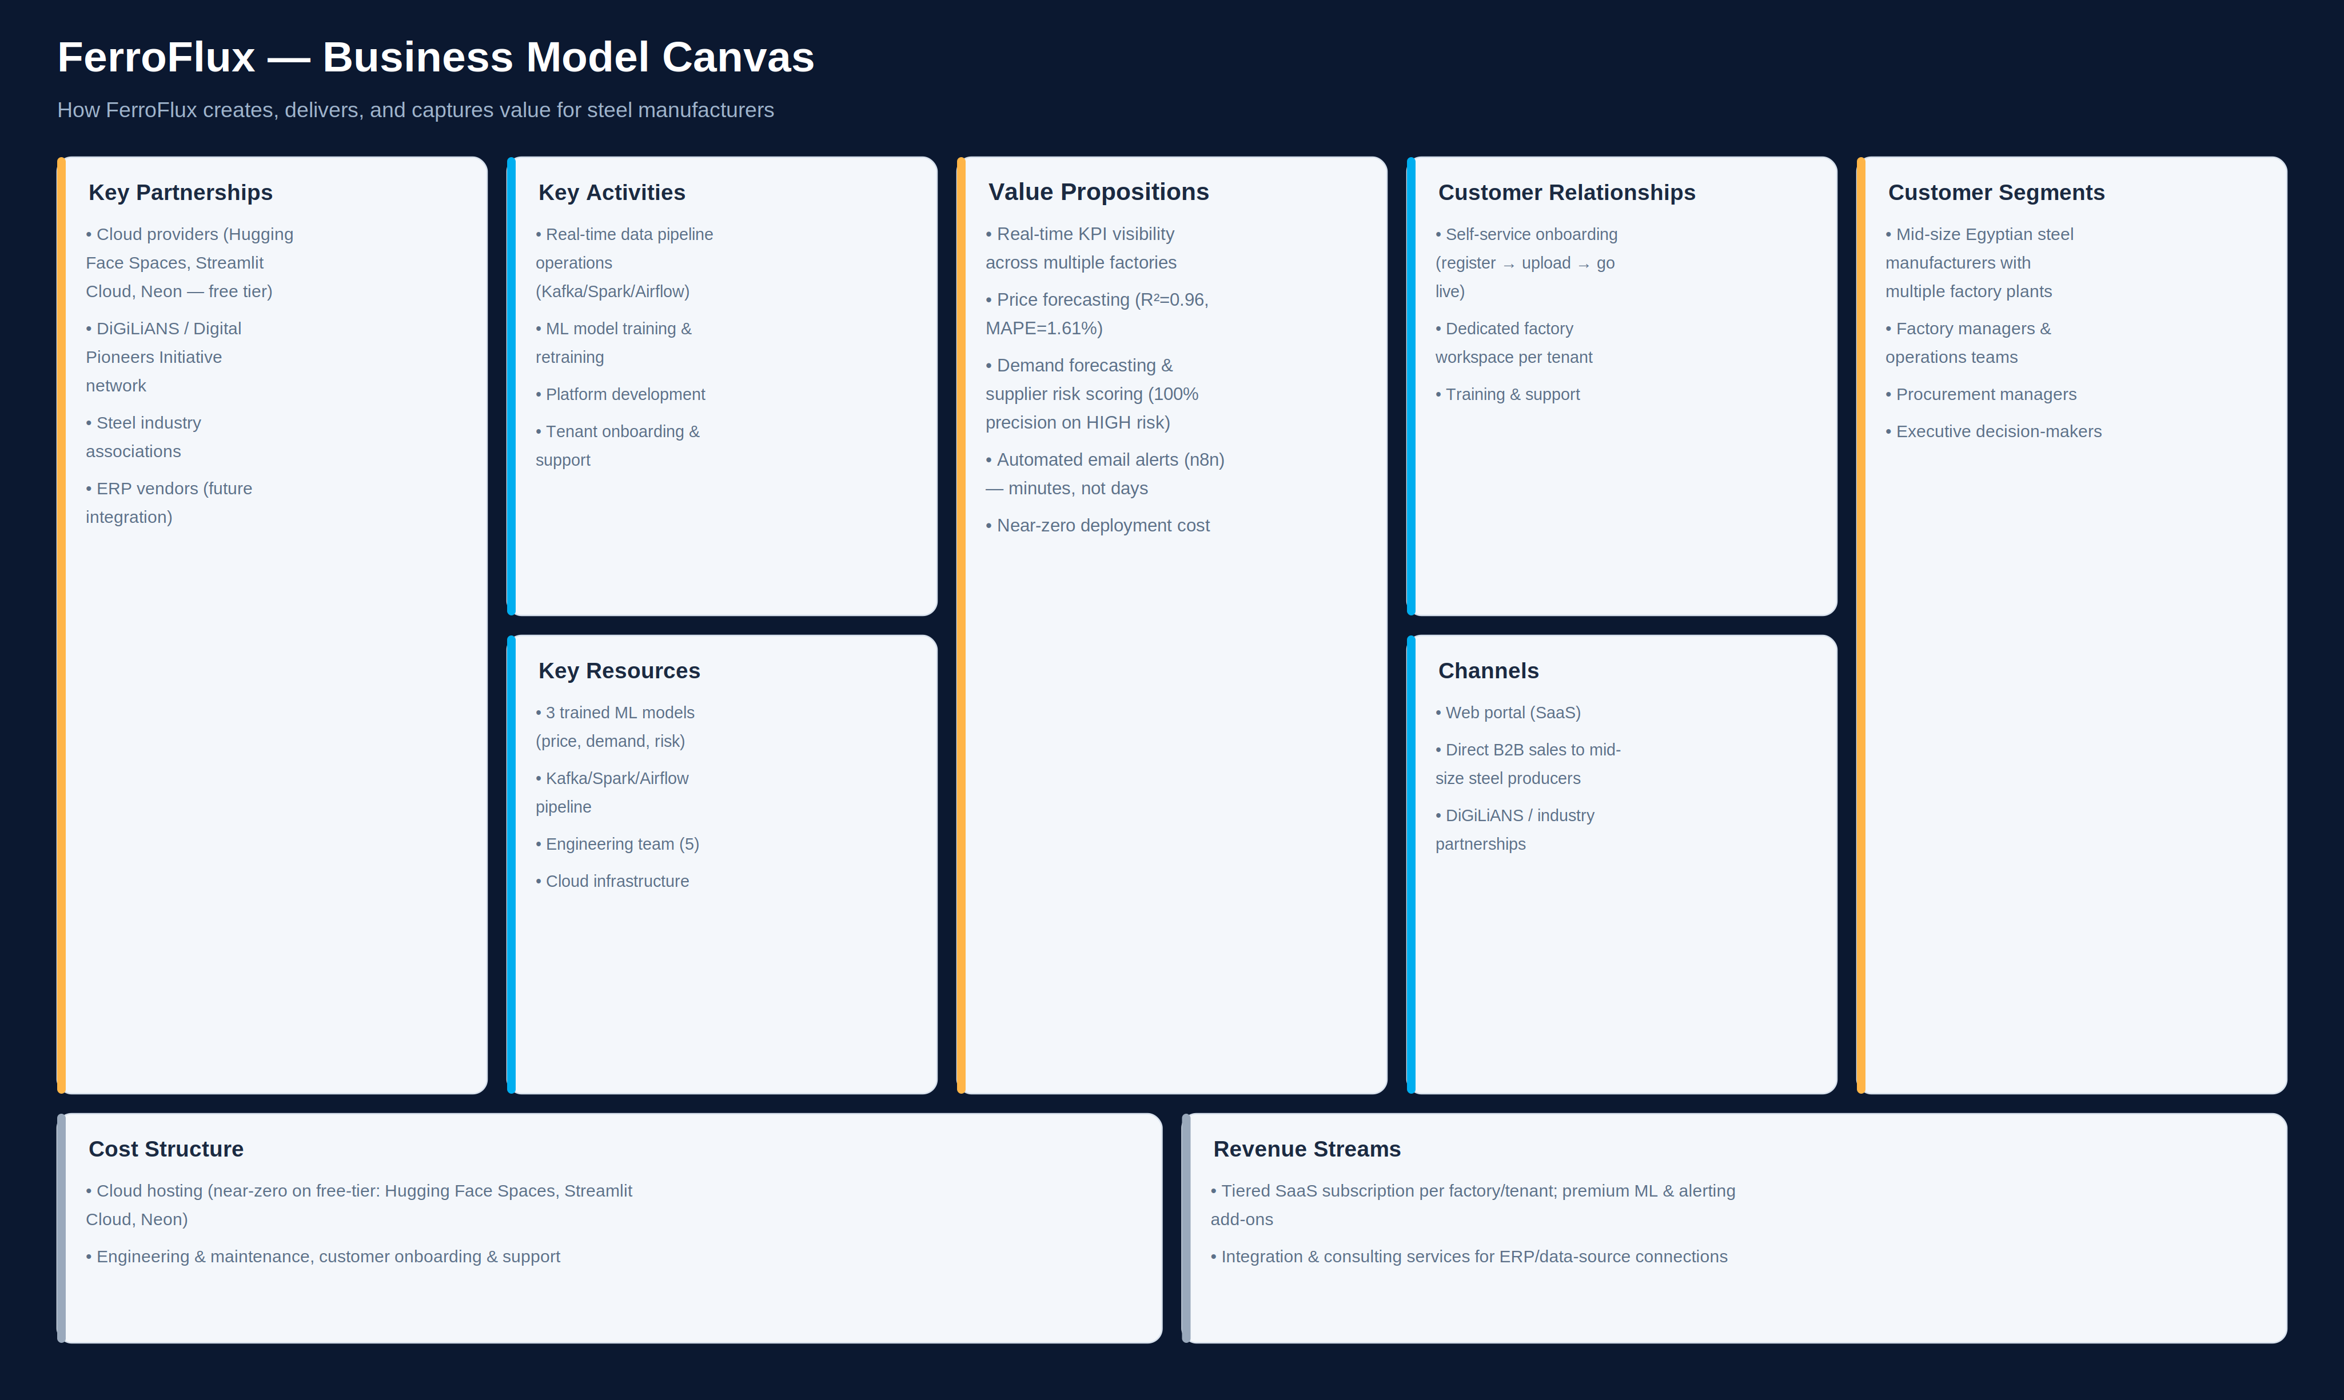
Business Model
FerroFlux is designed as a multi-tenant SaaS: factories subscribe for real-time KPIs, ML forecasts, and automated alerts — deployed at near-zero infrastructure cost.
DiGiLiANS — Digital Pioneers Initiative | Capstone Project Defense 2026
14

Slide 15
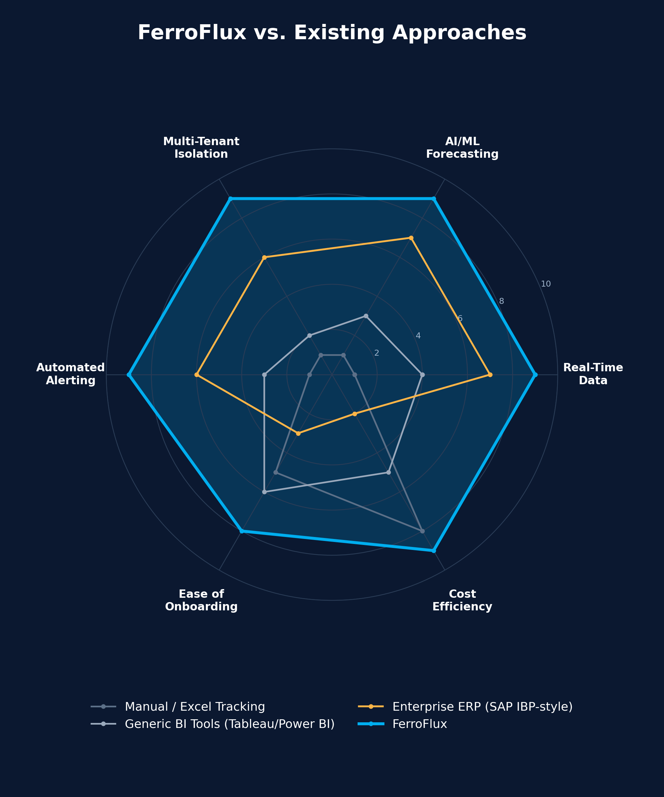
Competitive Landscape
FerroFlux outperforms manual tracking, generic BI tools, and enterprise ERPs on real-time data, AI forecasting, multi-tenant isolation, automated alerting, onboarding, and cost — at a fraction of the cost.
DiGiLiANS — Digital Pioneers Initiative | Capstone Project Defense 2026
15

Slide 16
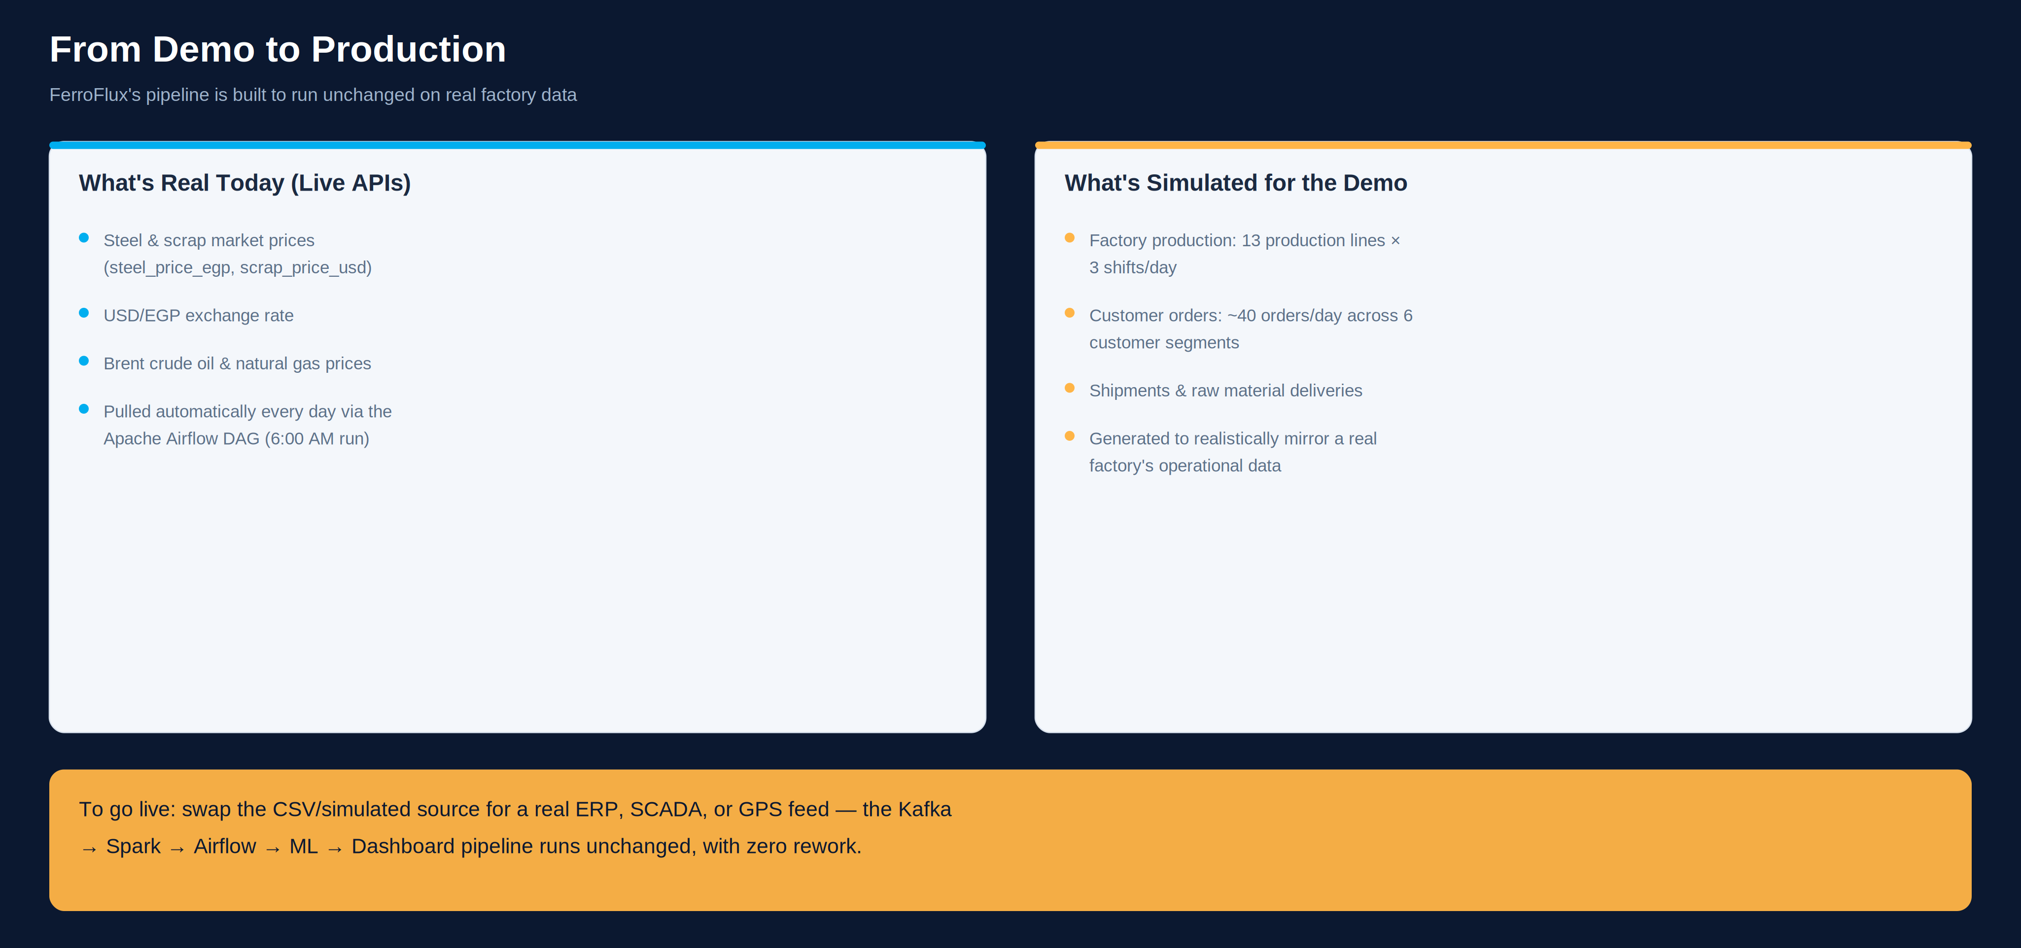
From Demo to Production
FerroFlux's pipeline is built so a real factory only needs to swap its data source from CSV/simulated to ERP, SCADA, or GPS — the rest of the pipeline runs unchanged.
DiGiLiANS — Digital Pioneers Initiative | Capstone Project Defense 2026
16

Slide 17
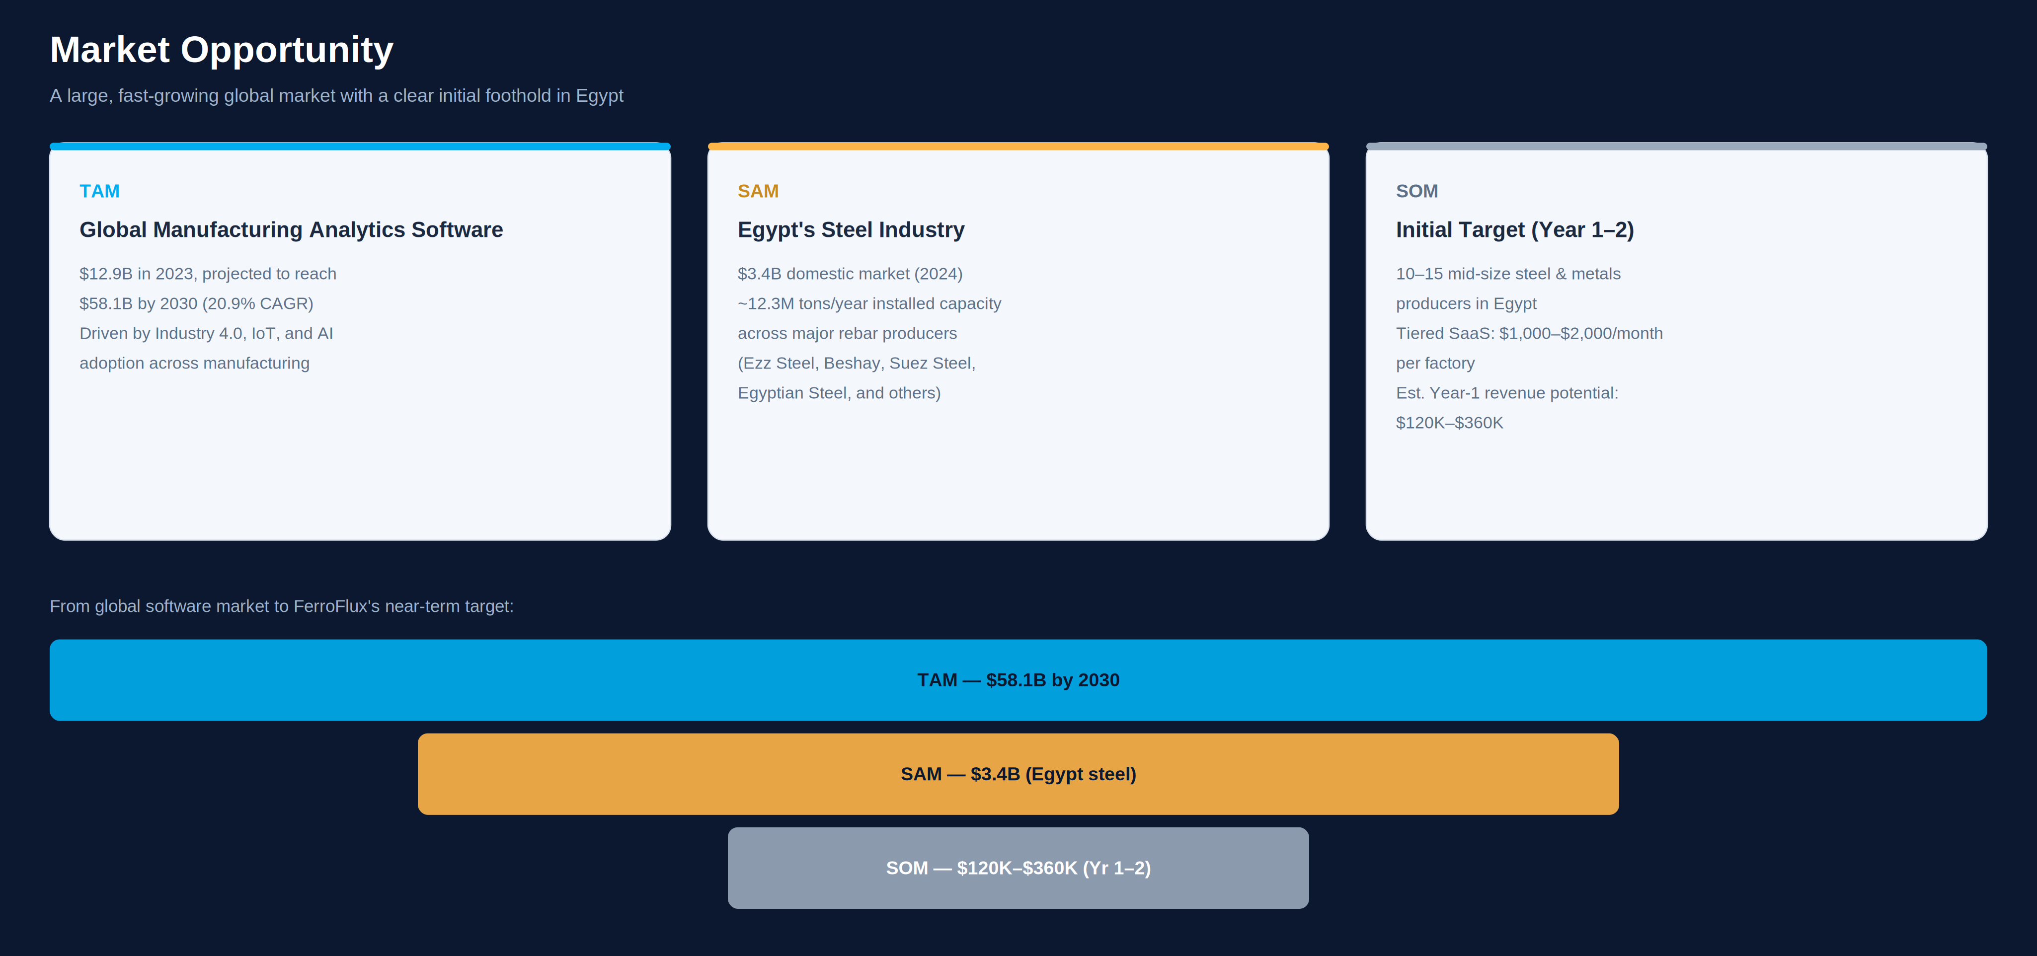
Market Opportunity
A $58.1B global market by 2030, with an immediate, addressable foothold among Egypt's mid-size steel producers.
DiGiLiANS — Digital Pioneers Initiative | Capstone Project Defense 2026
17

Slide 18
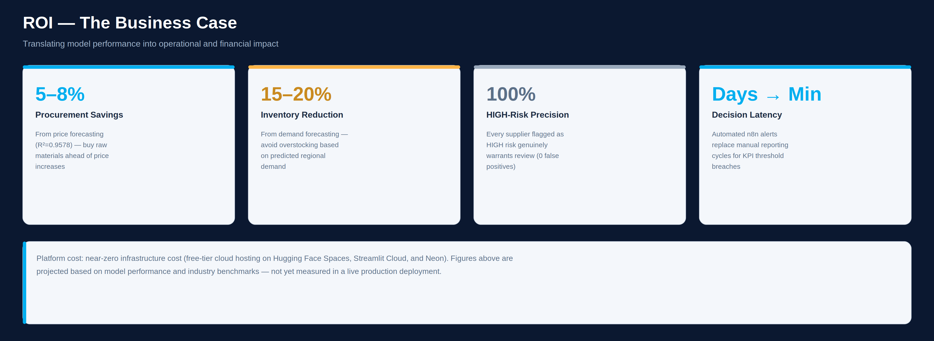
ROI — The Business Case
FerroFlux's ML models translate directly into measurable procurement, inventory, and risk-management savings.
DiGiLiANS — Digital Pioneers Initiative | Capstone Project Defense 2026
18

Slide 19
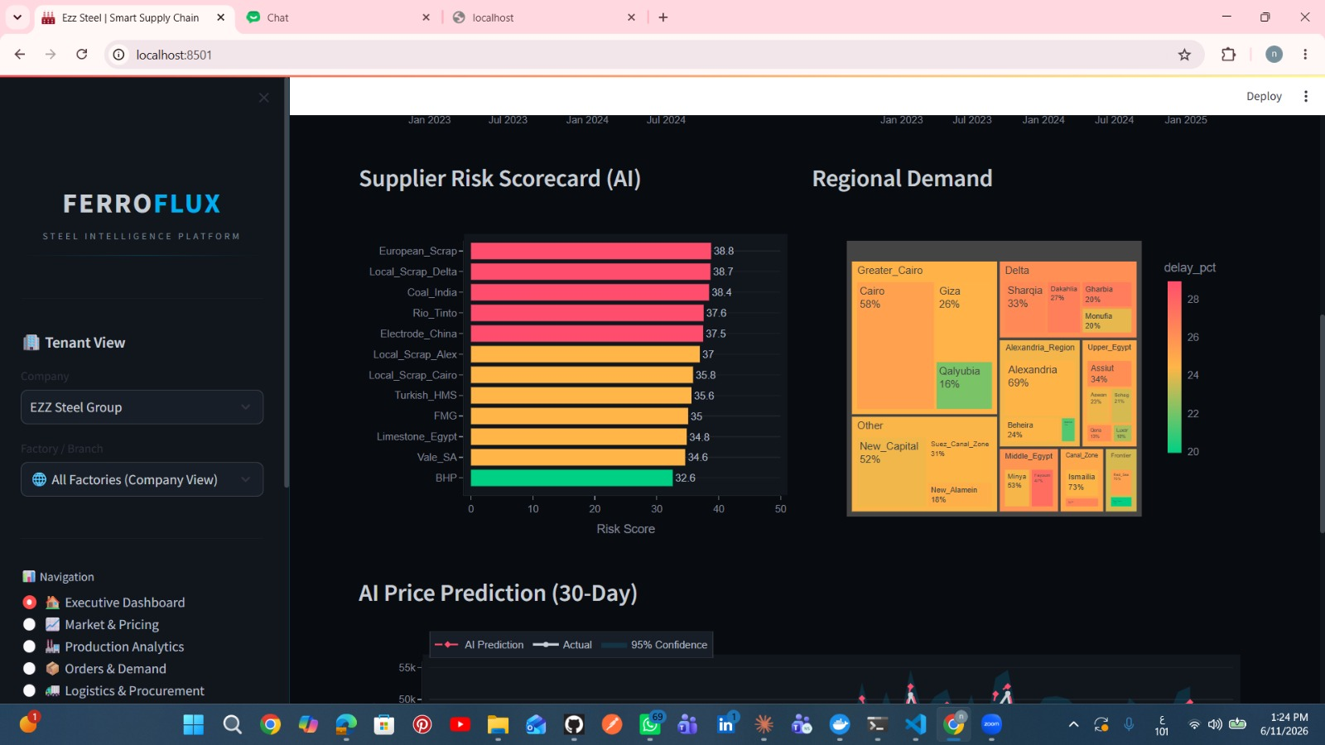
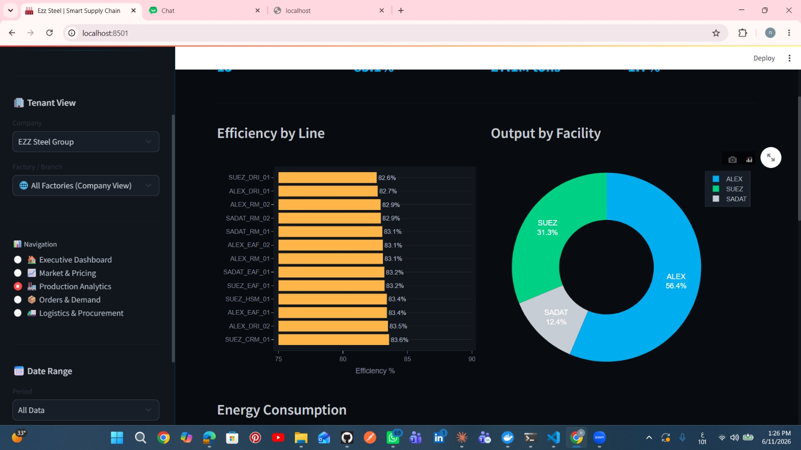
Implementation & Demo
FerroFlux Portal
[Portal screenshot — registration, login, factory overview, Excel upload]
Streamlit Dashboard
[Streamlit dashboard — Executive Summary, Market Intelligence, Supplier Risk]
Key highlights from the demo:
Live Demo Links:
Supplier Risk Scorecard (AI): ranks suppliers by risk score, with regional demand heatmap and 30-day AI price forecast
Production Analytics: efficiency by line, output by facility (ALEX/SUEZ/SADAT), and energy consumption
[QR Code
Here]
Portal: [Hugging Face Spaces link] | Dashboard: [Streamlit Cloud link]
DiGiLiANS — Digital Pioneers Initiative | Capstone Project Defense 2026
11

Slide 20
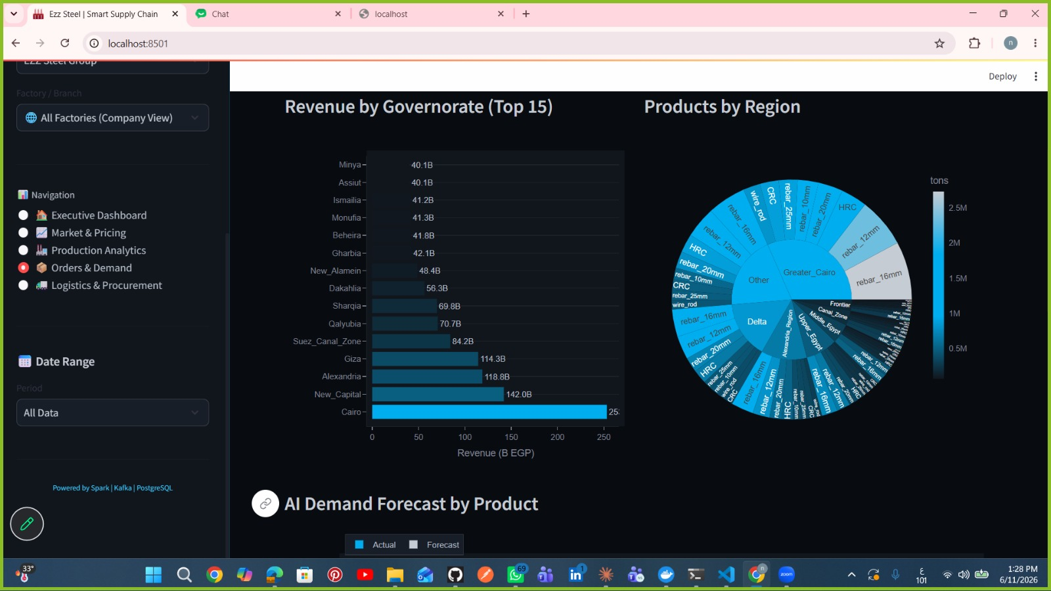
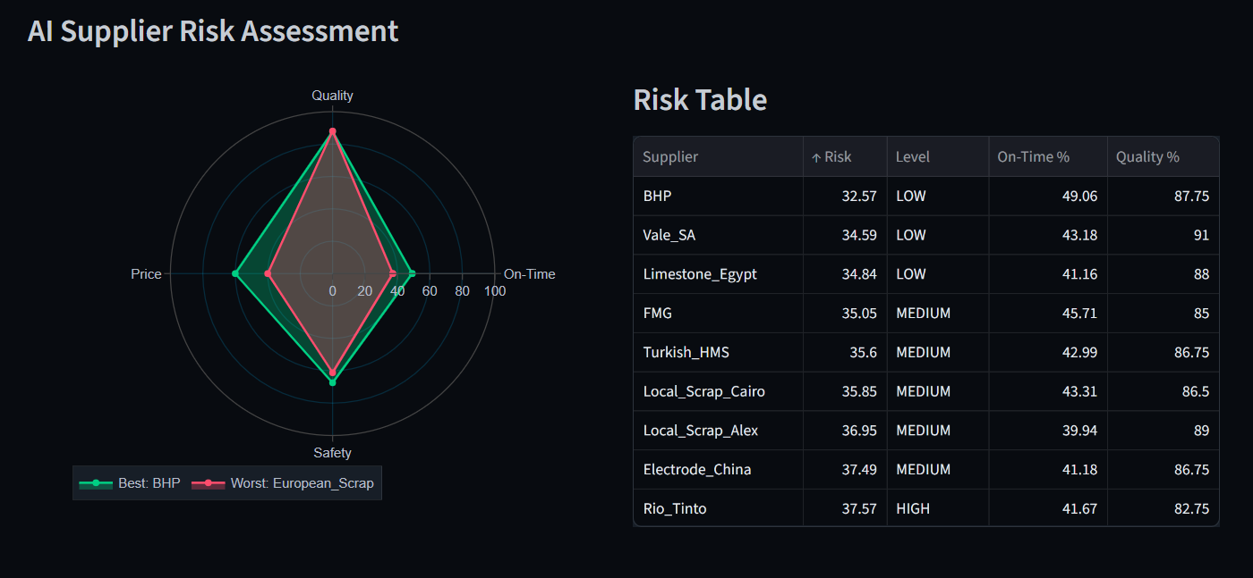
Implementation & Demo
FerroFlux Portal
[Portal screenshot — registration, login, factory overview, Excel upload]
Streamlit Dashboard
[Streamlit dashboard — Executive Summary, Market Intelligence, Supplier Risk]
Key highlights from the demo:
Orders & Demand: revenue by governorate, products by region, and AI demand forecast by product
AI Supplier Risk Assessment: multi-factor radar (quality, price, on-time, safety) with ranked risk table by supplier
DiGiLiANS — Digital Pioneers Initiative | Capstone Project Defense 2026
11

Slide 21
Results & Key Performance Indicators
95.78%
8,400+
<2s
100%
Accuracy / Performance
Price Forecast R² (MAPE=1.61%)
Users / Records
Order records (3 tenants)
Response Time
Dashboard query latency
Improvement
Precision on HIGH-risk suppliers
Model performance summary: Price Forecasting R²=0.9578 / MAPE=1.61% — Demand Forecasting R²=0.8030 / MAPE=35.74% — Supplier Risk Accuracy=94.78%, Precision(HIGH)=100%, Recall(HIGH)=89.5%
DiGiLiANS — Digital Pioneers Initiative | Capstone Project Defense 2026
12

Slide 22
Project Impact & Innovation
Solves fragmented, manual supply chain data management for Egyptian steel manufacturers — benefiting factory operators, procurement managers, and executives.
Economic: near-zero deployment cost on open-source/free-tier infrastructure. Technical: production-grade medallion architecture with 3 deployed ML models. Social: brings modern data engineering to an underserved industrial sector.
Unlike SAP IBP (enterprise, costly) or Tableau+Excel (the current norm), FerroFlux uniquely combines real-time streaming, domain-specific ML, multi-tenant isolation, and automated alerting in one open-source platform.
Directly supports Egypt Vision 2030's Industry 4.0 and digital manufacturing priorities by making advanced analytics accessible to mid-size manufacturers.
Multi-tenant architecture enables onboarding additional steel producers with zero rework; future work includes live price feeds, LSTM forecasting, and Arabic UI.
💡 FerroFlux demonstrates that DiGiLiANS-trained engineers can deliver production-grade big data platforms addressing real national industrial priorities.
DiGiLiANS — Digital Pioneers Initiative | Capstone Project Defense 2026
13

Slide 23
Future Work
Planned enhancements for future development iterations:
Performance & Optimization
Improve system speed and efficiency
Evaluate LSTM/Transformer models for price forecasting on 5+ years of price data
Feature Enhancement
Expand based on user feedback
Add Arabic-language UI for the portal and dashboard alert messages
Testing & Validation
Conduct broader user / field testing
Expand usability testing with more factory operators across product lines
Integration & Deployment
Connect with external systems or APIs
Integrate a live steel exchange price feed and an ERP adapter (e.g., Microsoft Dynamics NAV)
Scale & Wider Reach
Deploy to a broader user base
Build a mobile-responsive portal UI for factory-floor managers
Research & Impact
Publish findings or open-source the work
Expand role-based access control: analyst, auditor, and supplier-facing roles
DiGiLiANS — Digital Pioneers Initiative | Capstone Project Defense 2026
14

Slide 24
Team Contributions
Maram Mostafa —Streamlit dashboard, testing coordination, and documentation
Nourhan Saber Shalaby —Price & demand forecasting, Supplier risk classification and FastAPI endpoints
Hager Elkahlawy — Apache Airflow DAGs (ETL Orchestration)
Haidy Nageh — Spark medallion ETL (Silver/Gold)
Zeinab Elgabalawy — Kafka producers and Bronze-layer ingestion
All members participated in: planning, code reviews, testing, and final integration
💡 Roles map directly to the methodology and Team Roles table in the project documentation.
DiGiLiANS — Digital Pioneers Initiative | Capstone Project Defense 2026
15

Slide 25
References & Resources
Academic & Technical References
Tools, Datasets & Repositories
Dean & Ghemawat (2008) — MapReduce: Simplified Data Processing on Large Clusters. CACM.
Chen & Guestrin (2016) — XGBoost: A Scalable Tree Boosting System. ACM SIGKDD.
Taylor & Letham (2018) — Forecasting at Scale (Prophet). The American Statistician.
Databricks (2023) — Medallion Architecture: A Data Design Pattern for Lakehouses.
GitHub Repository: [Insert FerroFlux repository link]
Dataset: Simulated steel/scrap market prices (24 months) & factory order data (~8,400 records, 3 tenants)
Cloud Services: Hugging Face Spaces (portal), Streamlit Community Cloud (dashboard), Neon (PostgreSQL)
Framework Docs: Apache Kafka, Apache Spark, Apache Airflow, FastAPI, Streamlit, n8n
💡 Full reference list (17 sources) is available in the project documentation.
DiGiLiANS — Digital Pioneers Initiative | Capstone Project Defense 2026
16

Slide 26
Thank You!
Team Name: FerroFlux
Track: AI — Big Data Engineering
GitHub / Demo: [Insert GitHub repository / Portal / Dashboard links]
DiGiLiANS — Digital Pioneers Initiative | Capstone Project Defense 2026

